Slide 1
Chapter 14
Demand Forecasting

Slide 2
Forecasting Some examples & context
Manufacturing
A manufacturer of household appliances wants to add to add another product line for manufacturing microwave ovens The decision requires a good understanding of the nature of demand for the range of microwave ovens proposed to be manufactured
Services
A hospital chooses to add one more specialty health care wing, it needs to make some assumptions about the demand for the facility
Public Policy
Government of India needs to have a reasonable estimate of the population growth over the next 10 – 20 years while it formulates long term plans for creating infrastructure for transport

Slide 3
Forecasting
Forecasts are estimates of
magnitude and
timing
of uncertain events that happen in every business setting
An estimation tool
A way of addressing complex and uncertain environment surrounding business decision-making
A tool for predicting events related to operations planning & control
A vital pre-requisite for the planning process in organizations

Slide 4
Need for Forecasting
The key applications of forecasting are:
Understanding Dynamic & Complex environment
Managing Short-term fluctuations in production
Better Materials Management
Rationalized man-power decisions
Providing a basis for
Strategic decisions
Planning & scheduling

Slide 5
Forecasting Time Horizon
Criterion | Short-term | Medium-term | Long-term
Typical Duration | 1 – 3 months | 12 – 18 months | 5 – 10 Years
Nature of decisions | Purely Tactical | Tactical as well as Strategic | Purely Strategic
Key considerations | Random (short-term) effects | Seasonal and Cyclical effects | Long-term trends Business Cycles
Nature of data | Mostly quantitative | Subjective & Quantitative | Largely subjective
Degree of uncertainty | Low | Significant | High
Some examples | Revising quarterly production plans Rescheduling supply of raw material | Annual Production Planning Capacity Augmentation | New Product Introduction Facilities Location decisions New business development

Slide 6
Design of a forecasting system Three stage process
Develop a forecasting logic by identifying the purpose, data and models to be used
Stage 1
Establish control mechanisms to obtain reliable forecasts
Stage 2
Incorporate managerial considerations in using the forecasting system
Stage 3

Slide 7
Developing a forecasting logic Steps
Identify purpose
Purpose of forecast
Time horizon
Type of data needed
Identify a suitable technique
Collect/analyze past data
Select an appropriate model
Start
Develop a forecasting logic
Establish model parameters
Build the model
No
Satisfactory
Test model adequacy
Test using historical data
Stop
Yes

Slide 8
Sources of Data
Field Data
Sales force estimates
Point of Sale (POS) Data systems
Forecasts from supply chain partners
Secondary data
Trade/Industry Association Journals
B2B Portals/Market Places
Economic Surveys and Indicators
Subjective Knowledge

Slide 9
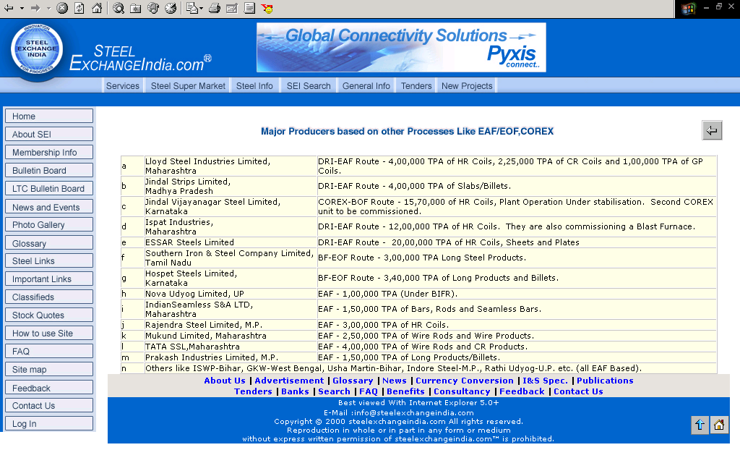
B2B Portal as a source of data An illustration
Source: http://www.steelexchangeindia.com

Slide 10
Models for forecasting
Extrapolative Models
Make use of past data and essentially prepare the future estimate by some method of extrapolating the past data
Examples
Moving Averages – Weighted, Simple
Exponential Smoothening
Time Series Methods
Causal or Explanatory Models
Analyse the data from a point of cause – effect relationship
Examples
Multiple Regression Models
Econometric Models
Technological Forecasting
Subjective Judgement Methods
Draw substantially from the expertise of a group of senior managers using some collective decision making framework

Slide 11
Moving Average Model
F_{t} = The moving average forecast for period t
n = The number of periods for moving average
D_{i} = Actual demand during period i
W_{i} = Weight for the i^{th} period demand data
The generalised formula for forecasting using MA method
is given by:
If different periods do not have different weights, the forecast obtained will be based on a simple moving average model, given by:

Slide 12
Weighted & Simple Moving Averages An illustration
Simple Moving Averages
Weighted Moving Averages
Model parameter
Number of periods for moving average |  |  | 3 months
Month | Actual Sales | Forecast*
January | 24,500
February | 27,000
March | 25,500
April | 26,000 | 25,667
May | 21,200 | 26,167
June | 18,900 | 24,233
July | 17,500 | 22,033
August | 19,000 | 19,200
September |  | 18,467
Model parameter
Number of periods for moving average |  |  | 3 months
Weights for three periods
Immediate past |  |  | 0.45
Two periods before |  |  | 0.30
Three periods before |  |  | 0.25
Month | Actual Sales | Forecast*
January | 24,500
February | 27,000
March | 25,500
April | 26,000 | 25,700
May | 21,200 | 26,100
June | 18,900 | 23,715
July | 17,500 | 21,365
August | 19,000 | 18,845
September |  | 18,525
* Forecasts in this illustration are rounded to units

Slide 13
Exponential Smoothening Method
The forecast for the next period is computed on the basis of the forecast for the current period and the actual demand during the current period, the difference between forecast and actual demand is incorporated in the next period’s forecast
F_{t+1} = Exponentially smoothened forecast for period t+1
F_{t} = Exponentially smoothened forecast for period t
D_{t} = Actual demand during period t
α = Smoothening coefficient

Slide 14
Exponential Smoothening Method An illustration
An example with α = 0.20
An example with α = 0.80
A lower value of α indicates that the forecast is not responsive to the demand

Slide 15
Exponential Smoothening Method Impact of model parameter (alpha)

Slide 16
Time Series Methods Components
Trend (T)
Long term secular movement in the pattern
Seasonality (S)
Fixed cycles in which the time series data often move from period to period
Cyclical (C)
Business cycles that repeat over a much longer period of say 10 – 20 years
Random (R)
Uncontrollable events happening in the short term that could influence the demand

Slide 17
Components of Time Series Trend: An illustration

Slide 18
Components of Time Series Seasonality, Cyclical, Random: An illustration

Slide 19
Estimating Trend Method of Least Squares
Treat the time periods as independent variable and the actual demand as dependant variable.
Linear regression of the form Y = a + bX could be constructed to predict the demand Y for any value of X
X_{i} = Time periods
Y_{i} = Actual demand during period X_{i}
a = Intercept (at period 0)
b = Slope of the line
n = Number of periods
The coefficients of the regression equation are as follows:

Slide 20
Extracting the components of Time Series Example 14.1
From the above table we compute
The linear trend for the time series is given by Y = 346.91 + 15.59*X

Slide 21
Extracting the components of Time Series Example 14.2
If D_{i} is the demand during a period i and
is the average demand for the corresponding period
Then the seasonality index Si is given by:

Slide 22
Extracting the components of Time Series Example 14.2
Normalised Seasonality Indices
Trend Adjusted Forecasts
Forecast for Year 4 – Q1 = 346.91 + 15.59*13 = 550
Forecast for Year 4 – Q2 = 346.91 + 15.59*14 = 565
Forecast for Year 4 – Q3 = 346.91 + 15.59*15 = 581
Forecast for Year 4 – Q4 = 346.91 + 15.59*16 = 596
Forecast adjusted for Trend & Seasonality

Slide 23
Causal Models for forecasting
A set of independent variables are identified and associated with the dependent variable through a functional relationship
In general the forecast for a dependent variable Y using n independent variables X1, X2, X3, …, Xn involves developing a functional relationship as follows:
Y = f(X1, X2, X3, …, Xn)
There are several computer packages available today such as SPSS to help the forecast designer in this process

Slide 24
Causal Method for Forecasting Solution to Example 14.3
Since the causal relationship is a simple linear regression, use method of least squares to determine the coefficients of linear regression Y = a + bX
No. of tricycles demanded = 61.29 + 0.5104 * Number of new marriages
If number of new marriages is 150, then demand = 138 tricycles
If number of new marriages is 250, then demand = 189 tricycles

Slide 25
Accuracy of Forecasts Alternative Measures
Forecast Error (FE):
Sum of Forecast Errors (SFE):
Mean Absolute Deviation (MAD):
Mean Absolute Percentage Error (MAPE):
Mean Squared Error (MSE):
Tracking Signal (TS):
D_{t} = Demand during period ‘t’, F_{t} = Forecast during period ‘t’, n = No. of periods

Slide 26
Accuracy of Forecasts An illustration: Example 14.4
MAD for period 6
Cumulative absolute deviation up to period 6: 54
Number of periods: 6
Therefore, MAD = 54/6 = 9.00
MAPE for period 12
Cum. absolute percent error up to period 12 = 9.2% + 3.5% + … + 0.0% = 92.0 %
Number of periods: 12
Therefore, MAPE = 92/12 = 7.7%
TS for period 15
SFE for period 15 = 96
MAD for period 15 = 10.27
Therefore, TS = 96/10.27 = 9.35
MSE for period 18
Cumulative Squared error up to period 18 = 121 + 16 + … + 900 = 4106
Number of periods: 18
Therefore, MSE = 4106/18 = 228.11

Slide 27
Tracking Signal (Example 14.4)

Slide 28
Using the Forecasting System
Cost
Data
Availability
Time
Frame
Key inferences
from
research/practice
How to get started?
Choice of model
Estimation of parameters
New
Competitor
Issues in using the system
How to incorporate external information
Stability Vs Responsiveness
Sales
Promotions
When to change the system?
Parameter re-estimation Vs model change
Forecast
Reliability

Slide 29
Demand Forecasting Chapter Highlights
Forecasting is an important planning tool in organizations
It helps to estimate the future demand,
Predict events pertaining to operational planning and control
Provides useful information for the strategic planning exercise
Forecasting context and methodology varies with time horizon. Consequently, the type of data required and the nature of analyses done also varies with the planning time horizon.

Slide 30
Demand Forecasting Chapter Highlights…
Design of a forecasting system involves three steps
Developing an appropriate forecasting logic
Establishing control mechanisms to obtain reliable forecasts
Incorporating managerial considerations in using the system
Extrapolative and Causal methods are the two generic classes of forecasting models available.
Extrapolative methods devise methods of identifying some patterns in the past data and extend a similar logic into the future
Causal methods identify cause – effect relationships between dependent and independent variables
By changing the model parameters in moving averages and exponential smoothening methods, it is possible to have a responsive or a stable forecasting model

Slide 31
Demand Forecasting Chapter Highlights…
A time series consists of four components;
Trend, Seasonality, Cyclical and Random.
Developing time series models for forecasting involves estimating the parameter values for the first three components
Several methods are available to assess the accuracy of the forecasts obtained from a forecasting model.
Tracking signal detects impending tendencies of a forecasting model to consistently overestimate or underestimate the demand.
Despite having a sophisticated forecasting system, managers must use the forecasts obtained from the system in the context of external information available from time to time.

