Slide 1
Chapter 15
Operations Planning

Slide 2
Business Planning Exercise
Business plan is strategic in nature and addresses the following questions:
Should we meet the projected demand entirely or a portion of the projected demand?
What are the implications of this decision on the overall competitive scenario and the firm’s standing in the market?
How is this likely to affect the operating system and planning in other functional areas of the business such as marketing and finance?
What resources should we commit to meet the chosen demand during the planning horizon?
Aggregate production planning seeks to translate business plans to operational decisions

Slide 3
Planning Hierarchies in Operations
Business Plan
Marketing Plan
Financial Plan
Operations Plan
(rough cut capacity)
Level 1
Level 2
Master Operations Schedule
Materials
Requirement
Plan
Capacity
Requirement
Plan
Detailed Scheduling
Level 3
Shop Floor Control

Slide 4
Aggregate Operations Planning Decision Variables: An illustration
The decisions involve
Amount of resources (productive capacity and labour hours) to be committed
Rate at which goods and services needs to be produced during a period
Inventory to be carried forward from one period to the next
An example from Garment Manufacturing
Produce at the rate of 9000 metres of cloth everyday during the months of January to March
Increase it to 11,000 metres during April to August
Change the production rate to 10,000 metres during September to December
Carry 10% of monthly production as inventory during the first 9 months of production.
Work on a one-shift basis throughout the year with 20% over time during July to October

Slide 5
Aggregate Units for Capacity Examples
Sl. No | Product/Service | Aggregate Unit of capacity
1 | Phenyl Acetic Acid | Metric tonnes
2 | Data Entry Systems | Numbers
3 | Mini computer | Value (ex-factory) in Rs.
4 | Printed Circuit Board | Square Metres
5 | Alloy Iron Castings | Metric tonnes
6 | Cement | Metric tonnes
7 | Multi-specialty Clinic | Patient-Bed Days
8 | Bank | No. of Accounts
9 | Insurance Firm | No. of Policies

Slide 6
Aggregate Operations Planning Why is it necessary?
Demand fluctuations
Capacity fluctuations
Difficulty level in altering operation rates
Operating systems are complex and varying the rate of operation requires prior planning and co-ordination with other trading partners
Benefits of multi-period planning
Aggregate Operations Planning is done in an organisation to match the demand with the supply on a period-by-period basis in a cost effective manner

Slide 7
Aggregate Operations Planning Framework
Alternatives for
Modifying demand
Forecasting
Arriving at effective
Period-by-period
Demand to be met
Targeted Demand
to be fulfilled
Arriving at
Period-by-Period
Supply Schedules
Actual period-by-period
Supply Schedules
Alternatives for
Modifying supply

Slide 8
Alternatives for managing demand
Reservation of Capacity
Hospital Appointment system
Influencing Demand
Special Tariffs
Late night calls are cheaper
Midnight flight to Bombay is cheap
Differential Discount Structures
Senior Citizen Discount
Limited period special offers
Happy Meal (Selected time of day)

Slide 9
Alternatives for Managing Supply
Inventory Based Alternatives
Stock out, Backordering/Backlogging
Carrying Inventory
Capacity Adjustment Alternatives
Hiring/Lay-off of workers
Varying shifts
Varying Working Hours (OT,UT)
Capacity Augmentation Alternatives
Sub-contracting/Outsourcing
De-bottlenecking
Addition of new capacity

Slide 10
Aggregate Operations Planning Alternatives
 | Description of the alternative | Costs
Alternatives for managing demand | Reservation of capacity | Planning and Scheduling costs
 | Influencing Demand | Marketing oriented costs
Alternatives for managing supply | Inventory based alternatives
 | (a) Build Inventory | Inventory holding costs
 | (b) Backlog/Backorder/Shortage | Shortage/Loss of Goodwill
 | Capacity Adjustment Alternatives
 | (a) Over Time/Under Time | OT premium, Lost productivity
 | (b) Vary no. of shifts | Shift change costs
 | (c) Hire/Lay-off workers | Training/Hiring costs, Morale issues
 | Capacity augmentation alternatives
 | (a) Sub-contract/Outsource | Transaction costs for sub-contract
 | (b) De-bottleneck | Annualised de-bottlenecking cost
 | (c) Add new capacity | Annualised cost of new capacity

Slide 11
Aggregate Operations Planning Two generic strategies
In Level strategy, the emphasis is not to disturb the existing production rate at all
In Chase strategy, no effort is made to carry inventory from one period to another; the supply – demand mismatch is addressed during each period by employing capacity related alternatives
AOP Strategy | AOP alternatives applicable | Key features
Level Strategy | Inventory based alternatives | Inventory as the critical link between the periods; Made-to-stock environments; Products with low risks of obsolescence
 | (a) Build Inventory
 | (b) Backlog/Backorder/Shortage
Chase Strategy | Capacity adjustment alternatives | No inventory carried from one period to another; Made-to-order and project environments; Several service systems
 | (a) Over Time/Under Time
 | (b) Vary no. of shifts
 | (c) Hire/Lay-off workers
 | Capacity augmentation alternatives
 | (a) Sub-contract/Outsource
 | (b) De-bottleneck

Slide 12
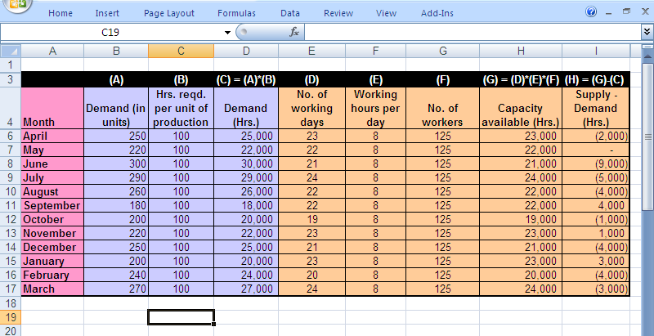
Level Strategy Example 15.1

Slide 13
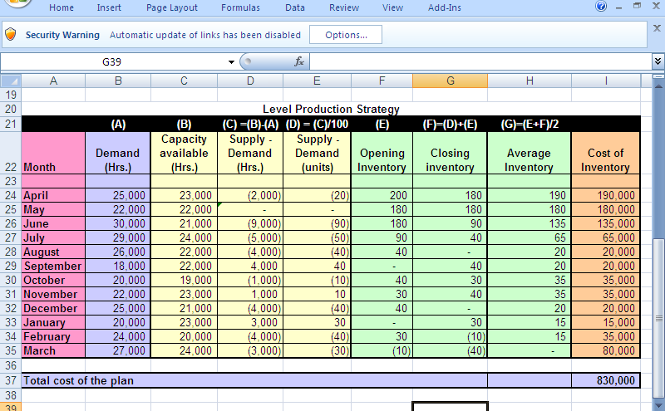
Cost of level strategy Example 15.1.

Slide 14
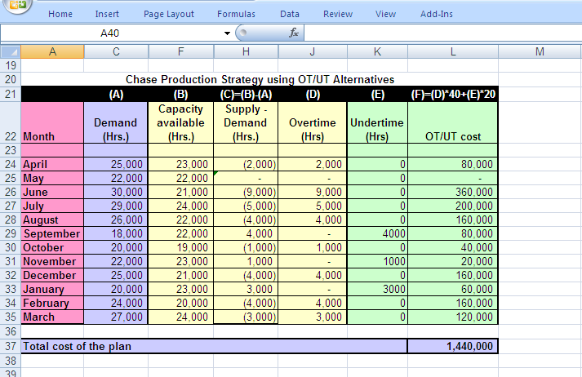
Chase strategy using OT/UT Example 15.2

Slide 15
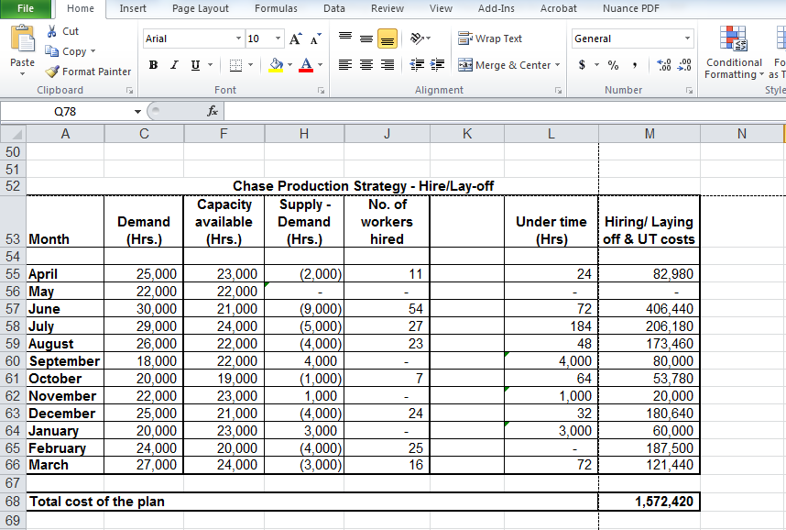
Chase strategy using Hire/Layoff Example 15.2

Slide 16
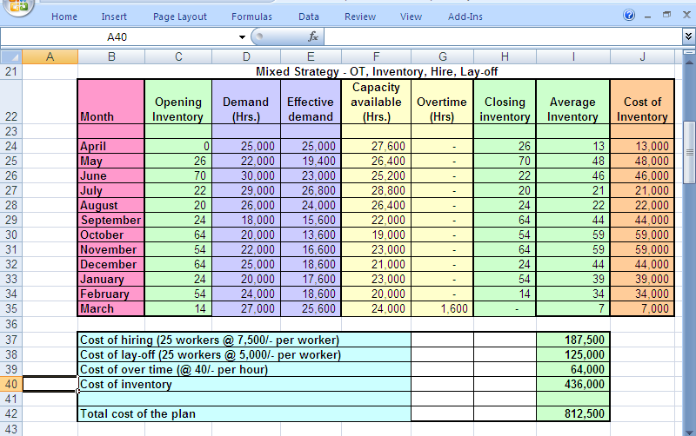
AOP using Mixed Strategy Example 15.3

Slide 17
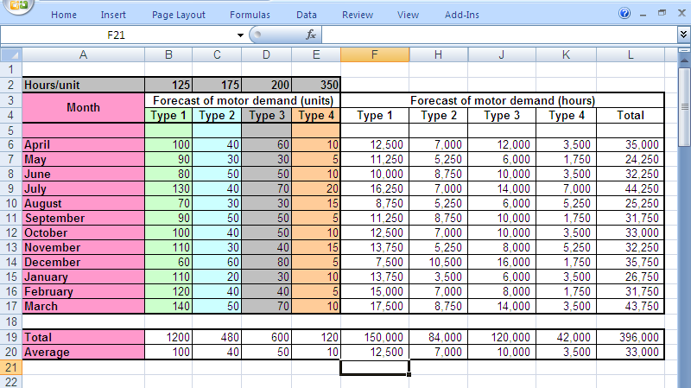
Evaluating alternative strategies Example 15.4

Slide 18
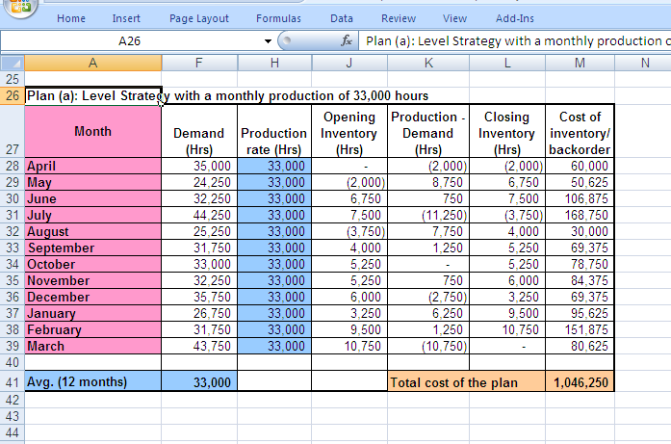
Plan (a): Level Strategy Example 15.4

Slide 19
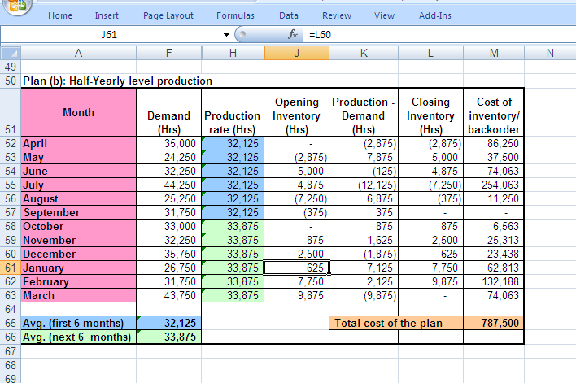
Plan (b): Half-yearly production rates Example 15.4

Slide 20
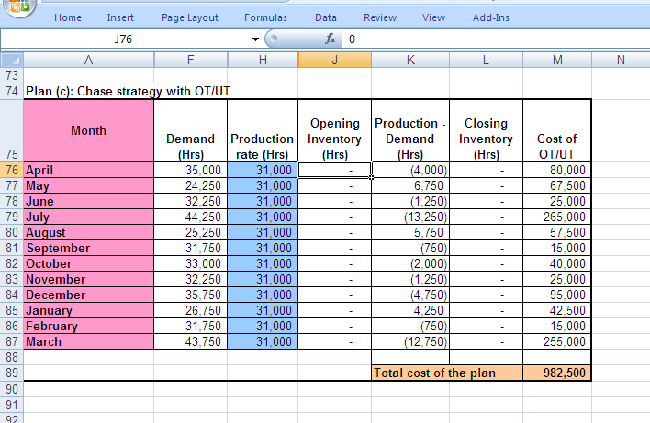
Plan (c): Chase Strategy with UT/OT Example 15.4

Slide 21
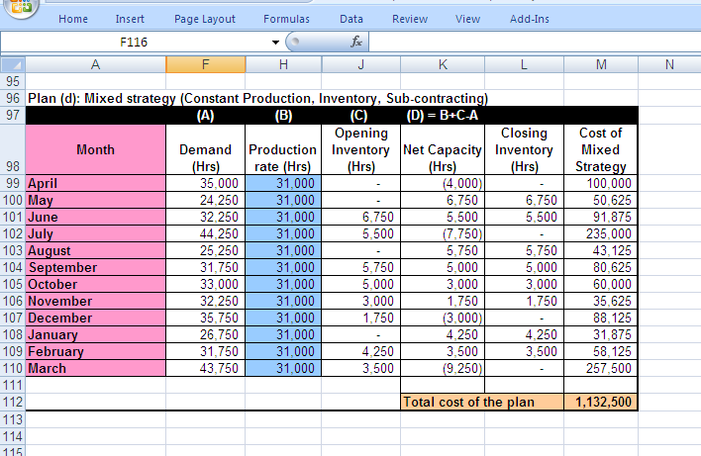
Plan (d): Mixed Strategy Example 15.4

Slide 22
Aggregate Operations Planning Alternative methods
Optimal Methods
Linear Programming (LP)
Transportation
Dynamic Programming (DP)
Heuristics
Trial & Error Methods (Examples 15.1. to 15.4.)
Generalised search methods
Linear Decision Rule (LDR)
Simulation

Slide 23
Search Procedure
Identify parameters
Setup the stopping
criterion
Start
Generate one
candidate solution.
Evaluate the cost
Current solution
the best?
Have we met
the stopping
criterion?
No
No
Yes
Yes
Replace the best solution
with the current solution
End

Slide 24
Demand
A Transportation
Problem
formulation for
Aggregate Operations
Planning (Example 15.5)
Supply
Indicates no feasible
APP alternative available

Slide 25
Linear Programming Method for AOP An illustration
Cost parameters
C_{r} Per unit cost of regular production
C_{o} Per unit cost of overtime production
C_{s} Per unit cost of sub-contracted units
C_{h} Per unit cost related to hiring of workers
C_{l} Per unit cost related to laying off workers
C_{i} Per unit costs related to inventory
Decision variables for the time period “t”
R_{t} Number of units produced in regular time
O_{t} Number of units produced using over time
S_{t} Number of units obtained through sub-contracting
H_{t} Number of additional units obtained though hiring of workers
L_{t} Number of units reduced through laying off workers
I_{t} Inventory during the period
Other parameters
D_{t} Projected Demand during the period
K Minimum amount to be sub-contracted
Maximum allowable OT as a proportion of regular production ( )

Slide 26
Linear Programming Method for AOP An illustration…
Objective function
Subject to the constraints
Amount Produced in regular time :
Inventory Balance Equation:
Over time constraint:
Sub-contracting constraint:
Non-negativity constraint:

Slide 27
Master Operations Scheduling Linkages with AOP & Forecasting
Aggregate
Operations
Planning
Order Inflow
Forecasting
Market
Master
Operations
Scheduling
Capacity Plan
Materials Plan
Labour &
Resources
Actual
Operations
Vendors
Resource availability
Material Inflow

Slide 28
Dis-aggregation process in MOS An illustration
Capacity Planned using AOP |  |  |  | 18,000
Capacity Required/unit |  |  | Silver | 20
 |  |  | Gold | 40
 |  |  | Platinum | 70
Type of service | Demand status | Planning Horizon
 |  | Month 1 | Month 2 | Month 3
Silver | Forecast | 100 | 120 | 140
 | Firm Order | 120 | 90 | 30
Gold | Forecast | 200 | 240 | 180
 | Firm Order | 180 | 200 | 60
Platinum | Forecast | 80 | 100 | 90
 | Firm Order | 50 | 110 | 20
MOS Quantity |  | Shaded area represents MOS Qty.
Capacity required (for MOS Quantity) |  | 16,000 | 19,700 | 16,300

Slide 29
Operations Planning Chapter Highlights
Aggregate Operations Planning (AOP) serves to translate the business plans into operational decisions
The decisions include
amount of resources (productive capacity and labour hours) to commit,
rate at which to produce
inventory to be carried forward from one period to the next
AOP is done to match the demand and the available capacity on a period-by-period using a set of alternatives available to modify demand and/or the supply
Alternatives for modifying demand include reservation of capacity and methods of influencing (changing) the demand during a period
Alternatives for modifying the supply include inventory variations, capacity adjustment and capacity augmentation

Slide 30
Operations Planning Chapter Highlights…
AOP exercise employs the two generic strategies; chase and level production. A chase strategy is often found to be expensive and hard to implement in organisations
In reality a mixed strategy using a combination of alternatives is employed in an AOP exercise. It uses a variety of alternatives for modifying supply.
The structure of a transportation model lends itself to studying the AOP problem
Linear programming can also be used to model the AOP problem
MOS involves dis-aggregation of product information and ensuring the required capacity and material are available as per the plan

