Slide 1
Supplement 15A
Linear Programming

Slide 2
Linear Programming Problem context
An operations manager often faces issues with respect to effective use of resources such as men, material, machine capacity and other similar resources under some constraints
In a manufacturing organization the availability of machines is limited. An operations manager would like to understand how best to make use of the available machines while meeting certain objectives such as maximizing the production, or minimizing the waiting time for the machine.
In a service system such as a hospital or restaurant one of the issues for planning would be to make the best use of available resources while minimizing the waiting time of the customers in the system.
Linear programming is a methodology which helps an operations manager to address such problems that he/she faces in planning the operations in the system

Slide 3
Linear programming Definition
Linear Programming (LP), is a methodology in which
linear relationships between various elements in the system can be modeled
to study the behavior of the system
to identify the best set of decisions that one should make
in order to optimize the performance of the system
while taking into consideration the constraints that one faces in the system
LP also enables us to analyze the sensitivity of variables and constraints of the problem

Slide 4
LP Modelling fundamentals Decision Variables
The purpose of an LP modeling is to arrive at a decision with respect to the problem under study
If the decision is the number of machines of type A, type B and type C to be procured the decision variables are:
Let X_{A} be the number of machine of type A to be procured
Let X_{B} be the number of machine of type B to be procured
Let X_{C} be the number of machine of type C to be procured

Slide 5
LP Modelling fundamentals Objective Function
The operations manager analyzes the problem with specific objectives in his/her mind
In our example if the objective is to minimize the investment then the objective function is:
Let C_{A} be the cost of one unit of machine A
Let C_{B} be the cost of one unit of machine B
Let C_{C} be the cost of one unit of machine C
The cost of the decision
Z = X_{A} * C_{A} + X_{B} * C_{B} + X_{C} * C_{C}
The objective function is Minimize Z

Slide 6
LP Modelling fundamentals Constraints
Any management problem is solved in the context of certain constraints that the manager faces
Examples:
Need to meet with a certain daily production
Availability of raw materials for production
Skill requirements and the availability of such skills
Demand for the product /service for which the system is being designed
Funds available to procurement machines/resources
Using LP as a modeling tool also implies certain standard constraints:
Linearity: All relationships between variables are linear
Non-negativity: All decision variables are strictly nonnegative

Slide 7
LP Modelling Example 15A
A manufacturer of engineering components would like to decide on the daily production plan
Two major types of components are being manufactured; machined castings (Product A) and Cylinders (Product B)
Machines required for manufacturing include CNC lathe (Machine 1), Grinding machine (Machine 2) and Milling machine (Machine 3)
The number of hours required in each of these machines per unit of manufacturing is known
The contribution per unit of sold products is also known
A certain number of machines are available
The shop operates with a single shift of eight hours
There is sufficient demand in the market

Slide 8
Example 15A Relevant data for the problem
Number of shifts per day | 1
Number of hours per shift | 8
Products | Castings |  | Cylinders
Contribution (Rs. per unit) | 115.00 |  | 146.00
 | Minutes per unit |  |  |  | Minutes
Machine Requirements & Availability Details | Reqt. for Castings | Reqt. for Cylinders |  | Available machines | Daily Availability
CNC Lathe | 14 | 17 |  | 4 | 1,920.00
Grinding Machine | 15 | 22 |  | 5 | 2,400.00
Milling Machine | 18 | 20 |  | 5 | 2,400.00

Slide 9
Example 15A LP Formulation
Decision variables for the problem
Let X₁ denote the number of units of product A to be produced daily
Let X₂ denote the number of units of product B to be produced daily
Objective function for the problem
The contribution per unit of each of the product is known. The objective is to maximize the daily contribution
The contribution is computed as Z = 115* X₁ + 136 * X₂
The objective function is Max (Z)
Constraints for the problem
(Machine 1 capacity constraint)
(Machine 2 capacity constraint)
(Machine 3 capacity constraint)

Slide 10
Example 15A LP Formulation…

Slide 11
Solving LP using Excel Solver 3-step approach
1. Open the Microsoft Excel worksheet and set up the required information in the worksheet
The information to be entered includes parameters of the problem and their values, decision variables, relationships between the decision variables and resources that manifest in terms of constraints
2. On the Data tab, in the Analysis group, click Solver to input the required data for solving the LP problem
Once the solver utility is invoked a screen appears
Using the solver screen the mathematical formulation needs to be entered
Target cell is the value of the objective function to be optimized
Select if the optimization is maximize or minimize
Constraint sets are to be added using the Add tab
3. Once the formulation is complete, the Solve tab can be used to obtain the solution

Slide 12
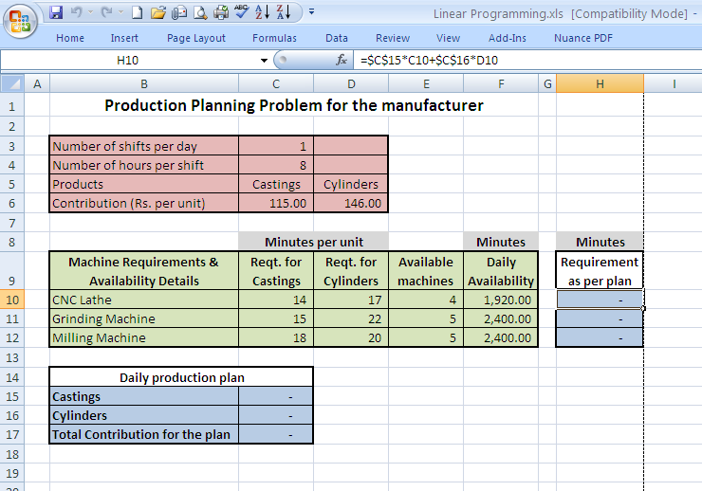
Example 15A Step 1: Entering relevant data

Slide 13
Relevant cells for example 15A
Decision Variables: Cells C15 and C16
Objective function: Cell C17
Constraints Equations:
Machine 1: Cell H10 must be less than or equal to cell F10
Machine 2: Cell H11 must be less than or equal to cell F11
Machine 3: Cell H12 must be less than or equal to cell F12
Non-negativity constraint: Cell C15 and C16 must be greater than or equal to 0

Slide 14
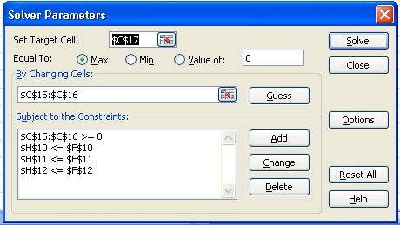
Example 15A Step 2: Setting up the solver

Slide 15
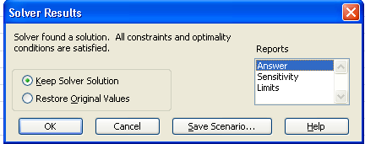
Example 15A Step 3: Invoking “Solve” tab
Once we click the solve tab, the following screen will appear

Slide 16
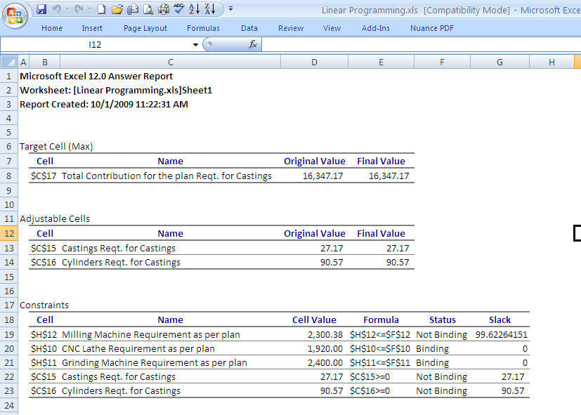
Example 15A Output screen of the solution

Slide 17
Example 15B Relevant data for the problem
Number of shifts per day | 1
Number of hours per shift | 8
Machines | 1 | 2 | 3
Cost per unit (Rs. Million) | 1.65 | 2.12 | 1.60
 | Packing/Assemby capacity per hour |  |  | Units
Packaging Capacity & Demand | Machine 1 | Machine 2 | Machine 3 | Minimum Daily Demand
Product A | 45 | 60 | 30 | 1,100
Product B | 70 | 52 | 27 | 1,700
Product C | 26 | 28 | 41 | 900

Slide 18
Example 15B Formulation of the Problem
Decision Variables
Let X1 be the number of machines of type 1 to be procured
Let X2 be the number of machines of type 1 to be procured
Let X3 be the number of machines of type 3 to be procured
Total investment cost Z = 1.65*X1+2.12*X2+1.60*X3
Min (Z)
Subject to:

Slide 19
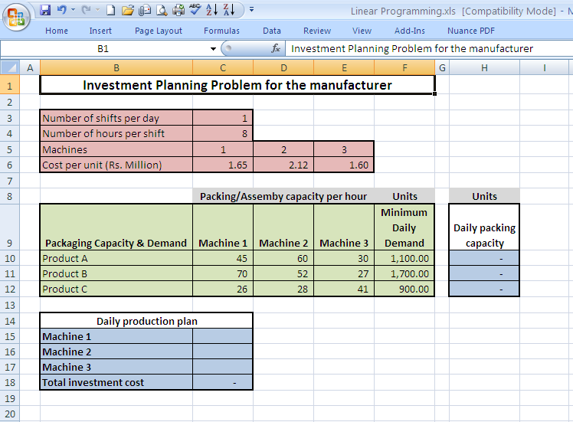
Example 15B Solution using Solver

Slide 20
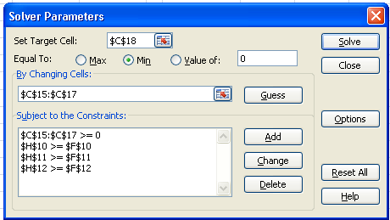
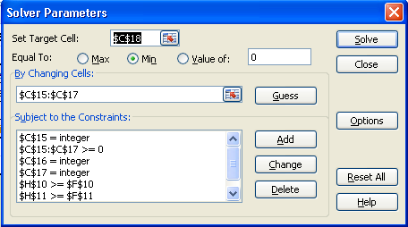
Example 15B Solution using Solver…
Setting cells c15, c16 and c17 as integers makes it a integer programming formulation

Slide 21
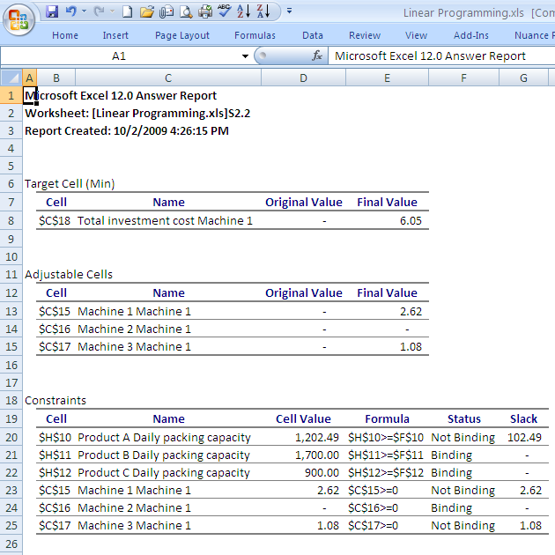
Example 15B Solution using Solver…
The optimal solution for the Linear programming problem:
Number of
machine 1 to be procured: 2.62
machine 3 to be procured: 1.08
Total investment : Rs. 6.05 million
Daily packaging capacities are:
Product A: 1202.49 units
Product B: 1700 units
Product C: 900 units
The optimal solution for the Integer programming problem:
Number of
machine 1 to be procured: 3
machine 3 to be procured: 1
Total investment : Rs. 6.55 million
Daily packaging capacities are:
Product A: 1320 units
Product B: 1896 units
Product C: 952 units

Slide 22
Applications of LP
Linear programming is a genetic solution methodology. Application domain includes
Several operations management problems
Advertising and media selection
Capital budgeting and a host of other situations
Specifically in operations management LP is used often for the following problems:
Production planning
Capacity planning
Inventory control
Supply Chain Management

Slide 23
Linear Programming Chapter Highlights
Linear programming is a methodology which helps an operations manager to address problems that he/she faces in planning the operations in the system
Linear Programming (LP), is a methodology in which
linear relationships between variables can be modeled
to study the behavior of the system
to identify the best set of decisions
to optimize the performance of the system
while taking into consideration the constraints
Before formulating the problem it is important to understand the decisions to be made (decision variables), the constraints, and the performance measures for which the decision is being made (objective function).

Slide 24
Linear Programming Chapter Highlights…
Using LP as a modeling tool also implies linearity of all relationships between various elements that are being studied using and non-negativity of the decision variables used in an LP modeling exercise
A number of computer packages are available today to solve a well formulated LP problem
Developing a good skill in formulating the problem will be more valuable than developing skills in actually solving the problem using a known solution methodology
Linear programming could be used to model several operations management problems, advertising and media selection, inventory control, capital budgeting and a host of other situations

