Slide 1
Chapter 16
Resources Planning

Slide 2
Material Requirements Planning (MRP)
Material Requirements Planning (MRP)
Is a computerised information system that aids in the planning of materials in organisation
MRP systems exploit certain unique characteristics of the production items
Utilise information on lead time, inventory status and master production schedule to make material available exactly at the time of requirement
The logic applied to plan materials could be extended to other resources required in any operations system. Therefore, these planning methodologies can be broadly defined as resources planning

Slide 3
Planning for Materials Two types of inventories
Two types of inventories exist in any operations system
Operating Inventory:
Denotes all the resources (broadly of material and capacity) that are available for the operating system to consume in the production process
Example: Number of steering wheels required for a day’s production of 5,000 cars in Maruti Plant
Exhibit Dependant demand attributes
Distribution Inventory:
Meant for market consumption
Exhibit Independent demand attributes
Example: Number of Alto’s to be stocked to meet a day’s demand
They differ in their demand attributes & therefore require alternative planning methodologies

Slide 4
Types of inventories Demand Attributes
Attribute | Dependant Demand | Independent Demand
Nature of Demand | No uncertainty; Dependant; Parent - Child relationships cause dependency | Considerable Uncertainty, Independent
Goal | Make availability meet requirements exactly | Make availability meet estimated demand for a targeted service level
Service Level | 100% a necessity, Feasible to achieve | 100% is not feasible
Demand Occurrence | Often lumpy | Often continuous
Estimation of demand | By Production Planning | By Forecasting
How much to order? (Quantity) | Known with certainty | Estimated based on past consumption
When to order? (Timing) | Very critical, can be estimated | Cannot be answered directly

Slide 5
Developing MRP Logic Basic Building Blocks
Existence of multiple levels of dependency
Product Structure – Bill of Materials (BOM)
Time phasing the requirement
Determining Lot Size
Incorporating lead time information
Establishing the planning premises

Slide 6

Dependency relationship The example of a phone
Basic Telephone
Hand Set
Cover Plate
Handset
A fastener secures a pair of the cover plates in the handset
Basic Telephone

Slide 7
Level-by-Level computation An illustration
Method A
Basic Telephone
Required :100
On hand Inventory : 30
Planned Quantity : 70
Handset
Required :100
On hand Inventory : 27
Planned Quantity : 73
Cover plate*
Required :200
On hand Inventory : 16
Planned Quantity :184
* (Each handset requires 2 cover plates)
Method B
Basic Telephone
Required :100
On hand Inventory : 30
Planned Quantity : 70
Hand set
Required : 70
On hand Inventory : 27
Planned Quantity : 43
Cover plate*
Required : 86
On hand Inventory : 16
Planned Quantity : 70
*(Each handset requires 2 cover plates)

Slide 8
MRP Logic Some terminologies
The iterative process of computing all requirements at a level and then moving down the level is known as explosion in MRP
Product Structure graphically depicts the dependency relationships among various items that make up the final product
A Bill of Material (BOM) is a list of all materials needed to assemble or put together one unit of the final product
BOM exists in various formats
Single level BOM
Indented BOM
Modular BOM

Slide 9


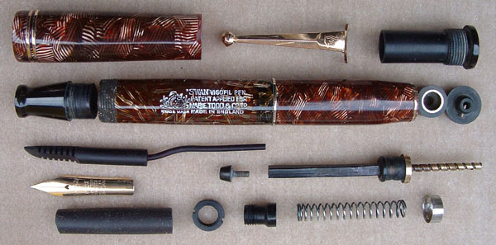
Product Structure An example of a fountain pen
Source: http://www.penhero.com/PenGallery/MabieTodd/MabieToddVisofilSystem.htm

Slide 10
Product Structure Tree An illustration using telephone
Telephone
Level 0
Base Unit (1)
Connecting
Cable (1)
Connecting
Jack (2)
Hand Set (1)
Level 1
Operating
Unit (1)
Panel
Board (1)
B. Cover
Plate (2)
Lug
(4)
Speaker
(1)
Mic.
(1)
H. Cover
Plate (2)
Level 2
Button Assy. (1)
Control Panel (1)
Level 3
Button (12)
Screw
(12)
Dial (3)
Screw
(3)
Screw
(4)
Screw
(2)
Level 4

Slide 11
Product Structure Example 16.1
0
A
1
B(1)
C(4)
2
E(2)
F(4)
E(2)
D(4)
D(2)
3
G(1)
H(3)
G(1)
H(3)

Slide 12
Single level BOM Telephone Example

Slide 13
Indented BOM Telephone Example

Slide 14
Modular BOM Telephone Example

Slide 15
Time Phasing of Requirement An illustration
A: On hand = 50
B: On order = 300
C: Required = 470 (200 + 120 + 150)
X: Net Qty. = -120
Computation without
Time phasing of data
Pending order is “out of phase” with the requirement
Order of 120 need to arrive at the manufacturing system only at the beginning of week 8

Slide 16
Lot Sizing Rules Lot for Lot and Fixed Order Qty.

Slide 17
Lot Sizing Rule Periodic Order Qty.
Number of periods (P) =
The total net requirement for the 8-week period is 560 (150 + 120 + 130 + 160 = 560).
Let us suppose that the economic order quantity is 210.
Therefore, using the above expression, we obtain P to be 3 periods.
The table shows implementation of POQ rule for P = 3.
An order is scheduled to arrive at the beginning of week 3 and the quantity ordered is sufficient to cover the net requirements during weeks 3 – 5.

Slide 18
Impact of Lead Time
Planned Order Release Time = Planned Receipt Time – Lead Time
Manufacture 200
Operating Units
Assemble
200 base units
LT for manufacture of Operating Unit
Assemble
200 telephones
Offset
Offset
Weeks 5 - 6
Week 7
Week 8
Manufacture of
Operating units begin
Assembly of
Base units begin
Assembled
Base units arrive

Slide 19
Incorporating Lead Time An illustration
Planned Order Release Time = Planned Receipt Time – Lead Time

Slide 20
Master Production Schedule (MPS)
Drives MRP process with a schedule of finished products
Quantities represent production not demand
Quantities may consist of a combination of customer orders & demand forecasts
Quantities represent what needs to be produced, not what can be produced
Planned order release of the parent = POR_{t}
Quantity required to assemble one unit of the parent = BOMQ_{t}
Independent demand of the component as spares = ID_{t}
Gross requirements of a component = GR_{t}
GR_{t} = (POR_{t}*BOMQ_{t})+ ID_{t}

Slide 21
Establishing Planning Premises through MPS: An illustration

Slide 22
MRP Inputs & Outputs
Master Production Schedule
Product
Structure
File
Material
Requirements
Planning
Inventory
Master
File
Planned Order Releases
Work Orders
Purchase Orders
Rescheduling Notices

Slide 23
MRP: Core Logic
Inventory
Status
MPS
Net
Explode
Lot
Lot sizing
rule
BOM
Offset
Lead
Time
Shop
Orders
Procurement
Notices

Slide 24
Developing MRP Example 16.2

Slide 25
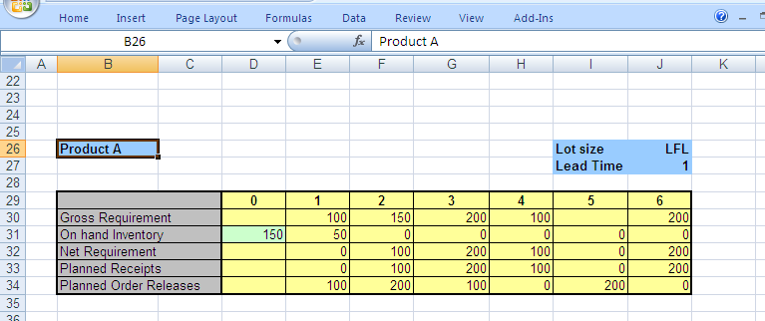
Developing MRP Example 16.2 (Product A)

Slide 26
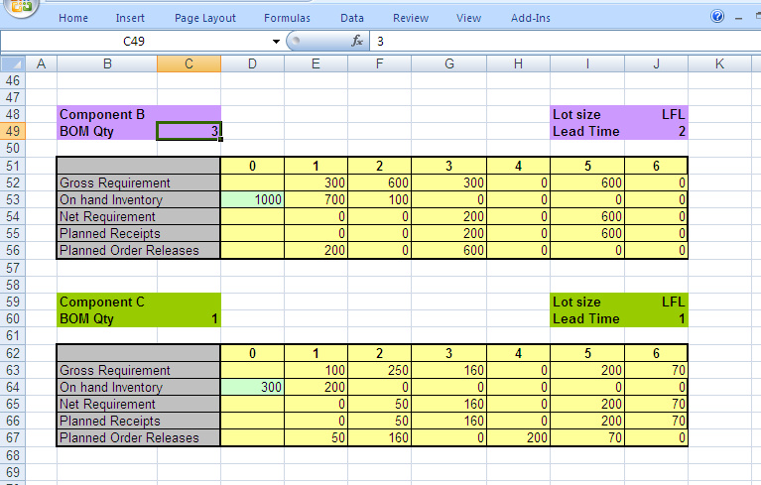
Developing MRP Example 16.2 (Components B,C)

Slide 27
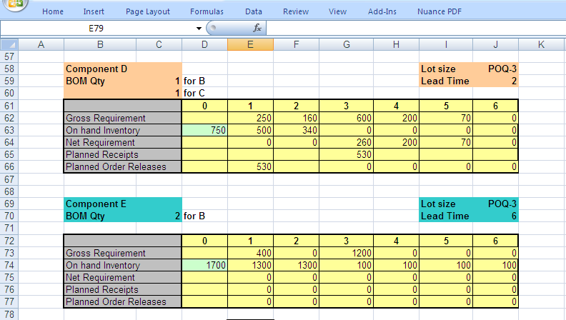
Developing MRP Example 16.2 (Components D,E)

Slide 28
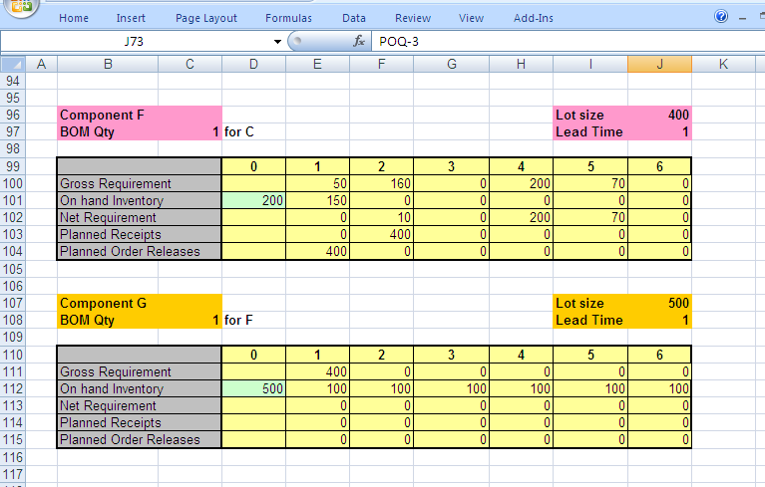
Developing MRP Example 16.2 (Components F,G)

Slide 29
Using the MRP Systems Issues & Challenges
Problems MRP systems potentially face:
Bad data integrity
Lack of discipline in updating the required data bases as and when changes take place elsewhere in the organisation
Uncertainties associated with issues that lie outside the control of people and the system
How often MRP must be updated and rerun?
Regenerative Method
Net Change Method
Handling uncertainties affecting the system by incorporating:
Safety Stock
Safety Lead times

Slide 30
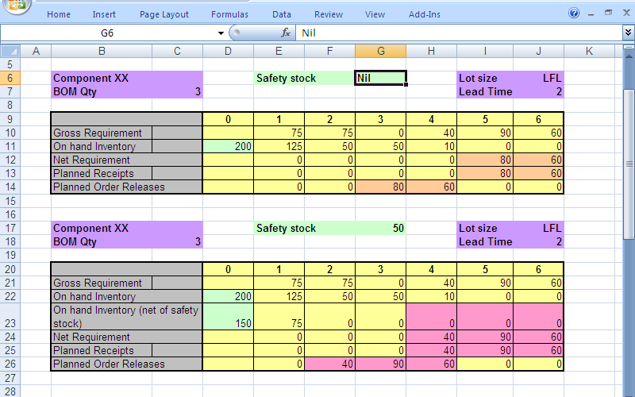
Incorporating Safety Stock An illustration

Slide 31
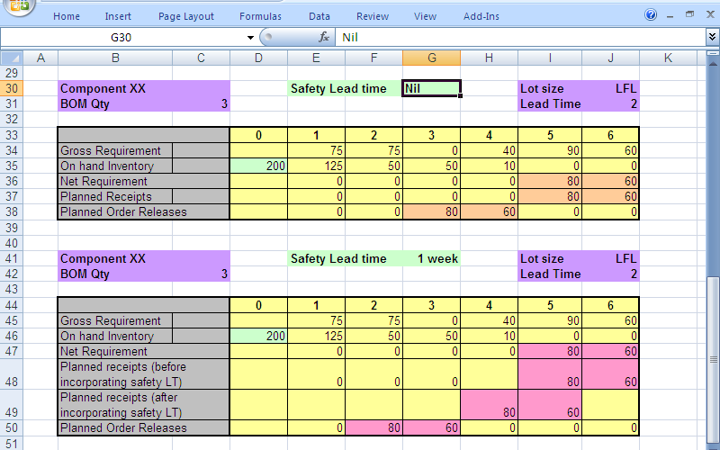
Incorporating Safety Lead Time An illustration

Slide 32
Capacity Requirements Planning (CRP): Logic
MRP planned
order
releases
Routing File
(Process Plan)
Capacity
Requirements
Planning
Capacity
Status
Loading schedules
for each resource

Slide 33
MRP & CRP A comparative picture
Criteria for comparison | Material Requirements Planning (MRP) | Capacity Requirements Planning (CRP)
Input | Bill of Material (Product Structure) | Routing Information (Process Plan)
 | MPS | MRP Schedules
 | Lead time Data | Lead time Data
 | Inventory Status | Capacity Status
 | Lot Sizing Rules
Output | Purchase Orders | Capacity loading schedules
 | Work Orders | Capacity usage profiles

Slide 34
MPS – MRP – CRP Iterative Process
Begin
Modify MPS
Master Production
Scheduling (MPS)
Modify MPS
No
Modify MRP
Material Requirements
Planning (MRP)
Feasible?
Yes
No
Capacity Requirements
Planning (CRP)
Feasible?
Yes
Finalise
Plan

Slide 35
Manufacturing Resource Planning (MRP II)
Extension of MRP
Plans all resources needed for running a business
Variations include
Service Requirements Planning (SRP)
Business Requirements Planning (BRP)
Distribution Requirements Planning (DRP)

Slide 36
MRP II Modules
Forecasting
Customer order entry
Production planning / Master Production Scheduling
Product structure / Bill-of-Material processor
Inventory control
Material Requirements Planning
Capacity planning
Shop floor control
Purchasing
Accounting
Financial analysis

Slide 37
Enterprise Resources Planning (ERP): A tool for Inter-functional integration
Purchase
Purchase
Order
Accounts
Payable
Invoice
Payment
Accounts
Statement
Cash Management
Forecast
Cash Management
Current Position
Treasury
Accounts
Receivable
Invoice
Cash
Receipt
Accounts
Statement
Sales
Order
Sales

Slide 38
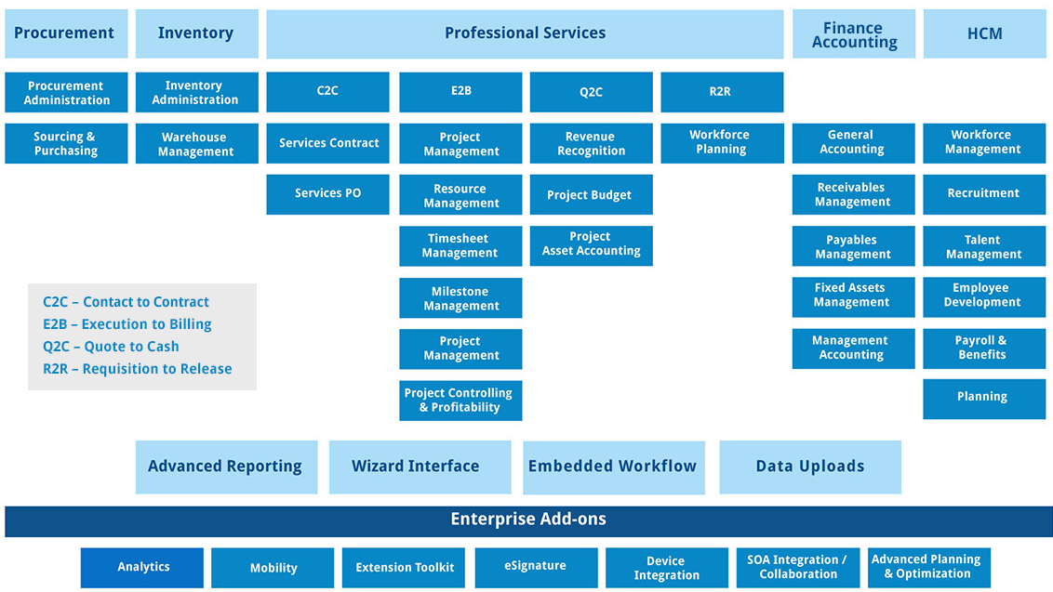
Services Resources Planning (SRP) An ERP Solution from Ramco

Slide 39
Resources Planning Chapter Highlights
Dependent demand items exhibit certain characteristics such as lumpy demand and parent – offspring relationships that could be exploited while planning for materials in organisations
Bill of Material and Product Structure depicts the dependency relationships among various components in a manufacturing set-up.
Various lot sizing rules could be utilised to batch the requirements and schedule orders.
The lot sizing rules strike an appropriate trade-off between carrying cost and ordering cost.
MRP logic involves a four-step logic; Net – Lot – Offset – Explode.

Slide 40
Resources Planning Chapter Highlights…
Through an iterative process, the material requirements of all components in an organisation during a planning horizon are arrived.
Regeneration and Net change are the two methods used for updating the MRP schedules.
Capacity Requirements Planning uses a similar logic to that of MRP
The logic of MRP could be extend to several other spheres of an operations system. MRP II systems provide this functionality.
Modern day ERP systems are further extensions of MRP logic to other areas of business such as Marketing. Finance and Personnel.

