Slide 1
Chapter 18
Operations Scheduling

Slide 2
Scheduling of Operations A planning tool for the short term
Provides an opportunity to make use of new information as we approach real time
A methodology to fine tune planning and decision making due to the occurrence of random events
Enables organisations to focus on micro-resources, a single machine, a set of workers and so on. Such a focus is neither possible nor warranted at the medium or long term planning.

Slide 3
Planning Context in the short term
How do we assign the jobs to various work centers?
Within each work center, how do we rank order the jobs?
How do we assign other resources such as skilled workers and material handling devices to the operating system?
How do we react to a breakdown in the system?
How do we measure the performance of the operating system?

Slide 4
Scheduling Alternative Terminologies
Loading is defined as a planning methodology using which the resources in an operating system are assigned with adequate number of jobs during the planning horizon (of say a week)
Scheduling is defined as the process of rank ordering the jobs in front of each resource with a view to maximise some chosen performance measure
Routing is defined as the order in which the resources available in a shop are used by the job for processing
Sequencing is the ordering of operations of the jobs in the operating system
Dispatching is defined as the administrative process of authorising processing of jobs by resources in the operating system as identified by the scheduling system

Slide 5
Scheduling Context
Number of jobs (n)
Number of machines (m)
Shop Configuration
Flow shop
Job Shop
Cellular Manufacturing System
Job Priorities
FCFS, SPT, LPT, EDD, LS, Random
Performance Measures
Due date based: lateness, tardiness
Completion based: Flow time, make span
Inventory/cost based

Slide 6
Pure Flow Shop A graphical illustration
Job 1
. . .
Machine 1
Machine 2
Machine 3
Machine m
Job 2
Job n
In a flow shop, the resources are organised one after the other in the order the jobs are processed
A pure flow shop is one in which all the jobs visit all the machines in the same order (beginning at machine 1 and ending at machine m)
In a mixed flow shop, some jobs are allowed to skip machines in between

Slide 7
Job Shop A graphical illustration
Job 1: 1-4-2-5-6
Job 2: 3-2-1-4-6-7
Job 3: 2-3-4-7-5-6
Machine 1
Machine 3
Machine 6
Job 1
Job 3
Machine 4
. . .
Machine 2
Machine 7
Job 2
Machine 5
In a job shop, machines are not organised in any processing order. Rather similar type of resources is grouped together

Slide 8
Scheduling Rules A sample
Shortest processing time (SPT): Chooses the job with the least processing time among the competing list and schedules it ahead of the others
Longest processing time (LPT): The job with the longest processing time is scheduled ahead of other competing jobs
Earliest Due Date (EDD): Establishes priorities on the basis of the due date for the jobs.
Critical Ratio (CR): Critical ratio estimates the criticality of the job by computing a simple ratio using processing time information and due date. A smaller value of CR indicates that the job is more critical.
First Cum First Served (FCFS): Schedules jobs simply in their order of job arrival
Random Order (RAN): Assign priorities to jobs on a random basis.

Slide 9
Scheduling Rules An illustration of their application
Current time = 0
Job No. | Processing time (mins) | Order of arrival | Due by | CR | Random Number
1 | 12 | 1 | 23 | 1.92 | 0.233
2 | 9 | 2 | 24 | 2.67 | 0.857
3 | 22 | 3 | 30 | 1.36 | 0.518
4 | 11 | 4 | 20 | 1.82 | 0.951
Rule | Rank ordering of jobs based on
SPT | 2 – 4 – 1 – 3
LPT | 3 – 1 – 4 – 2
EDD | 4 – 2 – 1 – 3
CR | 3 – 4 – 1 – 2
FCFS | 1 – 2 – 3 – 4
RAN | 1 – 3 – 2 – 4

Slide 10
Performance Criterion Completion based measures
Flow time is defined as the elapsed time between releasing a job into the shop and the time of completion of processing of the job
Release time of the job : R_{i}
Completion time of the job : C_{i}
Flow time of the job : F_{i} = (R_{i} – C_{i})
Make span is defined as the time taken to complete all the jobs released into the shop for processing
Make span (Max. Completion time):

Slide 11
Performance Criterion Due date based measures
Lateness defined as the difference between completion time and due date.
If the due date for a job i is denoted as D_{i}, then
Lateness of the job: L_{i} = (C_{i} – D_{i})
If a job is completed ahead of time, instead of computing a negative value for L_{i} if we take zero, then the resulting measure is known as tardiness
Tardiness of the job: T_{i} = max(0, L_{i})

Slide 12
Performance of Scheduling Rules Example 18.2: An illustration (SPT)
Scheduling Rule: SPT
Processing order | Release time (Ri) | Completion time (Ci) | Flow time (Fi) | Lateness | Tardiness
2 | 0 | 6 | 6 | 0 | 0
3 | 0 | 13 | 13 | 4 | 4
1 | 0 | 2 | 2 | -17 | 0
4 | 0 | 21 | 21 | 4 | 4
Mean |  | 10.50 | 10.50 | -2.25 | 2.00
Maximum |  | 21.00 | 21.00 | 4.00 | 4.00
Minimum |  | 2.00 | 2.00 | -17.00 | 0.00
No. of tardy jobs = 2; Make span = 21

Slide 13
Performance of Scheduling Rules Example 18.2: An illustration (EDD)
Scheduling Rule: EDD
Processing order | Release time (Ri) | Completion time (Ci) | Flow time (Fi) | Lateness | Tardiness
1 | 0 | 4 | 4 | -2 | 0
2 | 0 | 11 | 11 | 2 | 2
4 | 0 | 21 | 21 | 2 | 2
3 | 0 | 19 | 19 | 2 | 2
Mean |  | 13.75 | 13.75 | 1.00 | 1.50
Maximum |  | 21.00 | 21.00 | 2.00 | 2.00
Minimum |  | 4.00 | 4.00 | -2.00 | 0.00
No. of tardy jobs = 3; Make span = 21

Slide 14
Scheduling of Flow Shops Johnson’s Rule
Step 1: Let t_{1i} denote the processing time of job i in machine 1 and t_{2i} denote the processing time in machine 2.
Step 2: Identify the job with the least processing time in the list. If there are ties, break the tie arbitrarily.
If the least processing time is for machine 1, place the job at the front of the sequence immediately after any jobs already scheduled
If the least processing time is for machine 2, place the job at the back of the sequence immediately before any jobs already scheduled
Remove job i from the list.
Step 3. If there are no more jobs to be scheduled go to step 4. Otherwise go to step 1.
Step 4. The resulting sequence of jobs is the best schedule to minimise the make span of the jobs.

Slide 15
Johnson’s Rule An illustration: Example 18.3
Job No | Processing time
 | Machine 1 | Machine 2
1 | 4 | 7
2 | 6 | 3
3 | 2 | 3
4 | 7 | 7
5 | 8 | 6
Job 3 | Job 1 | Job 4 | Job 5 | Job 2

Slide 16
Job Shop Scheduling An illustration (Example 18.4, SPT rule)
Machines 1 and 2 are assigned jobs 4 and 1 respectively using the SPT rule

Slide 17
Job Shop Scheduling An illustration (Example 18.4, SPT rule)
After completion of job 1, job 3 is scheduled in machine 2 using SPT rule

Slide 18
Job Shop Scheduling An illustration (Example 18.4, SPT rule)
Gantt Chart representation of the final schedule using the SPT rule

Slide 19
Job Shop Scheduling An illustration (Example 18.4, EDD rule)
Gantt Chart representation of the final schedule using the EDD rule

Slide 20
Job Shop Scheduling Performance Summary of SPT & EDD
Job No | Due | SPT |  | EDD
 |  | C_{i} | Lateness | C_{i} | Lateness
1 | 10 | 13 | 3 | 23 | 13
2 | 12 | 21 | 9 | 20 | 8
3 | 9 | 17 | 8 | 14 | 5
4 | 14 | 18 | 4 | 23 | 9
Average |  | 17.25 | 6.00 | 20.00 | 8.75

Slide 21
Input – Output Control A schematic illustration
Pending
Orders
Input rate control
CONWIP
Existing
Load
Output rate control
Completed
Orders

Slide 22
Operational Control Issues Mass Production Systems
Much of control and scheduling boils down to appropriately arriving at balanced flow of components in the shop floor
Design the system for balanced flow using Line Balancing Techniques
Given a certain availability of resources modify the cycle time to meet daily production targets
Machine Redeployment
Altering Operator Allocations
Adjusting Material Feed rates
TAKT time provides a rhythm for the overall functioning of the shop

Slide 23
Worker deployment for adjusted TAKT: An illustration
Required output per day | 400 | 450 | 371
No. of shifts per day | 2 | 2 | 2
Required output per shift | 200 | 225 | 185.5
Net available production time (Mins) | 420 | 420 | 420
TAKT Time (Seconds) | 126 | 112 | 136
Work Content (Seconds) | 1,764 | 1,764 | 1,764
No. of Operators required per shift | 14 | 16 | 13
Total number of operators required | 28 | 32 | 26

Slide 24
Theory of Constraints & Synchronous Manufacturing
Theory of constraints is a systematic body of knowledge, which recognizes that
Resources in manufacturing organizations differ from one another in their ability to process components
Statistical fluctuations and dependant events are characteristic of resources in a manufacturing organization
Uses specific methods to improve the performance of the system under these conditions.
Synchronous manufacturing is a specific application of theory of constraints to scheduling and operational control of manufacturing systems
In synchronous manufacturing the focus is on synchronizing flow rather than balancing capacities

Slide 25
Theory of constraints Guiding principles
Do not balance capacity – balance flow
The level of utilisation of a non-bottleneck resource is determined by not by its own potential but by some other constraints in the system
An hour lost at the bottleneck is an hour lost at the entire system
An hour saved at a non-bottleneck is a mirage
Bottlenecks govern both the throughput and inventory in the system

Slide 26
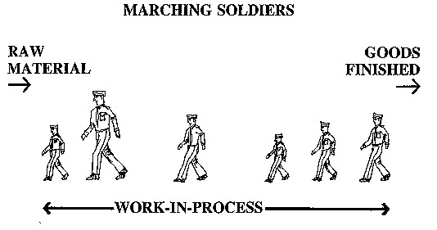
Synchronous Manufacturing The analogy of marching soldiers

Slide 27
Marching soldiers & A production system A comprison
Resource | Marching Soldiers | Production System
Processing | Ground to be covered | Raw Material to be processed
WIP | Gap between the first and the last soldier | Work in Process in the shop floor
Throughput | The extent of ground covered by the marching soldiers | Amount produced and sold by the production system
Operating Expenses | Amount of energy expounded by the soldiers to complete the march | Cost of transforming the raw material into throughput
Objective | To cover a certain extent of the ground in a given time | To achieve a certain throughput in a given time

Slide 28
Two types of resources
Based on the capacity availability to meet demand
Bottleneck resource
Non-bottleneck resource
Bottleneck resources determine the (planned) output of the system
Ability to become a bottleneck if poorly scheduled
Capacity constrained resource (CCR)
Non-CCR
CCR will ensure that the actual throughput do not deviate from the planned in a manufacturing system.
Focusing on maximizing utilisation of bottleneck resource is key to maximising throughput in a manufacturing system. On the other hand, scheduling is done in synchronous manufacturing with reference to CCRs.

Slide 29
Synchronous Manufacturing Guiding Principles
1 | Do not focus on balancing capacities. Instead, focus on synchronizing the flow
2 | The marginal value of time spent at a bottleneck resource is negligible. Do not attempt to reduce time at a non-bottleneck resource.
 | 2a. An hour gained at a non-bottleneck resource is a mirage
 | 2b. An hour lost at a bottleneck resource is an hour of throughput loss
3 | The level of utilization of a non-bottleneck resource is controlled by other constraints within the system
4 | Resources in the system must be utilized, not simply activated.
5 | A constraint is any element that preempts the system from achieving the goal of making more money.
6 | The transfer time need not, and many time should not equal to the process batch

Slide 30
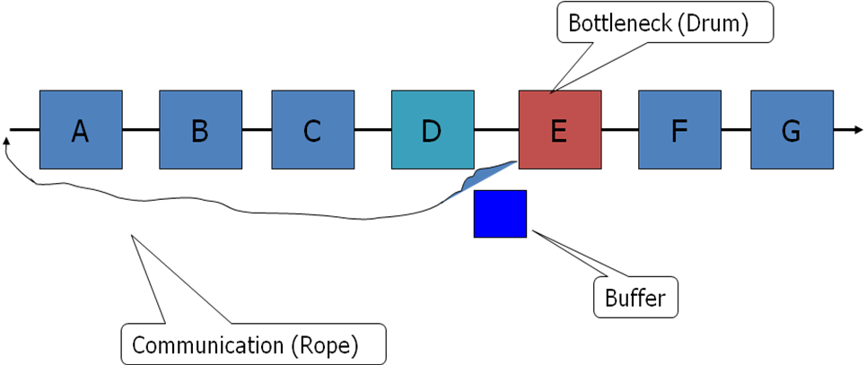
Synchronous Manufacturing Drum – Buffer – Rope Methodology
Develop a schedule so that it is consistent with the constraints of the systems (Drum)
The schedule is actually the drum beat
Protect the throughput of the system from statistical fluctuations through the use of buffers at some critical points in the system (Buffer)
Tie the production at each resource to the drum beat (Rope)

Slide 31
Constraint Management In the Long run
Soft Constraints
Identify the constraint
Hard constraints
Gainfully exploit it using
Synchronous Manufacturing
Revised
systems
Mount a time bound
procedure for
removing the constraint
Progressive
Mind-set
Process
improvements
Constraints
shift elsewhere

Slide 32
Scheduling of Operations Chapter Highlights
The focus shifts from operations planning to operational control in the case of a short-term. Scheduling aids operational control in manufacturing and service systems.
The scheduling context relates to the number of jobs and machines in the system and the physical configuration of the machines. These factors greatly influence the complexity of scheduling.
Flow shop and Job shops are two alternatives for configuration of a manufacturing system. The scheduling methodology and complexity differ vastly between these two. Job shops are far more complex to schedule than flow shops.

Slide 33
Scheduling of Operations Chapter Highlights…
Johnson’s algorithm provides an optimal schedule for a two machine – n job problem using the shortest processing time rule for scheduling.
Operational control in mass production systems are primarily achieved through use of TAKT time based scheduling.
Theory of constraints indicates that scheduling of operations must take into account the existence of bottlenecks and statistical fluctuations in operations.
Synchronous manufacturing principles apply the theory of constraints and develop alternative schedules using a drum – buffer – rope methodology.

