Slide 1
Chapter 19
Six-Sigma Quality Control

Slide 2
Six Sigma Approach to Quality
Six sigma is a new approach to process control first practiced by companies such as General Electric and Motorola to achieve near zero defects in processes
Elements of six-sigma
Understanding customer needs well
Appropriate and disciplined use of data and statistical tools
Statistical analysis and a closer attention to managing and improving business processes using a set of tools

Slide 3
How is it different from traditional approach?
A new metric, Defects Per Million Opportunities, to predict/assess the quality of a business process
A new methodology, DMAIC (Define-Measure-Analyze-Improve-Control), to ensure that very high levels of quality could be assured in the chosen business processes thereby generating favourable outcomes to both the business and the customers
An organizational framework for ensuring the above outcomes are generated on a sustained basis

Slide 4
Defects Per Million Opportunities (DPMO)
It indicates how many defects a process generates in a million opportunities
While service industries find it convenient to use DPMO, manufacturing organizations use Parts Per Million (PPM). Both are conceptually same.
If in a process
“k” Denotes the number of opportunities for making a defect per unit of execution of that process
“n” Number of units of observation of the process
“d” Number of defects that occurred in that process during the observation
The defects per opportunity =

Slide 5
DMAIC Methodology
Define
Measure
Control
Analyze
Improve

Slide 6
DMAIC Methodology
Define
Define the problem, the requirements, project scope, project charter
Set goals for improvement
Measure
Identify variables to be measured, the type of measurement
Data collection and synthesis
Analyze
Develop a set of tools for analysis
Apply graphical tools of analysis
Identify possible sources of variation and “vital” few root causes
Explore means of eliminating them

Slide 7
DMAIC Methodology
Improve
Generating and validating improvement alternatives
Creating new process maps for the process
Control
Develop control plan
Establish revised standard measures to maintain performance
Develop relevant raining plans to maintain standards

Slide 8
Organization for six sigma
Process Owner
Supervisor or a manager who takes responsibility for various steps of a process that is responsible for delivering some output to the customer. It could be the in a particular work area where the improvement project has been identified
Team Leader & Members
Team leader (the project leader) and the members will comprise of the employees in the chosen work area
They will have day-to-day operational control of activities
In six sigma, three terminologies are used to indicate these organizational entities. This includes Master Black Belt, Black Belt and Green Belt. The depth of training and experience differentiates these three.

Slide 9
Organization for six sigma
Six sigma coach
A consultant or a senior person in the organization who offers expert knowledge on various aspects of six sigma.
This includes statistical tools, process design & analysis, change management, small group improvement, use of QC tools for improvement etc.
Sponsor
A member of the senior management who oversees the overall progress and implementation
Helps the team refine the project scope, sorts out issues cutting across other parts of the organization, approves projects and provides the necessary support in terms of resources

Slide 10
Statistical Process Control
Collective set of tools & techniques used to develop a quality assurance system when business processes exhibit variations is known as Statistical Process Control (SPC)
Key issues addressed in SPC based quality assurance system:
How does one ensure that the random events are indeed rare events?
How do we know whether the observed changes are due to random variations or assignable causes?

Slide 11
Common & Assignable Causes
Two types of variations occur in business processes
Chance variations due to common causes
Common causes are those due to random events that cannot be controlled
Non-random variations due to assignable causes
When observed variations are not statistically found to be due to random events, it clearly points to the existence of assignable causes
Errors due to operator skill level differences
Changes in the operating condition of an equipment
Changes introduced in the standard operating procedures
In the case of assignable causes, the system will drift from desired level of performance over time

Slide 12
Quality Assurance using SPC Some terminologies
Designed Standard
Centre of specification limits (Target)
Upper Specification Limit (USL)
Lower Specification Limit (LSL)
(USL – LSL): Desired Tolerance for the specs.
This represents the voice of the customer
Status of process
Centre of the process (Process Average)
Upper Control Limit (UCL)
Lower Control Limit (LCL)
(UCL – LCL): Spread of the process
This represents the voice of the process

Slide 13
Control Chart A generalised representation
Upper Control Limit (UCL)
Plot of sample data
Process Average
Lower Control Limit (LCL)

Slide 14
Setting up a process control system
Choose the characteristic
for process control
Choose the
Measurement method
Choose an appropriate
Sampling procedure
Choose the type of
Control Chart
Calculate
control limits
Plot the data & Analyse

Slide 15
Characteristics for process control Some examples
Sl. No. | Type of Applications | Characteristic for Measurement
1 | Component Manufacturing | Conformance of physical measurements of components and sub-assemblies to specifications Conformance to operating characteristics of machines and other resources involved in the process
2 | Final Assembly | Number of defects in the product Conformance to test specifications Number of missing elements
3 | Process Industries | Temperature, Pressure and Heat specifications Conformance to product specifications Conformance to equipment specifications Vibrations and other variations in equipments and sub-systems Conformance to specifications of the automation & control system
4 | Service Systems | Number of defects in various business processes Errors in processing documents Conformance to waiting time/lead time related specifications

Slide 16
Choosing a characteristic Examples from service industry
How long does it take to complete the patient admission process in a hospital?
How dissatisfied were the customers when they stayed in a hotel for a holiday?
Does our process of understanding customer requirements needs improvement?
How capable are my sub-processes in software development?

Slide 17
Measurement Methods
Attribute Based
simple clustering of the characteristic into a few categories (such as good or bad)
Two frequently used attribute measures are:
Proportion of defects (denoted as p)
Number of defects (denoted as c)
measurements are easy to make, quick & less expensive, but reveal very little information about the process
Variable Based
Detailed observation of the characteristic (such as length, diameter, weight)
measurement will be expensive and more time consuming but will provide a wealth of information about the process

Slide 18
Types of Control Charts
Variable based control chart
X bar and R Charts
Attribute based control chart
P chart
C chart

Slide 19
Notations for control charts

Slide 20
X bar and R Chart Setting control limits

Slide 21
Coefficients for computing LCL and UCL in X-bar and R charts*
Source: Juran, J.M. and F.M. Gryna, (1995), “Quality Planning and Analysis”, Tata McGraw-Hill, 3rd Edition, New Delhi, pp 385.

Slide 22
X bar Chart An example

Slide 23
R Chart An example

Slide 24
P chart Setting the control limits

Slide 25
P Chart An example

Slide 26
C Chart Setting up the control limits

Slide 27
C Chart An example (with an outlier)

Slide 28
C Chart Is this process behaving normally?

Slide 29
When to stop the process? 15 points in a row in Zone C
+3σ
Zone A
+2σ
Zone B
+1σ
Zone C
Zone C
-1σ
Zone B
-2σ
Zone A
-3σ

Slide 30
When to stop the process? 14 points in a row alternating up and down
+3σ
Zone A
+2σ
Zone B
+1σ
Zone C
Zone C
-1σ
Zone B
-2σ
Zone A
-3σ

Slide 31
When to stop the process? Additional rules
One point beyond Zone A
Nine points in a row in Zone C or beyond
Six points in a row, steadily increasing or decreasing
Fourteen points in a row, alternating up and down
Two out of three points in a row in Zone A or beyond
Four out of five points in a row in Zone B and beyond
Fifteen points in a row in Zone C

Slide 32
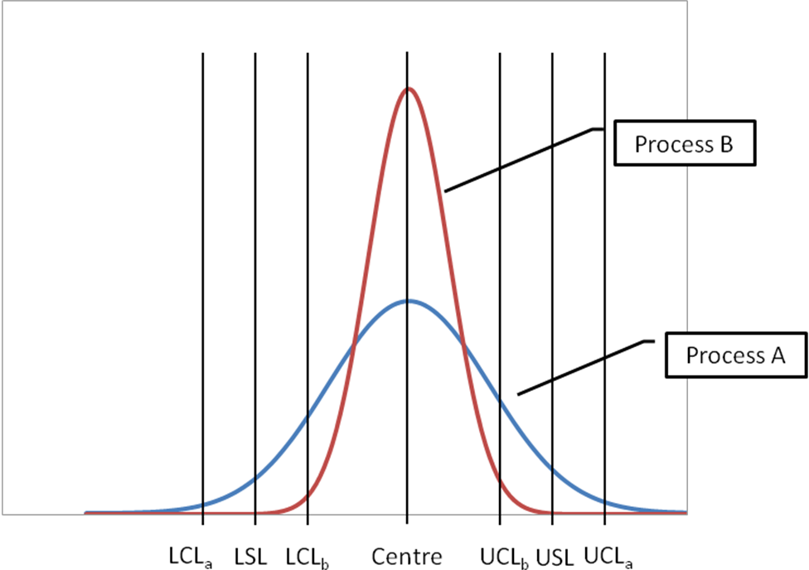
Predictive capability of processes Which process is better?
Spread of a process is indicative of its capability

Slide 33

Predictive capability of processes Which process is better?
Offset
A process that is aligned closer to the desired target is likely to be more capable
Process B
Process A
LSL
Target
USL

Slide 34
Process Capability
Process Capability is defined by the spread of the process
Potential capability (C_{p}) is defined as the ratio of the difference in specification limits to the process spread
C_{p} =
Actual capability (C_{pk}) takes into consideration the extent to which the process has deviated from the desired target
C_{pk} =

Slide 35
Process Capability & Defects
Process Capability Index (C_{pk}) | Total Products outside two-sided specification limits
0.25 | 453,255 ppm
0.50 | 133,614 ppm
0.60 | 71,861 ppm
0.80 | 16,395 ppm
1.00 | 2,700 ppm
1.20 | 318 ppm
1.50 | 7 ppm
1.70 | 0.34 ppm
2.00 | 0.0018 ppm
Source: Quality Planning & Analysis, Juran & Gryna, Chapter 17, 3e

Slide 36
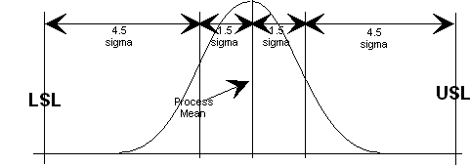
Six sigma quality A graphical representation
C_{p}

Slide 37
Acceptance Sampling
A method in which the decision with regard to acceptance or otherwise of a lot of incoming material is based on the observations made using a sample
Setting up a system for acceptance sampling requires addressing the following questions:
What is the size of the sample required for assessing the quality?
What should be the criteria for acceptance of the lot?
Is it enough to have just one sample or is it desirable to go for multiple samples
How do we assess the impact of the choice of the above parameters on the quality level in the long run?

Slide 38
Sampling Plan
A sampling plan describes
the Lot size (N)
size of the sample to be assessed (n)
the acceptance number (c): the number of defects permissible in the observed sample
Therefore, a single sampling plan is denoted by (N, n, c)
In the case of multiple sampling plans, for each of the plan, the sample size (n1, n2 etc.) and the acceptance number (c1, c2 etc.) needs to be specified

Slide 39
Acceptance Sampling Operating Characteristics
Acceptable Quality Level (AQL): the percent defect that the buyer is willing to tolerate in the lot delivered by the supplier
Lot Tolerance Percent Defective (LTPD): the worst quality beyond which the manufacturer is not willing to accept the incoming lot
Producer’s risk: the risk supplier faces in getting his/her lot rejected when indeed it was conforming to the agreed terms
Consumer’s risk: the risk that a manufacturer faces of accepting a lot with poor quality beyond his/her tolerance level
Operating Characteristics (OC) Curve: A graphical representation of a sampling plan that reveals the above aspects of a sampling plan

Slide 40
Operating Characteristics Curve Example 19.5
Producer’s Risk
OC Curve for n=500, c=2
Consumer’s Risk
AQL
LTPD

Slide 41
Statistical Process Control Chapter Highlights
Six sigma is a new approach to process control based on as set of principles that enable organizations improve their quality to near zero defects level
Six sigma quality control differentiates itself from the traditional quality control methodology on the basis of three features:
A new metric, Defects Per Million Opportunities, to predict/assess the quality of a business process,
A new methodology, DMAIC (Define-Measure-Analyze-Improve-Control)
An organizational framework for ensuring the above outcomes are generated on a sustained basis

Slide 42
Statistical Process Control Chapter Highlights…
All processes exhibit variations on account of two causes
Common causes of variations happen on account of random events
Assignable causes introduce variations that can be detected and eliminated
Setting up a process control system involves
choosing a characteristic to control
identifying a measurement method and
developing a relevant control chart
A plot of the data helps a quality manager to assess if the process is in control and also helps her to detect any impending shift in process parameters

Slide 43
Statistical Process Control Chapter Highlights…
Superimposing the specification limits on the control chart helps an organisation to assess the process capability and the likely number of defects that the process will produce. It also helps to target for a six-sigma quality improvement programme.
Acceptance sampling is used to accept a lot of items based on the observed number of defects in the sample drawn out of the lot
The performance of an acceptance sampling plan could be judged by developing an Operating Characteristics (OC) curve for the plan
An acceptance sampling design results in a certain amount of risk for both the customer and supplier

