Slide 1
Computing Multi-Commodity
Flows
Under the guidance of
Prof. Naveen Garg
Naveen Kumar Tiwari(2013MCS2566)
Alind(2013MCS2542)

Slide 2
Linear Programming
Definition: A mathematical technique to optimize a linear function of several variables based on some constraint.
Linear Model consist of following components:
Set of decision variables
An objective function
Set of constraints

Slide 3
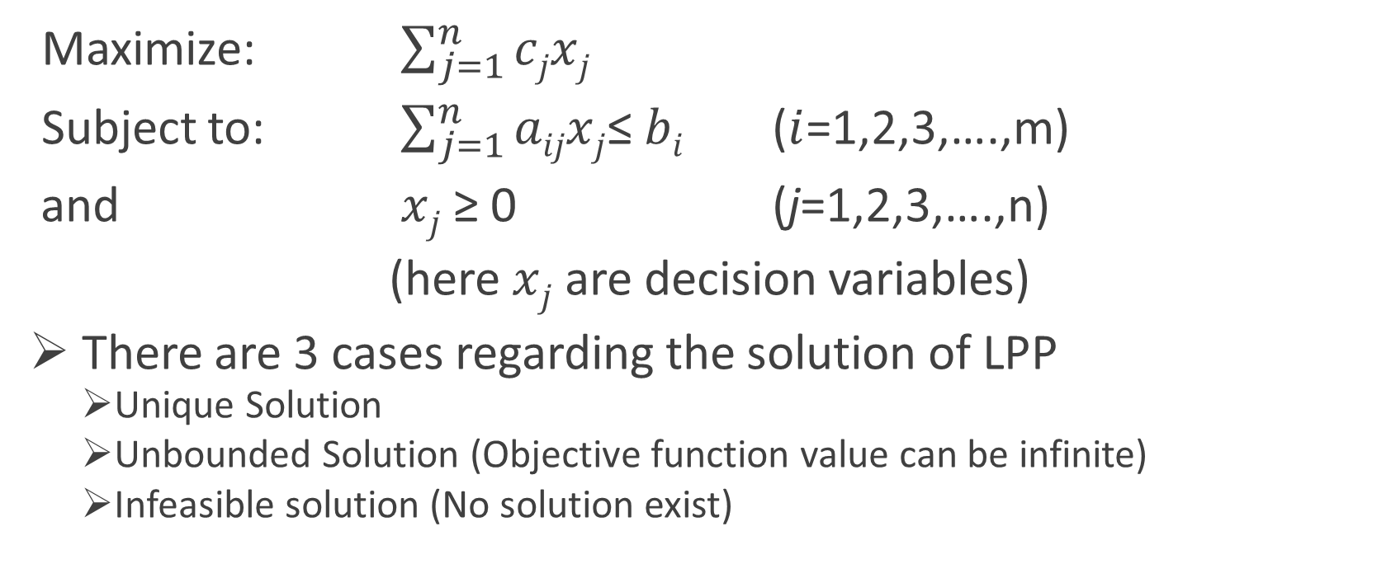
Example of LP
Maximize: $\sum_{j=1}^{n}{cjxj}$
Subject to: $\sum_{j=1}^{n}{aijxj}$≤ $bi$ ($i$=1,2,3,….,m)
and $xj$ ≥ 0 (j=1,2,3,….,n)
(here $xj$ are decision variables)
There are 3 cases regarding the solution of LPP
Unique Solution
Unbounded Solution (Objective function value can be infinite)
Infeasible solution (No solution exist)

Slide 4
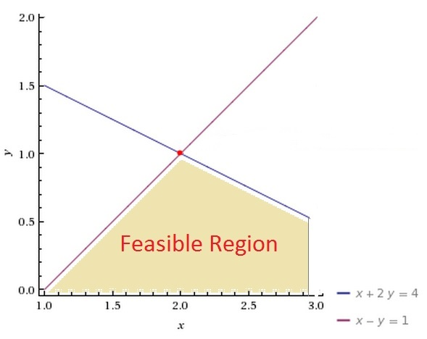

Graphical Significance of LPP
Linear Programming model for the following problem can be formulated as:
Maximize $z=3x+2y$
subject to constraints $x+2y≤4$
$x−y≤1$
$x,y≥0$
Maximum value of z can occur at the vertices of
Convex hull formed by plotting the constraints.
(Proof: advanced mathematics)

Slide 5
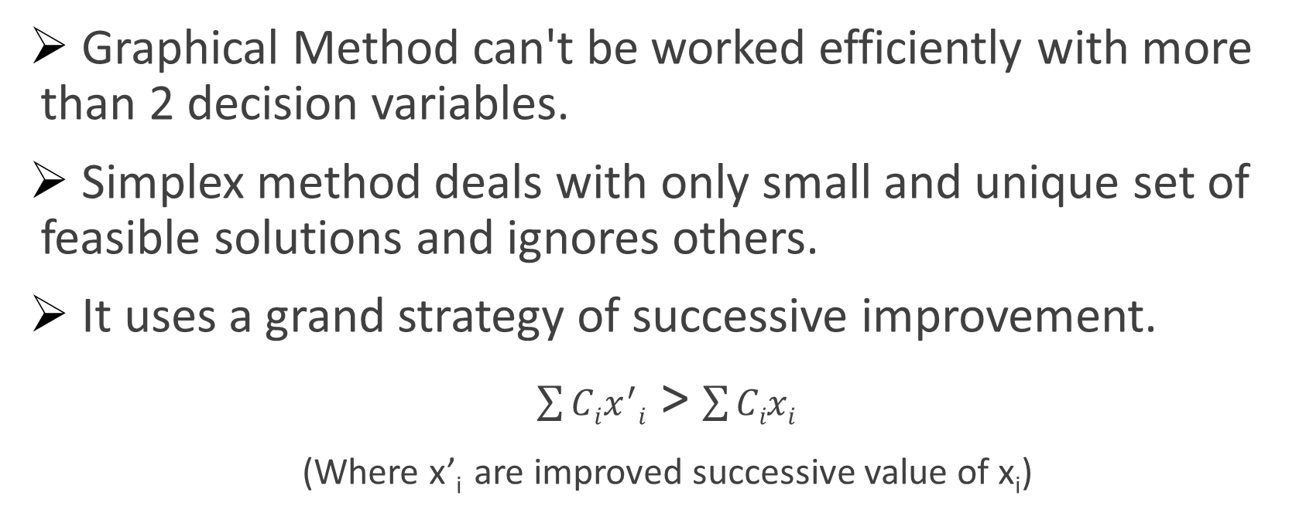
Simplex Method:
Graphical Method can't be worked efficiently with more than 2 decision variables.
Simplex method deals with only small and unique set of feasible solutions and ignores others.
It uses a grand strategy of successive improvement.
$\sum{Cix^{′}i}$ > $\sum{Cixi}$
(Where x’_{i} are improved successive value of x_{i})

Slide 6
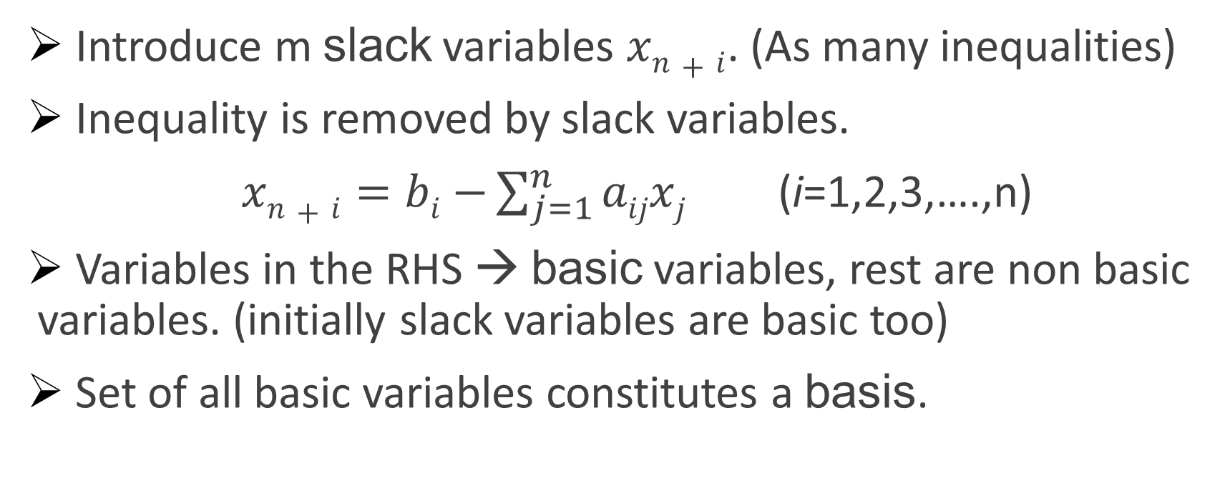
Simplex Method: steps(1)
Introduce m slack variables $xn+i$. (As many inequalities)
Inequality is removed by slack variables.
$xn+i=bi$ $−\sum_{j=1}^{n}{aijxj}$ (i=1,2,3,….,n)
Variables in the RHS → basic variables, rest are non basic variables. (initially slack variables are basic too)
Set of all basic variables constitutes a basis.

Slide 7
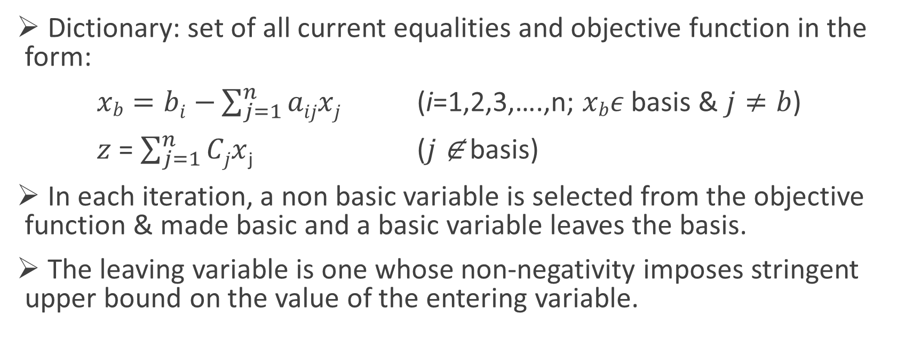
Simplex Method: steps(2)
Dictionary: set of all current equalities and objective function in the form:
$xb=bi$ $−\sum_{j=1}^{n}{aijxj}$ (i=1,2,3,….,n; $xb$𝜖 basis & $j≠b$)
$z$ = $\sum_{j=1}^{n}{Cjx}$_{j} ($j$ ∉ basis)
In each iteration, a non basic variable is selected from the objective function & made basic and a basic variable leaves the basis.
The leaving variable is one whose non-negativity imposes stringent upper bound on the value of the entering variable.

Slide 8
Simplex Method: steps(3)
Entering variable has the largest non-negative coefficient in objective function. (Selection may have some other alternative approaches)
Getting new dictionary is called pivoting.
Simplex method terminates when objective function have only negative variables.

Slide 9
Pitfalls of simplex method
Initialization: Finding an initial feasible solution to start.
Infeasible origin
Iteration: Choosing entering & leaving variable.
Degeneracy: Pivoting doesn’t change value of objective function.
Termination: Eliminating endless sequence of iteration.
Cycling: Simplex method go through an endless sequence of iterations without finding optimal solution

Slide 10
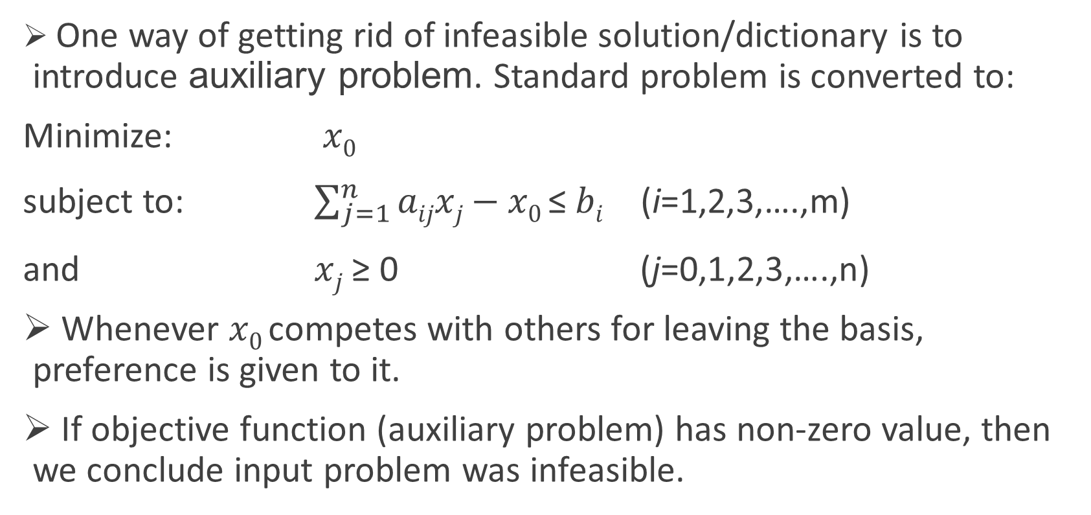
Avoiding: Infeasible initial dictionary
One way of getting rid of infeasible solution/dictionary is to introduce auxiliary problem. Standard problem is converted to:
Minimize: $x0$
subject to: $\sum_{j=1}^{n}{aijxj}\text{−} x\text{0 }\text{≤ }bi \text{ (}\text{i}\text{=1,2,3,….,}\text{m}\text{)}$
and $xj\text{ ≥ 0 }$ $\text{(}\text{j}\text{=}\text{0,}\text{1,2,3,….,}\text{n}\text{)}$
Whenever $x\text{0 }$competes with others for leaving the basis, preference is given to it.
If objective function (auxiliary problem) has non-zero value, then we conclude input problem was infeasible.

Slide 11
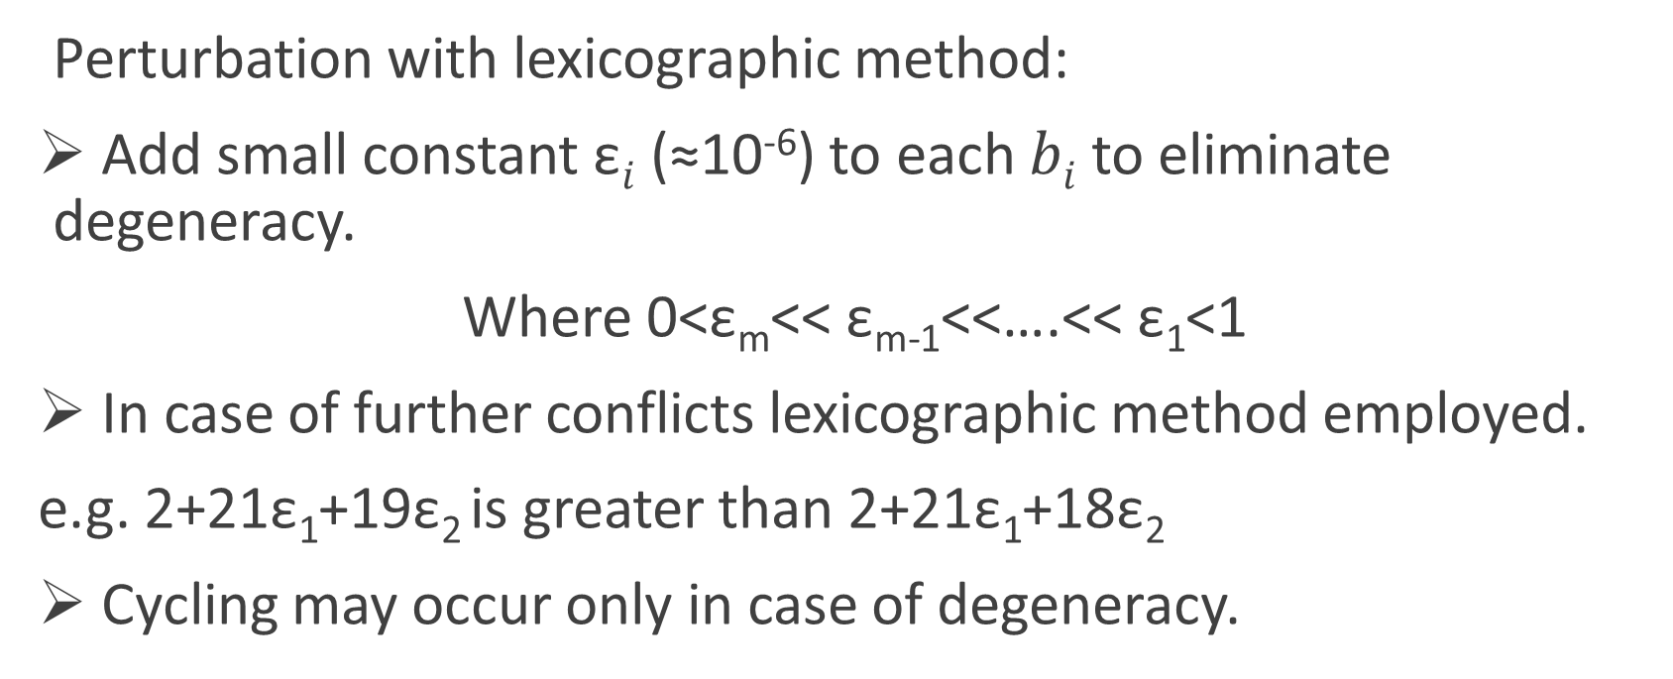
Avoiding: Degeneracy
Perturbation with lexicographic method:
Add small constant $\text{ε}i$ (≈10⁻⁶) to each $bi$ to eliminate degeneracy.
Where 0<$\text{ε}\text{m}$<< $\text{ε}\text{m}\text{−1}$<<….<< $\text{ε}\text{1}$<1
In case of further conflicts lexicographic method employed.
e.g. 2+21$\text{ε}\text{1}$+19$\text{ε}\text{2}$ is greater than 2+21$\text{ε}\text{1}$+18$\text{ε}\text{2}$
Cycling may occur only in case of degeneracy.

Slide 12
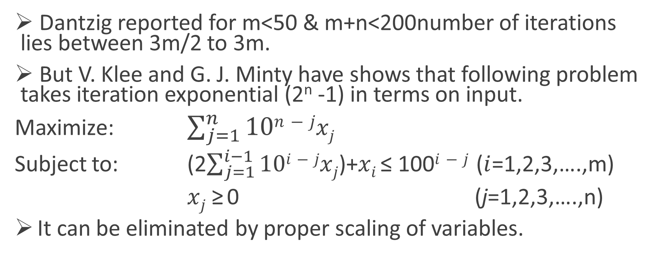
Efficiency
Dantzig reported for m<50 & m+n<200number of iterations lies between 3m/2 to 3m.
But V. Klee and G. J. Minty have shows that following problem takes iteration exponential (2^{n} -1) in terms on input.
Maximize: $\sum_{j=1}^{n}{10n−jxj}$
Subject to: (2$\sum_{j=1}^{i−1}{10i−jxj}$)+$xi$ ≤ 100$i−j$ ($i$=1,2,3,….,m)
$xj$ $\text{≥}$ 0 (j=1,2,3,….,n)
It can be eliminated by proper scaling of variables.

Slide 13
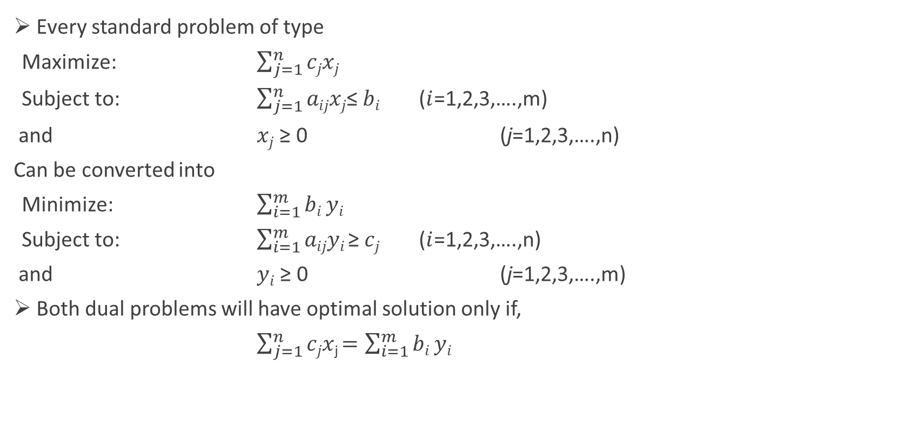
Duality
Every standard problem of type
Maximize: $\sum_{j=1}^{n}{cjxj}$
Subject to: $\sum_{j=1}^{n}{aijxj}$≤ $bi$ ($i$=1,2,3,….,m)
and $xj$ ≥ 0 (j=1,2,3,….,n)
Can be converted into
Minimize: $\sum_{i=1}^{m}{bi}yi$
Subject to: $\sum_{i=1}^{m}{aijyi }$≥ $cj$ ($i$=1,2,3,….,n)
and $yi$ ≥ 0 (j=1,2,3,….,m)
Both dual problems will have optimal solution only if,
$\sum_{j=1}^{n}{cjx}$_{j} $=\sum_{i=1}^{m}{bi}yi$

Slide 14
Thank You

