Slide 1
Evaluation of Trust in Android Devices using Machine Learning
PROJECT PROPOSAL PRESENTATION

Slide 2
Group Details
Group ID – 16 008
Group Members
Nipuna Jayasekara – IT13023256
Hasitha Priyadarshani – IT13067816
Lahiru Chathuranga – IT13048624
Anooj Raghavan – IT13096908
Supervisor – Mr. Lakmal Rupersinghe
Co-Supervisor – Mr. Krishnadeva Kesawan

Slide 3

What is Trust?
An abstract concept, which combines many complicated factors.
The trust of Node B, is a subjective assessment by Node A
On the reliability and accuracy of information, received from or traversing through Node B.
Node A
Node B

Slide 4
What is Trust? Contd.
Trust reflects the expectations on, the target node’s future activity
Honesty
Integrity
Ability
Availability
Quality of Service
Also reflects mutual relationships
A given node should behave in a trustworthy manner and maintain reliable communication with nodes that are highly trusted by the given node

Slide 5
What is Trust? Contd.
Node B
Node D
Node A
Node C

Slide 6
What is Machine Learning?
“Machine Learning focuses on the development of computer programs that can teach themselves to grow and change when exposed to new data. It enables computers to learn without being explicitly programmed.”

Slide 7
Why is Device Trust needed in IoT?
IoT consists of numerous heterogeneous devices
Security is the main threat for the growth in IoT
Evaluating the trust for devices in the domain helps to make a secure IoT environment.
Thus, sensitive information can be exchanged

Slide 8
Literature
 | Product/Paper
Feature | Andromaly | Peer-to-peer’s most wanted: Malicious peers | Dynamic Trust Management for Delay Tolerant Networks and Its Application to Secure Routing | Trust Evaluation in mobile devices | A Machine Learning based Trust evaluation
Ideal for IoT environment. | N | N | Y | N | N
Parameters for the computations can be easily obtained. | Y | N | Y | N | Y
User level parameters considered. | N | N | Y | N | Y
Presence of malware is considered. | Y | N | N | Y | N
Selfish nodes are detected. | N | Y | N | N | N
Malicious nodes are detected. | N | Y | N | N | N
Network parameters (Packet Size, No. of Packets, Duration of a Transaction, No of Transactions Completed) are considered. | N | N | N | Y | N
Vulnerabilities in Android OS is considered. | Y | N | N | Y | N
Vulnerabilities in the apps installed are considered | Y | N | N | Y | N
Overall trust value for the device is given | N | Y | Y | N | N
Creates a secure network | N | Y | N | N | Y

Slide 9
Research Gap
Most products and papers are:
Concerned only about one or few parameters that affect the trust
Not ideal to be used in the IoT environment conditions
Not capable of computing a continuous value for trust
Incapable of creating a secure network by omitting untrusted/malicious nodes

Slide 10
Objectives
To determine the overall trust of a device, using multiple factors.
To extract user level information
To extract network information
To identify vulnerabilities in the Android OS
To identify vulnerabilities in the applications installed
Build a secure network to exchange sensitive information
To connect devices with high trust value

Slide 11
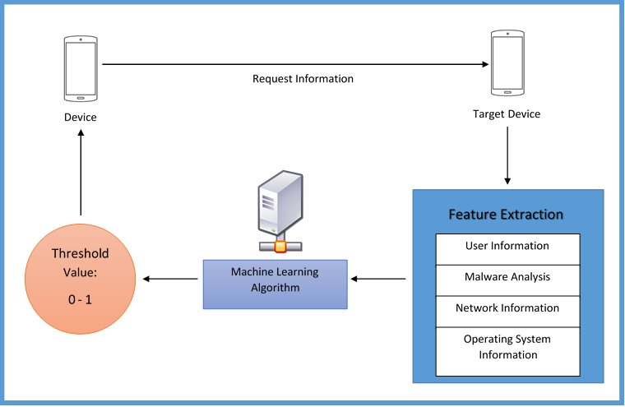
System Diagram

Slide 12
How Each Component is Developed
Feature Extraction in Android OS
Is the device updated
Appropriate security tools are utilized
Mobile Data usage in the background processes
Mobile Data usage in the foreground processes
Number of System Calls made by a particular app
These information are available in the Android OS.

Slide 13
How Each Component is Developed
Feature Extraction in Installed Applications
Number of times a particular application has been installed
Number of reviews for a particular application
Is the application up-to date
User rating a particular application has received
Is the Developer recognized
These information are obtained using the meta-data and the Google Play Store

Slide 14
How Each Component is Developed Contd.
User Information Extraction
If there are two users called x and y
Whether x is a friend of y
The designation of x
The similarities between the two users
The density of interactions of x and y
The distance between x and y
Ratio of Mutual friends to Total number of friends
These information can be obtained via Facebook and analyzed using social network analysis techniques.

Slide 15
How Each Component is Developed Contd.
Network Information Extraction
Hop count between the two devices
Number of packets transferred
Number of packets received
Size of a packet
Number of completed transactions
Duration of a transaction
Presence of Selfish nodes
Currently we are planning to use the IP header and the Watchdog mechanism to extract these information

Slide 16
How Each Component is Developed Contd.
Malware Detection

Slide 17
How Each Component add up to the Malware Analysis
All these features are extracted and a feature vector is built.
The finalized feature vector is analyzed using a machine learning technique
The machine learning technique we plan to use is “Deep Reinforcement Learning”
Reason:
Helps to determine the ideal behavior within a specific context, in order to maximize performance
It uses trial and error learning

Slide 18
Users & Benefits
Anyone who’s using a device in the IoT domain is benefited by the system.
User’s sensitive information will be protected.
More users will be willing to use IoT technologies.
What stopped the growth and adaption of IoT will be addressed.

Slide 19
Final Product
An effective mechanism to evaluate device trust using multiple factors, ideal to be used in the IoT environment.
We plan to present simulation results that support our work in the end.

Slide 20
References
K. Govindan and P. Mohapatra, "Trust Computations and Trust Dynamics in Mobile Adhoc Networks: A Survey", IEEE Communications Surveys & Tutorials, vol. 14, no. 2, pp. 279-298, 2012.
I. Chen, F. Bao, M. Chang and J. Cho, "Dynamic Trust Management for Delay Tolerant Networks and Its Application to Secure Routing", IEEE Trans. Parallel Distrib. Syst., vol. 25, no. 5, pp. 1200-1210, 2014.

Slide 21
Q & A

Slide 22
Thank You.

