Slide 1
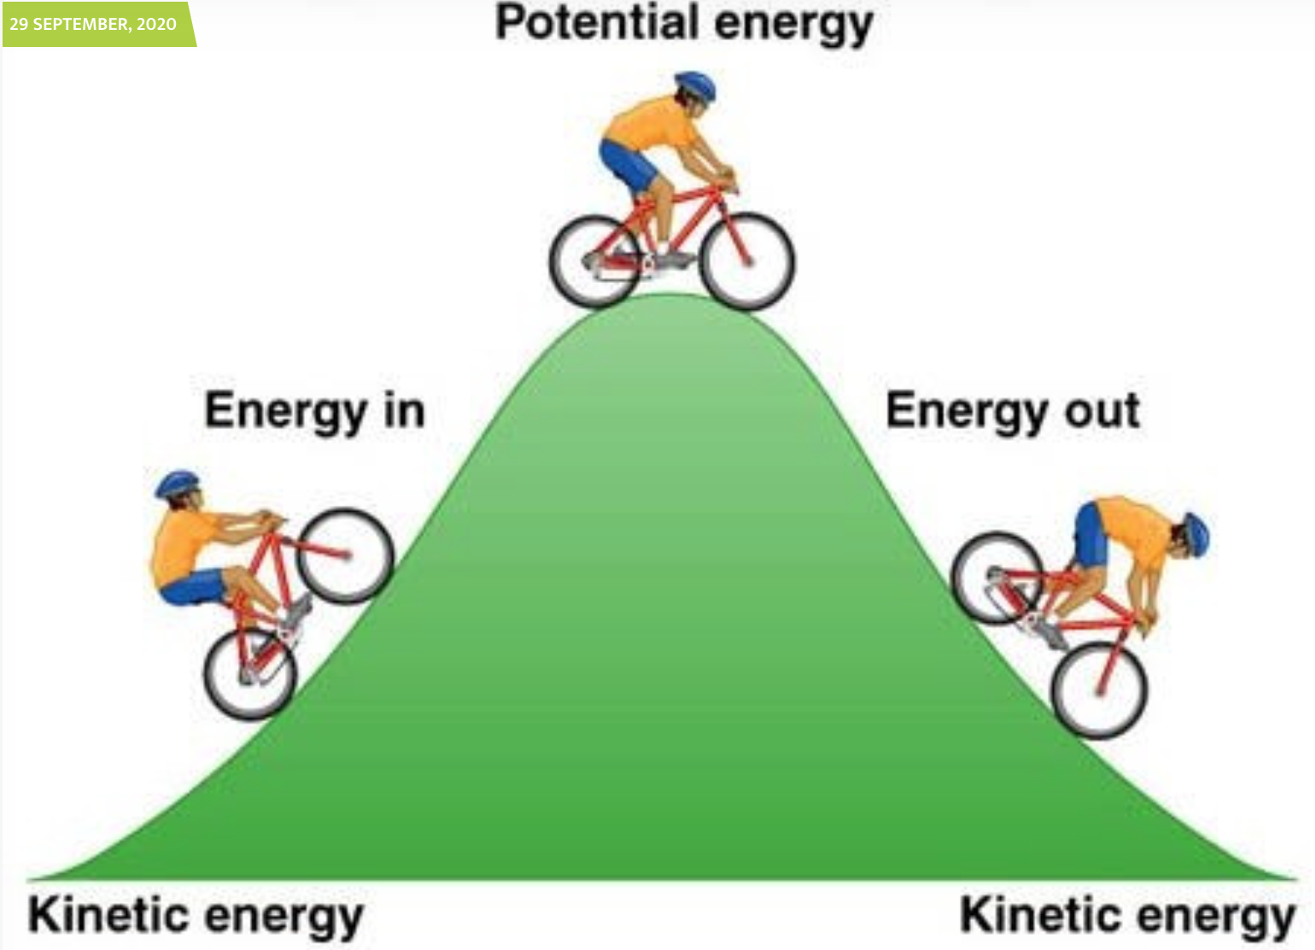
Chapter 8 – Conservation of Energy

Slide 2
Alternative to Newtonian Approach
During the same time Newton was active many contemporaries (like Leibniz, Euler, and the Bernoulli family to name a few) thought that nature worked in ways that minimized “effort”.

Slide 3

Alternative to Newtonian Approach
During the same time Newton was active many contemporaries (like Leibniz, Euler, and the Bernoulli family to name a few) thought that nature worked in ways that minimized “effort”.
They were more interested in what they called the “live force” $(mv^{2})$.

Slide 4

Alternative to Newtonian Approach
During the same time Newton was active many contemporaries (like Leibniz, Euler, and the Bernoulli family to name a few) thought that nature worked in ways that minimized “effort”.
They were more interested in what they called the “live force” $(mv^{2})$.
Leibniz in particular was convinced that all natural processes could be explained through minimization of scaler quantities.

Slide 5

Alternative to Newtonian Approach
During the same time Newton was active many contemporaries (like Leibniz, Euler, and the Bernoulli family to name a few) thought that nature worked in ways that minimized “effort”.
They were more interested in what they called the “live force” $(mv^{2})$.
Leibniz in particular was convinced that all natural processes could be explained through minimization of scaler quantities.
In part this was inspired by the famous “Brachistochrone” problem

Slide 6
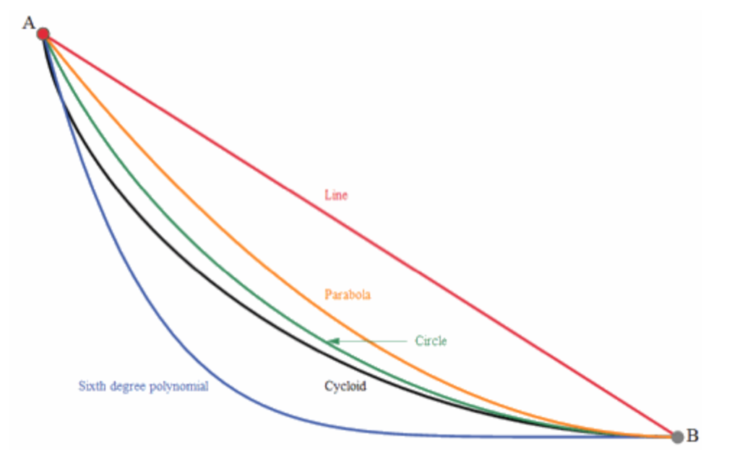
Brachistichrone Problem
“I, Johann Bernoulli, address the most brilliant mathematicians in the world. Nothing is more attractive to intelligent people than an honest, challenging problem, whose possible solution will bestow fame and remain as a lasting monument. Following the example set by Pascal, Fermat, etc., I hope to gain the gratitude of the whole scientific community by placing before the finest mathematicians of our time a problem which will test their methods and the strength of their intellect. If someone communicates to me the solution of the proposed problem, I shall publicly declare them worthy of praise.
Given two points A and B in a vertical plane, what is the curve traced out by a point acted on only by gravity, which starts at A and reaches B in the shortest time.”

Slide 7
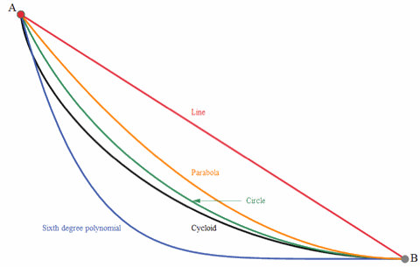
Brachistichrone Problem

Slide 8
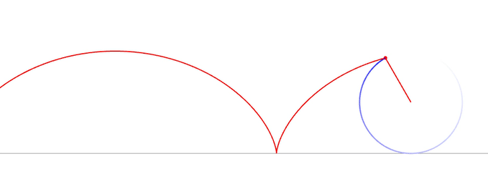
Cycloid

Slide 9
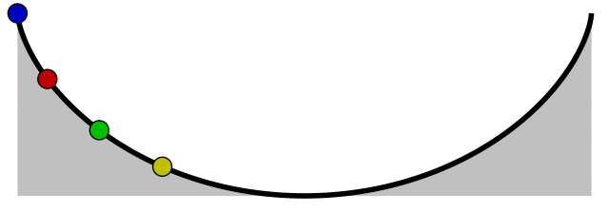
Cycloid is also a Tautochrone

Slide 10
Ideas of the Leibniz school of thought
Natural systems evolve in ways that minimize certain scalar quantities.

Slide 11
Ideas of the Leibniz school of thought
Natural systems evolve in ways that minimize certain scalar quantities.
This can be understood through consideration of the “live force”.

Slide 12

Ideas of the Leibniz school of thought
Natural systems evolve in ways that minimize certain scalar quantities.
This can be understood through consideration of the “live force”.
Today we know the “live force” as the ”Kinetic Energy” $(\frac{1}{2}mv^{2})$.

Slide 13
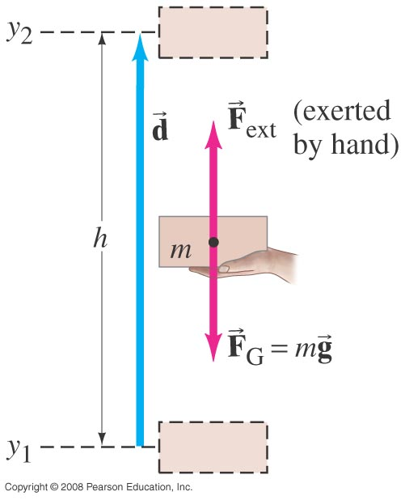
Potential Energy – Gravitational

Slide 14

Potential Energy – Gravitational
Lifting Eraser:
$W_{ext}={\overset{⃑}{F}}_{ext}∙\overset{⃑}{d}=mgh∗cos(0°)$=mgh
$W_{g}={\overset{⃑}{F}}_{g}∙\overset{⃑}{d}=mgh∗cos(180°)$=-mgh
Dropping Eraser:
$$K_{1}=\frac{1}{2}mv^{2}=\frac{1}{2}m\left(2gh\right)=mgh$$

Slide 15
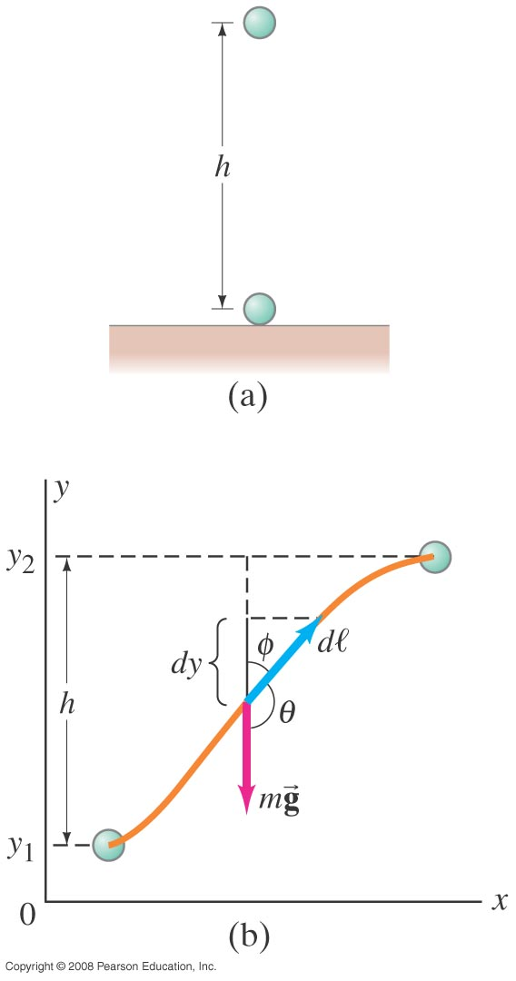
Conservative and non-conservative forces
A force is considered conservative if the work done by a force on an object moving from one point to another depends only on the initial and final positions and is independent of the path taken.

Slide 16

Conservative and non-conservative forces
A force is conservative if the work done by a force on an object moving from one point to another depends only on the initial and final positions and is independent of the path taken.
$$W_{g}=\int_{1}^{2}{{\overset{⃑}{F}}_{g}∙dl=}\int_{1}^{2}{mgcos\left(Θ\right)dl}$$
$$=−\int_{y_{1}}^{y_{2}}{mgdy}$$
$$=−mg(y_{2}−y_{1})$$

Slide 17
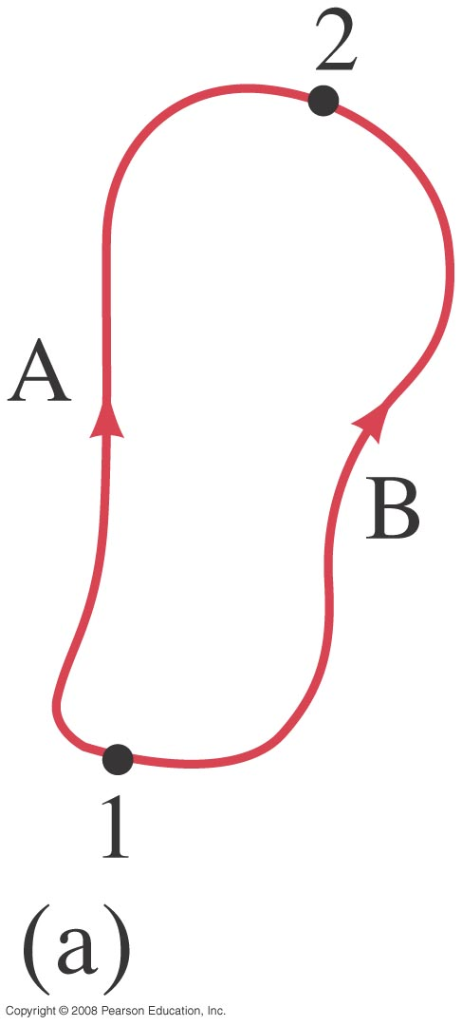
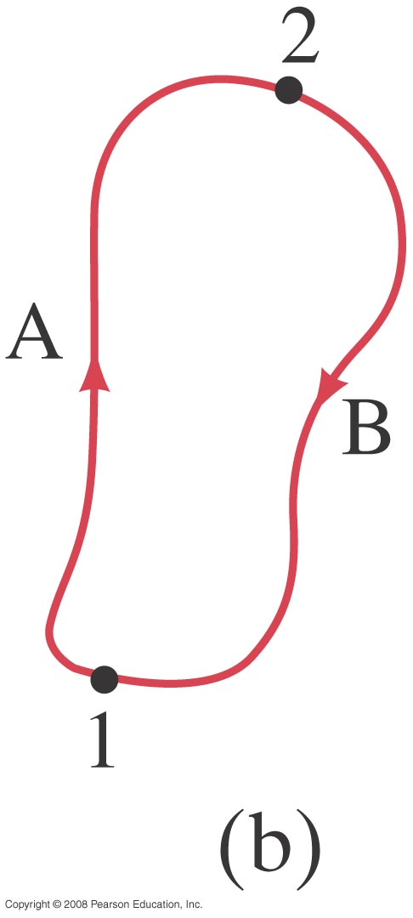
Conservative and non-conservative forces
A force is conservative if the net work done by the force on an object moving around any closed loop is zero.

Slide 18
Conservative and non-conservative forces
The work done by a conservative force is recoverable.

Slide 19
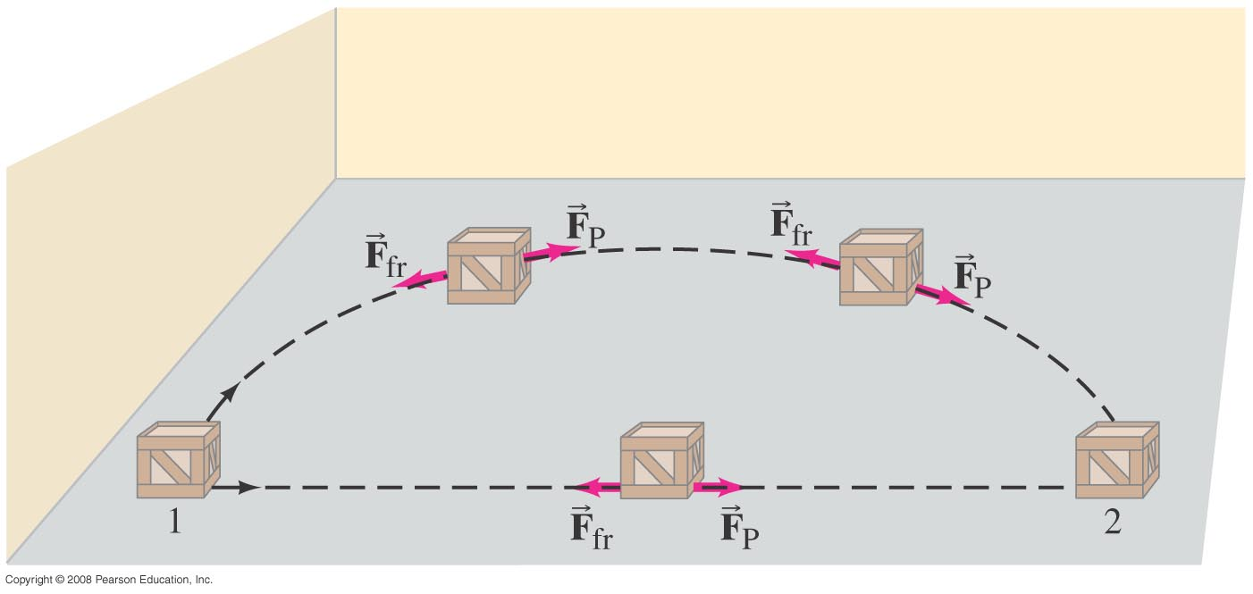
Conservative and non-conservative forces
A force is non-conservative if the net work done on an object depends on the path taken.

Slide 20
Conservative and non-conservative forces
Work done by a non-conservative force is not recoverable.

Slide 21
Conservative and non-conservative forces
Conservative Forces | Non-Conservative Forces
Gravitational | Friction
Electric | Fluid Drag
Elastic | Motor or Rocket Propulsion
 | Push or Pull by Organic Organisms

Slide 22

Potential Energy
Recall that we defined kinetic energy as the energy associated with the movement of an object
$$K=\frac{1}{2}mv^{2}$$
We now define potential energy as the energy stored in an object due to it’s position in a conservative field.

Slide 23
Potential Energy – Gravitational

Slide 24
Potential Energy – Gravitational
Lifting Eraser:
$W_{ext}={\overset{⃑}{F}}_{ext}∙\overset{⃑}{d}=mgh∗cos(0°)$=mgh
$W_{g}={\overset{⃑}{F}}_{g}∙\overset{⃑}{d}=mgh∗cos(180°)$=-mgh
Dropping Eraser:
$$K_{1}=\frac{1}{2}mv^{2}=\frac{1}{2}m\left(2gh\right)=mgh$$

Slide 25

Potential Energy - General
$$∆U=U_{2}−U_{1}=−W_{c}=\int_{1}^{2}{\overset{⃑}{F}∙d\overset{⃑}{l}}$$
Note: This expression only works for conservative forces!

Slide 26

Potential Energy - General
$$U\left(x\right)=−\int{F \left(x\right)dx}+C$$
$$\frac{dU\left(x\right)}{dx}=−\frac{d}{dx}\int{F\left(x\right)dx}=−F(x)$$
$$F\left(x\right)=−\frac{dU\left(x\right)}{dx}$$

Slide 27

Potential Energy – General in 3d
Forces associated with conservative fields can be broken into directional components.
$$F_{x}=−\frac{∂U_{x}}{∂x}, F_{y}=−\frac{∂U_{y}}{∂y},{ F}_{z}=−\frac{∂U_{z}}{∂z}$$
Which is equivalent to writing
$$\overset{⃑}{F}\left(x,y,z\right)=−\hat{i}\frac{∂U}{∂x}−\hat{j}\frac{∂U}{∂y}−\hat{k}\frac{∂U}{∂z}$$

Slide 28
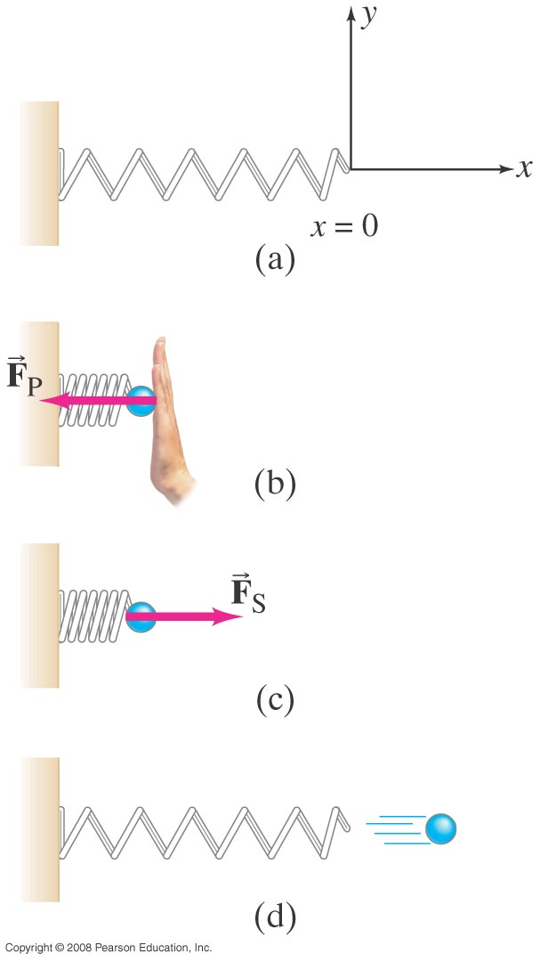


Potential Energy – Elastic potential
$$F_{X}=−kx$$
$$∆U=\int_{1}^{2}{{\overset{⃑}{F}}_{s}∙d\overset{⃑}{l}}=\frac{1}{2}{kx}^{2}$$

Slide 29
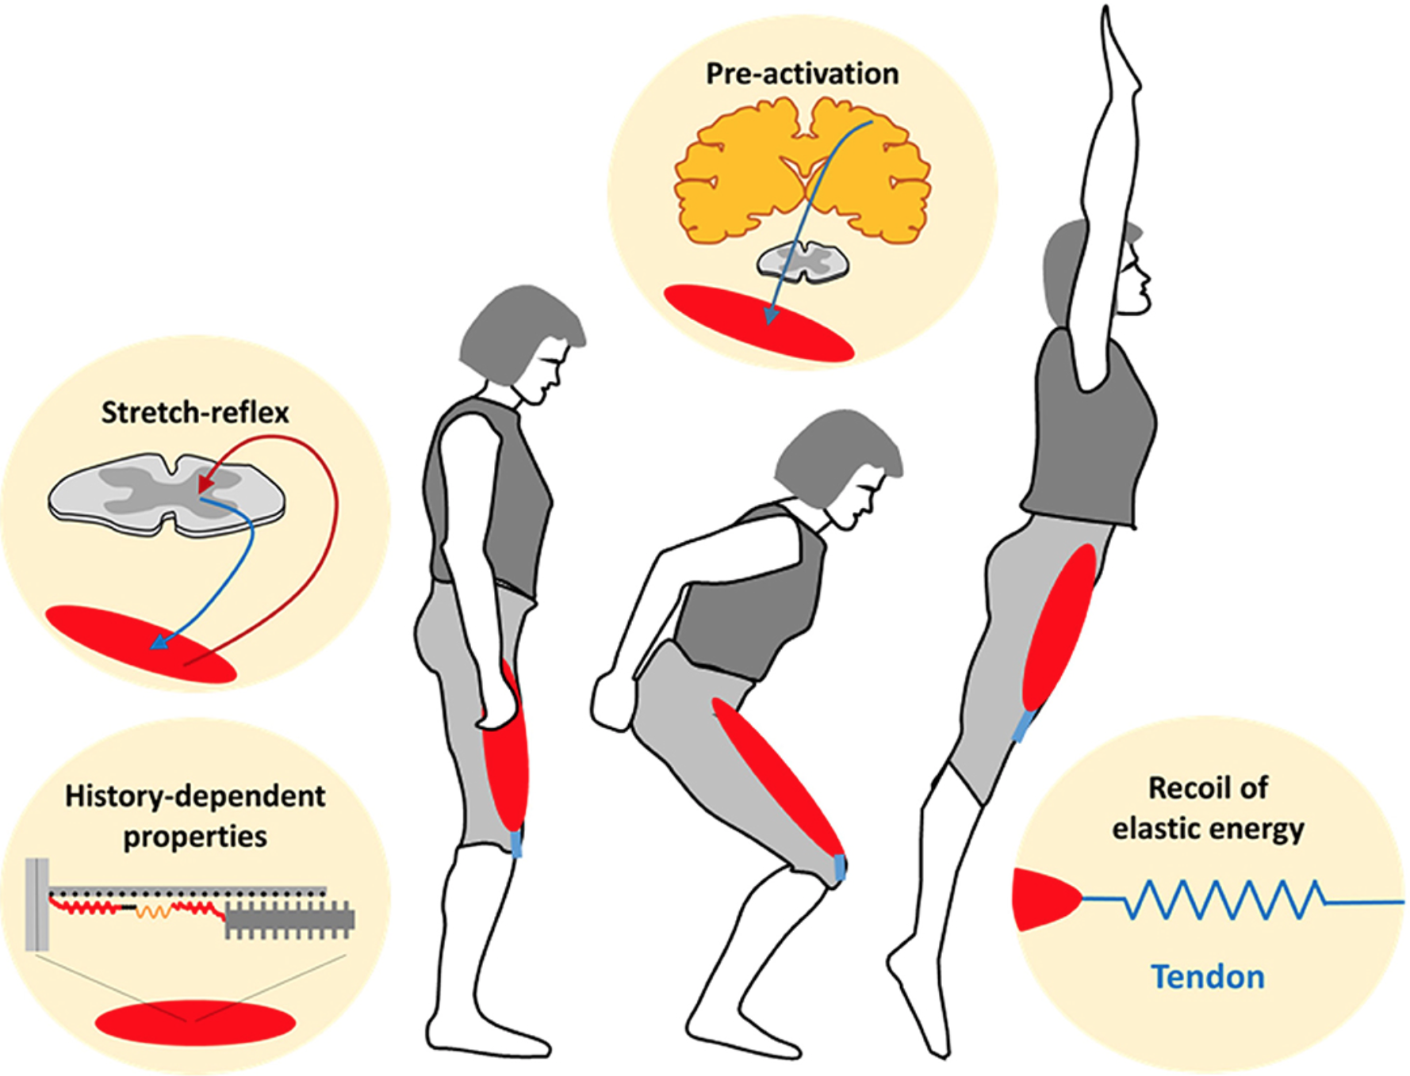
Potential Energy – Elastic potential
Releasing stored elastic potential is how our muscles generate force!

Slide 30
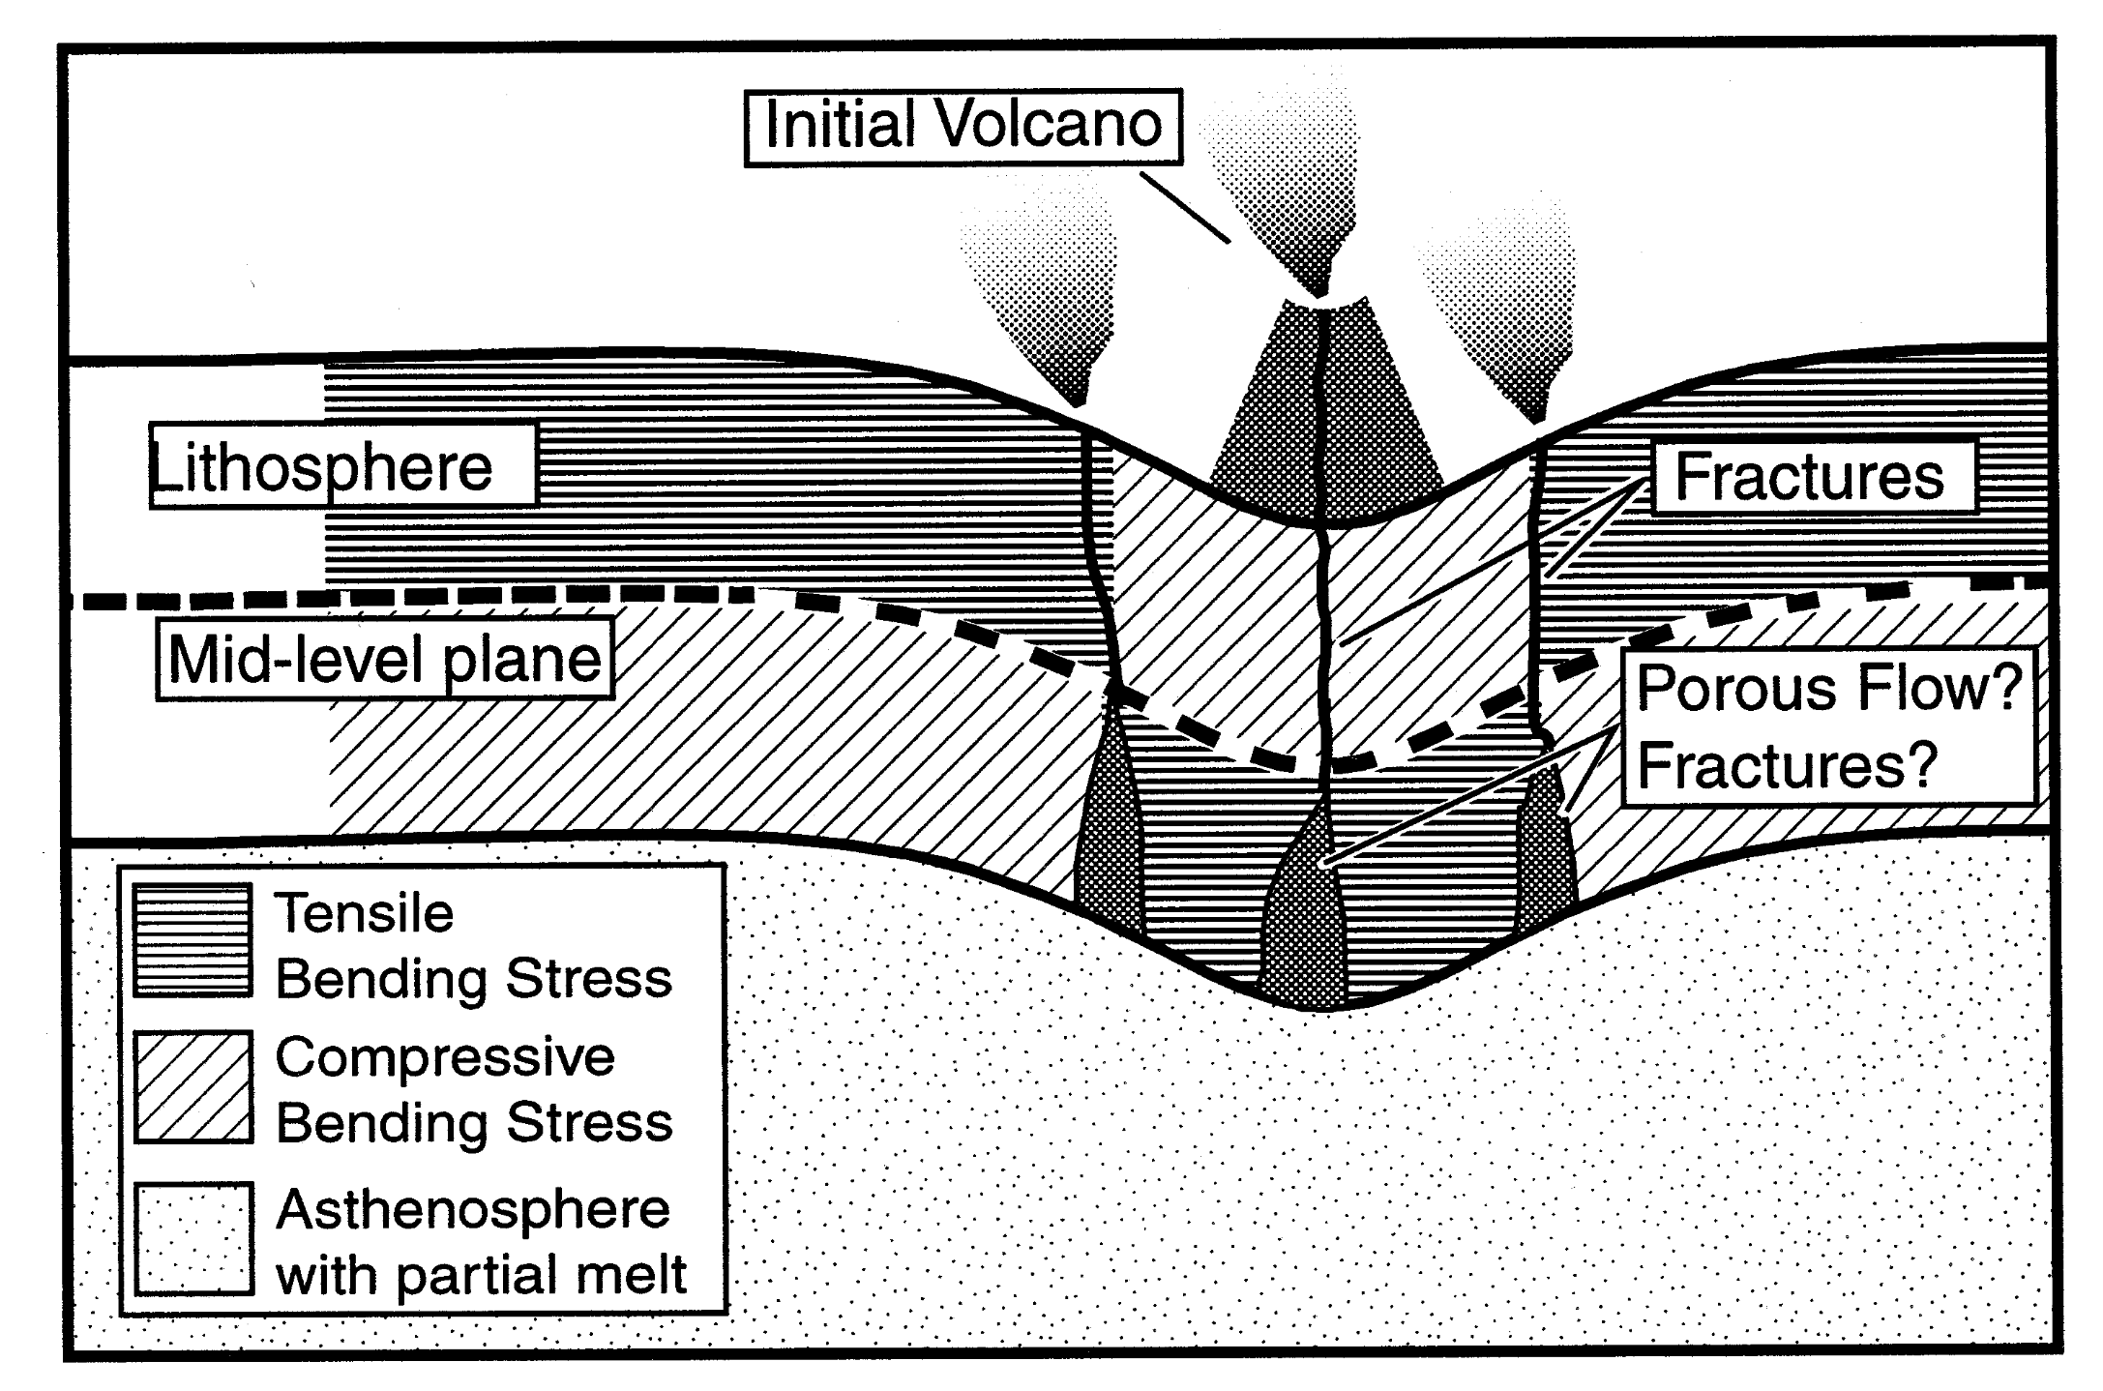
Potential Energy – Elastic potential
Elastic potential energy is also what supports many ocean islands such as Hawaii!
Hieronymus and Bercovici, EPSL, 2000

Slide 31

Mechanical energy and it’s conservation
Recall the work-energy principal
$$W_{net}=∆K$$
In a conservative system
$$∆U_{total}=−W_{net}$$
So
$$∆K+∆U=0→\left(K_{2}−K_{1}\right)+\left(U_{2}−U_{1}\right)=0$$

Slide 32

Conservation of mechanical energy
$$E=K+U (at any given moment)$$
If only conservative forces are doing work, the total mechanical energy of the system neither increases or decreases. In other words energy is conserved.
$$K_{2}+U_{2}=K_{1}+U_{1} (for objects in translation)$$

Slide 33
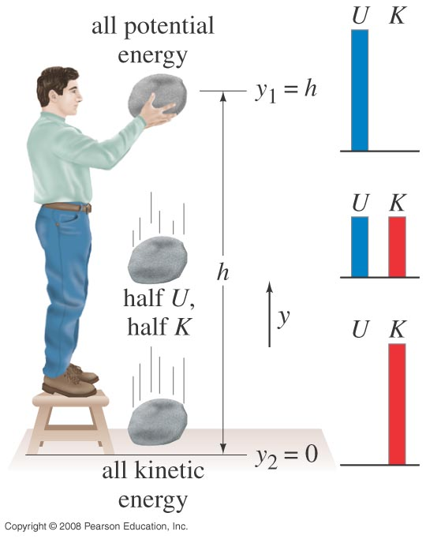


Conservation of mechanical energy
$$E=K+U=\frac{1}{2}mv^{2}+mgy$$
$$\frac{1}{2}mv_{1}^{2}+mgy_{1}=\frac{1}{2}mv_{2}^{2}+mgy_{2}$$

Slide 34
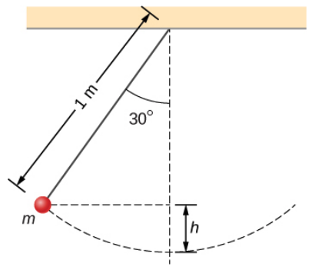
Example: Pendulum
A weight of mass m is hanging on a massless string with a length of 1.0 m as shown. The weight is pulled to an angle of 30˚ with the vertical and released. What is its speed at the lowest point in its arc?

Slide 35

Example: Pendulum
$$\frac{d^{2}Θ}{dt^{2}}+\frac{g}{L}sinΘ=0$$

Slide 36
Example: Pendulum
Could solve simple pendulum equation…
$$\frac{d^{2}Θ}{dt^{2}}+\frac{g}{L}sinΘ=0$$

Slide 37
Example: Pendulum
Could solve simple pendulum equation…
$$\frac{d^{2}Θ}{dt^{2}}+\frac{g}{L}sinΘ=0$$
For large displacements this can’t be done analytically!

Slide 38
Example: Pendulum
Let’s use Work-Energy theorem!

Slide 39
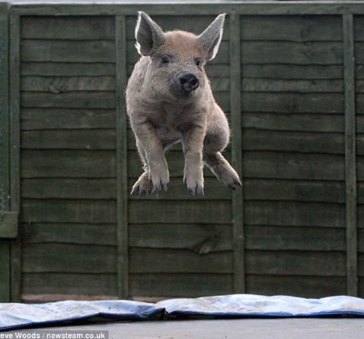
Example: Pig on trampoline
If a 14 kg pig is jumping on a trampoline, and flies 1.5 m in the air after depressing the trampoline 0.5 m. What is the effective “spring constant” of the trampoline if we assume linear elasticity?

Slide 40
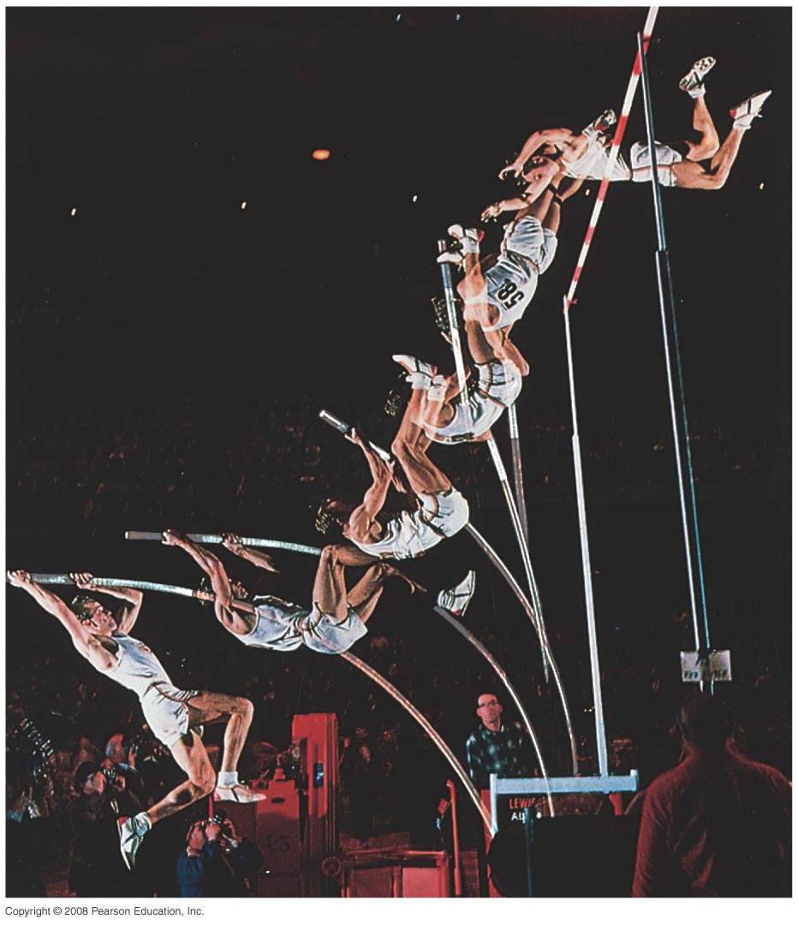
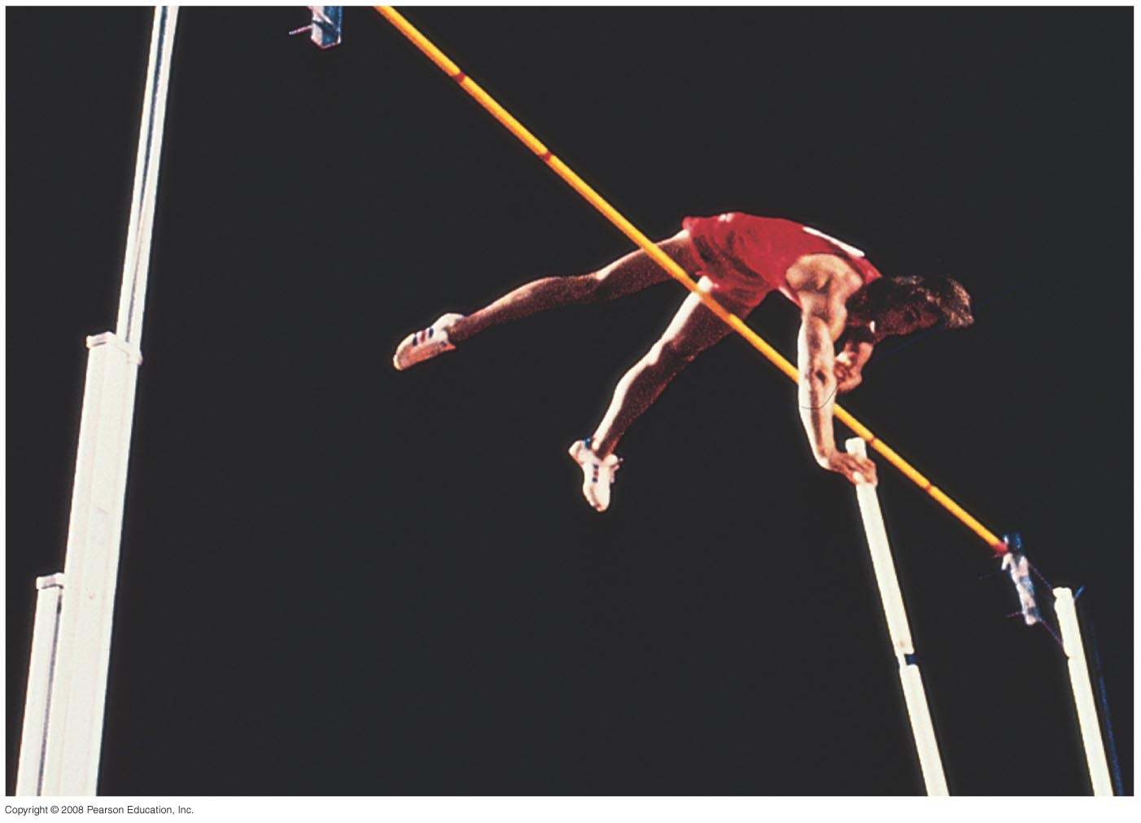
Example: Pole Vaulter
Estimate the minimum initial kinetic energy and velocity required for a 70-kg pole vaulter to pass over a 5 m high bar if their center of mass is initially 0.9 m above the ground.

Slide 41
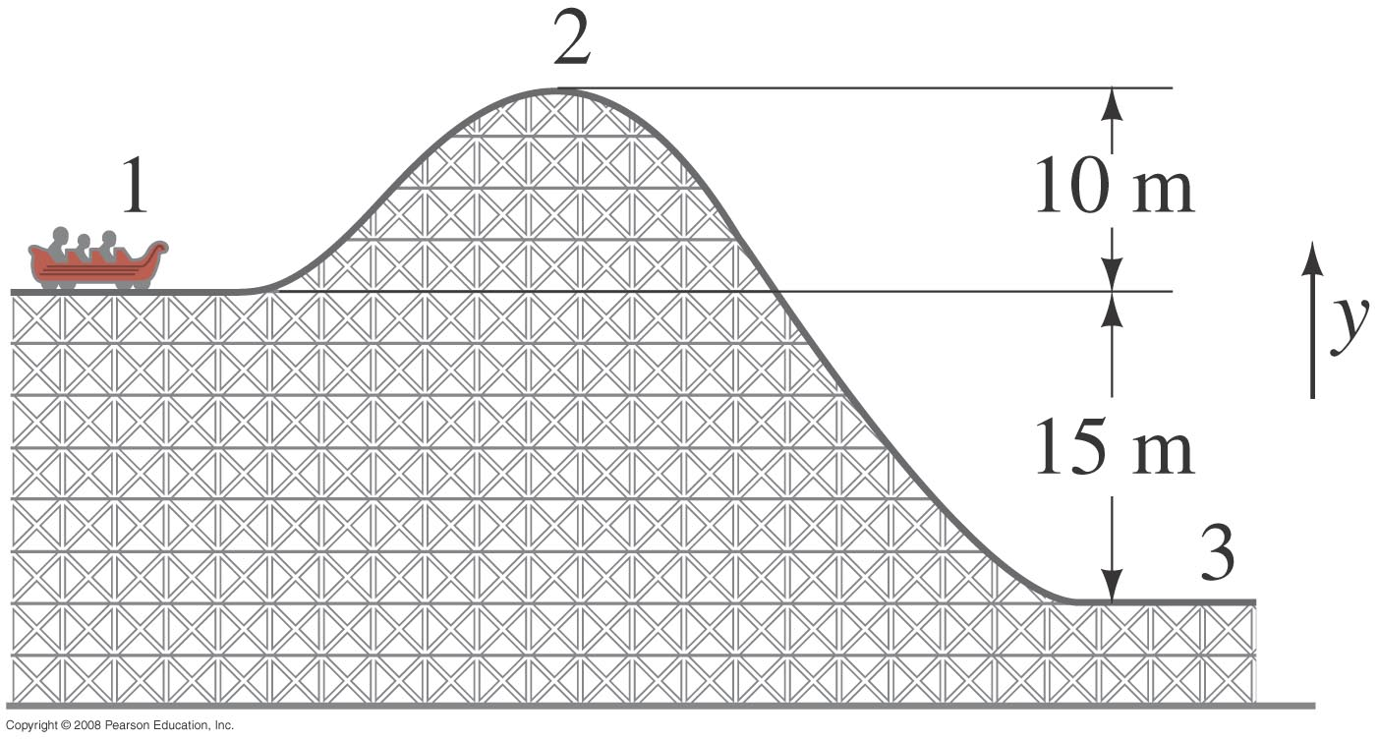

Example
A 1000 kg roller coaster moves from point 1 to point 2 and then to point 3.
A) What is U at points 2 and 3 relative to 1?
B) What is the potential energy change $(∆U)$ between points 2 and 3?
C) Repeat both steps using point 3 as a reference.

Slide 42
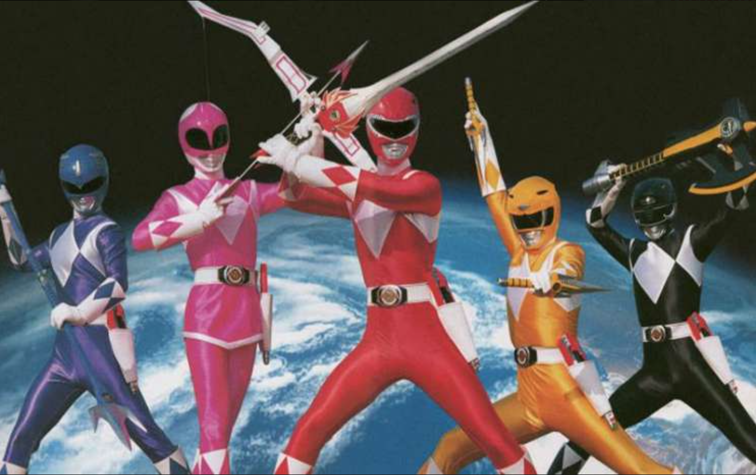

Power
Power is defined as the rate at which work is done.
Instantaneous power
$$P=\frac{dW}{dt}$$
Or
$$P=\frac{dE}{dt}$$

Slide 43

Units - Power
SI Systems
$$Power=\frac{J}{S}=Watts (W)$$
Imperial System
$$hp=horsepower=550 ft∗lb/s$$

Slide 44
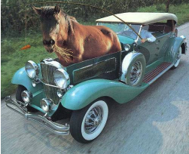
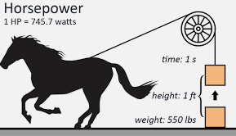

Units - Power
Imperial Systems
$$hp=horsepower=550\frac{ft∗lb}{s}=746 Watts$$

Slide 45

Power in terms of force
$$P=\frac{dW}{dt}$$
Where
$$\frac{dW}{dt}=\overset{⃑}{F}∙\frac{d\overset{⃑}{l}}{dt}=\overset{⃑}{F}∙\overset{⃑}{v}$$

Slide 46
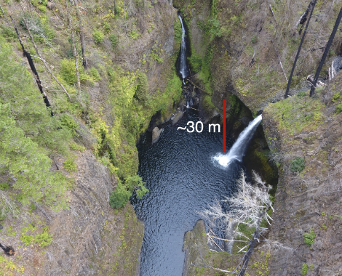

Example
A river with a discharge of 7.8 $\frac{m^{3}}{s}$ goes over a 30 m waterfall. Estimate the power generated by the waterfall. Assume standard density of water of $ρ=977 kg/m^{3}$ and negligible drag.

Slide 47
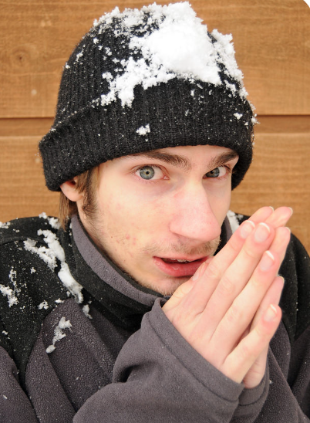
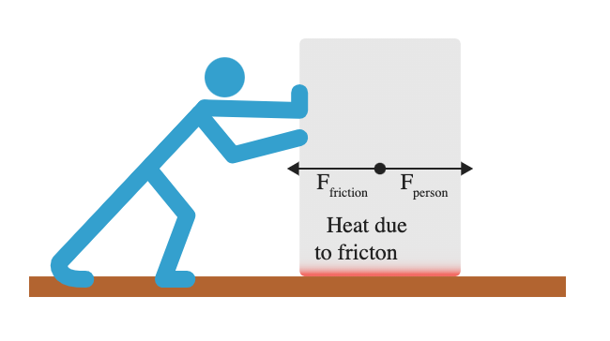
Dissipative Forces
So far this chapter we have been doing problems in which we assume that the total mechanical energy of systems remains constant.
In fact, when objects undergo motion a certain amount of mechanical energy is converted into thermal energy.

Slide 48
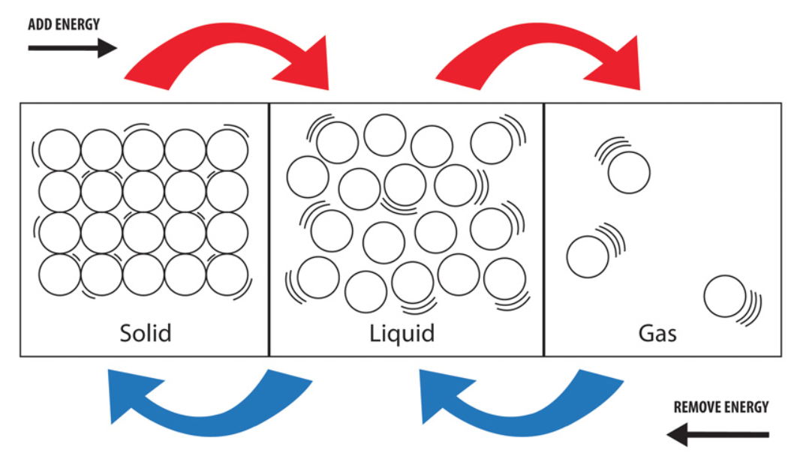
Thermal Energy
At the atomic level thermal energy is just a measure of the kinetic energy of excited rapidly moving molecules.

Slide 49
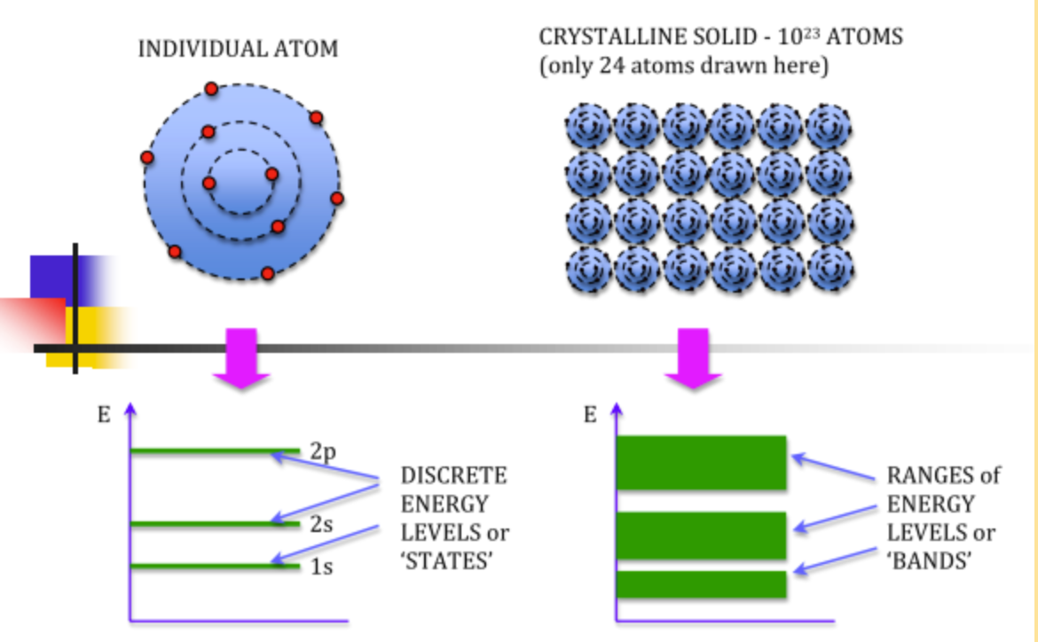
Band Theory of Solids

Slide 50
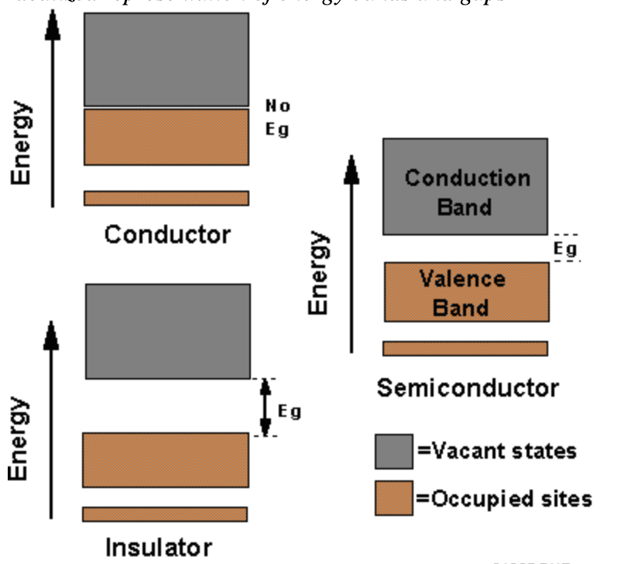
Tangent – Thermoelectric effect

Slide 51
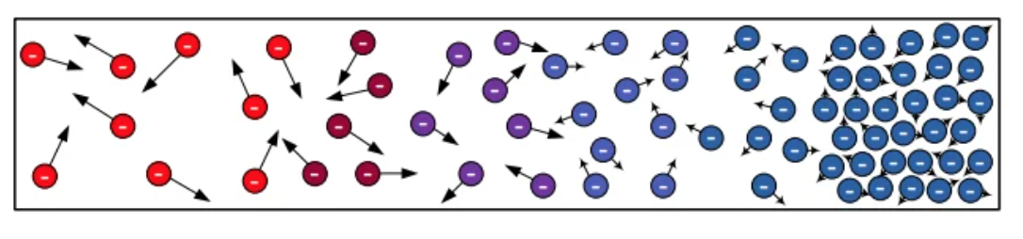
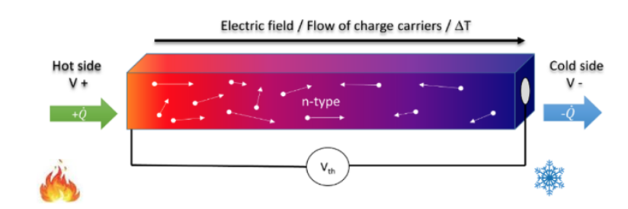
Tangent – Semiconductors

Slide 52

Internal Energy
Internal Energy is the sum of the kinetic and potential energies of molecules as the result of the relative position of electrons within them. In other words…
$$E=K+U$$

Slide 53
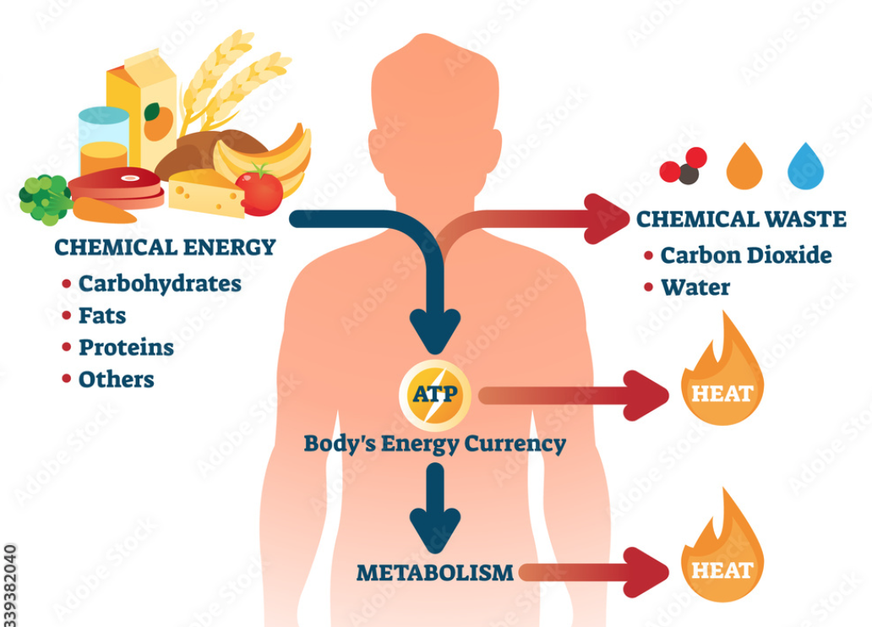
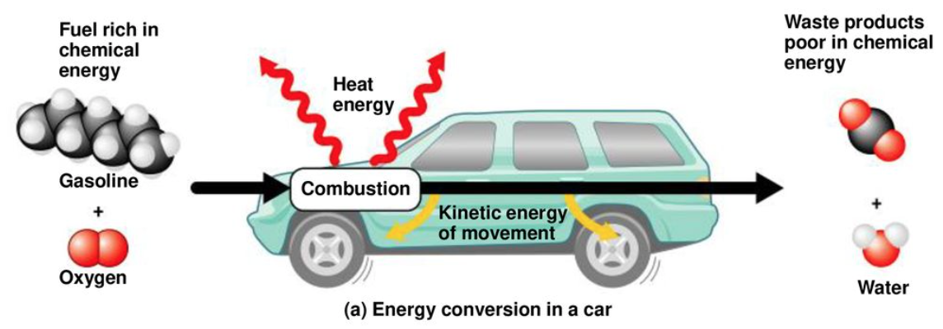
Internal Energy
Internal Energy (or chemical energy) can be released through chemical reactions. Such as the breakdown of food, or the combustion of fuel.

Slide 54

Law of Conservation of Energy
Total energy is neither increased nor decreased in any process. Energy can be transformed from one form to another, and transformed from one object to another, but the total amount remains constant.
$$∆K+∆U+\left[change in all other forms of energy\right]=0$$

Slide 55
Example: Drive to campus
This morning I drove from my house at an elevation of 2001 m to Sitter Family hall at an elevation of on 2098 m. I drive a Toyota Tacoma that weighs 1600 kg and gets around 24 miles/gallon. If I drove a total distance of 2.3 miles about how much heat did my truck produce? How much of that was translated into mechanical energy? There are about 120 MJ of energy in a gallon of gas.

Slide 56
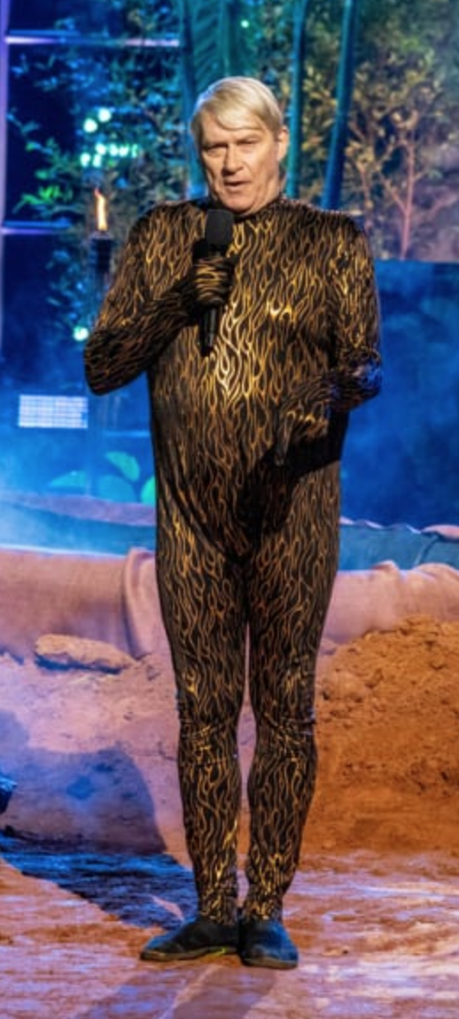
Example
A man from Denver who goes by “Professor Splash” holds the world record for the highest known bellyflop, which was from a height of 36 ft (11 m) into 12 inches (0.3 m) of water. Assuming professor splash weighs 90 kg and air drag is negligible find:
a) His kinetic energy when he hits the water.
b) The work done on professor splash by the water
c) The work done on professor splash by gravity

Slide 57
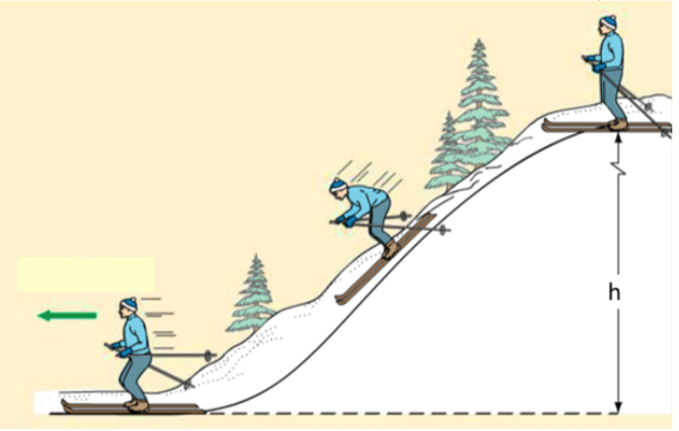
Example
A skier weighing 80 kg skis from the top of a hill to the flats below. When they are 12 m above the flats their velocity is 3 m/s. Assuming negligible friction, what is their velocity when they get to the bottom of the hill?

Slide 58
Back to the same skier
If in fact the skier from before reached the bottom of the hill going 10 m/s what was the total amount of thermal energy dissipated between their skis and the snow?

Slide 59
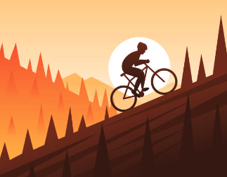
Example
A bicyclist coasts down a 6˚ hill at a steady speed of 4 m/s. Assuming a total mass (rider and bicycle) of 76 kg what must be the cyclists power output to climb the same hill with the same speed? Assume the bicycle is 100% efficient.

Slide 60

Conservation of Energy Problem Solving Workflow
Draw a picture of the situation
Determine the system for which you will apply energy conservation and the forces acting on it:
  - This can be a single object or group of objects for which you have collective information.
Identify what quantity you are looking for and choose initial and final positions.
If the object of interest changes heights define a convenient datum (location where y=0)
  For gravitational potential problems it is usually easiest to have y=0 at the lowest point
  For problems involving springs it is generally easiest to have y=0 where the spring at rest.
Ask if mechanical energy is conserved.
- If there is no friction or other non-conservative forces use conservation of mechanical energy applies:
$$K_{1}+U_{1}=K_{2}+U_{2}$$
- If there is friction (or other non-conservative forces) an additional term is needed
$$K_{1}+U_{1}=K_{2}+U_{2}+Q$$
6. Solve for the unknown quantity!

Slide 61
Example
Track the energy transfers and transformations of a soccer ball kicked in an arc into a goal.

Slide 62
Example
How much thermal energy will be generated from the impact of the 25 kg rock that has fallen from a height of 12 m?
How fast is it going on impact?

Slide 63

Example
A river with a discharge of 7.8 $\frac{m^{3}}{s}$ (exactly what the animas is flowing this morning) goes over a 30 m waterfall. Estimate the power generated by the waterfall. Assume standard density of water of $ρ=977 kg/m^{3}$ and negligible drag.

Slide 64
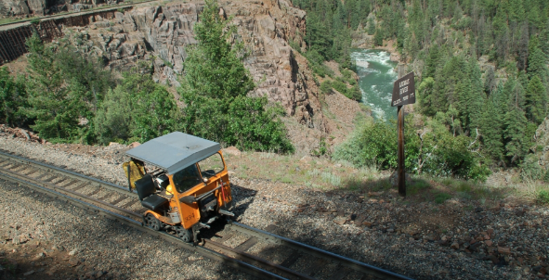
Example
A railroad pop car gets loose at Rockwood Depot (elev. 2245 m) and travels around 10 miles down the tracks to Hermosa (elev. 2026 m) where it comes to a stop. If the car weighs ~1600 kg estimate the magnitude of the sum of the friction forces in the pop-car.

Slide 65
Example
Now we need to get the 1600 kg pop car the 10 miles back to Rockwood Depot (elev. 2245 m) from Hermosa (elev. 2026 m). What is the power output required to do so in under 30 minutes. Assume the force from friction is the same we calculated in the previous example.

Slide 66
Example: Pole Vaulter
Estimate the minimum initial kinetic energy and velocity required for a 70-kg pole vaulter to pass over a 5 m high bar if their center of mass is initially 0.9 m above the ground.

Slide 67
Something to Ponder
Two people observe a 1 kg rock falling from the top of a cliff 10 m cliff. If one person is standing on top of the cliff and one is standing on the bottom, and each us their own position as a reference datum, which of the following quantities will they see as different?
A) The kinetic energy of the rock when it hits.
B) The change in potential energy.
C) The final gravitational potential.

Slide 68
Example
Two volleyballs with the same mass are hit such that they have the same initial velocity. If ball A is hit at an angle of 30˚ from the horizontal and ball B is hit an an angle of 60˚ from the horizontal compare:
A) The initial kinetic energy of the two balls.
B) The change in gravitational potential for each ball between the players hands and the top of it’s respective arc assuming negligible drag.
Why are the quantities calculated in parts A and B different?

Slide 69

KE and PE
You and your friend both solve a problem involving a skier going down a slope, starting from rest. The two of you have chosen different levels for y = 0 in this problem. Which of the following quantities will you and your friend agree on?
1) only B
2) only C
3) A, B, and C
4) only A and C
5) only B and C
A) skier’s PE B) skier’s change in PE C) skier’s final KE
Notes:
Answer: 5

Slide 70
KE and PE
You and your friend both solve a problem involving a skier going down a slope, starting from rest. The two of you have chosen different levels for y = 0 in this problem. Which of the following quantities will you and your friend agree on?
1) only B
2) only C
3) A, B, and C
4) only A and C
5) only B and C
A) skier’s PE B) skier’s change in PE C) skier’s final KE
The gravitational PE depends upon the reference level, but the difference ΔPE does not! The work done by gravity must be the same in the two solutions, so ΔPE and ΔKE should be the same.
Follow-up: Does anything change physically by the choice of y = 0?

Slide 71
Elastic Potential Energy
How does the work required to stretch a spring 2 cm compare with the work required to stretch it 1 cm?
1) same amount of work
2) twice the work
3) four times the work
4) eight times the work
Notes:
Answer: 3

Slide 72
Elastic Potential Energy
How does the work required to stretch a spring 2 cm compare with the work required to stretch it 1 cm?
1) same amount of work
2) twice the work
3) four times the work
4) eight times the work
The elastic potential energy is ½ kx². So in the second case, the elastic PE is four times greater than in the first case. Thus, the work required to stretch the spring is also four times greater.

Slide 73
Three balls of equal mass start from rest and roll down different ramps. All ramps have the same height. Which ball has the greater speed at the bottom of its ramp?
4) same speed
for all balls
1
2
3
Notes:
Answer: 4

Slide 74
Three balls of equal mass start from rest and roll down different ramps. All ramps have the same height. Which ball has the greater speed at the bottom of its ramp?
4) same speed
for all balls
1
2
3
All of the balls have the same initial gravitational PE, because they are all at the same height (PE = mgh). Thus, when they get to the bottom, they all have the same final KE, and hence the same speed (KE = ½ mv²).
Follow-up: Which ball takes longer to get down the ramp?

Slide 75
Maria applied 10 N of force over 3 m in 10 seconds. Joe applied the same force over the same distance in 1 minute. Who did more work?
1) Maria
2) Joe
3) both did the same work
Notes:
Answer: 3

Slide 76
Joe applied 10 N of force over 3 m in 10 seconds. Maria applied the same force over the same distance in 1 minute. Who did more work?
1) Maria
2) Joe
3) both did the same work
Both exerted the same force over the same displacement. Therefore, both did the same amount of work. Time does not matter for determining the work done.

Slide 77
Joe performed 5 J of work in 10 secs. Maria did 3 J of work in 5 secs. Who produced the greater power?
1) Maria produced more power
2) Joe produced more power
3) both produced the same amount of power
Notes:
Answer: 2

Slide 78
Joe performed 5 J of work in 10 secs. Maria did 3 J of work in 5 secs. Who produced the greater power?
1) Maria produced more power
2) Joe produced more power
3) both produced the same amount of power
Because power = work / time, we see that Joe produced 0.5 W and Maria produced 0.6 W of power. Thus, even though Joe did more work, he required twice the time to do the work, and therefore his power output was lower.

Slide 79


1) hair dryer
2) microwave oven
3) both contribute equally
4) depends upon what you
cook in the oven
5) depends upon how long
each one is on
Which contributes more to the cost of your electric bill each month, a 1500-Watt hair dryer or a 600-Watt microwave oven?
600 W
1500 W
Notes:
Answer: 5

Slide 80
1) hair dryer
2) microwave oven
3) both contribute equally
4) depends upon what you
cook in the oven
5) depends upon how long
each one is on
Which contributes more to the cost of your electric bill each month, a 1500-Watt hair dryer or a 600-Watt microwave oven?
To find the energy consumption of an appliance, you must know more than just the power rating—you have to know how long it was running.
600 W
1500 W

