Slide 1







CAPSTONE PROJECT REPORT
NATALIA KNIAZEVA
03.03.2023

Slide 2



OUTLINE
Executive Summary
Introduction
Methodology
Results
Visualization – Charts
Dashboard
Discussion
Findings & Implications
Conclusion
Appendix

Slide 3

EXECUTIVE SUMMARY
The Capstone Project is aiming to find out the popularity of programming languages and identify future skill requirements.
We choose two ways to identify the language popularity – counting the number of Google searches for each language and exploring salary surveys.
Once the data have been collected we analyzed it and identified insights and trends which include the following:
What are the top programming languages in demand?
What are the top database skills in demand?
What are the popular platforms and web frames?
The steps of the Projects include:
Webscraping and accessing APIs to collect the data
Wrangling in order to refine the data and make it ready for the analysis
Applying statistical techniques for analysis
Creating dashboards using IBM Cognos Analytics for visualization
Sharing the findings in a presentation

Slide 4

INTRODUCTION
The Capstone Project Report summarizes the findings from GitHub and StackOverflow datasets, and a salary survey
The Report provides information about the programming languages that are most in demand, and identifies trends, salaries, and future skill requirements in the IT-industry.
The Report may be of interest to:
C-suite executives and HR speciealists of IT-companies
Computer science students
IT-specialists working with programming languages
Labour market researchers
Career coachers

Slide 5

METHODOLOGY
Methods
Statistical Methods:
- Calculation of Mean
- Correleation
Visualisation:
- Bar Chart
Column Chart
Box Plot
Pie Chart
Line Chart
WordCloud
Job postings using the API were collected for the locations:
- Los Angeles
New York
San Francisco
Washington DC
Seattle
Austin
Detroit
Data Sources
GitHub
Website Kaggle
Salary Survey

Slide 6
RESULTS
Respondents:
Age scale is from 16 to 99 y.o. The average age is 29 y.o.
Men – 93,7 %, women – 6,3 %
Bachelor’s degree – 51,1 %, master’s degree - 23,9 %
Average annual salary:
Max - $130,801 for Swift, min – $84,727 for PHP
Job postings:
Max – 13,480 for C, min – 10 for PostgreSQL
Programming language trends:
Java is the most popular language as a current and future language to work with
Python will probably increase its popularity significantly next year
Database trends:
MySQL is currently the most popular database, but it can give way to Microsoft SQL Server next year
Platform trends:
Linux and Windows are the most popular platforms now, and Docker can replace Windows next year
Web Frames trends:
jQuery and Angular/Angular.js are on top of the list, whereas next year the popularity of jQuery may reduce considerably while React will take the first line in the list of the most desirable web frames to work with

Slide 7
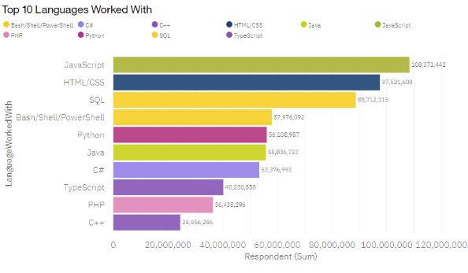
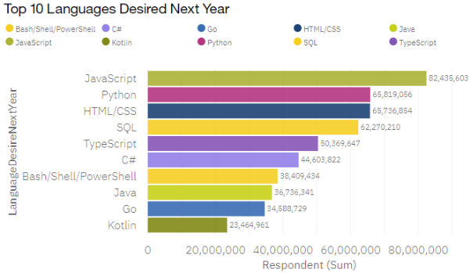
PROGRAMMING LANGUAGE TRENDS
Current Year
Next Year

Slide 8
PROGRAMMING LANGUAGE TRENDS - FINDINGS & IMPLICATIONS
Findings
The most popular language is JavaScript, staying on top next year as well
Python is moving up from 5th to 2d position
Bash/Shell/PowerShell and Java lose their popularity next year
PHP and C## are in the bottom of the list, and are replaced by Go and Kotlin in next year trend
Implications
Trends for the future are JavaScript, Python, and HTML/CSS
As a general-purpose, versatile language with simple syntax, Python grows rapidly in popularity, and leaves behind HTML/CSS, SQL, and Bash/Shell/PowerShell
Go and Kotlin are new emerging trends

Slide 9
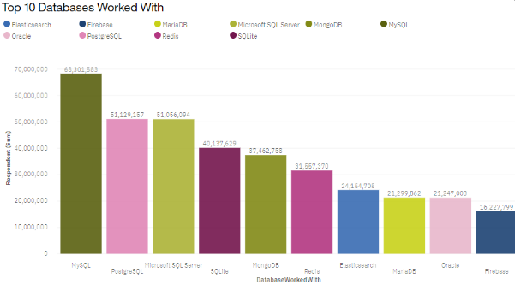
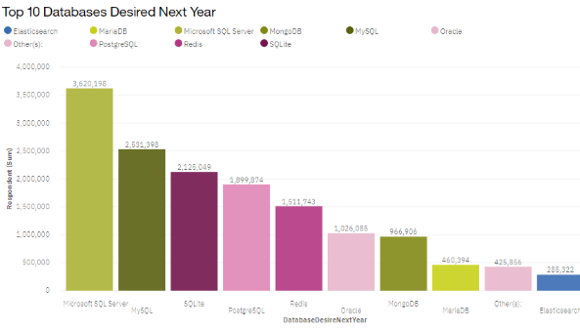
DATABASE TRENDS
Current Year
Next Year

Slide 10
DATABASE TRENDS - FINDINGS & IMPLICATIONS
Findings
Currently MySQL is leading Top-10 of databases worked with
Microsoft SQL Server wins the future trends. Its popularity can be 30% higher than of MySQL next year
The least popular database is Firebase
Implications
Microsoft SQL Server, MySQ, PostgreSQL and SQLite are in the current and future trends
There will be no new databases in Top-10 next year

Slide 11

DASHBOARD
https://eu-gb.dataplatform.cloud.ibm.com/dashboards/c0adab1b-a109-490d-81b0-de6b8b1e9ef3/view/4324df7e338063ff77f2e2e4079c250f7a637709b5bbd507d5857b4959607797f33f1093c8291f09de430166a0bf405d9f

Slide 12
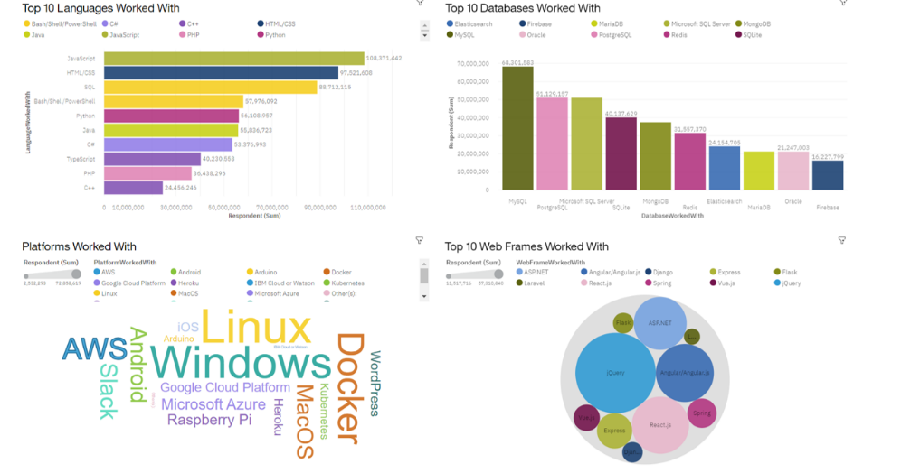
DASHBOARD TAB 1

Slide 13
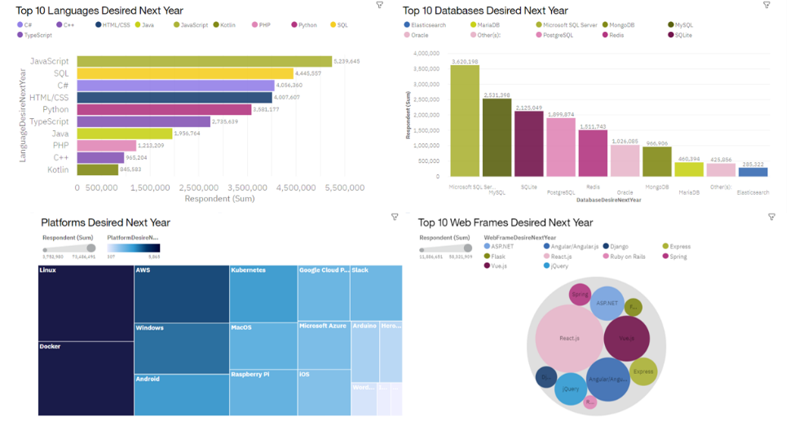
DASHBOARD TAB 2

Slide 14
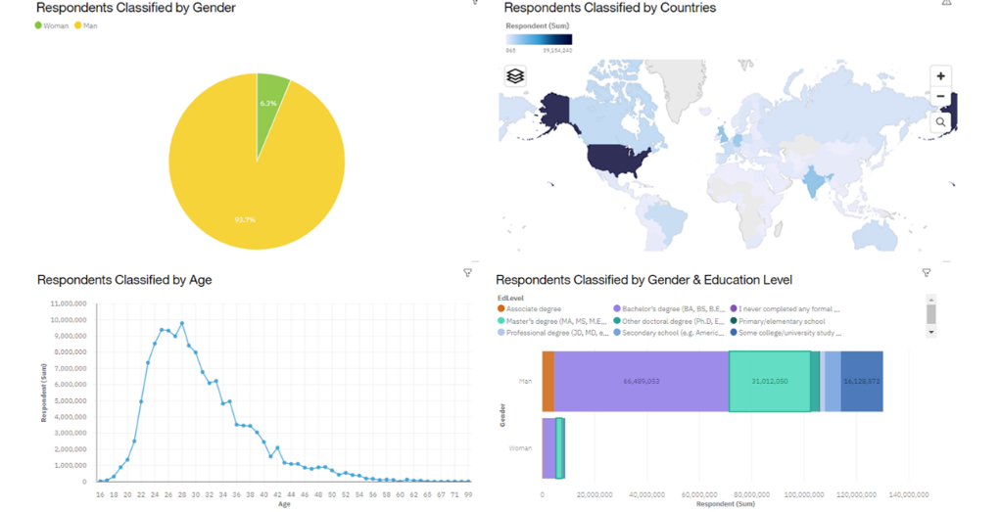
DASHBOARD TAB 3

Slide 15
DISCUSSION
The presented analysis has proved the value of using such methods as collecting data via APIs, applying statistical technigues and visualization. It has enabled to answer the initial questions:
What are the top programming languages in demand?
What are the top database skills in demand?
What are the popular platforms and web frames?

Slide 16
OVERALL FINDINGS & IMPLICATIONS
Findings
Fast changing trends
Gender imbalance in IT-professions
Implications
IT-companies should take into consideration these fast changes when working on new web development or mobile app development projects
IT-professionals should constantly gain new skills to stay competitive
IT field needs equal representation of men and women. It will bring diversity in thoughts while producing software, and diversity in business decisions, which will be a competitive advantage

Slide 17

CONCLUSION
Only C programmers are in relatively high demand
Average annual salary is acceptable
Remuneration listed for a number of programming languages from $130,801 to $84,727 with no apparent gender bias
General preference for change in technology:
Increase use of Python and introduction of TypeScript
Among top 5 databases there us a continued use of 3 current databases and introduction of Redis & Elasticsearch
Declining preference for Windows as a platform,
React.js webframe, ranked in top 3 for the next year, voted to become future leading webframe. Angular/Angular.js and jQuery are competitors, but only Angular/Angular.js is to retain constant use in future

Slide 18
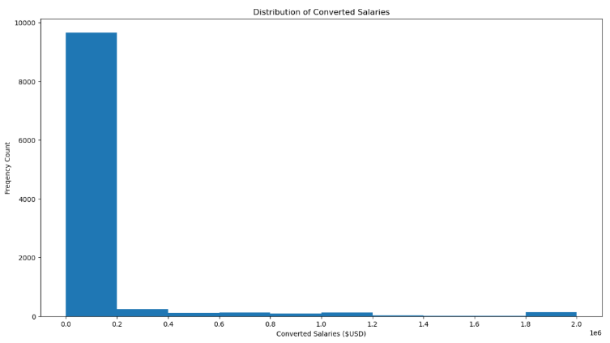

APPENDIX

Slide 19
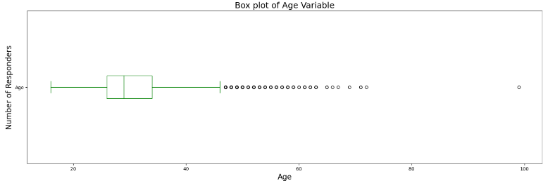
APPENDIX

Slide 20
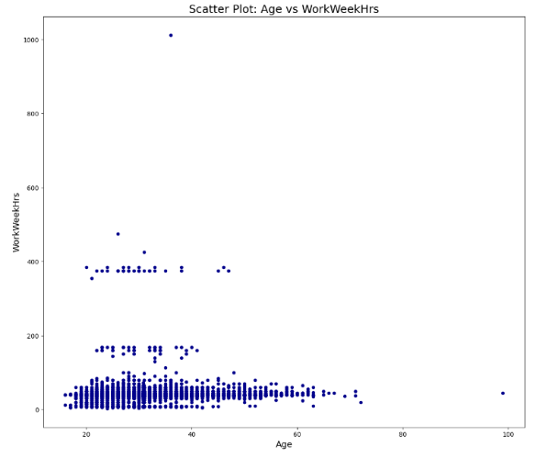
APPENDIX

Slide 21
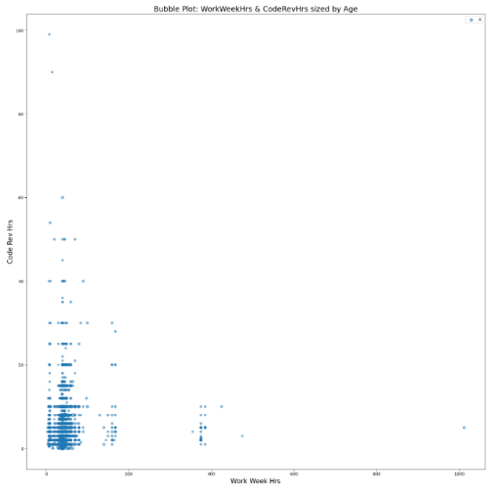
APPENDIX

Slide 22
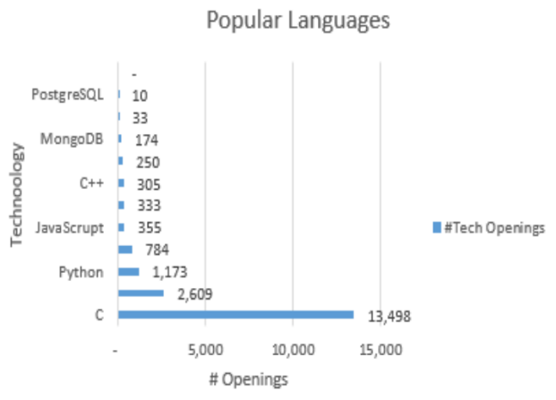
JOB POSTINGS

Slide 23
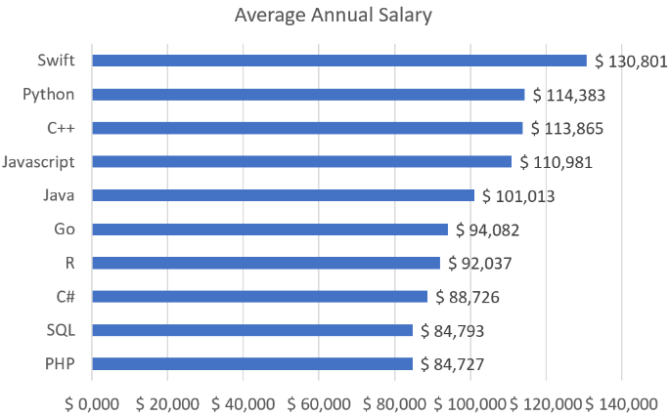
POPULAR LANGUAGES

