Slide 1
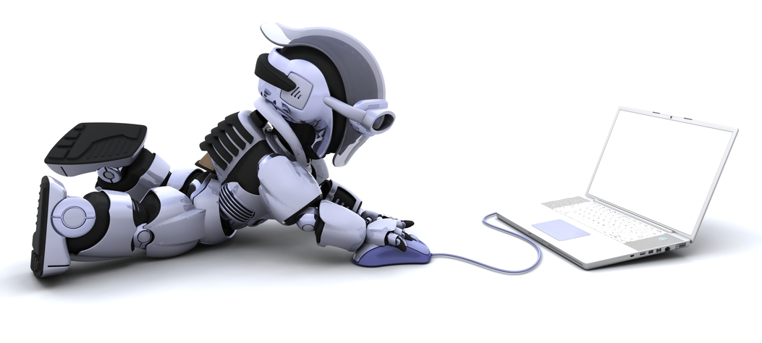
Adaptive Sensory Configurations in Robot Technologies (ASCiRT)
Project Proposal
Naeem Ganey
Jae Jang
Ntokozo Zwane

Slide 2
Robotics
Aim of robotics is to create Intelligent Robotic Systems
Artificial Intelligence
Useful in solving tasks unsuitable for human workers
Automation
Hazard
Remoteness
Cooperative Multi Robot Systems
Mobile Robot Applications
Medical/Surgical Applications
Aircraft Painting
Danger Seeking in Nuclear Power Plants with High Levels of Radiation

Slide 3
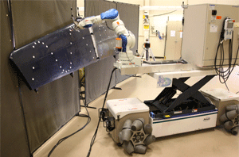
Mobile Robot Applications
www.robotics.org

Slide 4
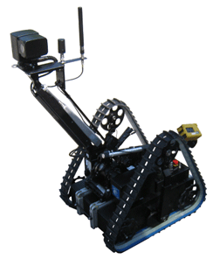
Mobile Robot Applications
www.robotics.org

Slide 5
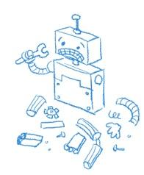
Problems of the Traditional Approach
Hand design set of simple sub-behaviours for robots
Emergent global behaviour
Design problem
Narrow range of applications

Slide 6
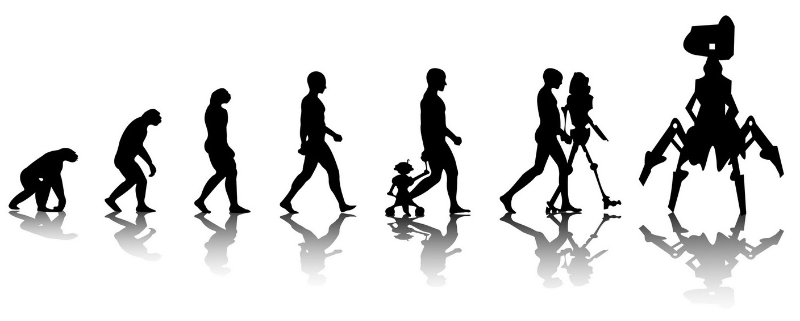
Evolutionary Robotics (ER)
Evolutionary Algorithms + Robotics = Evolutionary Robotics

Slide 7
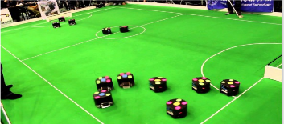
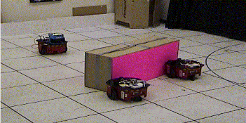
Mobile Robot Systems
Collective Behavior Tasks
Box-Pushing
Foraging
Advantages
Robustness
Scalability
Performance
Team Composition
Homogenous
Heterogeneous

Slide 8
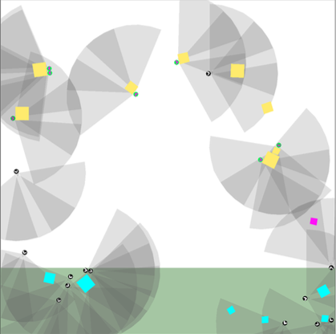
The Task
Task 1 – Foraging Task
Cooperate
Collect Boxes
Return to home Base
Task 2 – Construction Task
Arrange Boxes

Slide 9
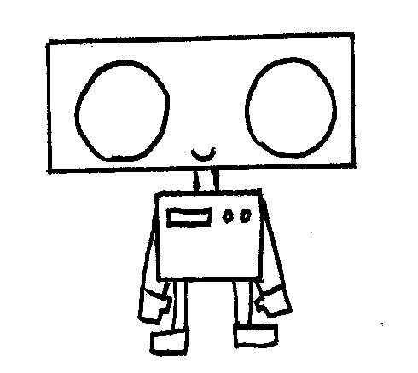
Research Objectives
The aim of our research is to compare the effectiveness of three approaches
Fixed Controller and Evolving Morphology
Fixed Morphology and Evolving Controller
Co-Evolution of Morphology and Controller
Co-Evolution of Morphology and Controller is the best approach

Slide 10
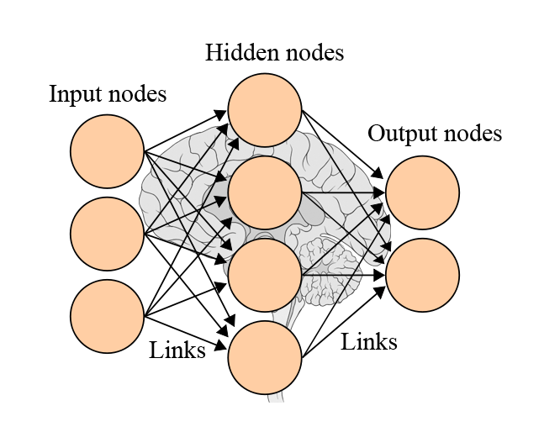
Evolving Controller
Fixed Robot Morphology
ANN for Robot Controller
Symbiotic Adaptive Neuro-Evolution (SANE)

Slide 11
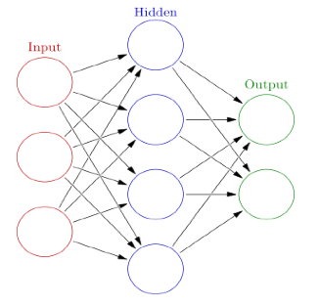
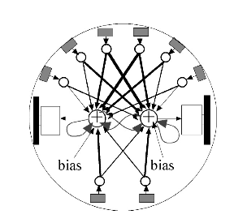
Artificial Neural Networks (ANN)

Slide 12
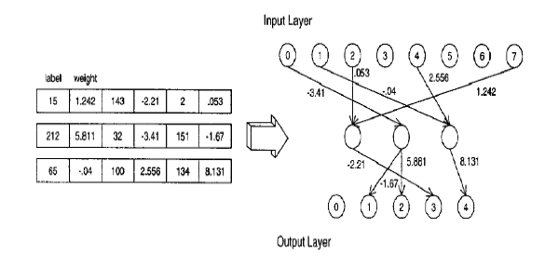
Symbiotic Adaptive Neuroevoltuion (SANE)

Slide 13
Agent Morphology
Different Types of sensors
IR Proximity Sensor
Ultrasonic Sensor
Color Proximity Sensor (Light Sensor)
Low/High Resolution Cameras
Limited Battery life
Torque of Wheels
Sensor type
Number of sensors

Slide 14
Evolving Morphology
Fixed Heuristic Robot Controller
Adaptation of the Morphology
Sensor Types
Number of Sensors
Parameters : Field of View & Range
Sensor Positions
Genetic Algorithms [Holland, 1992] for Morphology Adaptation

Slide 15
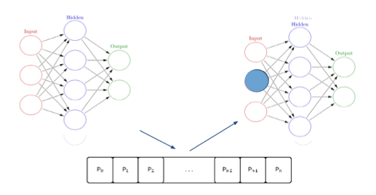
Evolving Morphology cont.

Slide 16
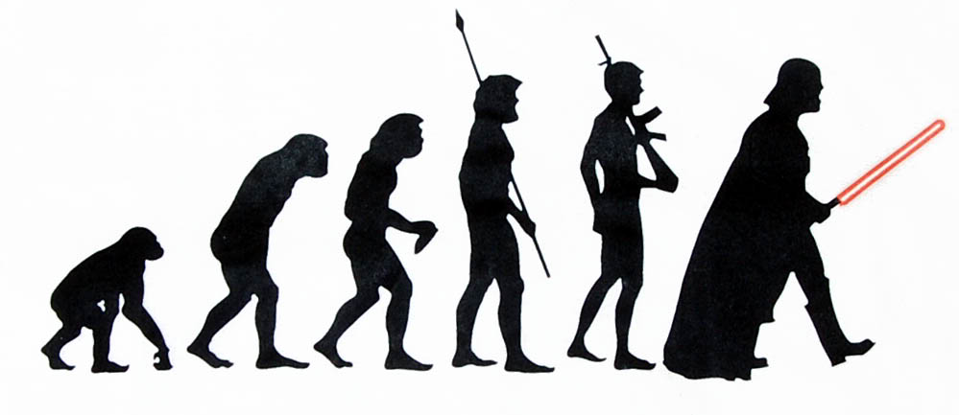
Evolving Controller & Morphology
The Co-Evolution Approach evolves the Controller and Morphology of a Robot
NeuroEvolution of Augmenting Topologies (NEAT) [Stanley and Miikkulainen, 2002]
Weight Adaptation
Topology Adaptation

Slide 17
NEAT-M
Artificial Neural Network (Controller)
Input Nodes : Sensory Readings
Output Nodes : Motor Controls
Adapting Morphology
Adding a new sensor = adding an input node
NEAT-M [Hewland, 2014]
Augmented Topologies
NEAT infrastructure for adding nodes can be reused

Slide 18
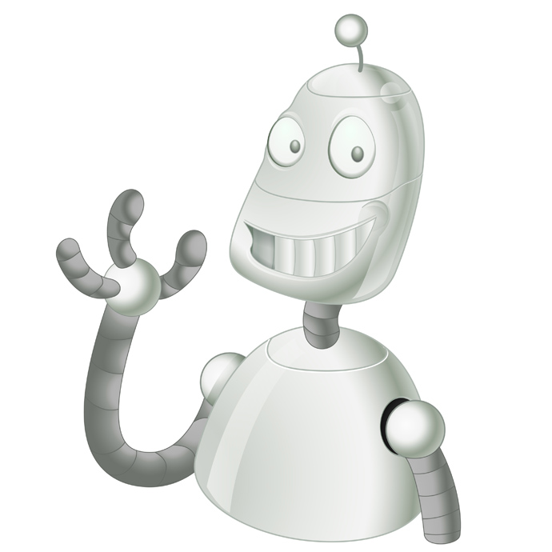
Expectations
Successful completion of the task
Efficient completion of the task
Sufficient amount of statistical data

