Slide 1




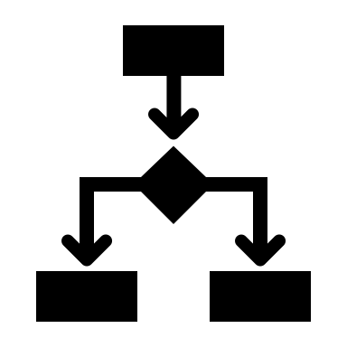


Application
AI
preprocess
predict
explain
ML/OPs
Database
train / eval / deploy
monitor

Slide 2








Quality controls on AI Model
Train/Eval/Deploy
Quality must be monitored
Banking Application
AI
Request for credit
No Risk
Insights
Business results
Risk
“Risk” predictions must be explained

Slide 3

Application
AI
Business Objective
preprocess
predict
explain
ML/OPs
Database
train / eval / deploy
monitor

Slide 4
Red Hat OpenShift
Application
AI
Business Objective
preprocess
predict
explain
ML/OPs
Database
train / eval / deploy
monitor
IBM DB2

Slide 5
KNative
Application
AI
KServe
Business Objective
Kubeflow includes KServe
preprocess
predict
explain
ML/OPs
Database
Kubeflow
train / eval / deploy
monitor
IBM DB2

Slide 6

Red Hat OpenShift
Application
AI
Business Objective
preprocess
predict
explain
PostgreSQL Database
ML/OPs
train / eval / deploy
monitor

Slide 7
KNative
Application
AI
KServe
Business Objective
Kubeflow includes KServe
preprocess
predict
explain
ML/OPs
Database
Kubeflow
train / eval / deploy
monitor
PostgreSQL

Slide 8
IBM Power Systems
Explainable AI
Trustworthy AI
Open Source

Slide 9

Train/Eval/Deploy Pipeline (Kubeflow)
Load Train & Test Data (DB2)
Fit Preprocessor
(scikit-learn pipeline)
Train Model
(Tensorflow & ONNX)
Train Explainer
(Alibi)
Evaluate Model
Deploy as OpenShift Service (KServe)
Data Quality Report
(Evidently AI)
Monitor Training
(TensorBoard)
Evaluate PR tradeoff (scikit-learn visualization)

Slide 10



Monitoring AI in Production (Kubeflow Pipeline)
Training Data
Model performance metrics Analysis (Evidently AI)
Production Data (with accuracy feedback)
Data Drift Analysis (Evidently AI)

Slide 11


AI Scaling in Production (KNative & KServe)
Normal Demand
Increased Demand
Scale to Zero

Slide 12
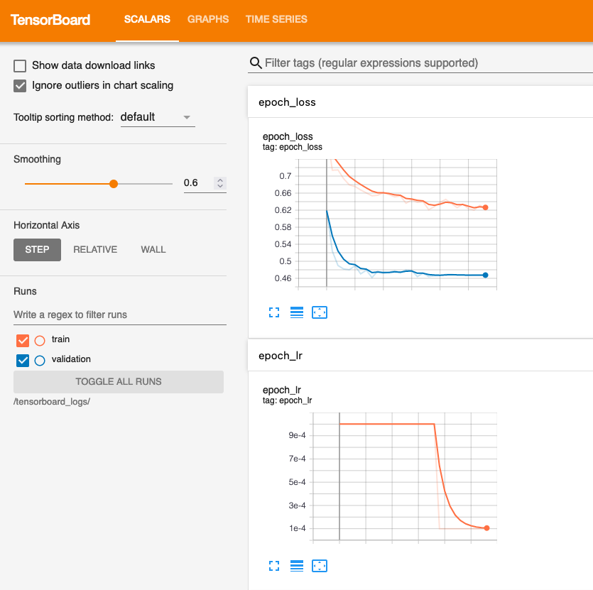
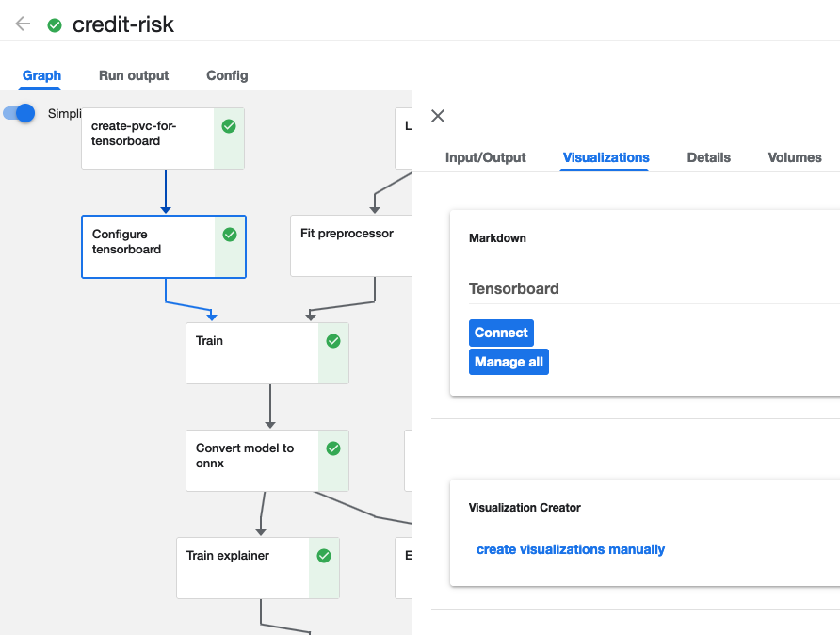
Monitor Training Metrics
(TensorBoard)

Slide 13
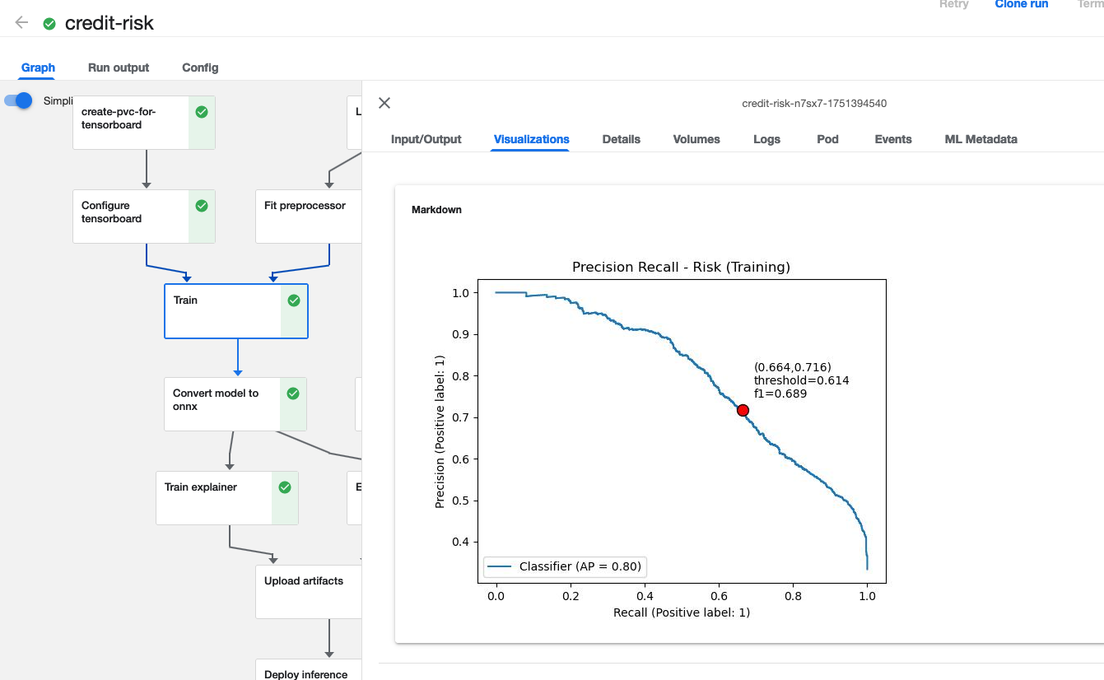
Visualize Training Performance
(Kubeflow visualizations)

Slide 14
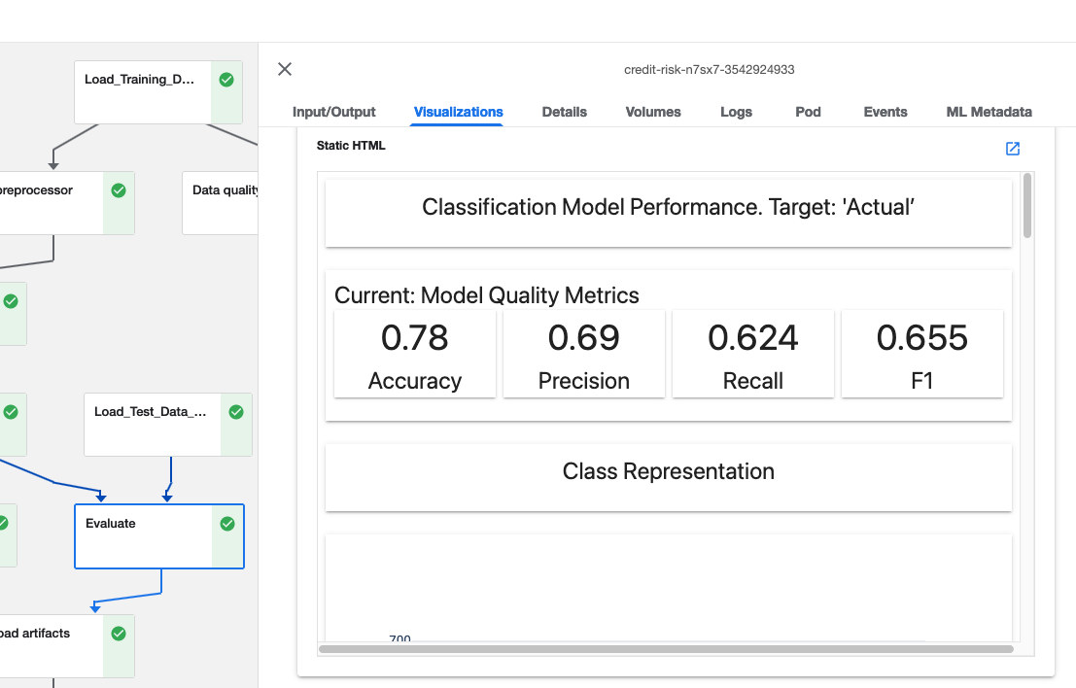
Report Model Performance on Test Data
(Evidently AI)

Slide 15
Owned by PyTorchJob
Kubeflow pipeline
Configure_tensorboard_task
POD
Worker #1
PyTorchJob
train_model_task
Train using DDP & All Reduce
Deploy & Synchronize
POD
Worker #2
POD
Worker #3
test_model_task

Slide 16


AI for the Enterprise
Credit Risk Demo
IBM Expert Labs

