Slide 1




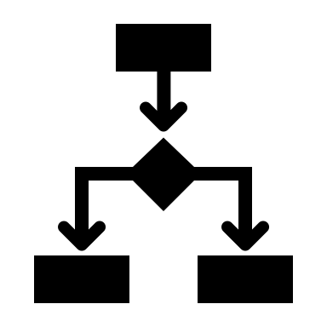


Application
AI
preprocess
predict
explain
ML/OPs
Database
train / eval / deploy
monitor

Slide 2








Banking Application
AI
Request for credit
No Risk
Insights
Business results
Risk

Slide 3

Application
AI
Business Objective
preprocess
predict
explain
ML/OPs
Database
train / eval / deploy
monitor

Slide 4
Red Hat OpenShift
Application
AI
Business Objective
preprocess
predict
explain
ML/OPs
Database
train / eval / deploy
monitor
IBM DB2

Slide 5
KNative
Application
AI
KServe
Business Objective
Kubeflow includes KServe
preprocess
predict
explain
ML/OPs
Database
Kubeflow
train / eval / deploy
monitor
IBM DB2

Slide 6
IBM Power Systems
Explainable AI
Trustworthy AI
Open Source

