Slide 1




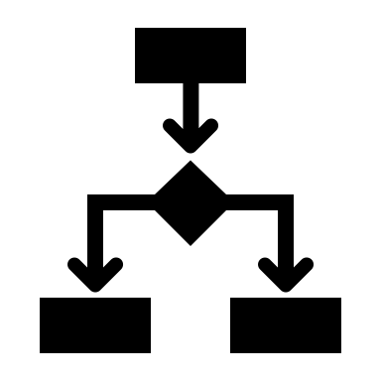


Application
AI
preprocess
predict
explain
ML/OPs
Database
train / eval / deploy
monitor

Slide 2








Banking Application
AI
Request for credit
No Risk
Insights
Business results
Risk

Slide 3

Application
AI
Business Objective
preprocess
predict
explain
ML/OPs
Database
train / eval / deploy
monitor

Slide 4
Red Hat OpenShift
Application
AI
Business Objective
preprocess
predict
explain
ML/OPs
Database
train / eval / deploy
monitor
IBM DB2

Slide 5
KNative
Application
AI
KServe
Business Objective
Kubeflow includes KServe
preprocess
predict
explain
ML/OPs
Database
Kubeflow
train / eval / deploy
monitor
IBM DB2

Slide 6
IBM Power Systems
Explainable AI
Trustworthy AI
Open Source

Slide 7

Train/Eval/Deploy Pipeline (Kubeflow)
Load Train & Test Data (DB2)
Fit Preprocessor
(scikit-learn pipeline)
Train Model
(Tensorflow & ONNX)
Train Explainer
(Alibi)
Evaluate Model
Deploy as OpenShift Service (KServe)
Data Quality Report
(Evidently AI)
Monitor Training
(TensorBoard)
Evaluate PR tradeoff (scikit-learn visualization)

Slide 8



Monitoring AI in Production (Kubeflow Pipeline)
Training Data
Model performance metrics Analysis (Evidently AI)
Production Data (with accuracy feedback)
Data Drift Analysis (Evidently AI)

Slide 9


AI Scaling in Production (KNative & KServe)
Normal Demand
Increased Demand
Scale to Zero

Slide 10


AI for the Enterprise
Credit Risk Demo
IBM Expert Labs

