Slide 1




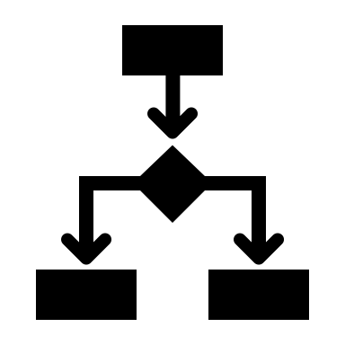


Application
AI
preprocess
predict
explain
ML/OPs
Database
train / eval / deploy
monitor

