Slide 1
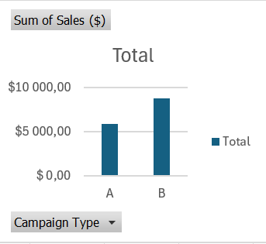
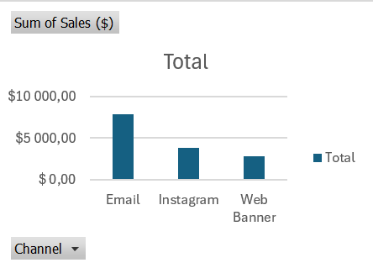
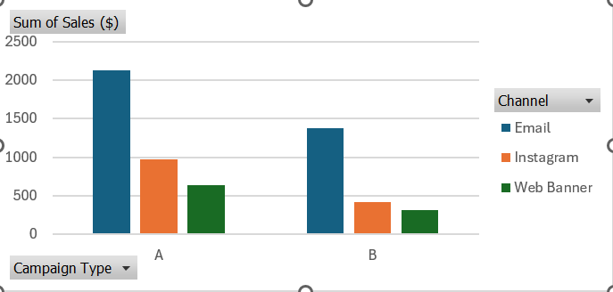
[Slide Title]
Customer Sales by Campaign
Customer Sales by Channel
Customer Sales by Campaign and Channel
Recommendation:Prioritize Campaign A + Email as the main combination to scale, while continuing to monitor performance across Instagram and Web Banner.

