Slide 1
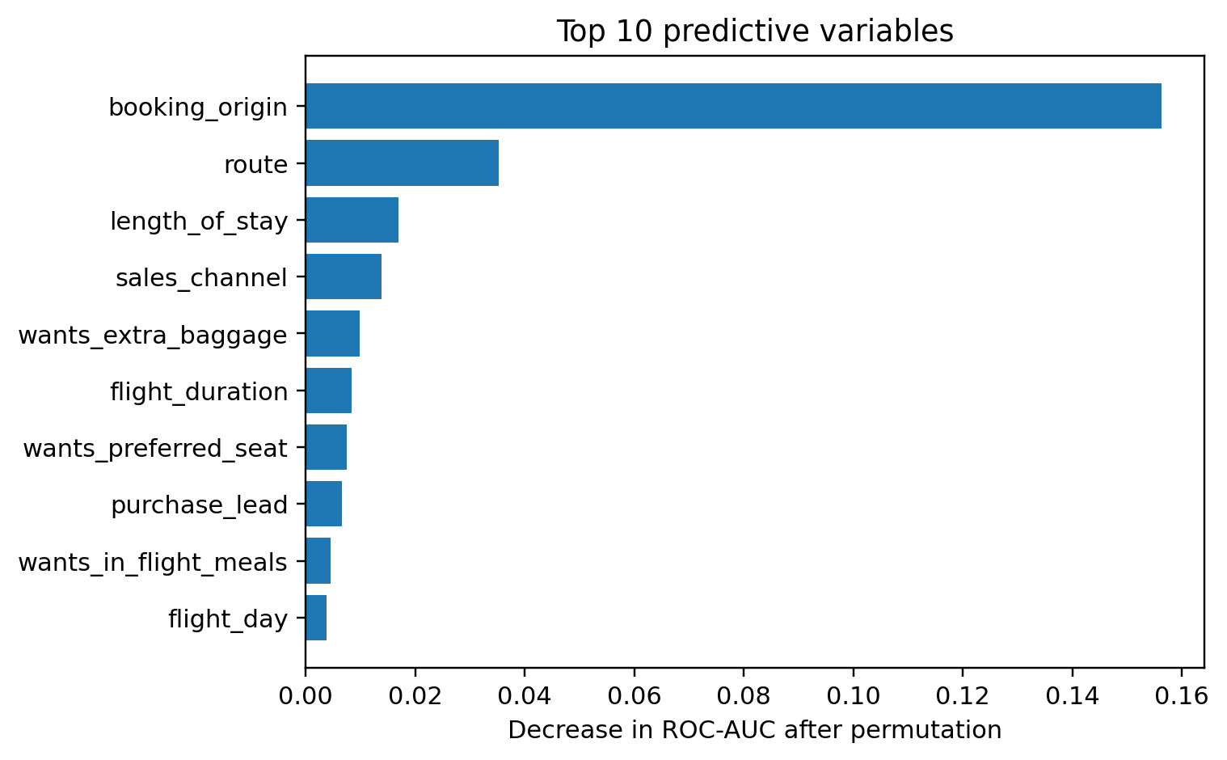
Predicting Customer Booking Behaviour
British Airways Data Science Simulation | Random Forest classification
Objective
Predict whether a customer completes a booking.
50,000 customer records; 14.96% of bookings were completed.
Random Forest with class balancing and one-hot encoding.
Model performance
ROC-AUC: 79.40% | CV: 78.14% ± 0.39% CV
F1-score: 38.67% | CV: 38.05% ± 1.46% CV
Precision: 40.00% | CV: 39.94% ± 1.76% CV
Recall: 37.43% | CV: 36.34% ± 1.30% CV
Test confusion matrix
TN 7,664 | FP 840 | FN 936 | TP 560
Business findings
Booking origin and route were the strongest contributors to prediction.
Length of stay and sales channel also provided meaningful predictive signal.
Feature importance reflects model reliance, not causation; further testing is needed before operational decisions.
Evaluation used stratified 5-fold cross-validation and a held-out 20% test set.

