Slide 1


Twitch Streaming Top Channel Analysis
Natalie Dela Cruz

Slide 2
Background
Twitch is the most popular interactive livestreaming service for content spanning gaming, music, sports, entertainment, and more
More than 11 million streaming channels
7,115,865 streamers in September 2022
Twitch.tv recorded a 129.82% increase in website traffic during the pandemic

Slide 3
Dataset
Followers
Integer
The dataset being used contains the performance of the top 1,000 channels on Twitch streaming within the past year.
There are 1000 records across 11 fields. For this analysis, only five fields will be used.
Followers Gained
Integer
Mature
Boolean
Stream Time
Integer
Views Gained
Integer

Slide 4
Research Questions
There are 2 questions that this analysis seeks to address:
Can we establish any correlation between Mature(18+) channels and Followers?
Is there a significant difference in the average Stream time(minutes) between channels geared towards a Mature(18+) audience and those that are for a general, all-ages, audience?

Slide 5
Purpose
Both Twitch streamers as well as companies searching for a new platform to advertise can use this analysis in deciding the following questions:
What type of content sets the top 1,000 streamers from the rest?
Which streamers control which audience demographics?
Is follower count or stream time more important for their audience?
Having answers to these questions will be helpful in channeling resources towards improving stream and ad performance.

Slide 6

The Hypotheses
H₁ A channel’s audience, Mature(18+) or General(all ages), and number of Followers are correlated.
H₂ There is a significant difference between Mature(18+) and General channels’ stream time.

Slide 7
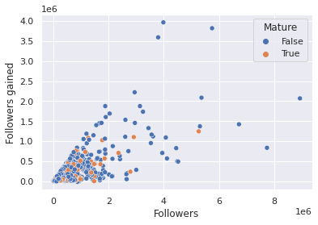
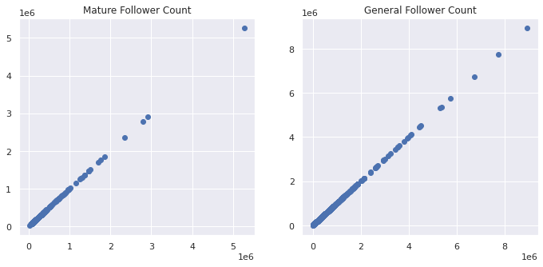
Hypothesis 1:
Ho: There is no significant difference is follower count between Mature(18+) streamers and general(all ages) streamers
Ha: There is a significant difference is follower count between Mature(18+) streamers and general(all ages) streamers
pvalue = 0.005, tested at 95% confidence level
From the scatter plots we can see that there is a presence of a significance difference/correlation between the follower count of mature streamers and general streamers, with general streamers having more. Null hypothesis rejected

Slide 8
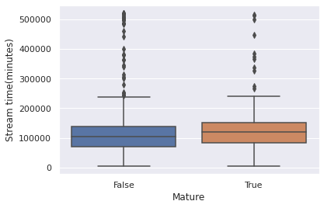
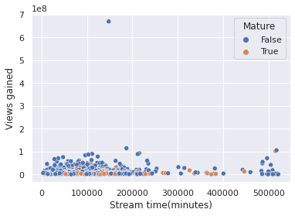
Hypothesis 2:
Ho: There is no difference between the stream time of both groups.
Ha: There is a significant difference in stream time between both groups
pvalue = 0.16, tested at 95% confidence level
Based off the t-test we see that there is no significant difference in stream time between 18+ streamers and the general streamers.
Both the box plot and scatter plot show similar results with the 18+ streamers having a higher total stream time.Fail to reject null hypothesis

Slide 9
Summary of Results
Mature (18+)
General (all ages)
Higher average screen time
Higher follower count

Slide 10
Recommendations
If your goal is to increase more followers/the number of people the channel regularly interacts with, I would suggest paying attention to general(all ages) streamers who were tested to have a higher average follower count.
If your goal is to increase stream time/the time you spend interacting with your viewers, Mature(18+) channels can be an example for maximizing stream time.
I would recommend sponsors invest in Mature(18+) channels, as they have been shown to spend more time interacting with their viewers.

Slide 11
Thank You!
Do you have any questions?
For reference:
Proposal
Notebook

