Slide 1
Lesson 6:Classes

Slide 2
Chapter 2: Functions and classes
2.2. Classes
What are classes?
Creating and using a class
Working with Classes and Instances
Inheritance
Importing Classes

Slide 3
What are classes?
Classes are the foundation of object-oriented programming.
Classes represent real-world things you want to model in your programs: for example: dogs, cars, and robots….
You use a class to make objects, which are specific instances of dogs, cars, and robots.
A class defines the general behavior that a whole category of objects can have, and the information that can be associated with those objects.
Classes can inherit from each other – you can write a class that extends the functionality of an existing class. This allows you to code efficiently for a wide variety of situations.

Slide 4

Creating and using a class
Creating the Dog Class
Name
Age
Weight
Sit
Roll over

Slide 5
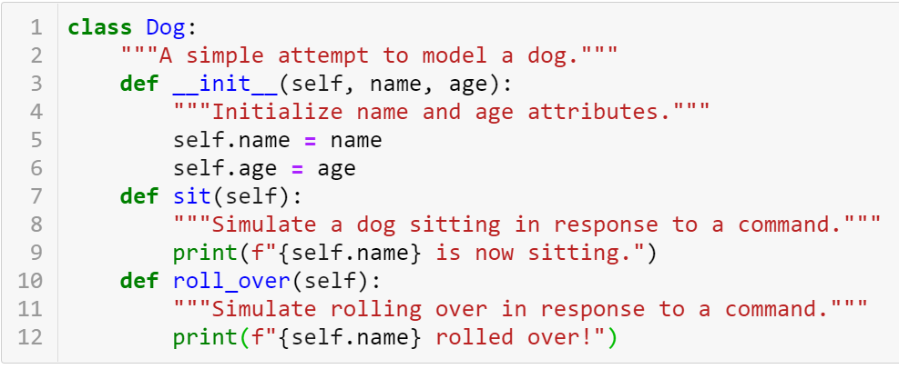

Creating and using a class
Creating the Dog Class
define a class called Dog
docstring
Method
attributes
The __init__() Method is a special method that Python runs automatically whenever we create a new instance based on the Dog class

Slide 6


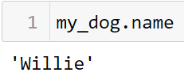
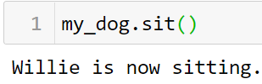
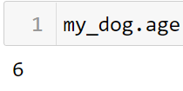


Creating and using a class
Making an Instance from a Class
Accessing Attributes
Calling Methods
Creating Multiple instances

Slide 7
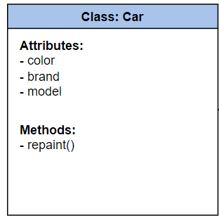
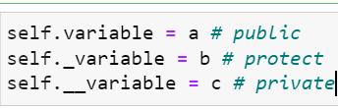
Practice
9-1,…,9-3

Slide 8
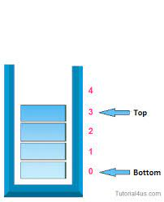
Practice
Exercise 1: Implementing a Stack using OOP
Problem:
Implement a Stack class using object-oriented programming (OOP). The class should have the following methods:
push(item): Add an item to the top of the stack.
pop(): Remove and return the item from the top of the stack.
peek(): Return the item from the top of the stack without removing it.
is_empty(): Check if the stack is empty.
size(): Return the number of items in the stack.
Steps to implement:
Create a Stack class using an internal list to store the elements.
Implement the methods as required by the problem.
Handle exceptions when calling pop() or peek() on an empty stack.

Slide 9
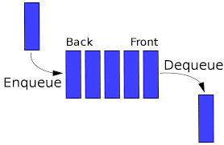
Practice
Exercise 2: Implementing a Queue using OOP
Problem:
Implement a Queue class using object-oriented programming (OOP). The class should have the following methods:
enqueue(item): Add an item to the end of the queue.
dequeue(): Remove and return the item from the front of the queue.
front(): Return the item from the front of the queue without removing it.
is_empty(): Check if the queue is empty.
size(): Return the number of items in the queue.
Steps to implement:
Create a Queue class using an internal list to store the elements.
Implement the methods as required by the problem.
Handle exceptions when calling dequeue() or front() on an empty queue.

Slide 10
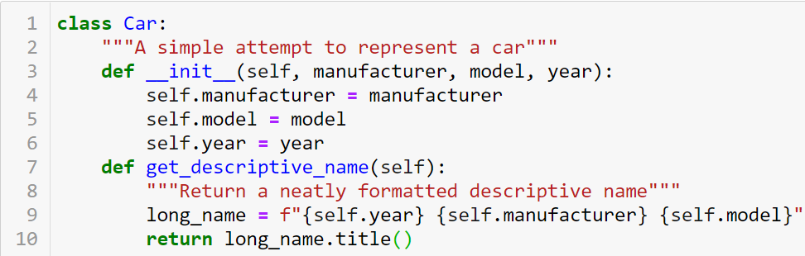
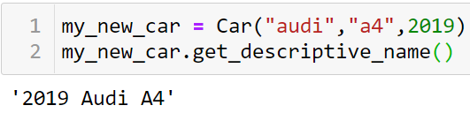
Working with Classes and Instances
The Car Class

Slide 11
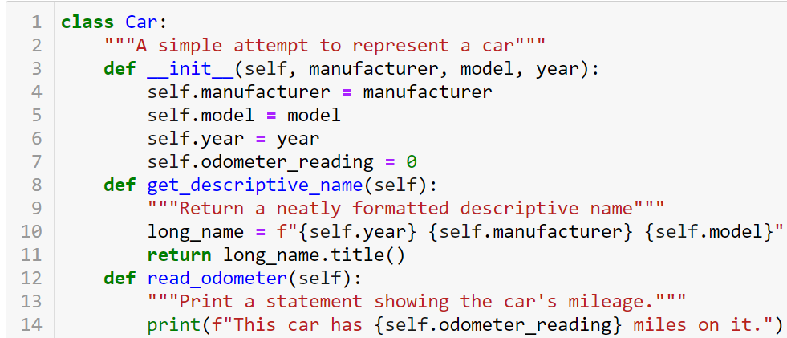
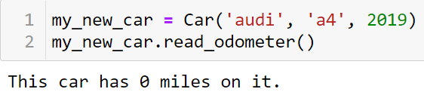
Working with Classes and Instances
Setting a Default Value for an Attribute

Slide 12
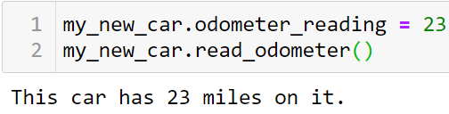
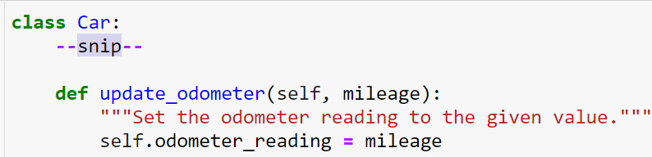
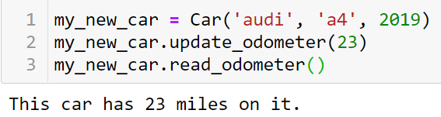
Working with Classes and Instances
Modifying Attribute Values
Modifying an Attribute’s Value Directly
Modifying an Attribute’s Value Through a Method

Slide 13
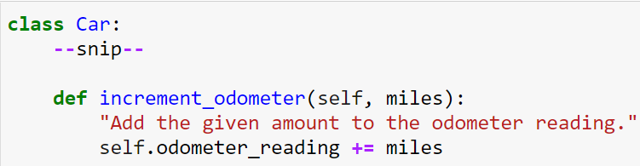
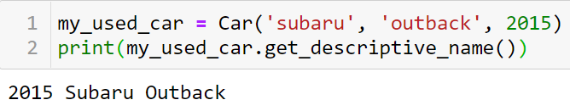
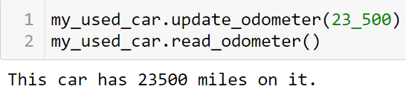
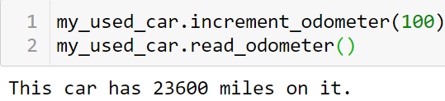
Working with Classes and Instances
Incrementing an Attribute’s Value Through a Method

Slide 14
Special Methods
All the built-in data types implement a collection of special object methods.
The names of special methods are always preceded and followed by double underscores (__).
Reference: https://www.pythonlikeyoumeanit.com/Module4_OOP/Special_Methods.html

Slide 15
Special Methods
String-Representations of Objects
Method | Signature | Explanation
Returns string for a printable representation of object | __repr__(self) | repr(x) invokes x.__repr__(), this is also invoked when an object is returned by a console
Returns string representation of an object | __str__(self) | str(x) invokes x.__str__()

Slide 16
Special Methods
Interfacing with Mathematical Operators
Method | Signature | Explanation
Add | __add__(self, other) | x + y invokes x.__add__(y)
Subtract | __sub__(self, other) | x - y invokes x.__sub__(y)
Multiply | __mul__(self, other) | x * y invokes x.__mul__(y)
Divide | __truediv__(self, other) | x / y invokes x.__truediv__(y)
Power | __pow__(self, other) | x ** y invokes x.__pow__(y)

Slide 17
Special Methods
Creating a Container-Like Class
Method | Signature | Explanation
Length | __len__(self) | len(x) invokes x.__len__()
Get Item | __getitem__(self, key) | x[key] invokes x.__getitem__(key)
Set Item | __setitem__(self, key, item) | x[key] = item invokes x.__setitem__(key, item)
Contains | __contains__(self, item) | item in x invokes x.__contains__(item)
Iterator | __iter__(self) | iter(x) invokes x.__iter__()
Next | __next__(self) | next(x) invokes x.__next__()

Slide 18
Practices
Exercise: Custom String Representation
Create a User class representing a user with attributes username and email. Implement the following special methods:
__init__(self, username, email): Initialize the user object with the given username and email.
__str__(self): Return a string representation of the user in the format "User: username, Email: email".

Slide 19
Practices
Exercise : Rectangle Class
Create a Rectangle class representing a rectangle with attributes width and height. Implement the following special methods:
__init__(self, width, height): Initialize the rectangle object with the given width and height.
__str__(self): Return a string representation of the rectangle in the format "Rectangle(width, height)".
__eq__(self, other): Compare two rectangles based on their area. Return True if the areas of the two rectangles are equal, otherwise False.
__lt__(self, other): Compare two rectangles based on their area. Return True if the area of the current rectangle is less than the area of the other rectangle, otherwise False.
__add__(self, other): Calculate the total area of two rectangles and return a new rectangle with a width equal to the sum of the widths of the two rectangles and a height equal to the sum of the heights of the two rectangles.

Slide 20
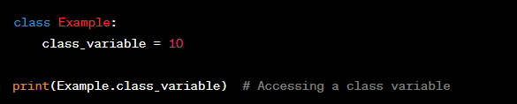
Class Variables vs. Object Variables
1. Class Variables:
Scope: Class variables are shared among all objects of a class.
Declaration and Usage: Declared inside the class and can be accessed without creating an object.
Access: Can be accessed through the class name without creating an object.

Slide 21
Class Variables vs. Object Variables
Exercise 1: Class Variable
Create a class BankAccount with a class variable interest_rate to store the common interest rate for all bank accounts.
Write a class method set_interest_rate(rate) to set a new interest rate for all bank accounts.
Create two objects account1 and account2 from the BankAccount class.
Modify the interest rate through the class variable and check if both accounts share the new interest rate.

Slide 22

Practice
Exercise 2: Email Class with Methods
Create an Email class with the following attributes: email_address (the email address of the user), inbox (a list to store received emails), and sent (a list to store sent emails). Implement the following methods for the class:
Method __init__(self, email_address): Initialize an Email object with the given email_address. Initialize inbox and sent lists as empty lists.
Method send(self, recipient, message): Create an email with the given message and send it to the specified recipient. Add the sent email to the sent list of the sender and add the email to the recipient's inbox.
Method read(self): Print all the emails in the inbox.
Method delete(self, index): Delete the email at the specified index from the inbox.

Slide 23
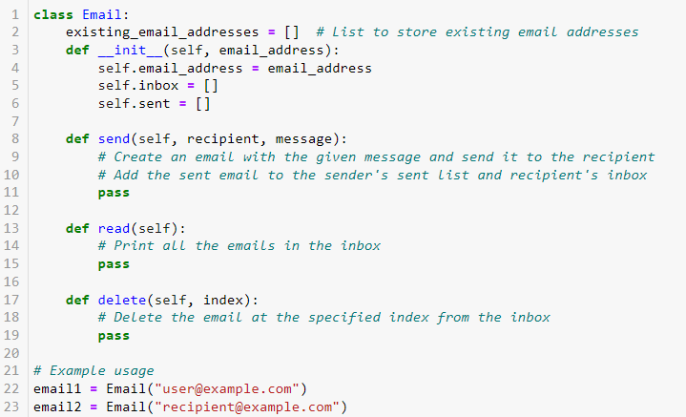
Here's a sample template to help you get started:

Slide 24
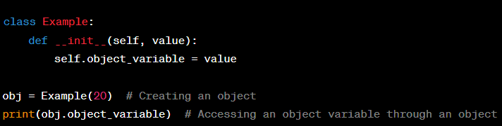
Class Variables vs. Object Variables
2. Object Variables:
Scope: Object variables belong to a specific instance of a class.
Declaration and Usage: Declared and used through an object created from the class.
Access: Requires creating an object of the class to access the object variable.

Slide 25
Class Variables vs. Object Variables
Exercise 2: Object Variables
Create a class Book with object variables title to store the book's title and author to store the author's name.
Create two objects book1 and book2 from the Book class with appropriate values for title and author.
Write a class method display_info() to display information about the book, including both title and author.
Call the display_info() method on both book1 and book2 objects to display the book information.

Slide 26
Class Variables vs. Object Variables
Exercise 3: Combination of Class and Object Variables
Extend the Book class from Exercise 2 to include a class variable total_books to track the total number of books created.
Create a class method display_total_books() to display the total number of books created.
Whenever a new Book object is created, increase the value of total_books by 1 using the class variable.
Create a book3 object from the Book class and call the display_total_books() method to show the total number of books created.

Slide 27
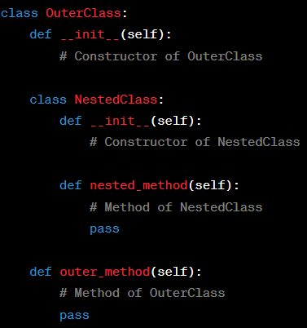
Nested Classes
Definition:
Nested classes, also known as inner classes, are classes defined within another class in Python.
Purpose:
Organize code: Improve code organization by encapsulating related classes.
Encapsulation: Hide inner class details from the outer world, enhancing data security.
Syntax of Nested Classes

Slide 28


Nested Classes
Working with Nested Classes
Creating Objects:
Calling Methods:

Slide 29
Nested Classes
Exercise: Creating a Classroom System with Nested Classes
Imagine you are building a simple classroom system in Python. Design a class structure using nested classes to represent the following entities: Classroom and Student.
Classroom Class:
Attributes:
class_name: Name or identifier of the classroom.
Nested Class: Student
Attributes:
name: Name of the student.
roll_number: Unique identifier for the student.
Methods:
display_info(): Display student information including name and roll number.

Slide 30
Inheritance
You don’t always have to start from scratch when writing a class. If the class you’re writing is a specialized version of another class you wrote, you can use inheritance.
When one class inherits from another, it takes on the attributes and methods of the first class.
The original class is called the parent class, and the new class is the child class.
The child class can inherit any or all of the attributes and methods of its parent class, but it’s also free to define new attributes and methods of its own.

Slide 31
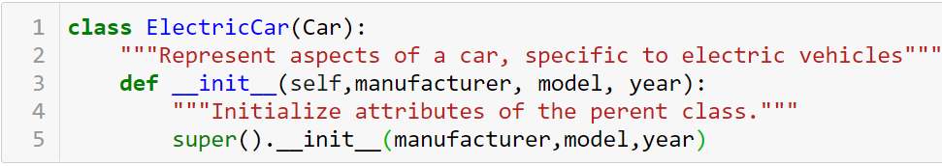
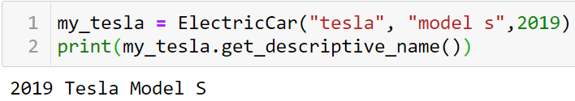
Inheritance
The __init__() Method for a Child Class
Name of parent class
define the child class
takes in the information required to make a Car instance
tells Python to call the __init__() method from Car, which gives an ElectricCar instance all the attributes defined in that method.
special function that allows you to call a method from the parent class

Slide 32
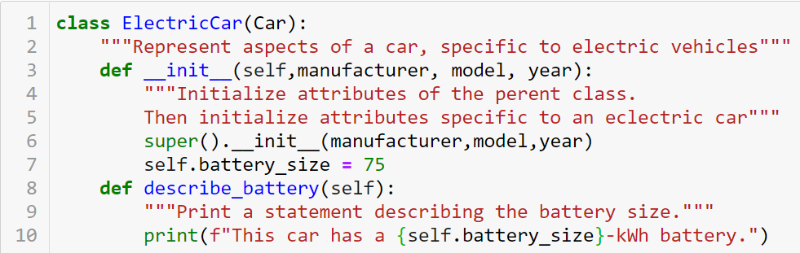
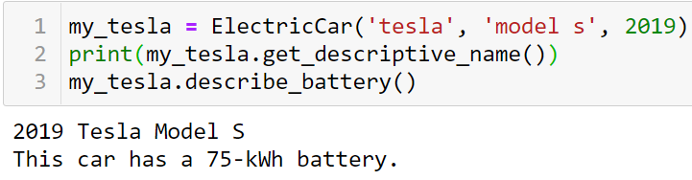
Inheritance
Defining Attributes and Methods for the Child Class

Slide 33
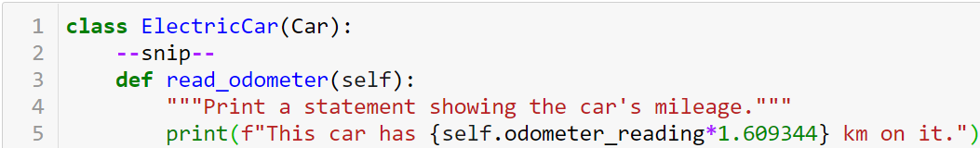
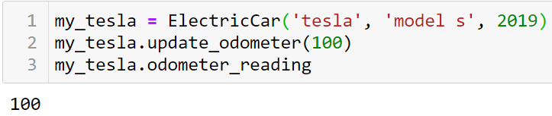

Inheritance
Overriding Methods from the Parent Class

Slide 34
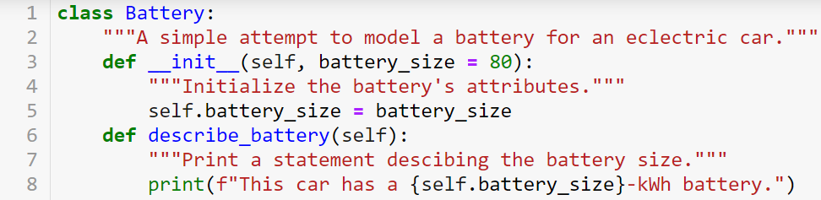
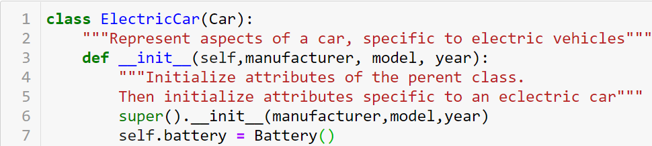
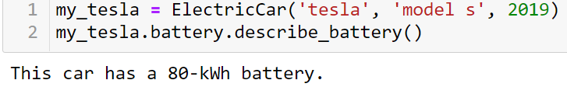
Inheritance
Instances as Attributes

Slide 35
Practice
9-6,…,9-9

Slide 36


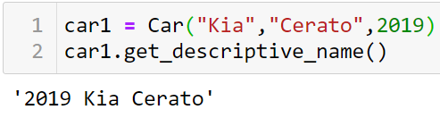
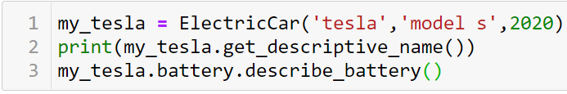
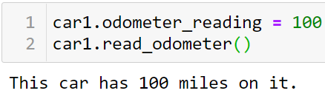

Importing Classes
Importing a Single Class
Storing Multiple Classes in a Module

Slide 37
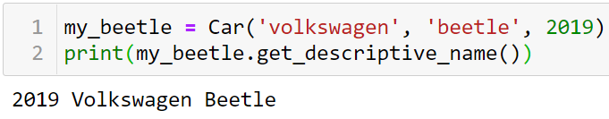
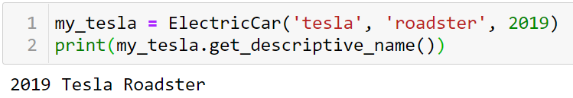

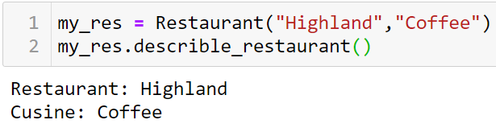
Importing Classes
Importing Multiple Classes from a Module
Importing Multiple Classes from a Module

Slide 38
Importing Classes
Importing Multiple Classes from a Module
Importing Multiple Classes from a Module

Slide 39
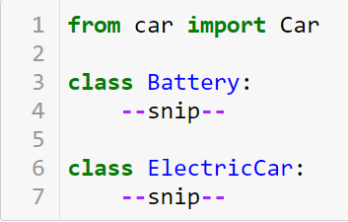


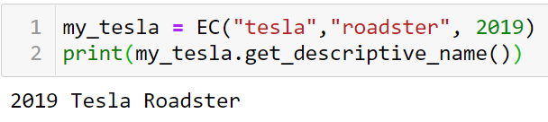
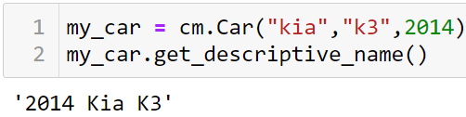
Importing Classes
Importing a Module into a Module
Using Aliases

