Slide 1
Chapter 2: Functions and classes

Slide 2
Chapter 2: Functions and classes
2.1. Functions
What are functions?
Defining a Function
Passing Arguments
Return Values
Passing a List
Passing an Arbitrary Number of Arguments
Modules

Slide 3
What are functions?
Functions are named blocks of code designed to do one specific job.
Functions allow you to write code once that can then be run whenever you need to accomplish the same task.
Functions can take in the information they need, and return the information they generate.
Using functions effectively makes your programs easier to write, read, test, and fix.

Slide 4
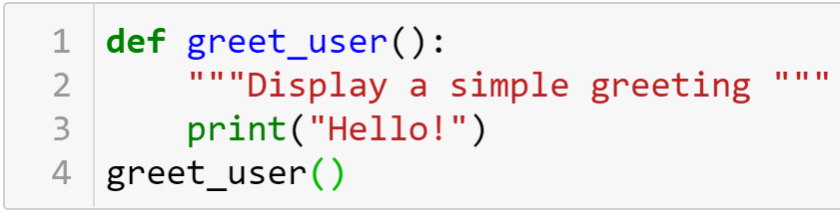

Defining a Function
The simplest structure of a function
keyword
The name of the function
Defining
Docstring
Body
Describes what the function does
Calling

Slide 5
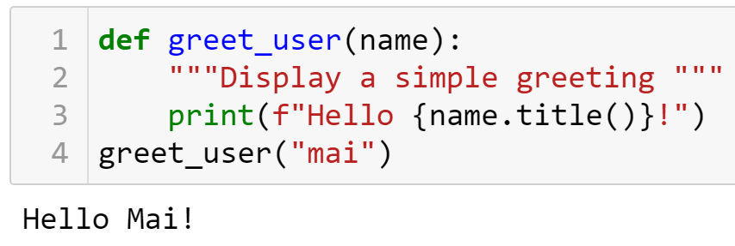


Defining a Function
Passing Information to a Function
Arguments and Parameters
Parameter
Argument

Slide 6
Defining a Function
Defining a function
The first line of a function is its definition, marked by the keyword def. The name of the function is followed by a set of parentheses and a colon.
A docstring, in triple quotes, describes what the function does. The body of a function is indented one level.
To call a function, give the name of the function followed by a set of parentheses

Slide 7
Practice
8-1,8-2

Slide 8
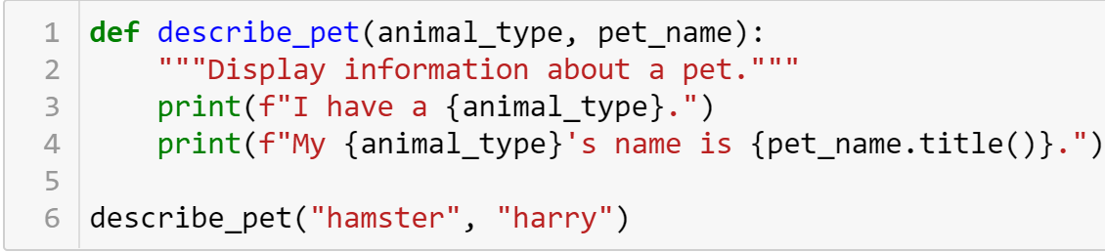

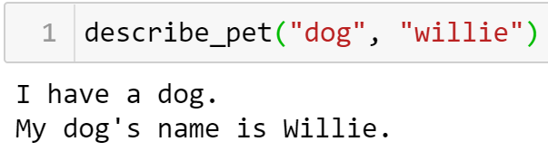
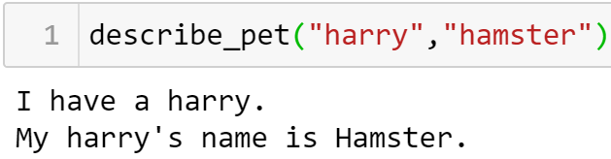
Passing Arguments
Positional Arguments

Slide 9
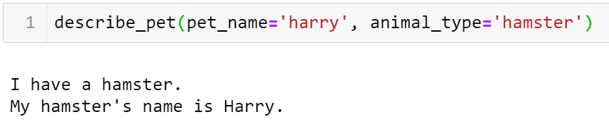
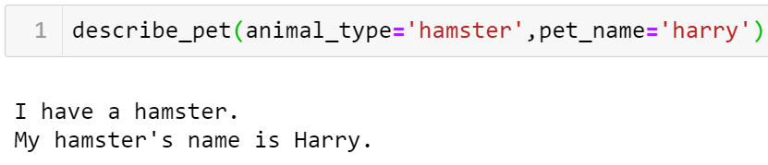
Passing Arguments
Using keyword arguments

Slide 10
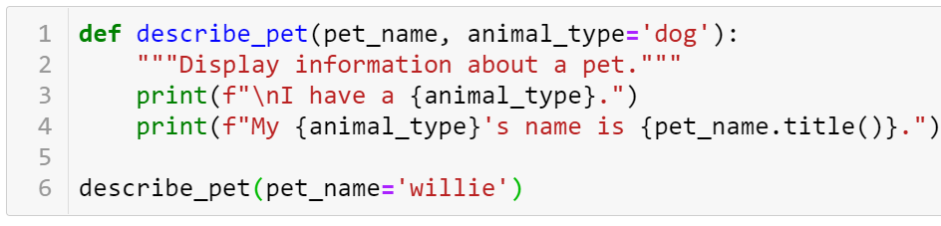


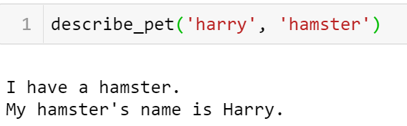
Passing Arguments
Default Values

Slide 11
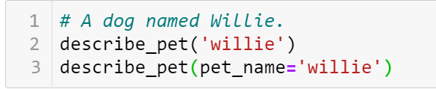
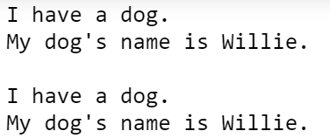
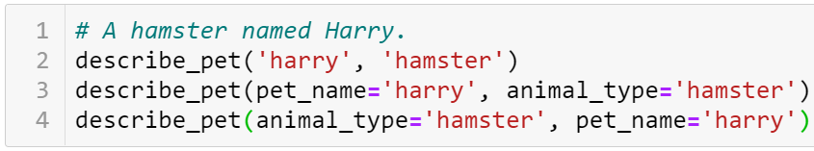
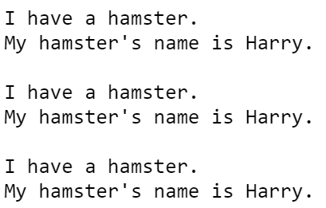
Passing Arguments
Equivalent Function Calls

Slide 12

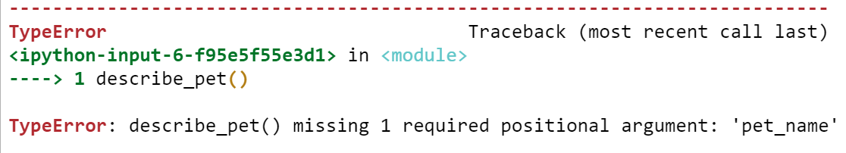
Passing Arguments
Avoiding Argument Errors

Slide 13
Practice
8-3,…,8-5

Slide 14
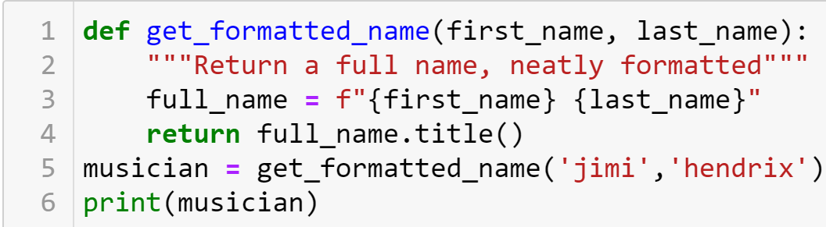

Return Values
Returning a Sinple Value

Slide 15
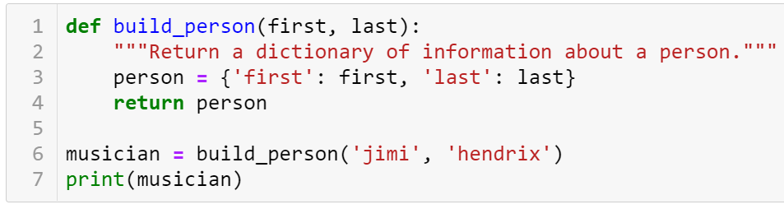
Return Values
Returning a dictionary

Slide 16
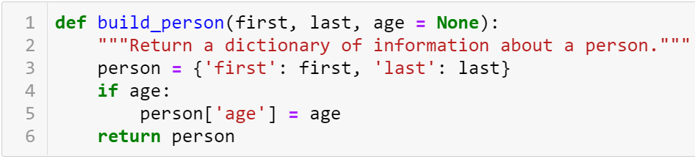
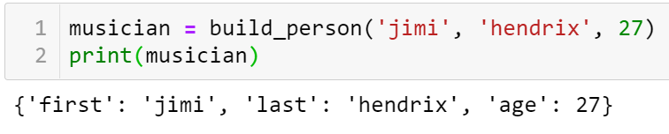
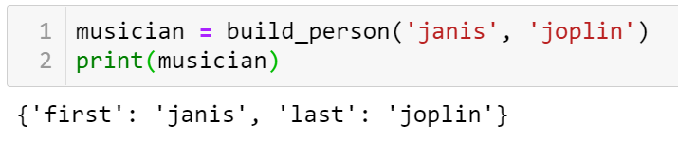
Return Values
Returning a dictionary with optional values

Slide 17
Return Values
A function can return a value or a set of values. When a function returns a value, the calling line should provide a variable which the return value can be assigned to.
A function stops running when it reaches a return statement.

Slide 18
Visualizing functions
http://pythontutor.com/

Slide 19
Practice
8-6,…,8-8

Slide 20
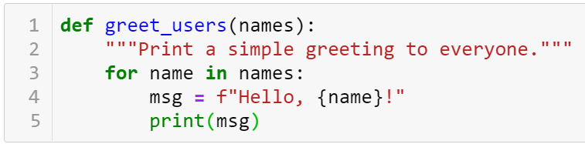

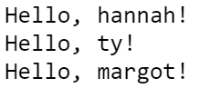
Passing a List
Passing a list as an argument

Slide 21
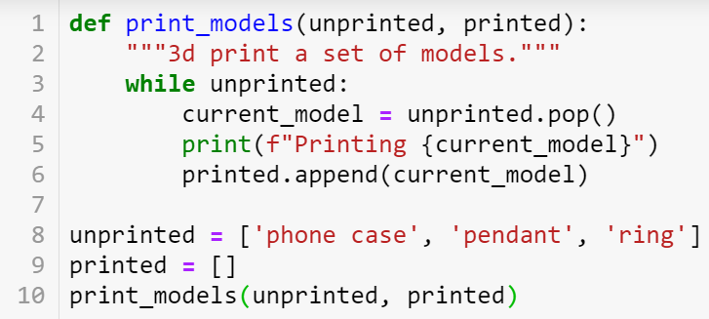

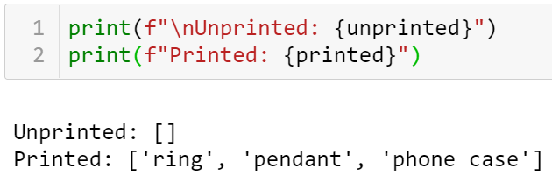
Passing a List
Allowing a function to modify a list

Slide 22
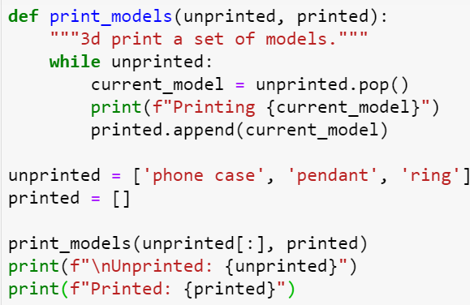
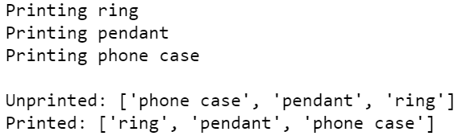
Passing a List
Preventing a function from modifying a list

Slide 23
Passing a List
Passing a list to a function
You can pass a list as an argument to a function, and the function can work with the values in the list.
Any changes the function makes to the list will affect the original list.
You can prevent a function from modifying a list by passing a copy of the list as an argument.

Slide 24
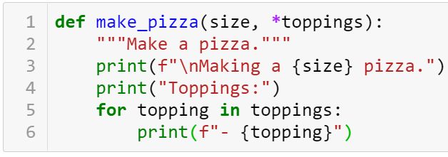
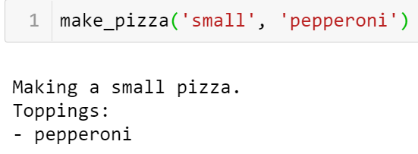
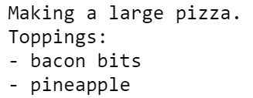
Passing an Arbitrary Number of Arguments
Sometimes you won't know how many arguments a function will need to accept. Python allows you to collect an arbitrary number of arguments into one parameter using the * operator .
A parameter that accepts an arbitrary number of arguments must come last in the function definition.
Collecting an arbitrary number of arguments

Slide 25
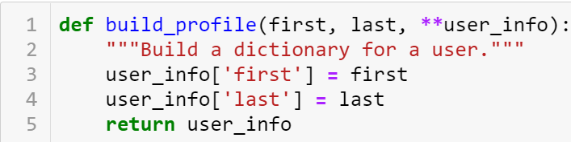
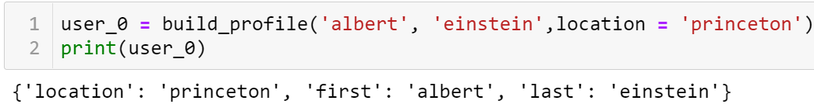
Passing an Arbitrary Number of Arguments
Collecting an arbitrary number of keyword arguments
The ** operator allows a parameter to collect an arbitrary number of keyword arguments.
These arguments are stored as a dictionary with the parameter names as keys, and the arguments as values.

Slide 26
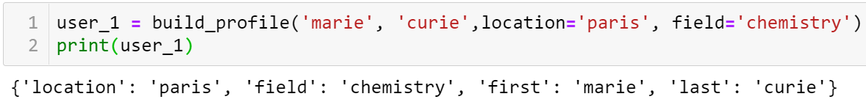
Passing an Arbitrary Number of Arguments
Collecting an arbitrary number of keyword arguments

Slide 27
Order of parameters
Normal parameters
*args
Parameters have default values
**kwargs

Slide 28
Practice
8-12,…,8-14
Exercise 1: Filter Prime Numbers using *args
Write a function that accepts n positive integers using *args to get a list of integers. The function will return a new list containing the prime numbers from the original list.
Exercise 2: Student Assessment
Write a function that takes a student's name and a list of scores via **kwargs and calculates the average of that student's scores.
Ex: student_info = {'name': 'Alice', ‘statistics': 85, ‘Pro4DS’: 90, ’ML1’: 92}
calculate_average_score(** student_info)=?

Slide 29
yield
def generate_numbers(n):
i = 0
while i < n:
yield i
i += 1
def generate_numbers(n):
i = 0
while i < n:
return i
i += 1

Slide 30
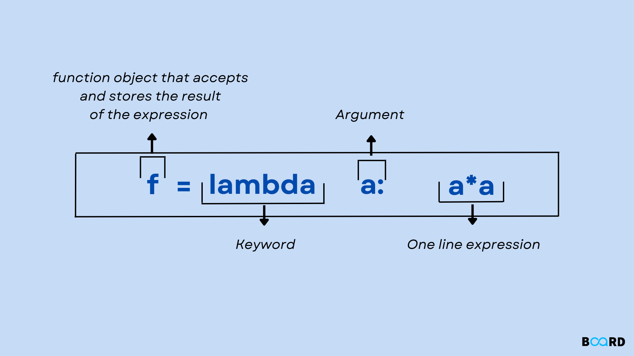
lambda

Slide 31
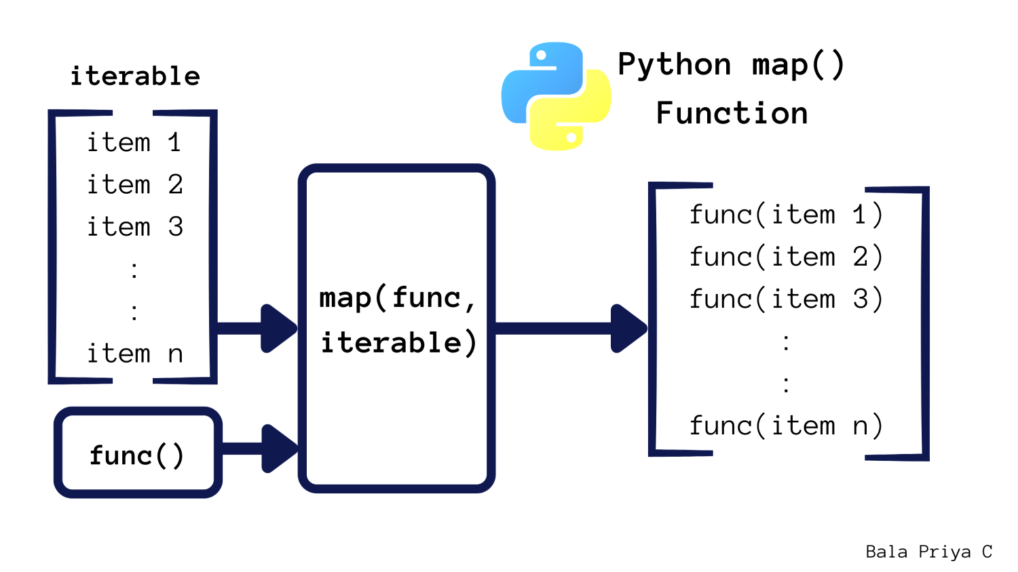
Map function
Definition: Applies a given function to all items in an iterable (like a list) and returns a map object (which is an iterator).
Syntax: map(function, iterable)
# Convert a list of integers to their squares
numbers = [1, 2, 3, 4]
squares = list(map(lambda x: x**2, numbers))
print(squares) # Output: [1, 4, 9, 16]

Slide 32
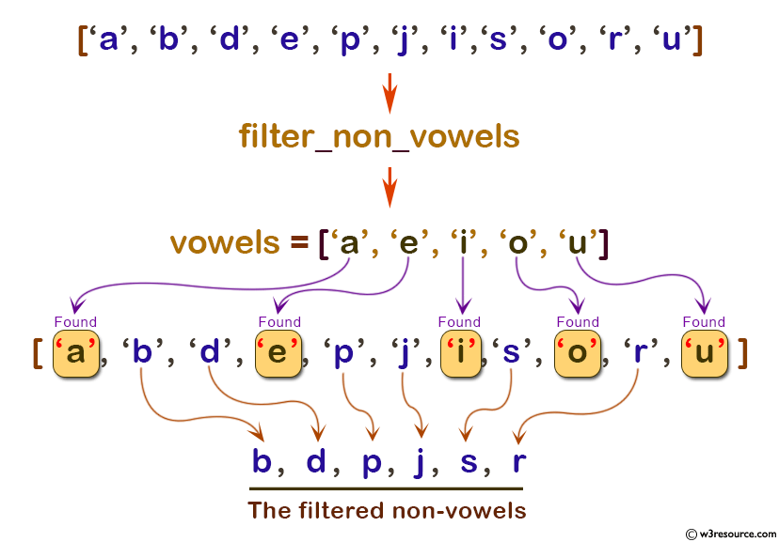
Filter function
Definition: Filters items in an iterable based on a function that returns either True or False.
Syntax: filter(function, iterable)
# Filter even numbers from a list
numbers = [1, 2, 3, 4, 5]
evens = list(filter(lambda x: x % 2 == 0, numbers))
print(evens) # Output: [2, 4]

Slide 33
Reduce function
Definition: Applies a function to the first two items of an iterable and continues applying it cumulatively to reduce the iterable to a single value.
Syntax: reduce(function, iterable)
Note: reduce() is not a built-in function and requires importing from functools.
from functools import reduce
# Sum of all numbers in a list
numbers = [1, 2, 3, 4]
total = reduce(lambda x, y: x + y, numbers)
print(total) # Output: 10

Slide 34
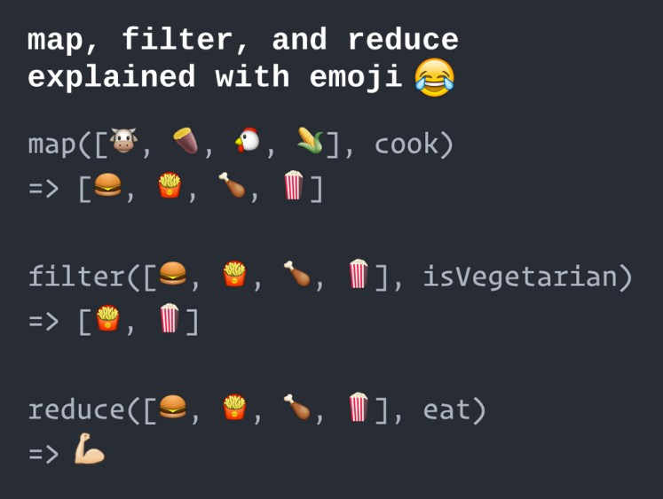
Map – Filter - Reduce

Slide 35
Practice
Exercise 1: Use `map()` to calculate the number of characters in each word in a sentence.
# Input: "Python is fun to learn“
#Output: [6, 2, 3, 2, 5].
Exercise 2: Use `filter()` to remove strings that contain numbers from a list of strings.
# Input: ['hello', 'world1', 'python', 'code123']
# Output: ['hello', 'python']
Exercise 3: Write a program using `reduce()` to find the largest number in a list without using the `max()` function.
# Input: [5, 1, 8, 2, 9, 3]
# Output: 9

Slide 36
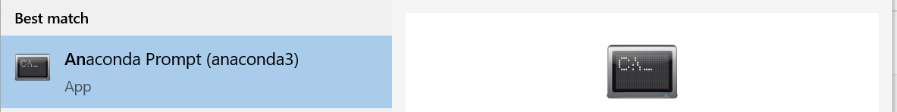
Modules
You can store your functions in a separate file called a module, and then import the functions you need into the file containing your main program.
This allows for cleaner program files. (Make sure your module is stored in the same directory as your main program.)
Setting:
Google seach: “How to fix Module Not Found Error in Jupyter Notebook (Anaconda)”

Slide 37
Modules
Storing a function in a module
Importing an entire module
Importing a specific function
Giving a module an alias
Importing all functions from a module Don't do this, but recognize it when you see it in others' code. It can result in naming conflicts, which can cause errors.

Slide 38
Practice
Exercise 1: Creating a Module and Using it in the Main Program
a) Create Module: Create a file named 'calculator.py' containing simple calculation functions such as addition, subtraction, multiplication, and division.
b) import calculator module and use calculation functions from this module.

