Slide 1
Introduction to NumPy
NUMPY

Slide 2
What is NumPy?
Fundamental package for numerical computing in Python.
Provides support for arrays, matrices, and a large collection of mathematical functions.

Slide 3
Why NumPy?
Benefits:
Efficient storage and manipulation of numerical data.
Powerful N-dimensional array object.
Broadcast capabilities.
…

Slide 4
Installing NumPy
Installation:
Using pip: pip install numpy
Using conda: conda install numpy

Slide 5
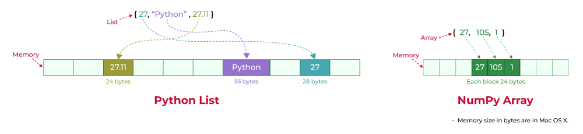
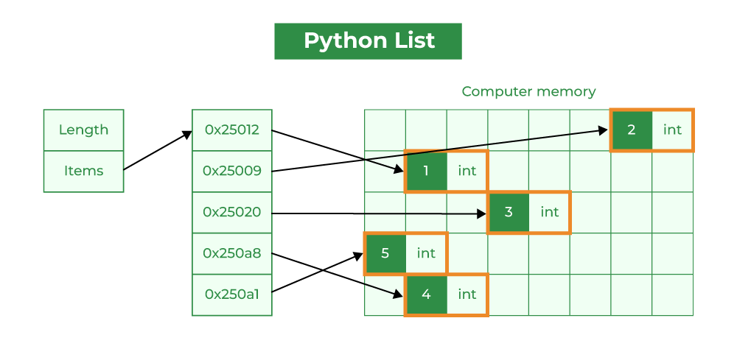
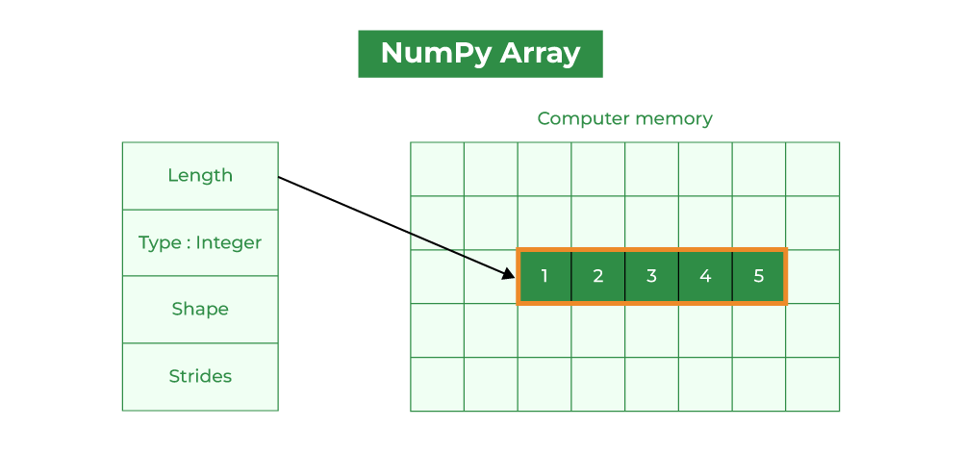
NumPy Array and List
Source: https://www.geeksforgeeks.org/python-lists-vs-numpy-arrays/

Slide 6
NumPy Arrays
Creating Arrays:
From lists: `np.array([1, 2, 3])`
From scratch: `np.zeros((3, 3))`, `np.ones((2, 2))`, `np.full((2, 2), 7)`, `np.eye(3)`
Using functions: `np.arange(0, 10, 2)`, `np.linspace(0, 1, 5)`
Note: Remember that unlike Python lists, NumPy is constrained to arrays that all contain the same type

Slide 7
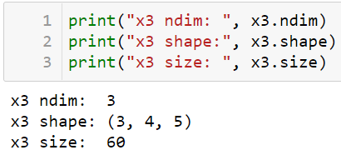
NumPy Array Attributes
Attributes:
`ndarray.ndim`
`ndarray.shape`
`ndarray.size`
`ndarray.dtype`
`ndarray.itemsize`
`ndarray.nbytes`
import numpy as np np.random.seed(0) # seed for reproducibility
x1 = np.random.randint(10, size=6) # One-dimensional array x2 = np.random.randint(10, size=(3, 4)) # Two-dimensional array x3 = np.random.randint(10, size=(3, 4, 5)) # Three-dimensional array
The number of dimensions
The size of each dimension
The total size of the array

Slide 8
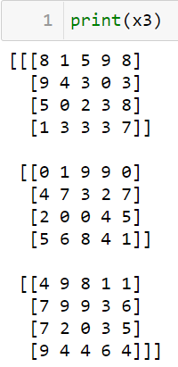
The Basic of NumPy Arrays
NumPy Array Attributes
import numpy as np np.random.seed(0) # seed for reproducibility
x1 = np.random.randint(10, size=6) # One-dimensional array x2 = np.random.randint(10, size=(3, 4)) # Two-dimensional array x3 = np.random.randint(10, size=(3, 4, 5)) # Three-dimensional array
The number of dimensions
The size of each dimension
The total size of the array

Slide 9
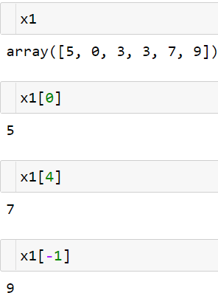
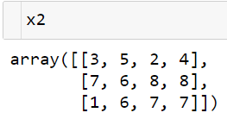
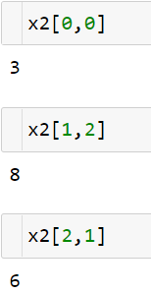
Array Indexing and Slicing
Array Indexing: Accessing Single Elements
One-dimensional array: the same as a list
Multidimensional array: using a comma-separated tuple of indices
0
1
2
3
0
1
2
x[row , column]
The first dimensional
The second dimensional

Slide 10
Array Indexing and Slicing
Array Slicing: Accessing Subarrays
x[start:stop:step]
One-dimensional subarrays
Multidimensional subarrays
Subarrays as no-copy views
One important—and extremely useful—thing to know about array slices is that they return views rather than copies of the array data. This is one area in which NumPy array slicing differs from Python list slicing: in lists, slices will be copies.
This default behavior is actually quite useful: it means that when we work with large datasets, we can access and process pieces of these datasets without the need to copy the underlying data buffer.

Slide 11
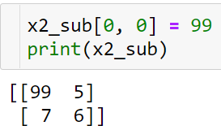
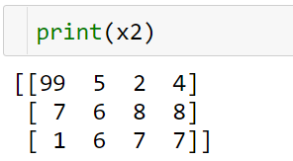
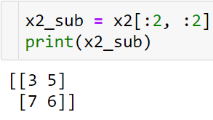
Subarrays with views
Subarrays as no-copy views
Now if we modify this subarray
Note:
One important—and extremely useful—thing to know about array slices is that they return views rather than copies of the array data. This is one area in which NumPy array slicing differs from Python list slicing: in lists, slices will be copies.
This default behavior is actually quite useful: it means that when we work with large datasets, we can access and process pieces of these datasets without the need to copy the underlying data buffer.

Slide 12
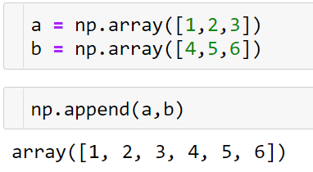
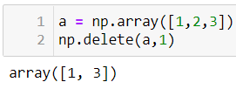
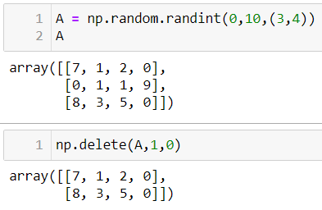
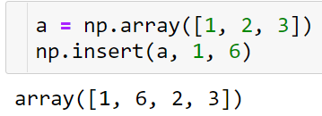
Adding – Removing
Removing
Adding
np.append(arr, values, axis = none)
Append values to the end of an array.
np.delete(arr, obj, axis = none)
Return a new array with sub-arrays along an axis deleted. For a one dimensional array, this returns those entries not returned by arr[obj].
np.insert(arr, obj, values, axis = none)
Insert values along the given axis before the given indices.
Obj: the index or indices

Slide 13
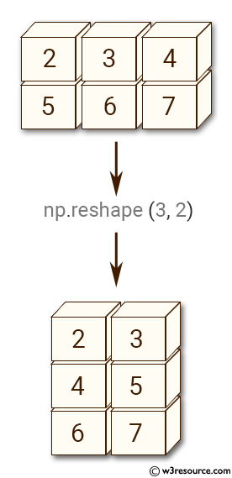
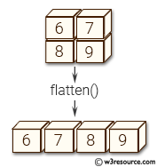
Array Reshaping
Reshaping arrays
array.reshape():
array.flatten():
Note:
The size of the initial array must match the size of the reshaped array.
The reshape method will use a no-copy view of the initial array.

Slide 14
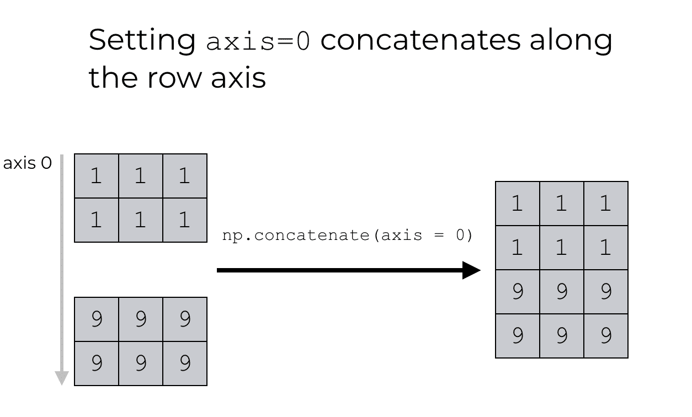
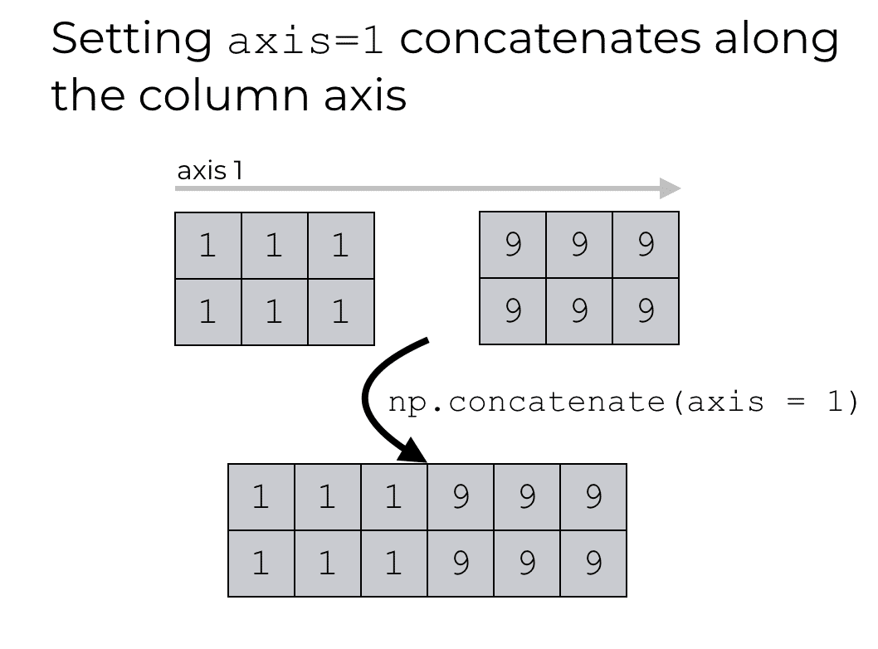
Array Concatenation and Splitting
Combining arrays:
np.concatenate([array1, array2], axis=0)

Slide 15
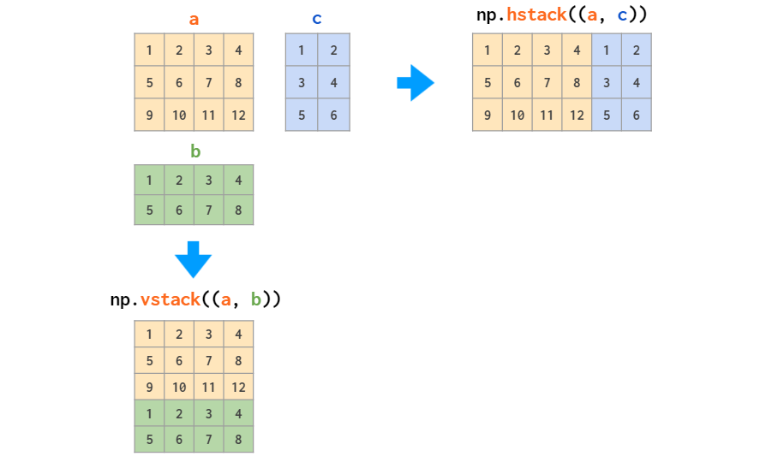
Array Concatenation and Splitting
Combining arrays:
`np.vstack([array1, array2])` , `np.hstack([array1, array2])`

Slide 16
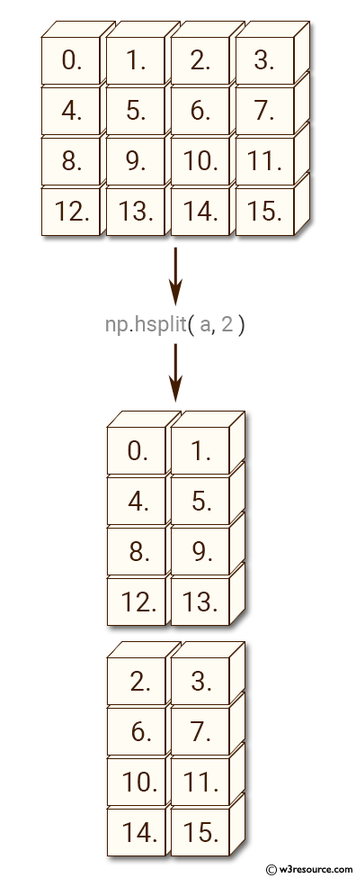
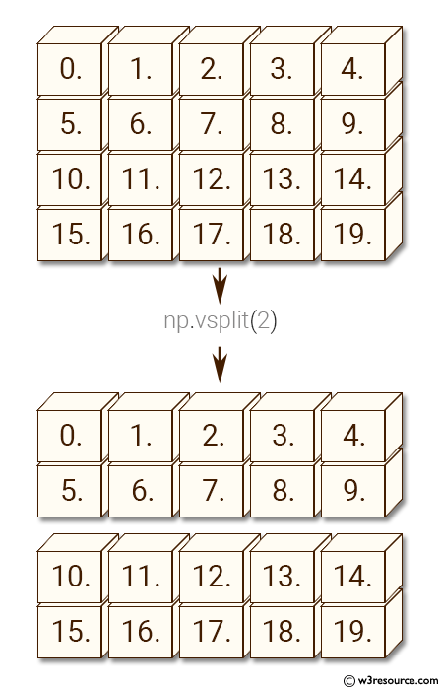
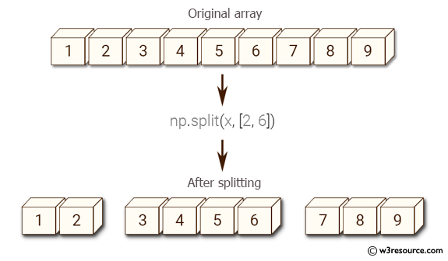
Array Concatenation and Splitting
Splitting arrays:
`np.split(array, index #or [indecies])` , `np.hsplit()`, `np.vsplit()`

Slide 17
Computation on NumPy Arrays
Universal Functions (ufuncs):
Element-wise operations: `np.add`, `np.subtract`, `np.multiply`, `np.divide`
Trigonometric functions: `np.sin`, `np.cos`, `np.tan`
Aggregation functions: `np.sum`, `np.min`, `np.max`, `np.mean`
import numpy as np
# Tạo một mảng NumPy lớn
arr = np.arange(1e6)
# Sử dụng hàm tổng hợp của NumPy
%timeit np.sum(arr)
# Sử dụng hàm tích hợp sẵn của Python
%timeit sum(arr)

Slide 18
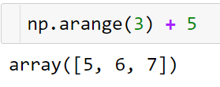

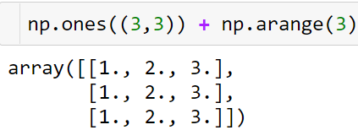
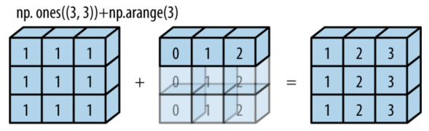
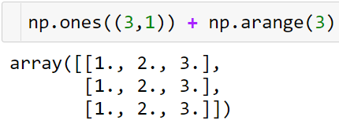
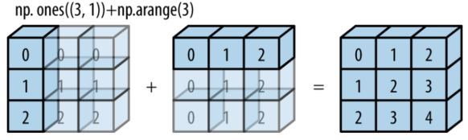
Broadcasting
Broadcasting

Slide 19
Broadcasting
Rules of Broadcasting
Rule 1: If the two arrays differ in their number of dimensions, the shape of the one with fewer dimensions is padded with ones on its leading (left) side.
Rule 2: If the shape of the two arrays does not match in any dimension, the array with shape equal to 1 in that dimension is stretched to match the other shape.
Rule 3: If in any dimension the sizes disagree and neither is equal to 1, an error is raised.

Slide 20
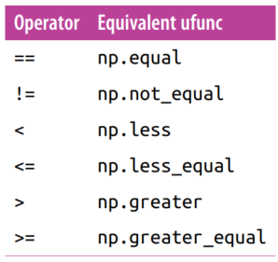
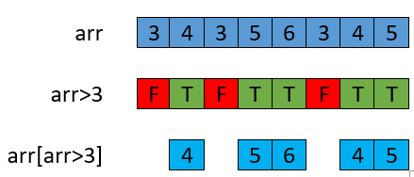
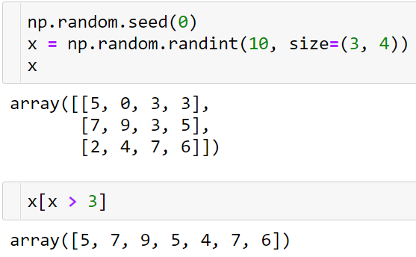
Comparisons, Masks, and Boolean Logic
Comparisons
Boolean masks

Slide 21
Practice 1
Exercises
Are there any values greater than 8?
Counts the frequency of 3 in x.
The sum of the elements is greater than 3 of x.
Product of odd numbers of x
The Sum of the prime numbers of x
How many values less than 6 in each row?

Slide 22
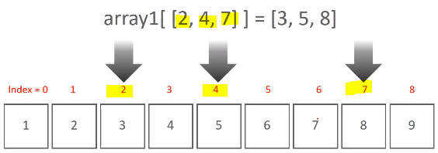
Fancy Indexing
Indexing with arrays of indices
Modifying values:
`array[[0, 1], [1, 2]] = 10`

Slide 23
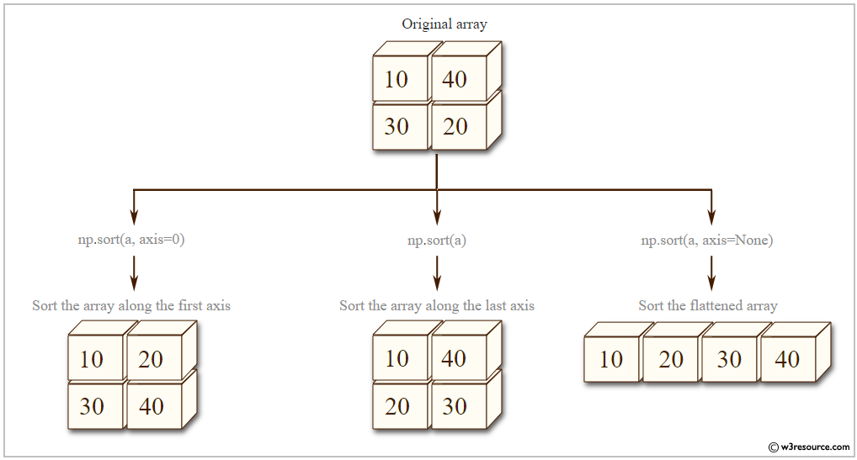
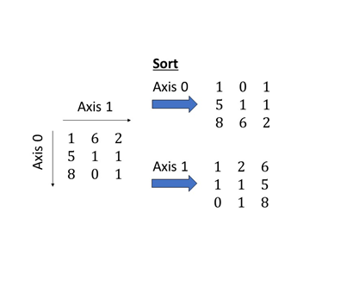
Sorting Arrays
np.sort(array, axis = ?)
Sorting Along an Axis

Slide 24
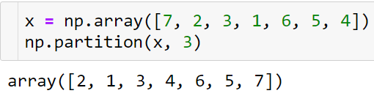
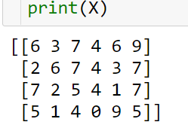
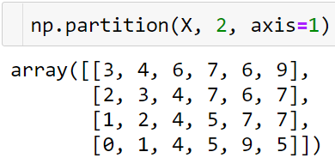
Sorting Arrays
Sorts: Partitioning
np.partition takes an array and a number K; the result is a new array with the smallest K values to the left of the partition, and the remaining values to the right, in arbitrary order.

Slide 25
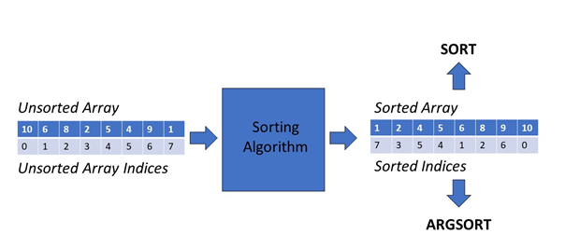
Sorting Arrays
np.argsort()
Returns the indices that would sort an array.

Slide 26
Practice 2
Exercises for Fancy Indexing, np.sort(), and np.argsort()
Fancy Indexing:
Create a 1D array [0-9], select elements at indices [1, 3, 5, 7, 9].
Create a 3x3 array [1-9], select diagonal elements [0,0], [1,1], [2,2].
Create a 1D array [10-100 step 10], select elements at even indices.
np.sort():
Create a 1D array of 10 random ints [0-100], sort it.
Create a 3x3 array of random ints [0-100], sort rows and columns.
Create a 1D array of random ints [0-100], sort in descending order.
np.argsort():
Create a 1D array of 10 random ints [0-100], get sorting indices.
Create a 3x3 array of random ints [0-100], get row sorting indices.
Create a 1D array of random ints [0-100], sort using indices in descending order.

