Slide 1
ITSS Software Development
EcoBike Application
Group 6

Slide 2
Team assignment
No. | Team member | Student ID | Assignment | Contribution
1 | Nguyen Thi Minh Chau | 20184238 | Team leader, guiding design and assigning tasks, refining documentation, backend implementation | 35%
2 | Tran Le Hai Duong | 20184248 | Preparing documentation, implementing backend | 35%
3 | Nguyen Thanh Long | 20184284 | Preparing documentation, implementing frontend | 30%

Slide 3
Content of presentation
1. Class diagrams
2. Design considerations
3. Design pattern
4. Demo

Slide 4
Interaction Diagram
One typical Interaction Diagram to represent the main activity of application

Slide 5
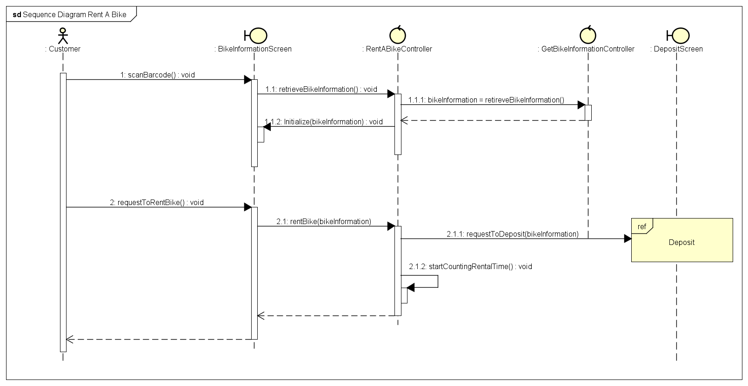

Slide 6
Class Diagram
How we design the architecture of application

Slide 7
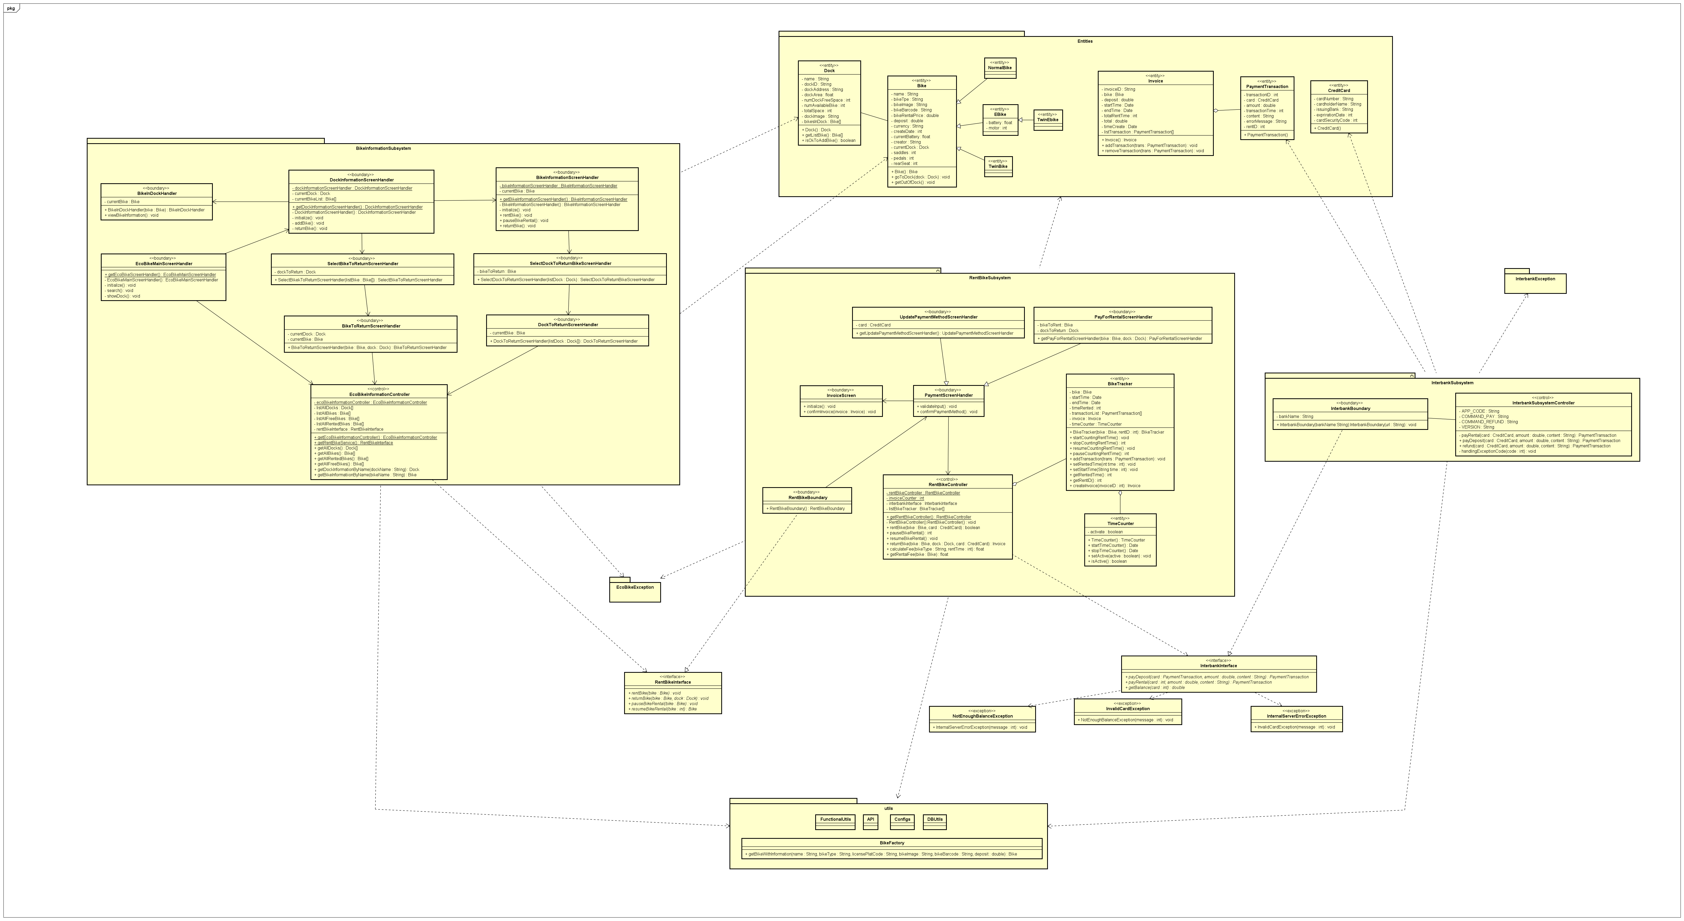

Slide 8
Design Considerations
Problems we met in our design and how we tackle them

Slide 9
Coupling
Content coupling: Use setter to access data; Access database via one special helper class
Control coupling: Eliminate if-else for controlling functions; separate codes into different functions or classes for specific purposes
Stamp coupling: A few functions receive whole object, but use only some attributes of them

Slide 10
Cohesion
Sequential cohesion: Mainly; output of this element is input of another element (E.g. Controllers vs Boundaries)
Logical cohesion: There are some specific classes used for reading information (E.g. Class for reading database)

Slide 11
SOLID
Single responsibility: some functions with different purposes are put in the same class, which make the design not good
Open-closed: Use interfaces and abstract classes
Liskov substitution: all types of Bikes (Normal bike, Ebike) can replace Bike type
Interface segeration: No specific modules
Dependency inversion: Communicate between subsystem by interfaces

Slide 12
Design Patterns
Software design patterns we have applied in the application

Slide 13
Design pattern used
Singleton: Use one controller of each type for controlling activities of the application
Observer: Bike changes will be notified to its corresponding Dock, and Dock changes will be announced to screen handler for display, no need to frequently query the database
Façade: use interfaces for communication with dependency injection
Factory: Use one factory class to create different types of Bike

Slide 14
Demo
How our application functions

Slide 15
Thanh you!

