Slide 1
ITSS Software Development
EcoBike Application
Group 6

Slide 2
Team assignment
No. | Team member | Student ID | Assignment | Contribution
1 | Nguyen Thi Minh Chau | 20184238 | Team leader, guiding design and assigning tasks, refining documentation, backend implementation | 35%
2 | Tran Le Hai Duong |  | Preparing documentation, implementing backend | 35%
3 | Nguyen Thanh Long |  | Preparing documentation, implementing frontend | 30%

Slide 3
Content of presentation
1. Interaction Diagram
2. Class diagrams
3. Design considerations
4. Design pattern

Slide 4
Interaction Diagram
One typical Interaction Diagram to represent the main activity of application

Slide 5
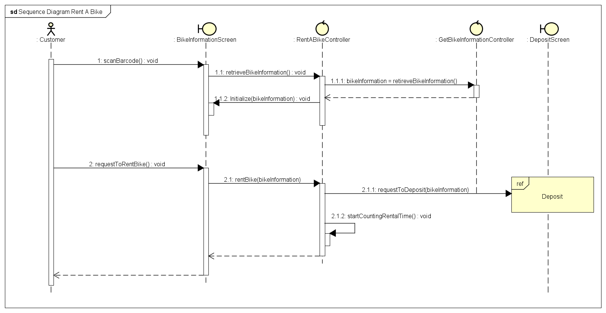
Notes:
Need to recheck this

Slide 6
Class Diagram
How we design the architecture of application

Slide 7
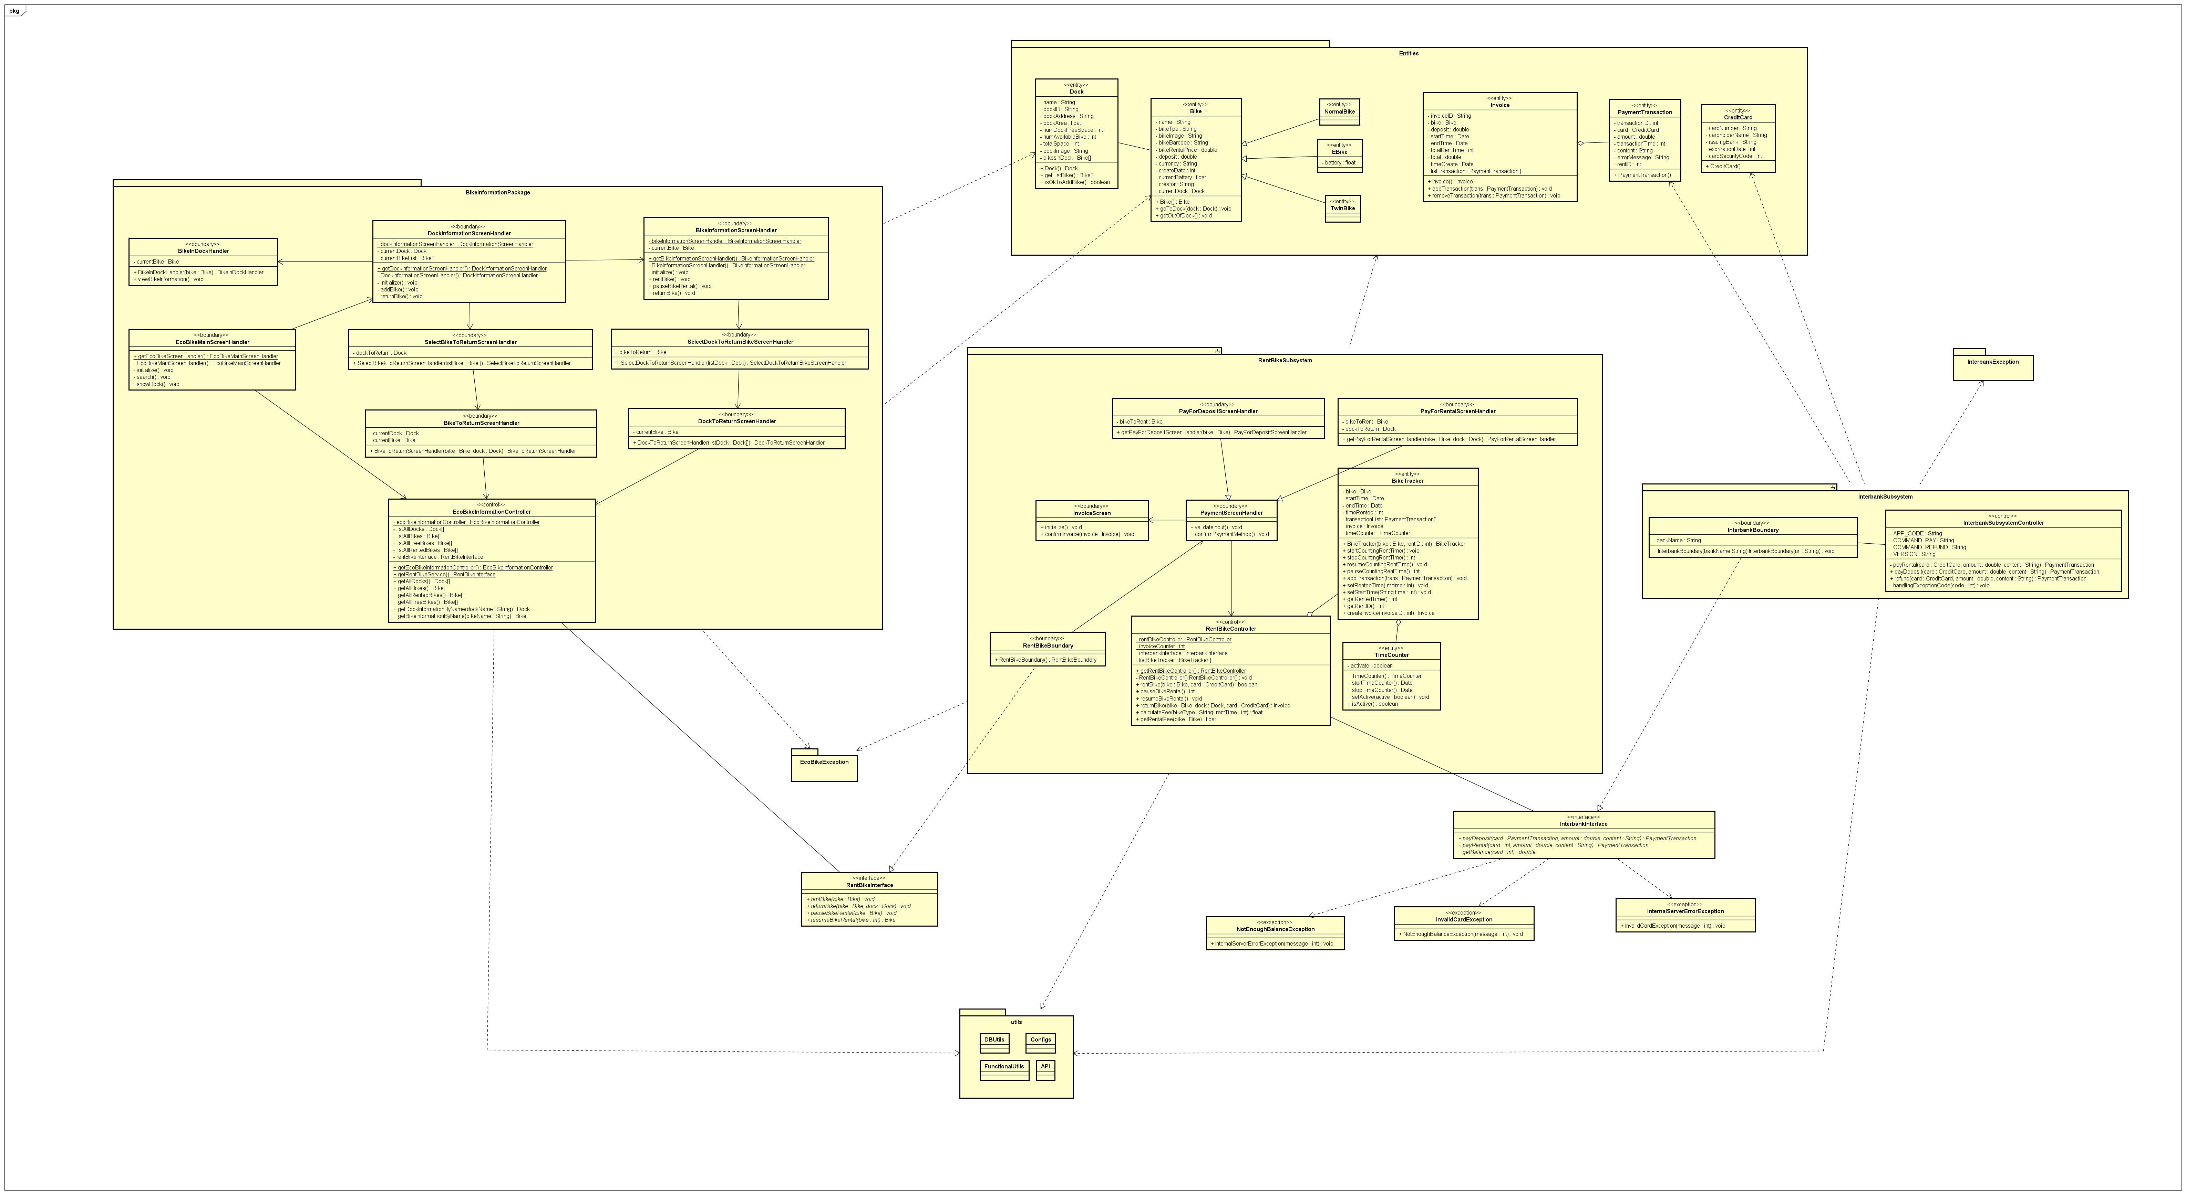

Slide 8
Design Considerations
Problems we met in our design and how we tackle them

Slide 9
Coupling
Content coupling: Use setter to access data; Access database via one special helper class
Control coupling: Eliminate if-else for controlling functions; separate codes into different functions or classes for specific purposes; using interfaces, abstract classes and design patterns
Stamp coupling: A few functions receive whole object, but use only some attributes of them

Slide 10
Cohesion
Sequential cohesion: Mainly; output of this element is input of another element (E.g. Controllers vs Boundaries)
Logical cohesion: There are some specific classes used for reading information (E.g. Class for reading database)

Slide 11
Design Patterns
Software design patterns we have applied in the application

Slide 12
Design pattern used
Singleton: Use one controller of each type for controlling activities of the application; UI for easily maintain and updating
Observer pattern: for Dock and Bike; to update states of docks and bikes automatically without having the query DB frequently
Factory pattern: Create Bike instances based on input

Slide 13
Thanh you!

