Slide 1
NETWORK PROGRAMMING
CARO GAME
GROUP 3
Nguyễn Thị Minh Châu
20184238
Trần Thái Dương
20176732
Nguyễn Mạnh Phúc
20176845

Slide 2
CONTENTS
Introduction
Game Concepts
Main Features
Architecture
Application Protocol Design
GUI design

Slide 3
INTRODUCTION
Caro (in Vietnamese), also called Tic Tac Toe, or Gomoku is an abstract strategy board game. It is traditionally played with Go pieces (black and white stones) on a Go board. It can be played using the 15×15 board or the 19×19 board. Because pieces are typically not moved or removed from the board, this game may also be played as a paper-and-pencil game.
Reference: Wikipedia

Slide 4
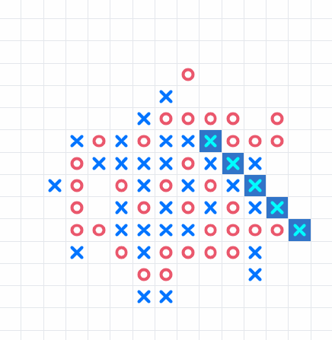
GAME CONCEPTS
Caro is played on a 15x15 board. Players alternate turns placing a move on an empty intersection. X is first by default. Then O.
The winner is the first player to form an unbroken chain of five moves horizontally, vertically, or diagonally. Placing so that a line of more than five same moves is created still results in a win

Slide 5
MAIN FEATURES
GAMEPLAY: CLIENT - SERVER - CLIENT MODEL
Player places a move. Client sends a command with coordinate info to server. Server forwards it to the opponent.
The game ends when one wins , or both accepts a draw, or the board is fully filled.
The client decides if the player wins, sends the message to server, and the server broadcasts it to the other opponent => The server plays the role of a 3rd party.
REGISTER, LOGIN AND RANKING SYSTEM
OTHER FEATURES
Register: Account with username, and password to record his result (stored in database)
Login: Player enters username and password for server to authenticate. Server returns success or fail login message
Playing as a guest, a temporary username is assigned and result is not recorded for future plays
Ranking: Win – 10 pts | Draw – 0 pts | Loss – 5 pts
Matching: Player is randomly placed into an available room, the system will find a match based on rank
Chat: client - server - client model
The server plays as a forwarder when receiving message from one player and send it to the target player.
Players can offer a draw
or resign the game

Slide 6
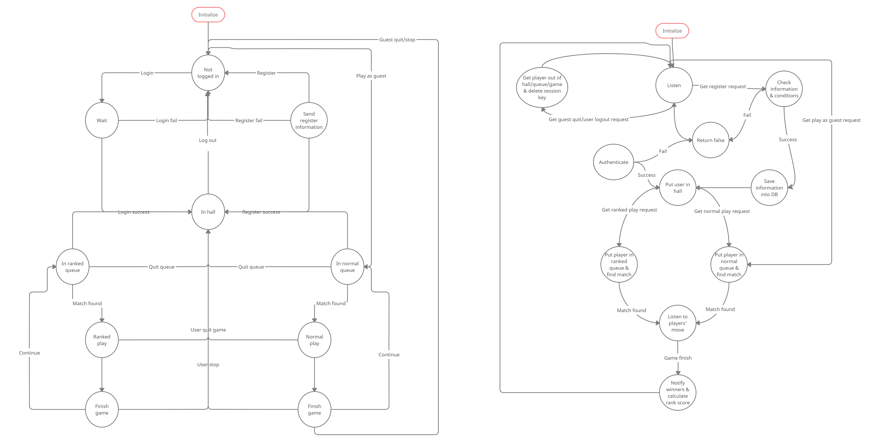
State machine – Main
Client
Server

Slide 7
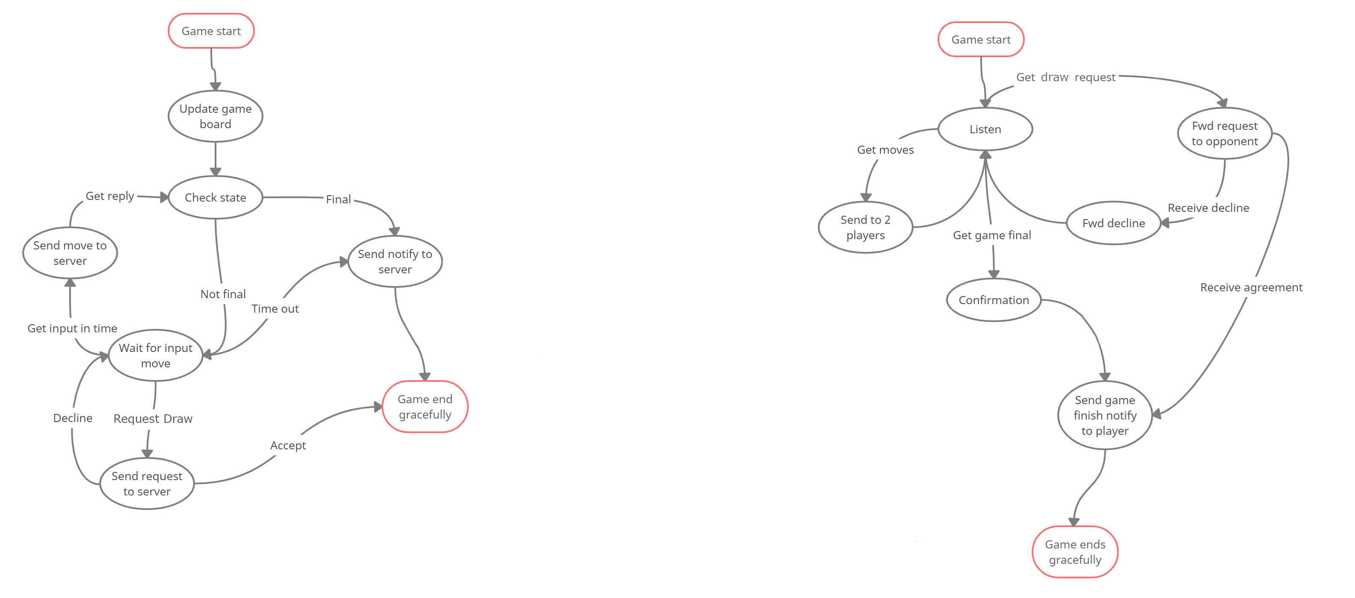
State machine – In-game
Client
Server

Slide 8
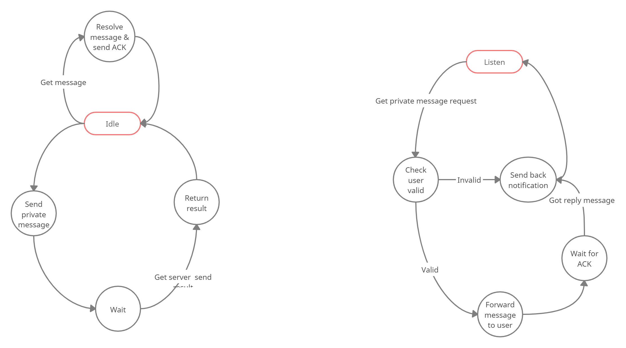
State machine – Chat
Client
Server

Slide 9
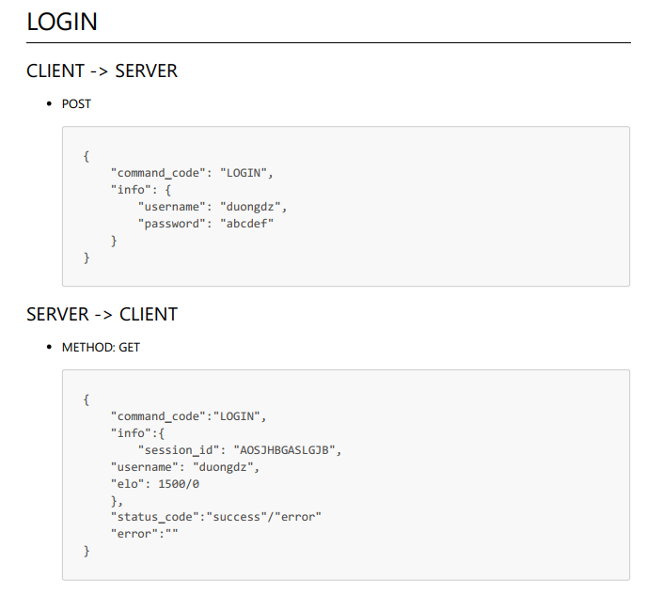
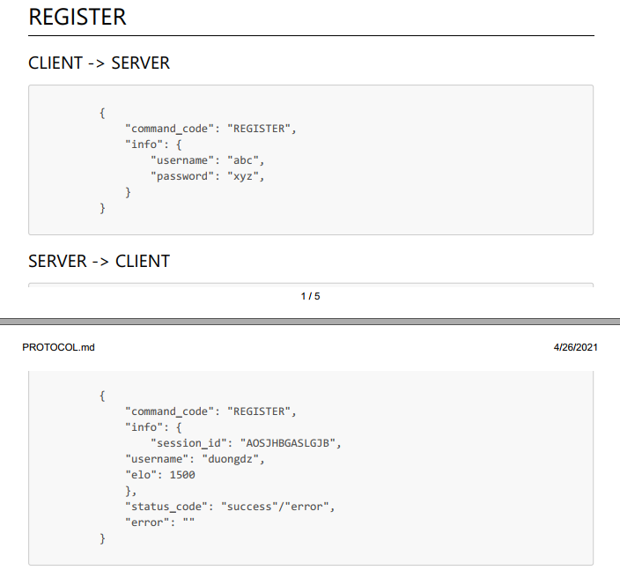
Application Protocol Design

Slide 10
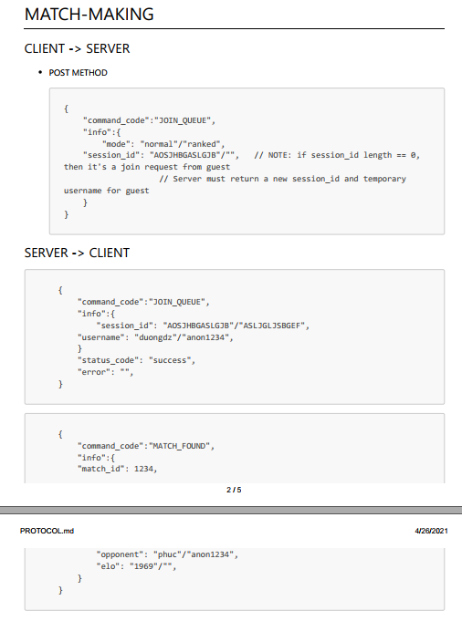
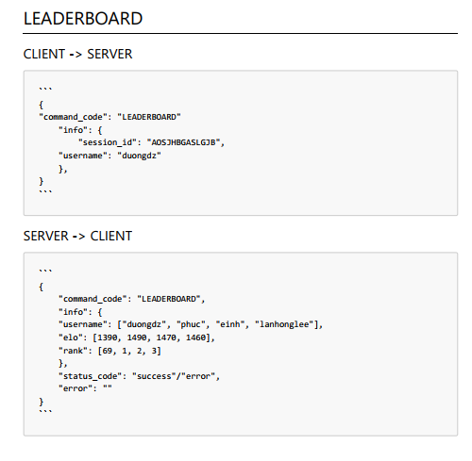
Application Protocol Design

Slide 11
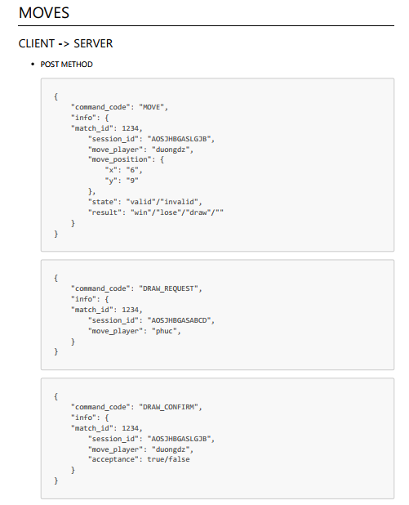
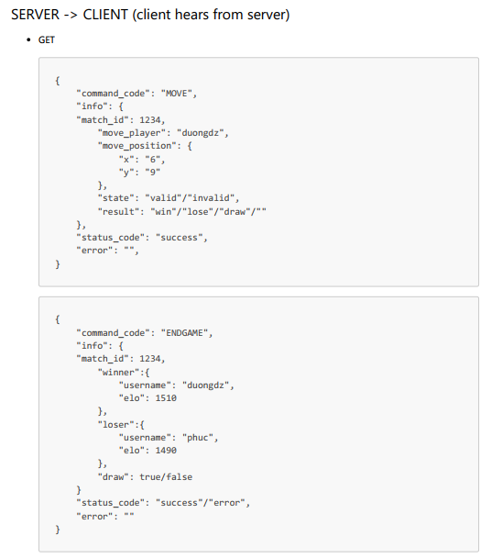

Slide 12
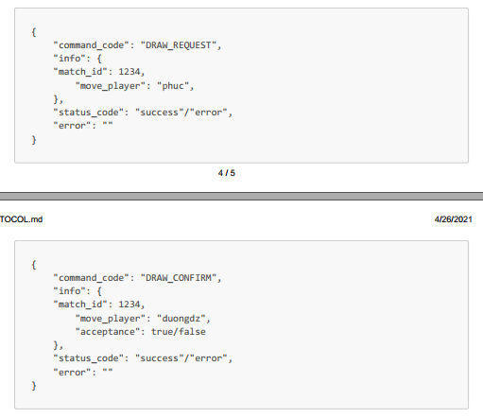
Application Protocol Design
Moves (cont.)

Slide 13
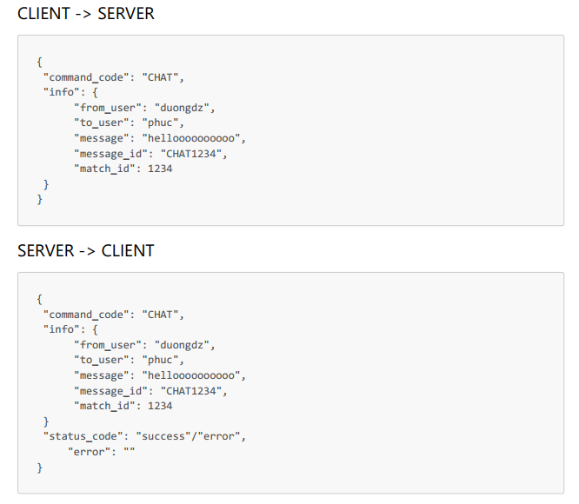
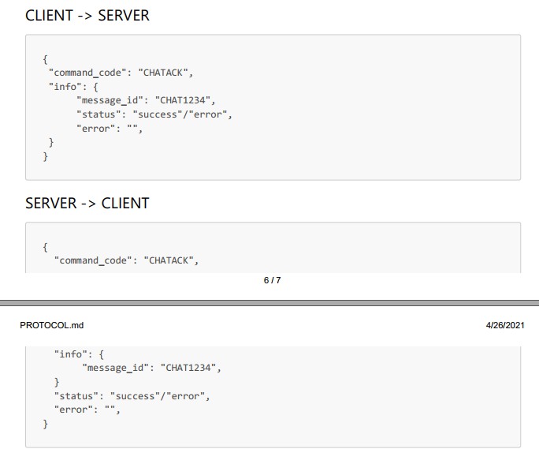
Application Protocol Design
Chat

Slide 14
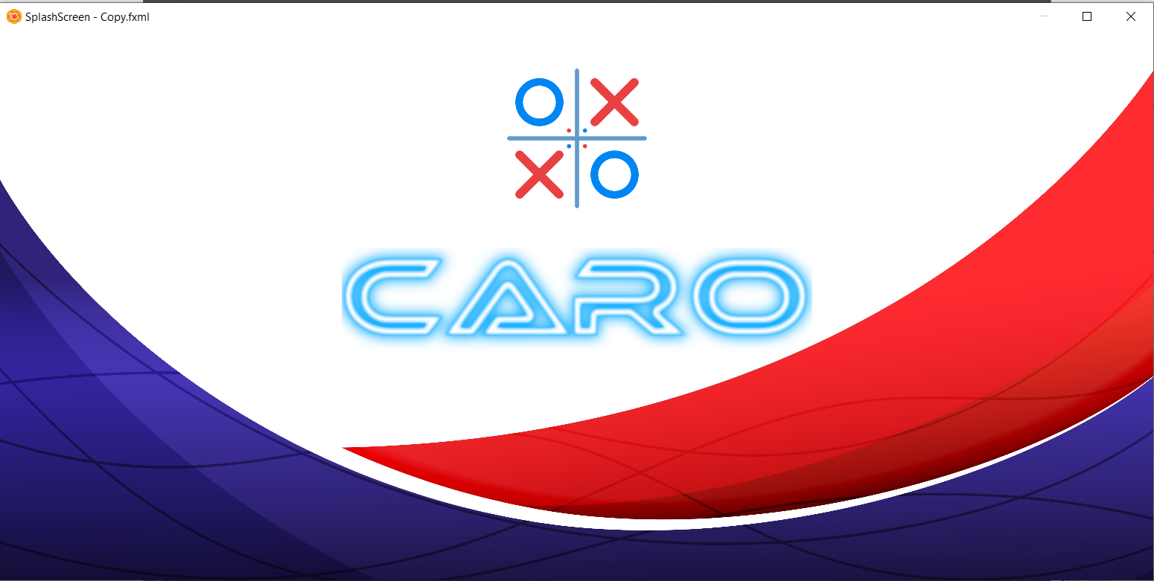
GUI Design

Slide 15
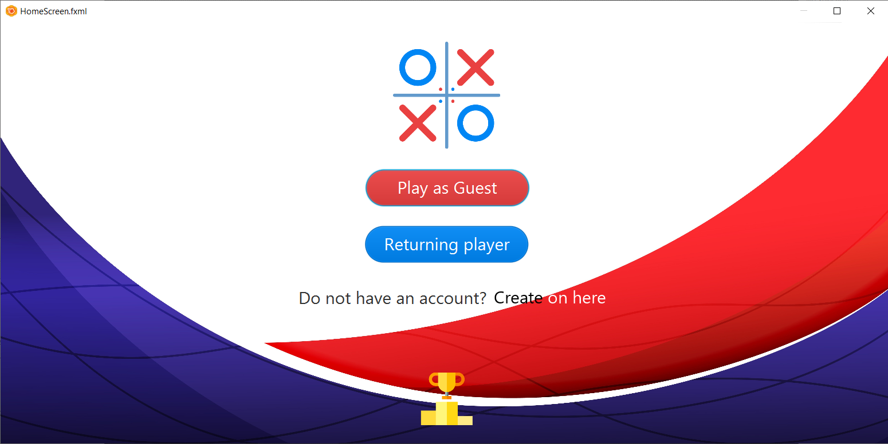
GUI Design (cont.)

Slide 16
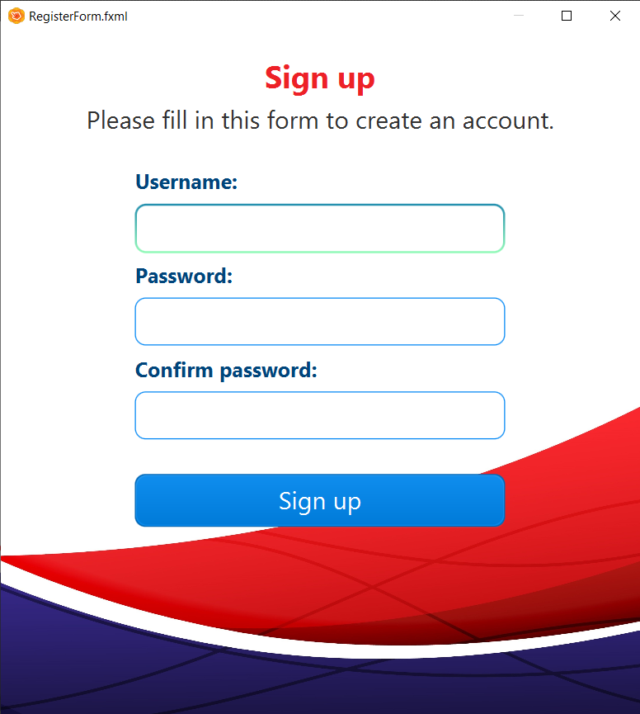
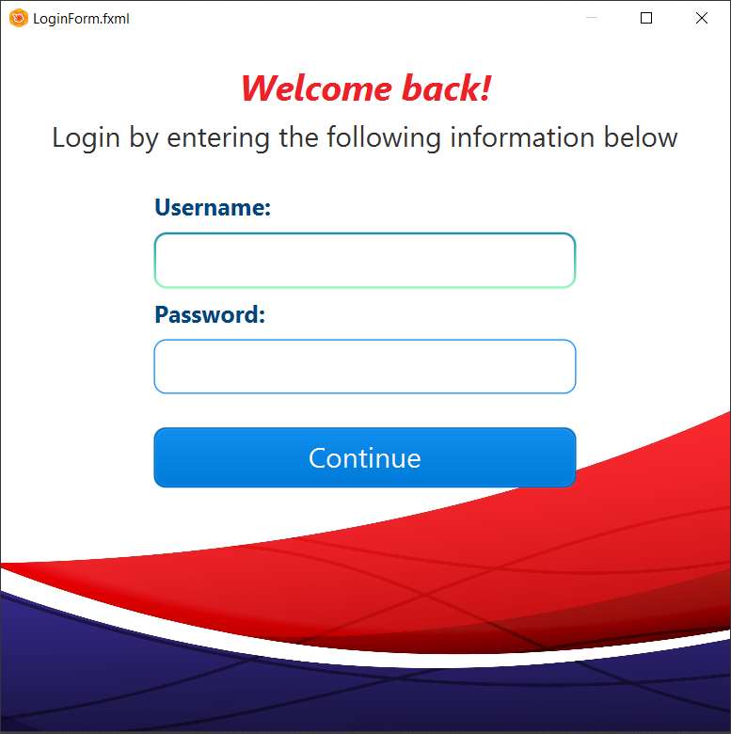
GUI Design (cont.)

Slide 17
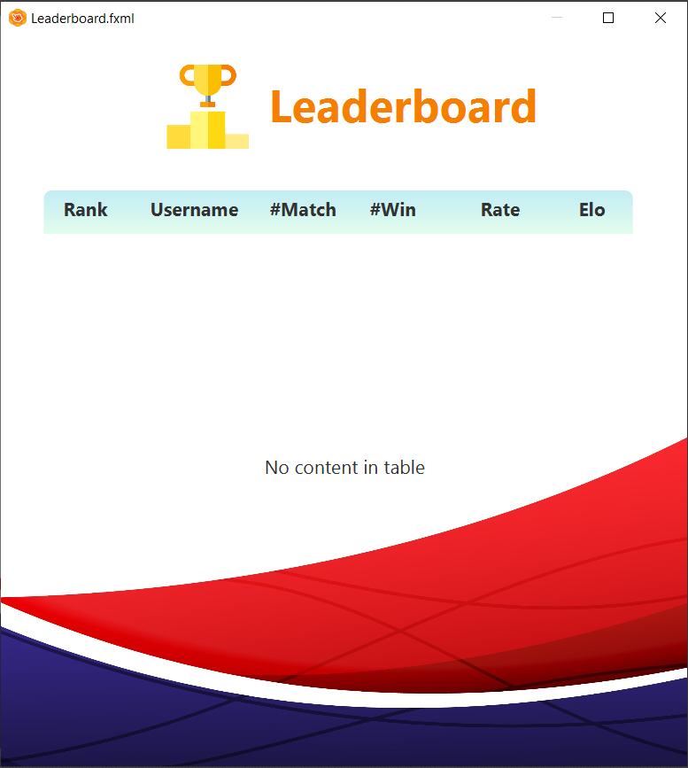
GUI Design (cont.)

Slide 18
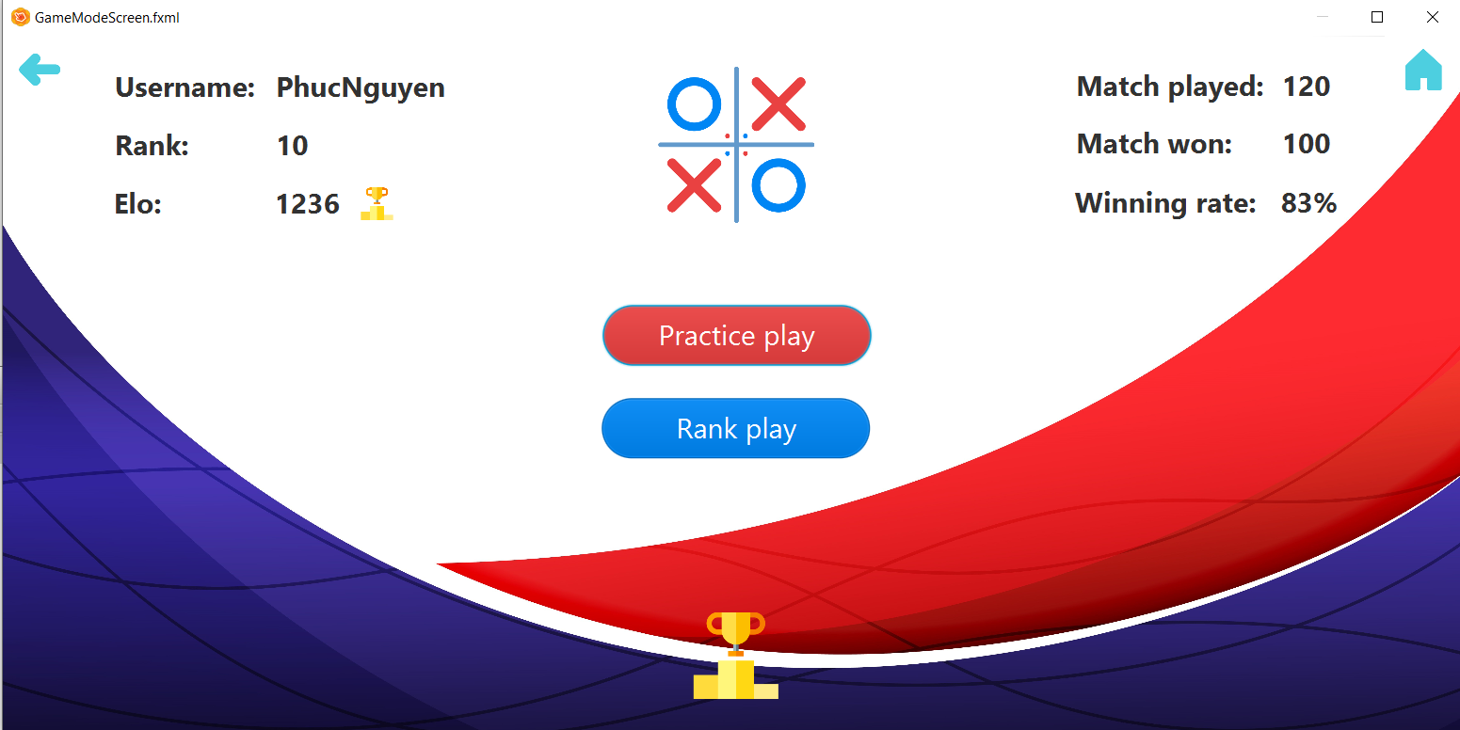
GUI Design (cont.)

Slide 19
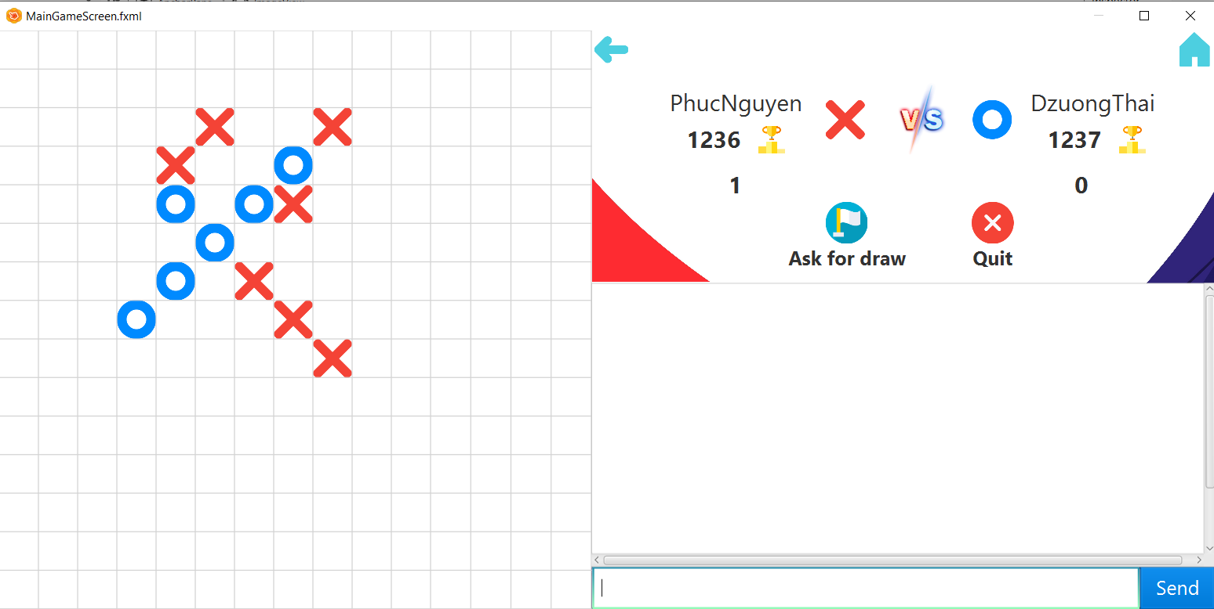
GUI Design (cont.)

Slide 20
THANK YOU FOR YOUR ATTENTION !
Any questions ?
Please keep this slide for attribution

