Slide 1
NETWORK PROGRAMMING
CARO GAME
GROUP 3
Nguyễn Thị Minh Châu
20184238
Trần Thái Dương
20176732
Nguyễn Mạnh Phúc
20176845

Slide 2
CONTENTS
Application Model
Database & Libraries
Structure of the project – Functions and methods for processing data
Code implementation for network
Integration of network programming to the application
Demo

Slide 3
APPLICATION MODEL
The application uses asynchronous socket in order to create connection and communicate between clients and server.
In this model, client or server makes the non-blocking call and start other background tasks instead of waiting for the request to be completed
When the operation is done, a completion callback is generated to finish the I/O operation.
Asynchronous socket communication brings several advantages:
Allow multiple connection at the same time with good quality
Save resources and avoid threading problems

Slide 4
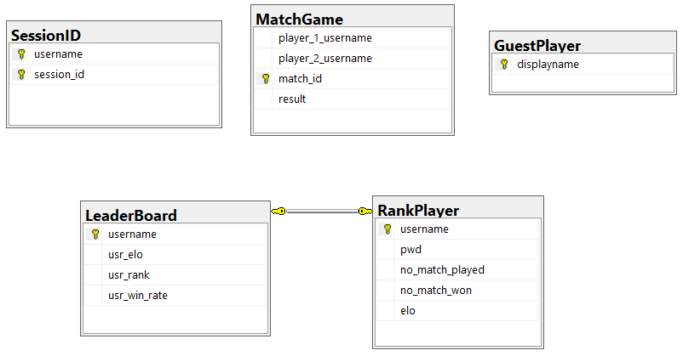
DATABASE & LIBRARIES
SQLite to save database
In order to create message, library org.json is used

Slide 5
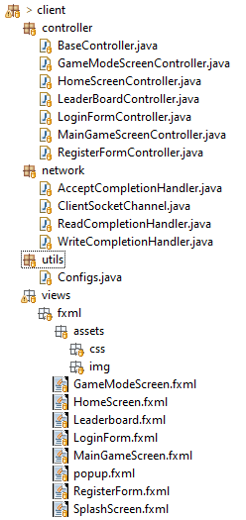
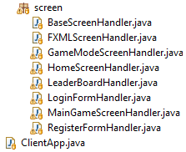
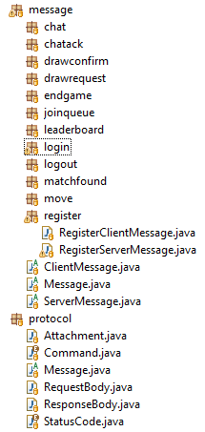
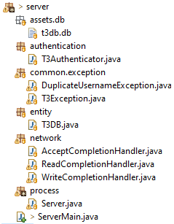

STRUCTURE OF THE PROJECT
Client side
Protocol & Message
Server side
Managing players

Slide 6

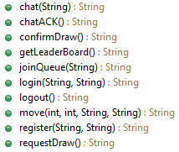

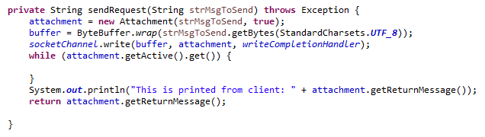
CODE IMPLEMENTATION FOR NETWORK
Client side
Client side

Slide 7
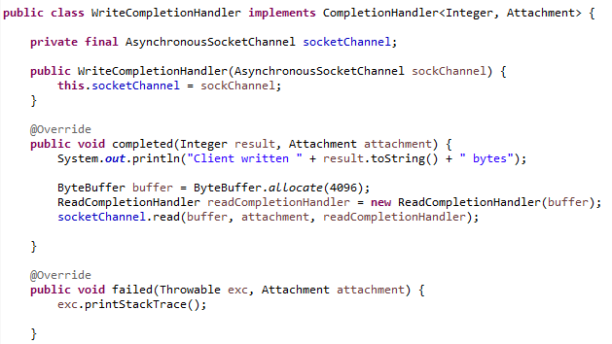
CODE IMPLEMENTATION FOR NETWORK
Client side
(cont.)

Slide 8
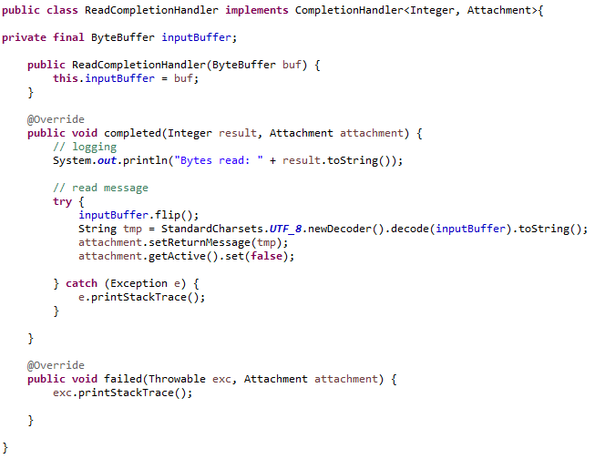
CODE IMPLEMENTATION FOR NETWORK
Client side
(cont.)

Slide 9
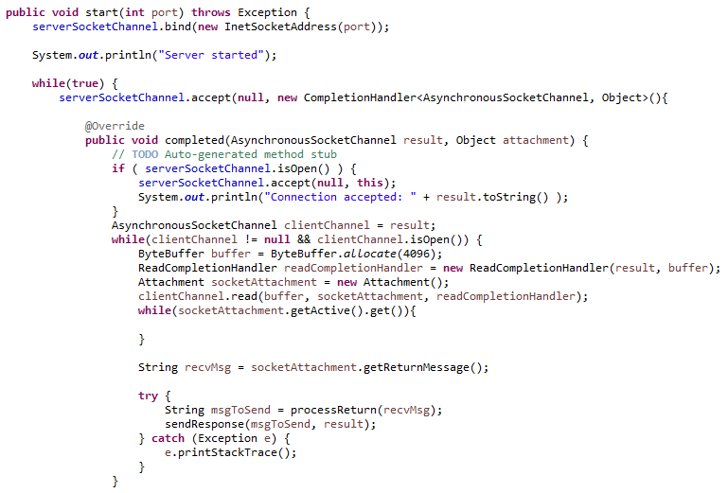
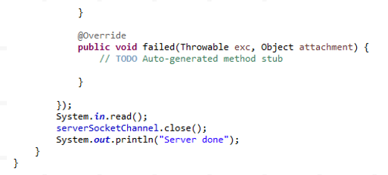
CODE IMPLEMENTATION FOR NETWORK
Server side

Slide 10
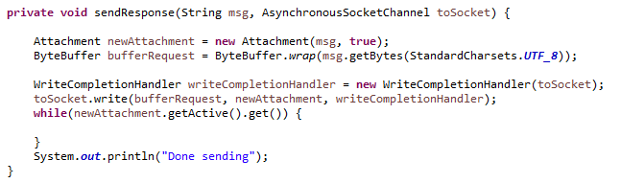
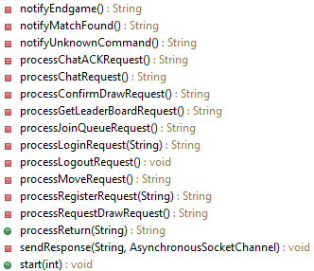
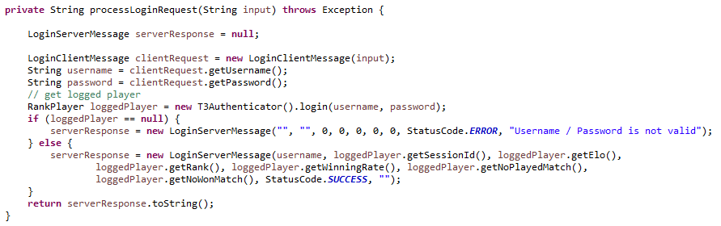
CODE IMPLEMENTATION FOR NETWORK
Server side (cont.)

Slide 11
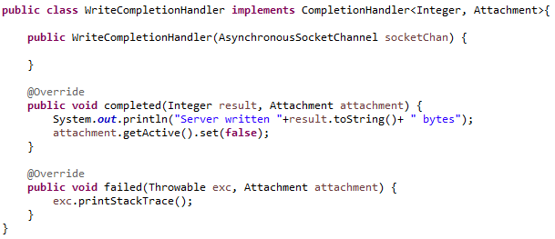
CODE IMPLEMENTATION FOR NETWORK
Server side (cont.)

Slide 12
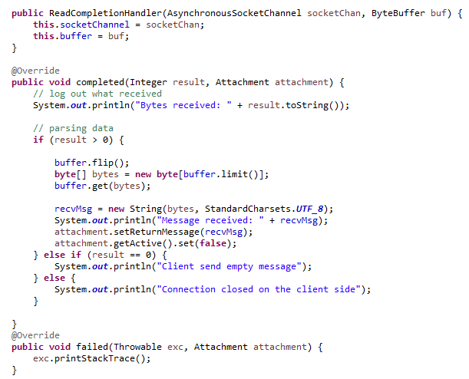
CODE IMPLEMENTATION FOR NETWORK
Server side (cont.)

Slide 13
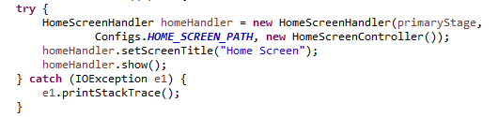
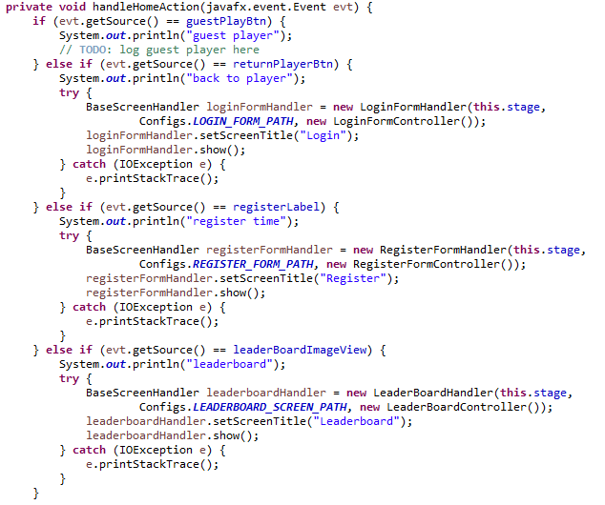
INTEGRATION OF NETWORK PROGRAMMING TO THE APPLICATION

Slide 14
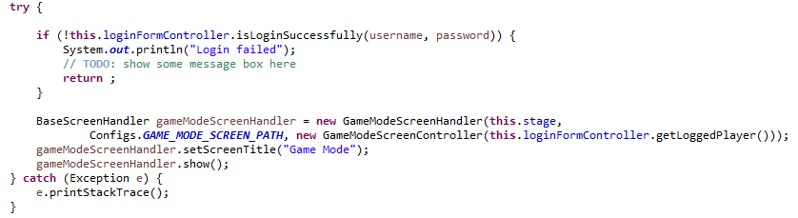
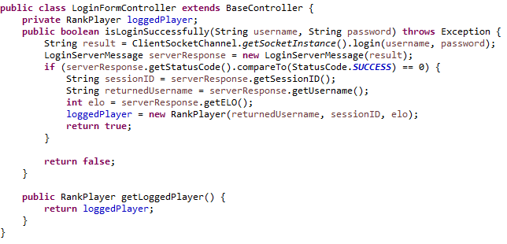
INTEGRATION OF NETWORK PROGRAMMING TO THE APPLICATION
(cont.)

Slide 15
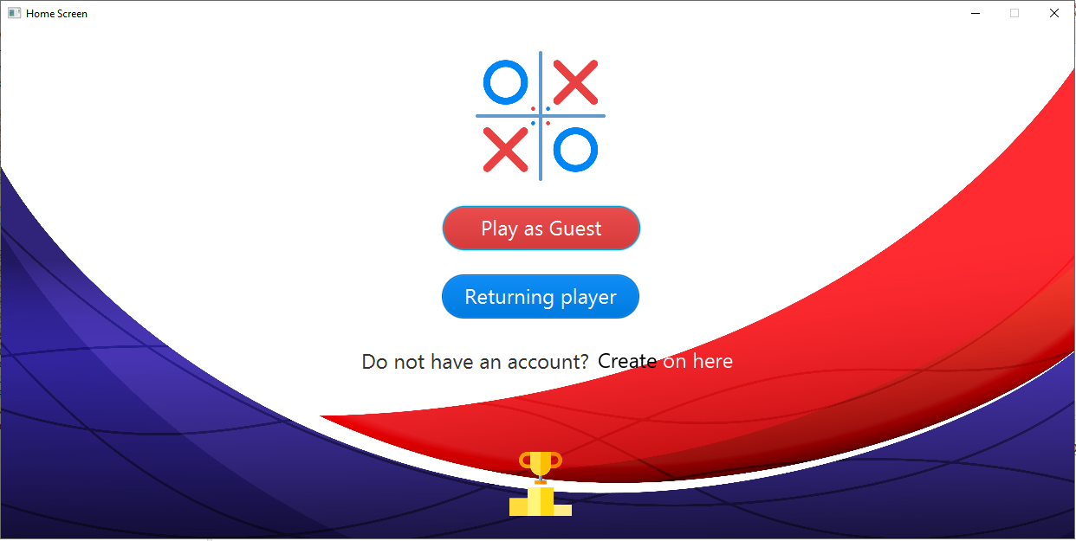
DEMO

Slide 16
THANK YOU FOR YOUR ATTENTION !
Any questions ?
Please keep this slide for attribution

