Slide 1
NETWORK PROGRAMMING
CARO GAME
GROUP 3
Nguyễn Thị Minh Châu
20184238
Trần Thái Dương
20176732
Nguyễn Mạnh Phúc
20176845

Slide 2
CONTENTS
Introduction
Game Concepts
Main Features
Architecture
Application Protocol Design
GUI design

Slide 3
INTRODUCTION
Caro (in Vietnamese), also called Tic Tac Toe, or Gomoku is an abstract strategy board game. It is traditionally played with Go pieces (black and white stones) on a Go board. It can be played using the 15×15 board or the 19×19 board. Because pieces are typically not moved or removed from the board, this game may also be played as a paper-and-pencil game.
Reference: Wikipedia

Slide 4
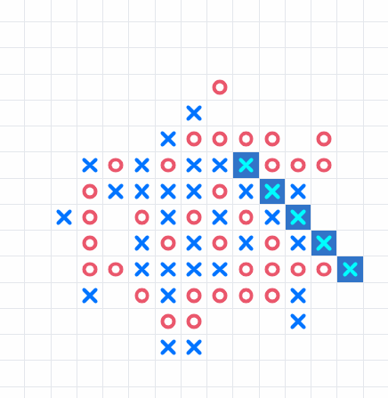
GAME CONCEPTS
Caro is played on a 15x15 board. Players alternate turns placing a move on an empty intersection. X is first by default. Then O.
The winner is the first player to form an unbroken chain of five moves horizontally, vertically, or diagonally. Placing so that a line of more than five same moves is created still results in a win

Slide 5
MAIN FEATURES
GAMEPLAY: CLIENT - SERVER - CLIENT MODEL
Player places a move. Client sends a command with coordinate info to server. Server forwards it to the opponent.
The game ends when one wins , or both accepts a draw, or the board is fully filled.
The client decides if the player wins, sends the message to server, and the server broadcasts it to the other opponent => The server plays the role of a 3rd party.
REGISTER, LOGIN AND RANKING SYSTEM
OTHER FEATURES
Register: Account with username, and password to record his result (stored in database)
Login: Player enters username and password for server to authenticate. Server returns success or fail login message
Playing as a guest, a temporary username is assigned and result is not recorded for future plays
Ranking: Win – 10 pts | Draw – 0 pts | Loss – 5 pts
Matching: Player is randomly placed into an available room, the system will find a match based on rank
Chat: client - server - client model
The server plays as a forwarder when receiving message from one player and send it to the target player.
Players can offer a draw
or resign the game

Slide 6
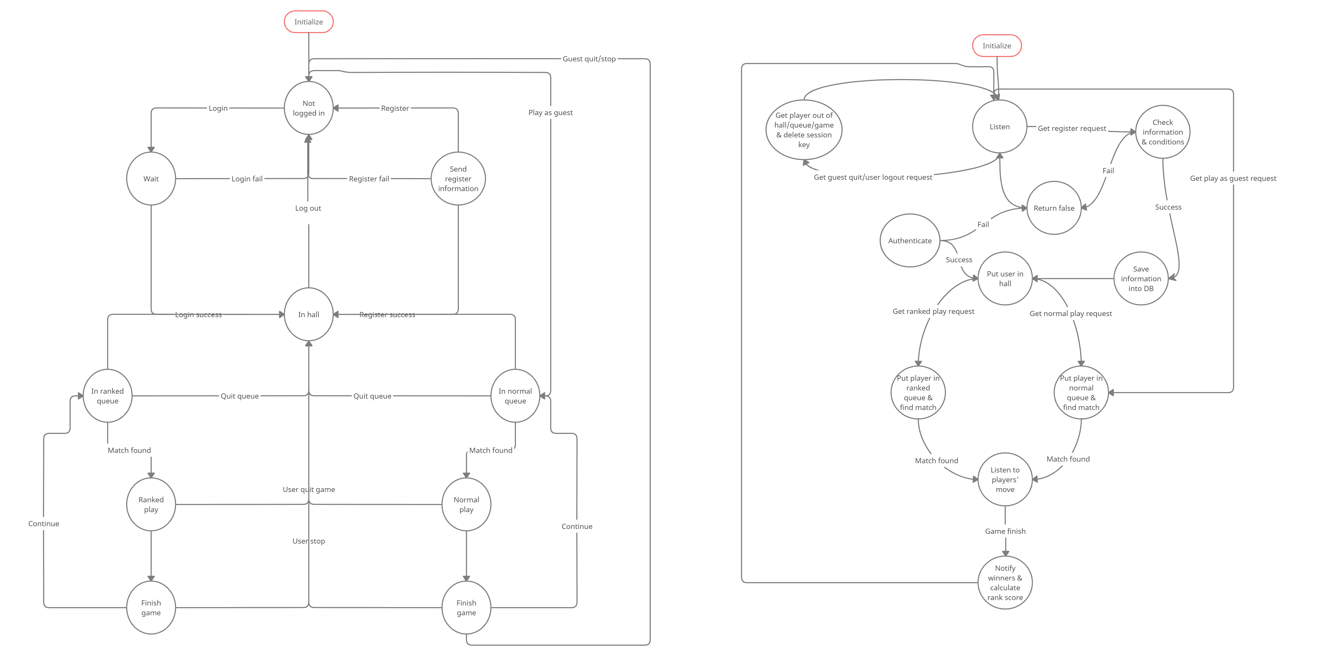
Architecture - Main
Client
Server

Slide 7
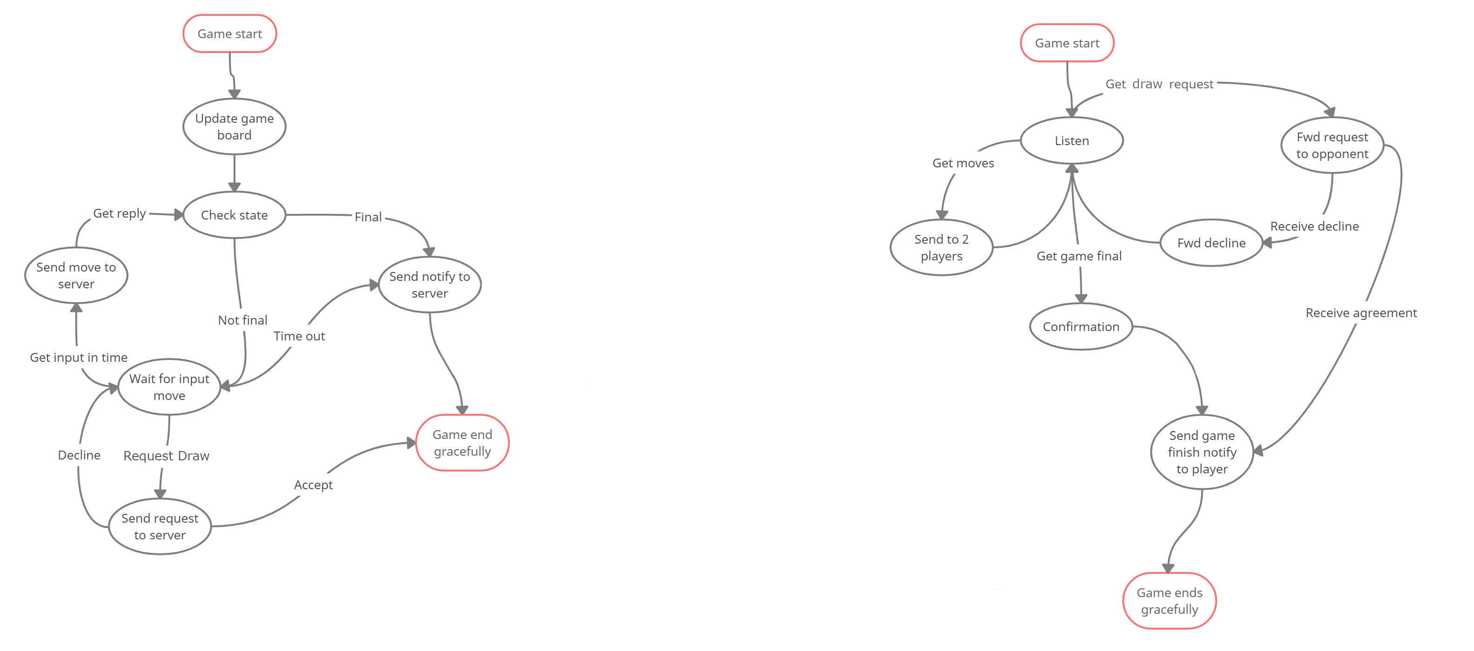
Architecture – In-game
Client
Server

Slide 8
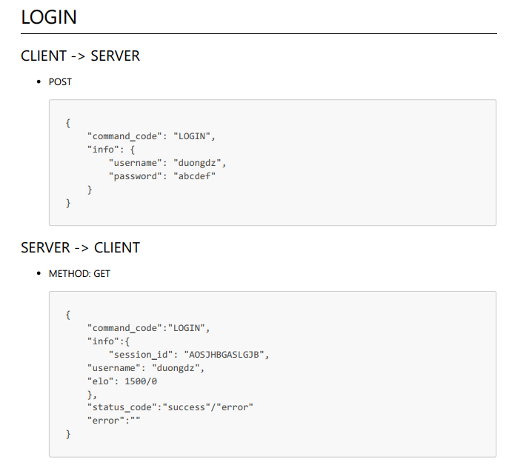
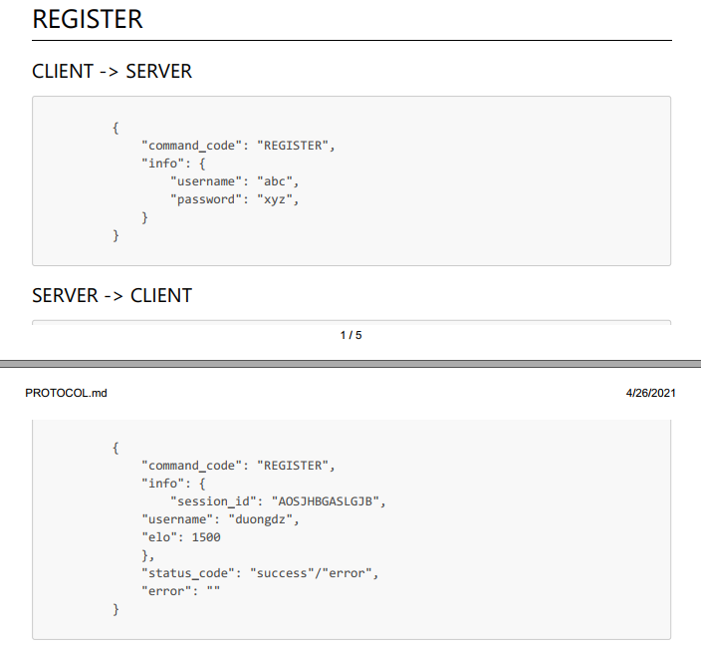
Application Protocol Design

Slide 9
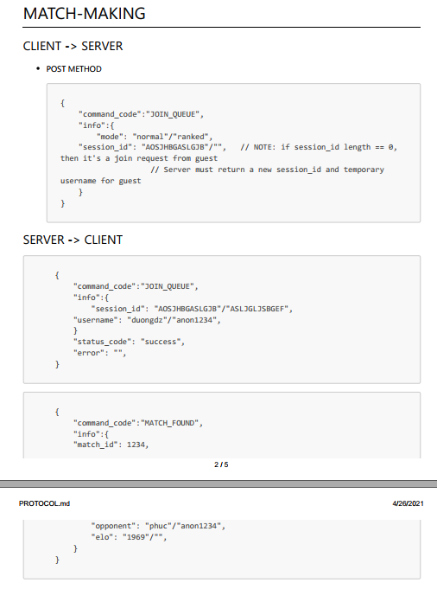
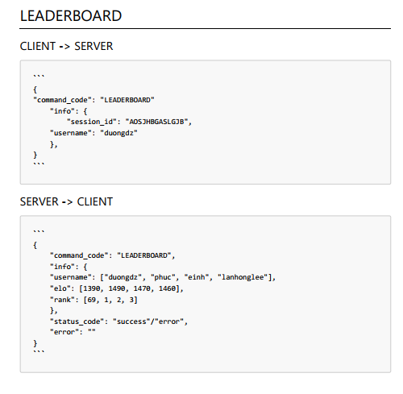
Application Protocol Design

Slide 10
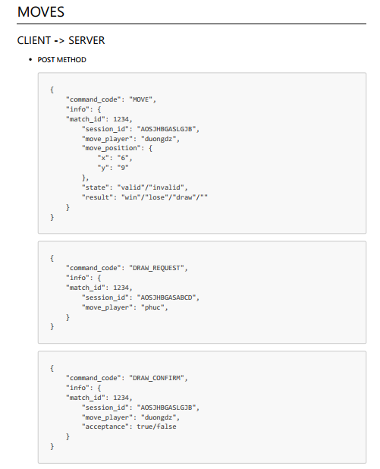
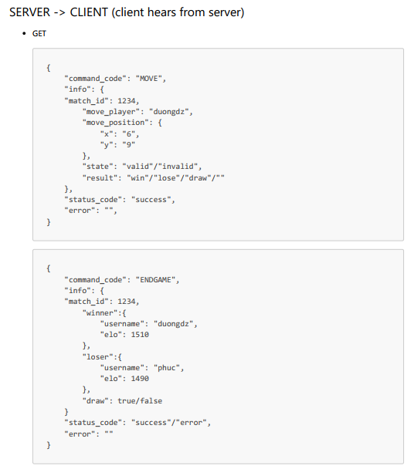

Slide 11
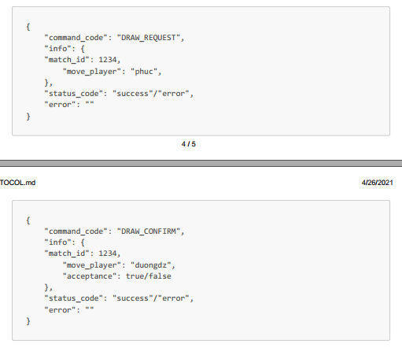
Moves (cont.)

Slide 12
GUI Design

Slide 13
THANK YOU FOR YOUR ATTENTION !
Any questions ?
Please keep this slide for attribution

