Slide 1
NETWORK PROGRAMMING
CARO GAME
GROUP 3
Nguyễn Thị Minh Châu
20184238
Trần Thái Dương
20176732
Nguyễn Mạnh Phúc
20176845

Slide 2
CONTENTS
2-player main game handling
Game logic at client
Leaderboard
Demo

Slide 3
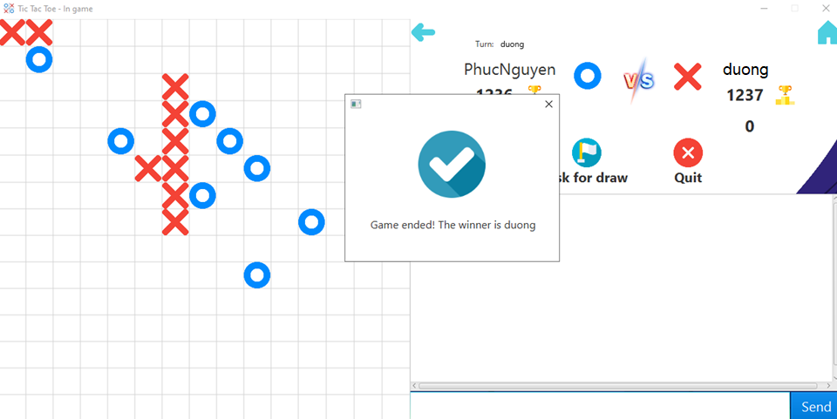
2-player Main game handling

Slide 4
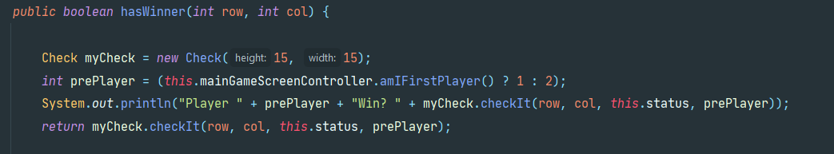
Game logic at client

Slide 5
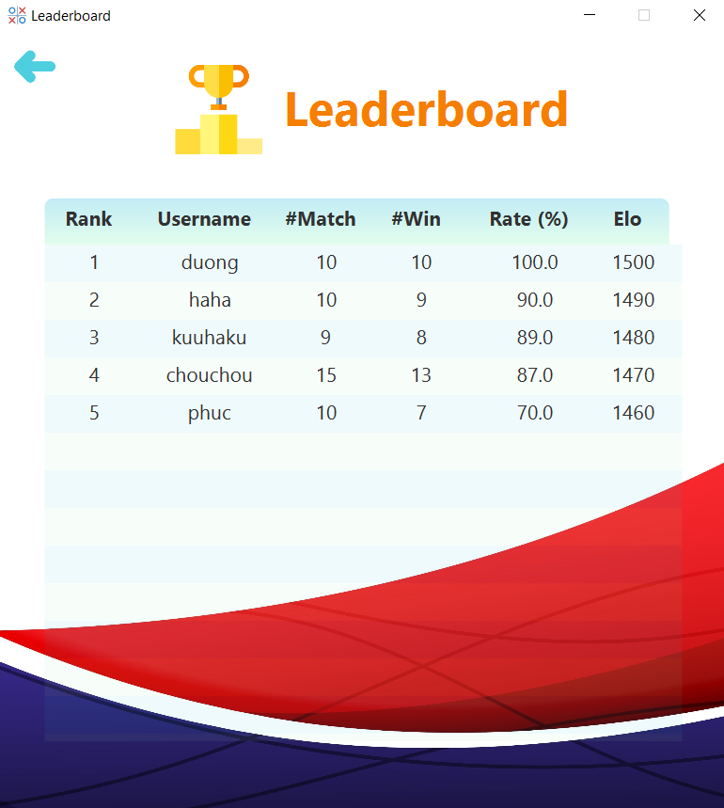
Leaderboard

Slide 6
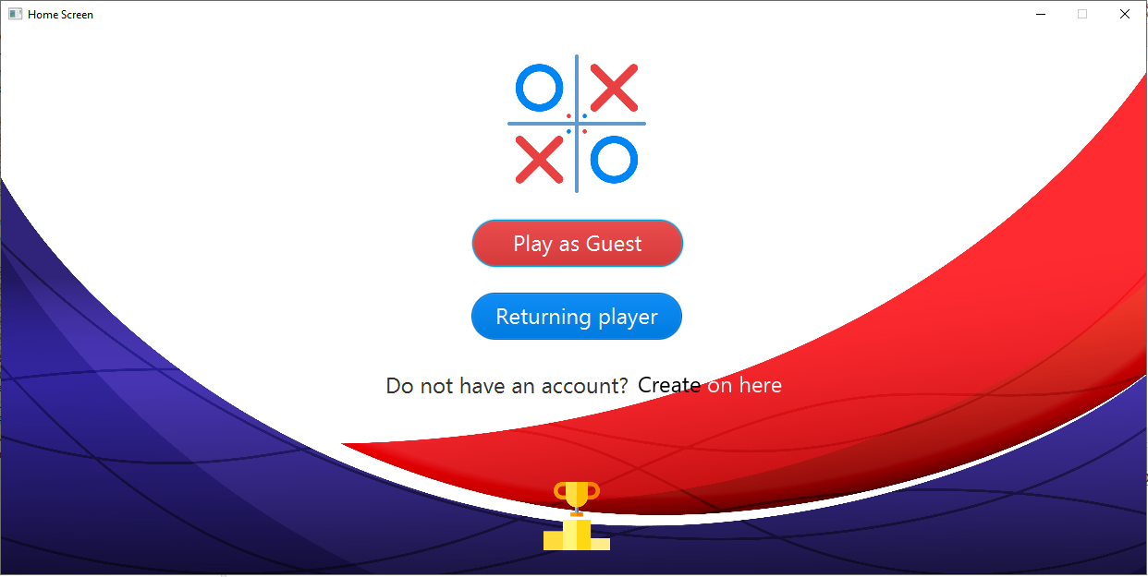
DEMO

Slide 7
THANK YOU FOR YOUR ATTENTION !
Any questions ?
Please keep this slide for attribution

