Slide 1

CDS6214 Data Science Fundamentals Project
TT4L, G03 (Retail Domain)
Tai Qi Tong – 1211102777
Chan Kar Kin – 1211102630

Slide 2
Introduction
Motivation
Impact
Enhance operational efficiency of adidas in the US market
Aim for greater business agility
Enhance adidas’ market presence in the US
Design more effective marketing/promotion strategies
Main Problem
Questions
To improve operational efficiency in the US market
Understand impact of:
Seasonal & regional trends
Product pricing & categories
How do seasonal trends affect sales and profitability across different regions and product categories?
How does the pricing of products influence both sales volume and profitability across different types of products?
What is the highest total units sold product category based on gender across different states, and how does the price per unit for these categories vary across different states?
Is there a significant difference in total sales across cities between weekdays and weekends?

Slide 3
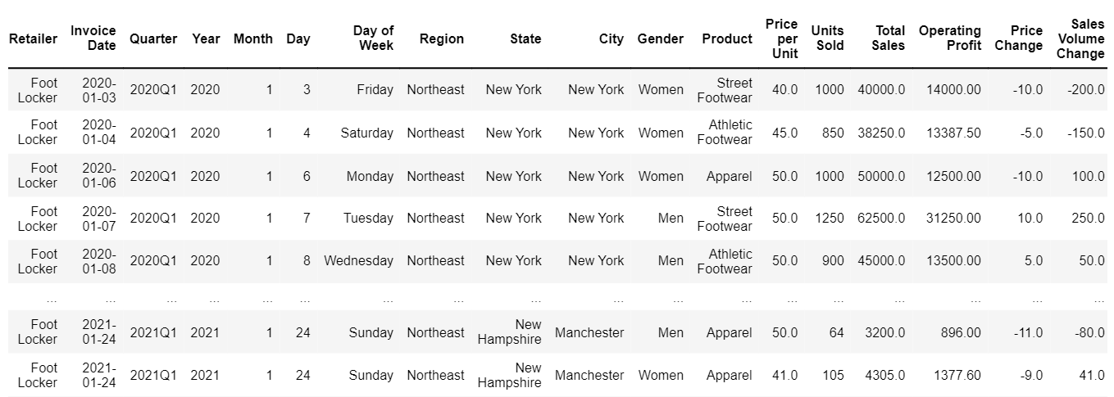
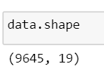
Data Collection & Preprocessing
Collect data (Adidas Sales Dataset, 2022)
Data preprocessing:
Delete columns with null values & set header
Ensure no duplicated rows
Convert data types
Recalculate numerical columns, check for inconsistencies
Dropped unused columns: Operating Margin, Sales Method, Retailer ID
Cleaned data:
Notes:
Data type conversion:
Retailer ID, and Units Sold are converted to integer
Invoice Date converted to datetime format, extracted Year, Month, Day, Day of Week and Quarter into new columns from Invoice Date
Price per Unit, Total Sales, Operating Profit, and Operating Margin are converted to float rounded to two decimal places
Gender from Product is extracted into Gender column
Added 2 new columns for changes in price and sales volume
Handling inconsistencies in columns:
Retailer ID is dropped (there are 4 retailer ID with 5 retailers)
Total Sales is recalculated by multiplying Price per Unit with Units Sold
Operating Profit is recalculated by multiplying Total Sales with Operating Margin

Slide 4
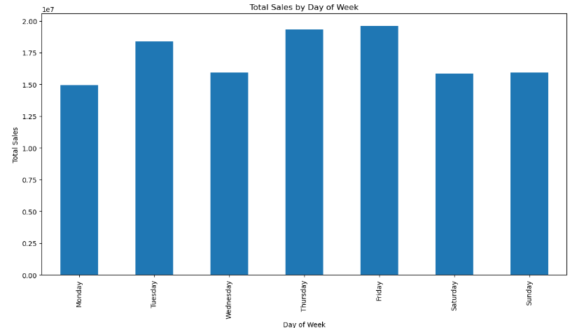
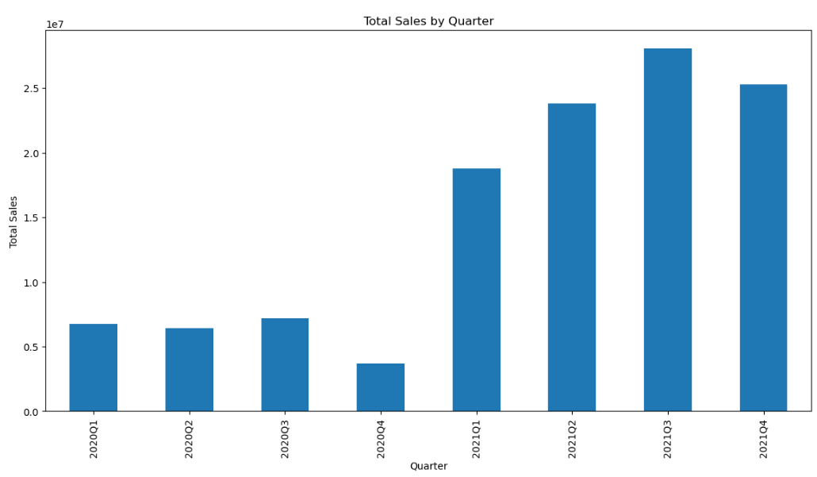
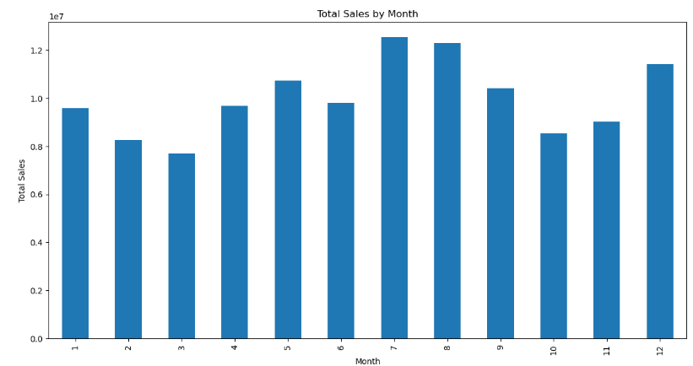
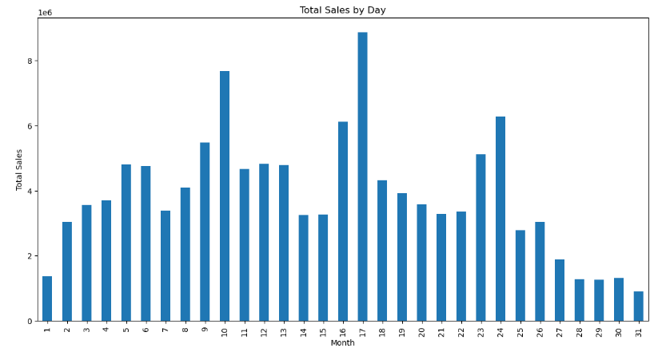
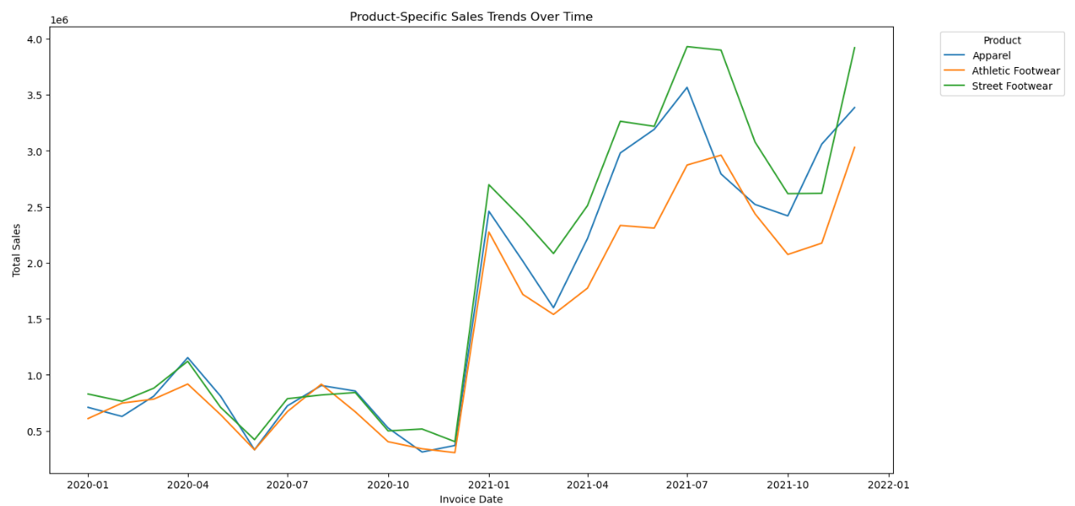
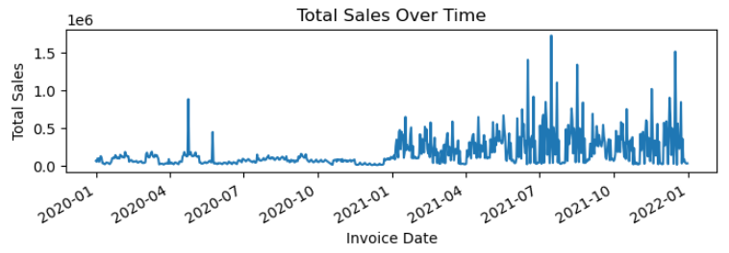
EDA:
Seasonal Sales Pattern

Slide 5
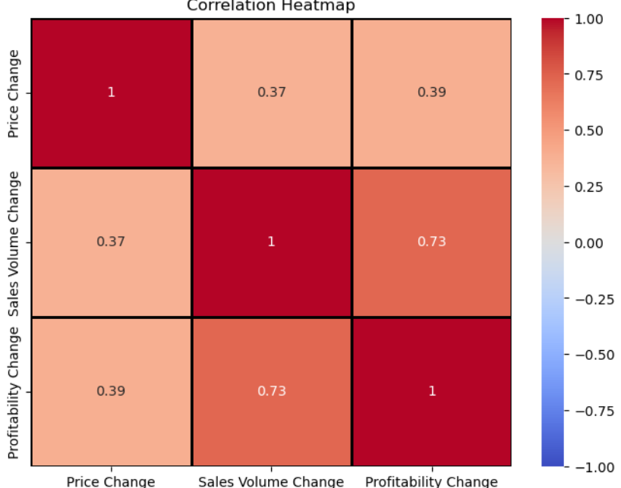
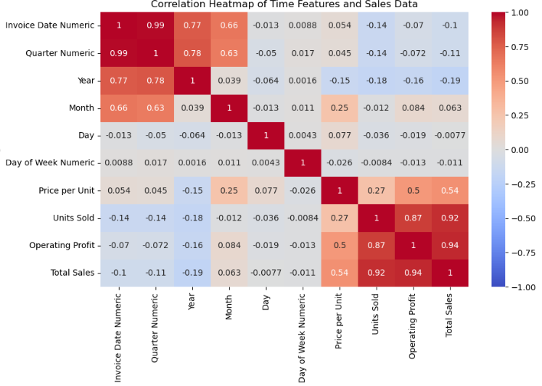
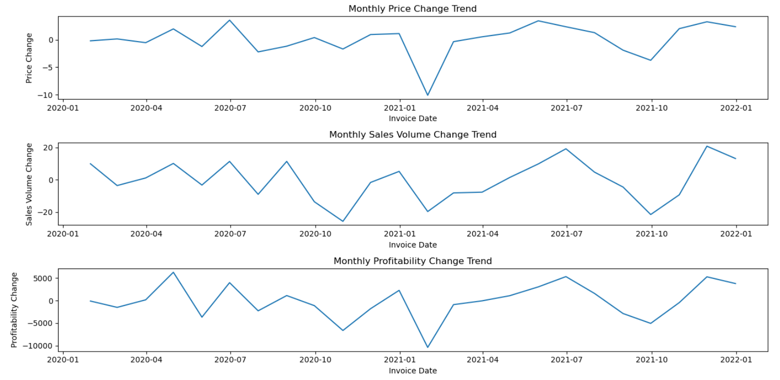
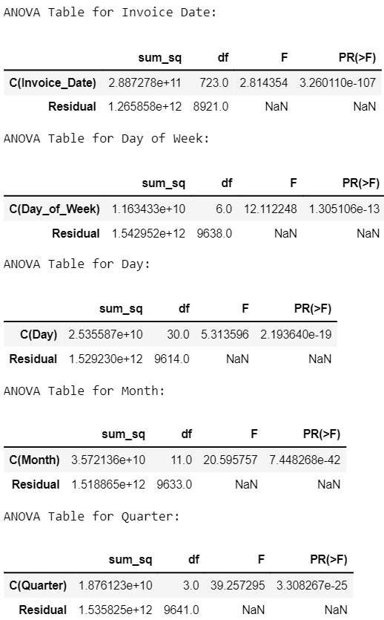
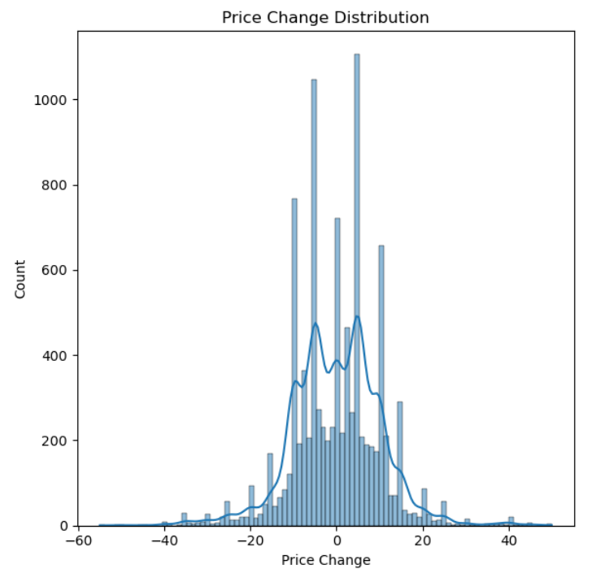
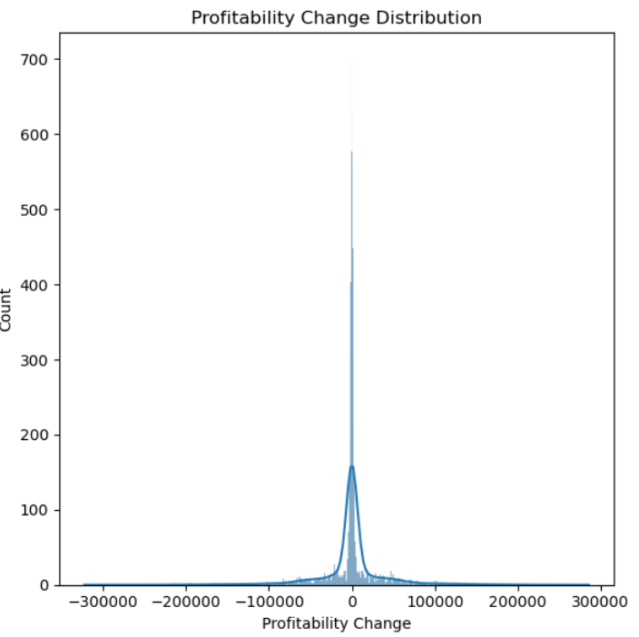
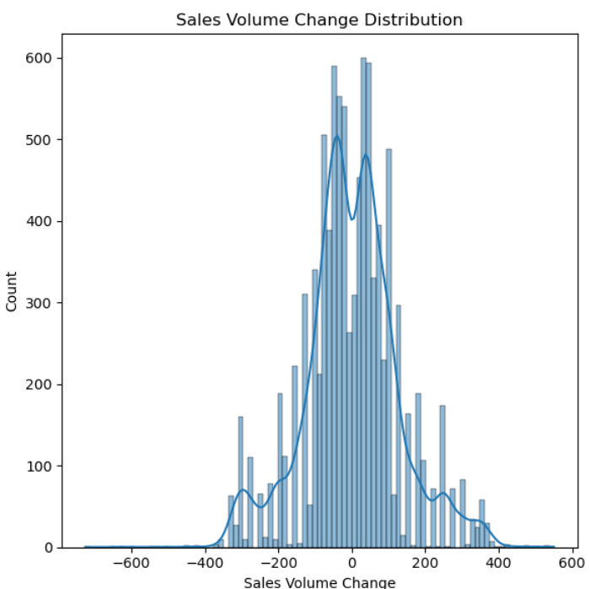
Monthly Trends
Correlation Analysis
Hypothesis Testing (ANOVA)
Normal distribution

Slide 6
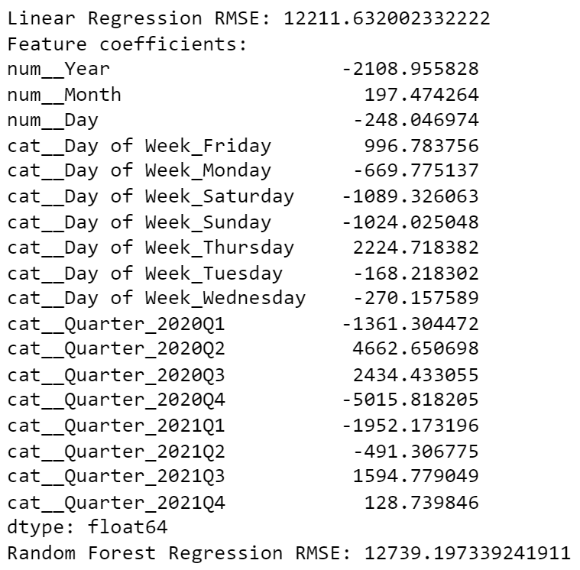
Solution: Question 1
How do seasonal trends affect sales and profitability across different product categories?
Data Modelling:
Linear Regression:
achieved an RMSE of approximately 12211.63 indicates the average difference between predicted and actual sales values.
coefficient represents the change in total sales for a one-unit change
2. Random Forest Regression​:
provided additional insights into feature importance.

Slide 7
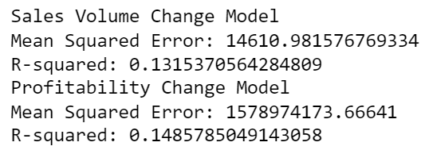
Solution: Question 2
How does the pricing of products influence both sales volume and profitability across different types of products?
Data Modelling: Multiple Linear Regression
Sales Volume Change Model:
weak relationship between price changes and sales volume changes
Profitability Change Model:
suggests a slightly stronger, but still weak, relationship between price changes and profitability changes

Slide 8
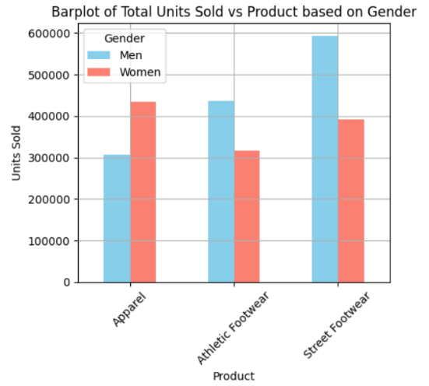
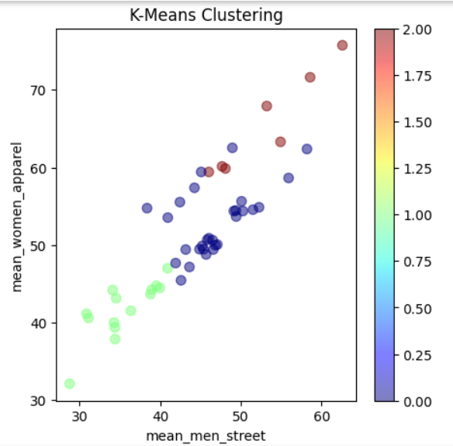
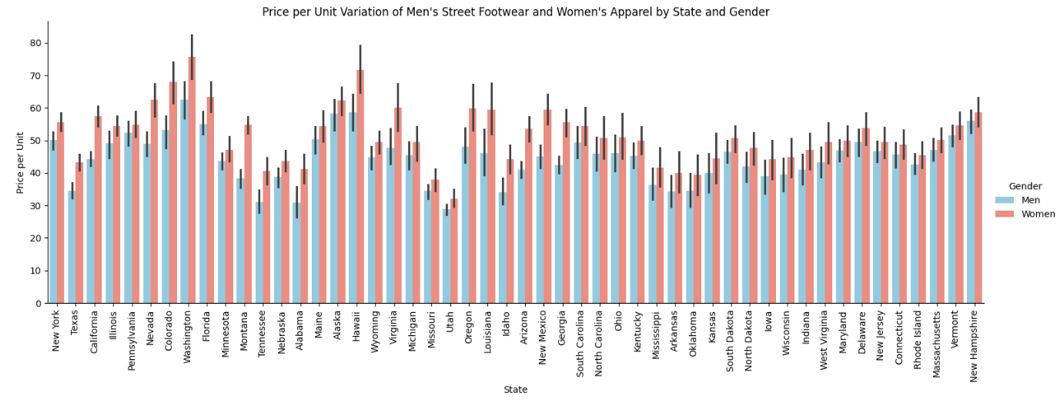
Solution: Question 3 (K-Means)
What is the highest total units sold product category based on gender, how do their price per unit vary across different states?
Highest total unit sold product:
Men: Street Footwear
Women: Apparel
In most states, higher price per unit for Women’s Apparel
Both prices relatively high: Washington, Hawaii, New Hampshire
Both prices relatively low: Missouri, Utah, Tennessee
3 clusters (Low: < $45, high: > $50)

Slide 9


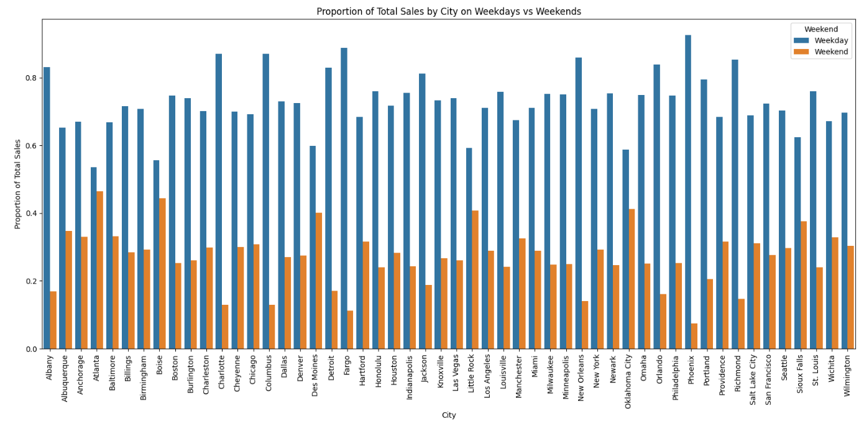
Solution: Question 4 (Hypothesis Testing)
Is there a significant difference in total sales across cities between weekdays and weekends?
Yes, significant difference in total sales between weekdays and weekends in cities
Larger proportion of total sales occurs on weekdays compared to weekends
Trend is consistent but varies in magnitude from city to city
Smallest difference: Atlanta
Largest difference: Phoenix

Slide 10
Challenges & Limitations
Conclusion
Data Inconsistencies: Seasonal patterns are affected by data inconsistencies and unaccounted external factors
Model Limitations: Current regression models show low predictive accuracy
Method Suitability: K-means may not be suitable for analyzing price variations (more dimensions)
Data Reliability: The reliability and accuracy of data sources impact the validity of hypothesis testing for weekday and weekend sales.
1. Seasonal Patterns: Sales peaked in August 2021, with higher sales on Fridays and lower on Mondays.
2. Impact of Price Changes: Price changes have minimal impact on sales volume and profitability
3. Regional and Gender Variations: Total units sold vary significantly across states due to gender preferences and price differences
4. City Sales Trends: Weekday and weekend sales differences across cities highlight the need for tailored promotional activities to align with consumer behavior

