Slide 1

SQUAD Datathon
Dang Quy Duong
Ngoc Bich Nguyen
Vu An

Slide 2
Executive Summary
This is continuous logit prediction task
The data is clean and has no negative outlier
Distribution is equal

Slide 3
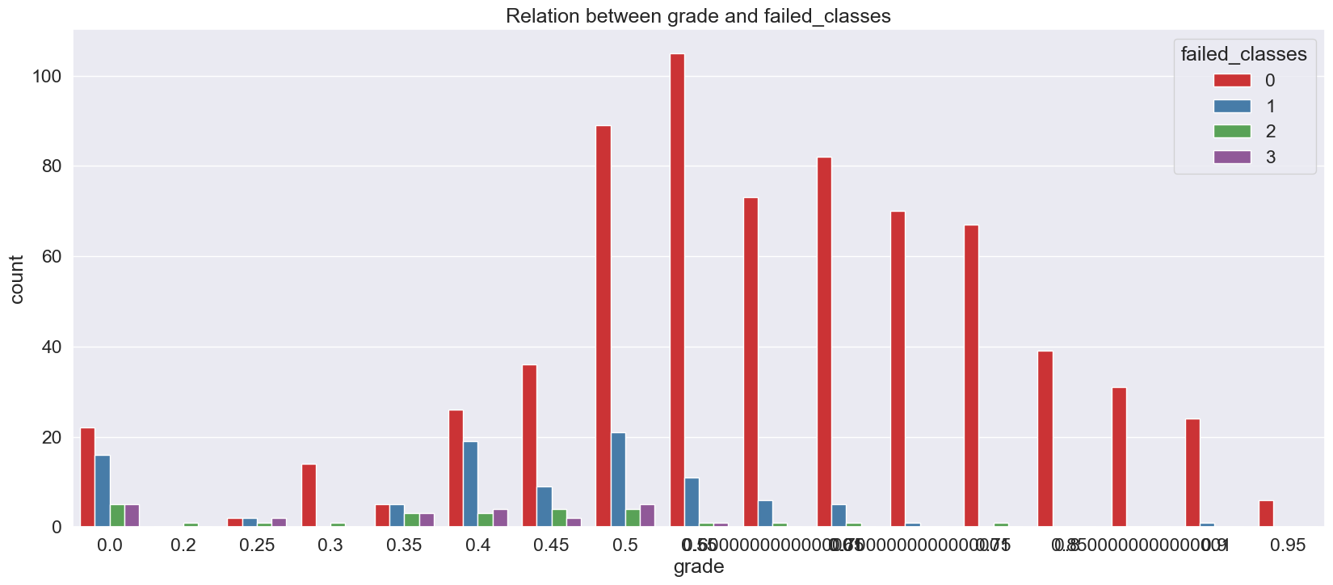
Insight
Pattern

Slide 4
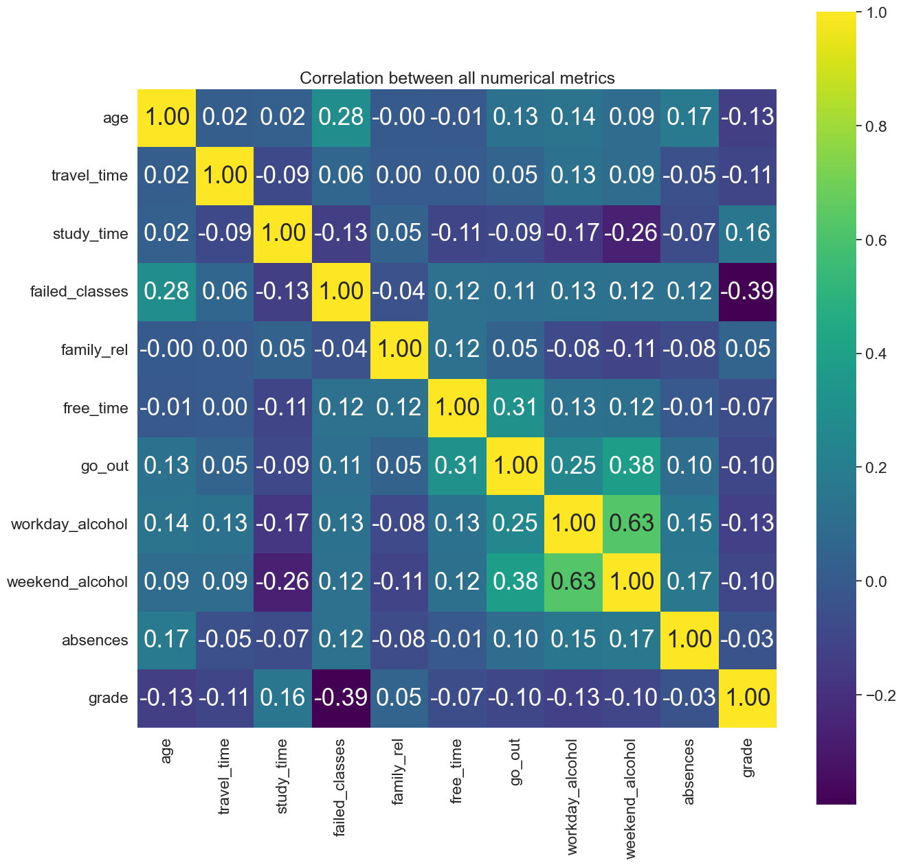
Insight
Correlation

Slide 5
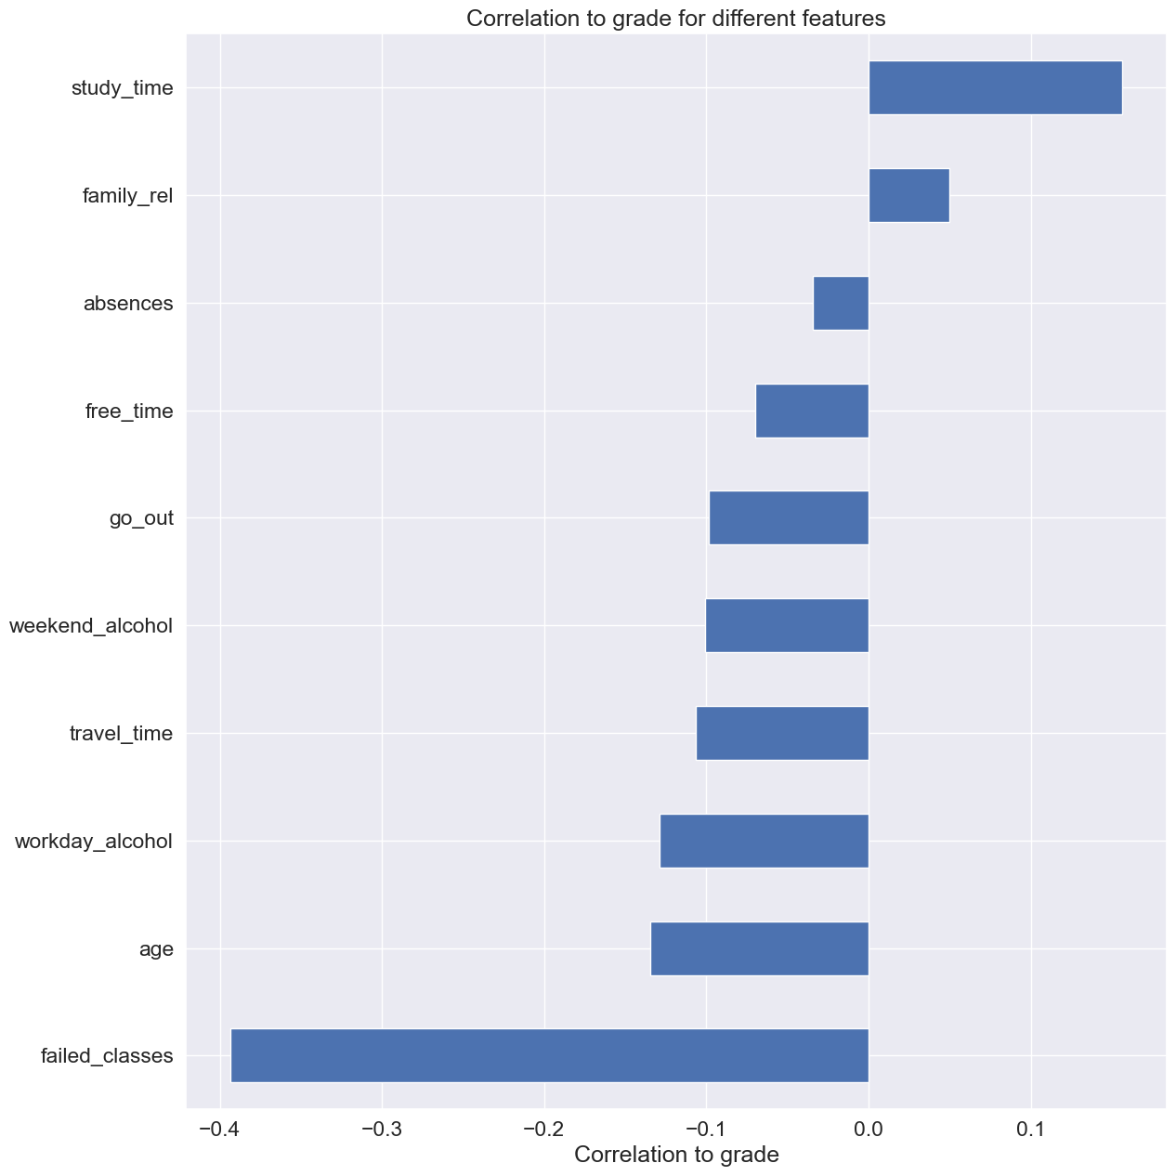
Insight
Correlation

Slide 6
Modeling
Preprocess data
Clean dataset: Find missing value and outlier
Train : Test = 8 : 2
Normalization: Standard scaler
Cross validation
K-Fold: 5 folds
Metrics:
RMSE

Slide 7
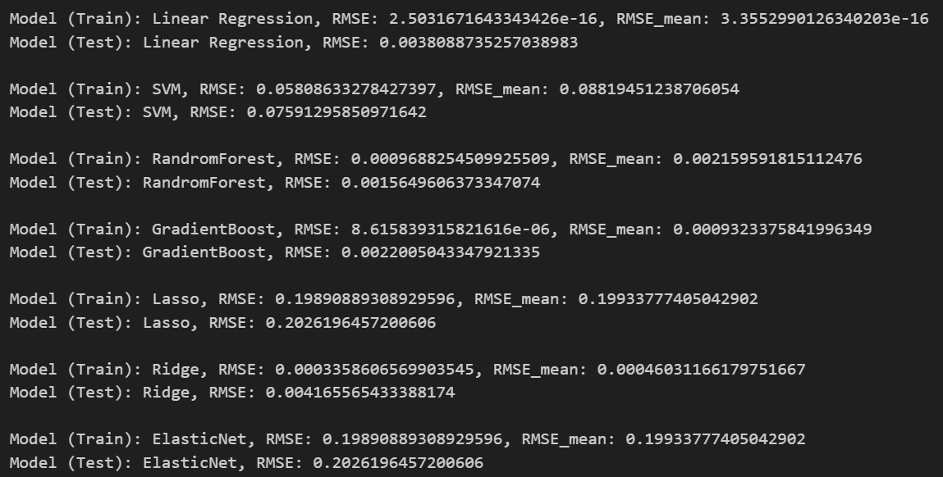
Modeling
Model selections
Linear regression
Support vector machine
Random forest (propose)
Gradient boost
Lasso
Ridge
ElasticNet

