Slide 1
AdapAD for automatic data quality control: Evaluative survey
Notes:
AI for automatic data quality control, AdapAD
Last autumn gathering
Final dev stage, need evaluation

Slide 2
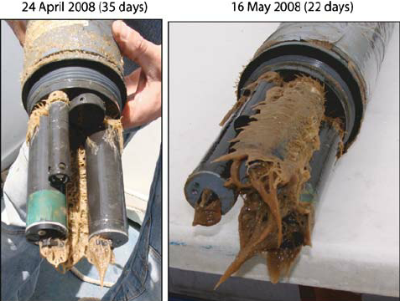
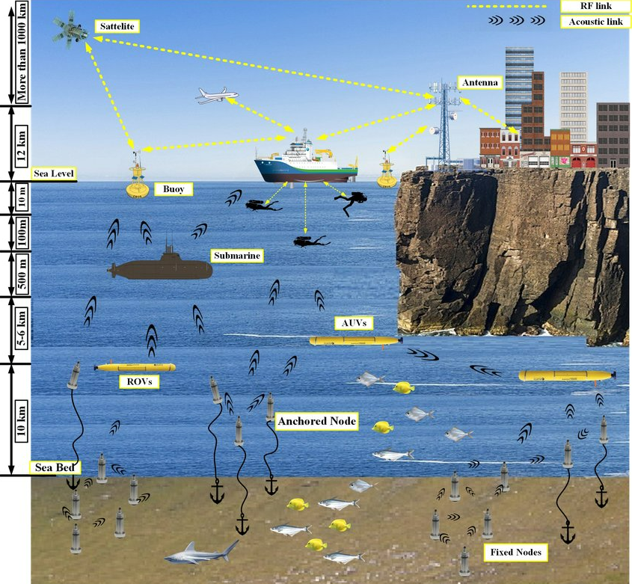
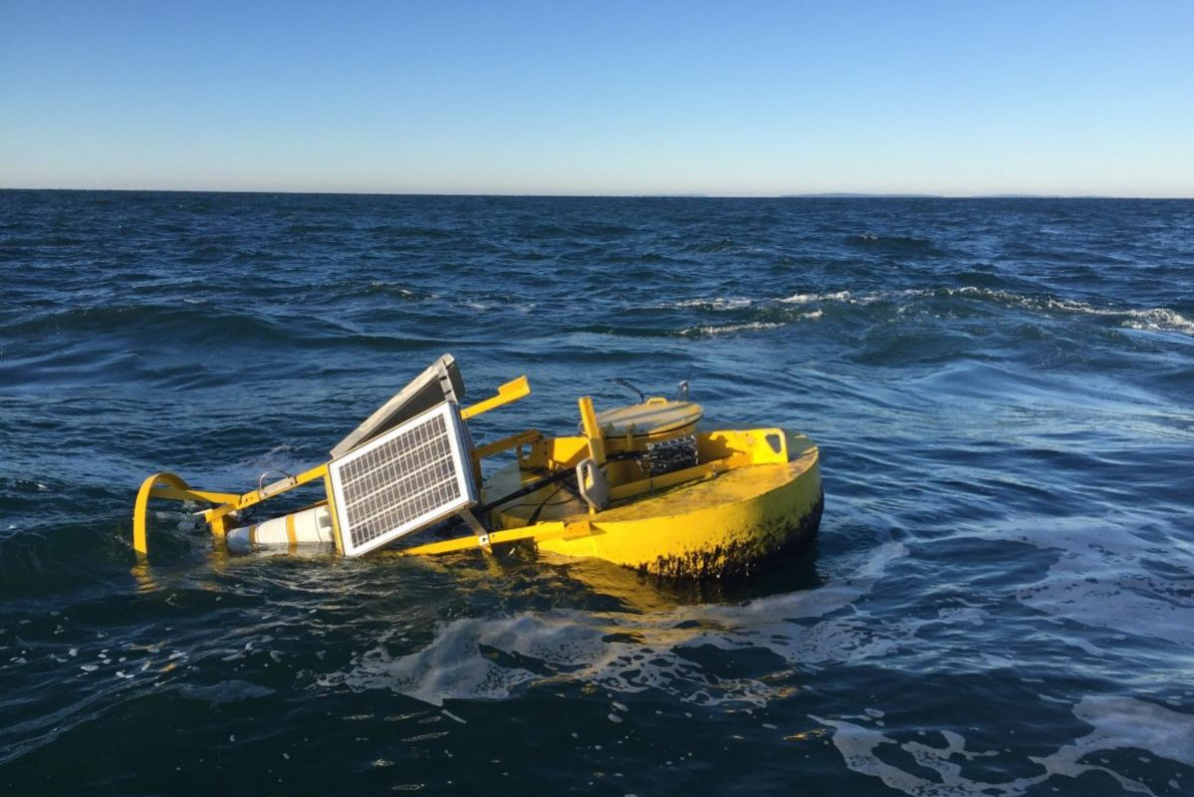
Marine data is prone to error
Important to perform data quality control (QC).
Adaptive Anomaly Detector (AdapAD) is a machine learning anomaly detection framework to automate the data QC process.
Possible communication problems
Notes:
Important
To automate
Short name for

Slide 3
Adaptive Anomaly Detector (AdapAD) for automatic data quality control
AdapAD
Notes:
AdapAD does, receives time-series data to be examined
Examine measurements in the data and tell which ones are anomalous

Slide 4
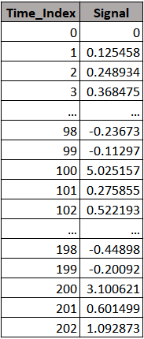
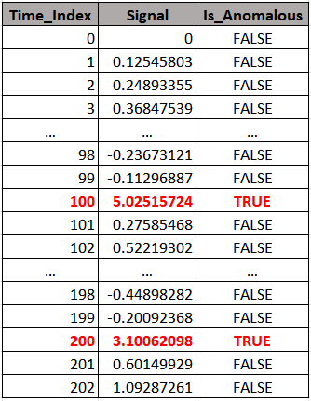
Adaptive Anomaly Detector (AdapAD) for automatic data quality control
AdapAD
for Time_Index in 0…∞:
Is_Anomalous =
AdapAD.is_anomalous(Signal[Time_Index])
Notes:
Technically
Loop through each measurement of the data
Call the API
Tell the examined measurement is anomalous or not

Slide 5
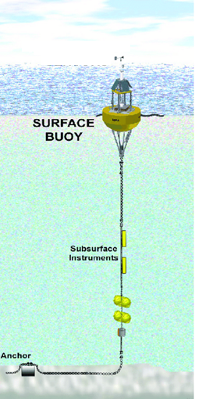
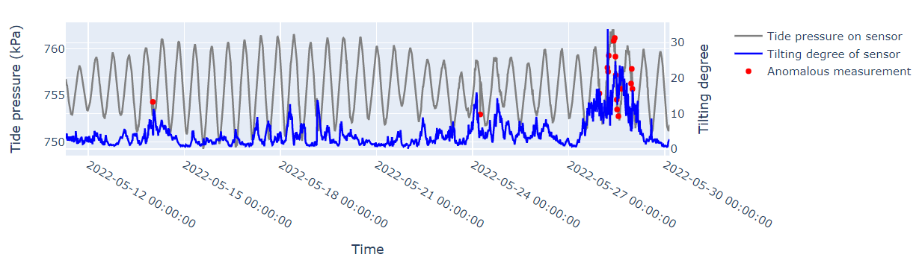

Anomalous measurements from Austevoll data (detected by AdapAD and validated by AADI)
Strong wind
Strong wind
The bouy was hit by a ship
Strong wind or ship may move the buoy, disrupting the whole platform, generating anomalies
Notes:
Attach sensors to mooring system, operated by surface bouy.
The problem is strong wind, hitting by a ship
Then, generating a lot of anomalies

Slide 6
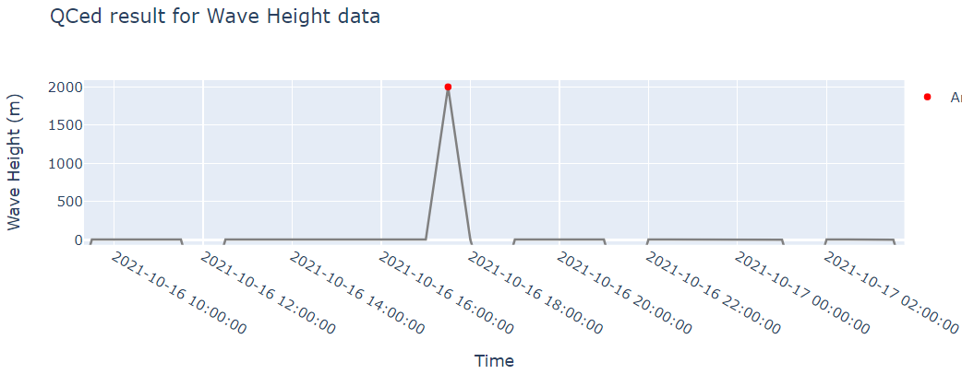
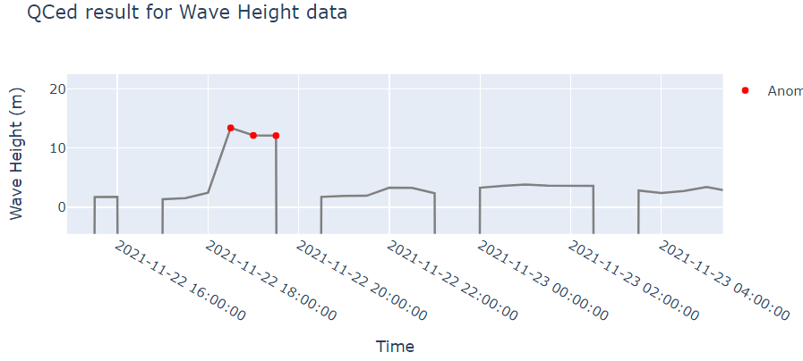
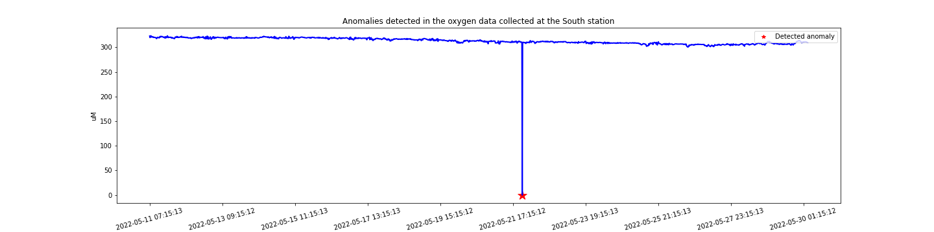
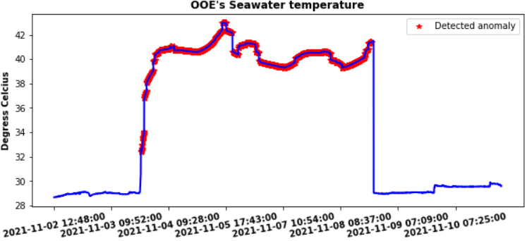
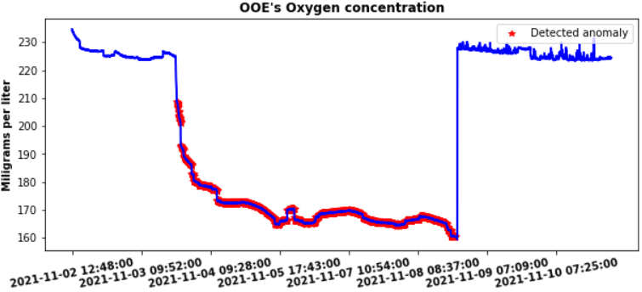
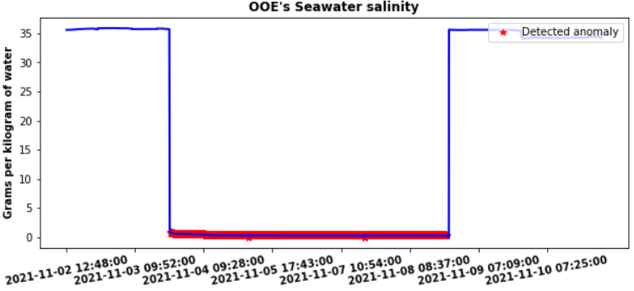
Other anomalous measurements detected by AdapAD
Validated by MET
Validated by MET
Validated by AADI
Validated by NIVA
Validated by NIVA
Validated by NIVA
Notes:
Figure, wave height data collected by OOE
Problem of sensor

Slide 7
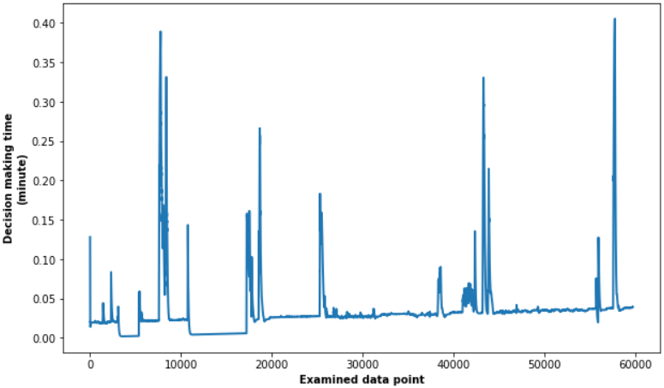
Runtime efficiency of AdapAD
Measured on a laptop
Intel Core i7 @2.80GHz (8 CPUs)
32GB of RAM
Notes:
Make it as lightweight as possible
Time needed to make decisons is mostly under .5 minute.
Measured on working laptop

Slide 8
Runtime efficiency of AdapAD
Validated by <one of our collaborative partners>
Validated by <one of our collaborative partners>
Validated by <one of our collaborative partners>
Validated by <one of our collaborative partners>
Validated by <one of our collaborative partners>
Validated by <one of our collaborative partners>
Notes:
Make it as lightweight as possible
Time needed to make decisons is mostly under .5 minute.
Measured on working laptop

Slide 9
We need your help to evaluate AdapAD (Adaptive Anomaly Detector) (from organizations producing and consume data)
Question | Feedback
How would you rate the potential of using AdapAD for automatic data quality control? | Scoring 1-5 ⬄ very unlikely – very likely
How would you rate the likelihood that AdapAD can speed up current data quality control process?
Other feedback/comments to further improve AdapAD | Free text
* Paper-based answer sheet will be distributed shortly.
Notes:
Usefulness, ease of use, and compability of AdapAD regarding automatic data quality control
Papers to give answers and distribute shortly

Slide 10
Thank you in advance for your feedback!

