Slide 1
Strategy pattern
Group 04

Slide 2
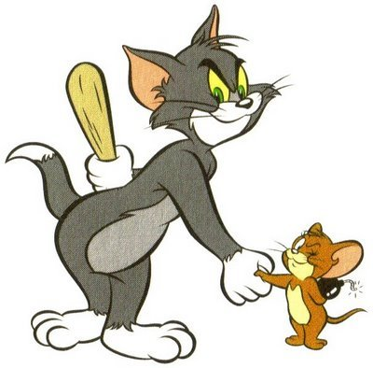
What is strategy?

Slide 3
Design Pattern summary
DESIGN PATTERN
Creational pattern
Structural pattern
Behavioral pattern
Strategy pattern is a behavioral pattern!

Slide 4
Strategy pattern
•
Origin: the Strategy Pattern is known as a behavioral pattern and is used to manage algorithms, relationships and responsibilities between objects
Definition: defines a family of algorithms, envelop each one, and makes them exchangable within that family
strategy lets the algorithm vary independently from clients who use it

Slide 5
SimUDuck Example
•
Joe works for a company that makes a highly successful duck pond simulation game, SimUDuck. The game can show a large variety of duck species swimming and making quacking sounds.

Slide 6
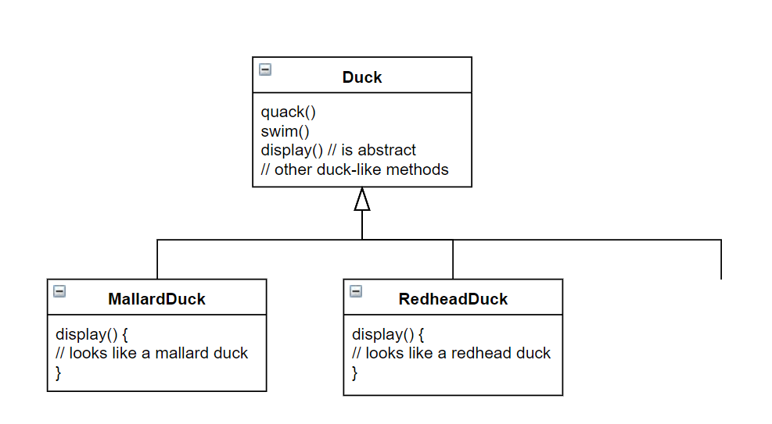
inheritance base design…
Lots of other types
of duck inherit from
the Duck class

Slide 7
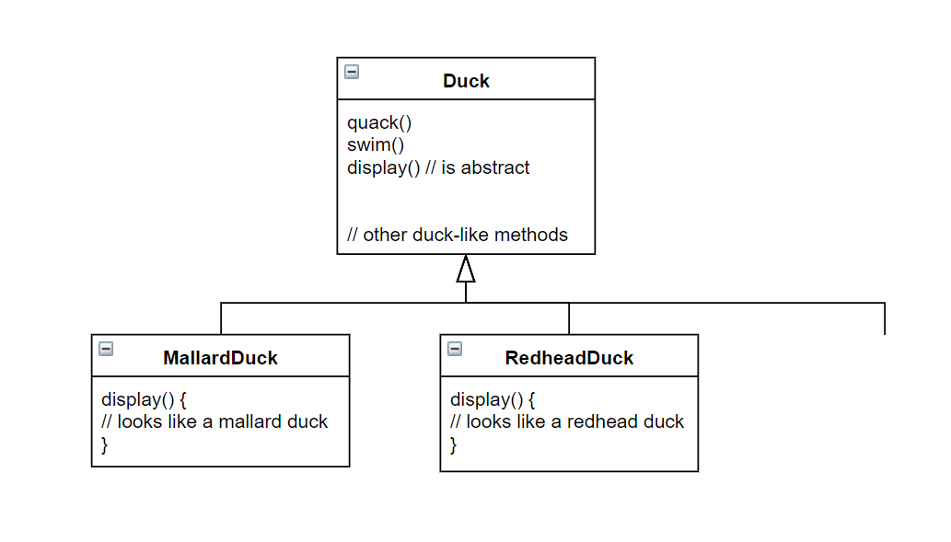

What Joe
added
fly()
Other duck
types

Slide 8
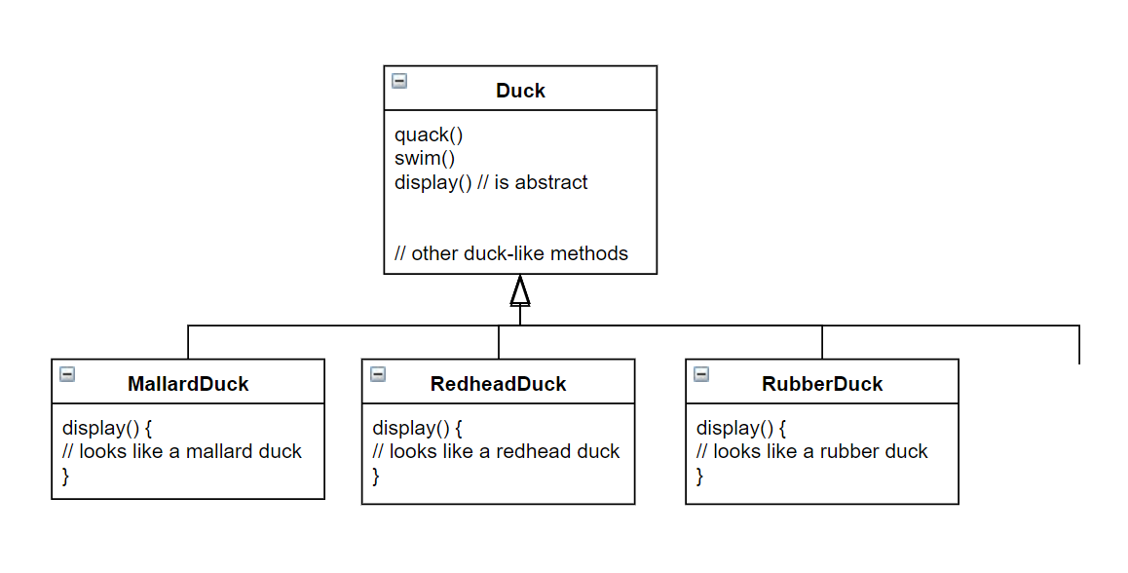
By putting fly() in
The superclass, he gave flying
ability to ALL ducks, including
those that shouldn’t
Now RubberDuck
can fly?
fly()
Other duck
types

Slide 9

Runtime behavior changes are difficult
Hard to gain knowledge of all duck behaviors
Changes can unintentionally affect other ducks
maintenance can be a nightmare!

Slide 10
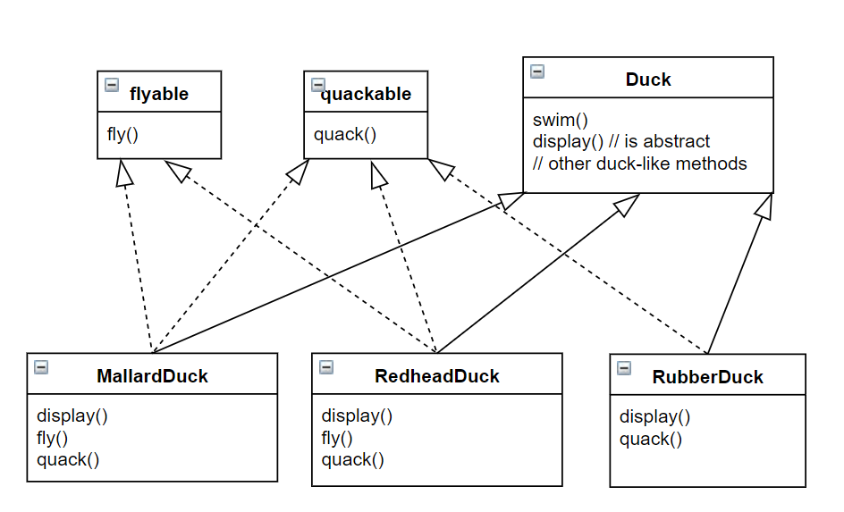
what about an interface?

Slide 11



what about an interface?
duplicated code!

Slide 12
OVERVIEW
When to use:
You have an easy-to-change code, and you separate them from the main program for easy maintenance
You want to avoid the hassle of having to implement a function over too many subclasses
- You want to change the algorithm used when running the program

Slide 13
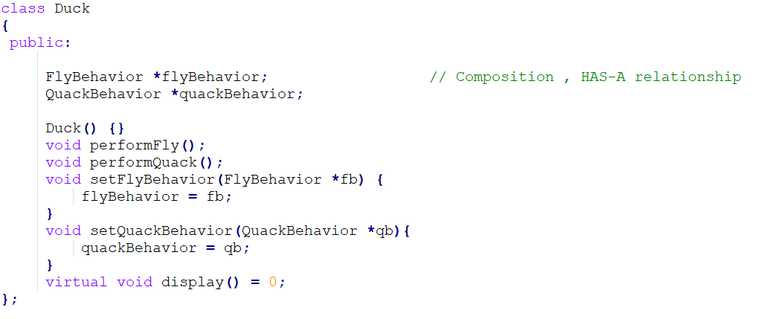
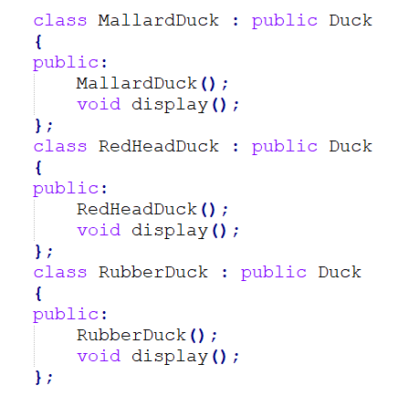

Slide 14
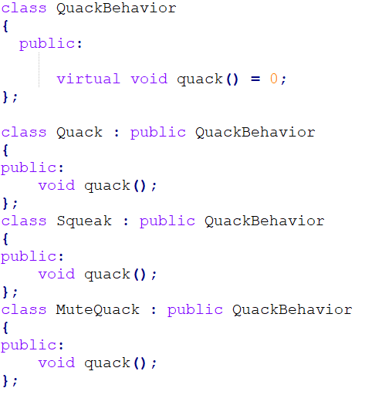
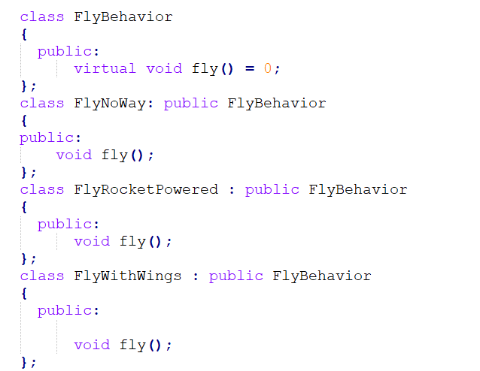

Slide 15
Participants
declares an interface common to all supported algorithms, context uses this interface to call the algorithm defined by a concreteStrategy
concreteStrategy implements the algorithm using the strategy interface
contex configured with a concreteStrategy object, maintains a reference to a strategy object, may define an interface that lets strategy access its data

Slide 16

Advantages & disadvantage

Slide 17
advantages
Easy to switch between different algorithms (strategies) at run-time
Cleaner code because conditional-infested code is avoided
Even cleaner code since the concerns are separated into classes (a class to each strategy)

Slide 18
disadvantages
The user must be aware of all the strategies to select the right one for the right situation.
Strategy base class must expose interface for all the required behaviors, which some concrete Strategy classes might not implement.
In most cases, the application configures the Context with the required Strategy object. Therefore, the application needs to create and maintain two objects instead of one.

Slide 19
QUIZ
Which is the definition of Strategy Pattern?
A. Encapsulate a command request as an object
B. Encapsulates an algorithm inside a class
C. Creates an instance of several families of classes
D. Separates an object’s interface from its implementation
Encapsulates an algorithm inside a class

Slide 20
Which group does Strategy pattern belong to?
Creational
Behavioral
C. Structural
D. None of the above
Behavioral

Slide 21
Which of the following describes the Strategy pattern correctly?
In this pattern, a class behavior changes based on its state.
In this pattern, a null object replaces check of NULL object instance.
In this pattern, a class behavior or its algorithm can be changed at run time.
In this pattern, an abstract class exposes defined way(s)/template(s) to execute its methods.
In this pattern, a null object replaces check of NULL object instance.

Slide 22
Which of the following are disadvantages of using inheritance to provide Duck behavior?
Code is duplicated across subclasses.
Runtime behavior changes are difficult.
We can’t make ducks dance.
Ducks can’t fly and quack at the same time.
Runtime behavior changes are difficult.

Slide 23
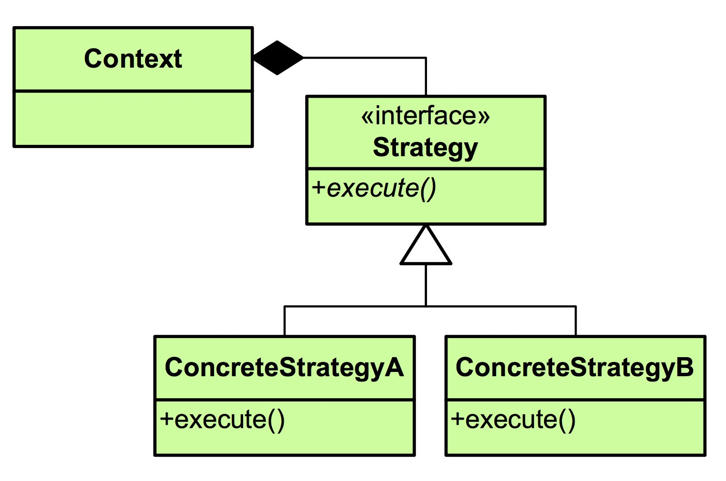


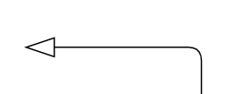
?
Choose the most suitable answer
A.
B.
C.
D. Both A and B

