Slide 1
Strategy pattern
Group 04
Nguyen Thao Ninh -18125106
Truong Thuy Quyen -18125110
Nguyen Trung Hau -18125129

Slide 2
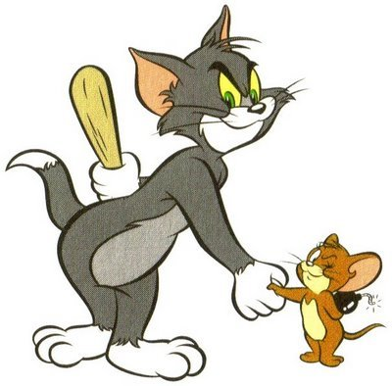
What is strategy?

Slide 3
Design Pattern summary
DESIGN PATTERN
Creational pattern
Structural pattern
Behavioral pattern
Strategy pattern is a behavioral pattern!

Slide 4
Strategy pattern
•
Origin: the Strategy Pattern is known as a behavioral pattern and is used to manage algorithms, relationships and responsibilities between objects
Definition: A family of algorithms, encapsulates each one, and makes them interchangeable.
Strategy lets the algorithm vary independently from clients that use it.

Slide 5
SimUDuck Example
•
Joe works for a company that makes a highly successful duck pond simulation game, SimUDuck. The game can show a large variety of duck species swimming and making quacking sounds.

Slide 6
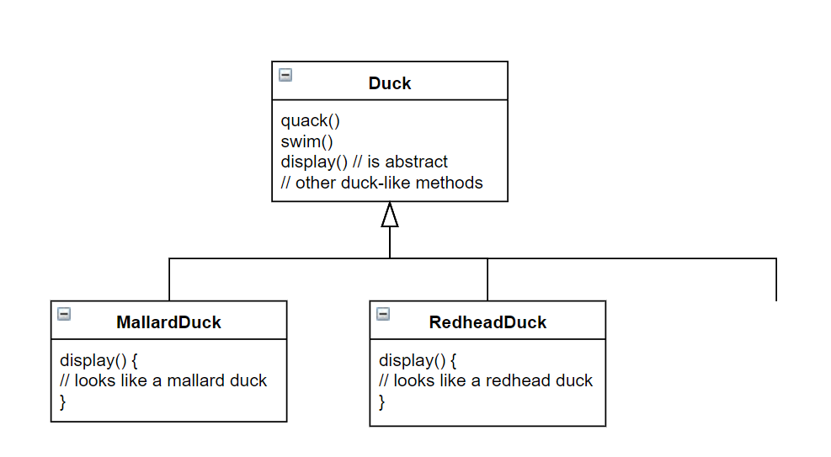
inheritance base design…
Lots of other types
of duck inherit from
the Duck class

Slide 7
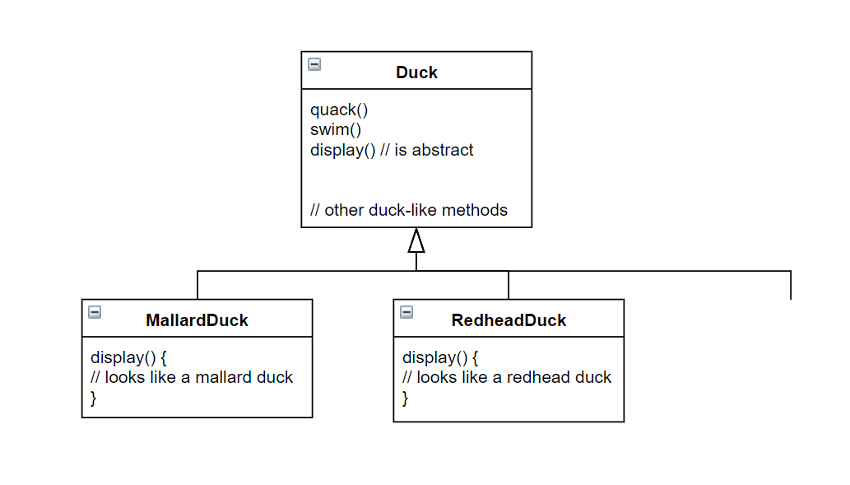

What Joe
added
fly()
Other duck
types

Slide 8
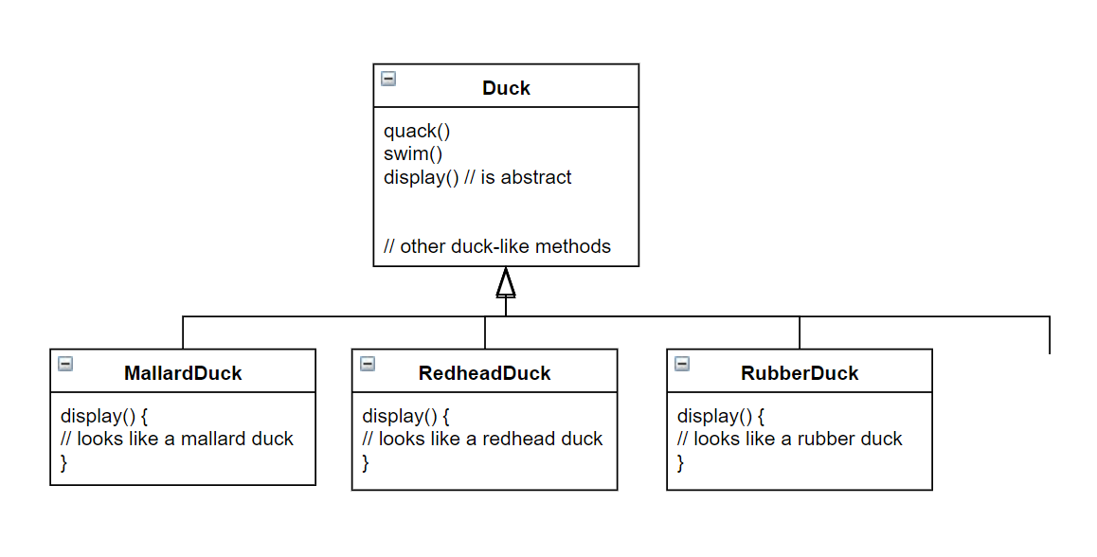
By putting fly() in
The superclass, he gave flying
ability to ALL ducks, including
those that shouldn’t
Now RubberDuck
can fly?
fly()
Other duck
types

Slide 9

Runtime behavior changes are difficult
Hard to gain knowledge of all duck behaviors
Changes can unintentionally affect other ducks
maintenance can be a nightmare!

Slide 10
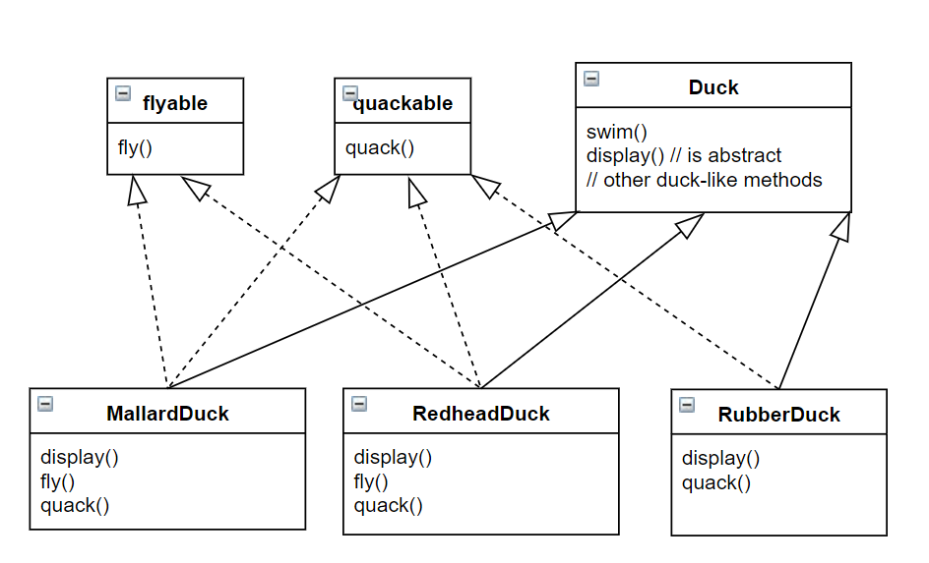
what about an interface?

Slide 11



what about an interface?
duplicated code!

Slide 12
OVERVIEW
When to use:
You have an easy-to-change code, and you separate them from the main program for easy maintenance
You want to avoid the hassle of having to implement a function over too many subclasses
- You want to change the algorithm used when running the program

Slide 13
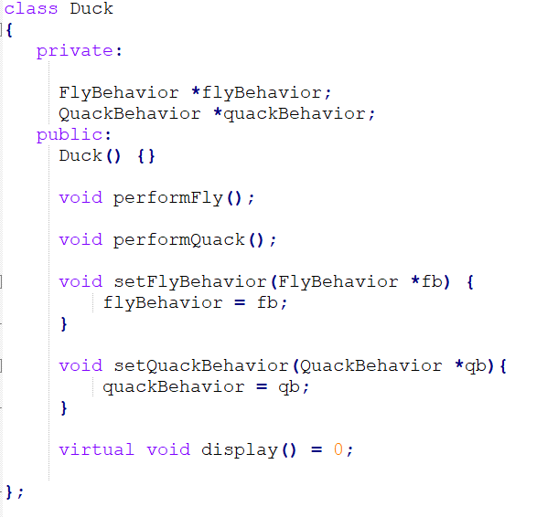
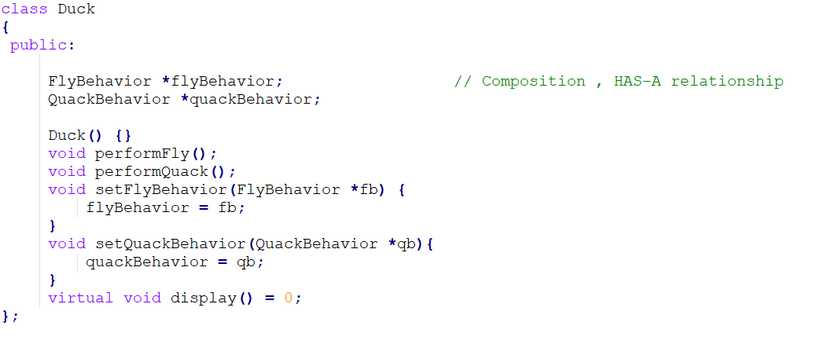
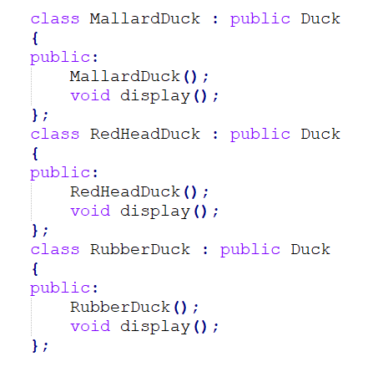

Slide 14
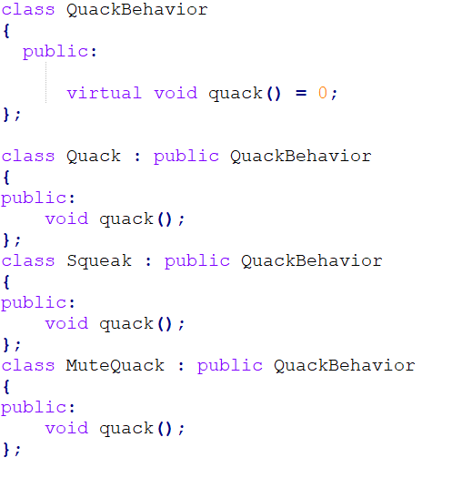
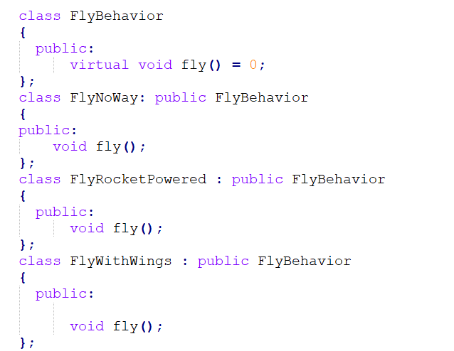

Slide 15
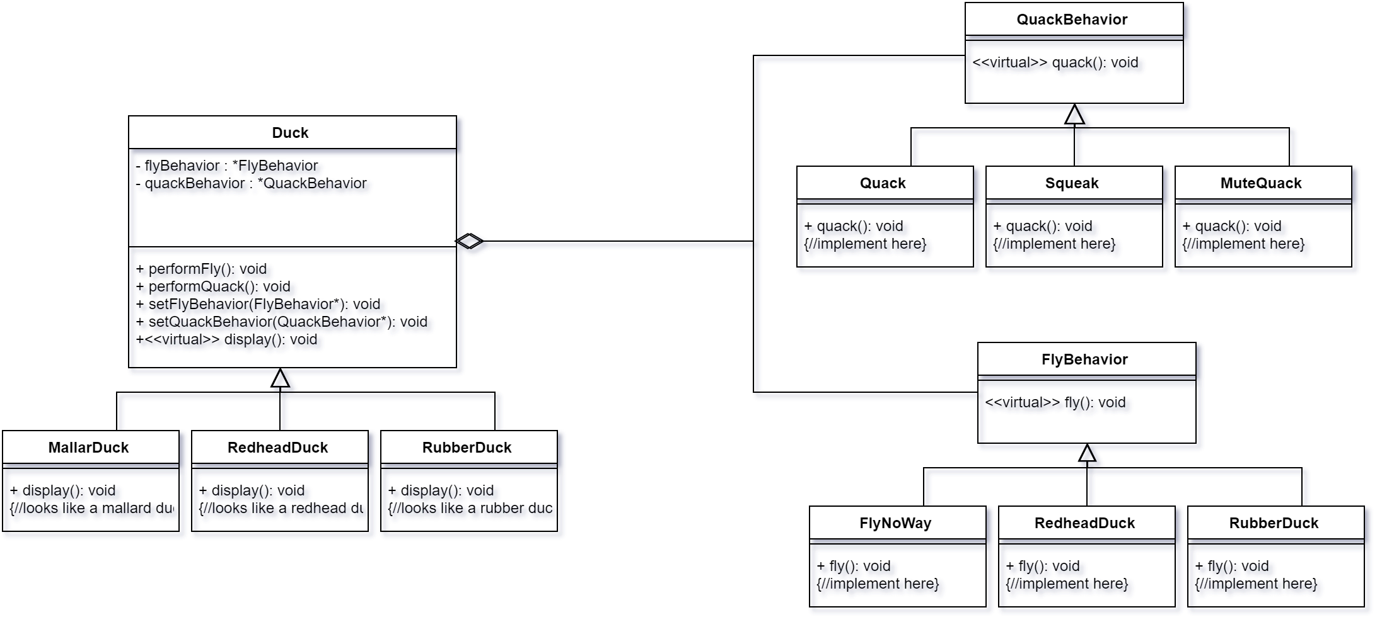

Slide 16
Participants
declares an interface common to all supported algorithms, context uses this interface to call the algorithm defined by a concreteStrategy
concreteStrategy implements the algorithm using the strategy interface
contex configured with a concreteStrategy object, maintains a reference to a strategy object, may define an interface that lets strategy access its data

Slide 17

Advantages & disadvantages

Slide 18
advantages
Encapsulating the algorithm make it easier to switch, understand and extend.
Reduces long lists of conditionals.
Avoid duplicate code.
Encapsulate/hide complicate/secret code from users.

Slide 19
disadvantages
Increased number of objects/classes.
Change the structure of program easily to confuse if you don’t know the structure well.
The user must be aware of all the strategies to select the right one for the right situation.
There will be times when the context creates and initializes parameters that never get used (Communication overhead between Strategy and Context).

Slide 20

QUIZ

Slide 21
QUIZ
Which is the definition of Strategy Pattern?
A. Encapsulate a command request as an object
B. Encapsulates an algorithm inside a class
C. Creates an instance of several families of classes
D. Separates an object’s interface from its implementation
Encapsulates an algorithm inside a class

Slide 22
Which group does Strategy pattern belong to?
Creational
Behavioral
C. Structural
D. None of the above
Behavioral

Slide 23
When would the Strategy Pattern be used?
many related classes differ only in their behavior.
you need different variants of an algorithm.
an algorithm uses data that clients shouldn't know about.
Both A, B, C
Both A, B, C

Slide 24
Which of the following are disadvantages of using inheritance to provide Duck behavior?
Code is duplicated across subclasses.
Runtime behavior changes are difficult.
We can’t make ducks dance.
Ducks can’t fly and quack at the same time.
Runtime behavior changes are difficult.

Slide 25
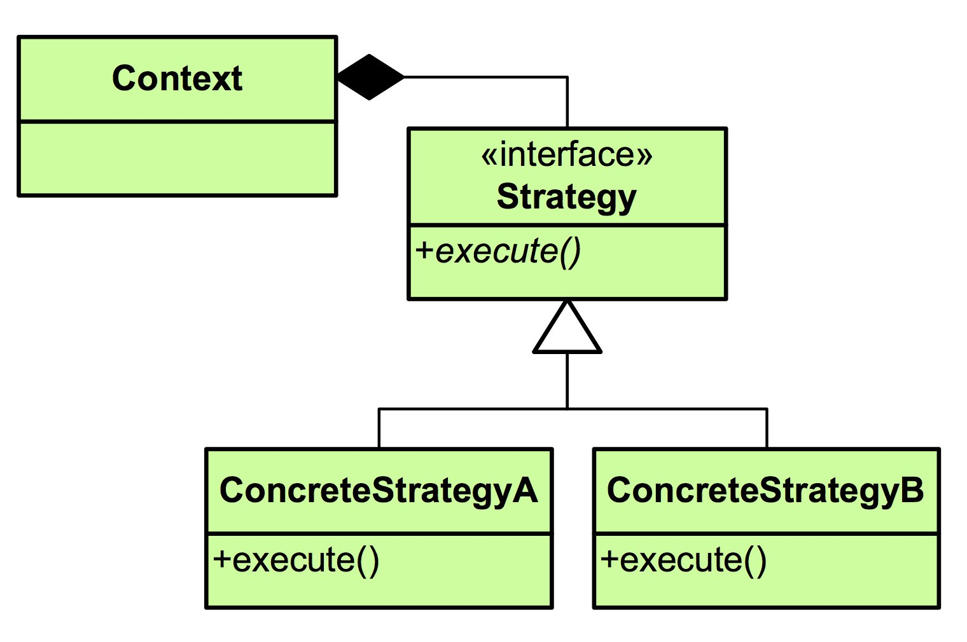


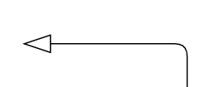
?
Choose the most suitable answer
A.
B.
C.
D. Both A and B

Slide 26
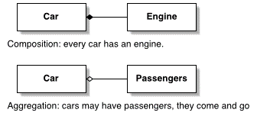
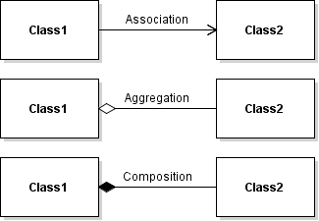

Slide 27
Thank you for listening
Group 04

