Slide 1
Strategy pattern
Group 04

Slide 2
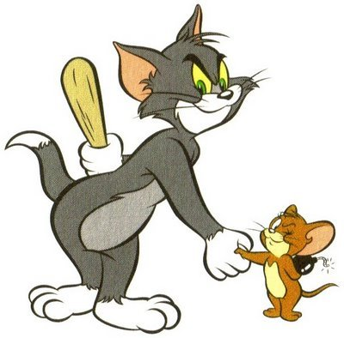
What is strategy?

Slide 3
Design Pattern summary
DESIGN PATTERN
Creational pattern
Structural pattern
Behavioral pattern
E.g: Abstract Factory, Factory Method, Singleton,..
E.g: Adapter, Bridge, Composite,..
E.g: Interpreter, Template Method,...
Strategy pattern is a behavioral pattern!

Slide 4
SimUDuck Example
•
Joe works for a company that makes a highly successful duck pond simulation game, SimUDuck. The game can show a large variety of duck species swimming and making quacking sounds.

Slide 5
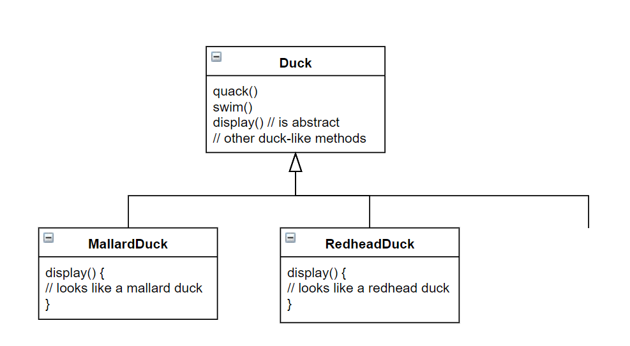
inheritance base design…
Lots of other types
of duck inherit from
the Duck class

Slide 6
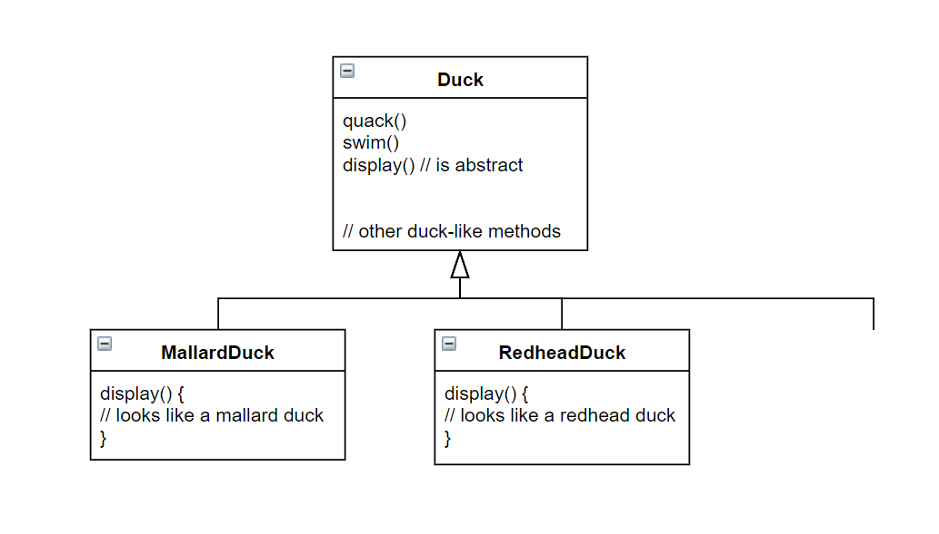

What Joe
added
fly()
Other duck
types

Slide 7
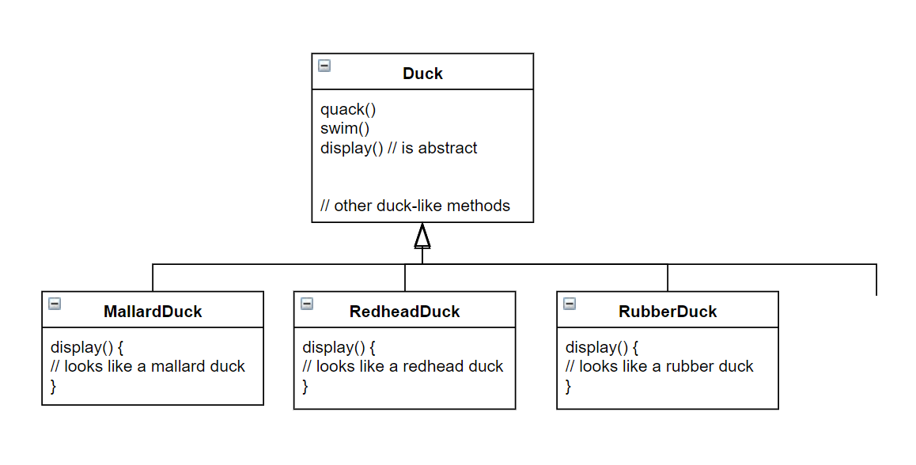
By putting fly() in
The superclass, he gave flying
ability to ALL ducks, including
those that shouldn’t
Now RubberDuck
can fly?
fly()
Other duck
types

Slide 8

Runtime behavior changes are difficult
Hard to gain knowledge of all duck behaviors
Changes can unintentionally affect other ducks
maintenance can be a nightmare!

Slide 9
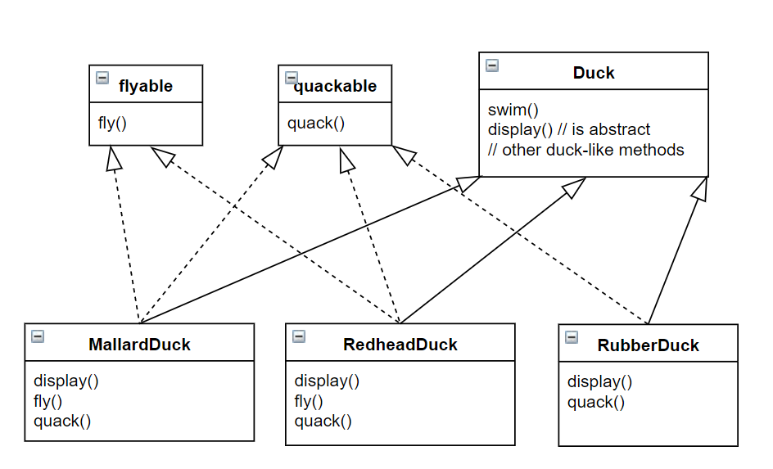
what about an interface?

Slide 10



what about an interface?
duplicated code!

Slide 11
Strategy pattern
•
Origin: the Strategy Pattern is known as a behavioral pattern and is used to manage algorithms, relationships and responsibilities between objects
Intent: defines a family of algorithms, encapsulates each algorithm, and makes them interchangeable within that family strategy lets the algorithm vary independently from clients who use it

Slide 12
OVERVIEW
When to use:
You have an easy-to-change code, and you separate them from the main program for easy maintenance
You want to avoid the hassle of having to implement a function over too many subclasses
- You want to change the algorithm used when running the program

Slide 13
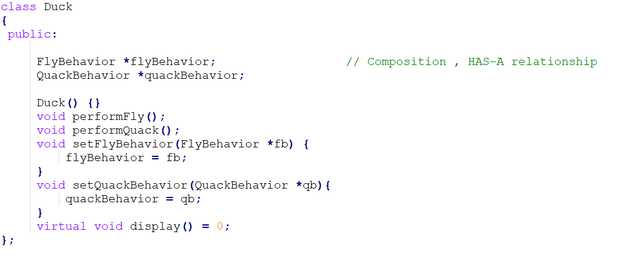
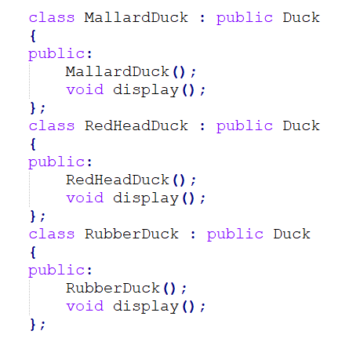

Slide 14
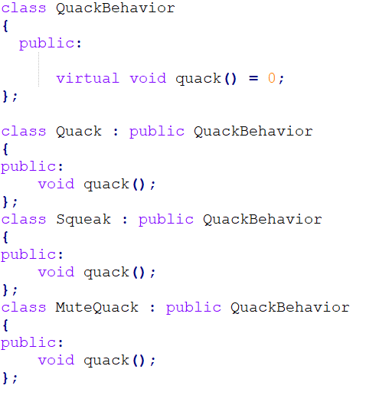
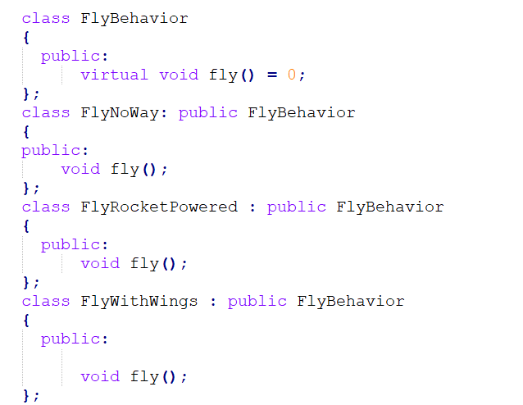

Slide 15

Advantages & disadvantage

Slide 16
advantages
Easy to switch between different algorithms (strategies) at run-time
Cleaner code because conditional-infested code is avoided
Even cleaner code since the concerns are separated into classes (a class to each strategy)

Slide 17
disadvantages
The user must be aware of all the strategies to select the right one for the right situation.
Strategy base class must expose interface for all the required behaviors, which some concrete Strategy classes might not implement.
In most cases, the application configures the Context with the required Strategy object. Therefore, the application needs to create and maintain two objects instead of one.

Slide 18
QUIZ
Which group does Strategy pattern belong to?
A. Encapsulate a command request as an object
B. Encapsulates an algorithm inside a class
C. Creates an instance of several families of classes
D. Separates an object’s interface from its implementation
Encapsulates an algorithm inside a class

Slide 19
Which group does Strategy pattern belong to?
Creational
Behavioral
C. Structural
D. None of the above
Behavioral

Slide 20
Which of the following describes the Strategy pattern correctly?
In this pattern, a class behavior changes based on its state.
In this pattern, a null object replaces check of NULL object instance.
In this pattern, a class behavior or its algorithm can be changed at run time.
In this pattern, an abstract class exposes defined way(s)/template(s) to execute its methods.
In this pattern, a null object replaces check of NULL object instance.

Slide 21
Which of the following are disadvantages of using inheritance to provide Duck behavior?
Code is duplicated across subclasses.
Runtime behavior changes are difficult.
We can’t make ducks dance.
Ducks can’t fly and quack at the same time.
Runtime behavior changes are difficult.

Slide 22
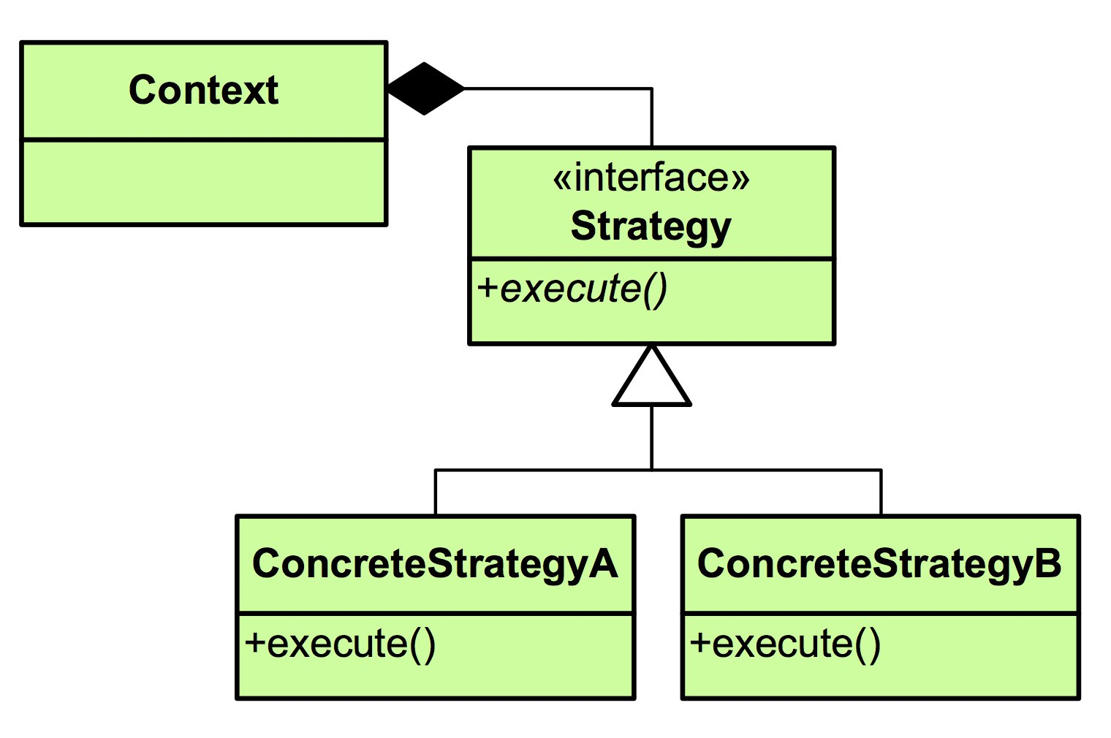


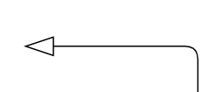
?
Choose the most suitable answer
A.
B.
C.
D. Both A and B

