Slide 1
Strategy pattern
Group 04

Slide 2
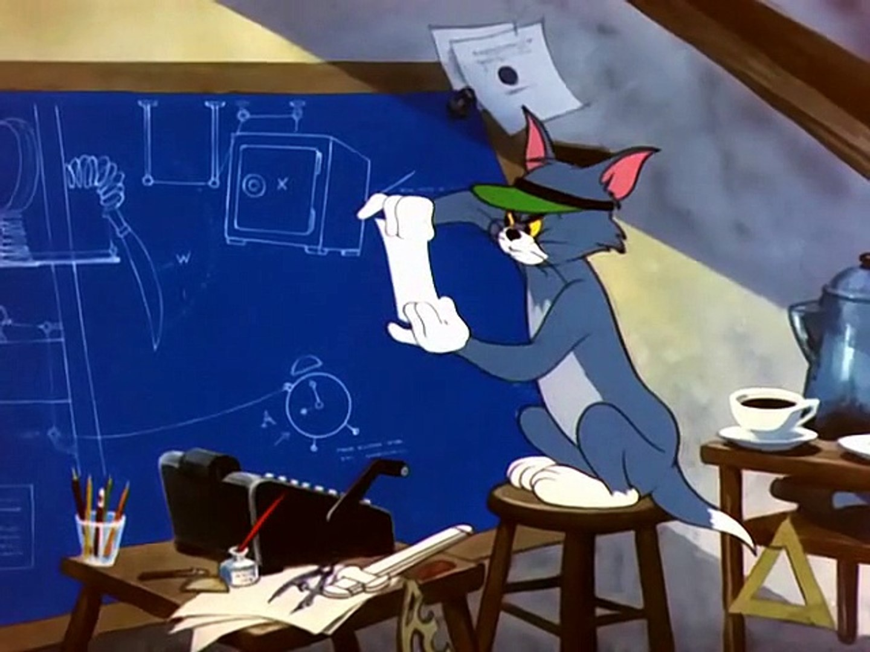
What is strategy?

Slide 3
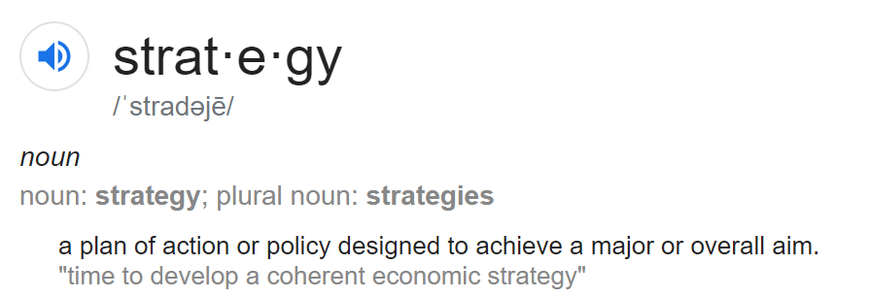

Slide 4
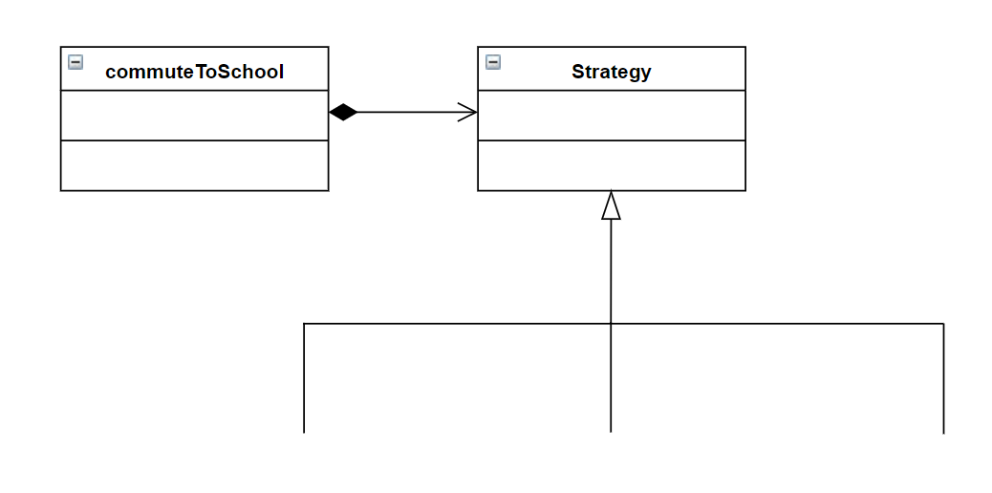



Personal vehicle
Public bus
Ride hailing
services

