Slide 1
Strategy pattern
Group 04

Slide 2
SimUDuck Example
•
Joe works for a company that makes a highly successful duck pond simulation game, SimUDuck. The game can show a large variety of duck species swimming and making quacking sounds.

Slide 3
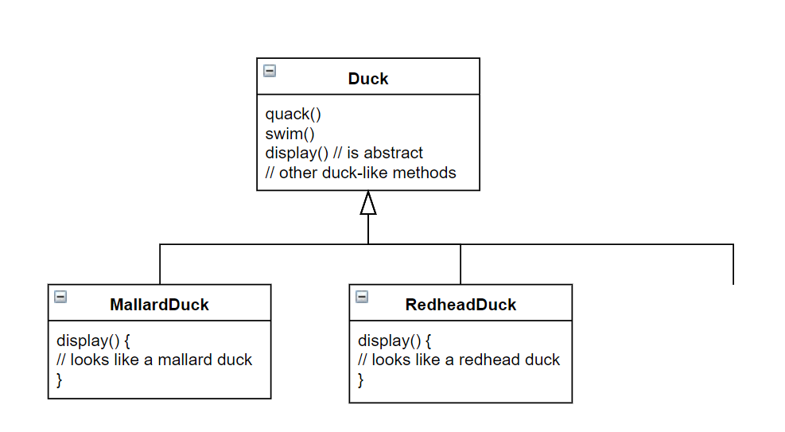
inheritance base design…
Lots of other types
of duck inherit from
the Duck class

Slide 4
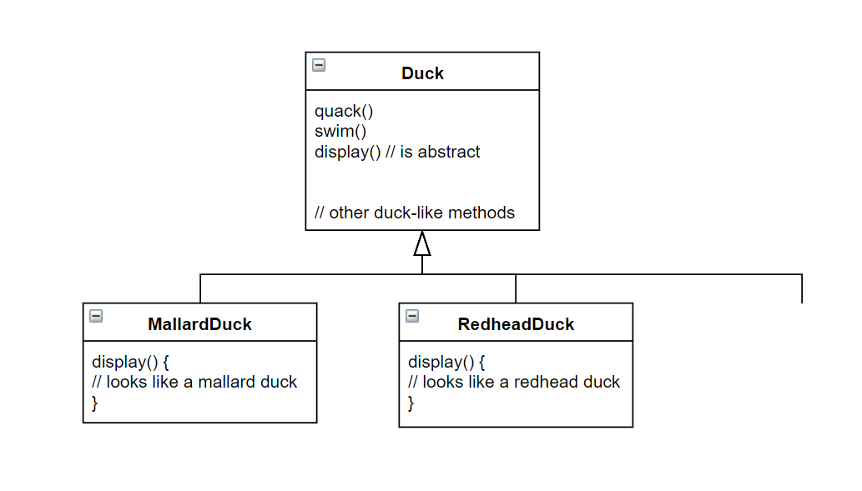

What Joe
added
fly()
Other duck
types

Slide 5
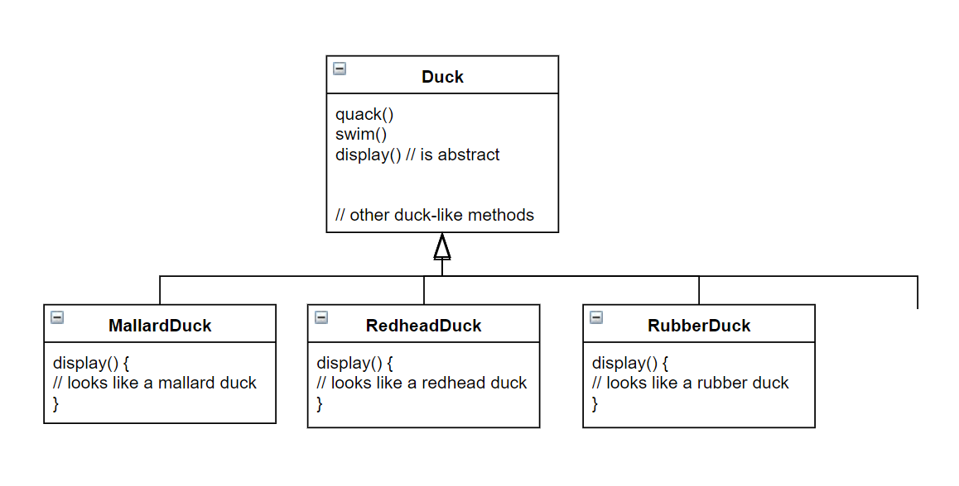
By putting fly() in
The superclass, he gave flying
ability to ALL ducks, including
those that shouldn’t
Now RubberDuck
can fly?
fly()
Other duck
types

Slide 6

Runtime behavior changes are difficult
Hard to gain knowledge of all duck behaviors
Changes can unintentionally affect other ducks
maintenance can be a nightmare!

Slide 7
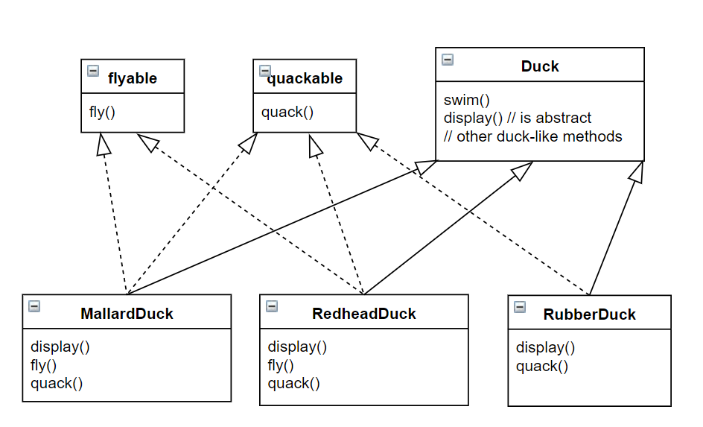
what about an interface?

Slide 8



what about an interface?
duplicated code!

Slide 9
Strategy pattern
•
Origin: the Strategy Pattern is known as a behavioural pattern and is used to manage algorithms, relationships and responsibilities between objects
Intent: defines a family of algorithms, encapsulates each algorithm, and makes them interchangeable within that family
strategy lets the algorithm vary independently from clients who use it

