Slide 1
2020
Ce
CUSTOMER
OUTAGE EXPERIENCE

Slide 2
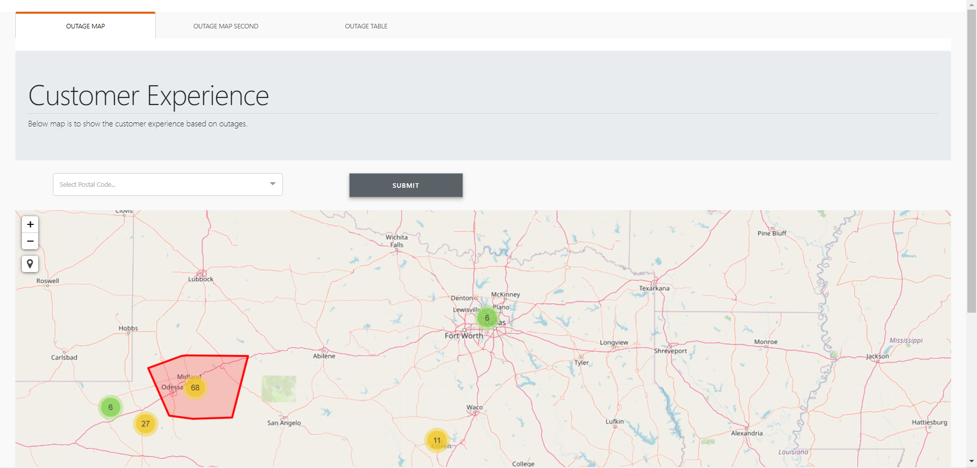
OUTAGE MAP- Overview- Based on Service Area
Provide an Overview of Number of Outages based each of Oncor Service Areas(eg Metro and Non-Metro)

Slide 3
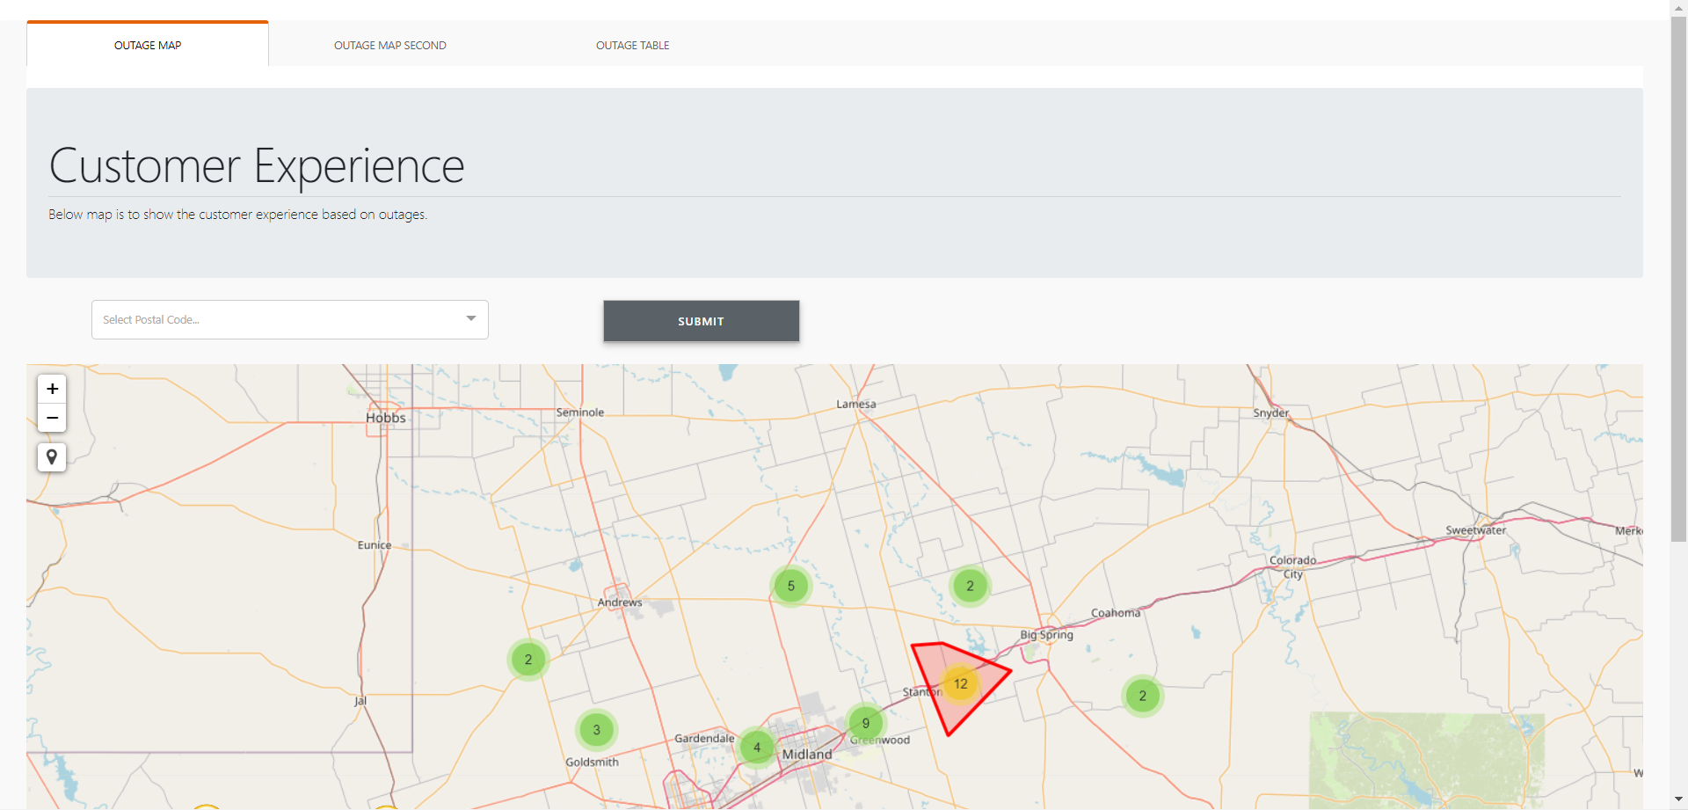
OUTAGE MAP- Zip Code
On click of the Service Outage. It Provides an Overview of Outages based on the Zip Codes

Slide 4
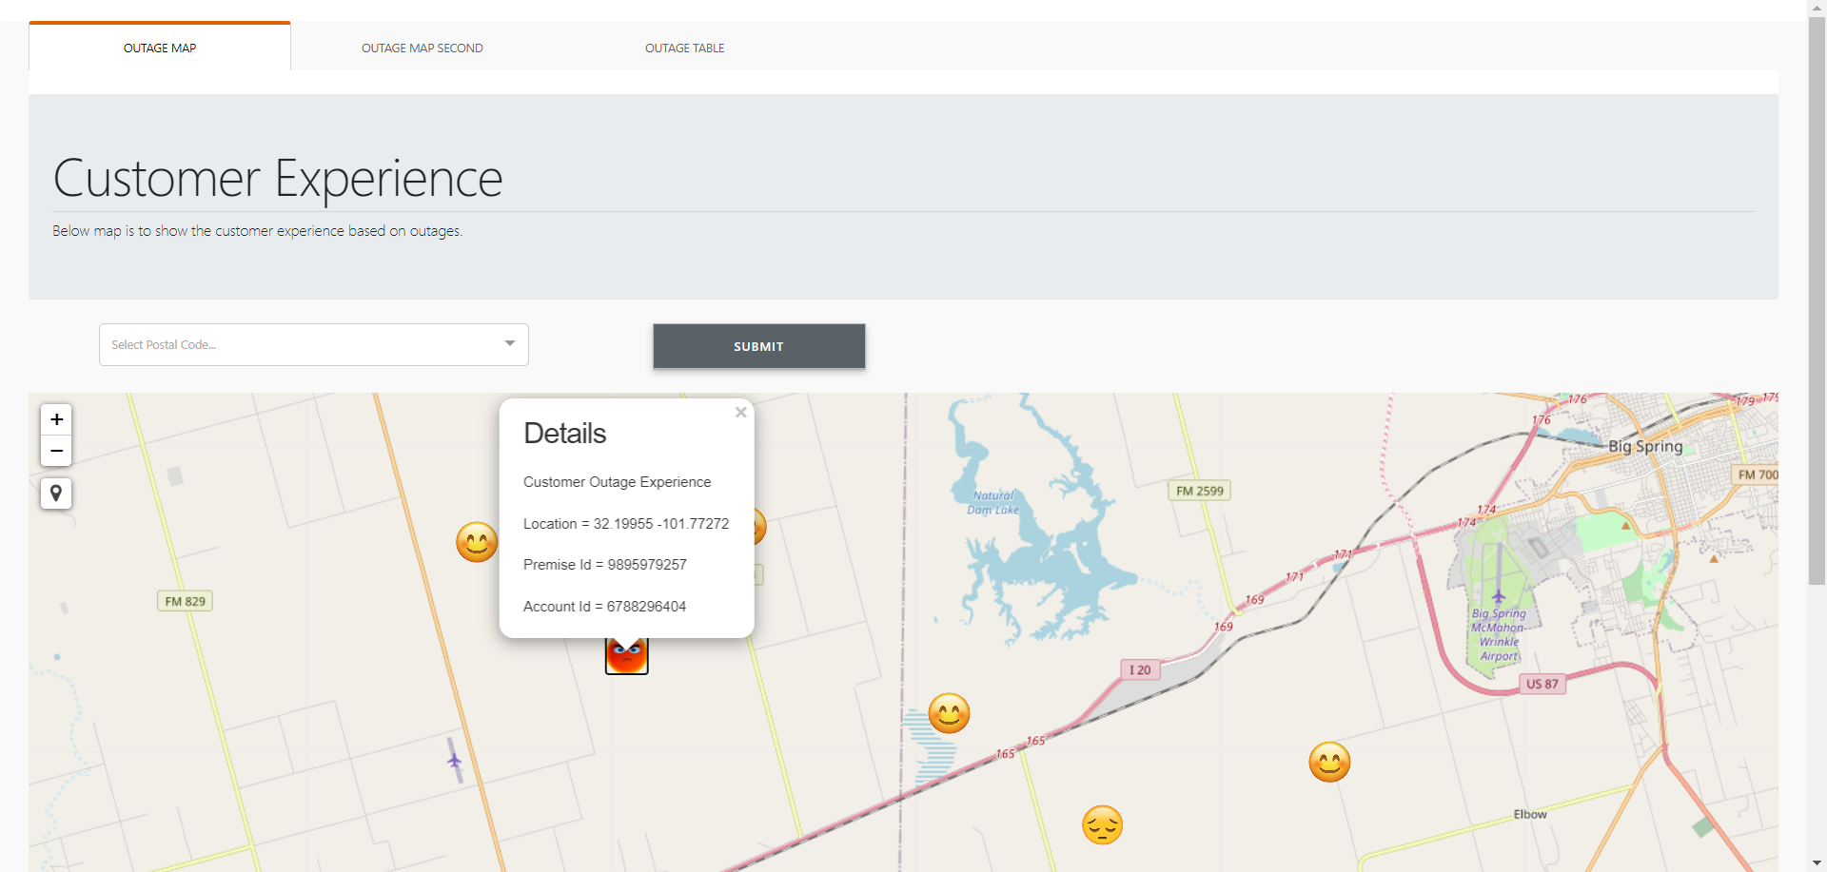
OUTAGE MAP- Account
On click of the Zip. It Provides an Overview of Outages based for the various accounts as well as the Perceived Emotion of the Accounts(based on the ETOR)

Slide 5
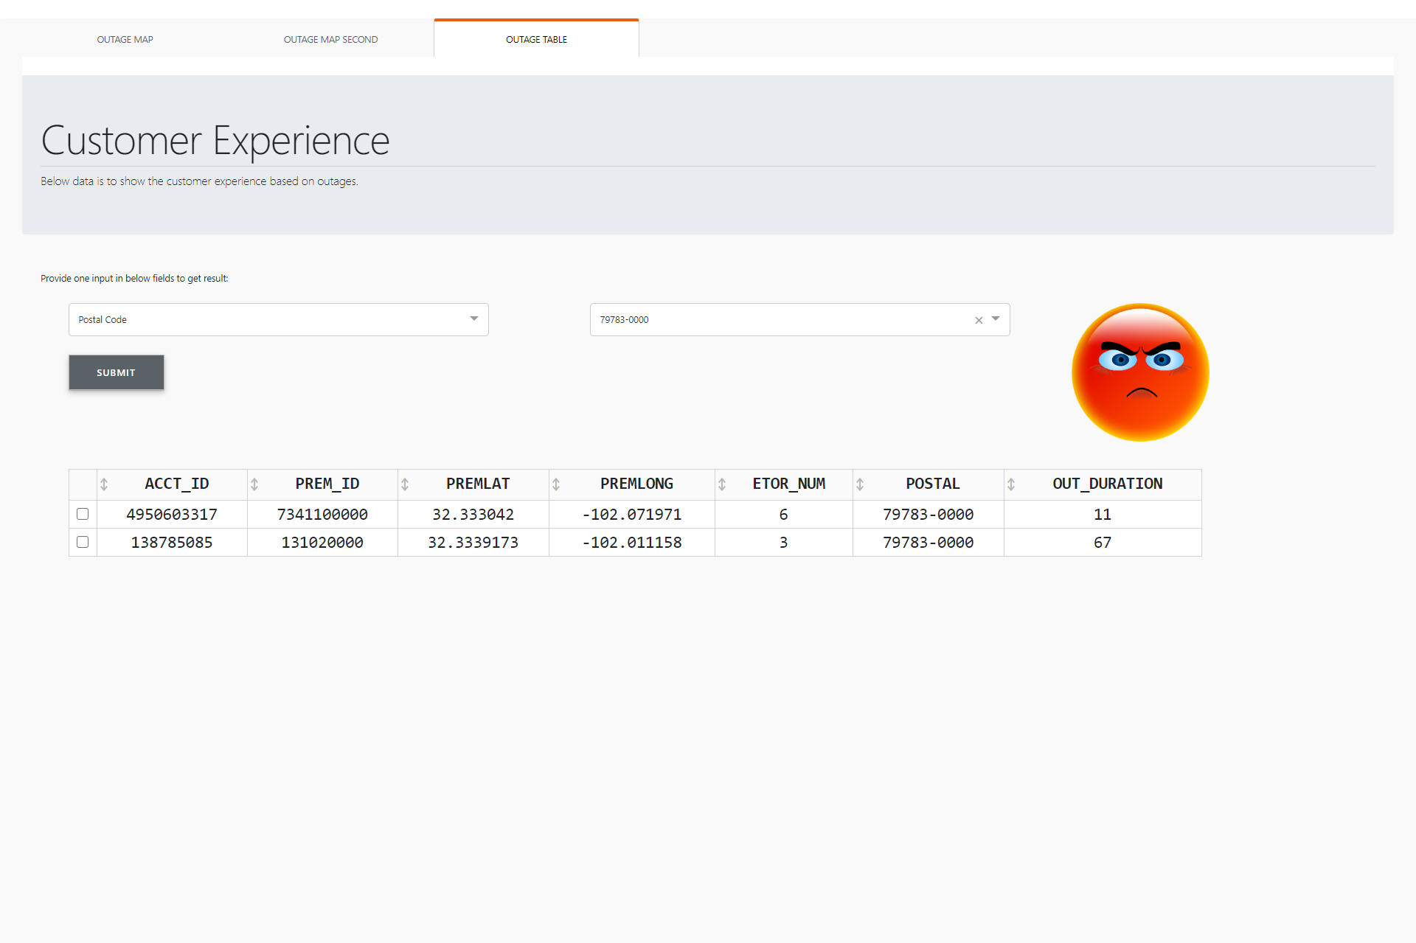
OUTAGE
TABLE
CUSTOMER EXPERIENCE

Slide 6
Thank You

