Slide 1
2020
Ce
CUSTOMER
OUTAGE EXPERIENCE

Slide 2

welcome
OUTAGES
This is a dashboard which shows the customer experience on outages in map.

Slide 3

MISSION
TO SHOW CUSTOMER EXPERIENCE
Ce
We want to create a dashboard which shows us customer experience on number of outages in area or locality. We can also search with postal codes, premise id, account id for a customer as well,

Slide 4
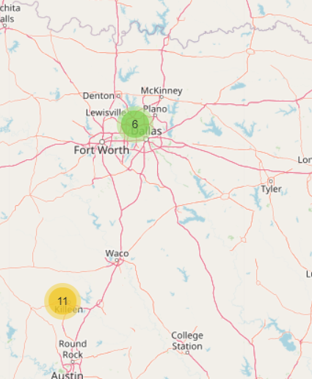
EXAMPLE
OUR VISION
TO MAP
The overall experience faced by customers in that locality
SEARCH

Slide 5
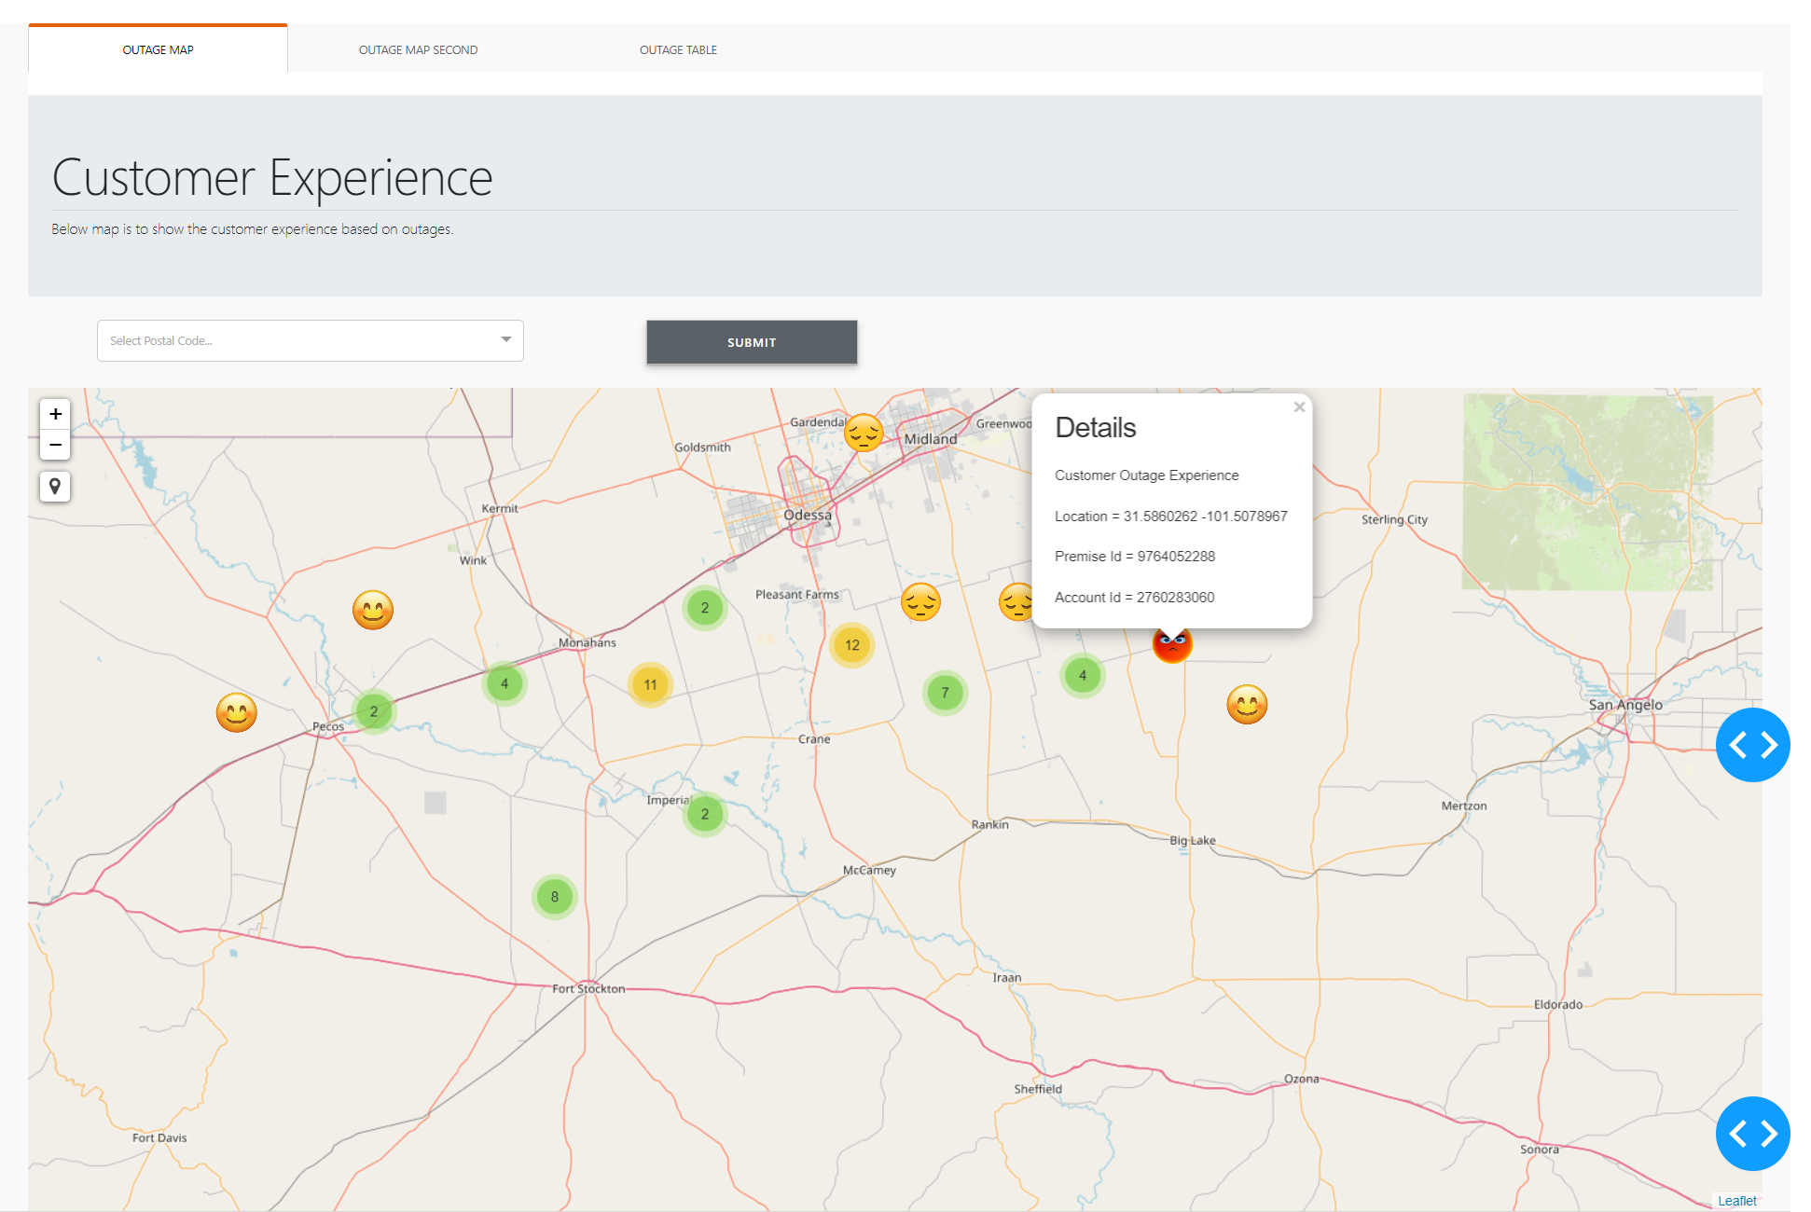
OUTAGE
MAP
CUSTOMER EXPERIENCE

Slide 6
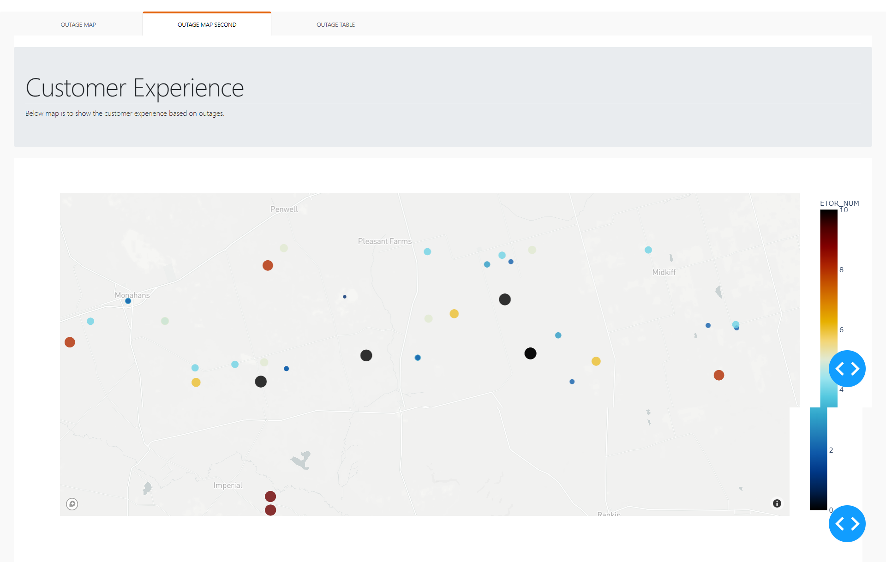
OUTAGE
MAP
CUSTOMER EXPERIENCE

Slide 7
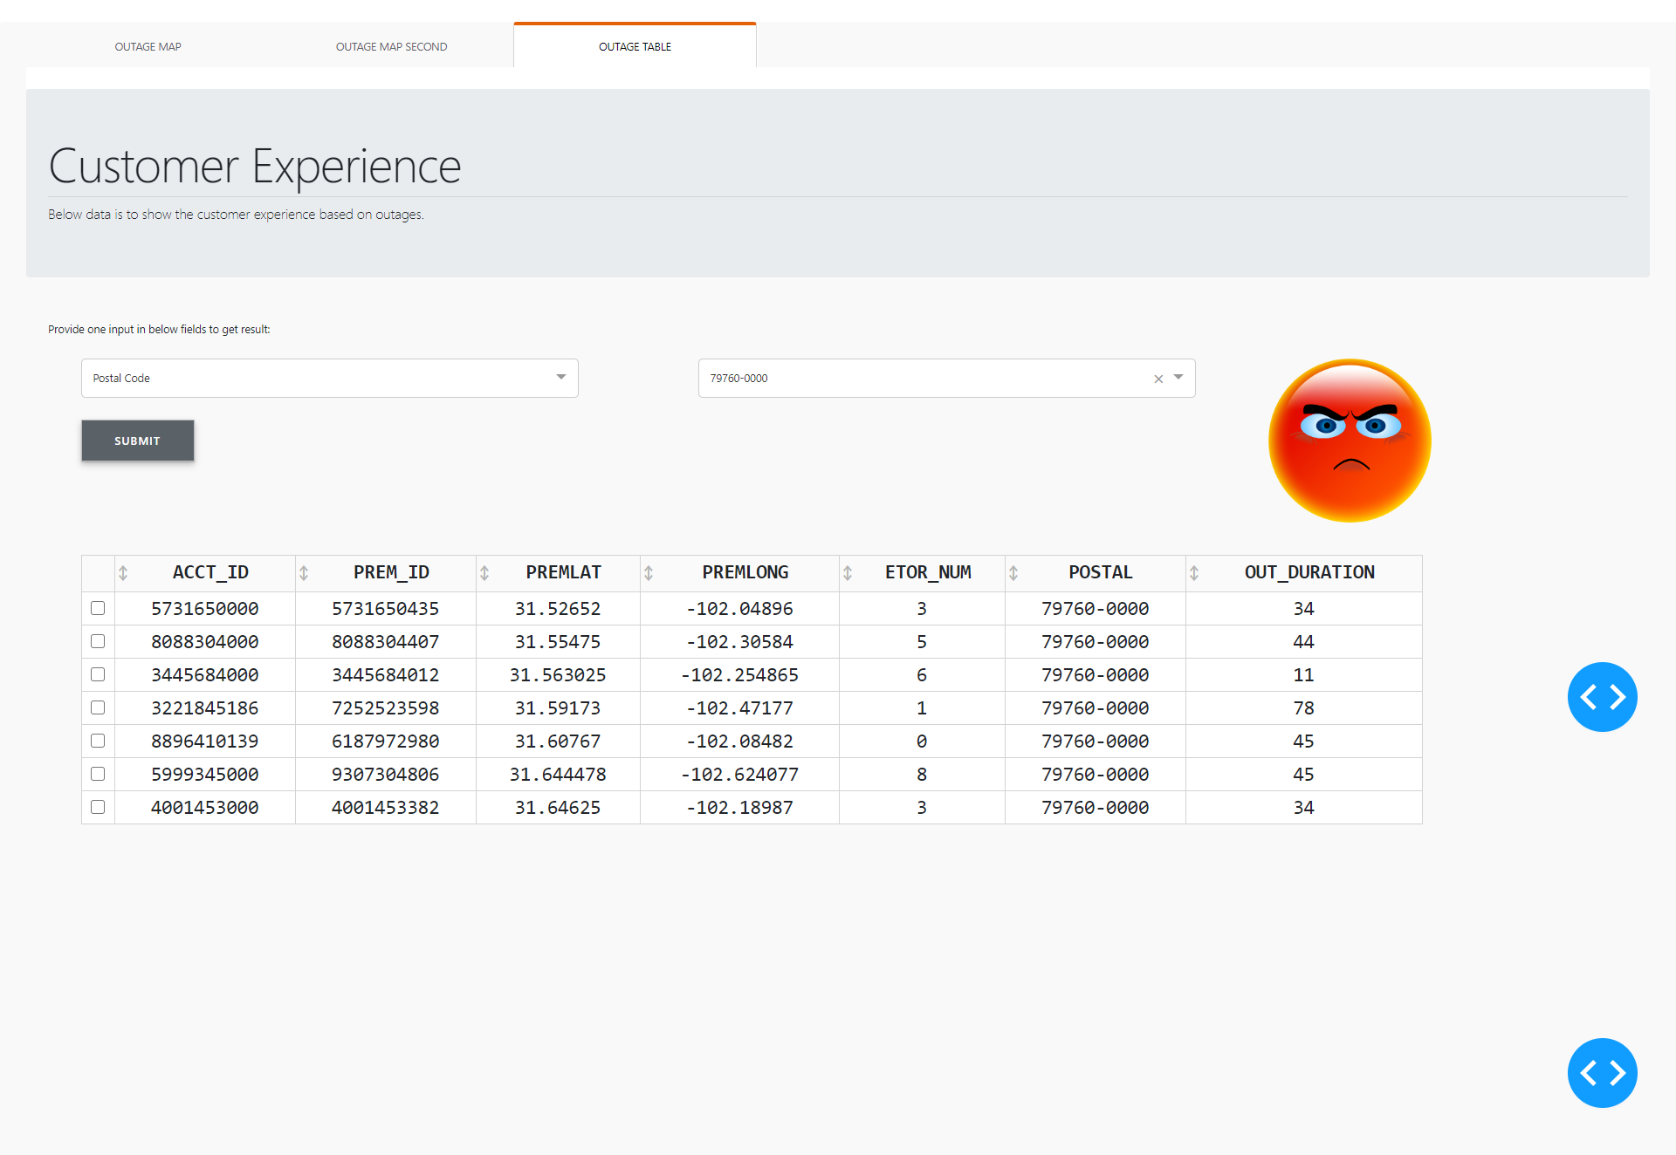
OUTAGE
TABLE
CUSTOMER EXPERIENCE

Slide 8
Thank You

