Slide 1




HEALTH PLANNER APPLICATION
Mission To Heal. Passion To Care.
CLOUDRACERS TEAM
Vaibhav Sobti
Maneesh Basmatkar
Nitin Kumar
Dhanaji Nalavade
Divya Attri
Mission To Heal. Passion To Care.

Slide 2
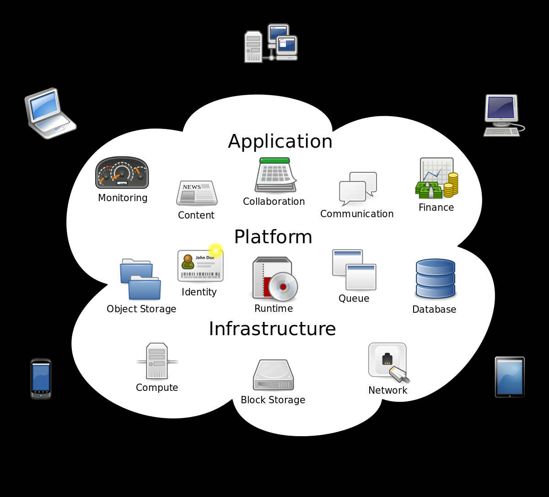

AGENDA
Overview of the Application
Project planning
Overall Architecture of the Solution
Demo of the Application
DevOps Implementation
Summary

Slide 3




APPLICATION OVERVIEW
REGISTER
User friendly registration Process to register patients and upload their Medical reports.
TRACKING
View the List of Patient Registered
SELF SERVICE
Ability for Patients using a secure login to self register on the Portal
COVID DATA
Ability to view COVID Data Real Time

Slide 4



Overview
Technical Solution Overview
Solution Overview
Web Based application used by the Hospital Administrator staff and patients to register and upload the patient medical records and history.
The application provides an ability to view country wide Covid Information using external API
CI/CD pipeline is implemented as part of this solution.
Solution implemented on Multi - Cloud
Technology Used
PYTHON
ANGULAR JS
MONGO DB
IBM Cloud API Gateway services
IBM Cloud Watson services
Public Novel COVID API
Jenkins on the Private Cloud

Slide 5

PROJECT PLANNING- SPRINT
Project implemented in four sprints as mentioned below
Sprint – I (06 Apr-25 April-2020)
Learning
Sprint – II (27 April- 16 May)
Architect & Prototype
Sprint– III (18 May-12 June)
Build and Integrate the Solution
Sprint– IV (15 June-04 July)
Implement the CI/CD Pipeline
Sprint - I
IBM Learning
Knowledge Sharing sessions
Sprint - II
Implement Seed Project on OpenShift Cluster
Build the Overall Architecture
Prototype the User Interface
Sprint - III
Implement the API Manager
Implement the Watson Service
Implement the COVID API
Implement the new UI
Integrate the application
Sprint - IV
Implement the CI/CD Pipeline
Test and fix the Issues

Slide 6
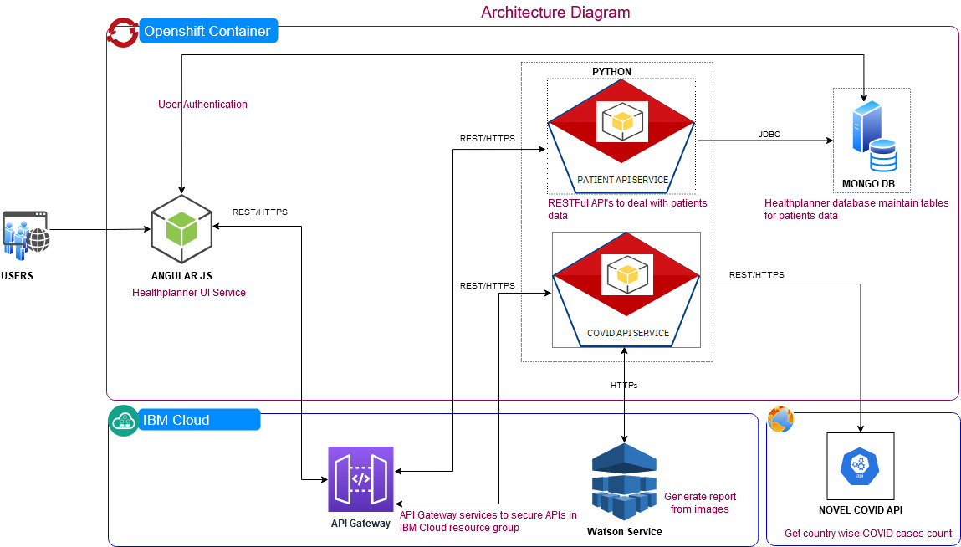
Architecture Overview
Below diagram represent overall architecture of Healthplanner application

Slide 7
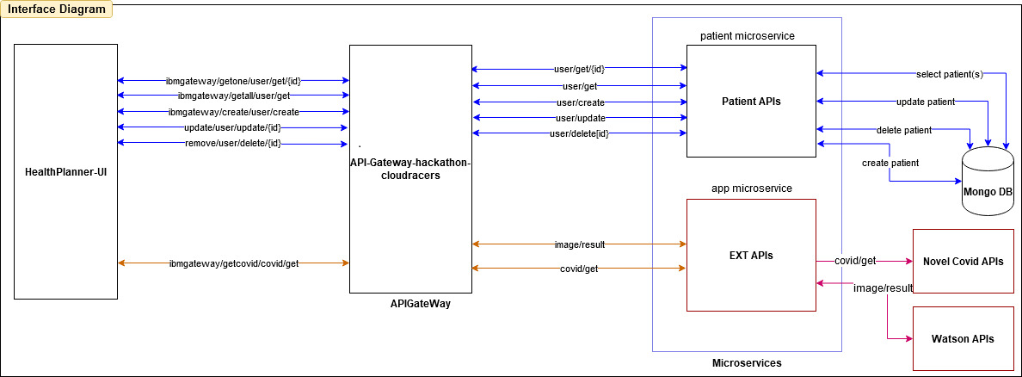
Interface Diagram

Slide 8
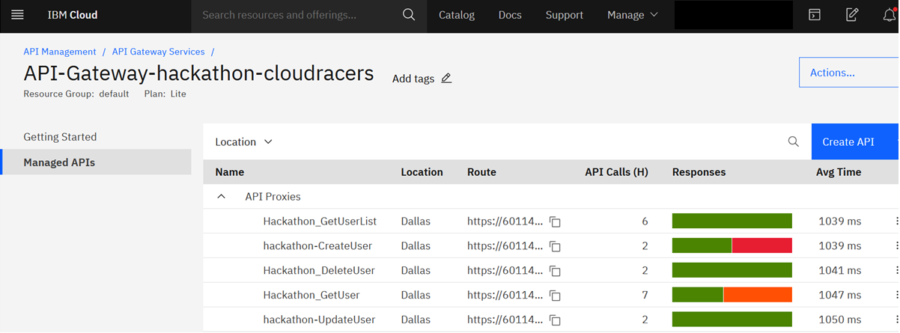
IBM Cloud API Gateway Configuration
IBM Cloud API gateway service used for API Management

Slide 9
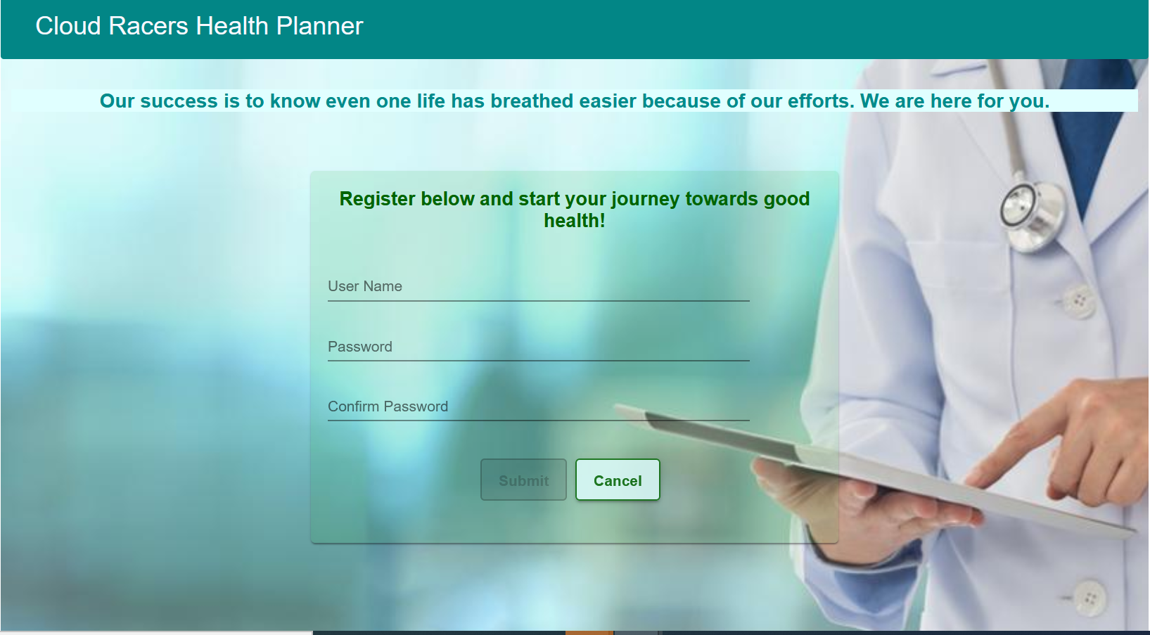
UI DESIGN- Self Registration
Self Registration page provided to create an account

Slide 10
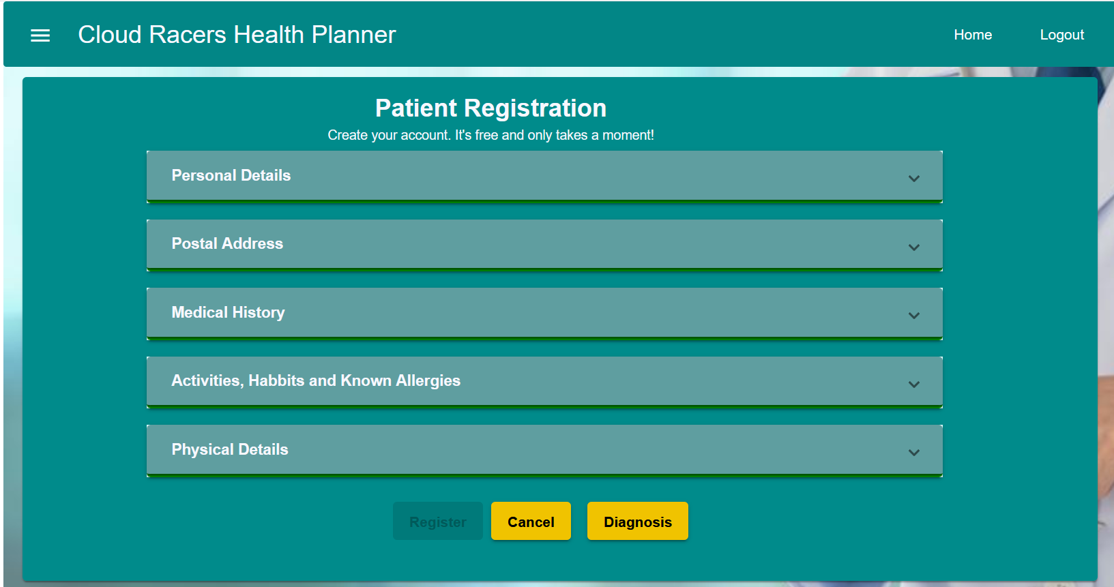
UI DESIGN-Patient Registration(1)
User friendly UI build to Add/Modify/Update/Delete patient information

Slide 11
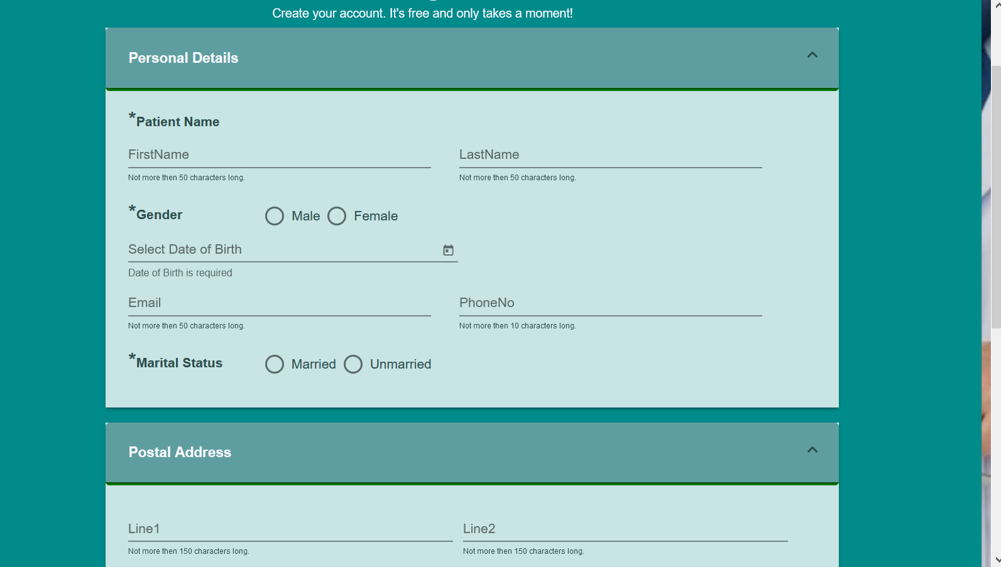
UI DESIGN-Patient Registration(2)
User friendly UI build to capture patient information

Slide 12
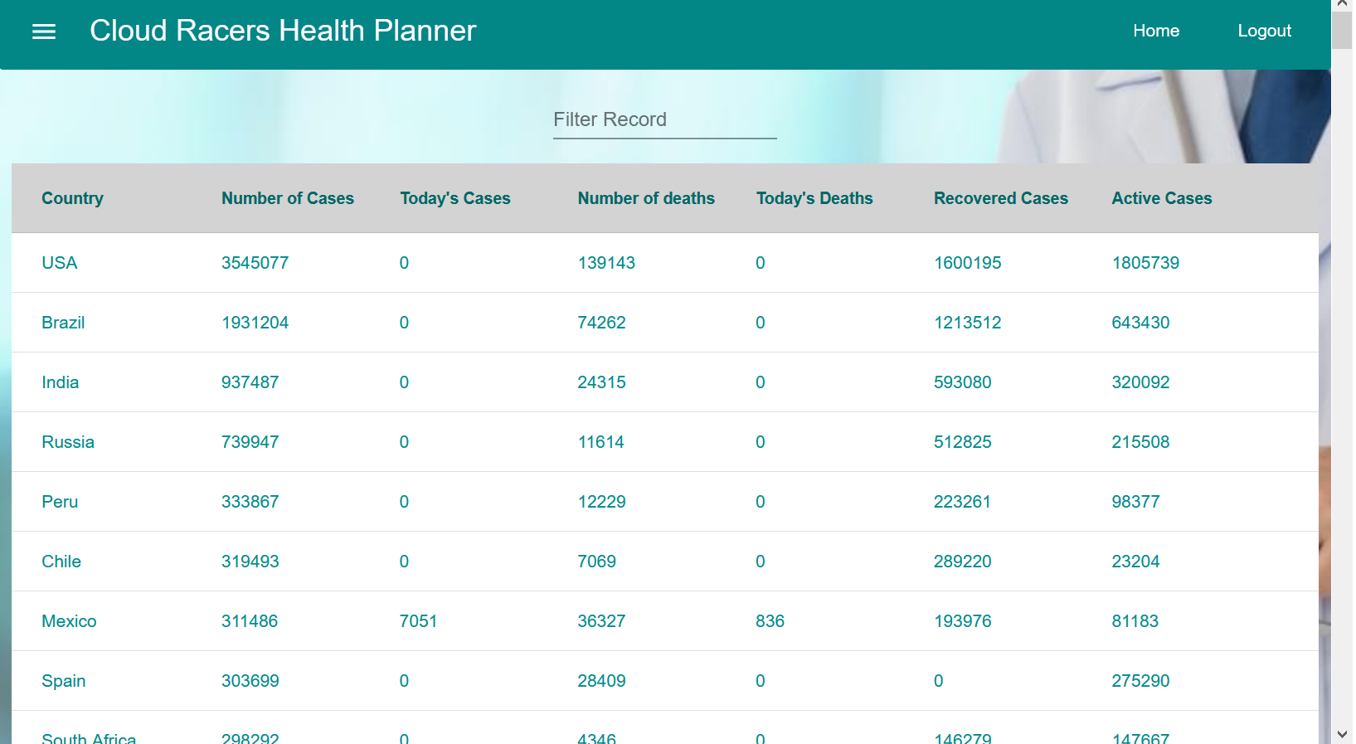
UI DESIGN-COVID DATA
Novel COVID Public API invoked to get country wide Covid cases data.

Slide 13
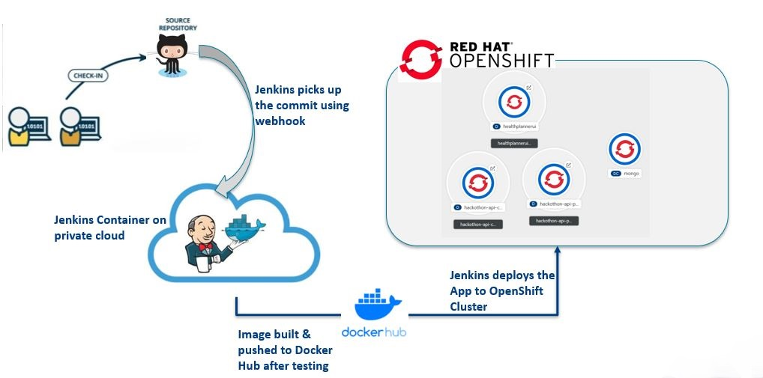
CI-CD PIPELINE Using Jenkins
CI-CD Pipeline is implemented on private cloud using Jenkins for build automation

Slide 14
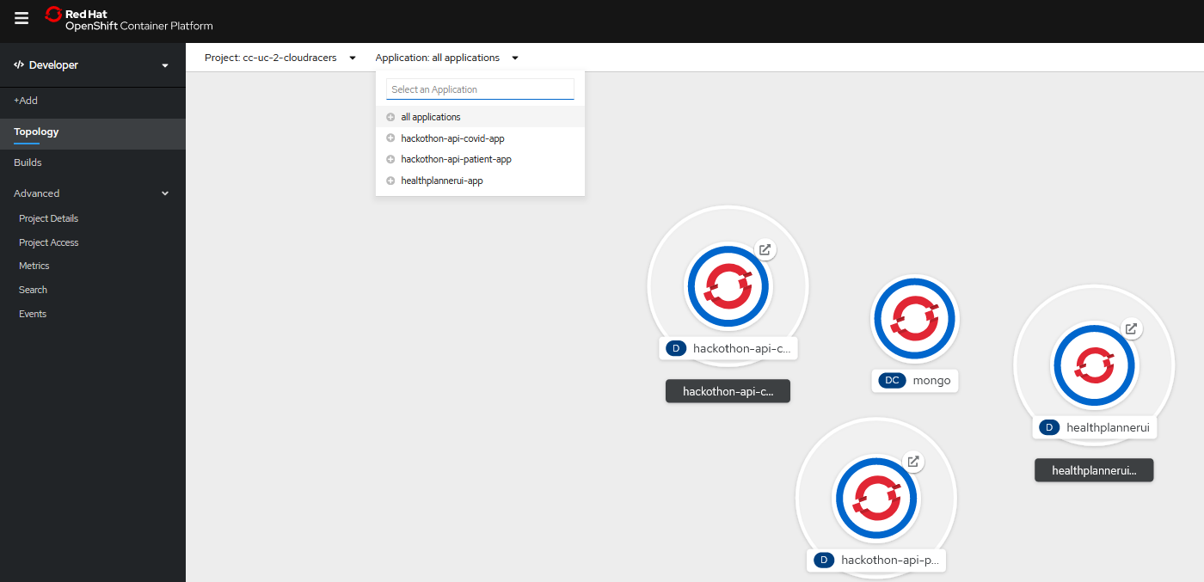
CLUSTER POD CONFIGURATION
POD configuration in OpenShift cluster

Slide 15


Achievements
The team got to learn market trending skills & technologies that will definitely help all of us in contributing or innovating more in our current project or even at IBM level.
The journey was beyond just virtual trainings as we had Webinars, Quizzes, Hands-On, Team collaboration & brain storming which has developed confidence in us for the areas covered under Hackathon. We feel confident that we can develop end to end cloud based solutions from scratch.
Participating in Hackathon enabled us to continue learning each day without fail owing to the Hackathon timelines and by looking at the spirit & dedication of everyone in the team . It kept us going even at times when project wise we were overloaded with work .
Being part of the Hackathon Slack channel we also became aware of the issues faced by other teams & their probable solutions which is also a good takeaway for us.

Slide 16

Thank You Note
We the CloudRacers team would like to extend special thanks to the efforts, dedication , availability & promptness of all the Hackathon Organizers & SMEs . The way the whole event was organized & carved assuring learning of the all the participants is really very appreciable. Thanks for being wonderful guides, teachers & problem solvers .
2) Would also like to extend our gratitude towards IBM who empowered all of us with these learning platforms like providing access to RedHat Openshift which we acknowledge wouldn’t have been an easy task.
3) At last but not the least thanks & Cheers to every team member of CloudRacers for making such a beautiful symphony of knowledge & commitment towards learning.

