Slide 1
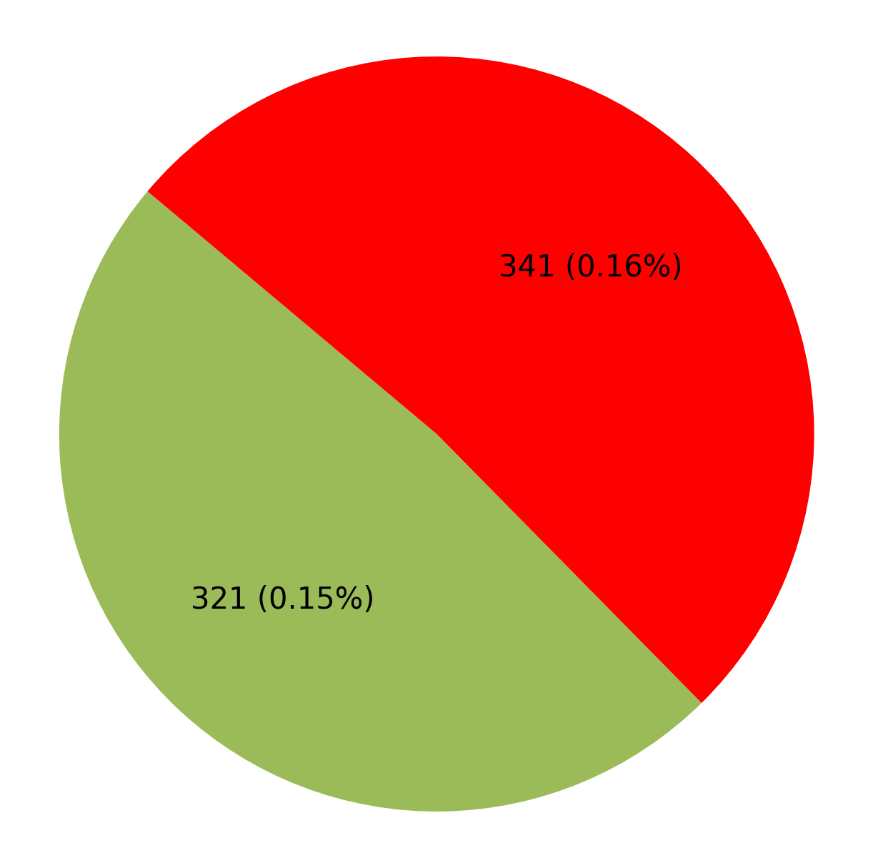
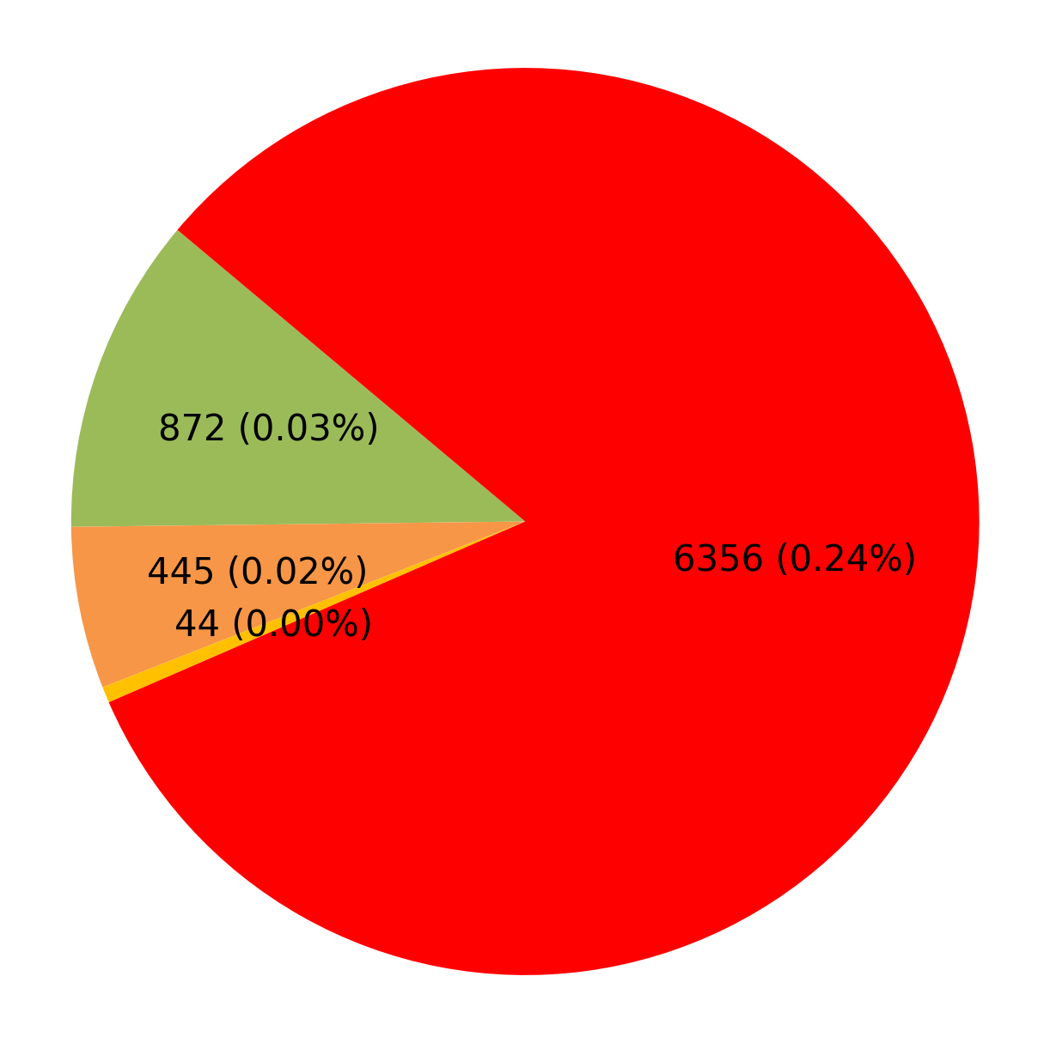
Defect % Analysis (Against Inspected Quantity)
ERIO AMBE FASTNERS PVT.LTD. Patna Bihar
ERIO CALCUTTA SPRINGS LTD. Howrah West Bengal
Plant-wise Defect Analysis
Toe load
PIO Rejection Reason
Hardness
Marking
1

Slide 2
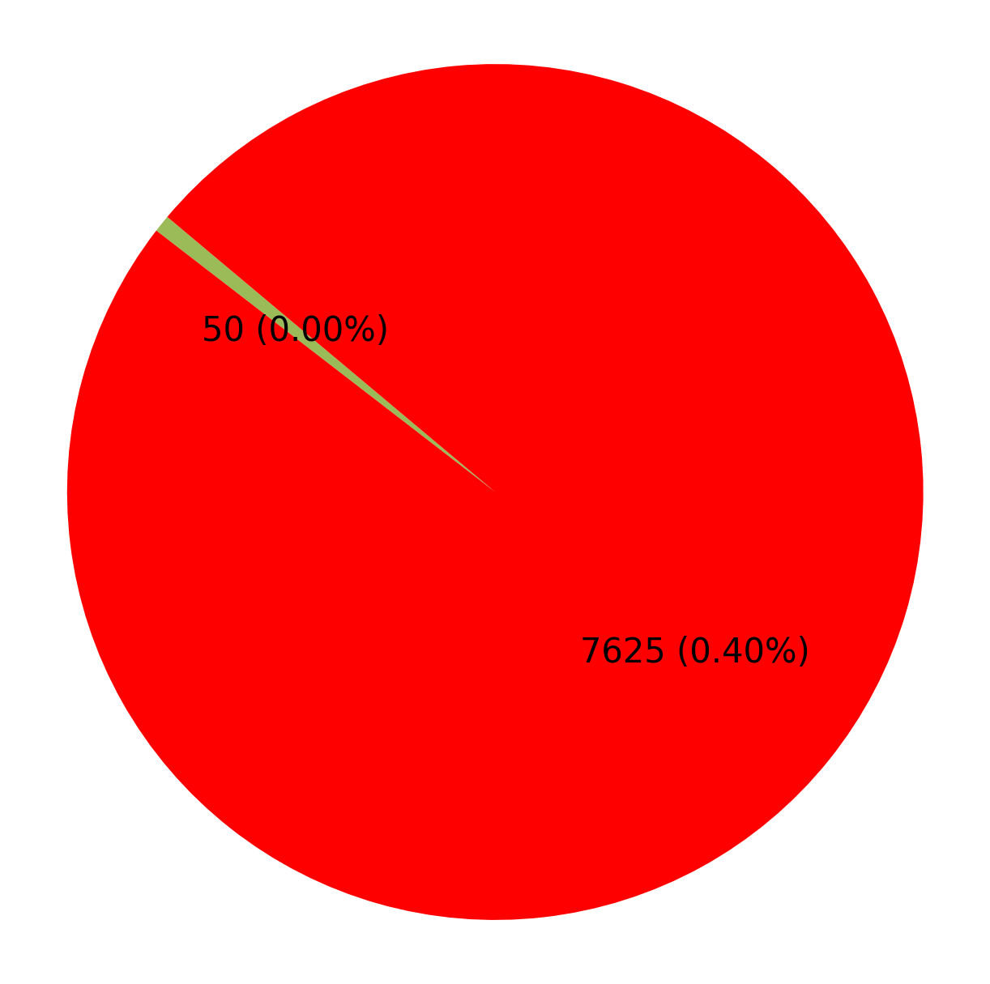
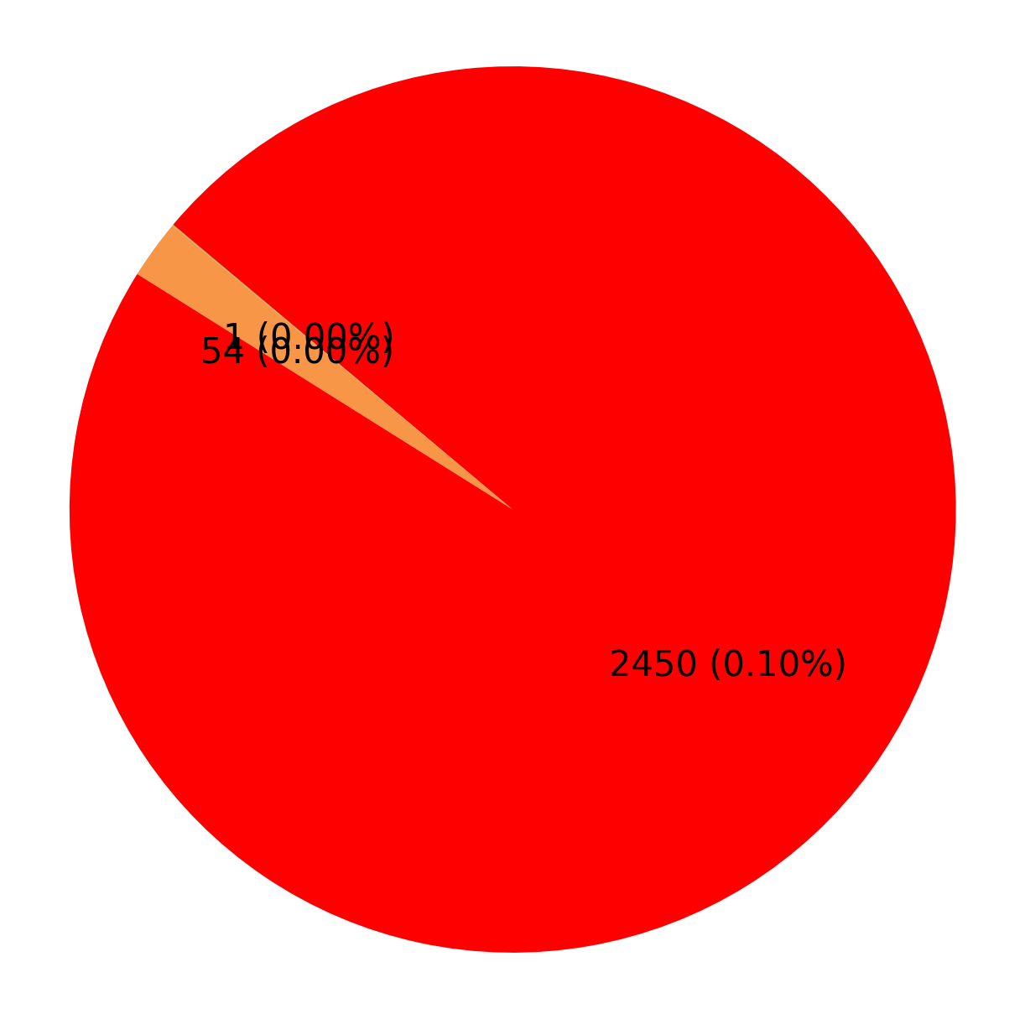
Defect % Analysis (Against Inspected Quantity)
ERIO KALIMATA ISPAT (Unit-1) Howrah West Bengal
ERIO KALIMATA ISPAT (Unit-II) Durgapur West Bengal
Plant-wise Defect Analysis
Toe load
PIO Rejection Reason
Hardness
1

Slide 3
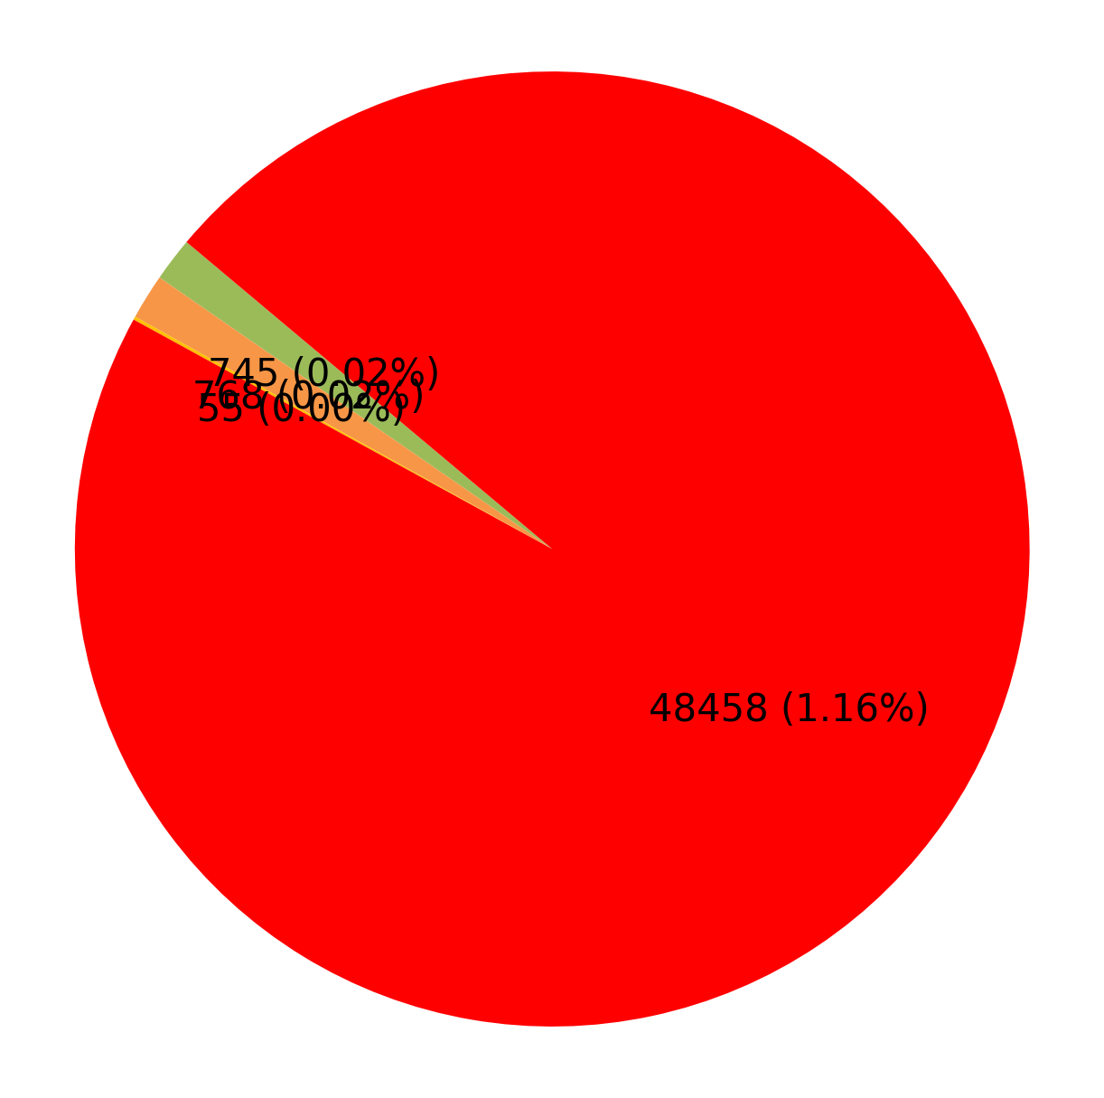
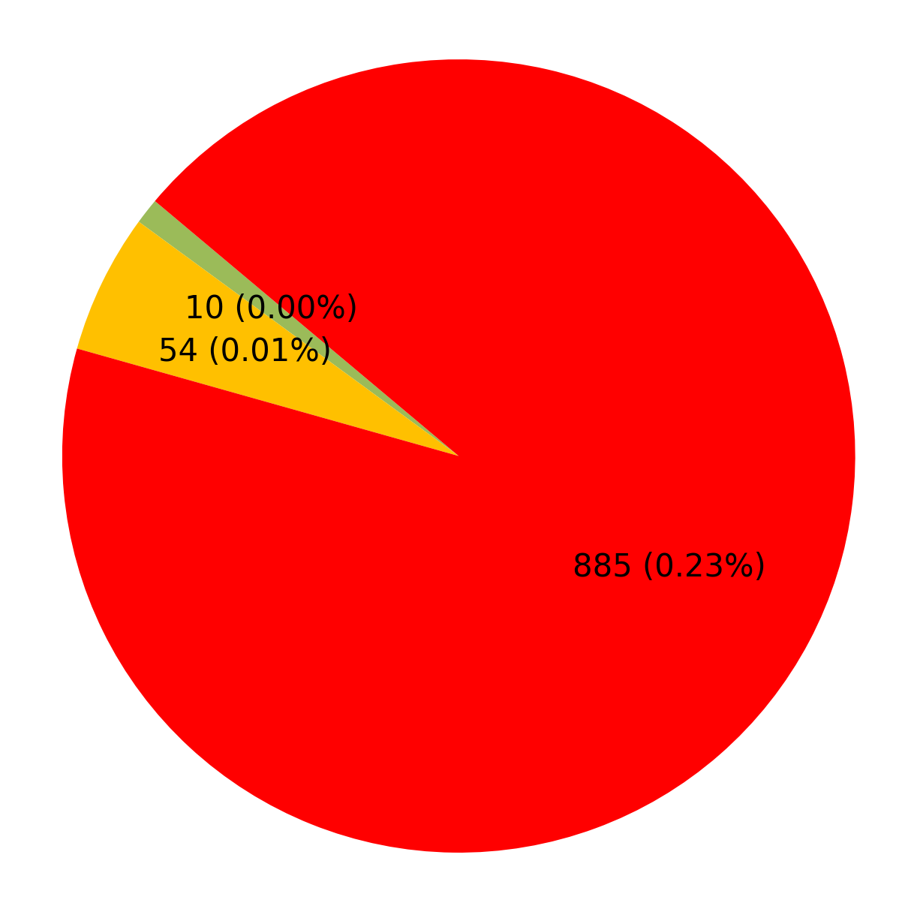
Defect % Analysis (Against Inspected Quantity)
ERIO KALIMATA VYAPAAR (Unit-II) Durgapur West Bengal
ERIO KDS ENGG. PVT. LTD. Howrah West Bengal
Plant-wise Defect Analysis
Toe load
Hardness
Marking
PIO Rejection Reason
1

Slide 4
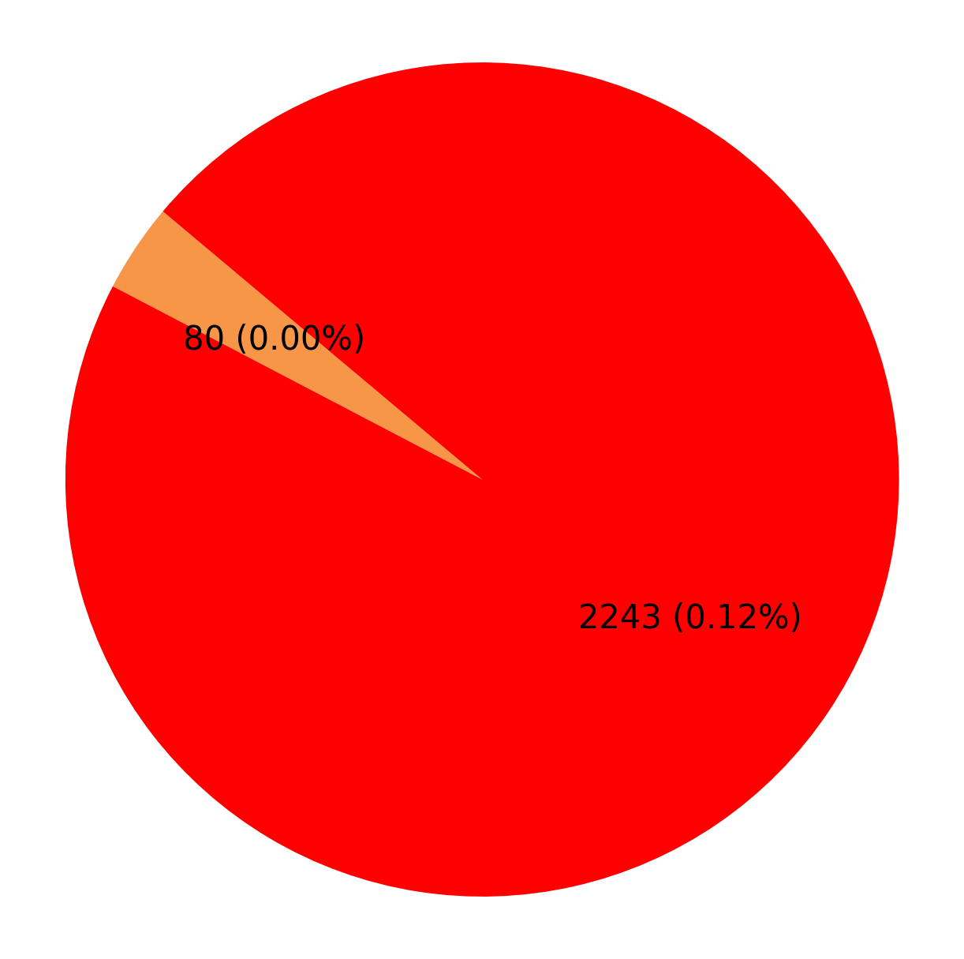
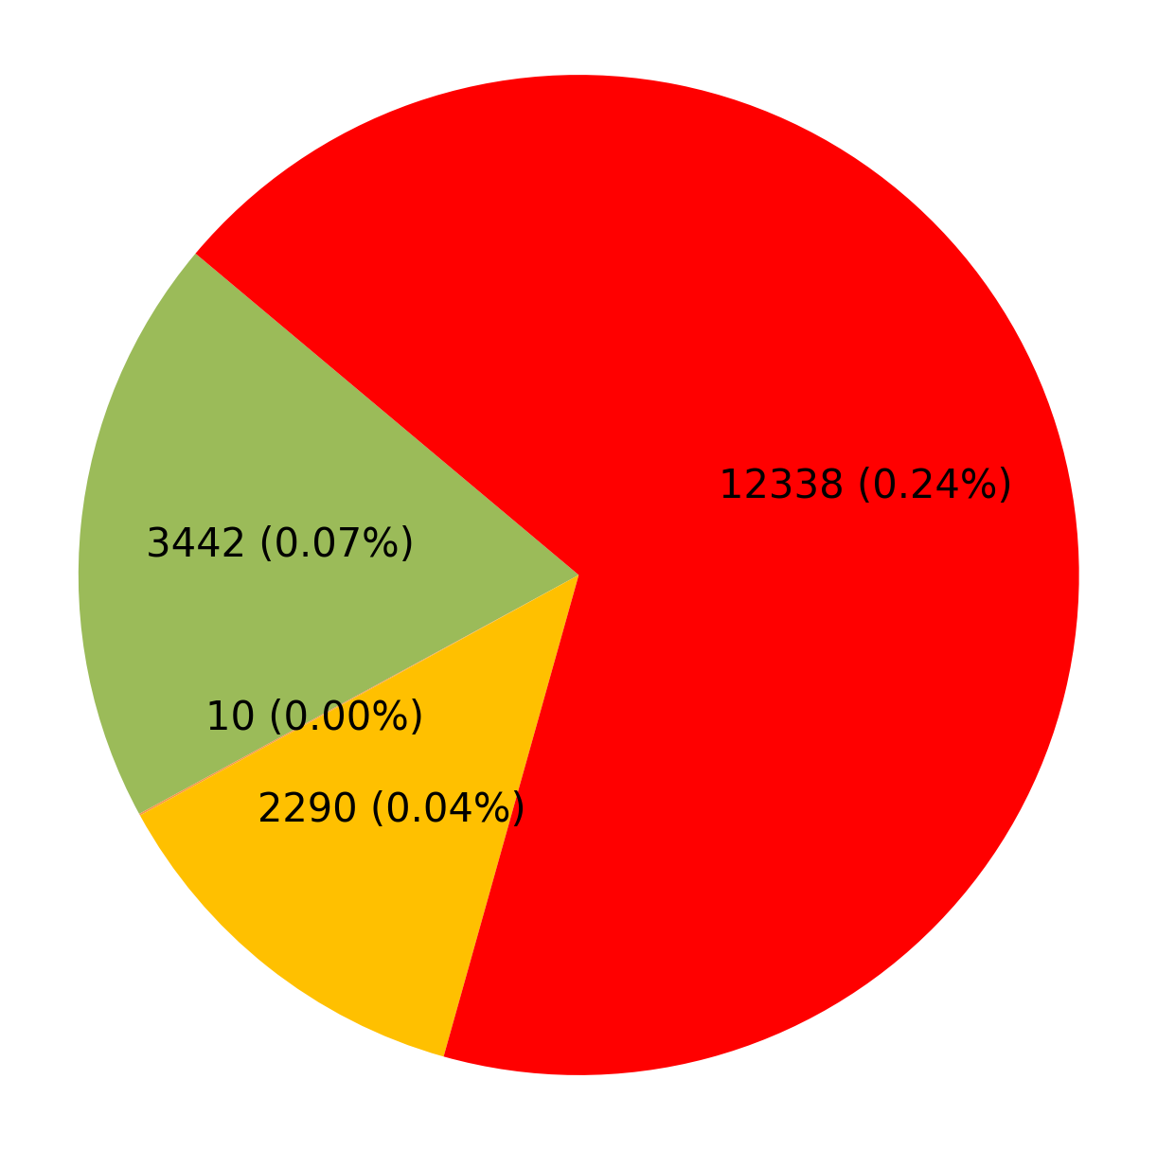
Defect % Analysis (Against Inspected Quantity)
ERIO KRISHNA INFRATECH Jharsuguda Odisha
ERIO KSE ELECTRICALS PVT LTD Howrah West Bengal
Plant-wise Defect Analysis
Hardness
PIO Rejection Reason
Toe load
Marking
1

Slide 5
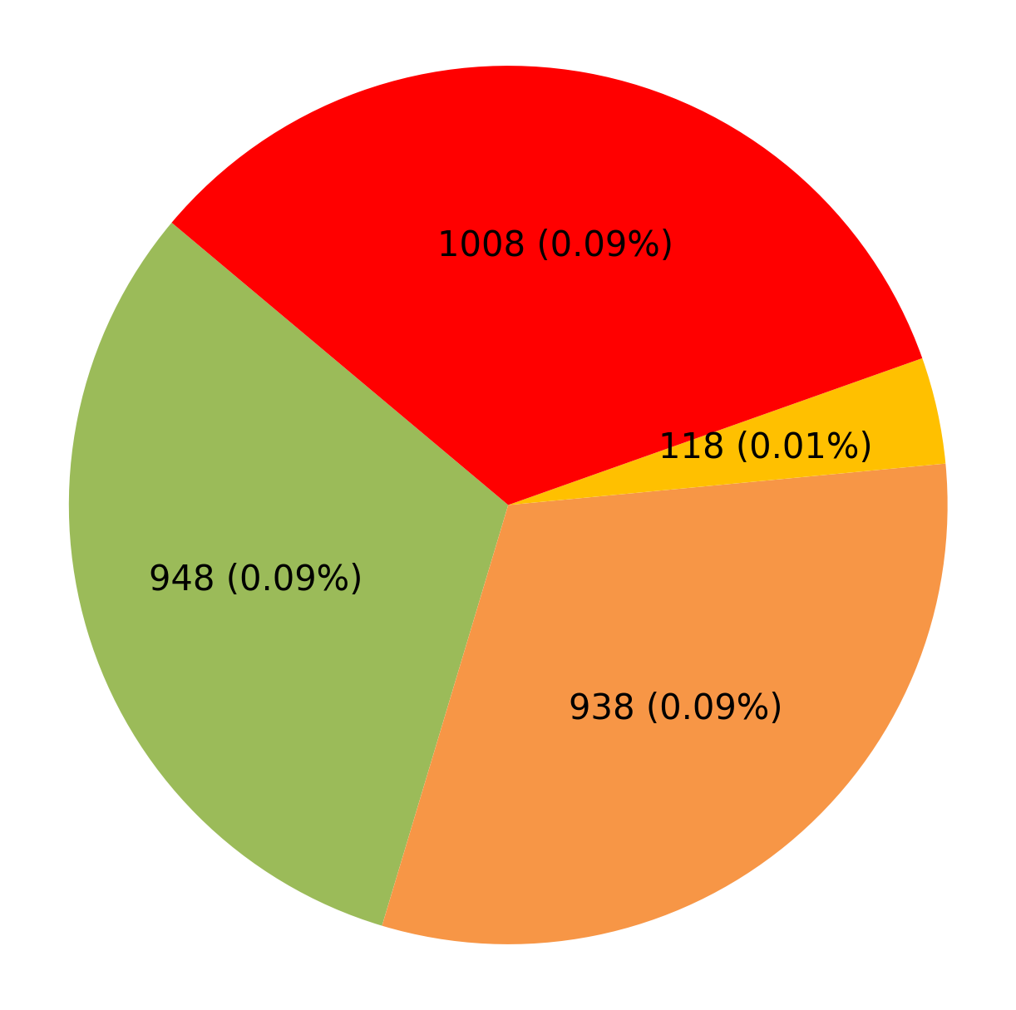
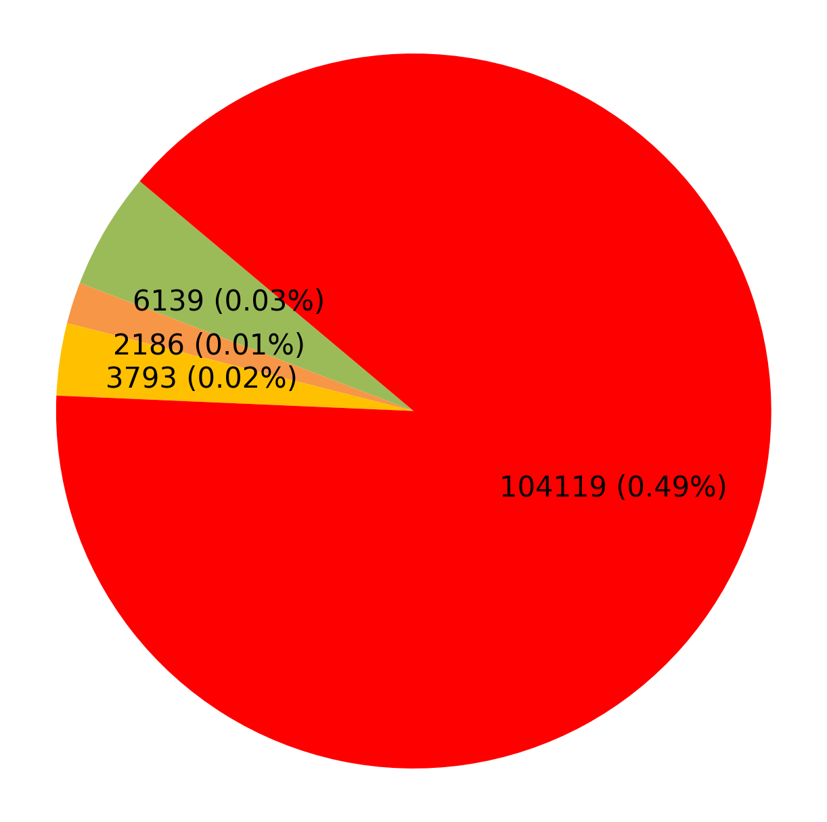
Defect % Analysis (Against Inspected Quantity)
ERIO LNVS INFRA PVT. LTD Tatanagar Jharkhand
ERIO Surya Alloys Industries Limited Durgapur West Bengal
Plant-wise Defect Analysis
Toe load
Hardness
Marking
PIO Rejection Reason
1

Slide 6
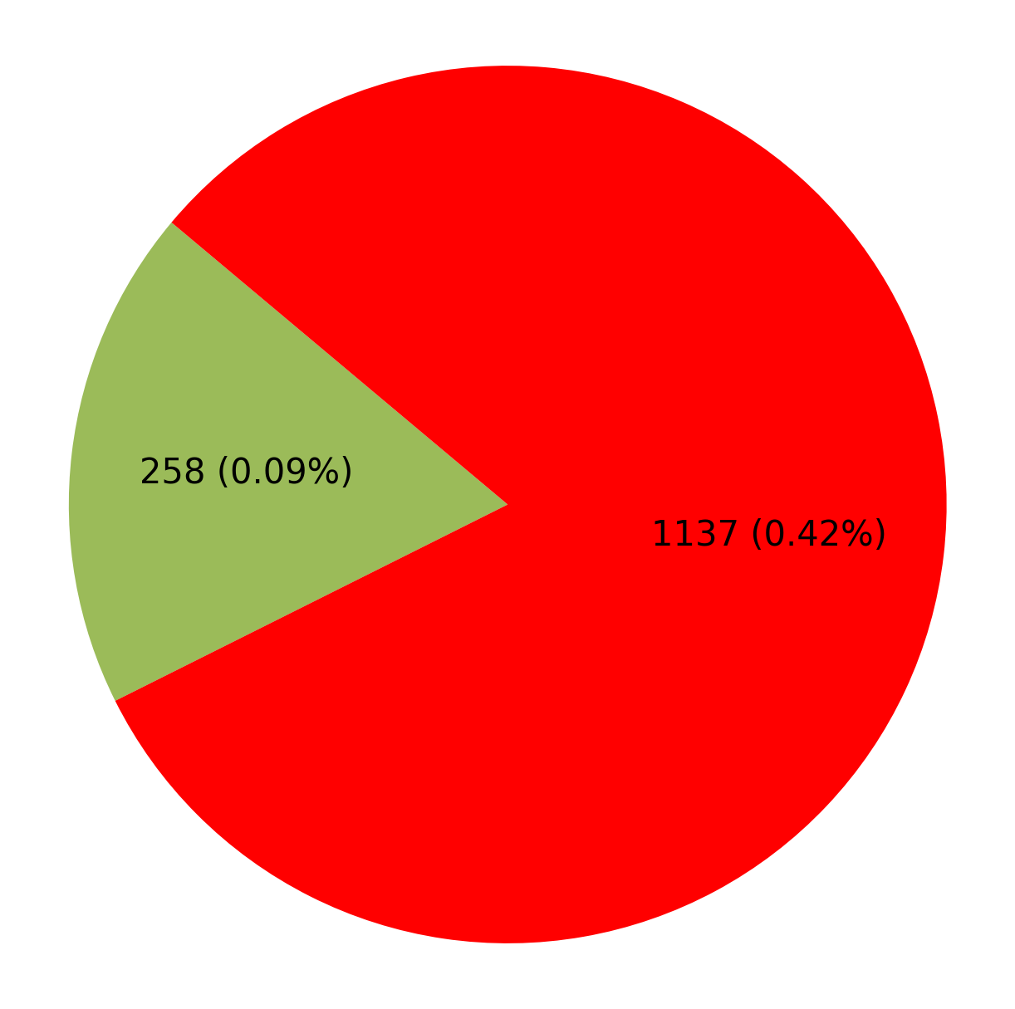
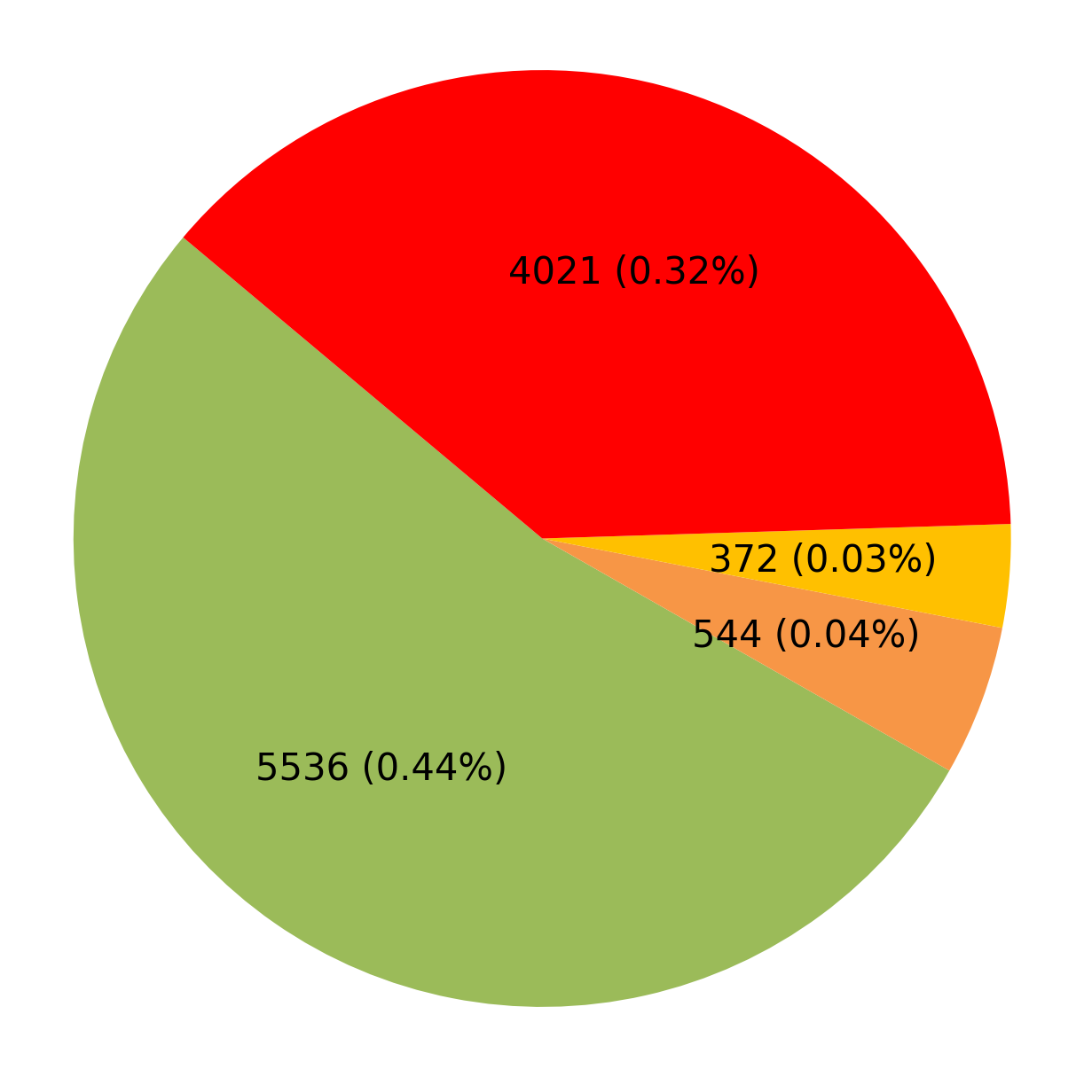
Defect % Analysis (Against Inspected Quantity)
ERIO TECHMA ENGG. Howrah West Bengal
ERIO UTKARSH INDIA LIMITED Howrah West Bengal
Plant-wise Defect Analysis
Toe load
PIO Rejection Reason
Hardness
Marking
1

Slide 7
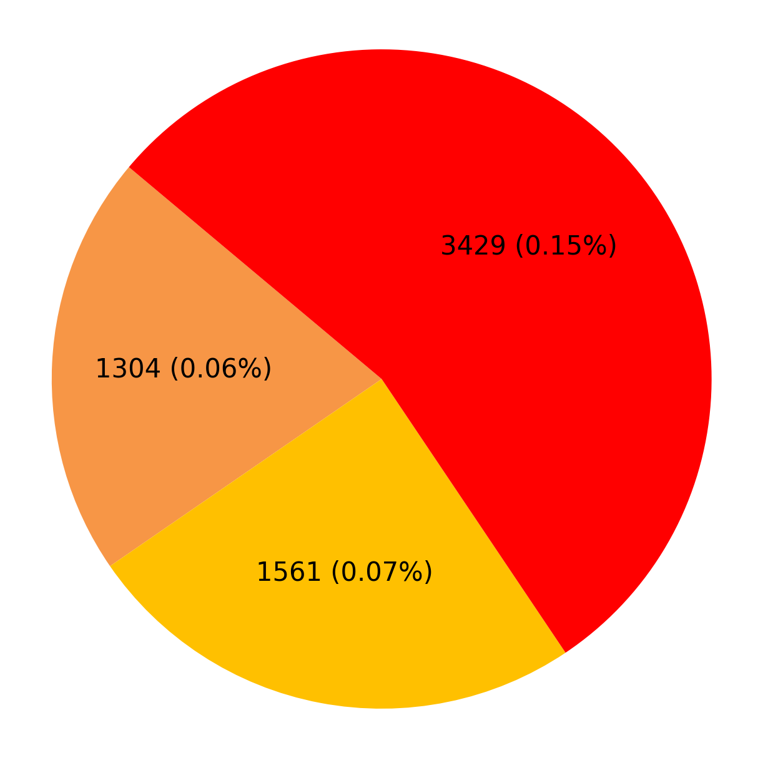
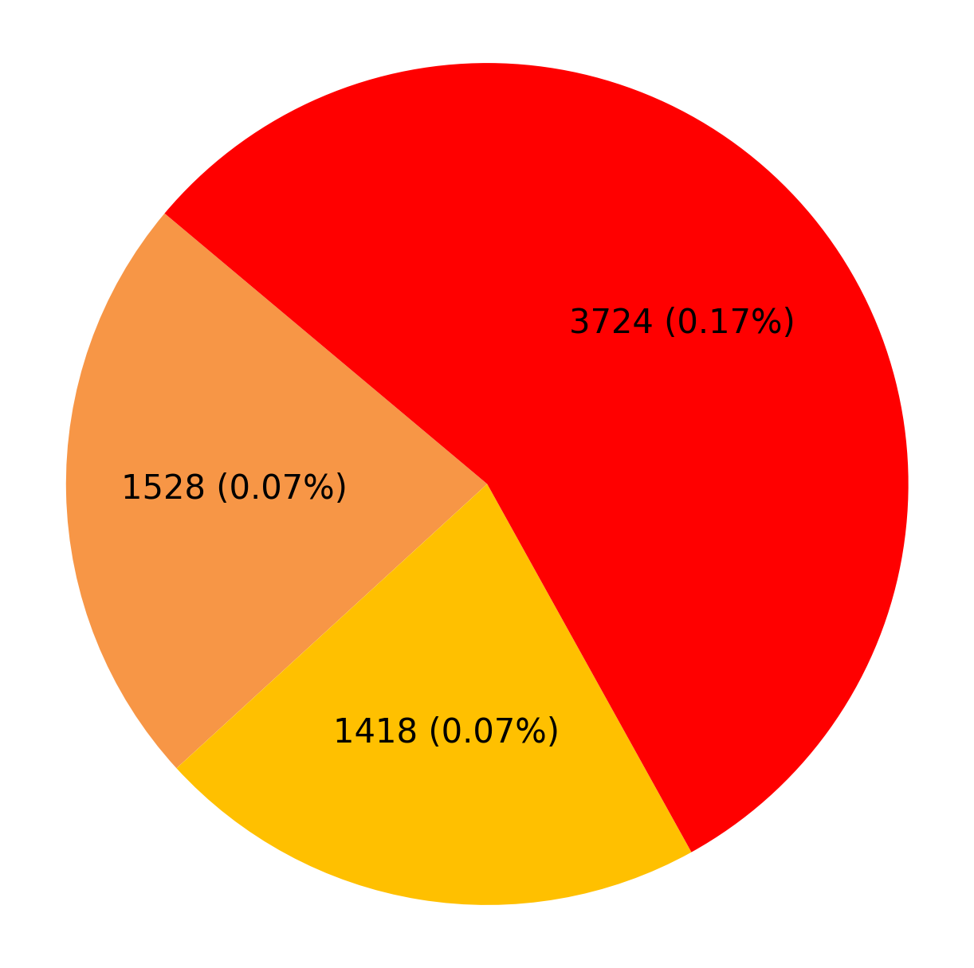
Defect % Analysis (Against Inspected Quantity)
NRIO Adinath Industries Bhiwadi Haryana
NRIO Adinath Industries INC Unit 1 Bhiwadi Haryana
Plant-wise Defect Analysis
Hardness
Marking
PIO Rejection Reason
1

Slide 8
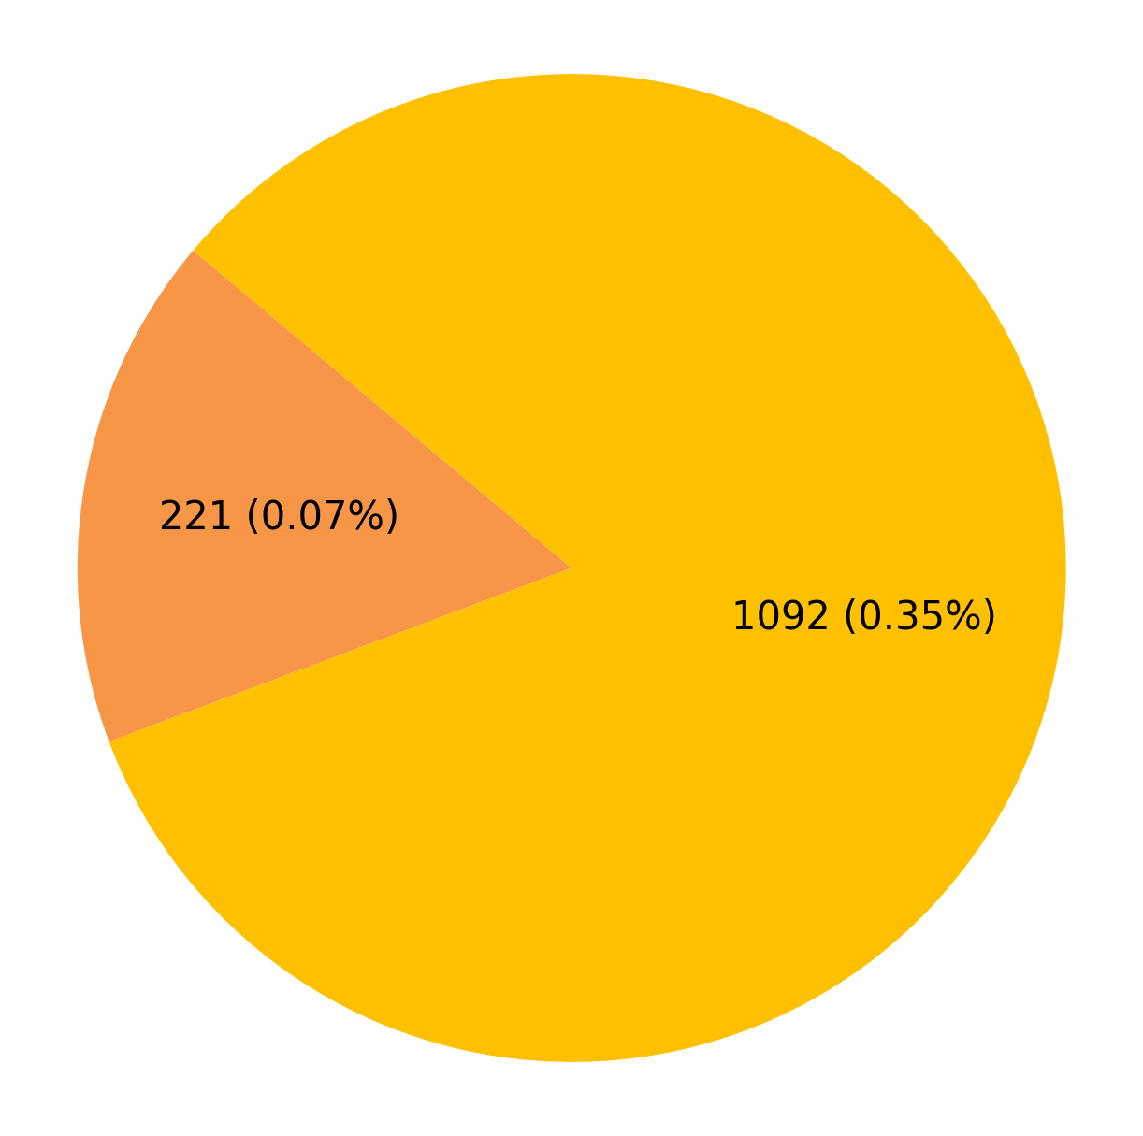
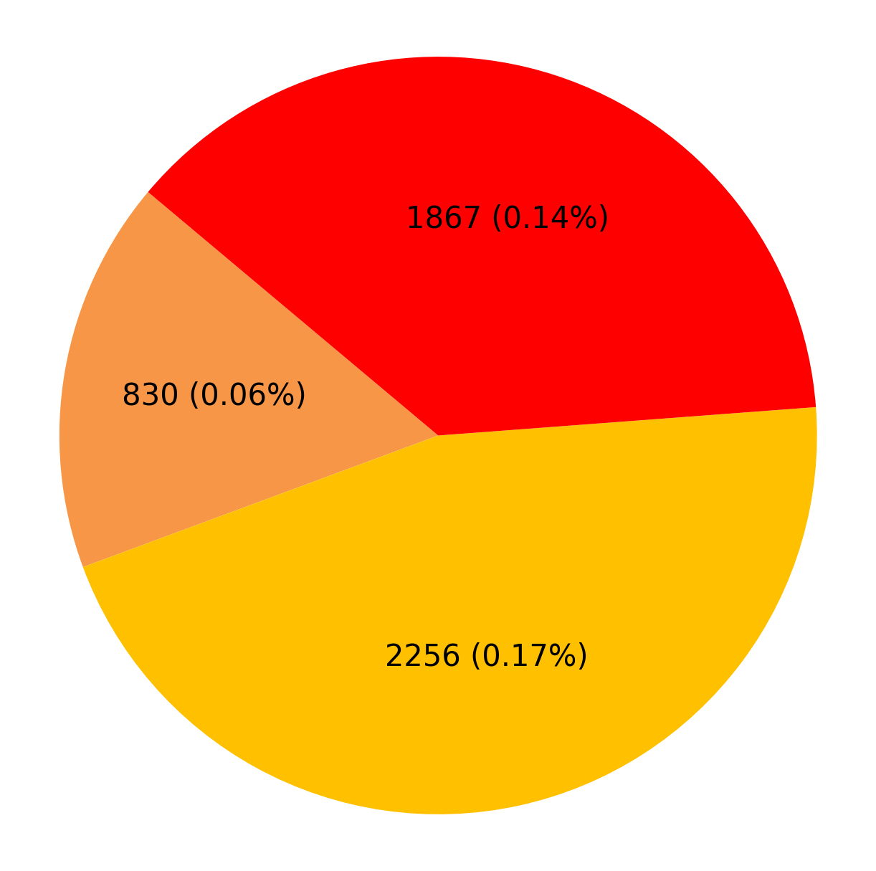
Defect % Analysis (Against Inspected Quantity)
NRIO Adinath Industries INC Unit 2 Bhiwadi Haryana
NRIO Avdesh Tracks(P) Ltd. Mohali Punjab
Plant-wise Defect Analysis
Hardness
Marking
PIO Rejection Reason
1

Slide 9
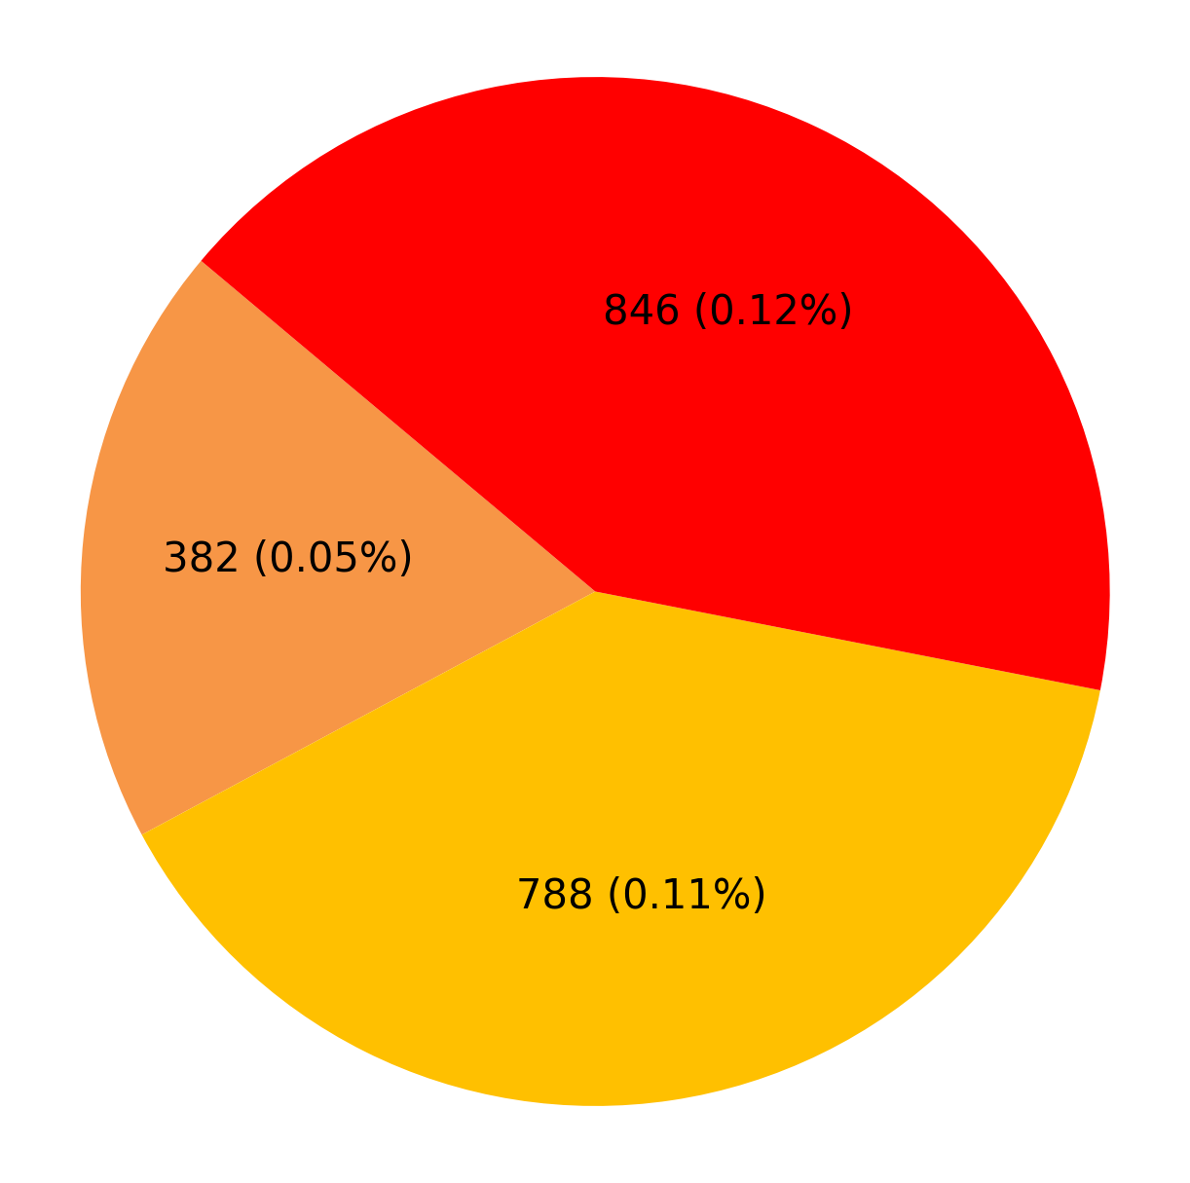
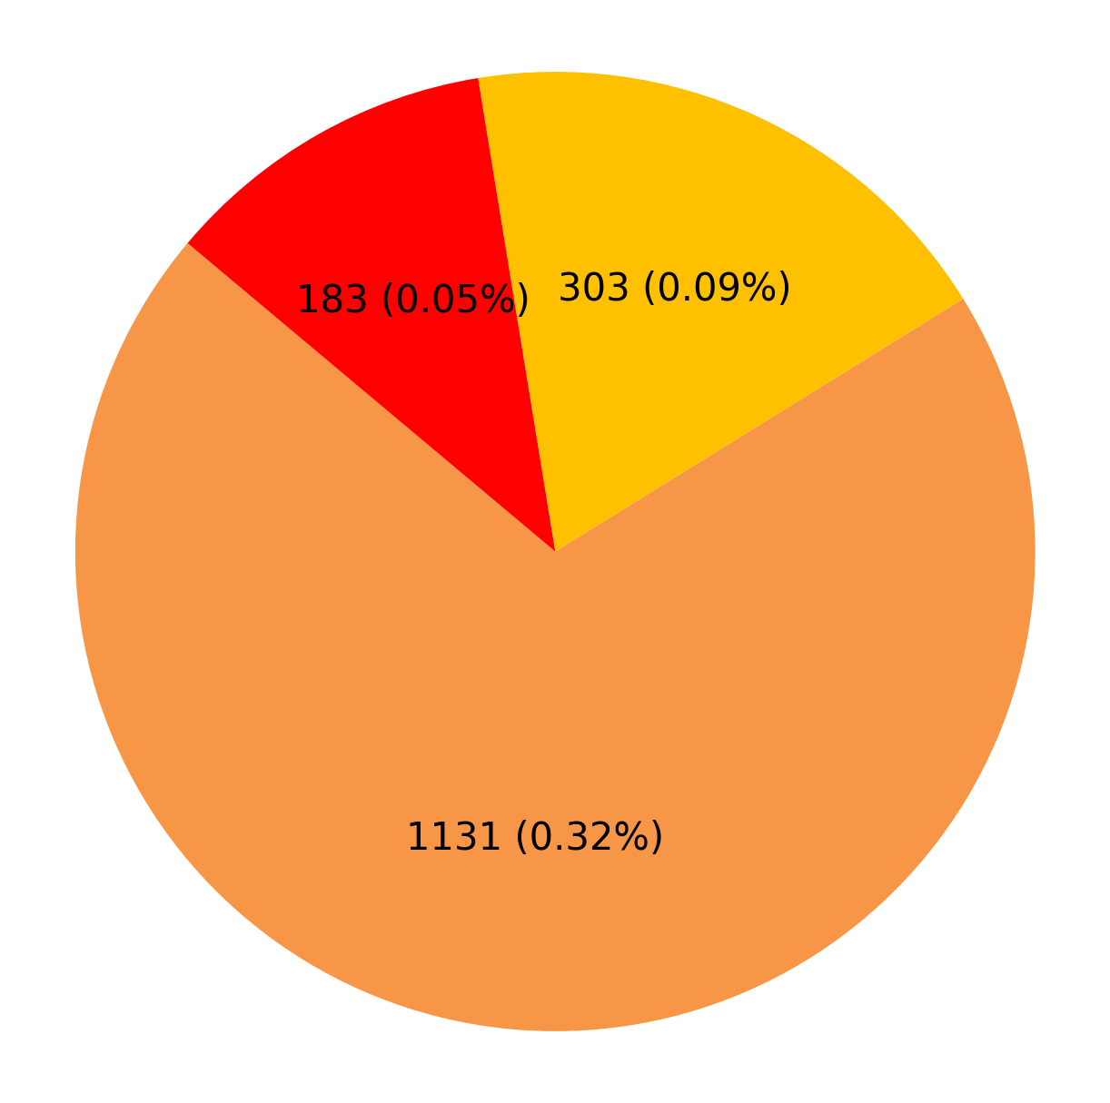
Defect % Analysis (Against Inspected Quantity)
NRIO Bimla Rail Fasteners Karnal Haryana
NRIO Cemcon Railway Industries Gohana Haryana
Plant-wise Defect Analysis
Hardness
Marking
PIO Rejection Reason
1

Slide 10
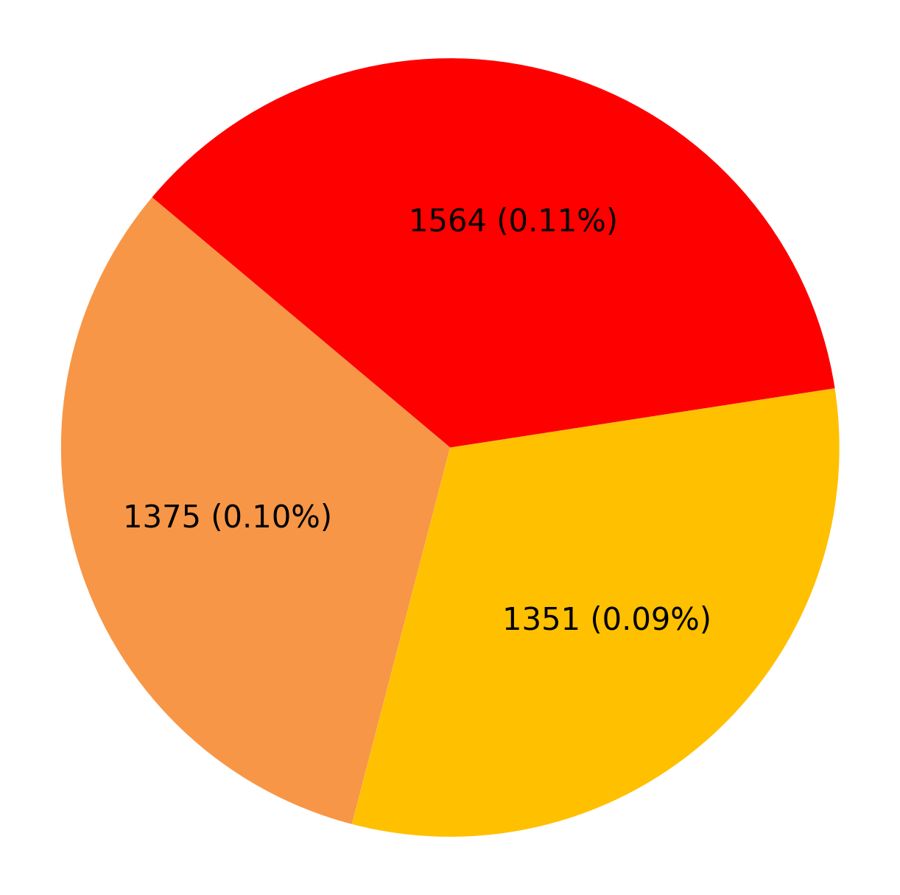
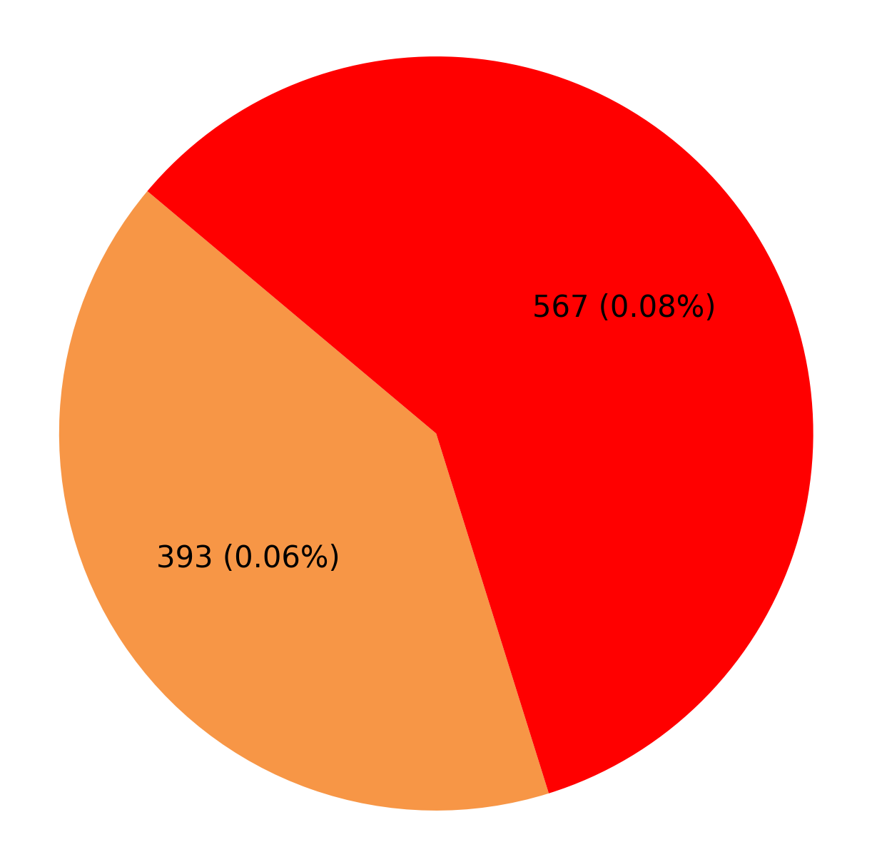
Defect % Analysis (Against Inspected Quantity)
NRIO Fateh Chand Jain Faridabad Haryana
NRIO Lauls Private Ltd. Faridabad Haryana
Plant-wise Defect Analysis
Hardness
Marking
PIO Rejection Reason
1

Slide 11
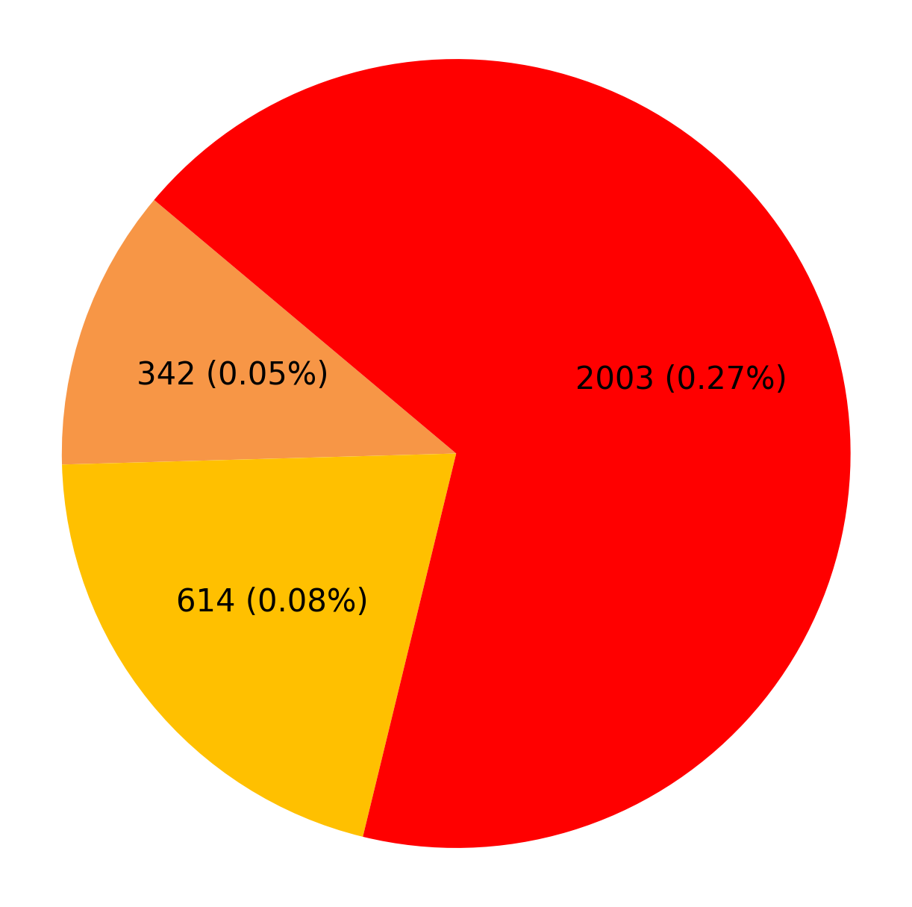
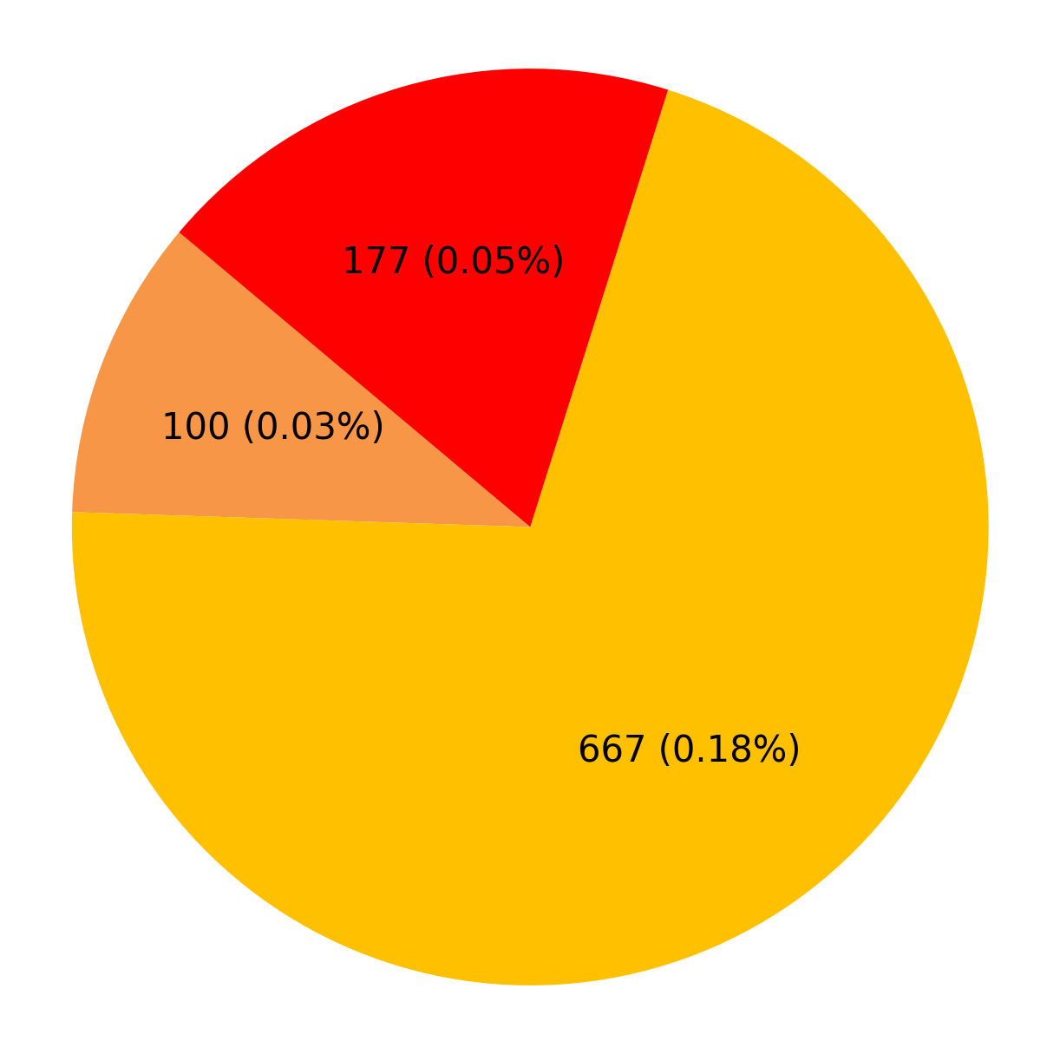
Defect % Analysis (Against Inspected Quantity)
NRIO Panna Lal Kanhiya Lal Bansal LLP Sonipat Haryana
NRIO Qualite Steels Sirsa
Plant-wise Defect Analysis
Hardness
Marking
PIO Rejection Reason
1

Slide 12

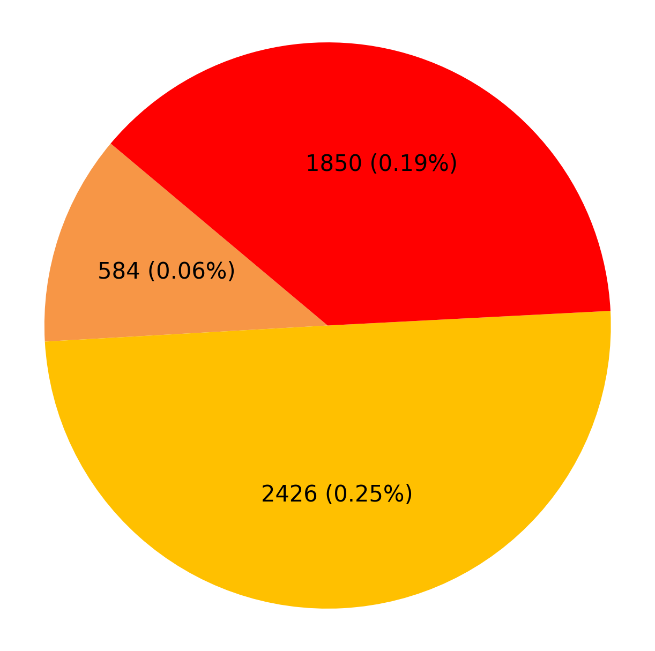
Defect % Analysis (Against Inspected Quantity)
NRIO R Rashmi Industries, Jaipur
NRIO Siddartha Metal Fabricators Faridabad Haryana
Plant-wise Defect Analysis
Hardness
Marking
PIO Rejection Reason
1

Slide 13
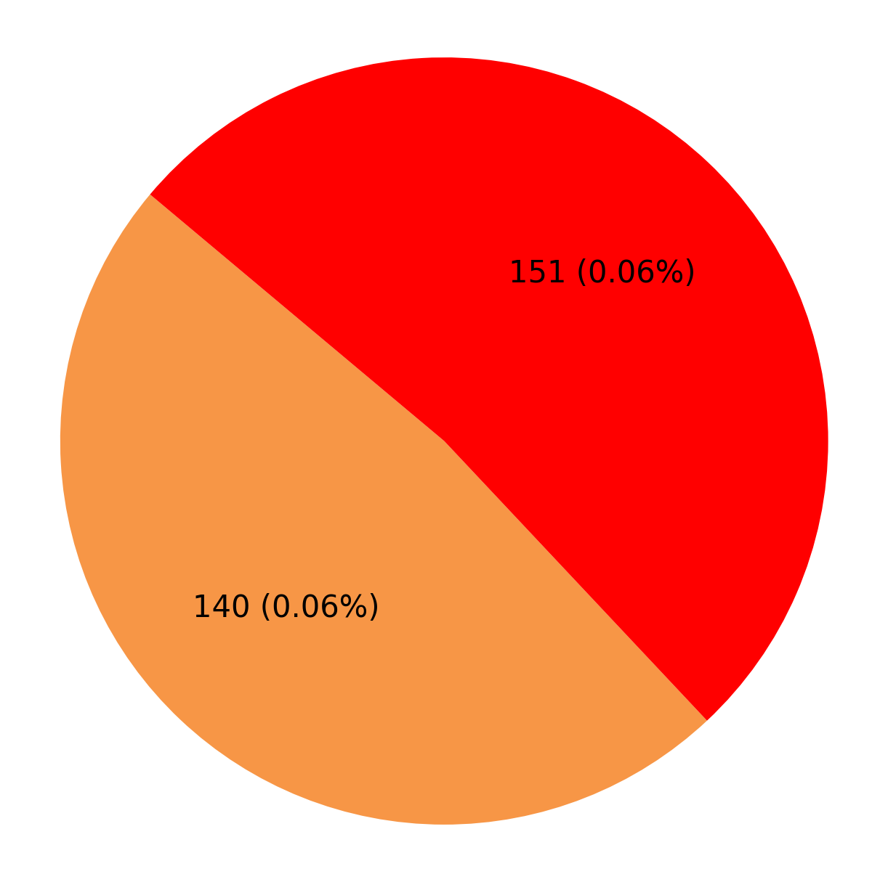
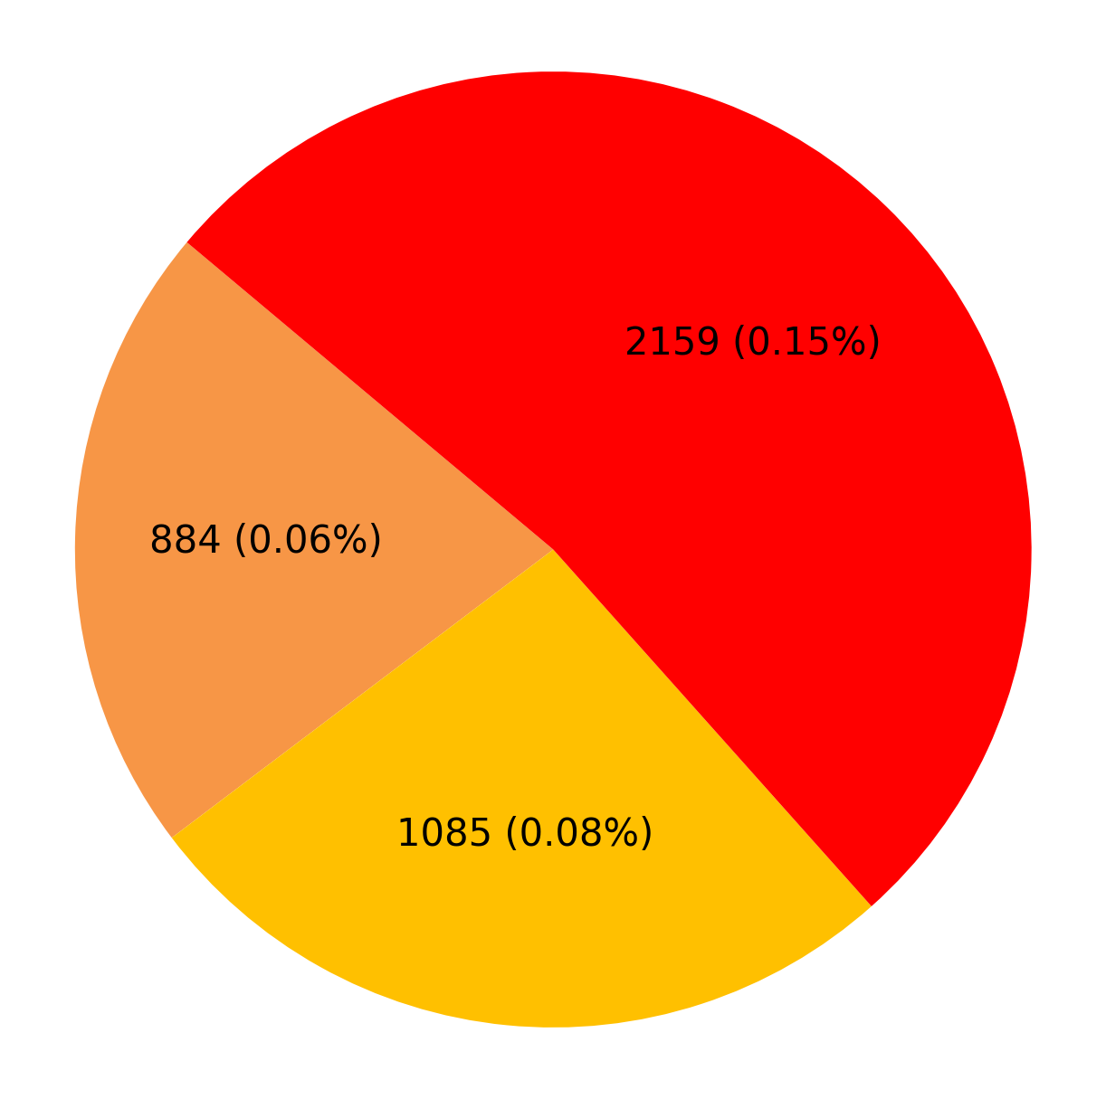
Defect % Analysis (Against Inspected Quantity)
NRIO Super Steels Mohali Punjab
NRIO Vedkiran Steel Industries Pvt. Ltd. Batala Punjab
Plant-wise Defect Analysis
Hardness
PIO Rejection Reason
Marking
1

Slide 14
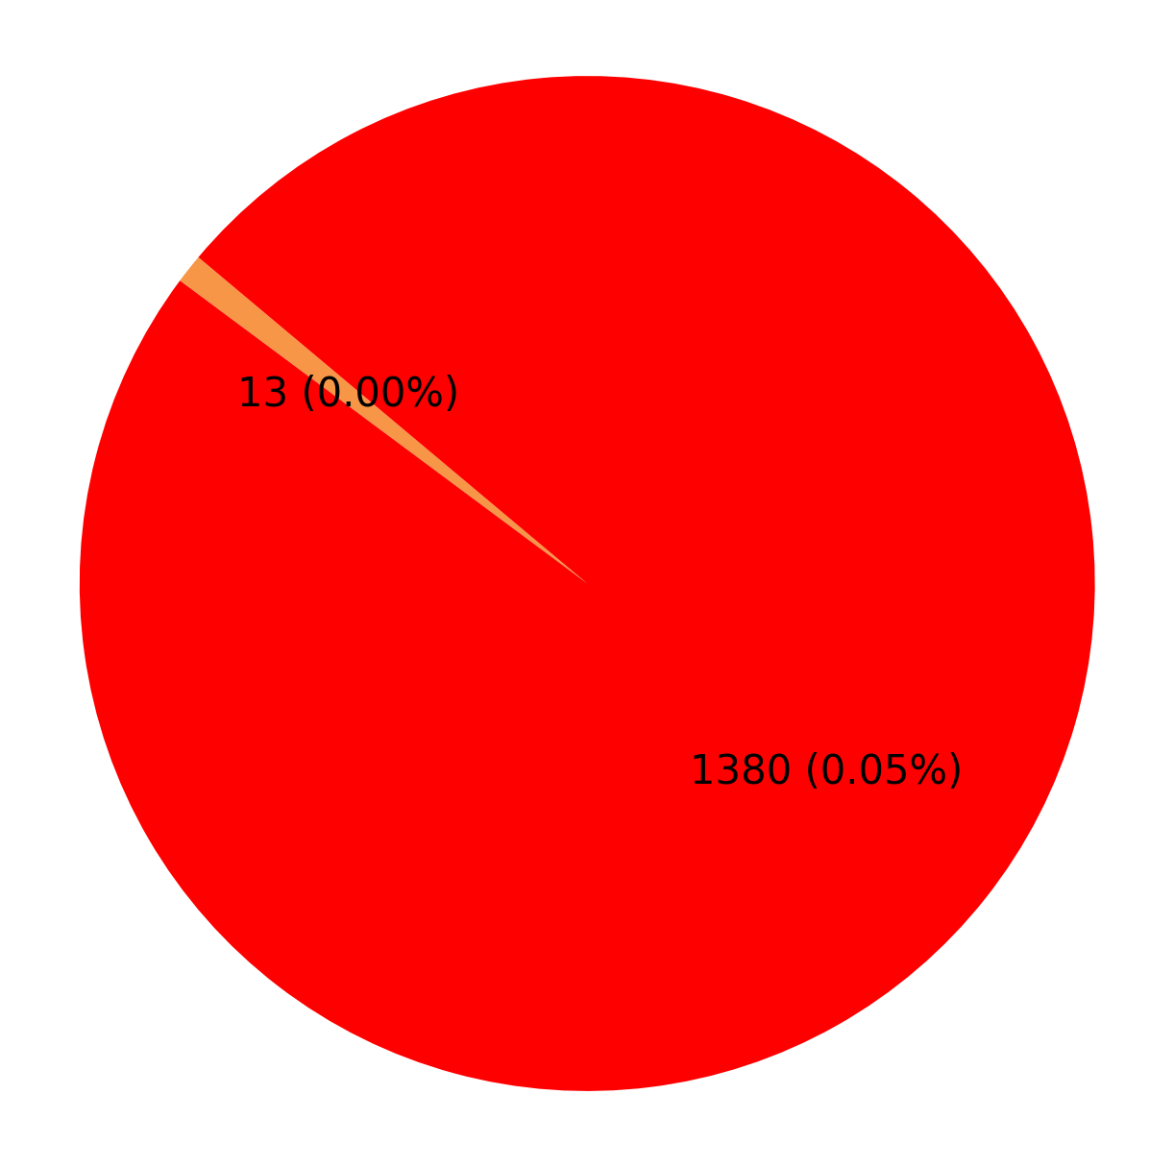
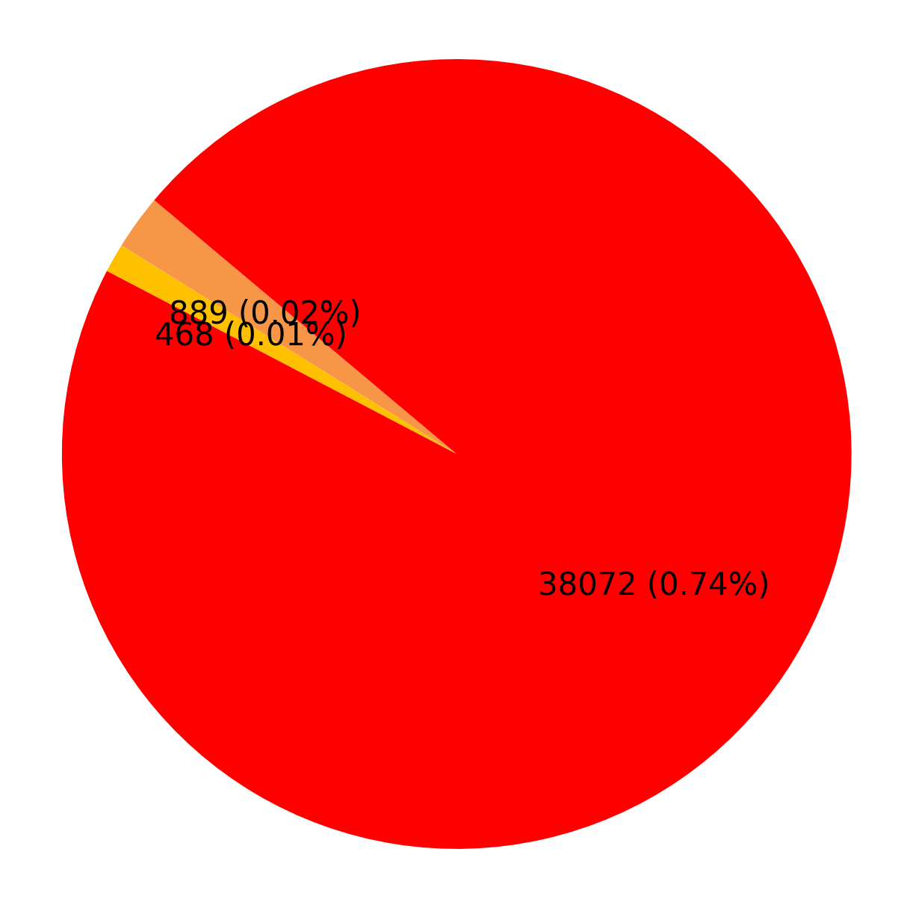
Defect % Analysis (Against Inspected Quantity)
SRIO Patil Rail Infrastructure pvt ltd Yellampet, Hyderabad Telangana
WRIO Bridge Track & Tower Pvt Ltd Raipur Chhatishgarh
Plant-wise Defect Analysis
Hardness
PIO Rejection Reason
Marking
1

Slide 15
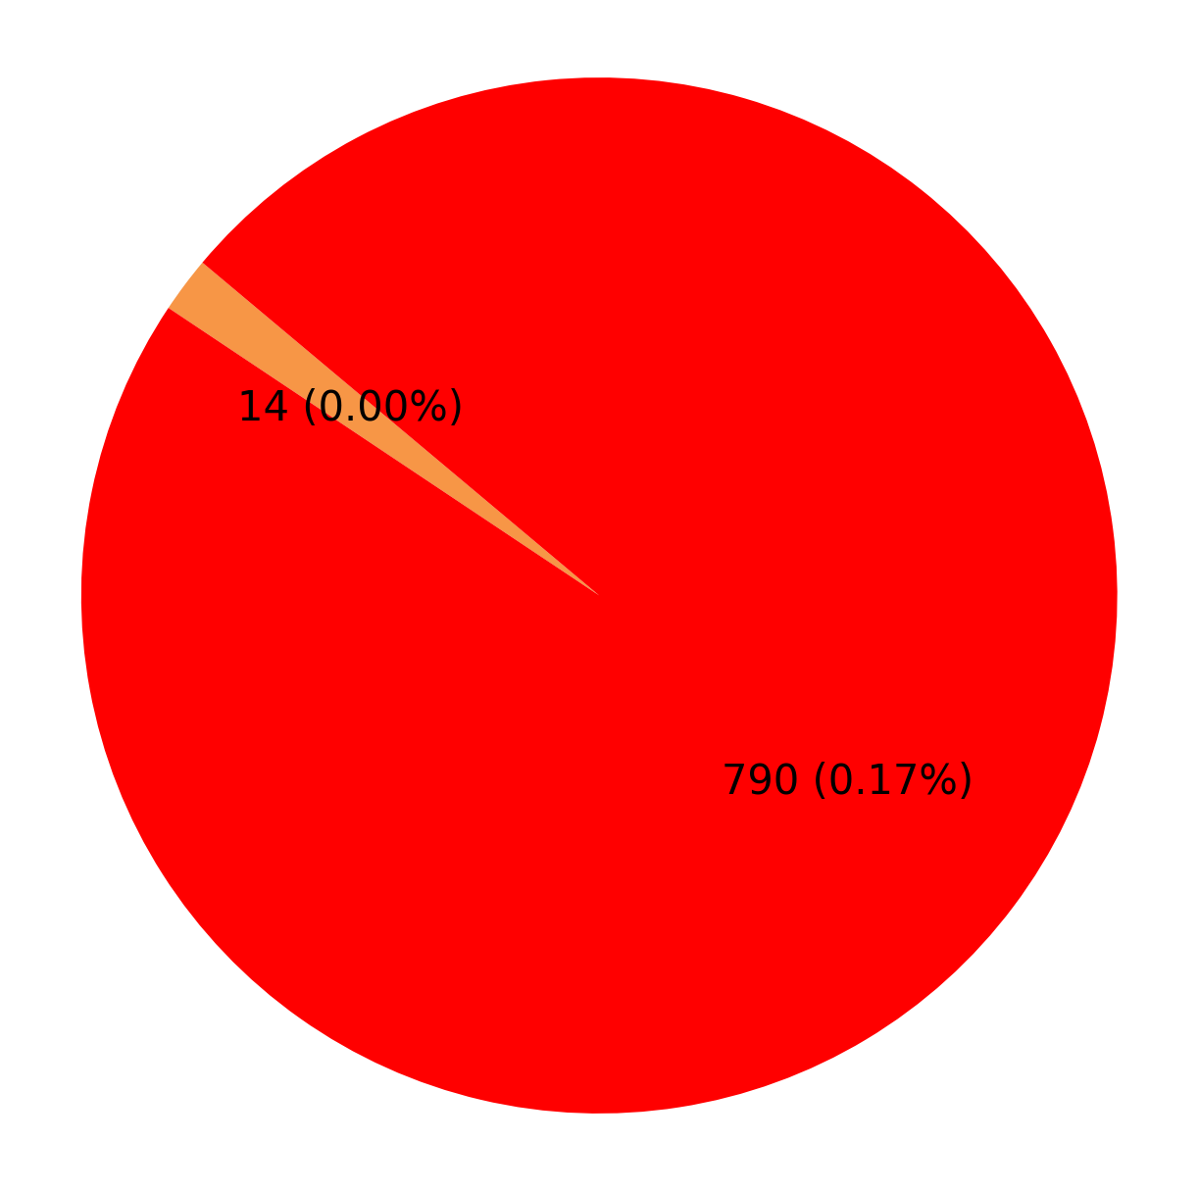
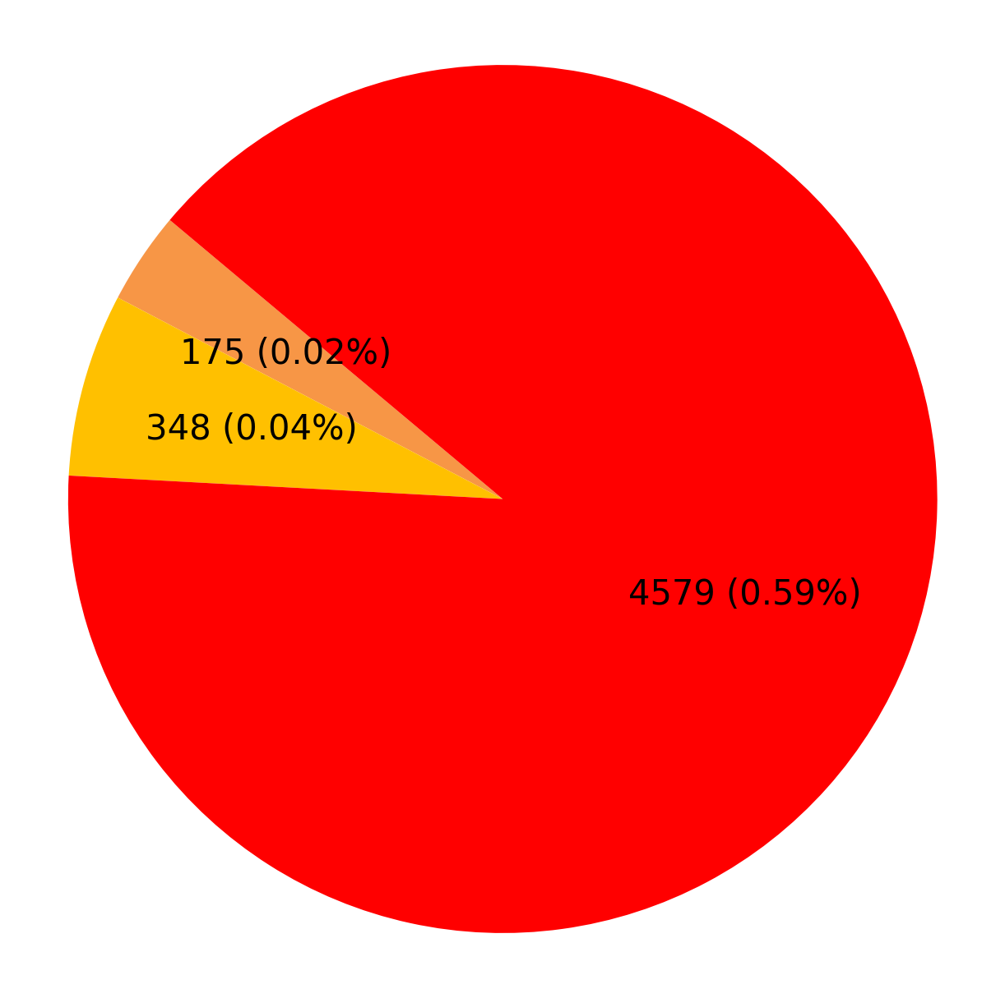
Defect % Analysis (Against Inspected Quantity)
WRIO Cosmo Enterprise Raipur Chhatishgarh
WRIO Jee Kay International Track Pvt. Urla Raipur
Plant-wise Defect Analysis
Hardness
PIO Rejection Reason
Marking
1

Slide 16
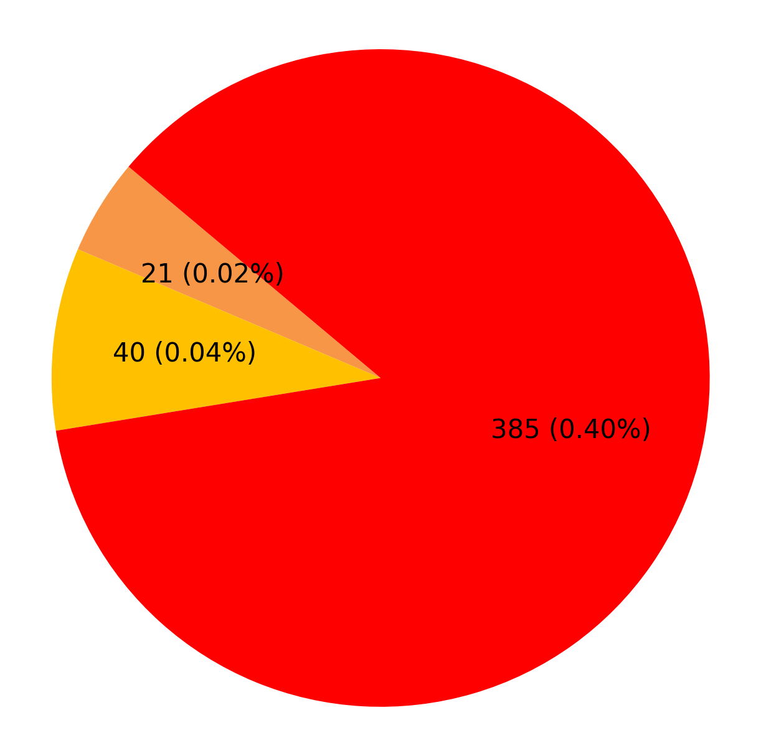
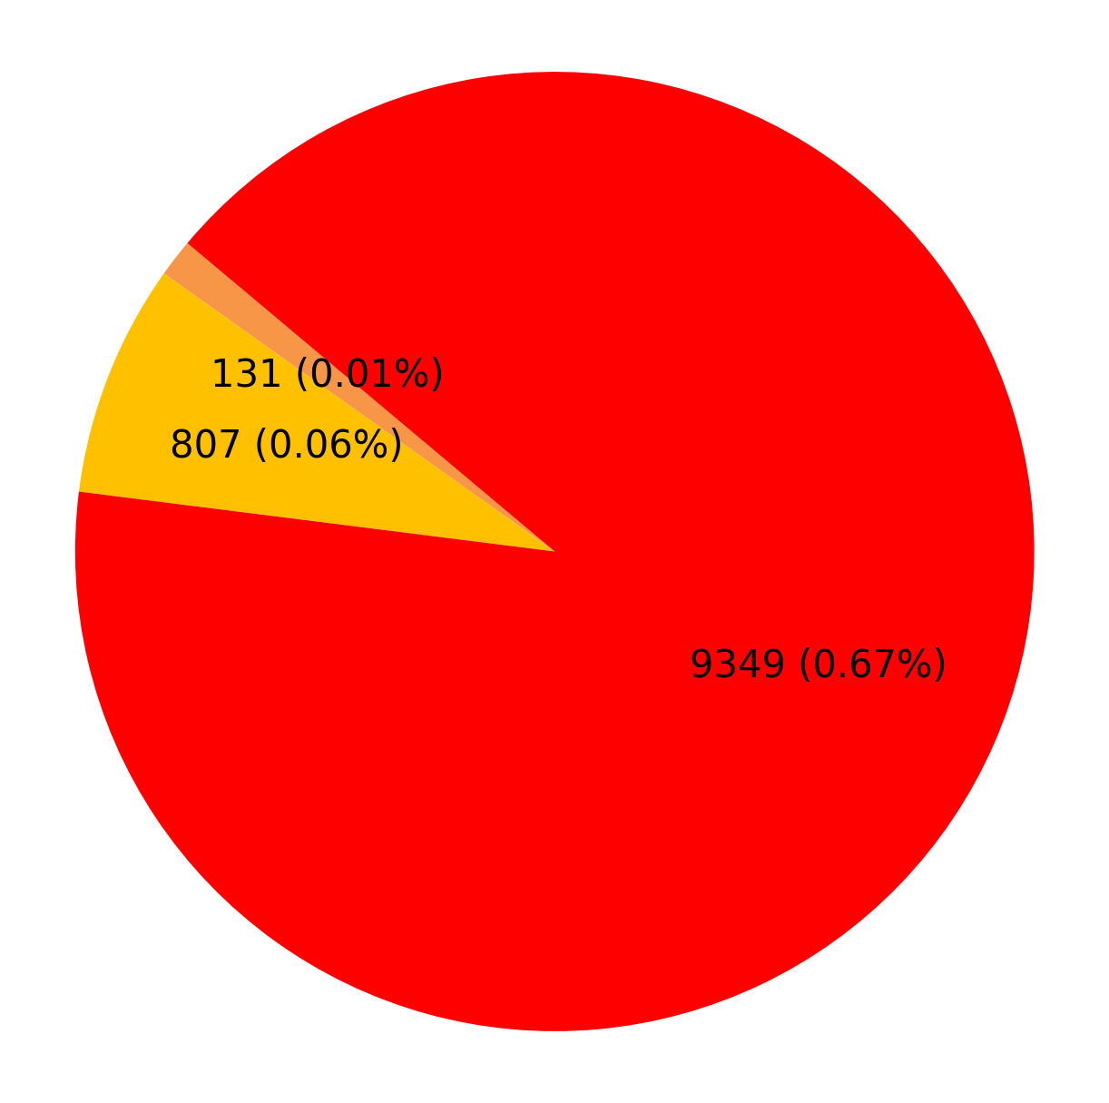
Defect % Analysis (Against Inspected Quantity)
WRIO M.K.Corporation
WRIO Pathik Engineering Works Rajnandgaon Chhatishgarh
Plant-wise Defect Analysis
Hardness
Marking
PIO Rejection Reason
1

Slide 17
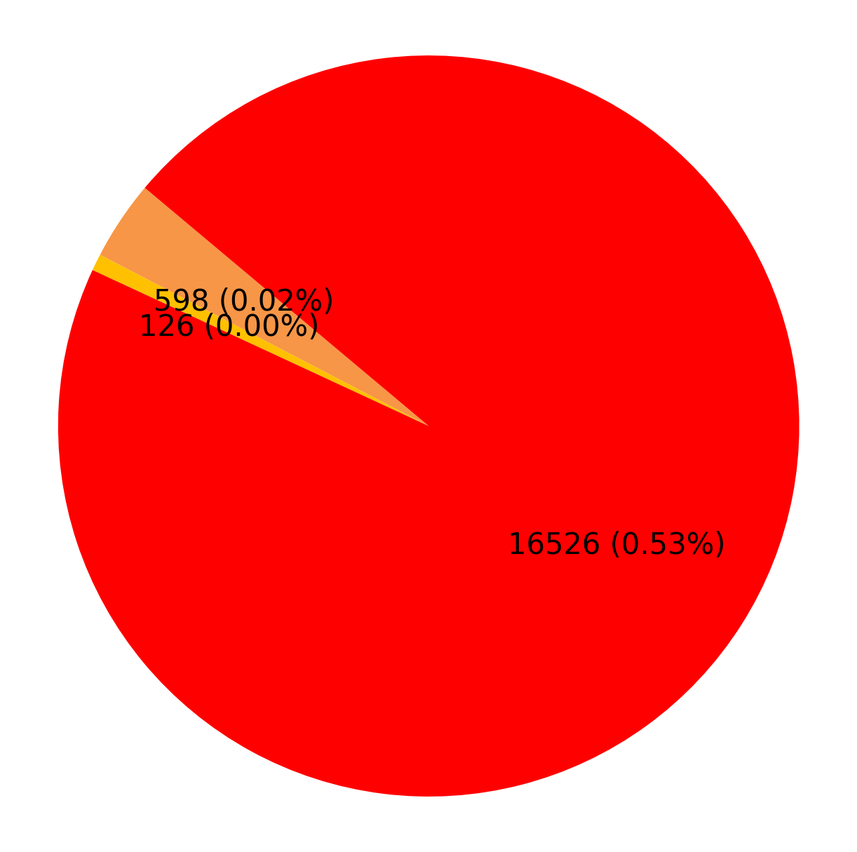

Defect % Analysis (Against Inspected Quantity)
WRIO Prakash Metallics Pvt Ltd Raipur Chhatishgarh
WRIO Prakash Monomers Pvt Ltd Raipur Chhatishgarh
Plant-wise Defect Analysis
Hardness
Marking
PIO Rejection Reason
1

Slide 18
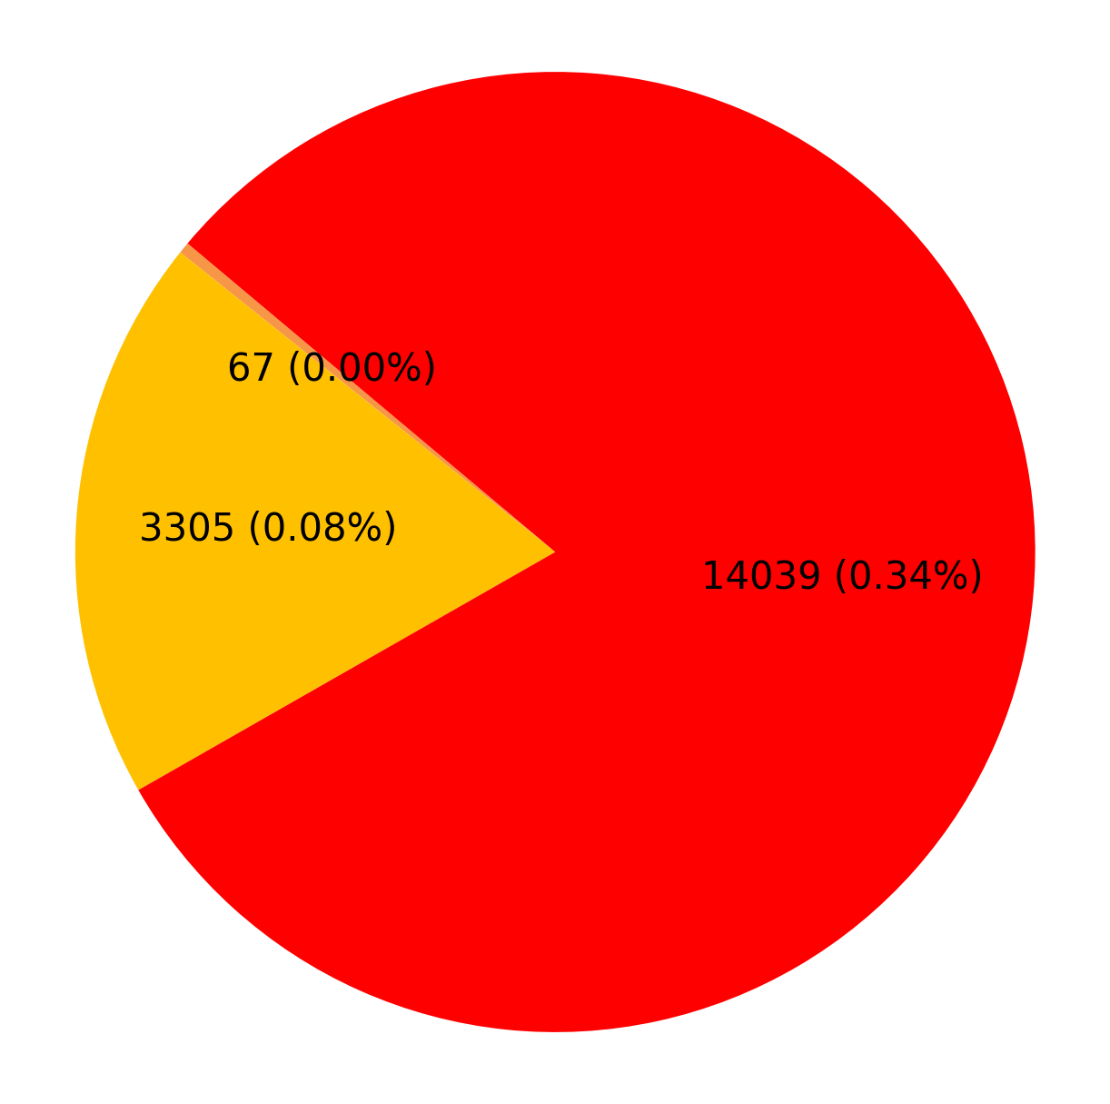
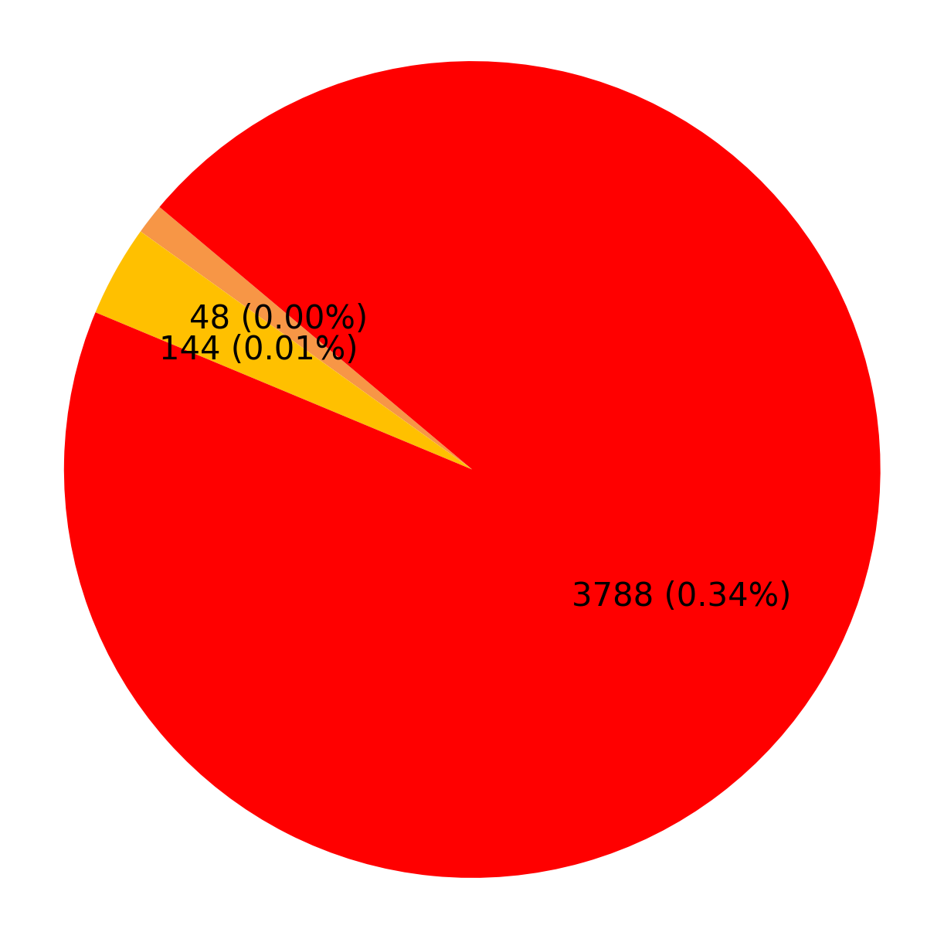
Defect % Analysis (Against Inspected Quantity)
WRIO Royal Infraconstru Raipur Chhatishgarh
WRIO Royal fasteners Raipur Chhatishgarh
Plant-wise Defect Analysis
Hardness
Marking
PIO Rejection Reason
1

Slide 19
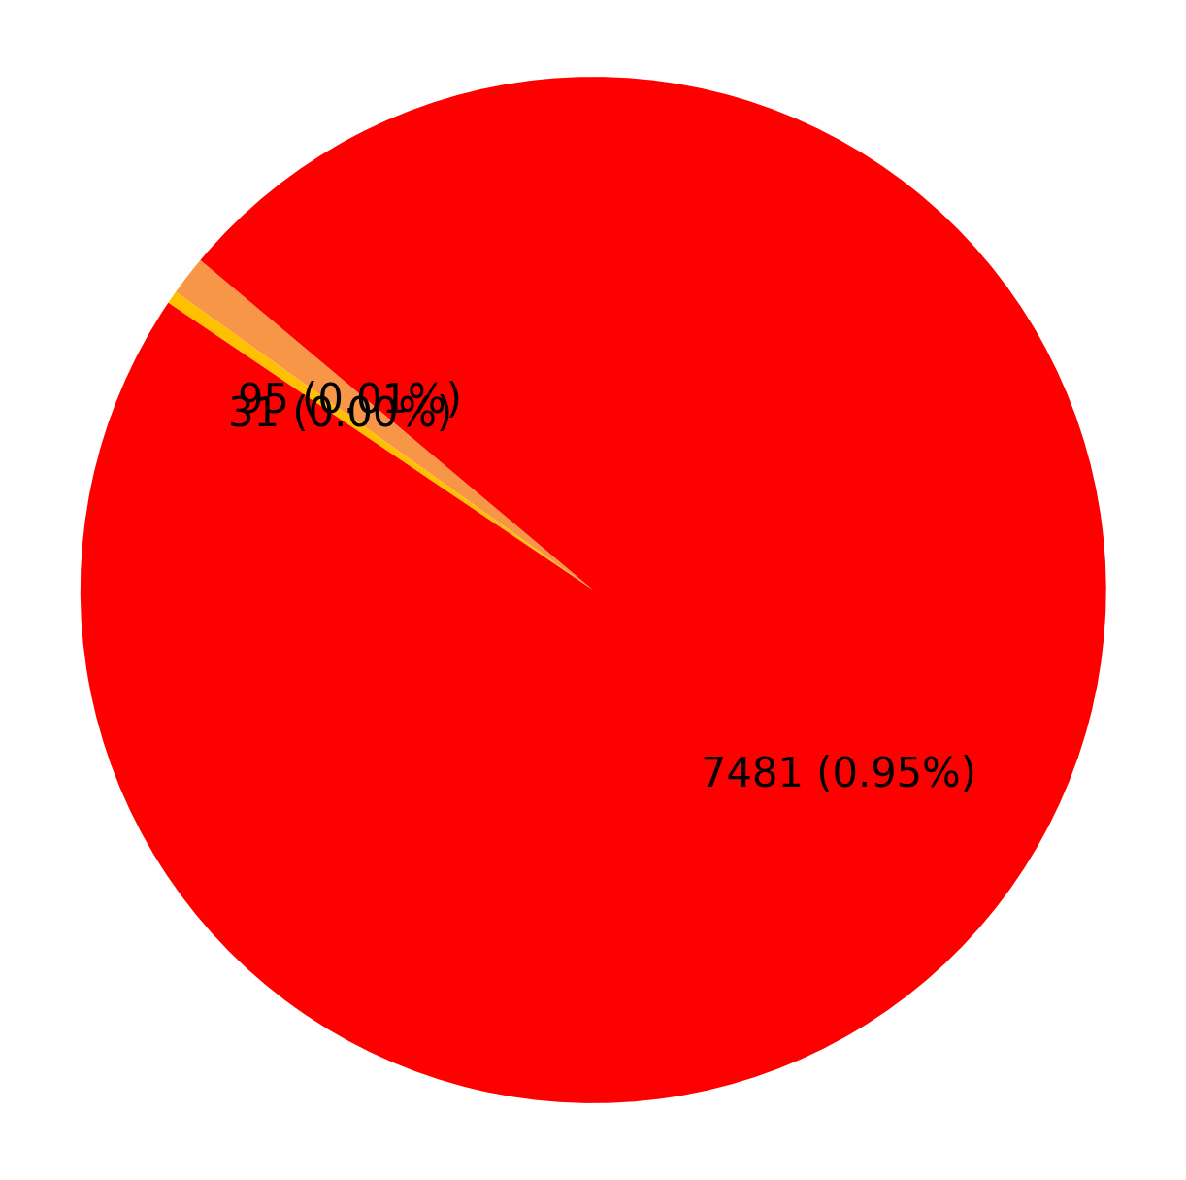
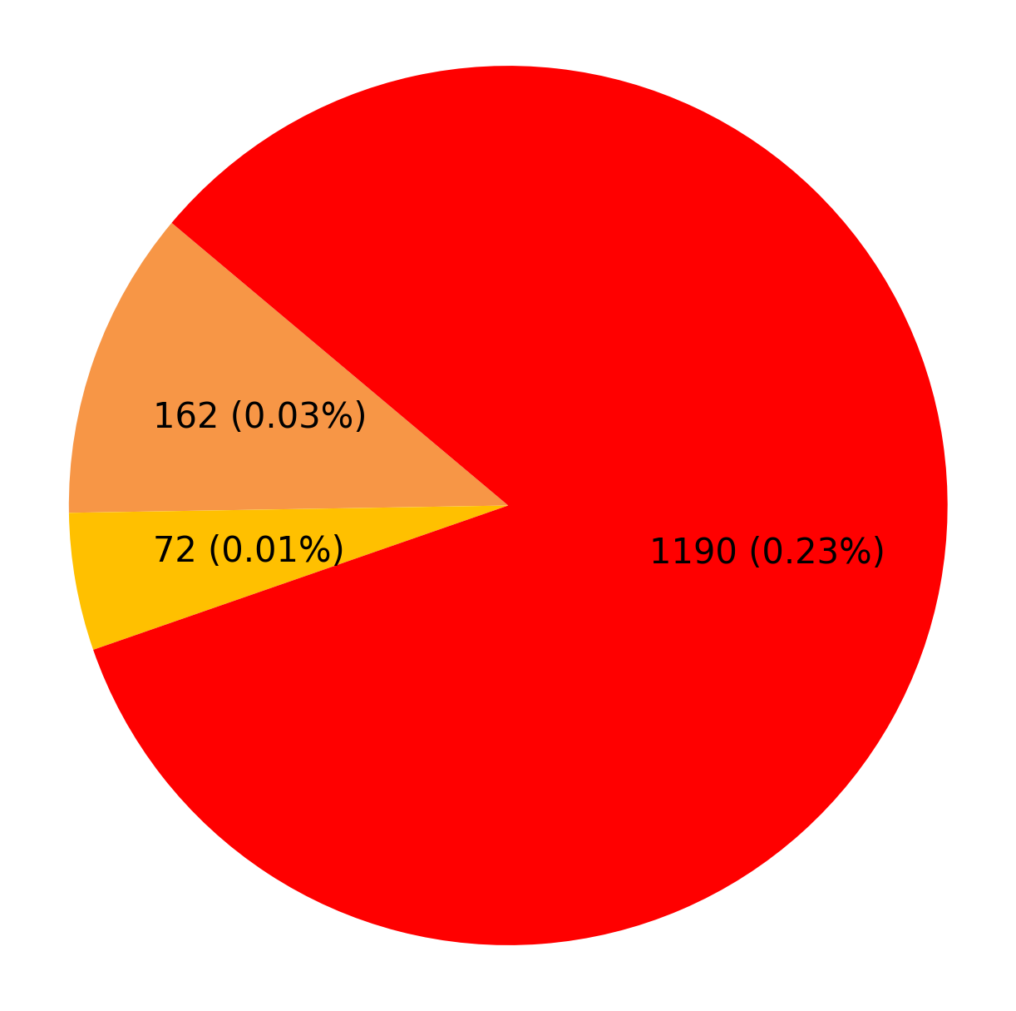
Defect % Analysis (Against Inspected Quantity)
WRIO Sai Kripa Industries Durg Chhatishgarh
WRIO Sheth & Co.
Plant-wise Defect Analysis
Hardness
Marking
PIO Rejection Reason
1

Slide 20
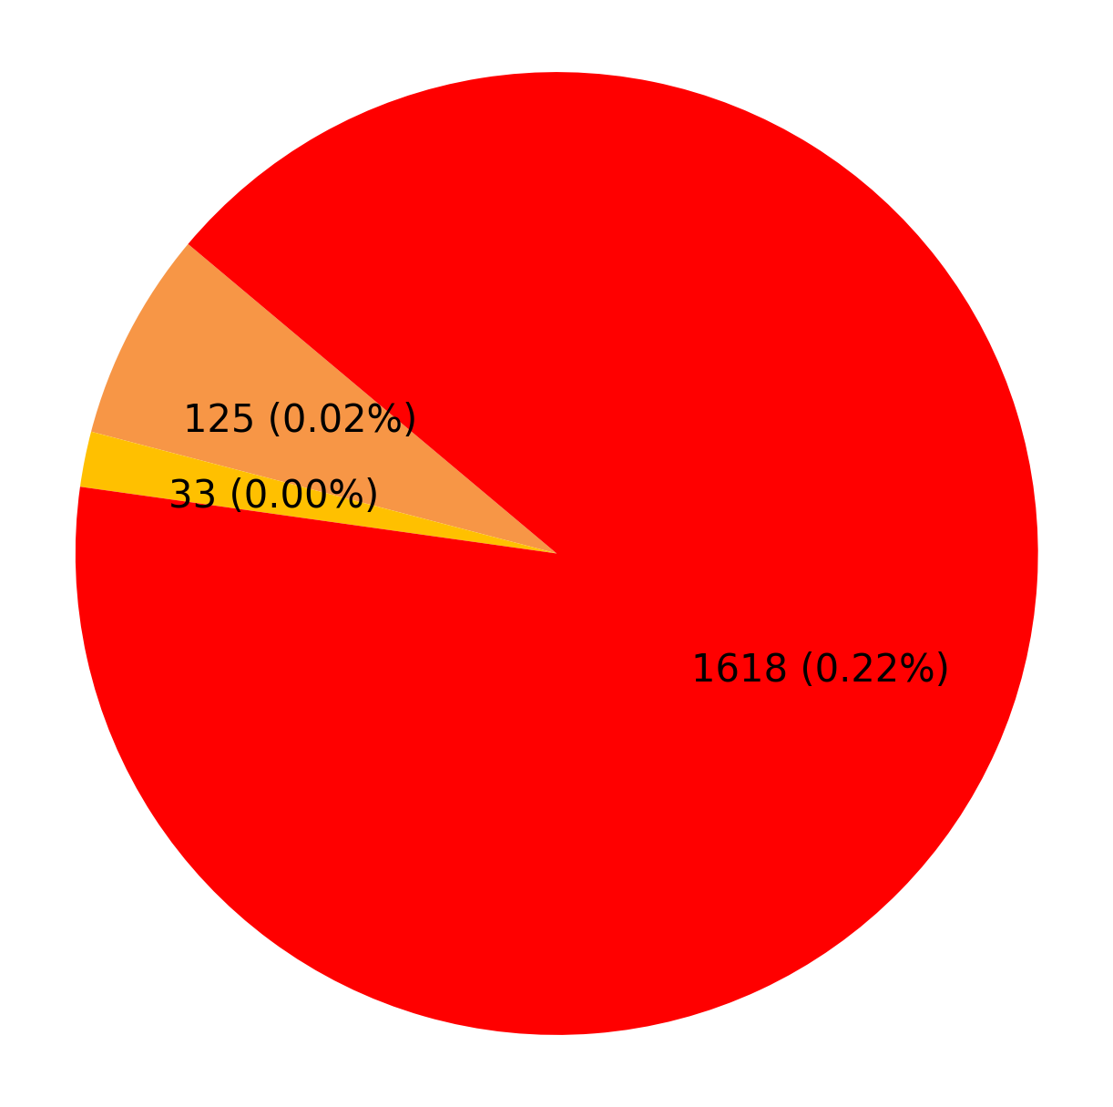
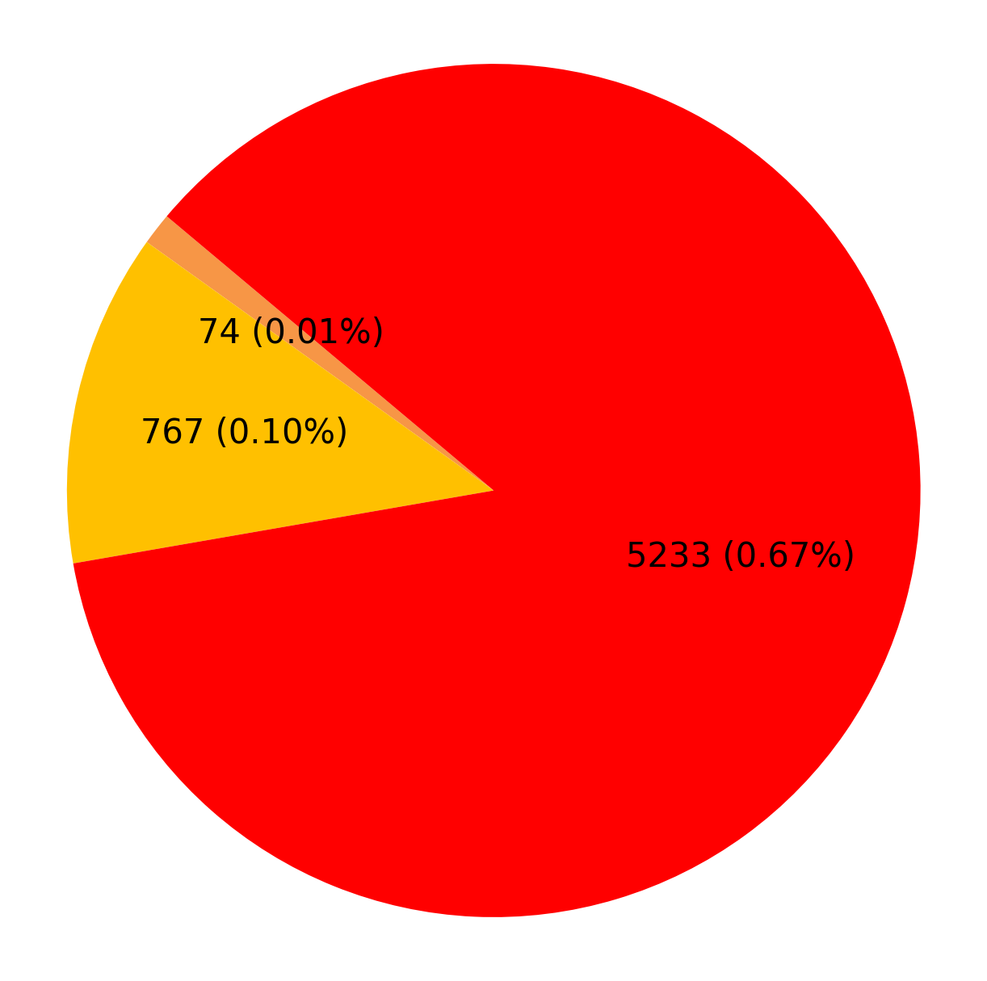
Defect % Analysis (Against Inspected Quantity)
WRIO Technosteel Infraprojects Nagpur Maharastra
WRIO Veera Track Fasteners Rajnandgaon Chhatishgarh
Plant-wise Defect Analysis
Hardness
Marking
PIO Rejection Reason
1

