Slide 1
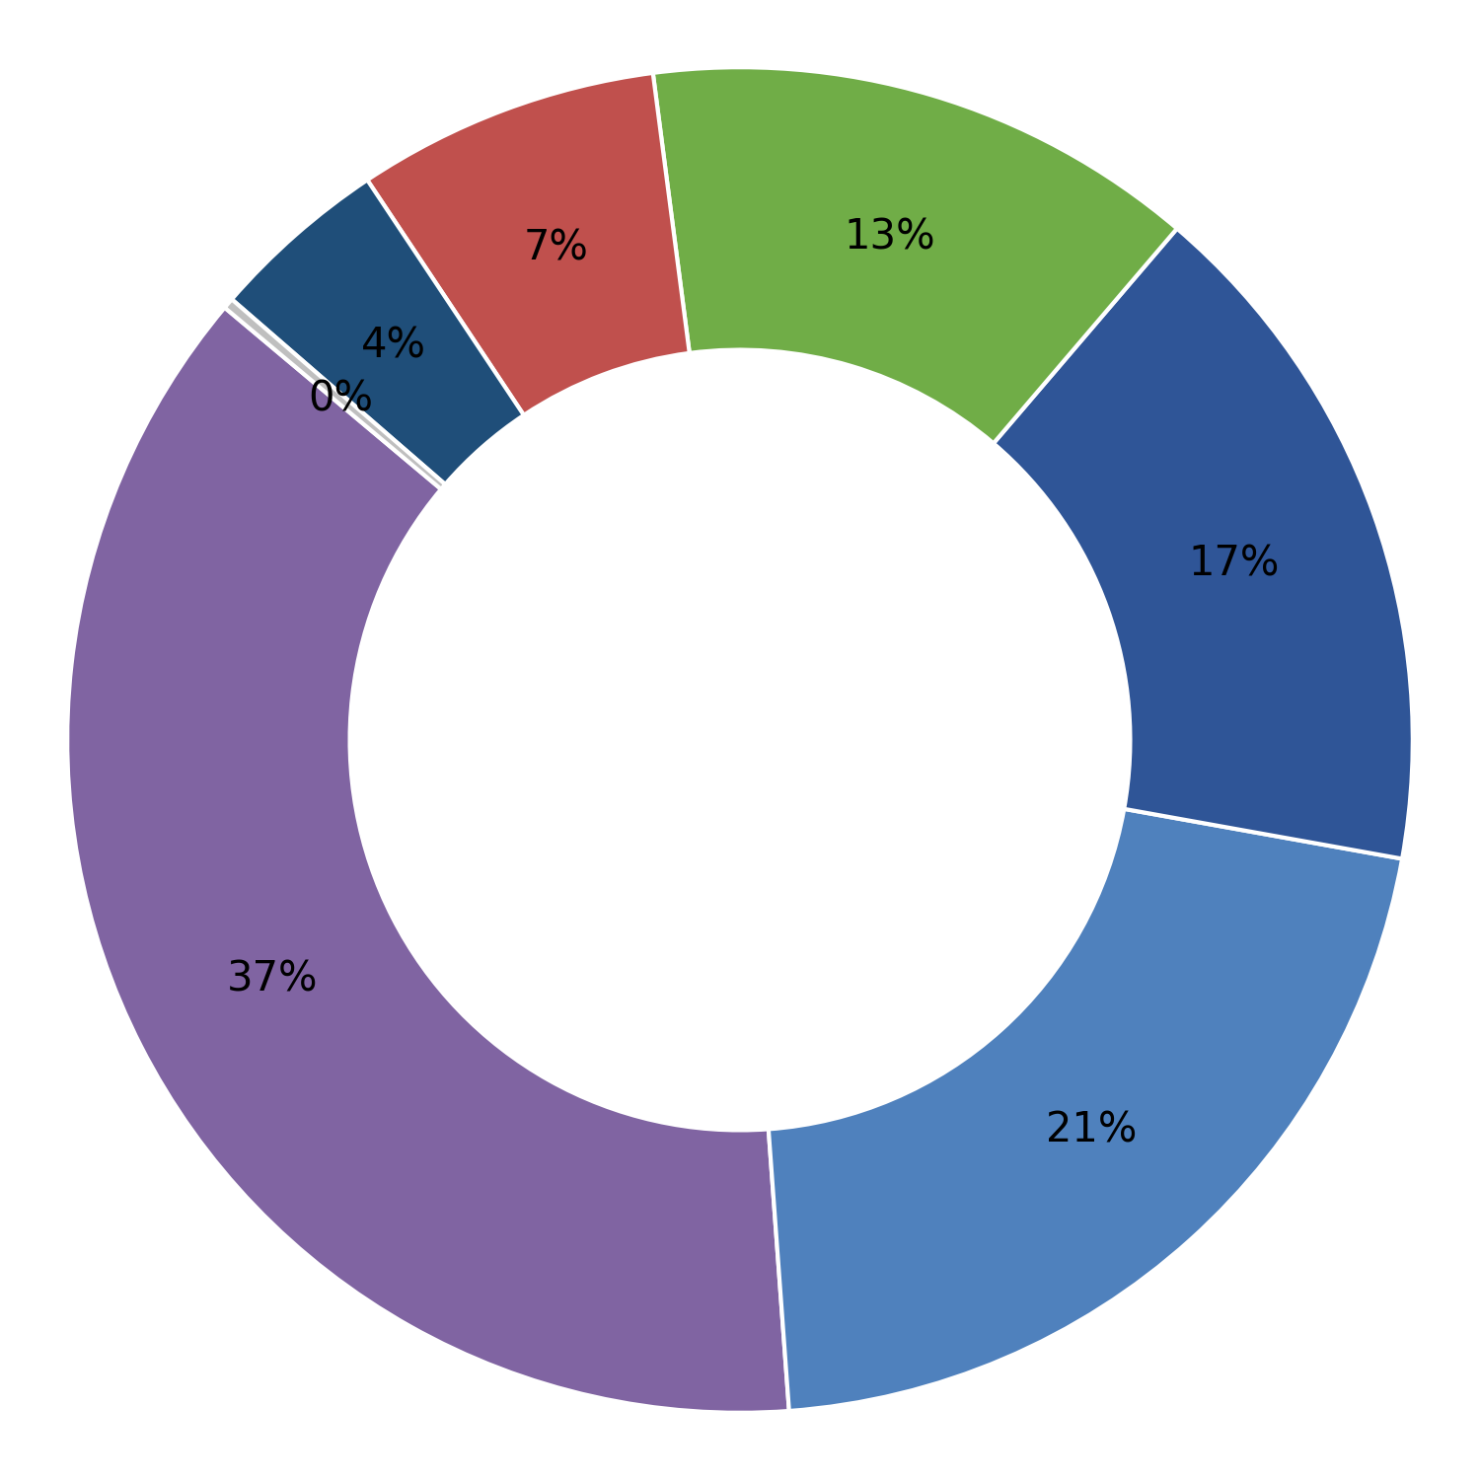
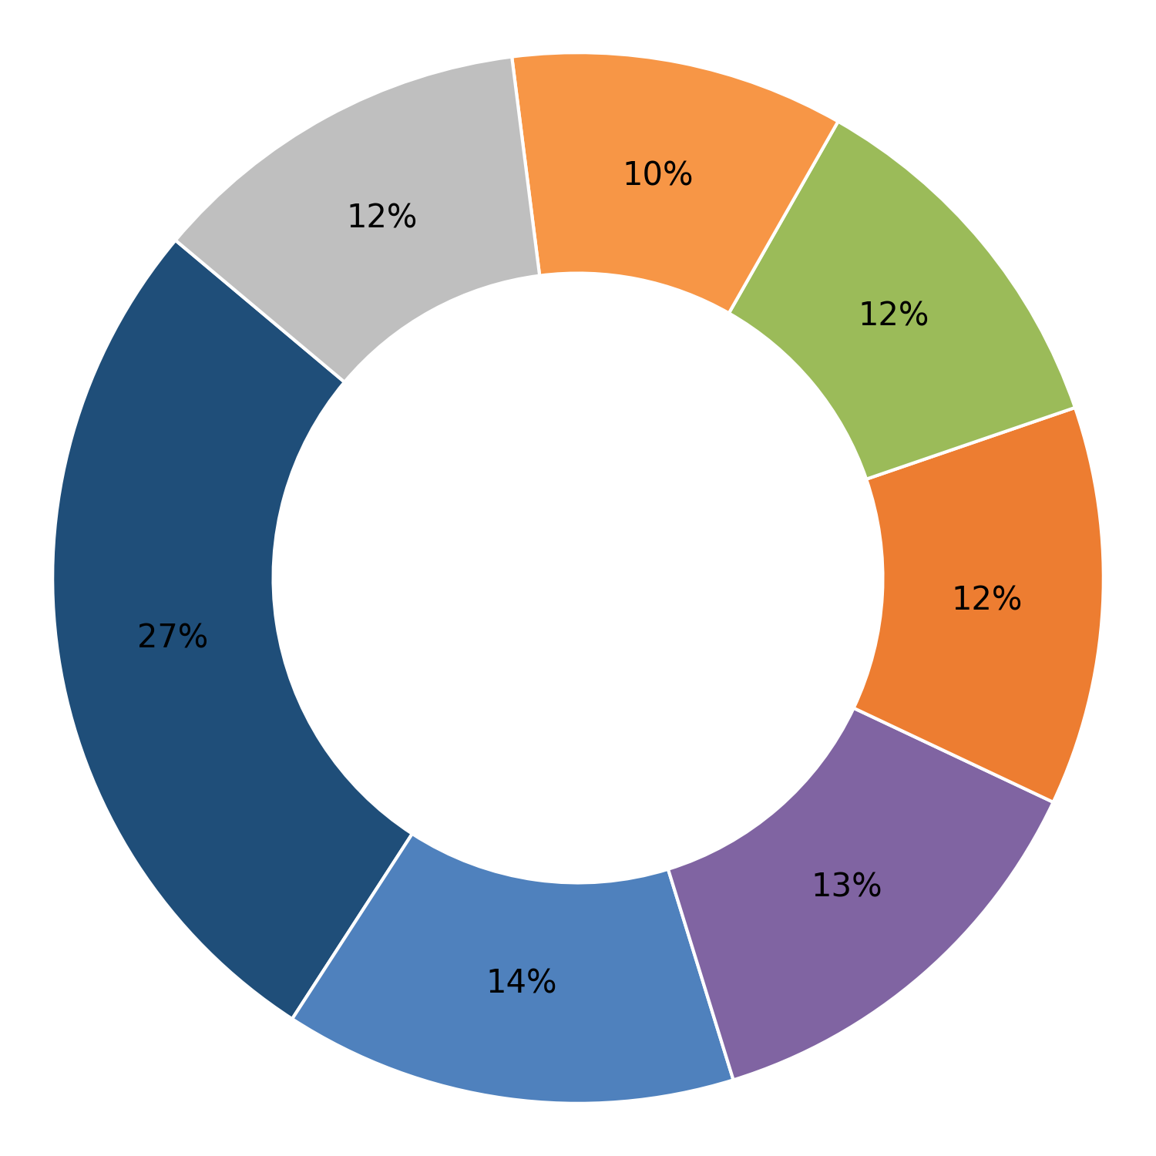
AMBE FASTNERS PVT.LTD. Patna Bihar
Adinath Industries Bhiwadi Haryana
Cut bar length
Plant-wise Defect Analysis
Dimensional
Toe load
Forging defect
Turning length
Embossing Die Impression / Failure
Others
Marking
Flat Bearing Area
Hardness
Cumulative Inspected (Nos.) | Cumulative Rejection (Nos.) | Rejection (%)
207730 | 1937 | 0.93
Cumulative Inspected (Nos.) | Cumulative Rejection (Nos.) | Rejection (%)
2270332 | 12720 | 0.56
Month | Inspected (Nos.) | Rejection (Nos.) | % Rej
Jan 26 | 0 | 0 | 0.00
Dec 25 | 0 | 0 | 0.00
Sep 25 | 13699 | 39 | 0.28
Aug 25 | 54536 | 651 | 1.19
Jul 25 | 64388 | 706 | 1.10
Jun 25 | 40443 | 324 | 0.80
May 25 | 34664 | 217 | 0.63
Month | Inspected (Nos.) | Rejection (Nos.) | % Rej
Apr 26 | 85168 | 671 | 0.79
Mar 26 | 131767 | 1012 | 0.77
Feb 26 | 231889 | 1759 | 0.76
Jan 26 | 203101 | 1615 | 0.80
Dec 25 | 284558 | 2232 | 0.78
Nov 25 | 242203 | 1724 | 0.71
Oct 25 | 163413 | 845 | 0.52
Sep 25 | 176936 | 747 | 0.42
Aug 25 | 170675 | 697 | 0.41
Jul 25 | 155705 | 659 | 0.42
Jun 25 | 165193 | 558 | 0.34
May 25 | 137207 | 105 | 0.08
1

Slide 2
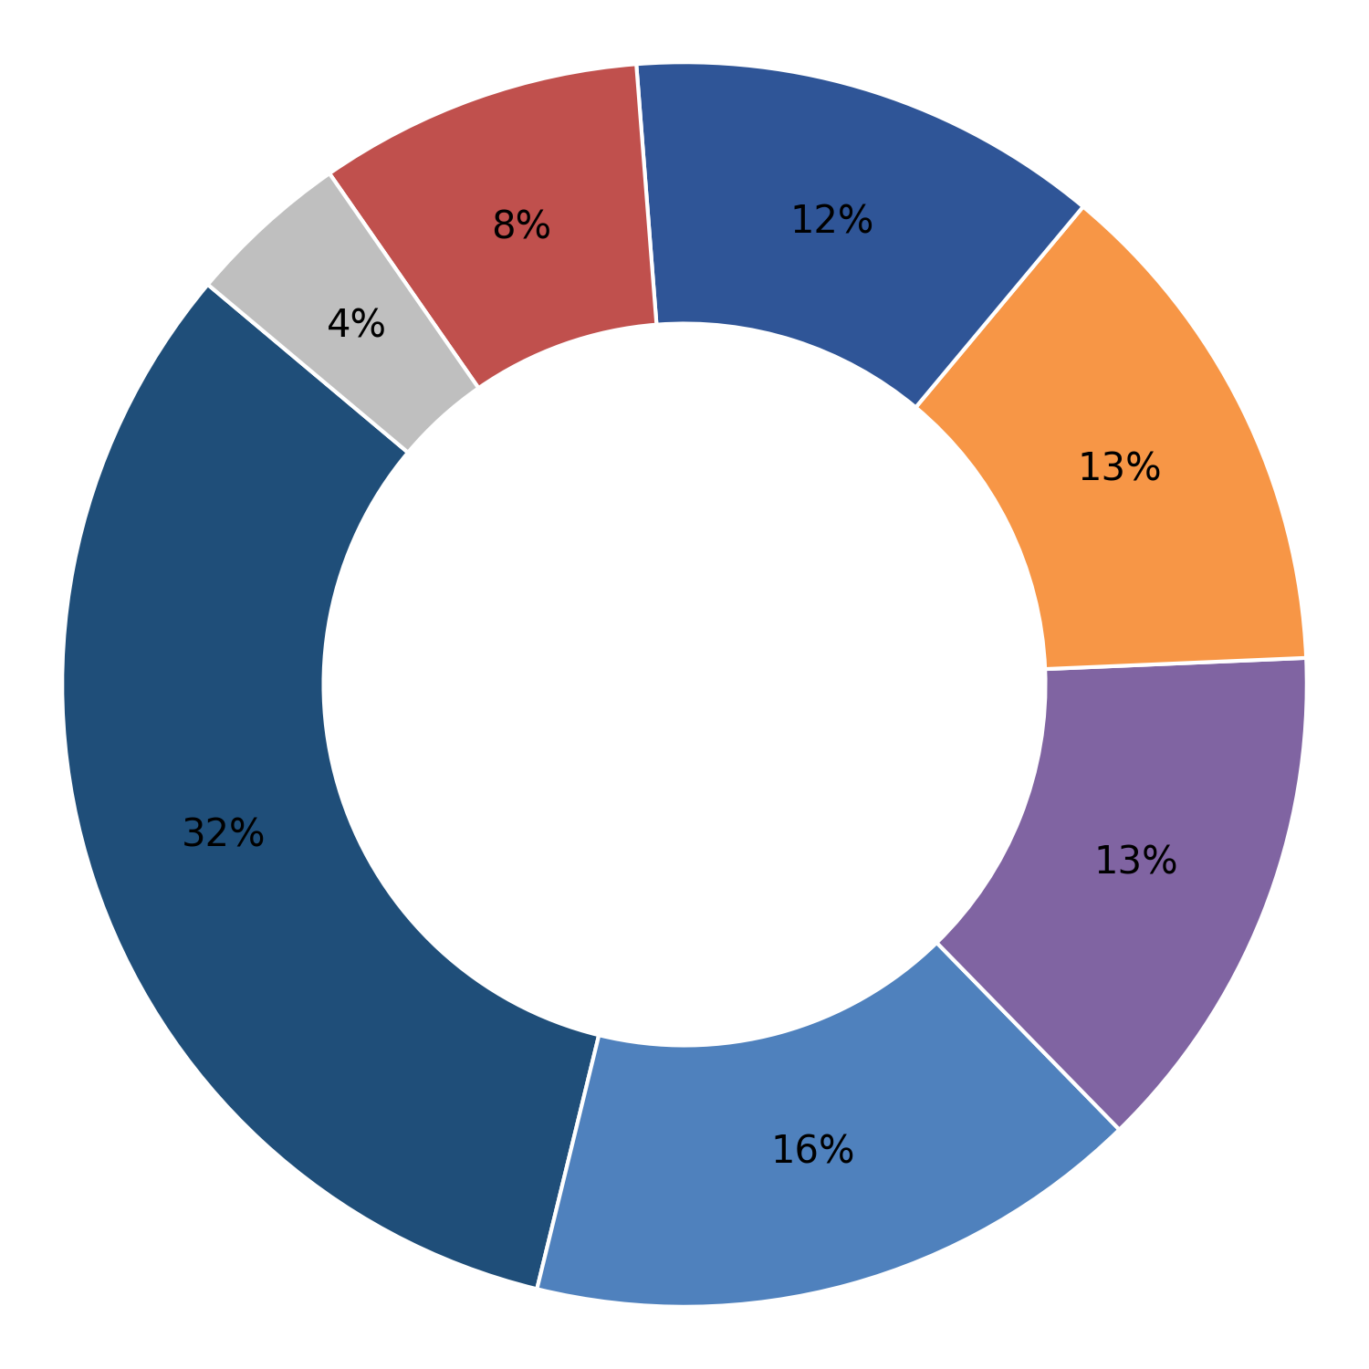
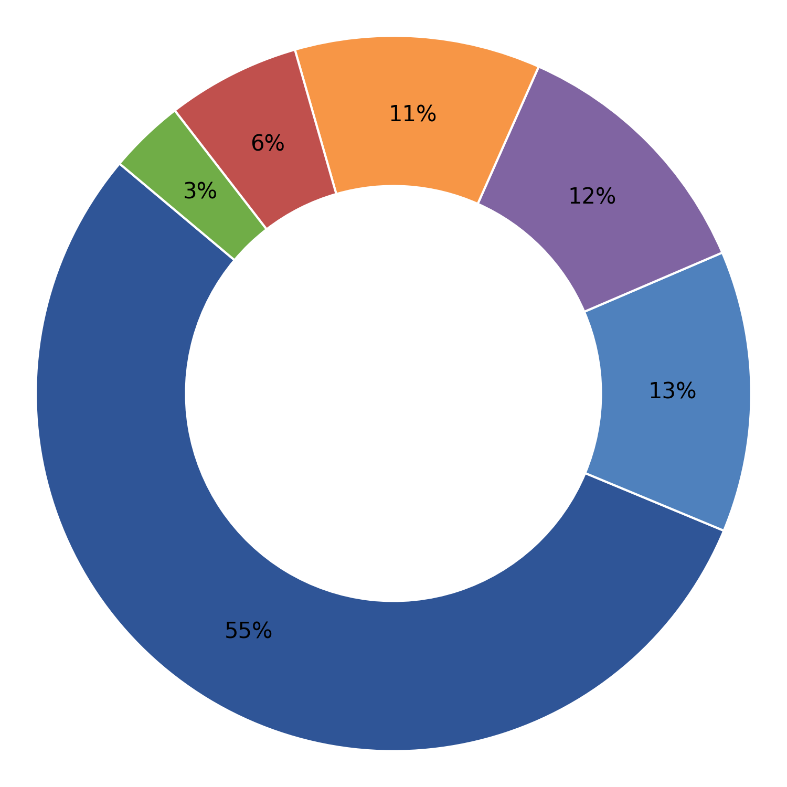
Adinath Industries INC Unit 1 Bhiwadi Haryana
Adinath Industries INC Unit 2 Bhiwadi Haryana
Embossing Die Impression / Failure
Plant-wise Defect Analysis
Dimensional
Cut bar length
Hardness
Marking
Turning length
Others
Turning Bar Diameter
Cumulative Inspected (Nos.) | Cumulative Rejection (Nos.) | Rejection (%)
2178594 | 11529 | 0.53
Cumulative Inspected (Nos.) | Cumulative Rejection (Nos.) | Rejection (%)
309289 | 1991 | 0.64
Month | Inspected (Nos.) | Rejection (Nos.) | % Rej
Apr 26 | 80789 | 567 | 0.70
Mar 26 | 79586 | 585 | 0.74
Feb 26 | 74068 | 501 | 0.68
Jan 26 | 438233 | 2578 | 0.59
Dec 25 | 304516 | 1727 | 0.57
Nov 25 | 226436 | 1435 | 0.63
Oct 25 | 203671 | 1214 | 0.60
Sep 25 | 225943 | 1153 | 0.51
Aug 25 | 195440 | 744 | 0.38
Jul 25 | 160472 | 624 | 0.39
Jun 25 | 117846 | 341 | 0.29
May 25 | 71594 | 60 | 0.08
Month | Inspected (Nos.) | Rejection (Nos.) | % Rej
Apr 26 | 174072 | 1125 | 0.65
Mar 26 | 135217 | 866 | 0.64
1

Slide 3
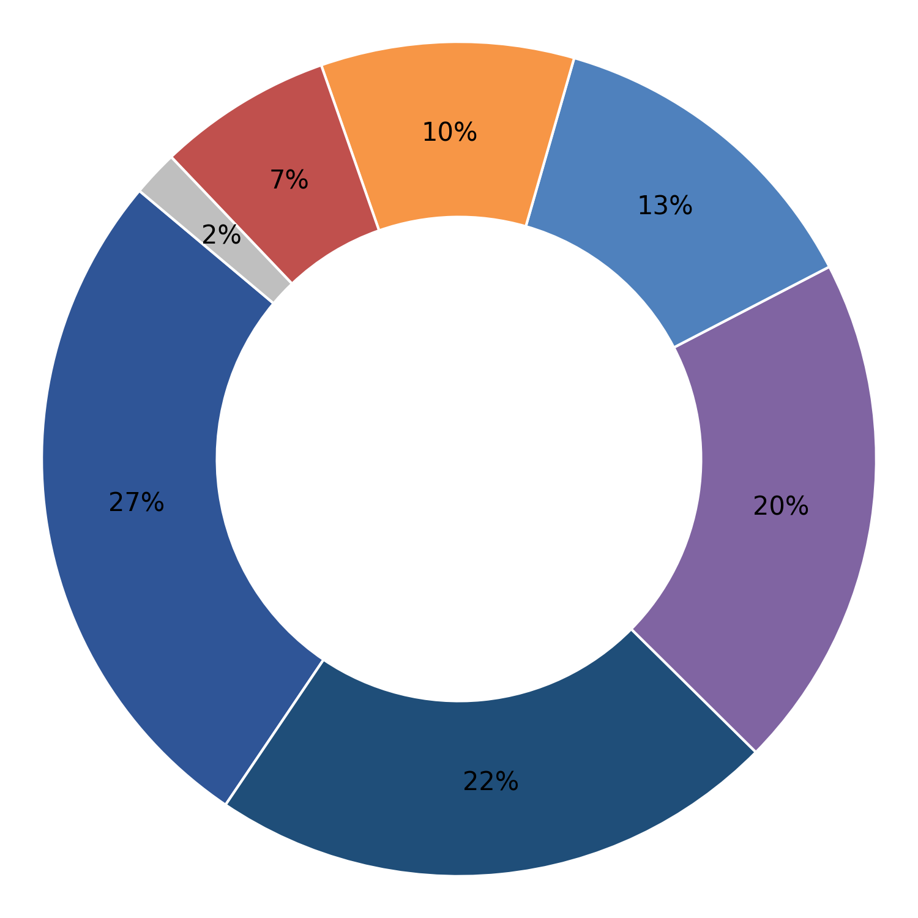
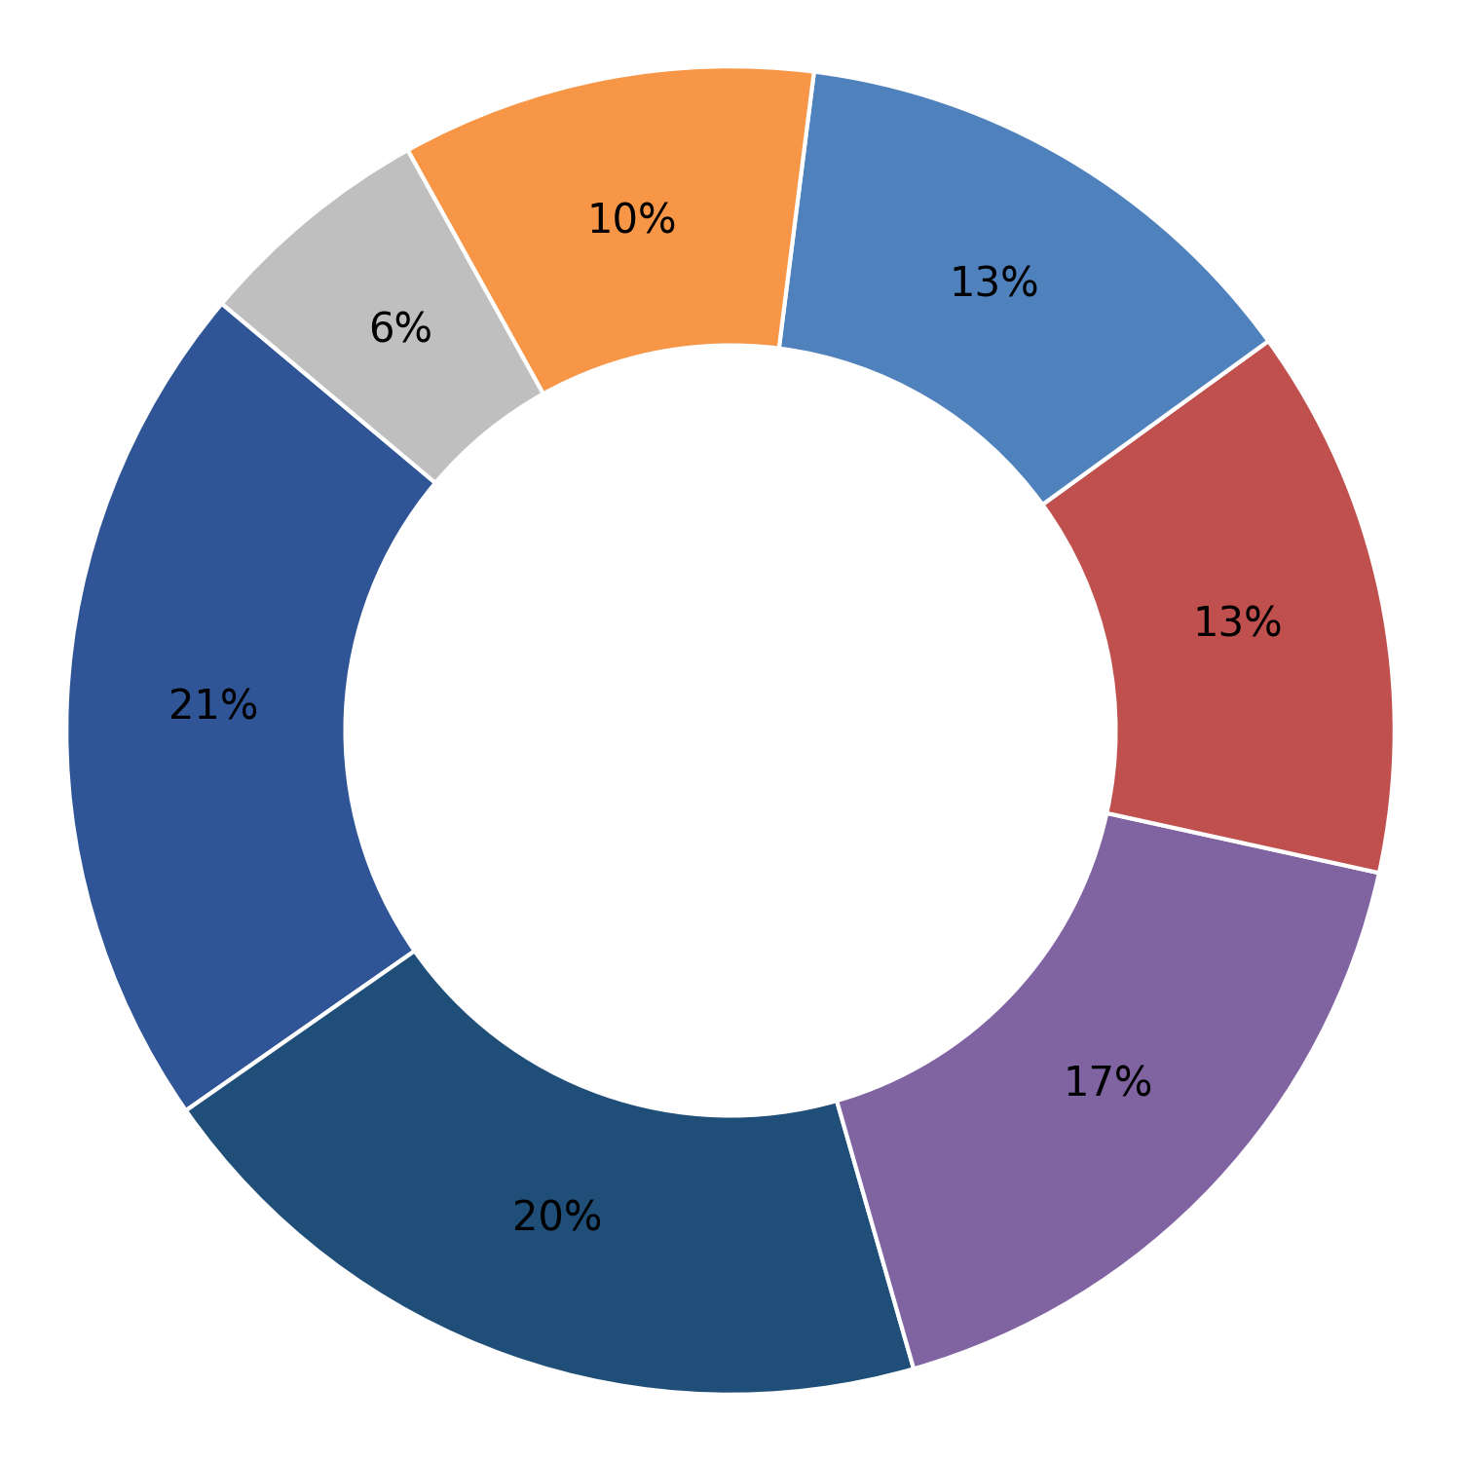
Avdesh Tracks(P) Ltd. Mohali Punjab
Bimla Rail Fasteners Karnal Haryana
Marking
Plant-wise Defect Analysis
Embossing Die Impression / Failure
Cut bar length
Dimensional
Hardness
Turning length
Others
Cumulative Inspected (Nos.) | Cumulative Rejection (Nos.) | Rejection (%)
1301242 | 8462 | 0.65
Cumulative Inspected (Nos.) | Cumulative Rejection (Nos.) | Rejection (%)
730104 | 3788 | 0.52
Month | Inspected (Nos.) | Rejection (Nos.) | % Rej
Apr 26 | 53296 | 2223 | 4.17
Mar 26 | 154267 | 844 | 0.55
Feb 26 | 145665 | 763 | 0.52
Jan 26 | 198608 | 1219 | 0.61
Dec 25 | 177753 | 949 | 0.53
Nov 25 | 128620 | 730 | 0.57
Oct 25 | 109358 | 440 | 0.40
Sep 25 | 90677 | 313 | 0.35
Aug 25 | 117392 | 394 | 0.34
Jul 25 | 109402 | 507 | 0.46
Jun 25 | 16204 | 80 | 0.49
Month | Inspected (Nos.) | Rejection (Nos.) | % Rej
Feb 26 | 233644 | 1327 | 0.57
Jan 26 | 204540 | 1405 | 0.69
Dec 25 | 110893 | 474 | 0.43
Nov 25 | 31163 | 191 | 0.61
Oct 25 | 15550 | 83 | 0.53
Sep 25 | 127933 | 303 | 0.24
Aug 25 | 6381 | 5 | 0.08
1

Slide 4
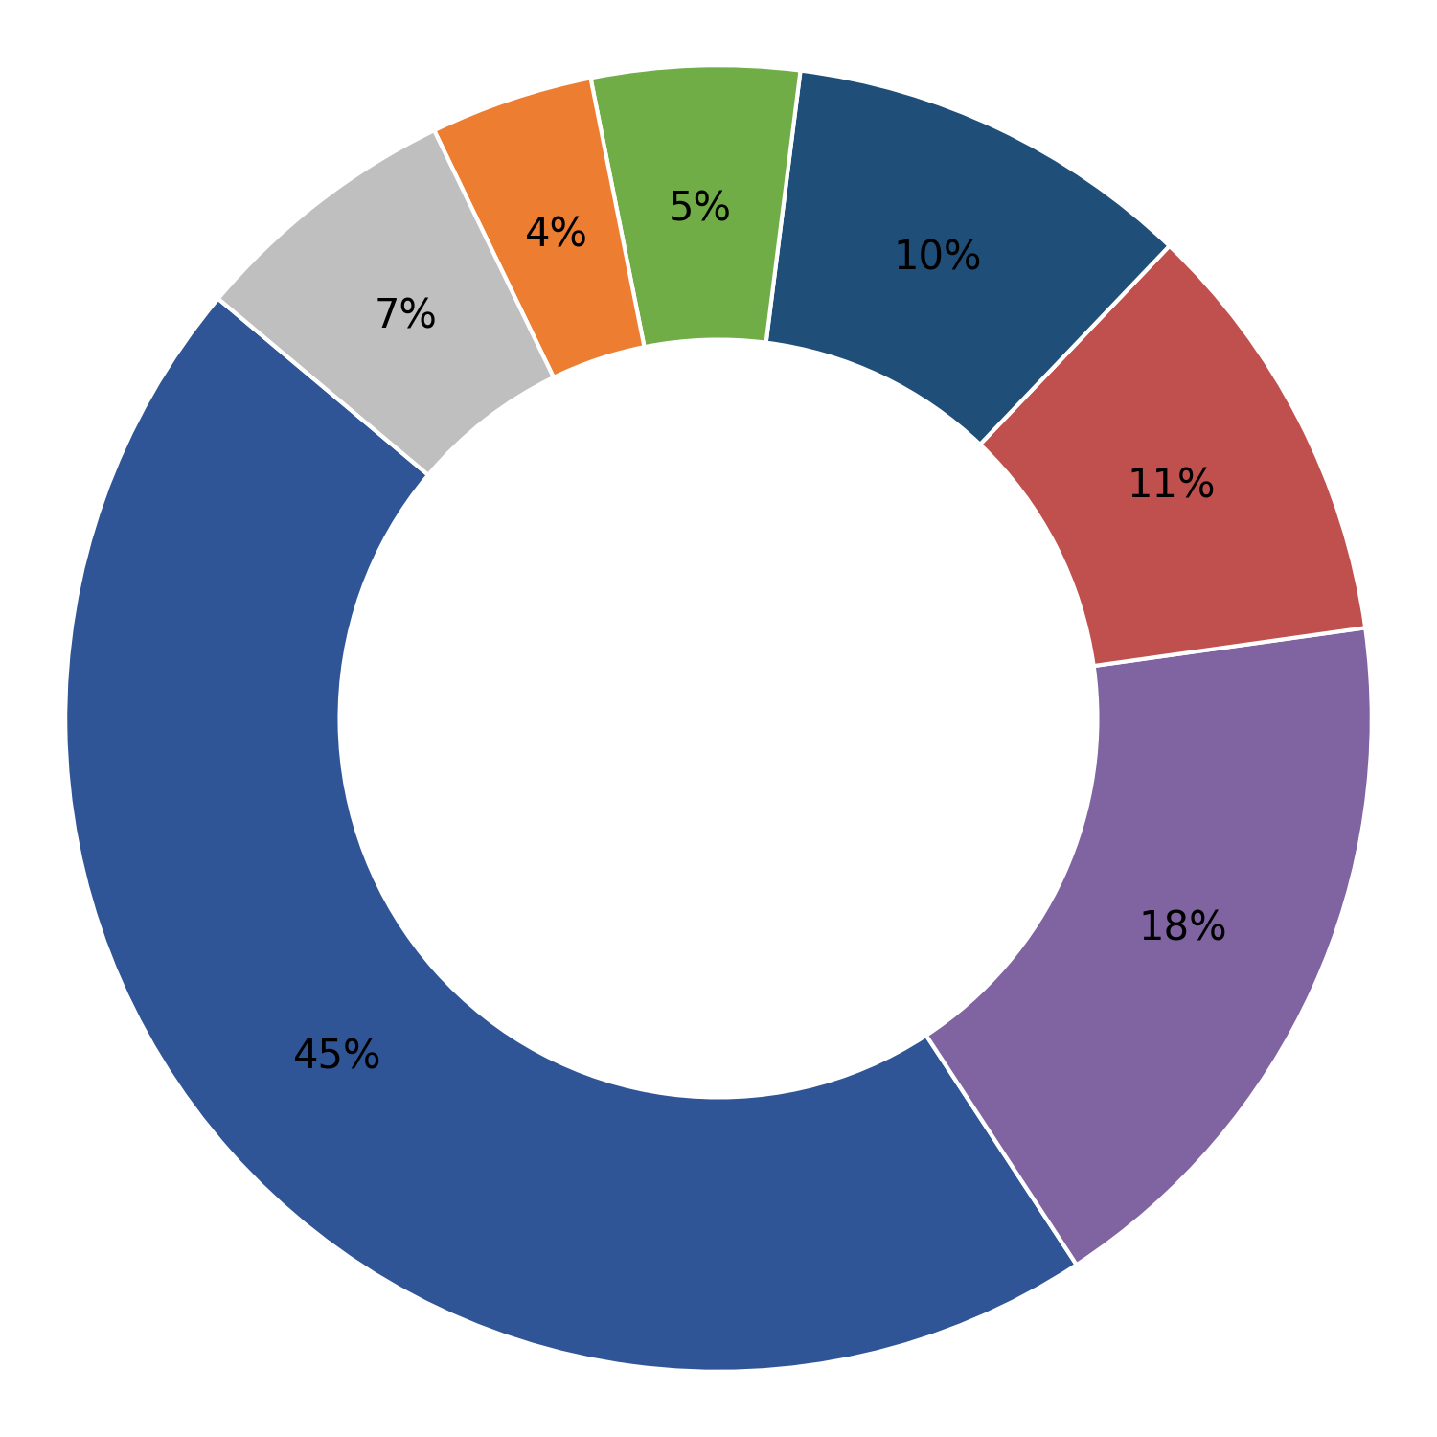
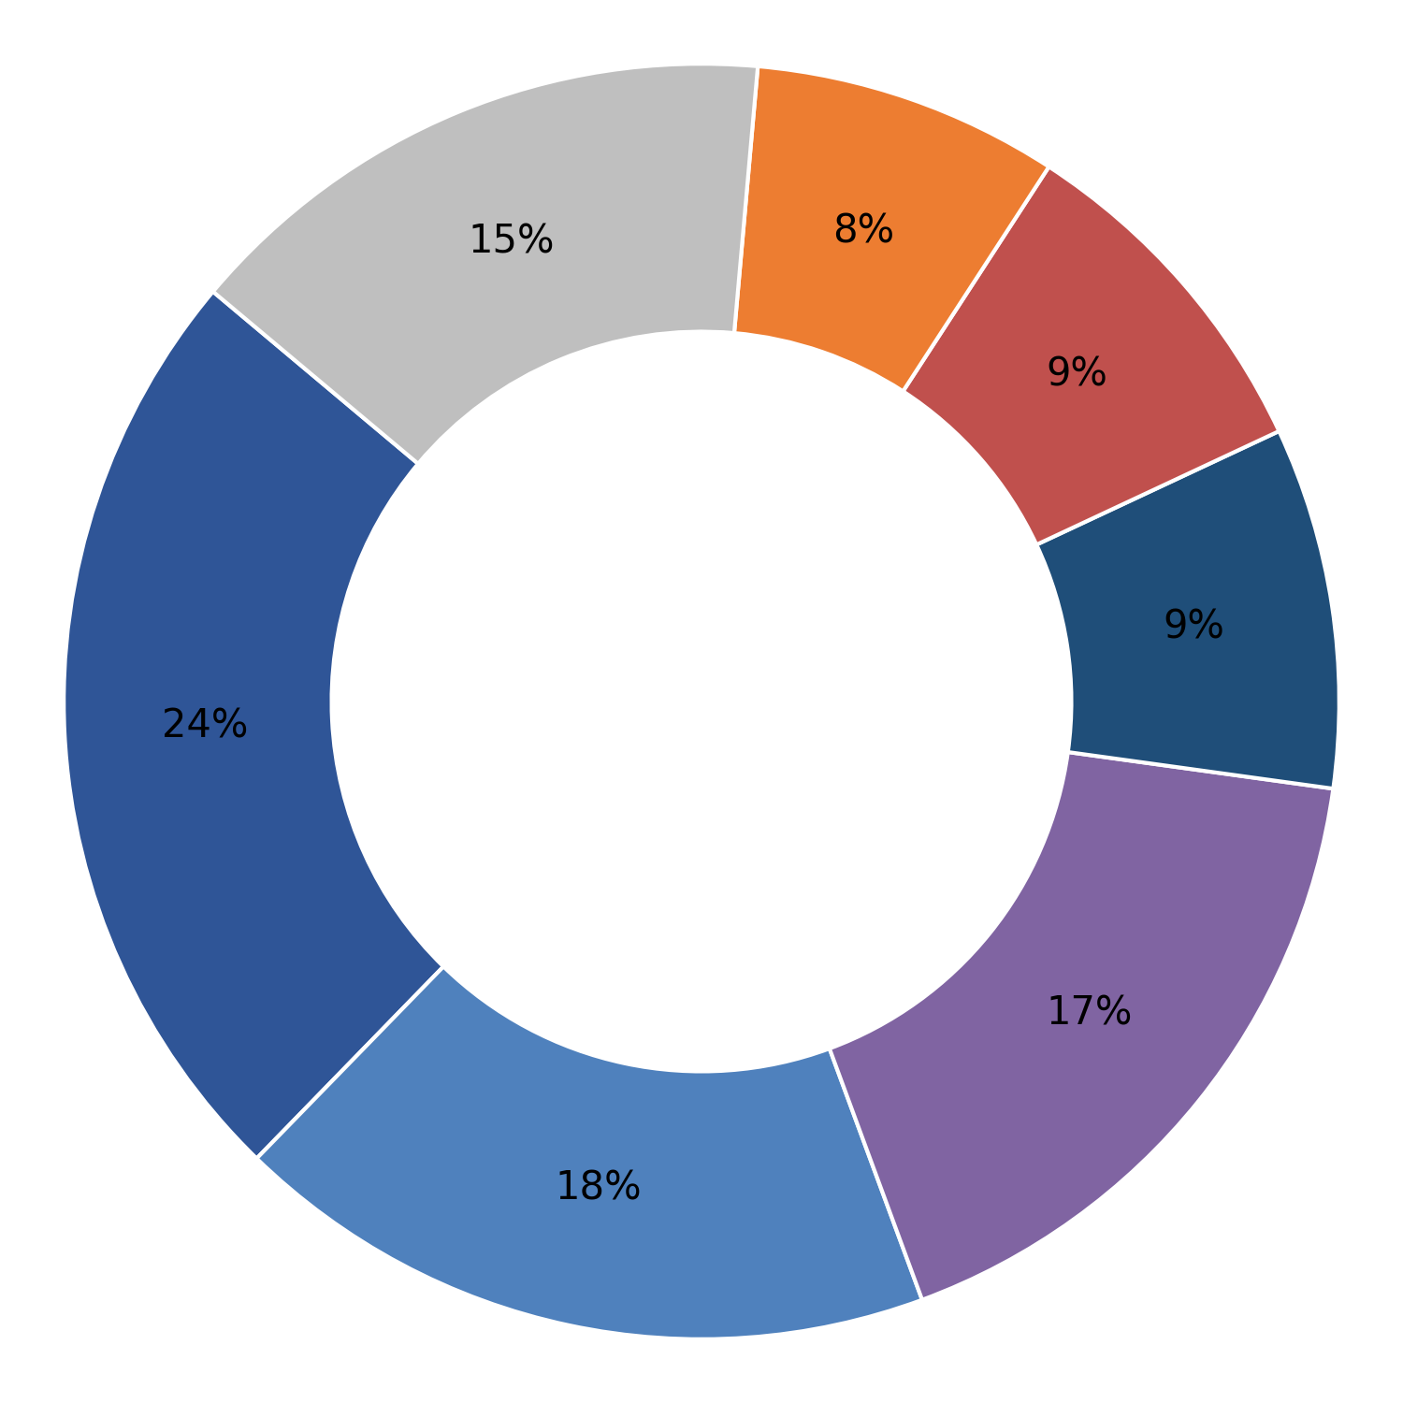
Bridge Track & Tower Pvt Ltd Raipur Chhatishgarh
CALCUTTA SPRINGS LTD. Howrah West Bengal
Forging defect
Plant-wise Defect Analysis
Cut bar length
Turning length
Embossing Die Impression / Failure
MPI
Turning Bar Diameter
Others
Dimensional
Cumulative Inspected (Nos.) | Cumulative Rejection (Nos.) | Rejection (%)
5146764 | 62805 | 1.22
Cumulative Inspected (Nos.) | Cumulative Rejection (Nos.) | Rejection (%)
2635973 | 18279 | 0.69
Month | Inspected (Nos.) | Rejection (Nos.) | % Rej
Apr 26 | 410802 | 6895 | 1.68
Mar 26 | 351670 | 4938 | 1.40
Feb 26 | 343228 | 4695 | 1.37
Jan 26 | 380851 | 4892 | 1.28
Dec 25 | 548699 | 7233 | 1.32
Nov 25 | 482534 | 6553 | 1.36
Oct 25 | 337924 | 4847 | 1.43
Sep 25 | 697985 | 8387 | 1.20
Aug 25 | 473904 | 5503 | 1.16
Jul 25 | 613766 | 6239 | 1.02
Jun 25 | 225745 | 2016 | 0.89
May 25 | 54808 | 105 | 0.19
Month | Inspected (Nos.) | Rejection (Nos.) | % Rej
Mar 26 | 197928 | 1993 | 1.01
Feb 26 | 256114 | 2206 | 0.86
Jan 26 | 302561 | 2140 | 0.71
Dec 25 | 375049 | 2973 | 0.79
Nov 25 | 318458 | 2646 | 0.83
Oct 25 | 417139 | 2166 | 0.52
Sep 25 | 355915 | 1871 | 0.53
Aug 25 | 198328 | 908 | 0.46
Jul 25 | 113463 | 578 | 0.51
Jun 25 | 85419 | 719 | 0.84
May 25 | 15599 | 79 | 0.51
1

Slide 5
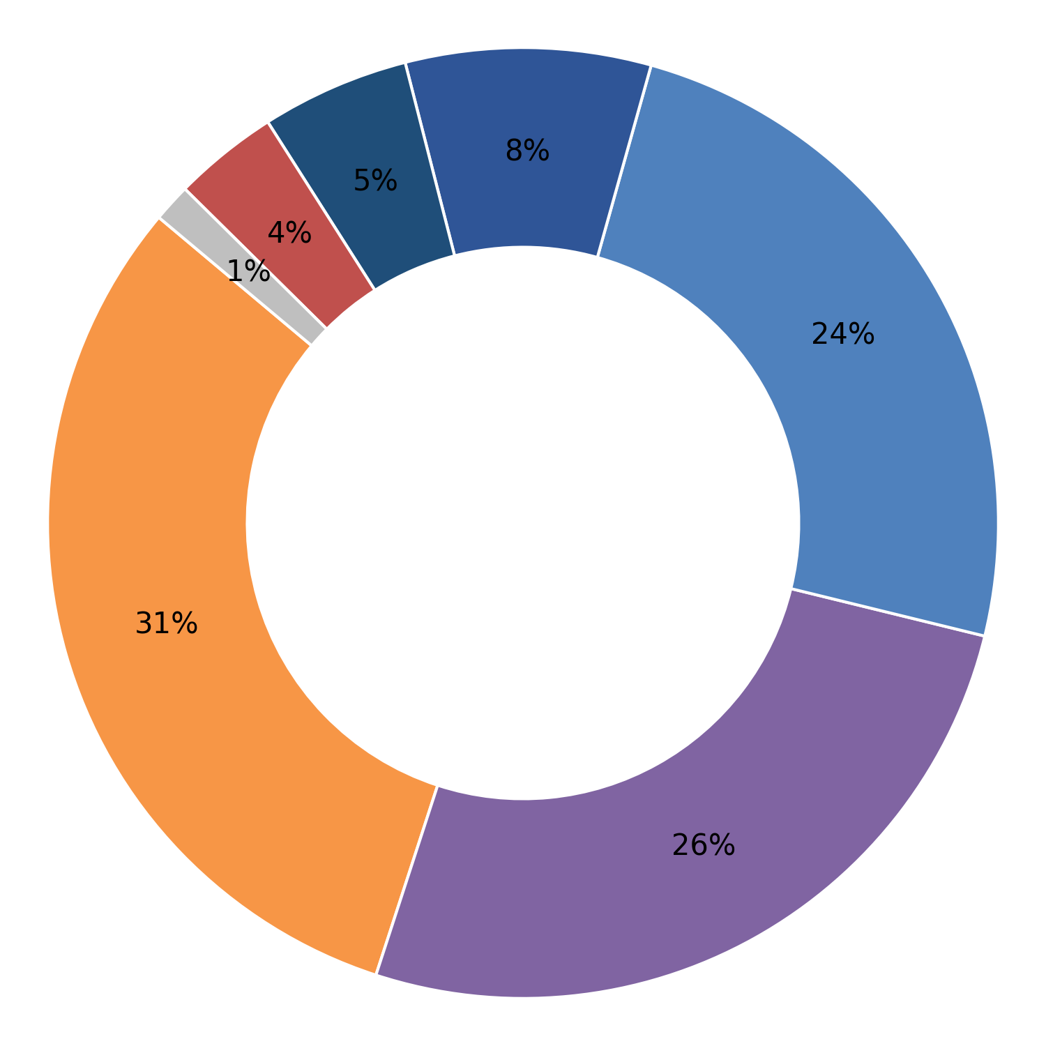
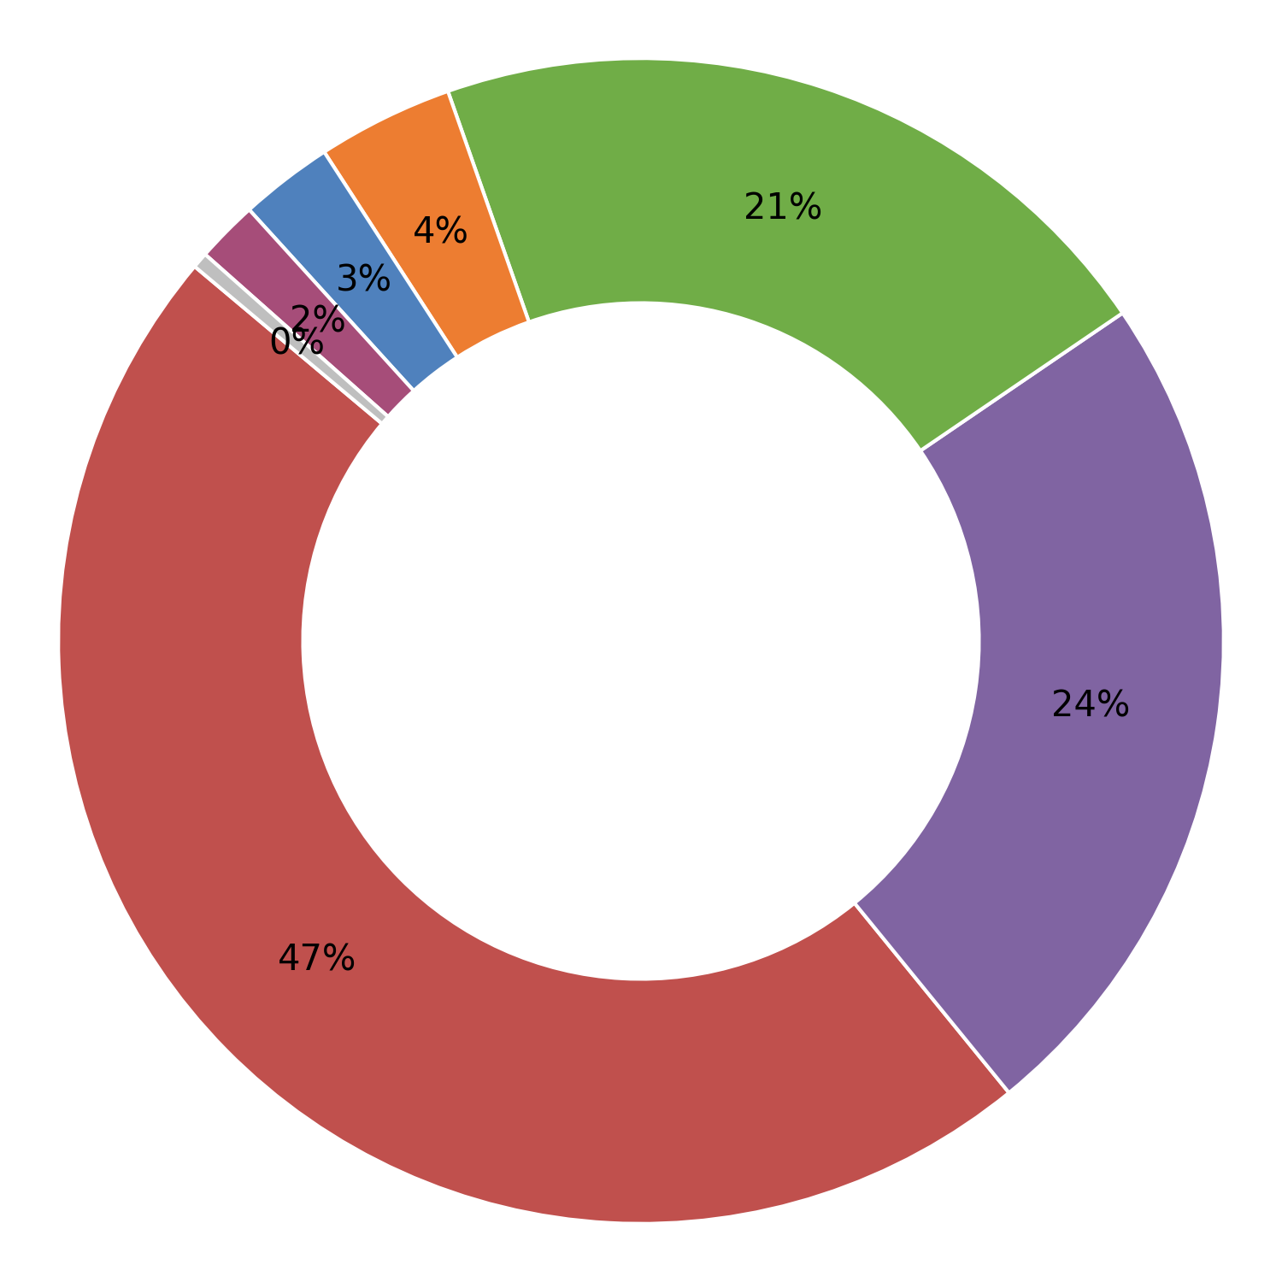
Cemcon Railway Industries Gohana Haryana
Cosmo Enterprise Raipur Chhatishgarh
Hardness
Plant-wise Defect Analysis
Cut bar length
Dimensional
Marking
Embossing Die Impression / Failure
Turning length
Others
Forging defect
MPI
Visual (Sheared Edges, Surface Defects)
Cumulative Inspected (Nos.) | Cumulative Rejection (Nos.) | Rejection (%)
354303 | 3636 | 1.03
Cumulative Inspected (Nos.) | Cumulative Rejection (Nos.) | Rejection (%)
461200 | 3207 | 0.70
Month | Inspected (Nos.) | Rejection (Nos.) | % Rej
Apr 26 | 67026 | 601 | 0.90
Mar 26 | 32624 | 462 | 1.42
Feb 26 | 40630 | 778 | 1.91
Jan 26 | 23431 | 348 | 1.49
Nov 25 | 50657 | 651 | 1.29
Oct 25 | 40732 | 485 | 1.19
Sep 25 | 0 | 0 | 0.00
Aug 25 | 46504 | 176 | 0.38
Jul 25 | 52699 | 135 | 0.26
Month | Inspected (Nos.) | Rejection (Nos.) | % Rej
Jan 26 | 0 | 0 | 0.00
Dec 25 | 0 | 0 | 0.00
Jun 25 | 292591 | 2606 | 0.89
May 25 | 168609 | 601 | 0.36
1

Slide 6
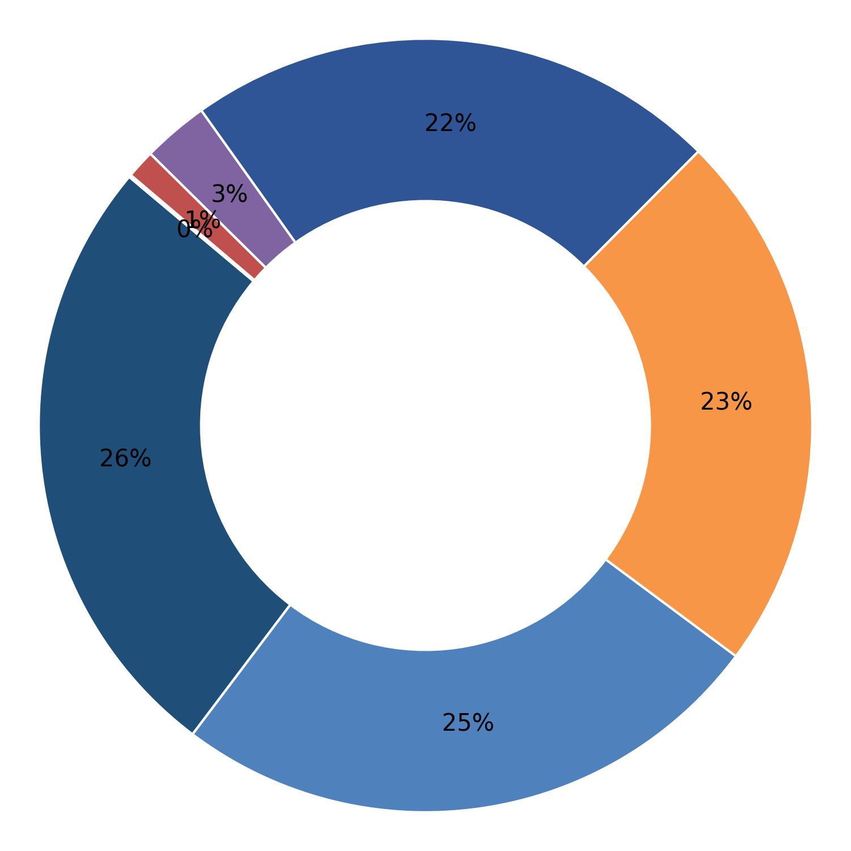
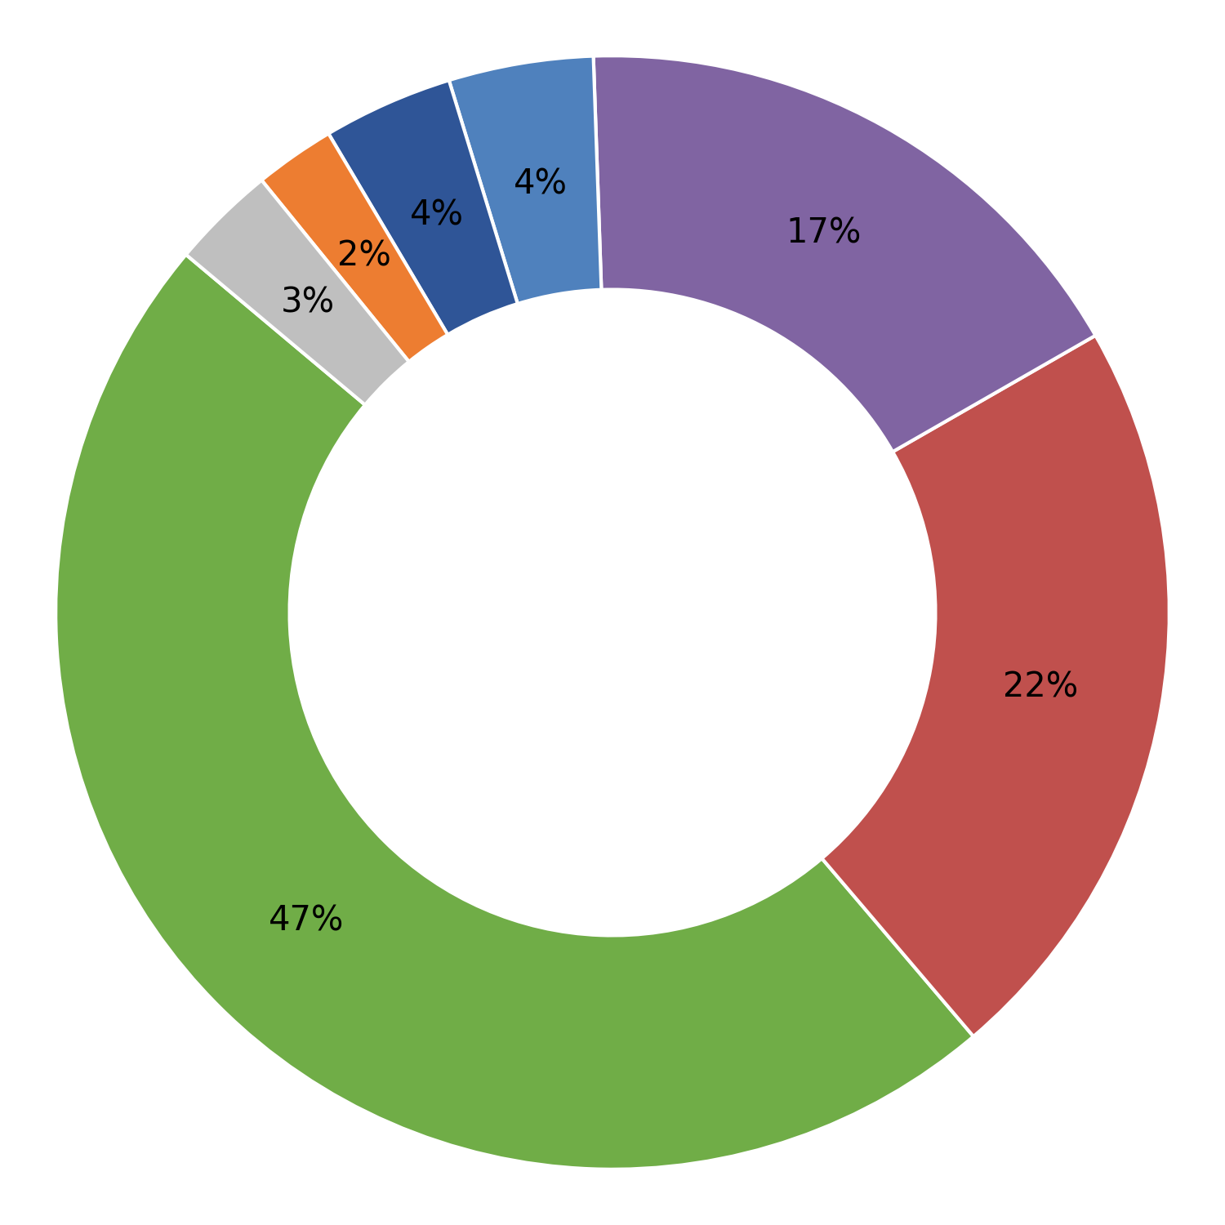
Fateh Chand Jain Faridabad Haryana
Jee Kay International Track Pvt. Urla Raipur
Embossing Die Impression / Failure
Plant-wise Defect Analysis
Dimensional
Hardness
Marking
Cut bar length
Turning length
Others
Forging defect
MPI
Cumulative Inspected (Nos.) | Cumulative Rejection (Nos.) | Rejection (%)
1439148 | 6056 | 0.42
Cumulative Inspected (Nos.) | Cumulative Rejection (Nos.) | Rejection (%)
774662 | 9219 | 1.19
Month | Inspected (Nos.) | Rejection (Nos.) | % Rej
Apr 26 | 72727 | 458 | 0.63
Mar 26 | 16790 | 120 | 0.71
Feb 26 | 138902 | 1165 | 0.84
Jan 26 | 132743 | 807 | 0.61
Dec 25 | 54772 | 798 | 1.46
Nov 25 | 144113 | 472 | 0.33
Oct 25 | 151718 | 876 | 0.58
Sep 25 | 104320 | 242 | 0.23
Aug 25 | 104777 | 186 | 0.18
Jul 25 | 167505 | 438 | 0.26
Jun 25 | 99053 | 276 | 0.28
May 25 | 94593 | 93 | 0.10
Month | Inspected (Nos.) | Rejection (Nos.) | % Rej
Apr 26 | 267357 | 3405 | 1.27
Mar 26 | 273041 | 3321 | 1.22
Feb 26 | 234264 | 2493 | 1.06
1

Slide 7
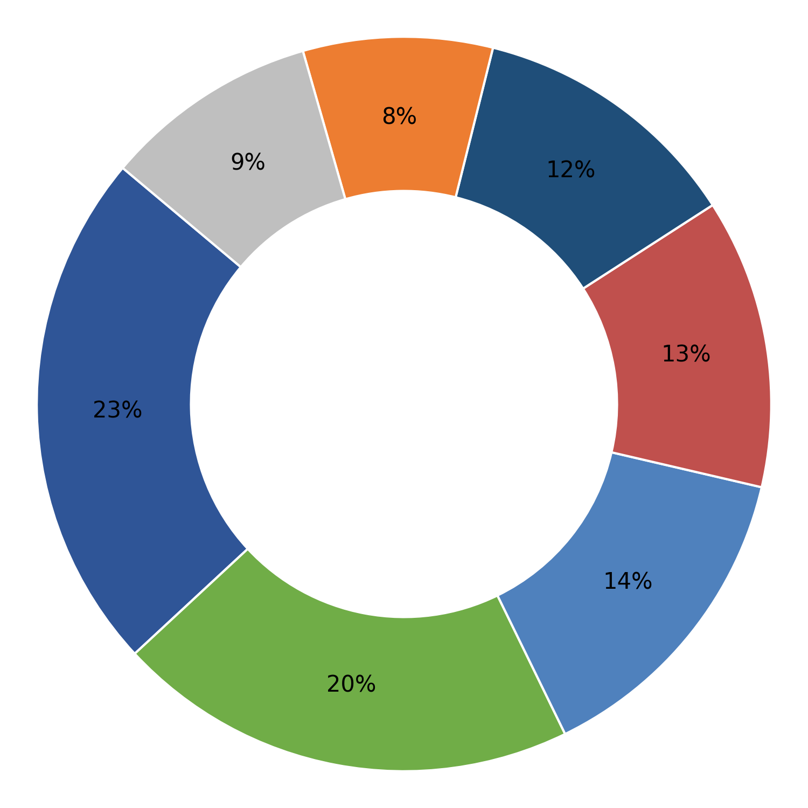
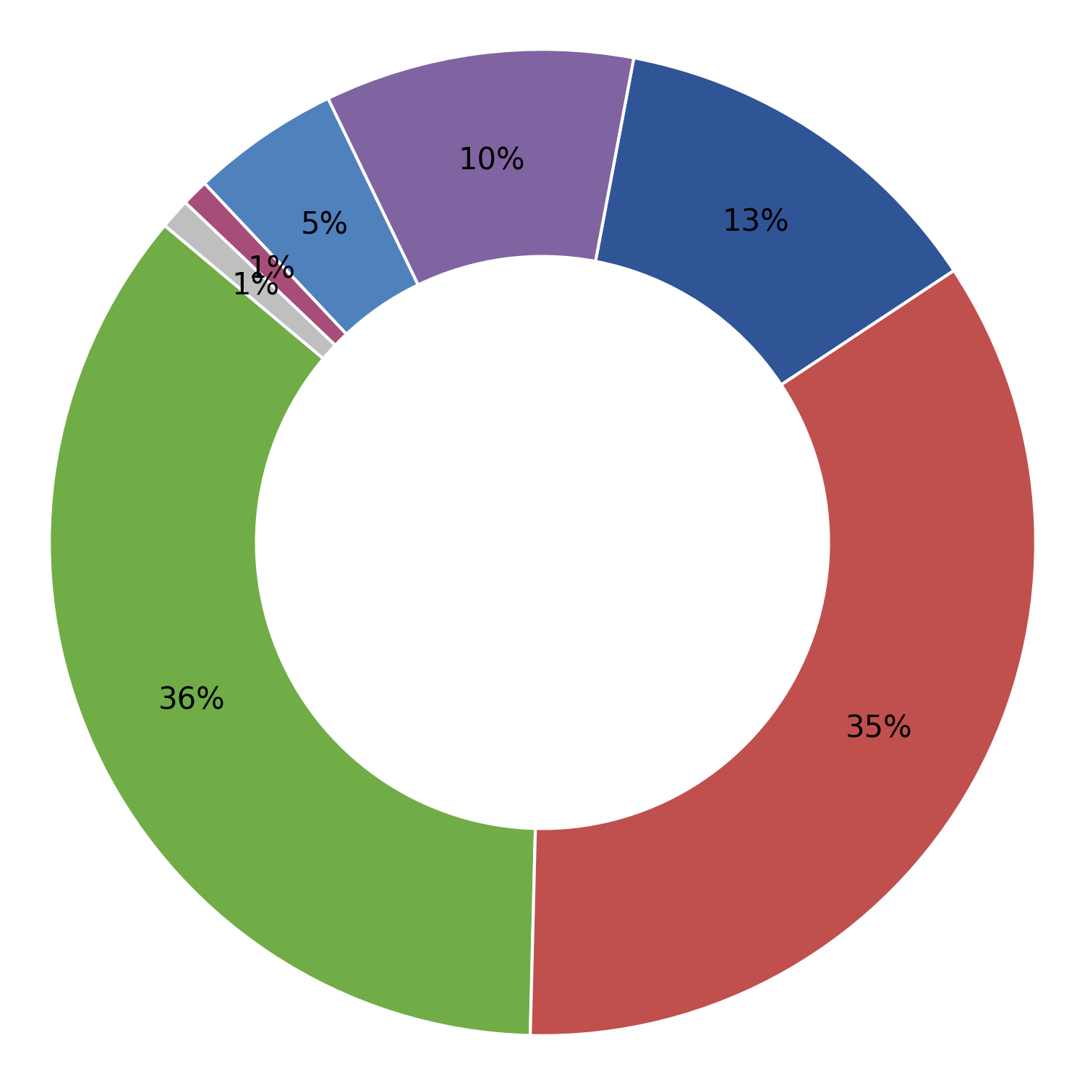
KALIMATA ISPAT (Unit-1) Howrah West Bengal
KALIMATA ISPAT (Unit-II) Durgapur West Bengal
Forging defect
Plant-wise Defect Analysis
Turning Bar Diameter
Dimensional
Turning length
Embossing Die Impression / Failure
Visual (Sheared Edges, Surface Defects)
Others
Cut bar length
MPI
Cumulative Inspected (Nos.) | Cumulative Rejection (Nos.) | Rejection (%)
1900765 | 19912 | 1.05
Cumulative Inspected (Nos.) | Cumulative Rejection (Nos.) | Rejection (%)
2577961 | 17320 | 0.67
Month | Inspected (Nos.) | Rejection (Nos.) | % Rej
Apr 26 | 0 | 0 | 0.00
Mar 26 | 26708 | 38 | 0.14
Feb 26 | 275977 | 2388 | 0.87
Jan 26 | 277280 | 2895 | 1.04
Dec 25 | 195702 | 3253 | 1.66
Nov 25 | 218950 | 2497 | 1.14
Oct 25 | 231607 | 2805 | 1.21
Sep 25 | 189733 | 2180 | 1.15
Aug 25 | 298771 | 1571 | 0.53
Jul 25 | 139254 | 1522 | 1.09
Jun 25 | 46783 | 763 | 1.63
Month | Inspected (Nos.) | Rejection (Nos.) | % Rej
Apr 26 | 107377 | 469 | 0.44
Mar 26 | 334893 | 2364 | 0.71
Feb 26 | 432347 | 3035 | 0.70
Jan 26 | 453521 | 2760 | 0.61
Dec 25 | 423755 | 3552 | 0.84
Nov 25 | 356696 | 1714 | 0.48
Oct 25 | 313842 | 1568 | 0.50
Sep 25 | 155530 | 1858 | 1.19
1

Slide 8
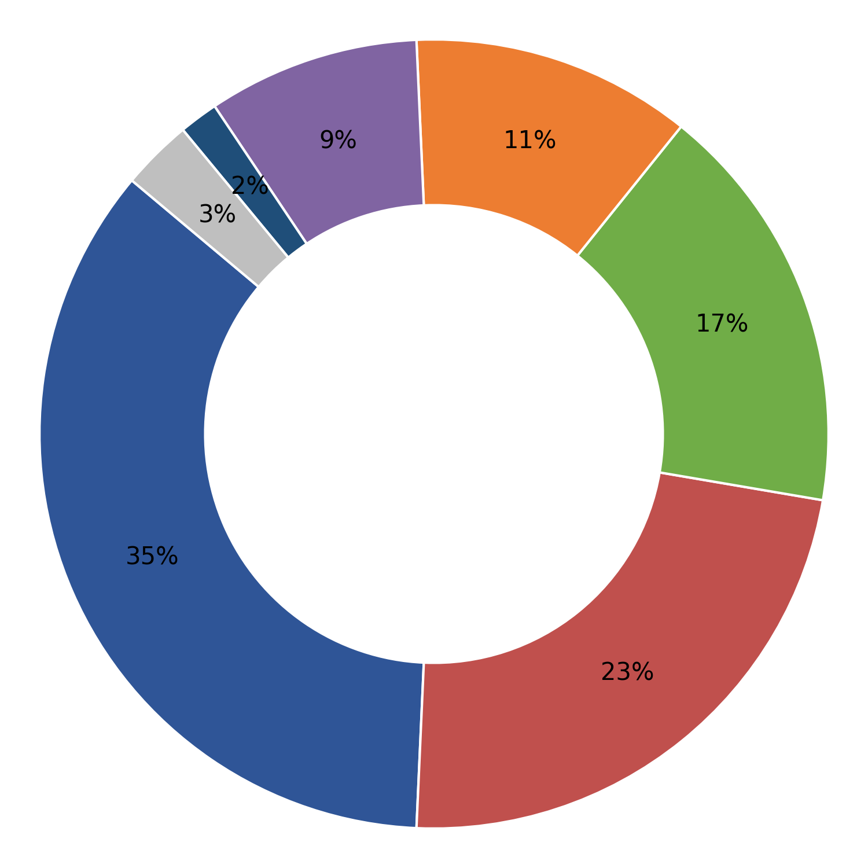
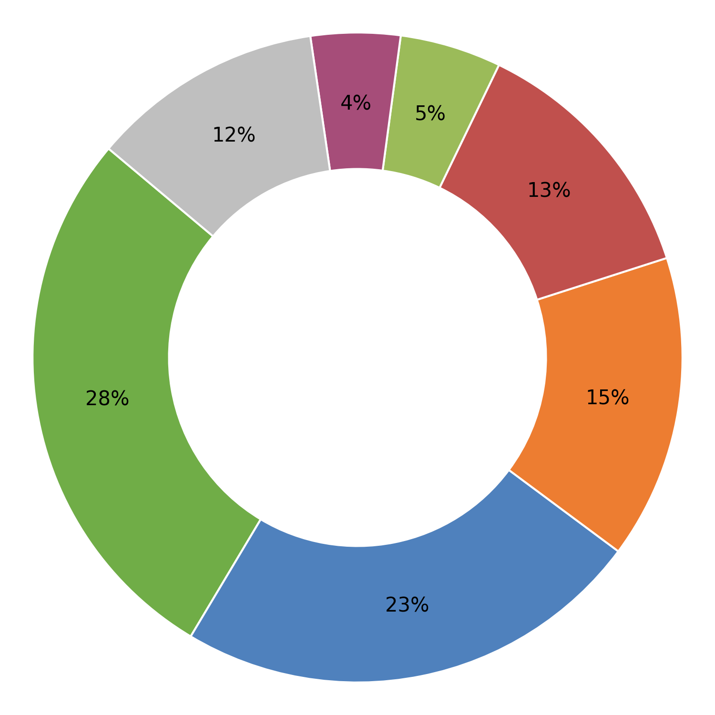
KALIMATA VYAPAAR (Unit-II) Durgapur West Bengal
KDS ENGG. PVT. LTD. Howrah West Bengal
Other (less weight)
Plant-wise Defect Analysis
Turning length
Turning Bar Diameter
Forging defect
Cut bar length
Embossing Die Impression / Failure
Others
Dimensional
Flat Bearing Area
Visual (Sheared Edges, Surface Defects)
Cumulative Inspected (Nos.) | Cumulative Rejection (Nos.) | Rejection (%)
4172926 | 99939 | 2.39
Cumulative Inspected (Nos.) | Cumulative Rejection (Nos.) | Rejection (%)
392913 | 4046 | 1.03
Month | Inspected (Nos.) | Rejection (Nos.) | % Rej
Mar 26 | 639221 | 13361 | 2.09
Feb 26 | 473333 | 41508 | 8.77
Jan 26 | 526344 | 8671 | 1.65
Dec 25 | 501848 | 6700 | 1.34
Nov 25 | 421734 | 5508 | 1.31
Oct 25 | 376988 | 7378 | 1.96
Sep 25 | 475451 | 7770 | 1.63
Aug 25 | 500964 | 5874 | 1.17
Jul 25 | 257043 | 3169 | 1.23
Month | Inspected (Nos.) | Rejection (Nos.) | % Rej
Mar 26 | 85467 | 810 | 0.95
Feb 26 | 148627 | 1471 | 0.99
Jan 26 | 39589 | 323 | 0.82
Dec 25 | 0 | 0 | 0.00
Aug 25 | 38729 | 391 | 1.01
Jul 25 | 49717 | 692 | 1.39
Jun 25 | 30784 | 359 | 1.17
1

Slide 9
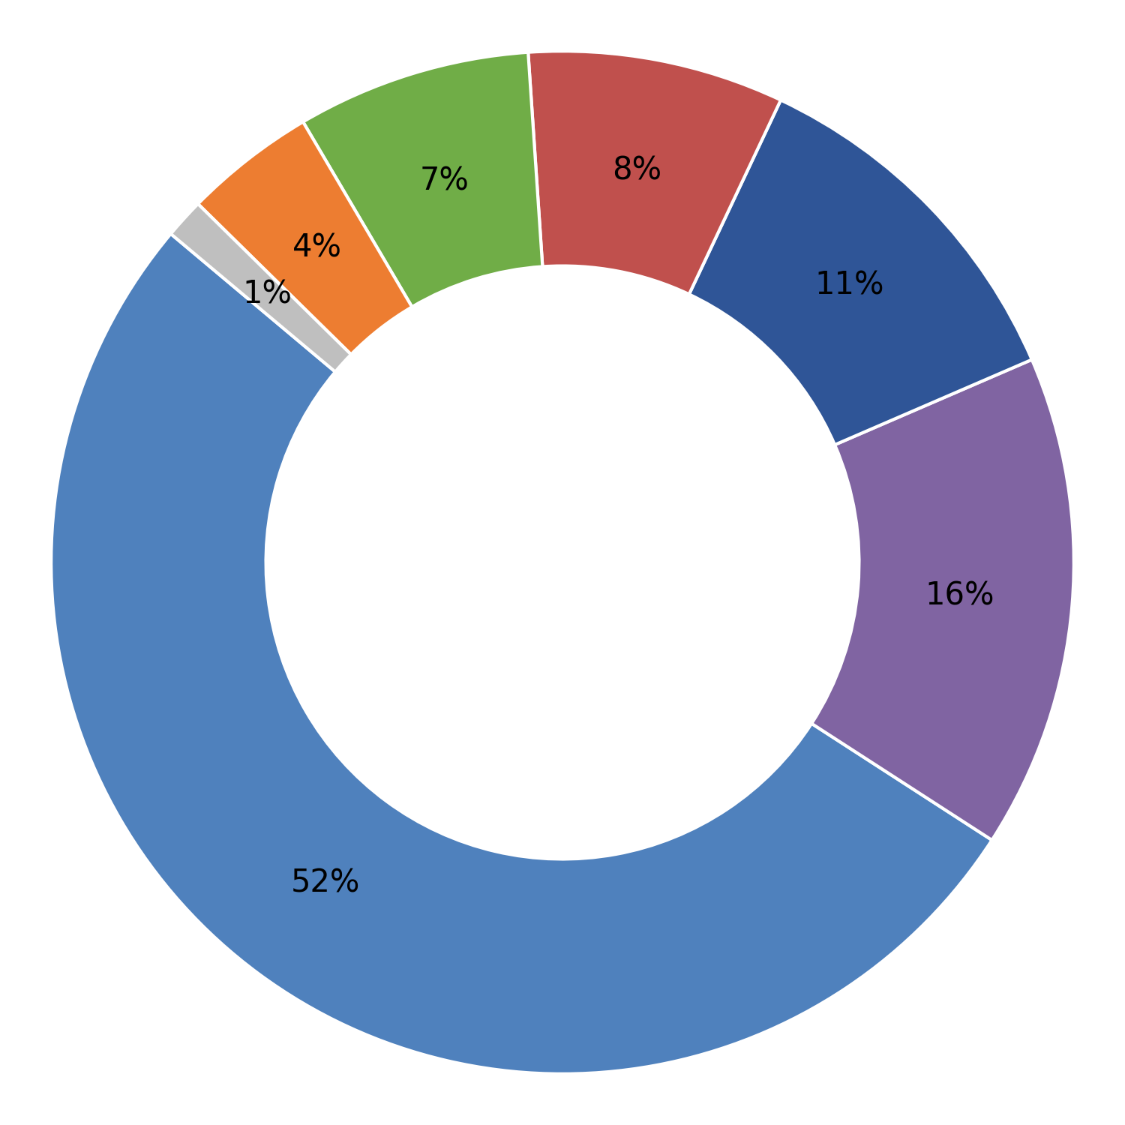
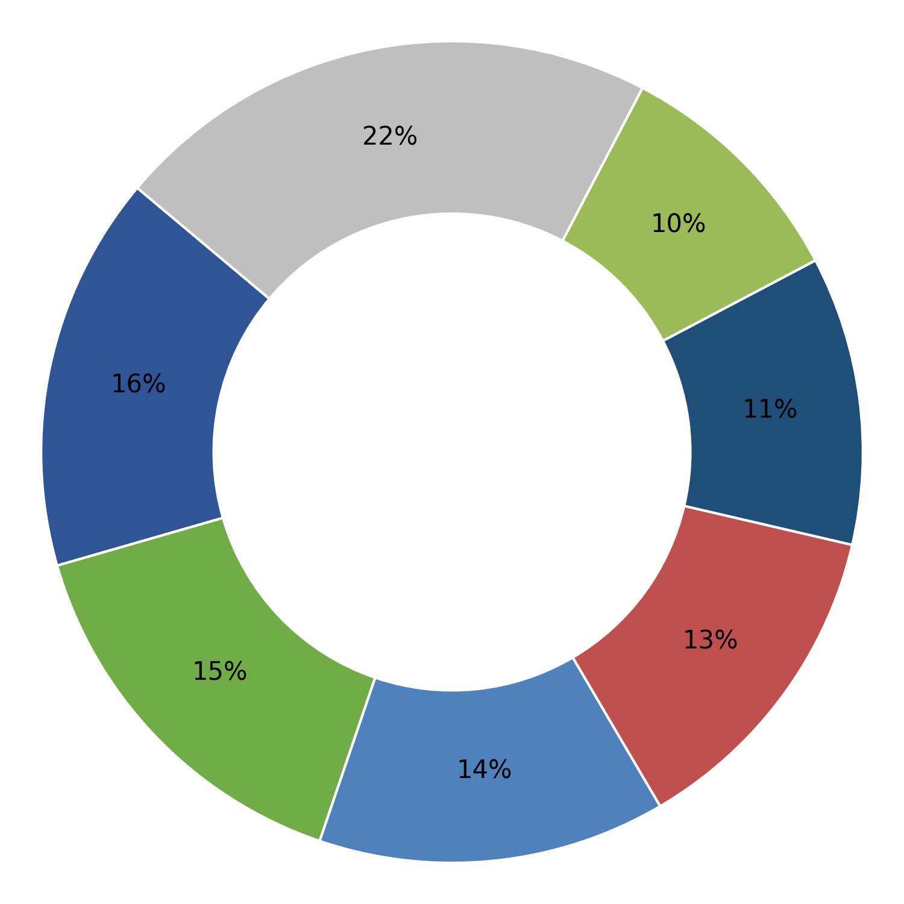
KRISHNA INFRATECH Jharsuguda Odisha
KSE ELECTRICALS PVT LTD Howrah West Bengal
Dimensional
Plant-wise Defect Analysis
Cut bar length
Turning Bar Diameter
Turning length
Forging defect
MPI
Others
Embossing Die Impression / Failure
Flat Bearing Area
Cumulative Inspected (Nos.) | Cumulative Rejection (Nos.) | Rejection (%)
1896445 | 18130 | 0.96
Cumulative Inspected (Nos.) | Cumulative Rejection (Nos.) | Rejection (%)
5179405 | 45940 | 0.89
Month | Inspected (Nos.) | Rejection (Nos.) | % Rej
Apr 26 | 134973 | 1603 | 1.19
Mar 26 | 42995 | 315 | 0.73
Feb 26 | 95341 | 961 | 1.01
Jan 26 | 131959 | 1159 | 0.88
Dec 25 | 228724 | 2314 | 1.01
Nov 25 | 175431 | 1841 | 1.05
Oct 25 | 155794 | 1514 | 0.97
Sep 25 | 205140 | 1974 | 0.96
Aug 25 | 201251 | 2081 | 1.03
Jul 25 | 280351 | 2784 | 0.99
Jun 25 | 142851 | 1149 | 0.80
May 25 | 101635 | 435 | 0.43
Month | Inspected (Nos.) | Rejection (Nos.) | % Rej
Mar 26 | 680214 | 6085 | 0.89
Feb 26 | 840556 | 7792 | 0.93
Jan 26 | 571012 | 5641 | 0.99
Dec 25 | 641496 | 5866 | 0.91
Nov 25 | 380553 | 3204 | 0.84
Oct 25 | 176257 | 1411 | 0.80
Sep 25 | 335406 | 2507 | 0.75
Aug 25 | 447014 | 4815 | 1.08
Jul 25 | 576522 | 5430 | 0.94
Jun 25 | 276461 | 2564 | 0.93
May 25 | 253914 | 625 | 0.25
1

Slide 10
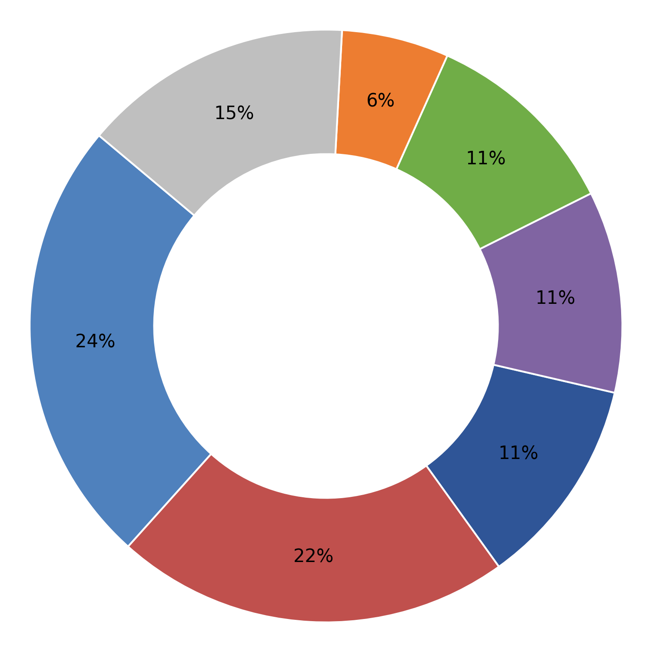
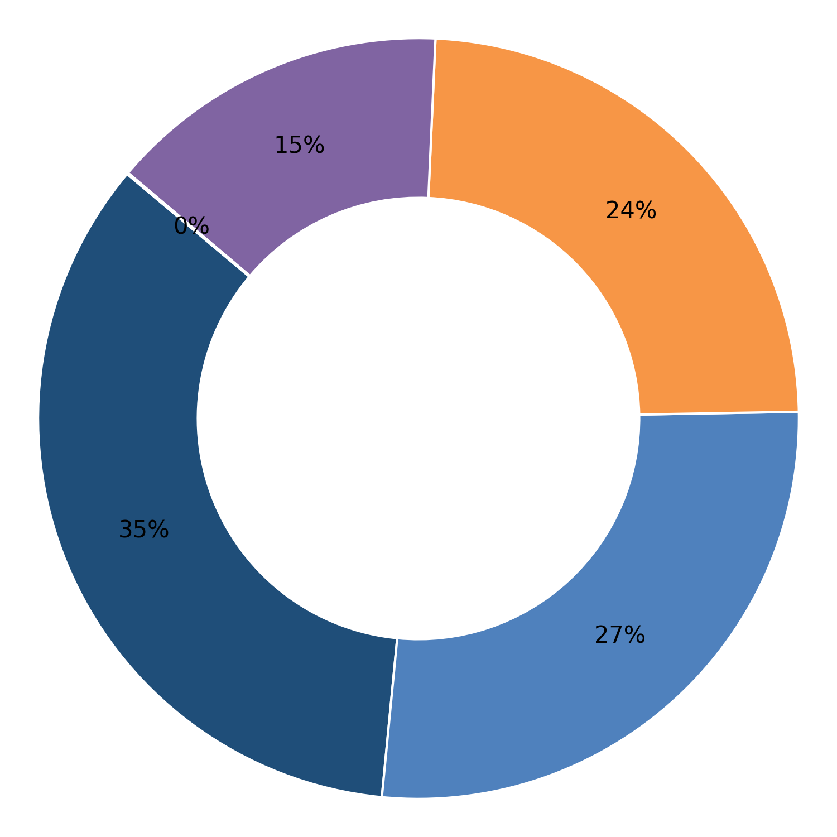
LNVS INFRA PVT. LTD Tatanagar Jharkhand
Lauls Private Ltd. Faridabad Haryana
Dimensional
Plant-wise Defect Analysis
Turning length
Visual (Sheared Edges, Surface Defects)
Cut bar length
Turning Bar Diameter
Toe load
Others
Embossing Die Impression / Failure
Hardness
MPI
Cumulative Inspected (Nos.) | Cumulative Rejection (Nos.) | Rejection (%)
1080103 | 16207 | 1.50
Cumulative Inspected (Nos.) | Cumulative Rejection (Nos.) | Rejection (%)
701858 | 1637 | 0.23
Month | Inspected (Nos.) | Rejection (Nos.) | % Rej
Mar 26 | 114427 | 1967 | 1.72
Feb 26 | 156270 | 685 | 0.44
Jan 26 | 73944 | 594 | 0.80
Dec 25 | 140773 | 2909 | 2.07
Nov 25 | 124745 | 1682 | 1.35
Oct 25 | 84033 | 4832 | 5.75
Sep 25 | 131555 | 1397 | 1.06
Aug 25 | 103185 | 595 | 0.58
Jul 25 | 72952 | 589 | 0.81
Jun 25 | 16017 | 472 | 2.95
May 25 | 46577 | 405 | 0.87
Apr 25 | 15625 | 80 | 0.51
Month | Inspected (Nos.) | Rejection (Nos.) | % Rej
Oct 25 | 47132 | 175 | 0.37
Sep 25 | 110750 | 366 | 0.33
Aug 25 | 101006 | 352 | 0.35
Jul 25 | 115072 | 382 | 0.33
Jun 25 | 104934 | 234 | 0.22
May 25 | 121436 | 79 | 0.07
Apr 25 | 101528 | 49 | 0.05
1

Slide 11
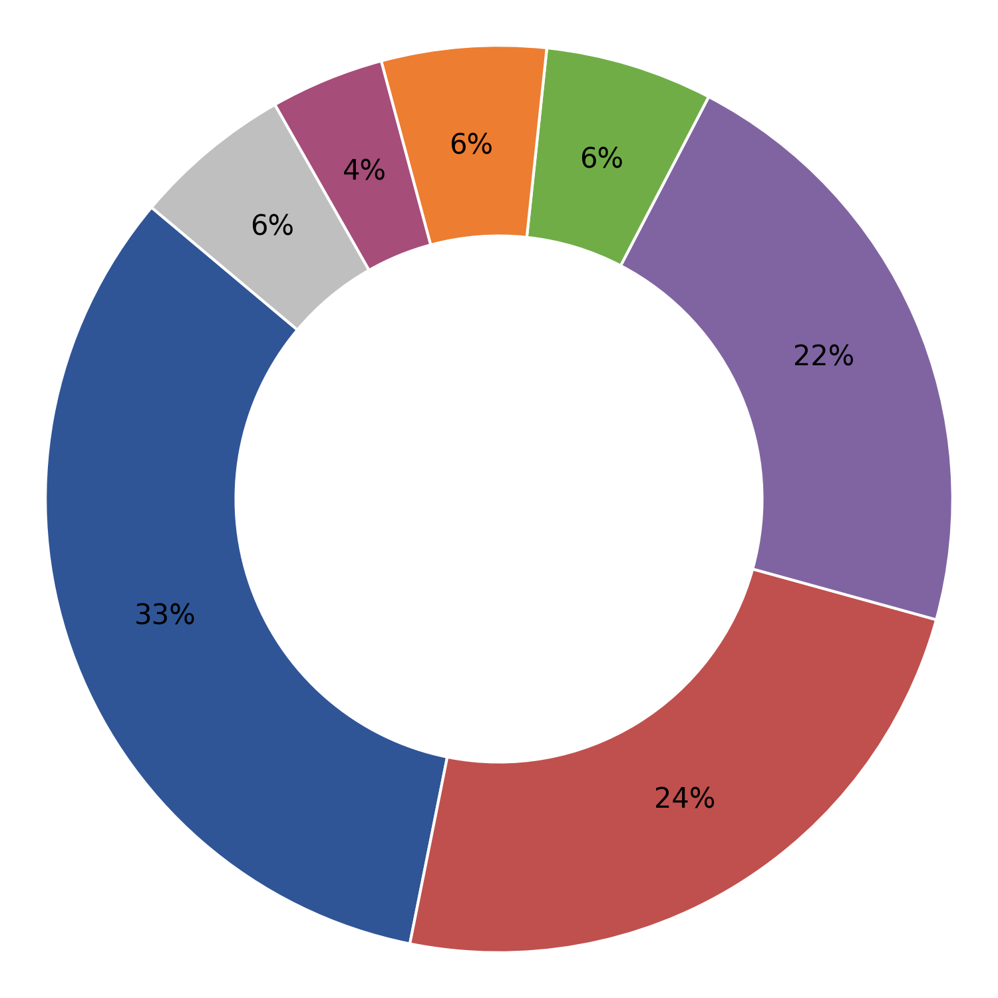
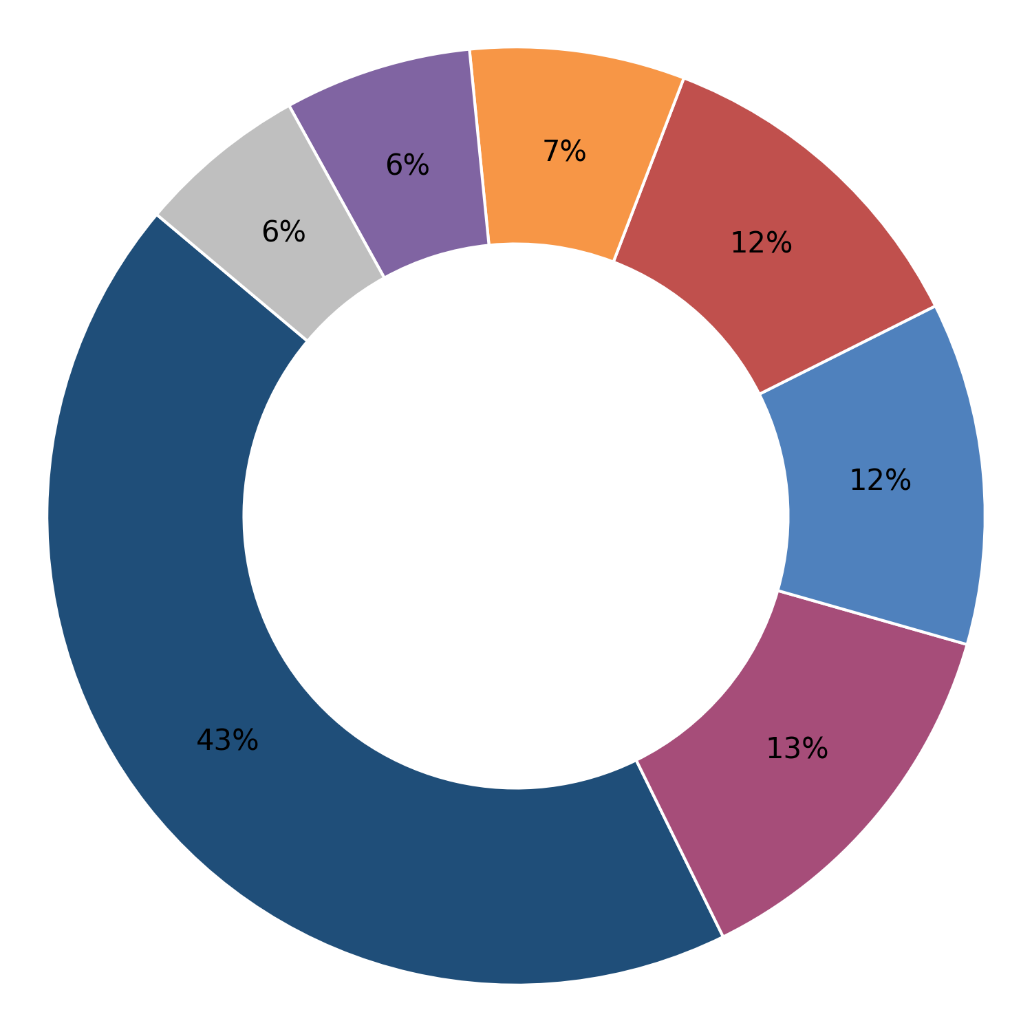
M.K.Corporation
Panna Lal Kanhiya Lal Bansal LLP Sonipat Haryana
Forging defect
Plant-wise Defect Analysis
Turning length
Cut bar length
MPI
Turning Bar Diameter
Marking
Others
Embossing Die Impression / Failure
Dimensional
Hardness
Cumulative Inspected (Nos.) | Cumulative Rejection (Nos.) | Rejection (%)
96807 | 989 | 1.02
Cumulative Inspected (Nos.) | Cumulative Rejection (Nos.) | Rejection (%)
742210 | 5004 | 0.67
Month | Inspected (Nos.) | Rejection (Nos.) | % Rej
Apr 26 | 33900 | 339 | 1.00
Mar 26 | 28171 | 188 | 0.67
Feb 26 | 34736 | 462 | 1.33
Month | Inspected (Nos.) | Rejection (Nos.) | % Rej
Apr 26 | 43328 | 634 | 1.46
Feb 26 | 24166 | 147 | 0.61
Jan 26 | 82110 | 790 | 0.96
Dec 25 | 194320 | 1335 | 0.69
Nov 25 | 107018 | 638 | 0.60
Oct 25 | 98912 | 570 | 0.58
Sep 25 | 88768 | 538 | 0.61
Aug 25 | 93116 | 304 | 0.33
Jul 25 | 10472 | 48 | 0.46
1

Slide 12
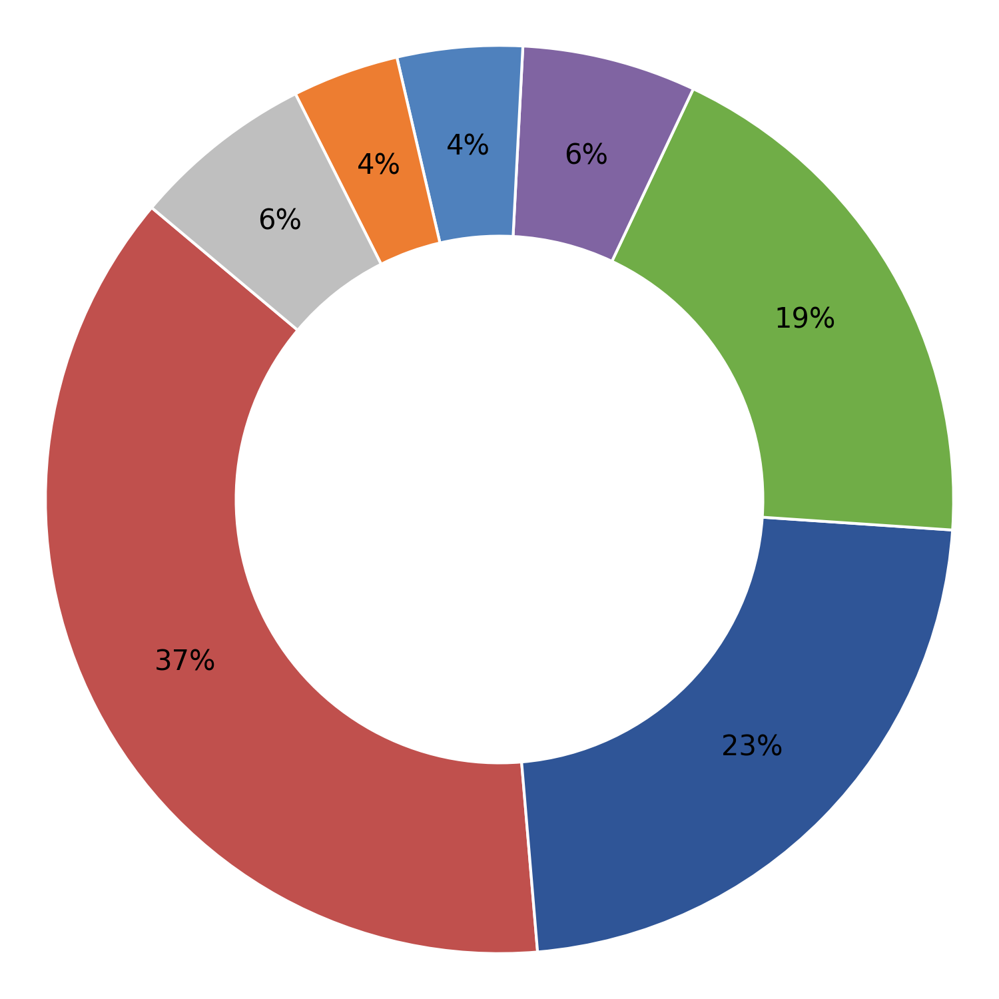
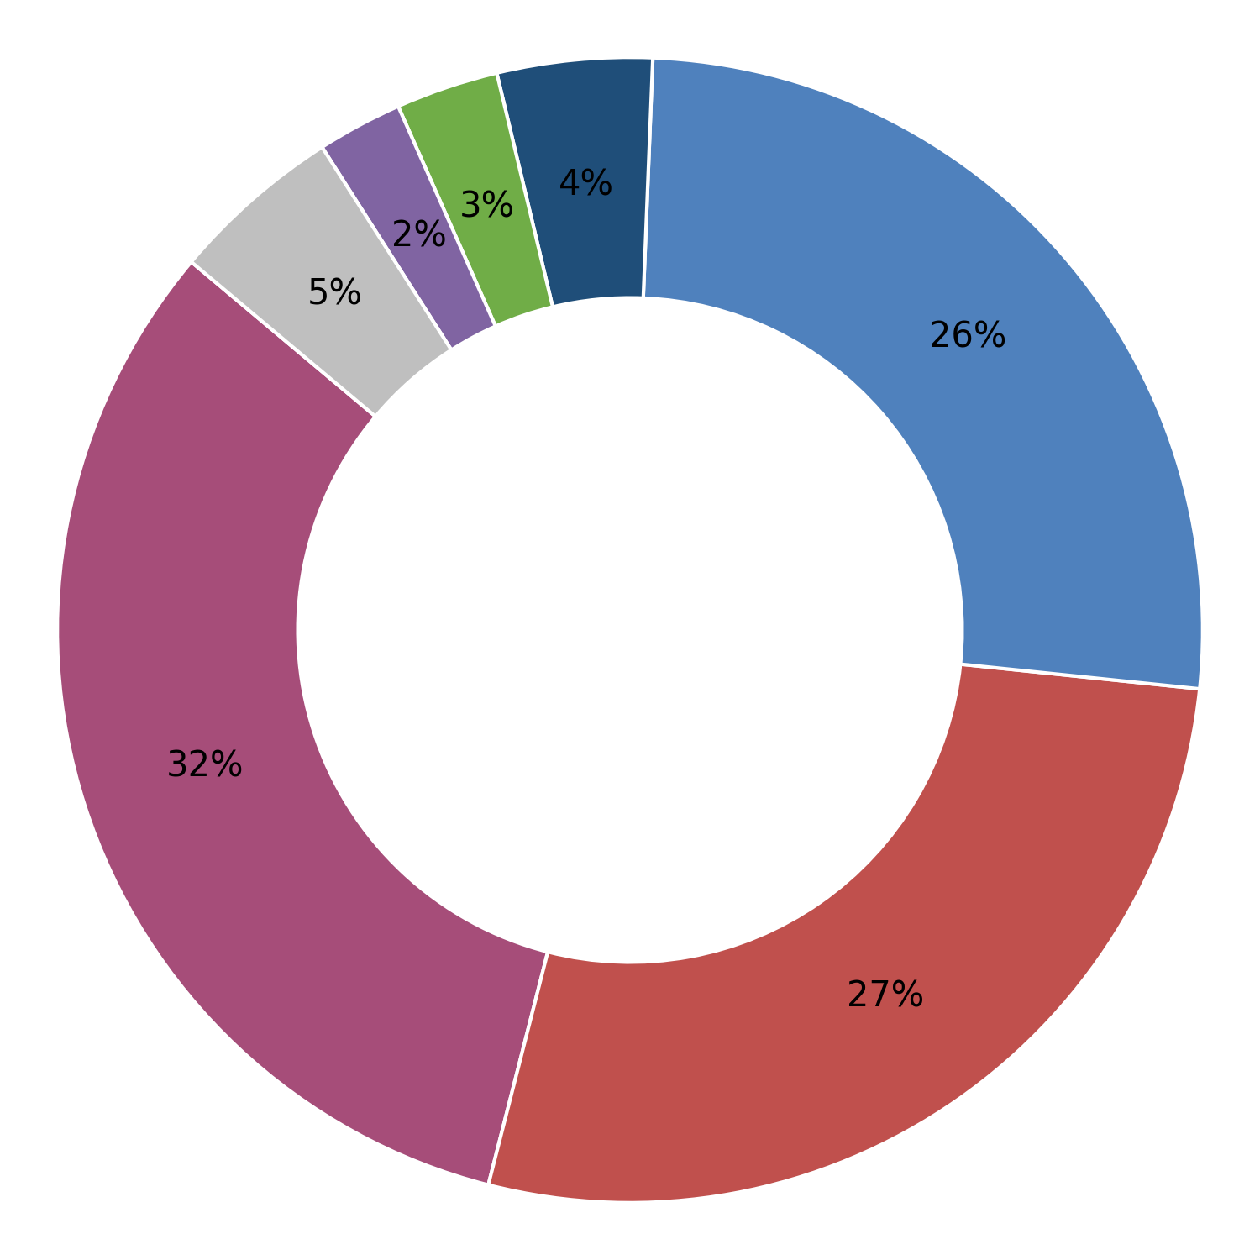
Pathik Engineering Works Rajnandgaon Chhatishgarh
Patil Rail Infrastructure pvt ltd Yellampet, Hyderabad Telangana
Turning length
Plant-wise Defect Analysis
MPI
Forging defect
Cut bar length
Dimensional
Marking
Others
Turning Bar Diameter
Embossing Die Impression / Failure
Cumulative Inspected (Nos.) | Cumulative Rejection (Nos.) | Rejection (%)
1403246 | 21240 | 1.51
Cumulative Inspected (Nos.) | Cumulative Rejection (Nos.) | Rejection (%)
2633653 | 15154 | 0.58
Month | Inspected (Nos.) | Rejection (Nos.) | % Rej
Mar 26 | 251347 | 3735 | 1.49
Feb 26 | 225613 | 3238 | 1.44
Jan 26 | 149357 | 3112 | 2.08
Dec 25 | 165540 | 1114 | 0.67
Nov 25 | 188288 | 3446 | 1.83
Oct 25 | 157911 | 3584 | 2.27
Sep 25 | 180647 | 2693 | 1.49
Aug 25 | 0 | 0 | 0.00
Jul 25 | 0 | 0 | 0.00
Jun 25 | 0 | 0 | 0.00
May 25 | 84543 | 318 | 0.38
Month | Inspected (Nos.) | Rejection (Nos.) | % Rej
Apr 26 | 142298 | 983 | 0.69
Mar 26 | 364147 | 2471 | 0.68
Feb 26 | 264246 | 1501 | 0.57
Jan 26 | 469375 | 1874 | 0.40
Dec 25 | 40345 | 279 | 0.69
Nov 25 | 241285 | 2003 | 0.83
Oct 25 | 228974 | 2159 | 0.94
Sep 25 | 144049 | 1679 | 1.17
Aug 25 | 0 | 0 | 0.00
Jul 25 | 48716 | 820 | 1.68
Jun 25 | 195845 | 891 | 0.45
May 25 | 227475 | 155 | 0.07
1

Slide 13
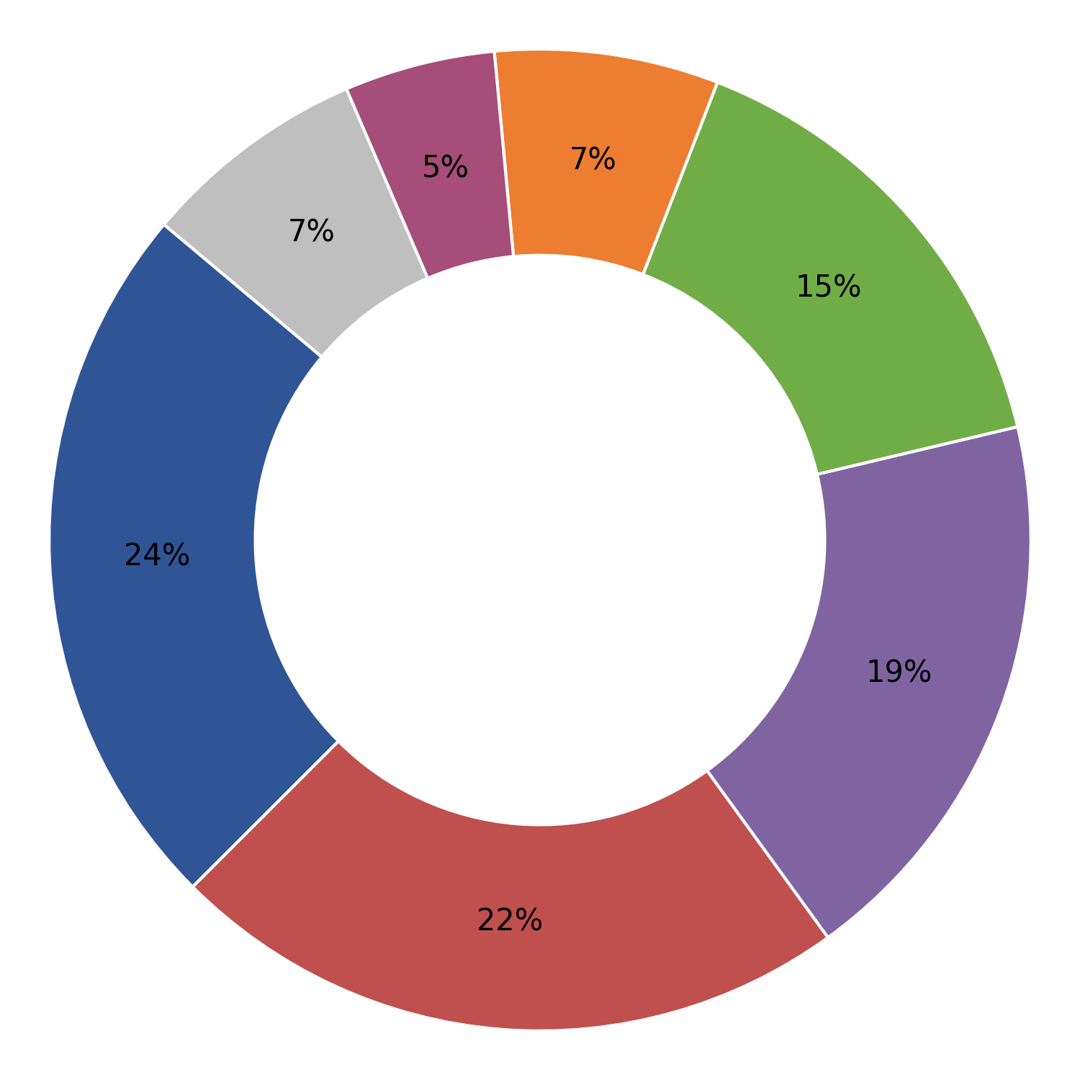
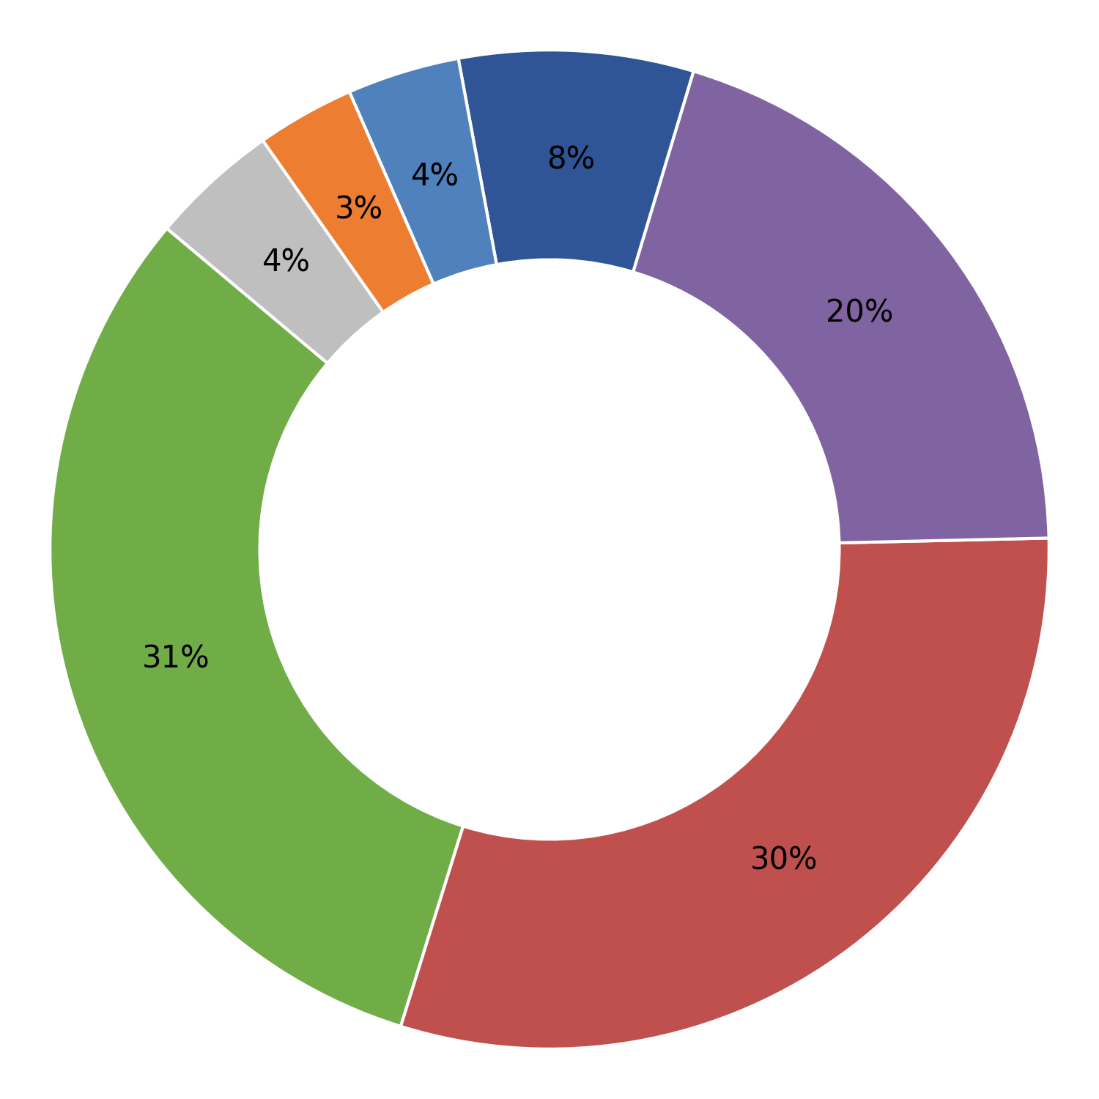
Prakash Metallics Pvt Ltd Raipur Chhatishgarh
Prakash Monomers Pvt Ltd Raipur Chhatishgarh
MPI
Plant-wise Defect Analysis
Turning length
Cut bar length
Forging defect
Turning Bar Diameter
Visual (Sheared Edges, Surface Defects)
Others
Dimensional
Cumulative Inspected (Nos.) | Cumulative Rejection (Nos.) | Rejection (%)
3133501 | 40477 | 1.29
Cumulative Inspected (Nos.) | Cumulative Rejection (Nos.) | Rejection (%)
826826 | 5991 | 0.72
Month | Inspected (Nos.) | Rejection (Nos.) | % Rej
Apr 26 | 326870 | 6189 | 1.89
Mar 26 | 305540 | 4412 | 1.44
Feb 26 | 319442 | 4775 | 1.49
Jan 26 | 220523 | 3826 | 1.73
Dec 25 | 348192 | 5607 | 1.61
Nov 25 | 329428 | 4316 | 1.31
Oct 25 | 244796 | 3135 | 1.28
Sep 25 | 303221 | 3318 | 1.09
Aug 25 | 147264 | 1532 | 1.04
Jul 25 | 153192 | 1051 | 0.69
Jun 25 | 86472 | 1306 | 1.51
May 25 | 158127 | 207 | 0.13
Month | Inspected (Nos.) | Rejection (Nos.) | % Rej
Apr 26 | 215238 | 2325 | 1.08
Mar 26 | 27942 | 504 | 1.80
Jan 26 | 0 | 0 | 0.00
Dec 25 | 0 | 0 | 0.00
Nov 25 | 0 | 0 | 0.00
Oct 25 | 0 | 0 | 0.00
Sep 25 | 0 | 0 | 0.00
Aug 25 | 150277 | 1330 | 0.89
Jul 25 | 47351 | 642 | 1.36
Jun 25 | 0 | 0 | 0.00
May 25 | 241301 | 844 | 0.35
Apr 25 | 144717 | 346 | 0.24
1

Slide 14
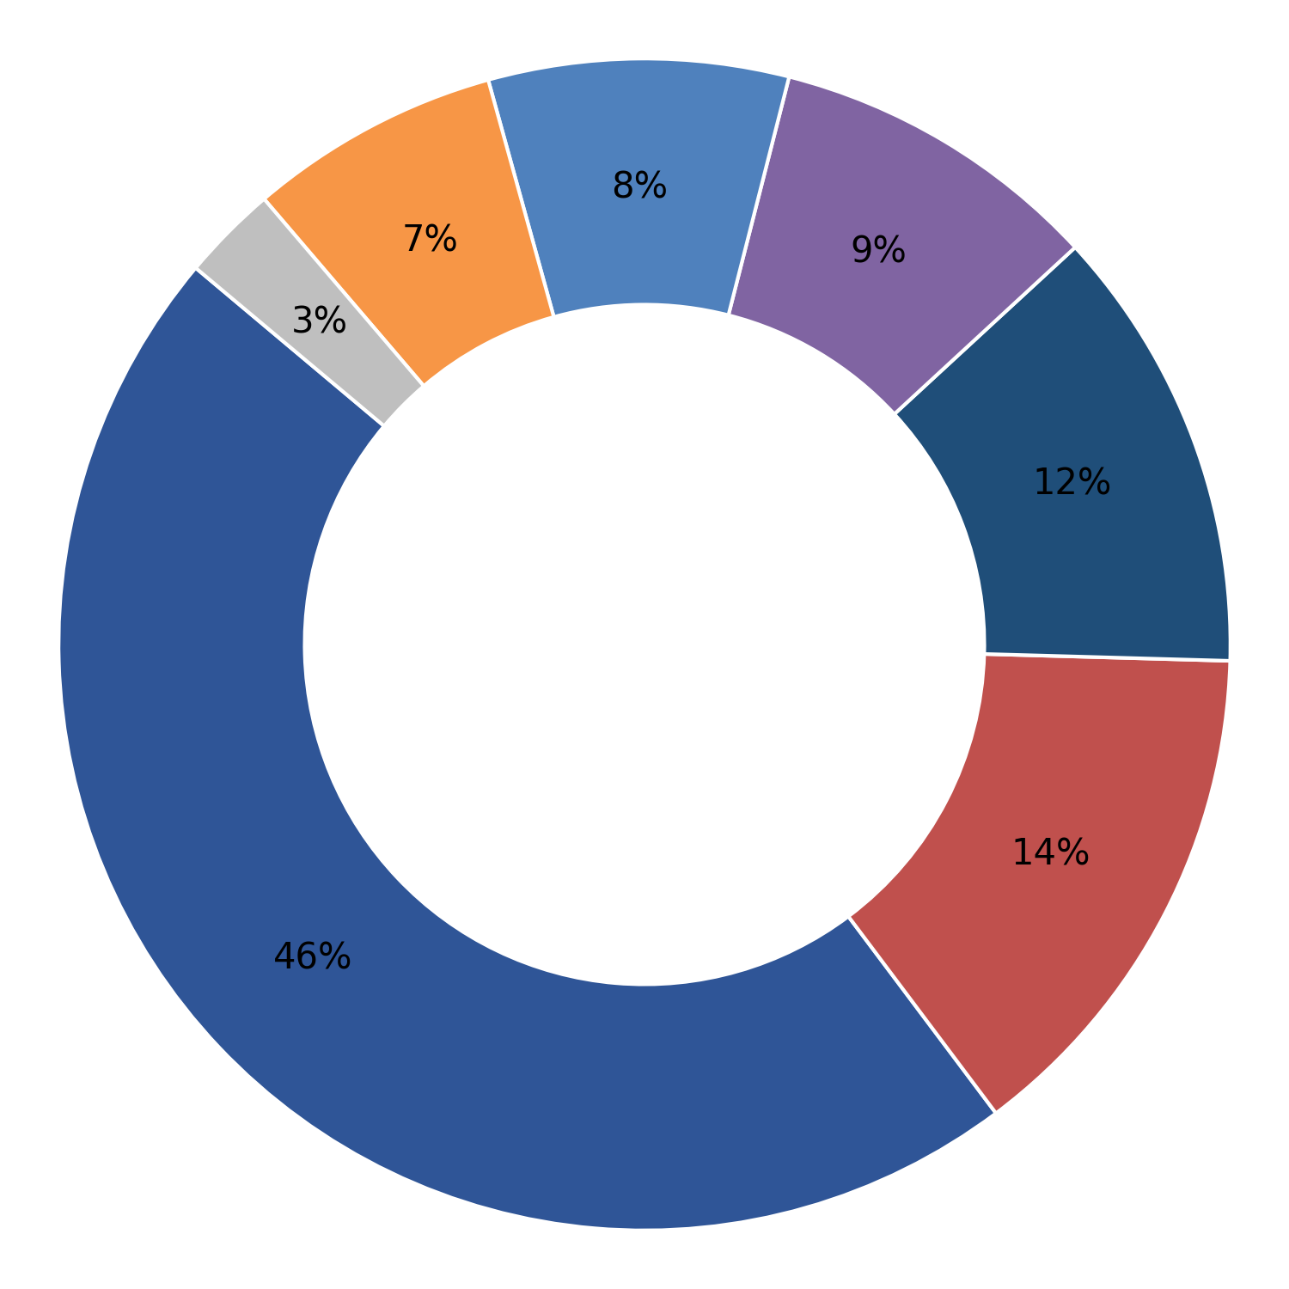
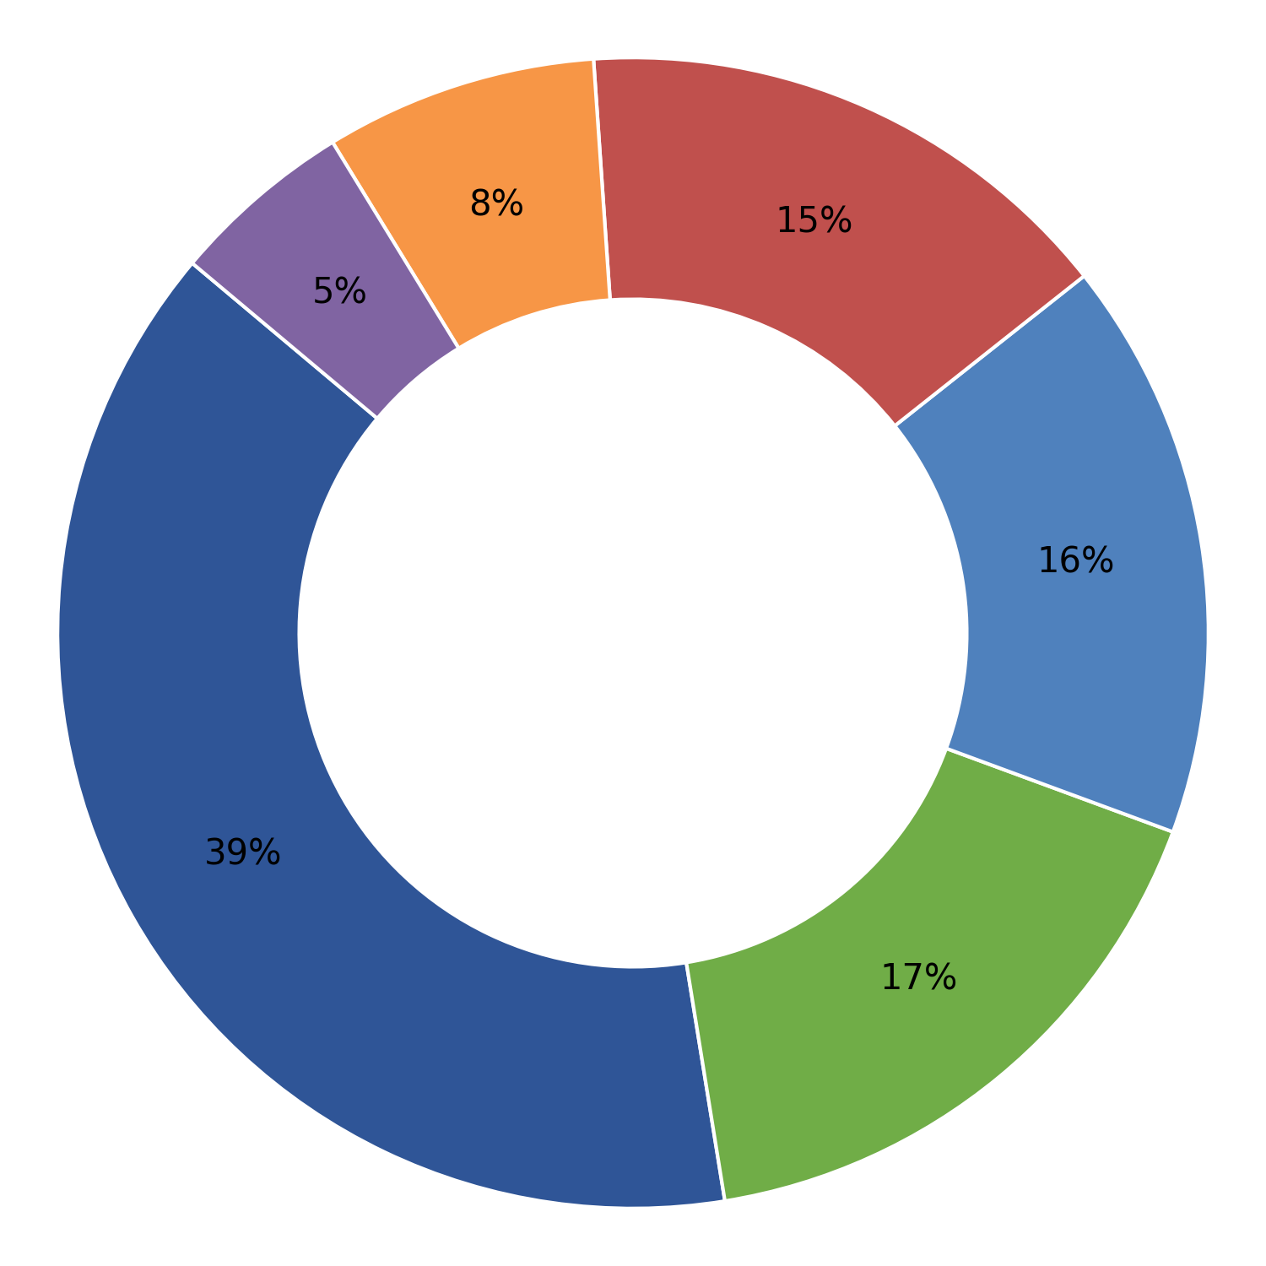
Qualite Steels Sirsa
R Rashmi Industries, Jaipur
Marking
Plant-wise Defect Analysis
Turning length
Embossing Die Impression / Failure
Cut bar length
Dimensional
Hardness
Others
Turning Bar Diameter
Cumulative Inspected (Nos.) | Cumulative Rejection (Nos.) | Rejection (%)
372579 | 1439 | 0.39
Cumulative Inspected (Nos.) | Cumulative Rejection (Nos.) | Rejection (%)
158416 | 719 | 0.45
Month | Inspected (Nos.) | Rejection (Nos.) | % Rej
Apr 26 | 102349 | 450 | 0.44
Mar 26 | 72500 | 293 | 0.40
Jan 26 | 146180 | 589 | 0.40
Dec 25 | 51550 | 107 | 0.21
Month | Inspected (Nos.) | Rejection (Nos.) | % Rej
Apr 26 | 158416 | 719 | 0.45
1

Slide 15
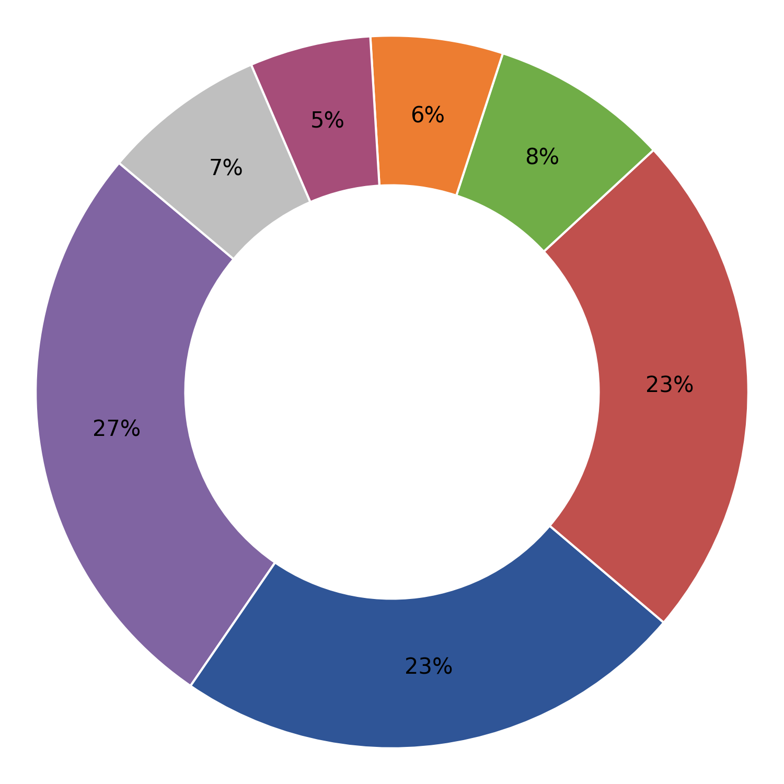
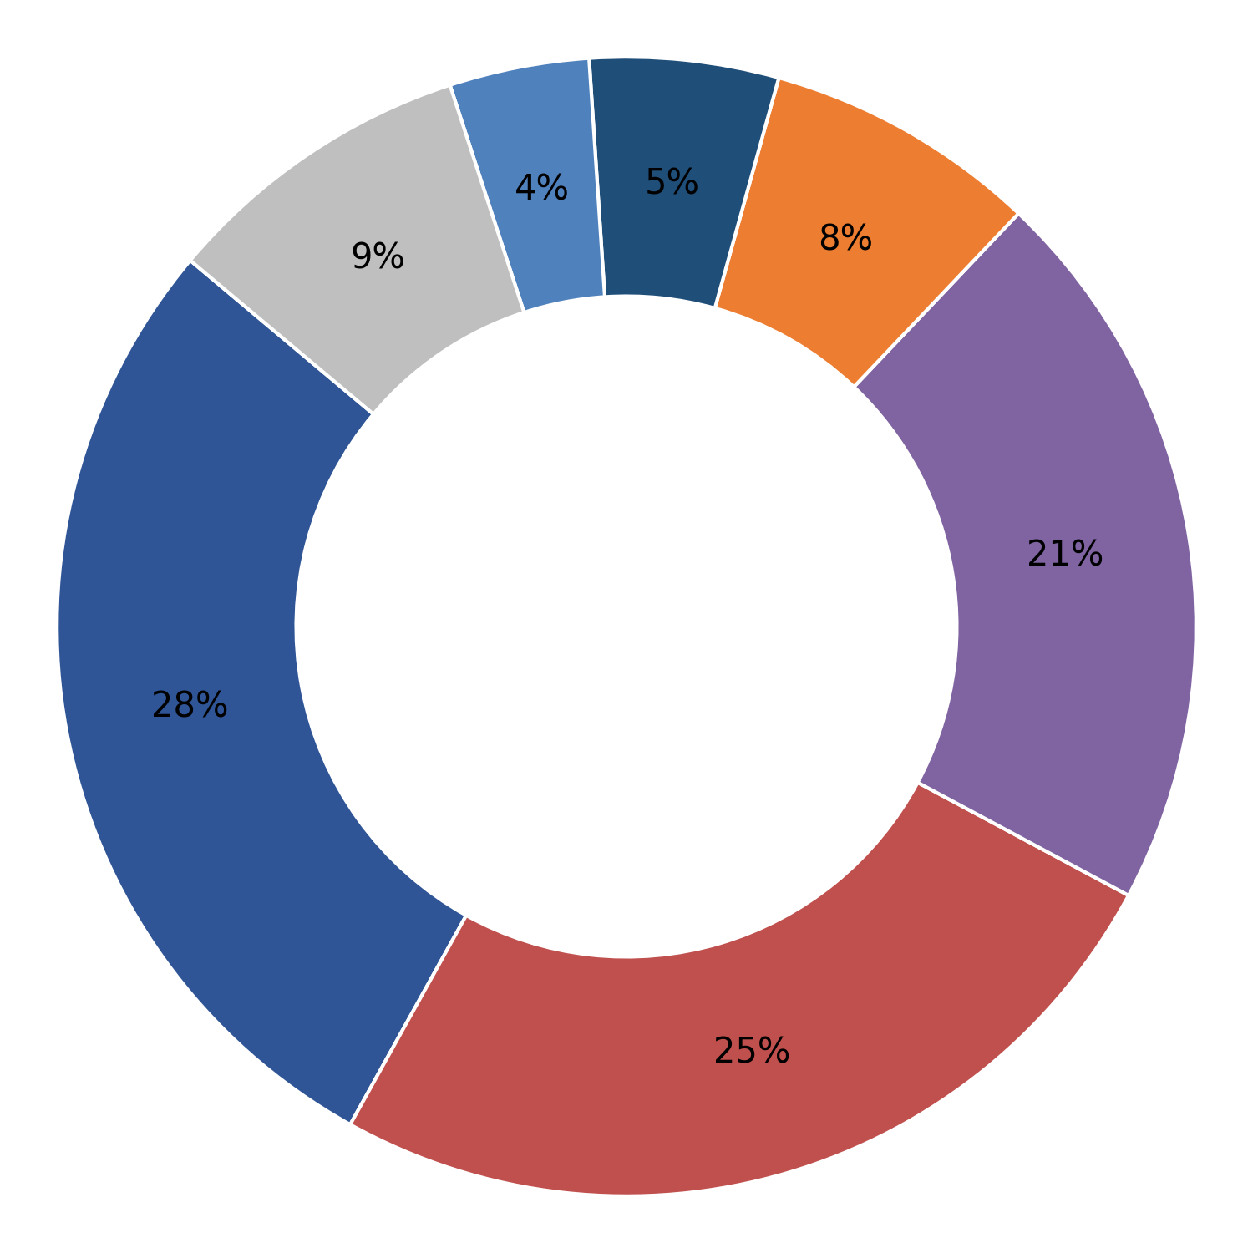
Royal Infraconstru Raipur Chhatishgarh
Royal fasteners Raipur Chhatishgarh
Cut bar length
Plant-wise Defect Analysis
Forging defect
Turning length
Marking
Turning Bar Diameter
MPI
Others
Embossing Die Impression / Failure
Dimensional
Cumulative Inspected (Nos.) | Cumulative Rejection (Nos.) | Rejection (%)
4082815 | 40977 | 1.00
Cumulative Inspected (Nos.) | Cumulative Rejection (Nos.) | Rejection (%)
1102805 | 11564 | 1.05
Month | Inspected (Nos.) | Rejection (Nos.) | % Rej
Apr 26 | 312134 | 3839 | 1.23
Mar 26 | 570551 | 4219 | 0.74
Feb 26 | 530812 | 5826 | 1.10
Jan 26 | 574850 | 5458 | 0.95
Dec 25 | 692025 | 6607 | 0.95
Nov 25 | 517609 | 5469 | 1.06
Oct 25 | 272990 | 3194 | 1.17
Sep 25 | 273163 | 2876 | 1.05
Aug 25 | 191395 | 1920 | 1.00
Jul 25 | 147286 | 1569 | 1.07
Month | Inspected (Nos.) | Rejection (Nos.) | % Rej
Mar 26 | 73292 | 702 | 0.96
Feb 26 | 225801 | 2374 | 1.05
Jan 26 | 135714 | 1525 | 1.12
Dec 25 | 137066 | 1632 | 1.19
Nov 25 | 199442 | 2103 | 1.05
Oct 25 | 84951 | 1178 | 1.39
Sep 25 | 118911 | 1386 | 1.17
Aug 25 | 23623 | 335 | 1.42
Jul 25 | 0 | 0 | 0.00
Jun 25 | 83160 | 276 | 0.33
May 25 | 20845 | 53 | 0.25
1

Slide 16
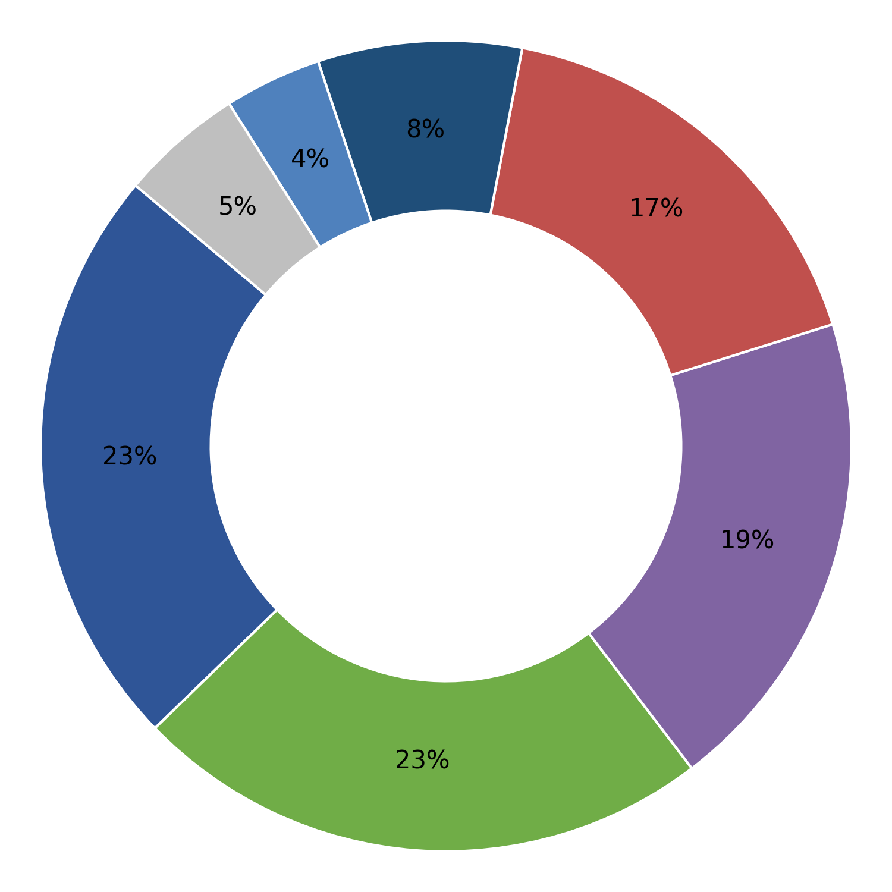
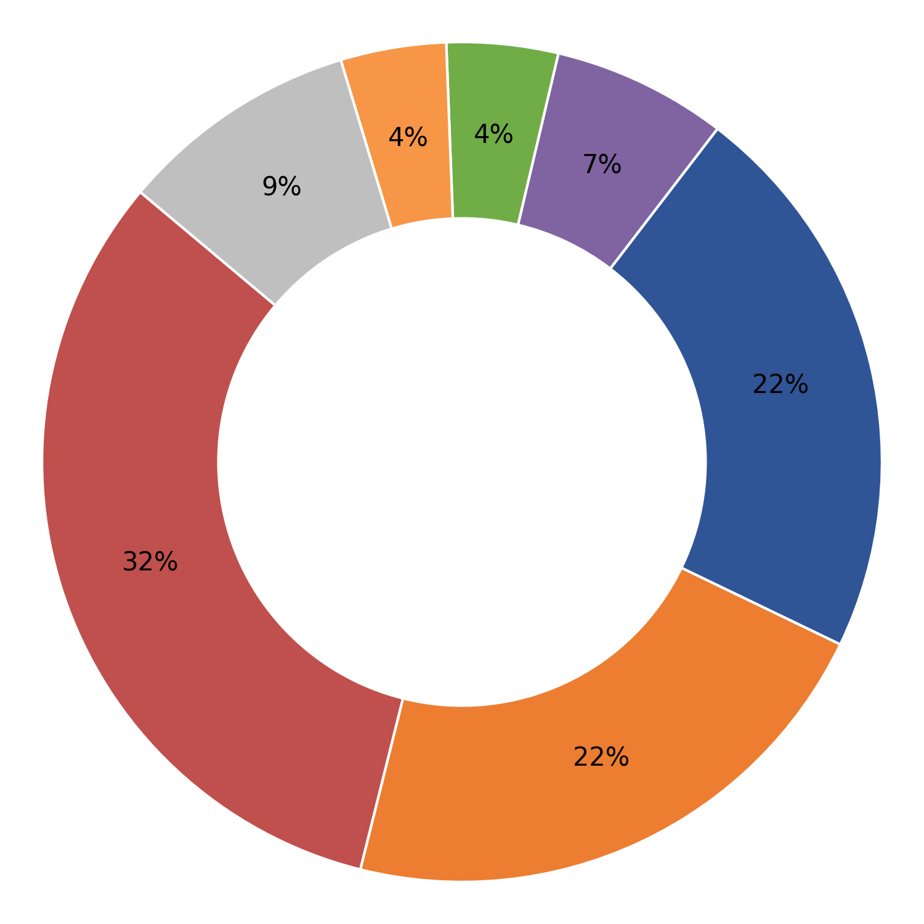
Sai Kripa Industries Durg Chhatishgarh
Sheth & Co.
Forging defect
Plant-wise Defect Analysis
MPI
Cut bar length
Turning length
Embossing Die Impression / Failure
Dimensional
Others
Turning Bar Diameter
Hardness
Cumulative Inspected (Nos.) | Cumulative Rejection (Nos.) | Rejection (%)
785776 | 13765 | 1.75
Cumulative Inspected (Nos.) | Cumulative Rejection (Nos.) | Rejection (%)
528826 | 3988 | 0.75
Month | Inspected (Nos.) | Rejection (Nos.) | % Rej
Apr 26 | 74513 | 632 | 0.85
Mar 26 | 92316 | 1093 | 1.18
Feb 26 | 57308 | 626 | 1.09
Jan 26 | 59927 | 999 | 1.67
Dec 25 | 104520 | 2415 | 2.31
Nov 25 | 92968 | 2232 | 2.40
Oct 25 | 68771 | 1366 | 1.99
Sep 25 | 33280 | 1195 | 3.59
Aug 25 | 88237 | 1825 | 2.07
Jul 25 | 8698 | 312 | 3.59
Jun 25 | 59471 | 836 | 1.41
May 25 | 19099 | 66 | 0.35
Month | Inspected (Nos.) | Rejection (Nos.) | % Rej
Apr 26 | 66072 | 1197 | 1.81
Mar 26 | 163101 | 851 | 0.52
Feb 26 | 93717 | 750 | 0.80
Jan 26 | 157647 | 760 | 0.48
Dec 25 | 48289 | 430 | 0.89
1

Slide 17
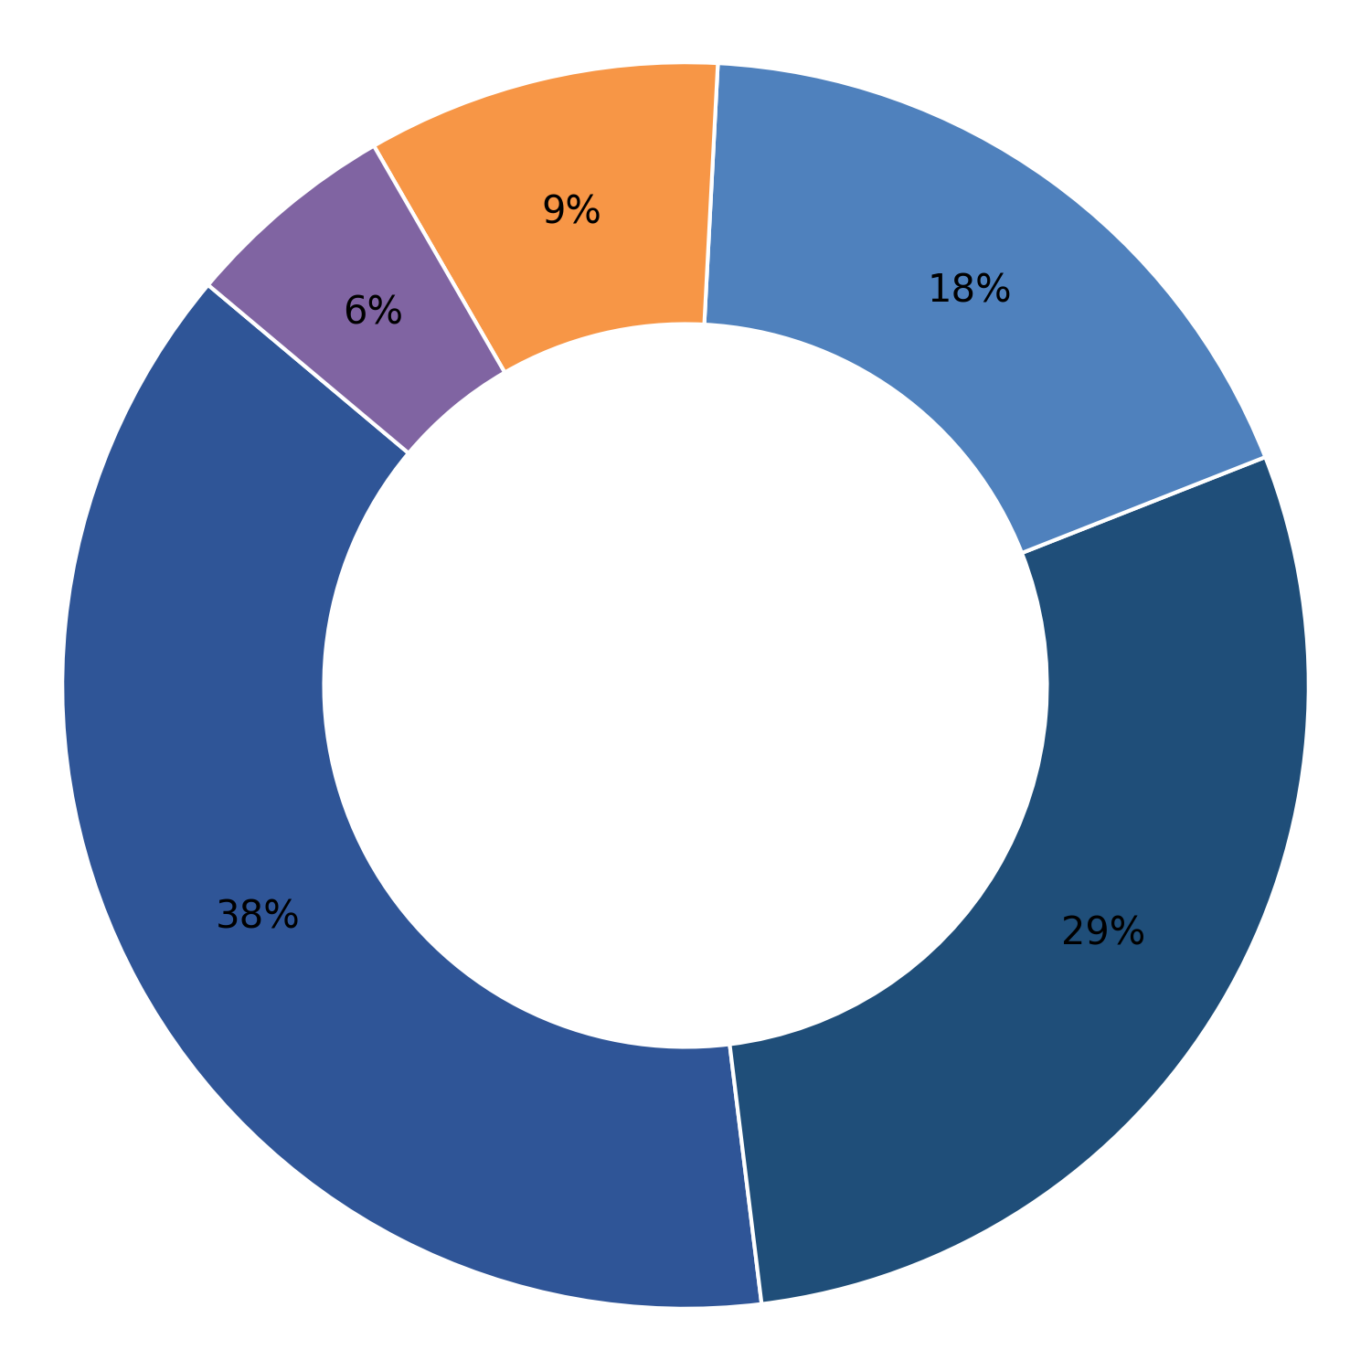
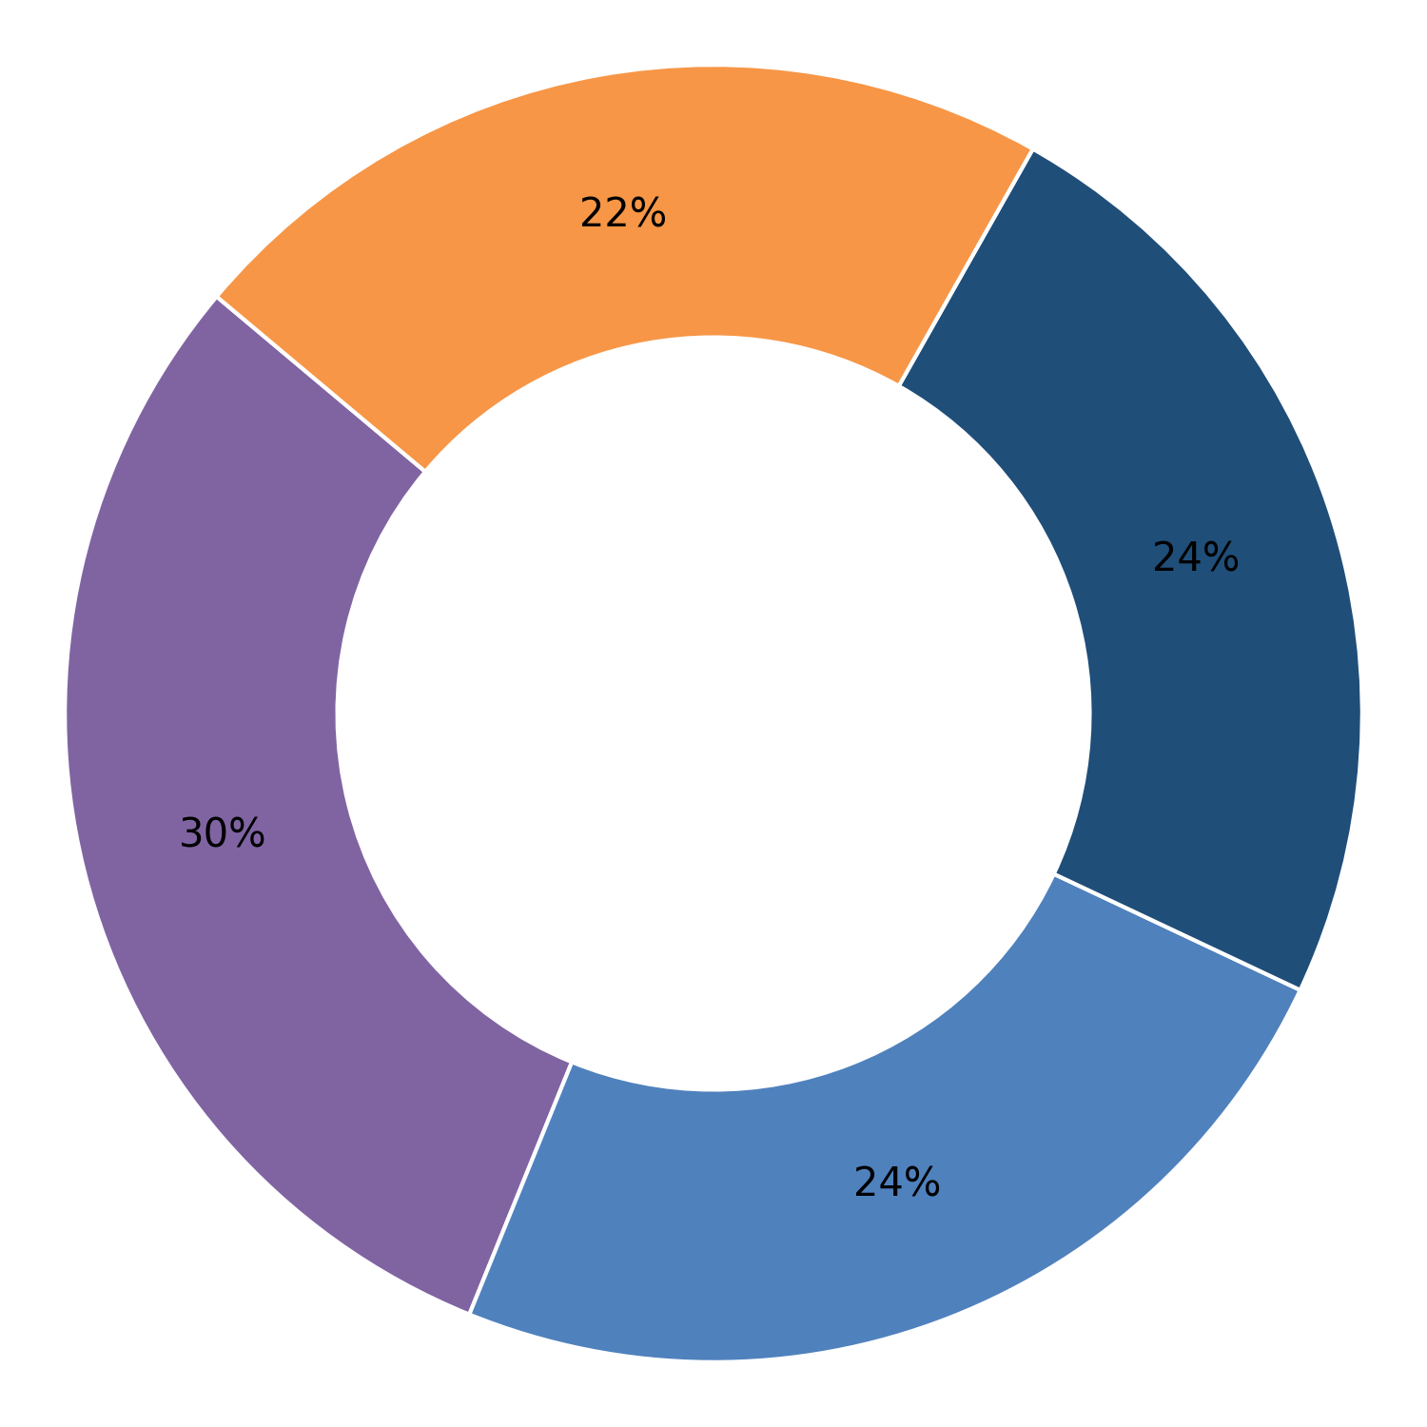
Siddartha Metal Fabricators Faridabad Haryana
Super Steels Mohali Punjab
Marking
Plant-wise Defect Analysis
Embossing Die Impression / Failure
Dimensional
Hardness
Cut bar length
Cumulative Inspected (Nos.) | Cumulative Rejection (Nos.) | Rejection (%)
986860 | 6374 | 0.65
Cumulative Inspected (Nos.) | Cumulative Rejection (Nos.) | Rejection (%)
239208 | 634 | 0.27
Month | Inspected (Nos.) | Rejection (Nos.) | % Rej
Apr 26 | 160216 | 1089 | 0.68
Mar 26 | 70536 | 450 | 0.64
Feb 26 | 133305 | 896 | 0.67
Jan 26 | 93037 | 867 | 0.93
Dec 25 | 148209 | 1331 | 0.90
Nov 25 | 77638 | 643 | 0.83
Oct 25 | 118323 | 777 | 0.66
Sep 25 | 125428 | 281 | 0.22
Apr 25 | 60168 | 40 | 0.07
Month | Inspected (Nos.) | Rejection (Nos.) | % Rej
Oct 25 | 60342 | 217 | 0.36
Sep 25 | 109376 | 301 | 0.28
Aug 25 | 46850 | 94 | 0.20
Jul 25 | 22640 | 22 | 0.10
1

Slide 18
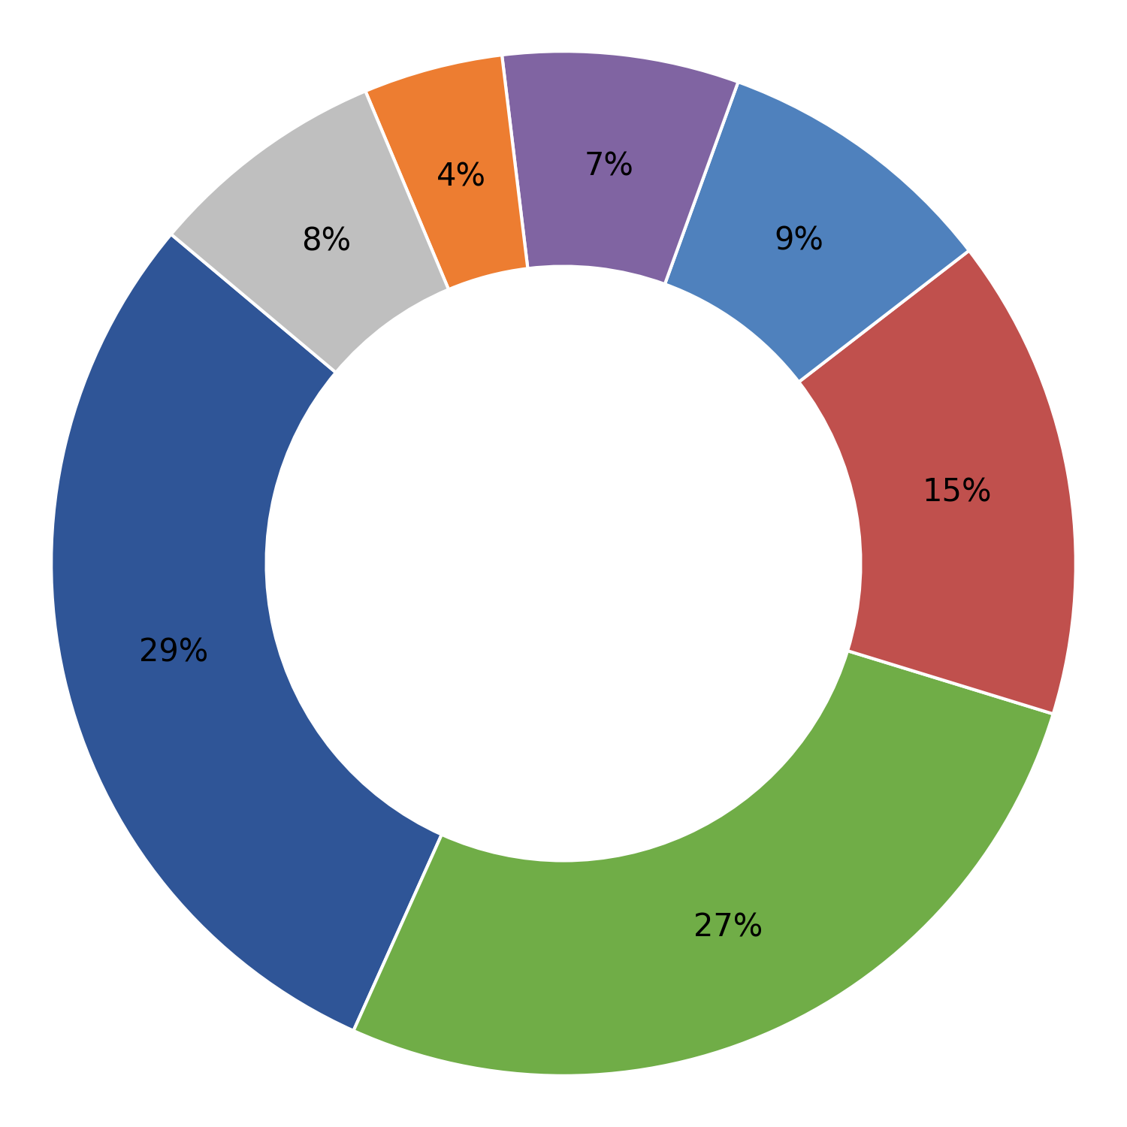
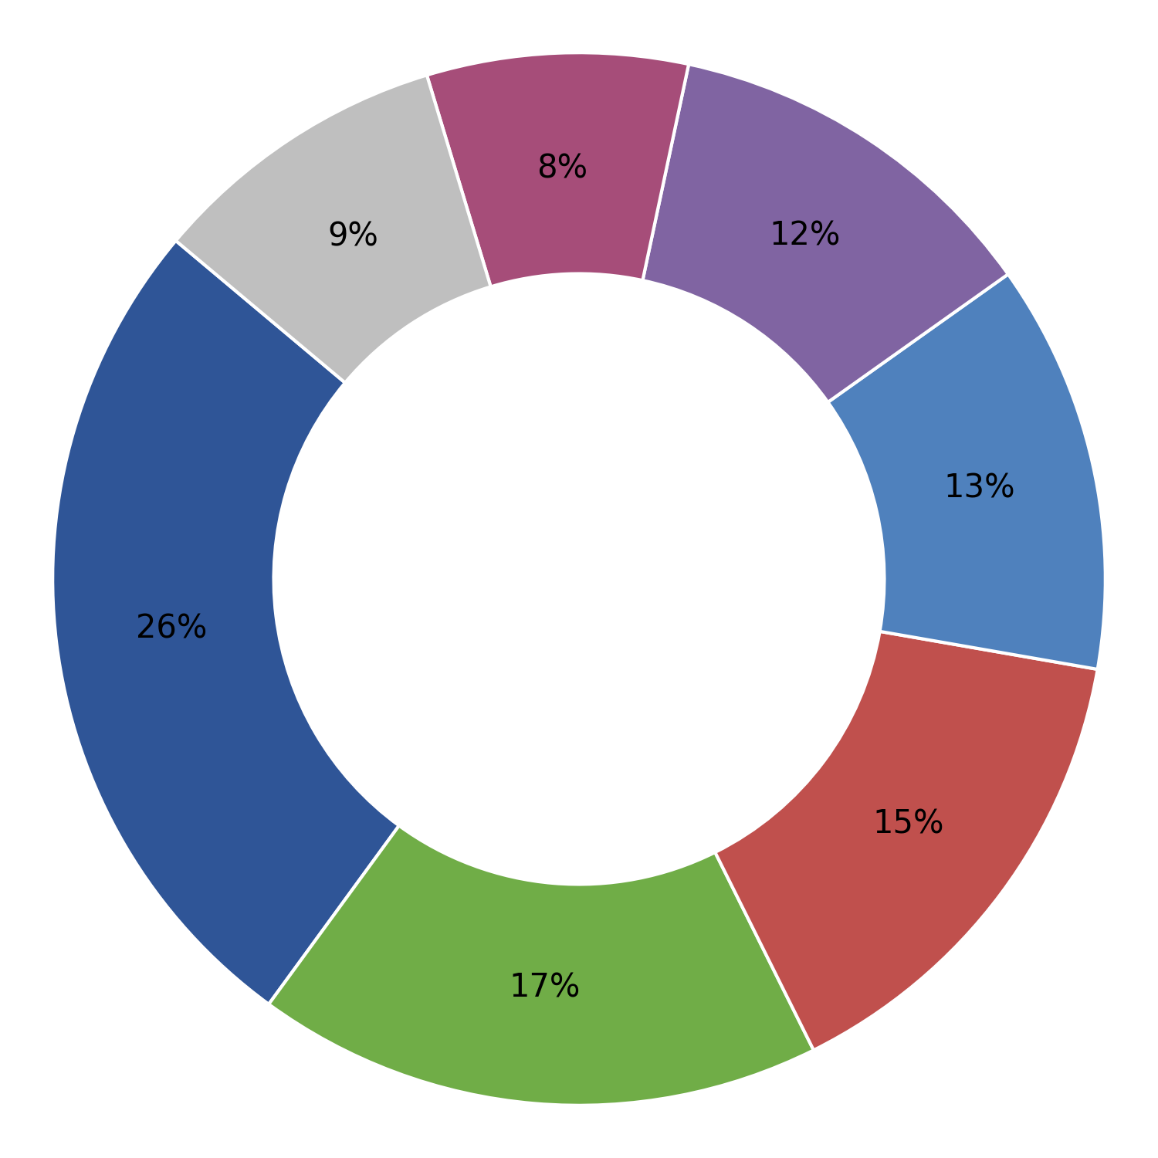
Surya Alloys Industries Limited Durgapur West Bengal
TECHMA ENGG. Howrah West Bengal
Forging defect
Plant-wise Defect Analysis
Turning Bar Diameter
Turning length
Dimensional
Cut bar length
Visual (Sheared Edges, Surface Defects)
Others
Toe load
Cumulative Inspected (Nos.) | Cumulative Rejection (Nos.) | Rejection (%)
21066131 | 322473 | 1.53
Cumulative Inspected (Nos.) | Cumulative Rejection (Nos.) | Rejection (%)
273552 | 3221 | 1.18
Month | Inspected (Nos.) | Rejection (Nos.) | % Rej
Apr 26 | 1754068 | 27636 | 1.58
Mar 26 | 221849 | 31038 | 13.99
Feb 26 | 1820686 | 29186 | 1.60
Jan 26 | 1873280 | 30843 | 1.65
Dec 25 | 1867938 | 31339 | 1.68
Nov 25 | 1686431 | 25779 | 1.53
Oct 25 | 1837714 | 26991 | 1.47
Sep 25 | 2114630 | 29048 | 1.37
Aug 25 | 1925013 | 32876 | 1.71
Jul 25 | 2285388 | 32605 | 1.43
Jun 25 | 1534702 | 15102 | 0.98
May 25 | 1220892 | 4280 | 0.35
Month | Inspected (Nos.) | Rejection (Nos.) | % Rej
Jan 26 | 0 | 0 | 0.00
Dec 25 | 0 | 0 | 0.00
Oct 25 | 52491 | 741 | 1.41
Sep 25 | 121732 | 1217 | 1.00
Aug 25 | 69663 | 678 | 0.97
Jul 25 | 29666 | 585 | 1.97
1

Slide 19
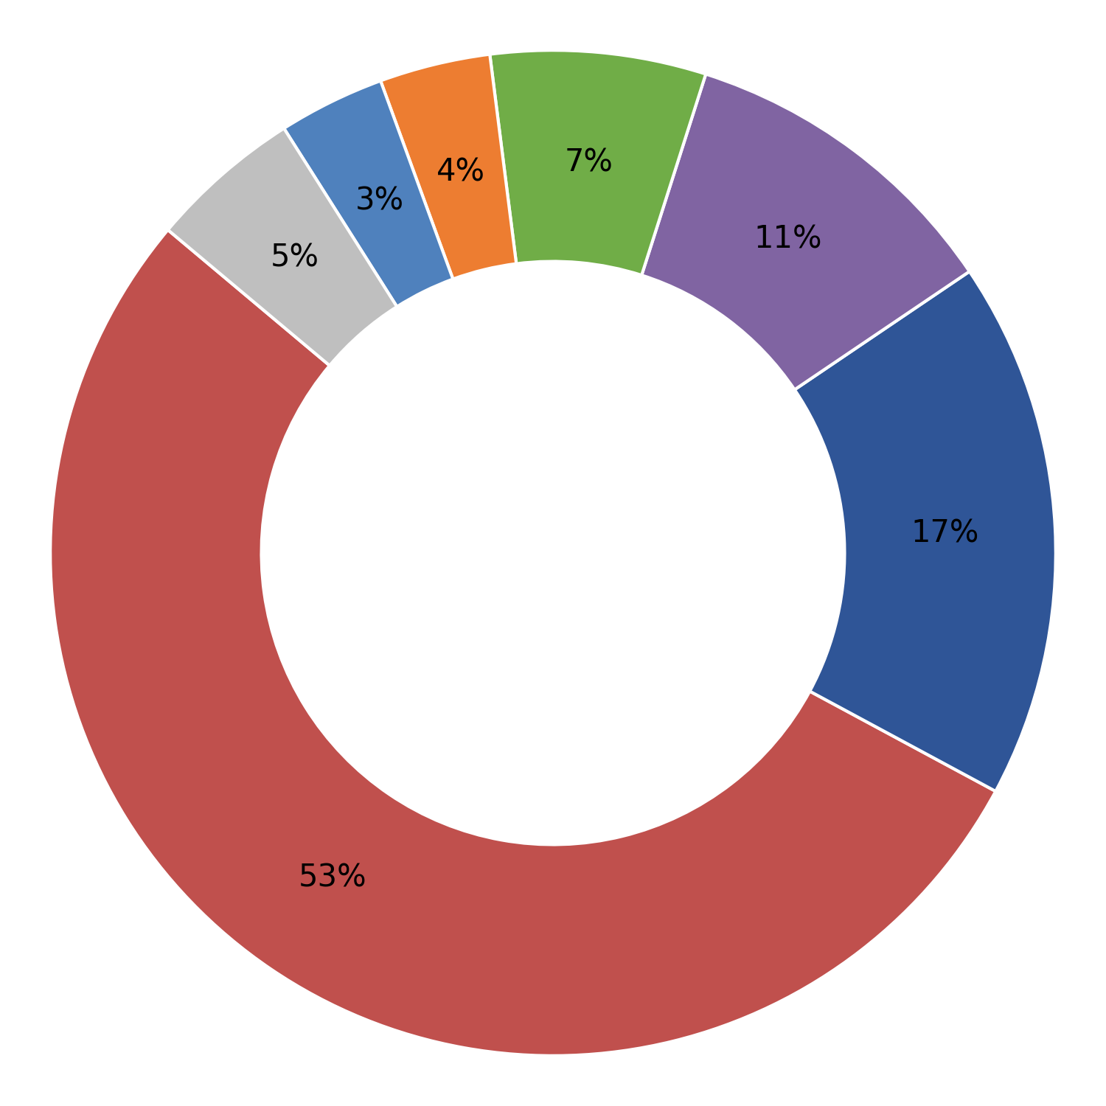
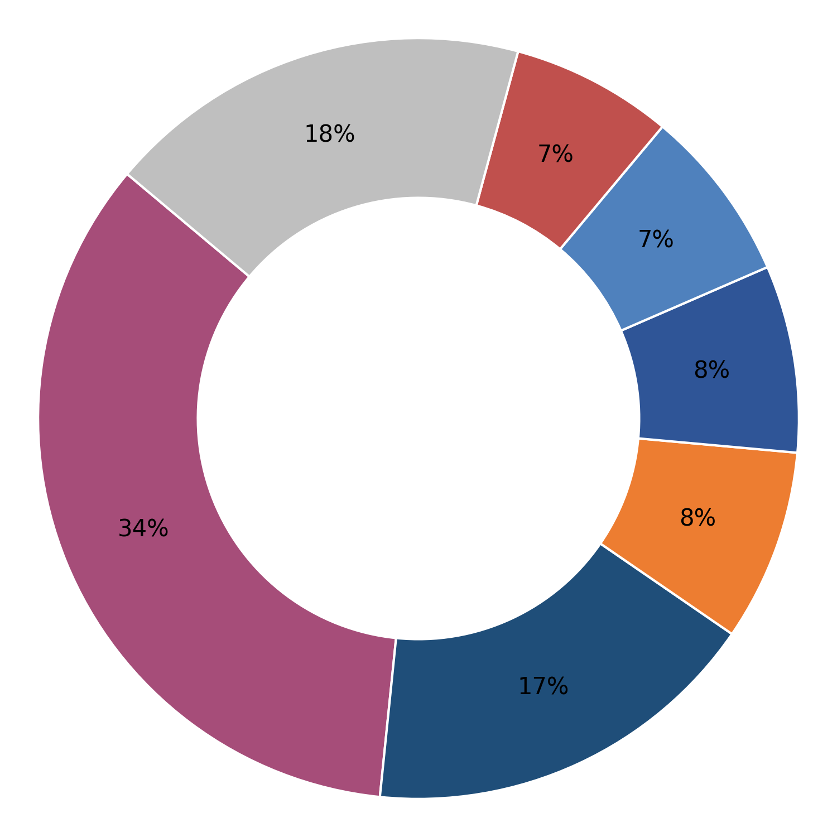
Technosteel Infraprojects Nagpur Maharastra
UTKARSH INDIA LIMITED Howrah West Bengal
Turning length
Plant-wise Defect Analysis
Forging defect
Cut bar length
MPI
Turning Bar Diameter
Dimensional
Others
Toe load
Embossing Die Impression / Failure
Cumulative Inspected (Nos.) | Cumulative Rejection (Nos.) | Rejection (%)
732640 | 6674 | 0.91
Cumulative Inspected (Nos.) | Cumulative Rejection (Nos.) | Rejection (%)
1268319 | 16050 | 1.27
Month | Inspected (Nos.) | Rejection (Nos.) | % Rej
Mar 26 | 210448 | 1448 | 0.69
Feb 26 | 50964 | 249 | 0.49
Jan 26 | 0 | 0 | 0.00
Dec 25 | 0 | 0 | 0.00
Nov 25 | 5512 | 0 | 0.00
Oct 25 | 233239 | 2447 | 1.05
Sep 25 | 232477 | 2530 | 1.09
Month | Inspected (Nos.) | Rejection (Nos.) | % Rej
Mar 26 | 73296 | 883 | 1.20
Feb 26 | 123518 | 1589 | 1.29
Jan 26 | 127660 | 1573 | 1.23
Dec 25 | 0 | 0 | 0.00
Nov 25 | 122296 | 5132 | 4.20
Oct 25 | 114287 | 1171 | 1.02
Sep 25 | 187515 | 1359 | 0.72
Aug 25 | 247141 | 1671 | 0.68
Jul 25 | 172632 | 1703 | 0.99
Jun 25 | 83437 | 932 | 1.12
May 25 | 16537 | 37 | 0.22
1

Slide 20
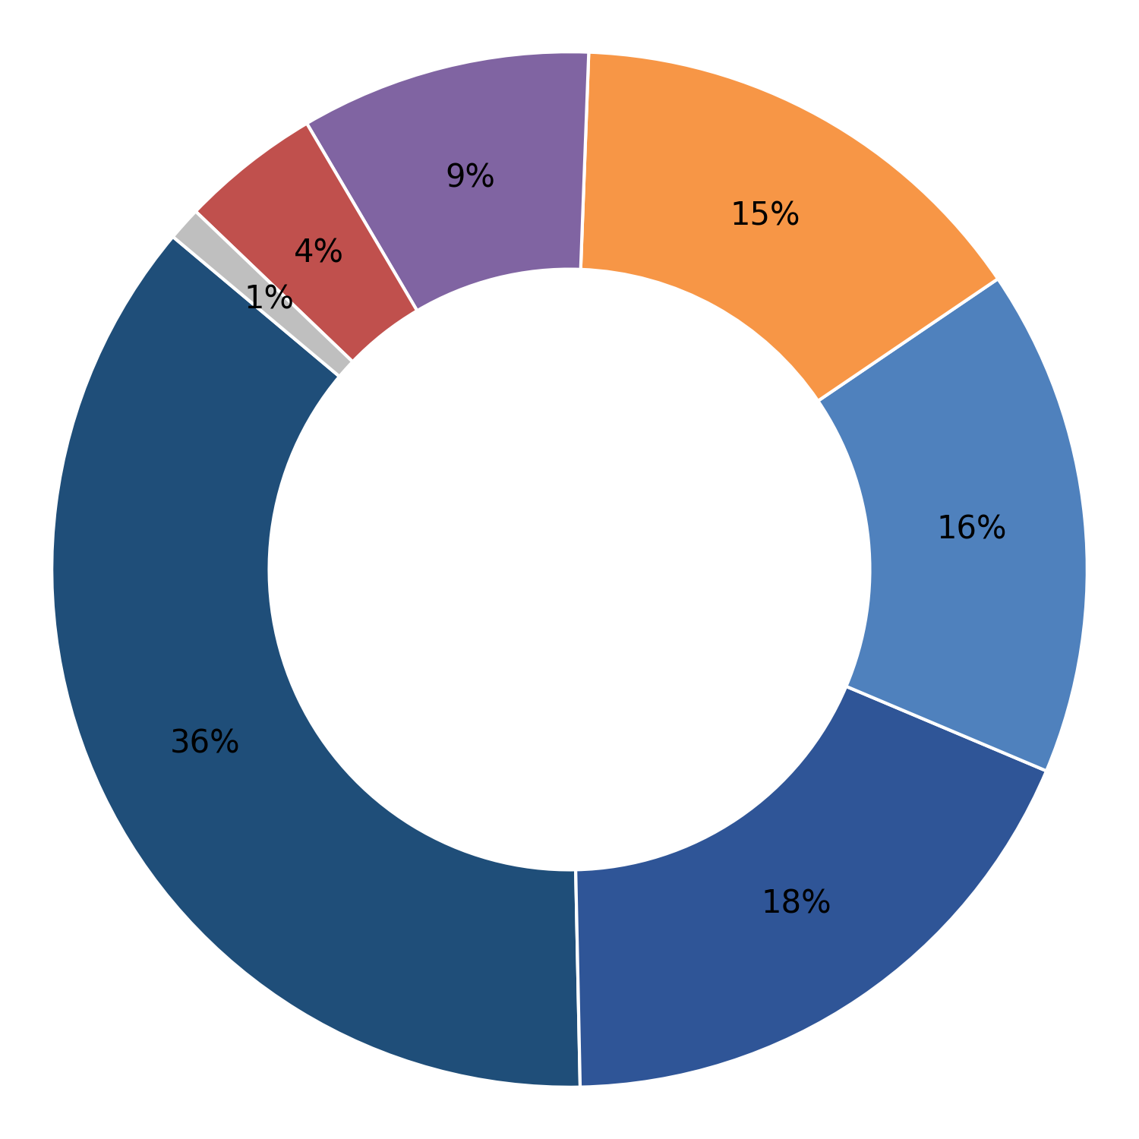
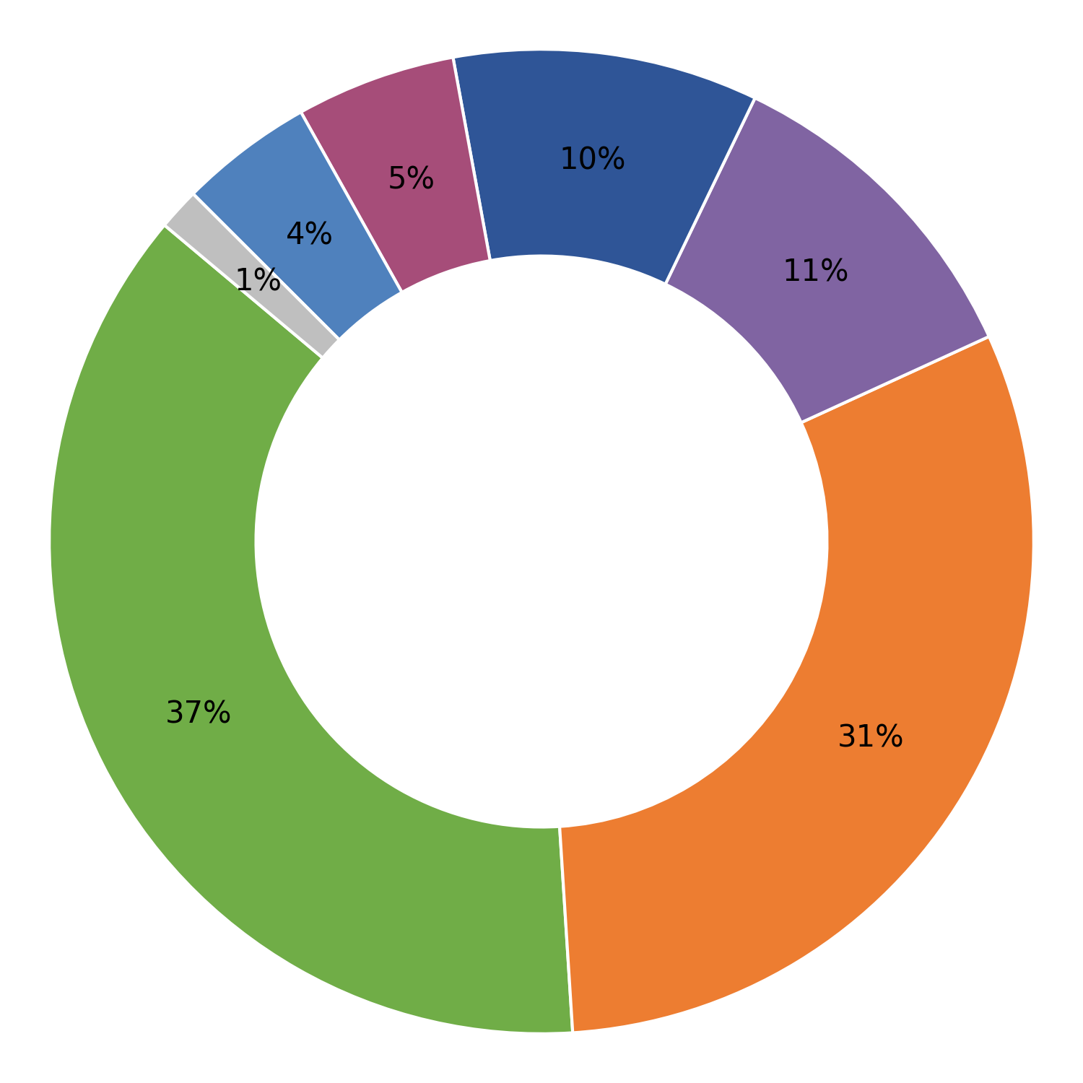
Vedkiran Steel Industries Pvt. Ltd. Batala Punjab
Veera Track Fasteners Rajnandgaon Chhatishgarh
Embossing Die Impression / Failure
Plant-wise Defect Analysis
Marking
Dimensional
Hardness
Cut bar length
Turning length
Others
Forging defect
MPI
Visual (Sheared Edges, Surface Defects)
Cumulative Inspected (Nos.) | Cumulative Rejection (Nos.) | Rejection (%)
1438413 | 5925 | 0.41
Cumulative Inspected (Nos.) | Cumulative Rejection (Nos.) | Rejection (%)
775661 | 7656 | 0.99
Month | Inspected (Nos.) | Rejection (Nos.) | % Rej
Apr 26 | 118811 | 692 | 0.58
Mar 26 | 78686 | 443 | 0.56
Feb 26 | 154454 | 827 | 0.54
Jan 26 | 123402 | 657 | 0.53
Dec 25 | 150503 | 831 | 0.55
Nov 25 | 115784 | 530 | 0.46
Oct 25 | 131433 | 555 | 0.42
Sep 25 | 168616 | 592 | 0.35
Jul 25 | 146597 | 541 | 0.37
Jun 25 | 41934 | 109 | 0.26
May 25 | 184539 | 136 | 0.07
Apr 25 | 23654 | 12 | 0.05
Month | Inspected (Nos.) | Rejection (Nos.) | % Rej
Mar 26 | 43801 | 464 | 1.06
Jan 26 | 184846 | 2001 | 1.08
Dec 25 | 15416 | 201 | 1.30
Nov 25 | 125347 | 1440 | 1.15
Oct 25 | 52406 | 245 | 0.47
Sep 25 | 169770 | 1334 | 0.79
Aug 25 | 165131 | 1083 | 0.66
Jul 25 | 18944 | 888 | 4.69
1

Slide 21
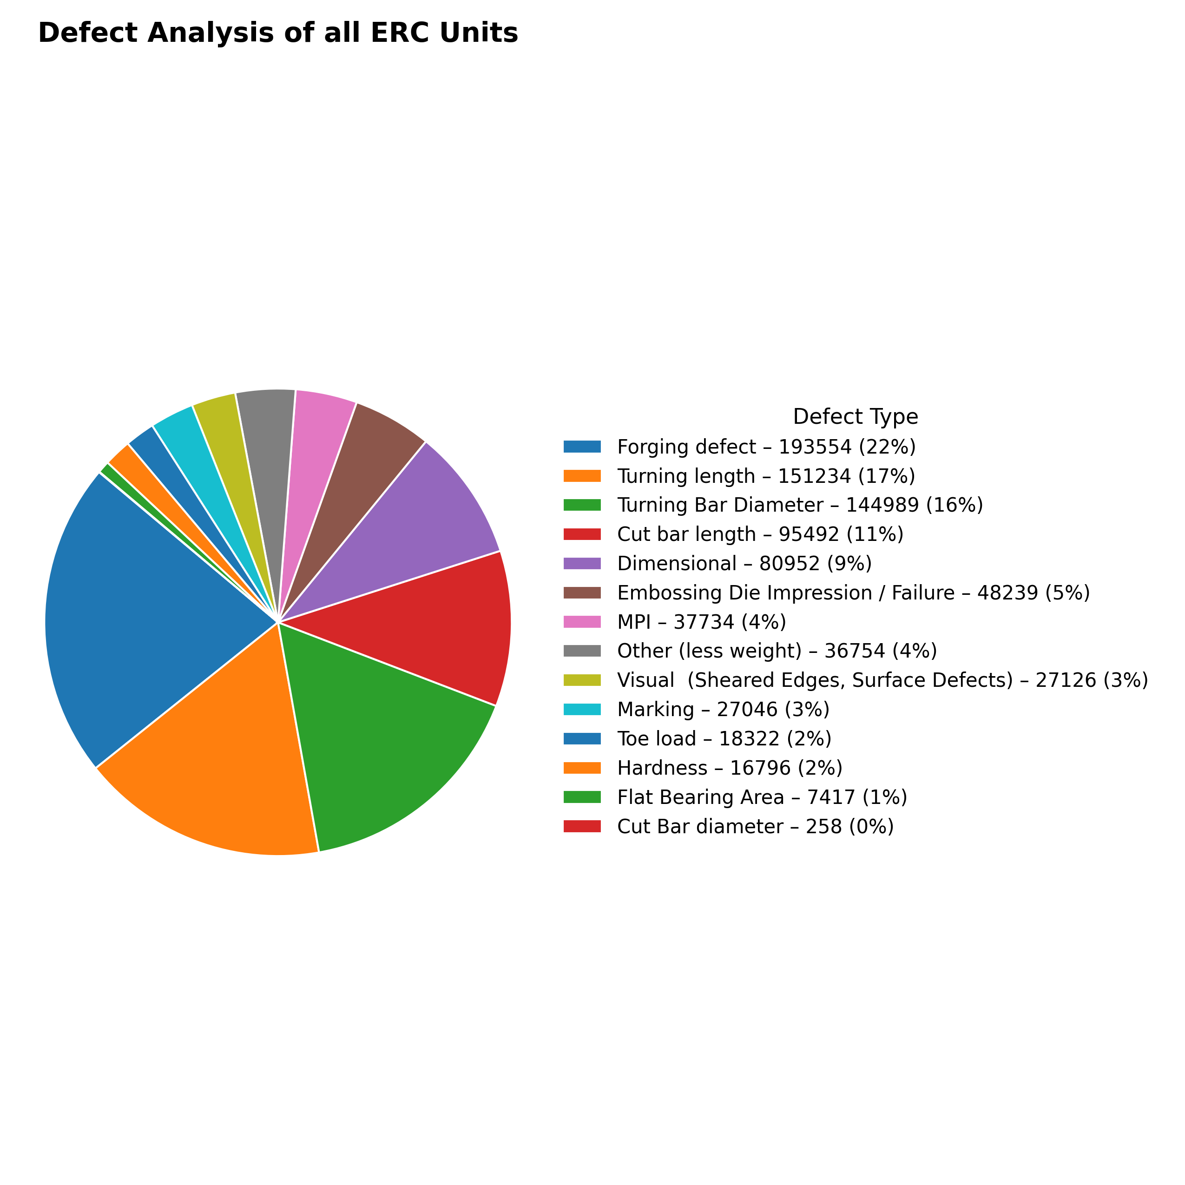
ERC Inspection – Since April 2025
Cumulative Inspected (Nos.) | Cumulative Rejection (Nos.) | Rejection (%)
78467701 | 897444 | 1.14%
Plant-wise Defect Analysis
Month | Inspected (Nos.) | Rejected (Nos.) | % Rej
Apr 26 | 4961800 | 64741 | 1.30
Mar 26 | 5944338 | 92275 | 1.55
Feb 26 | 8287363 | 126343 | 1.52
Jan 26 | 8355625 | 91921 | 1.10
Dec 25 | 7952451 | 94208 | 1.18
Nov 25 | 7111339 | 84579 | 1.19
Oct 25 | 6582698 | 78969 | 1.20
Sep 25 | 7768556 | 81454 | 1.05
Aug 25 | 6206567 | 68591 | 1.11
Jul 25 | 6019893 | 65240 | 1.08
Jun 25 | 3745345 | 31913 | 0.85
May 25 | 3273994 | 8900 | 0.27
Apr 25 | 2257732 | 8310 | 0.37
1

Slide 22
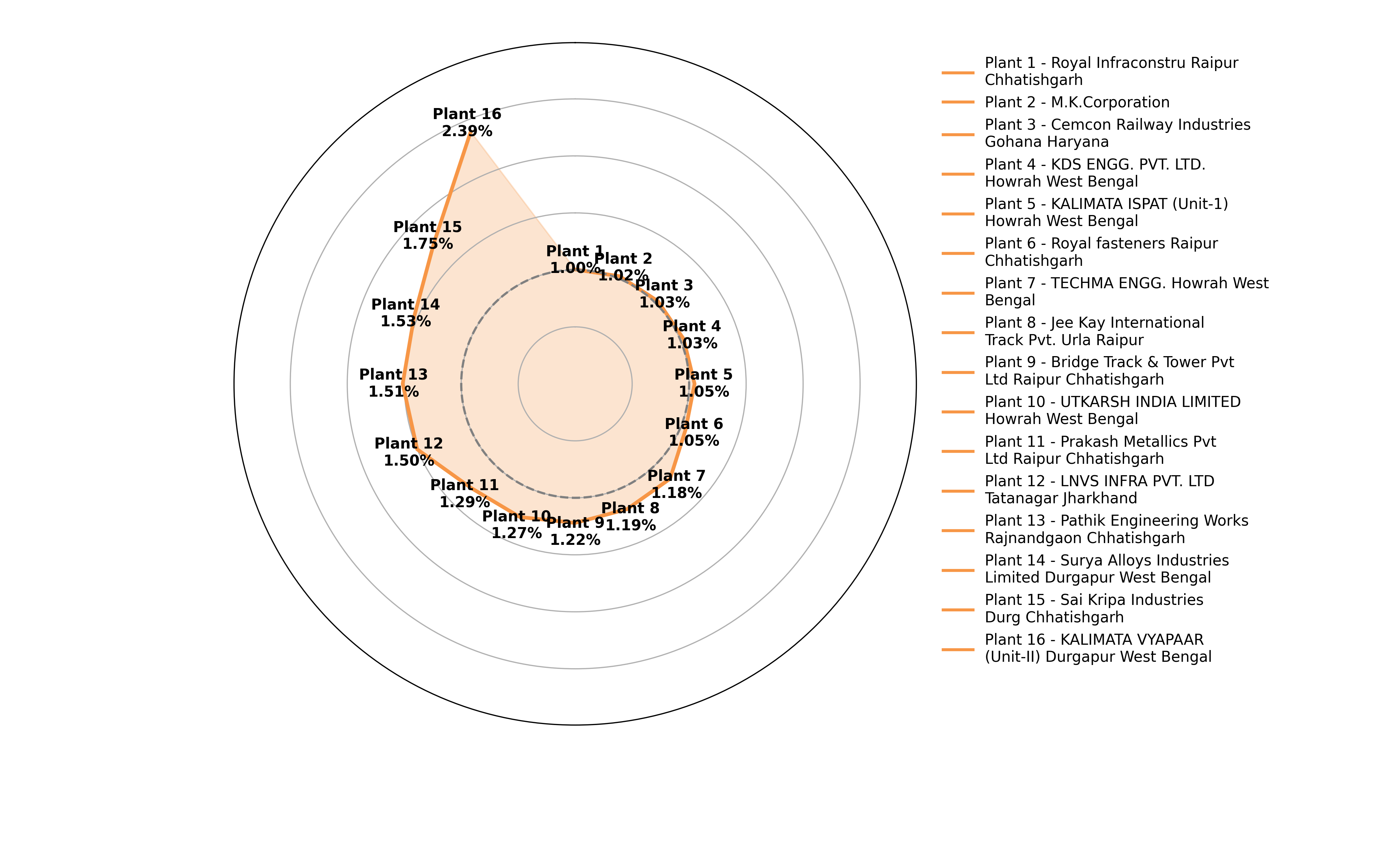
Plant-wise Rejection Trend (Rejection > 1%)
Plant-wise Defect Analysis
1

Slide 23
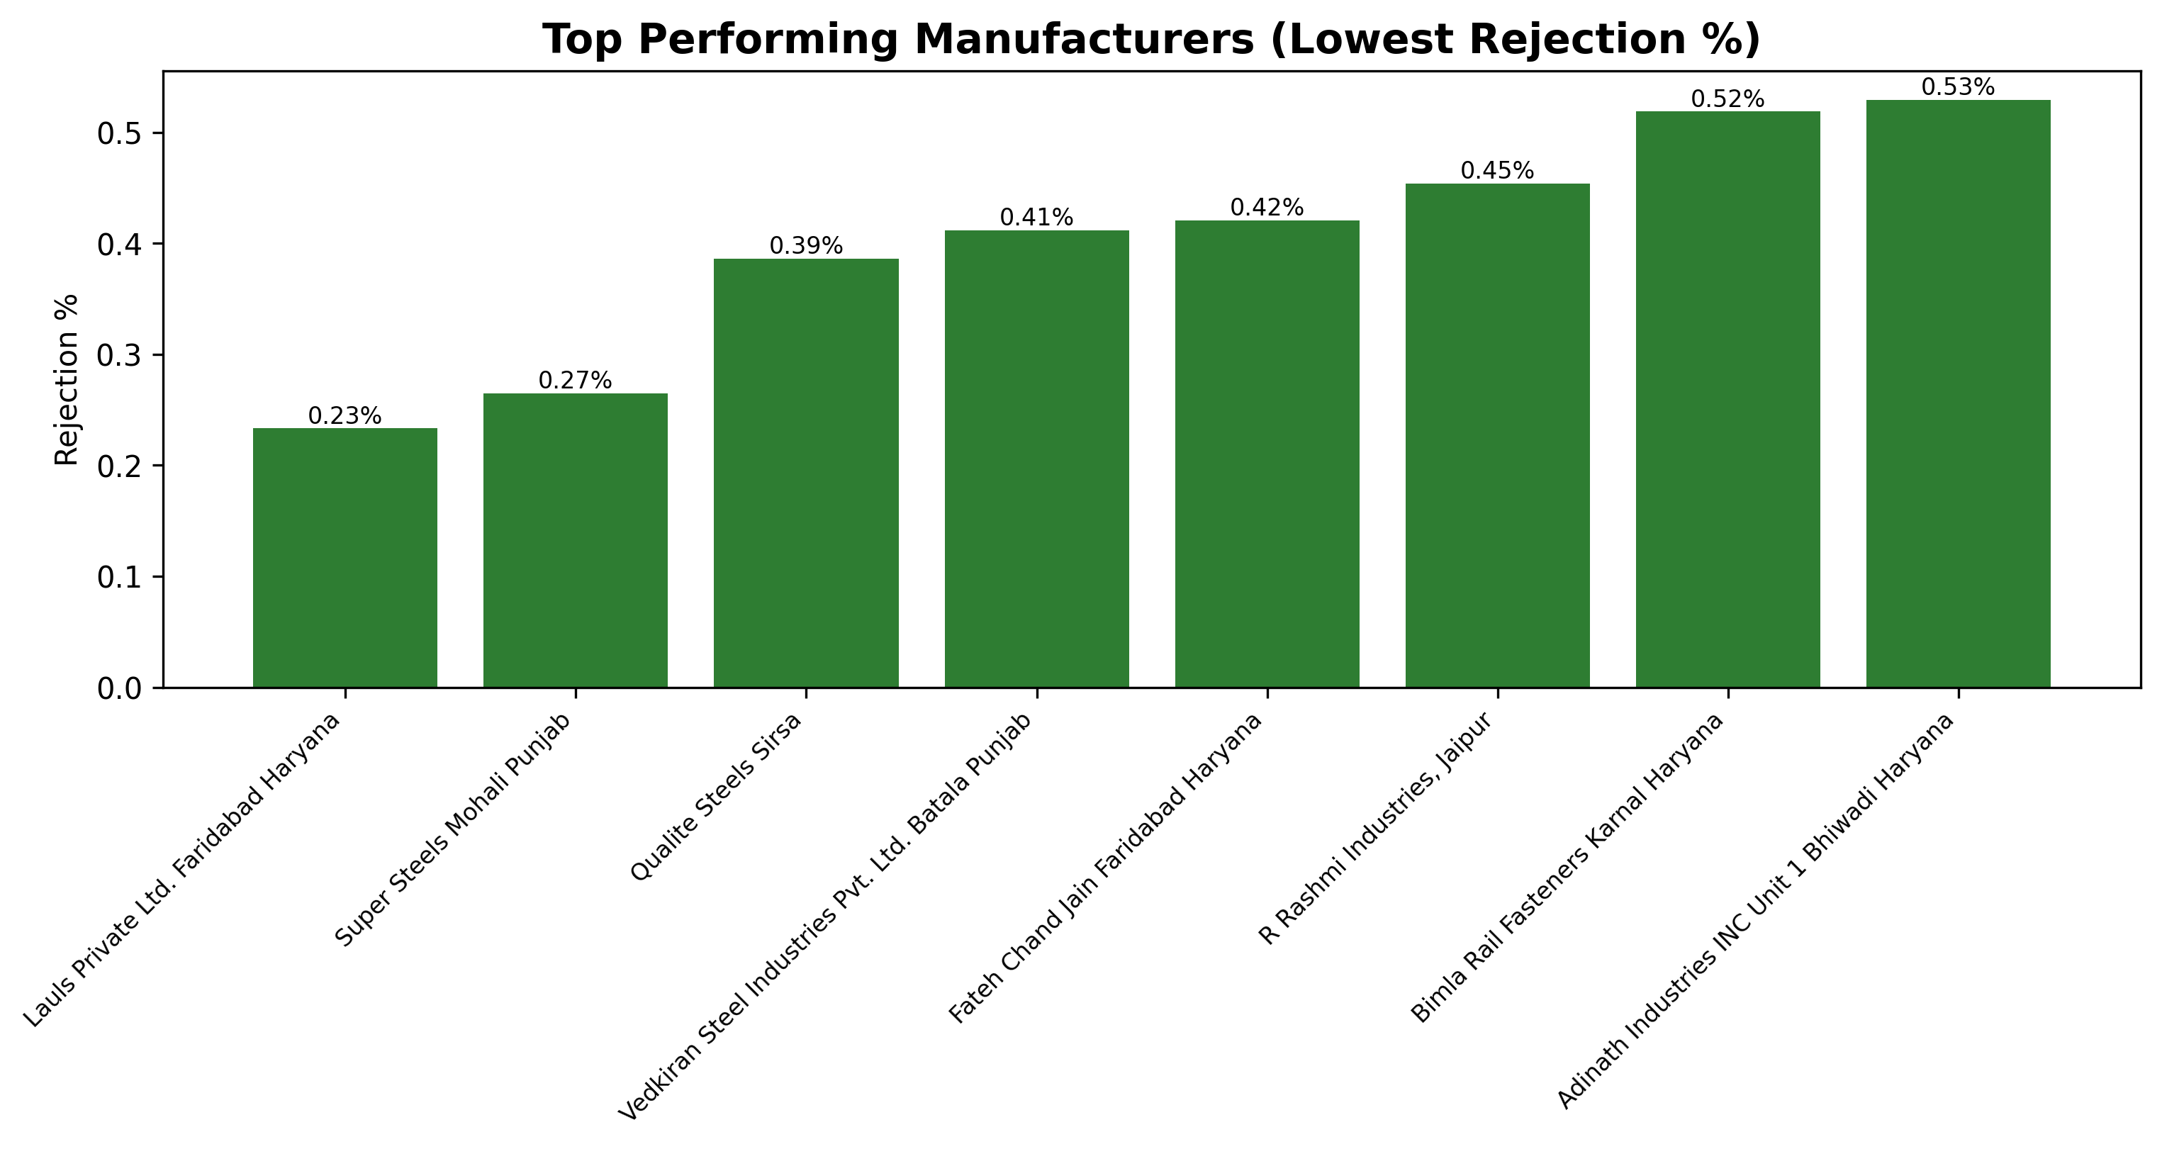
Top Performing Manufacturers (Lowest Rejection %)
Plant-wise Defect Analysis
1

Slide 24
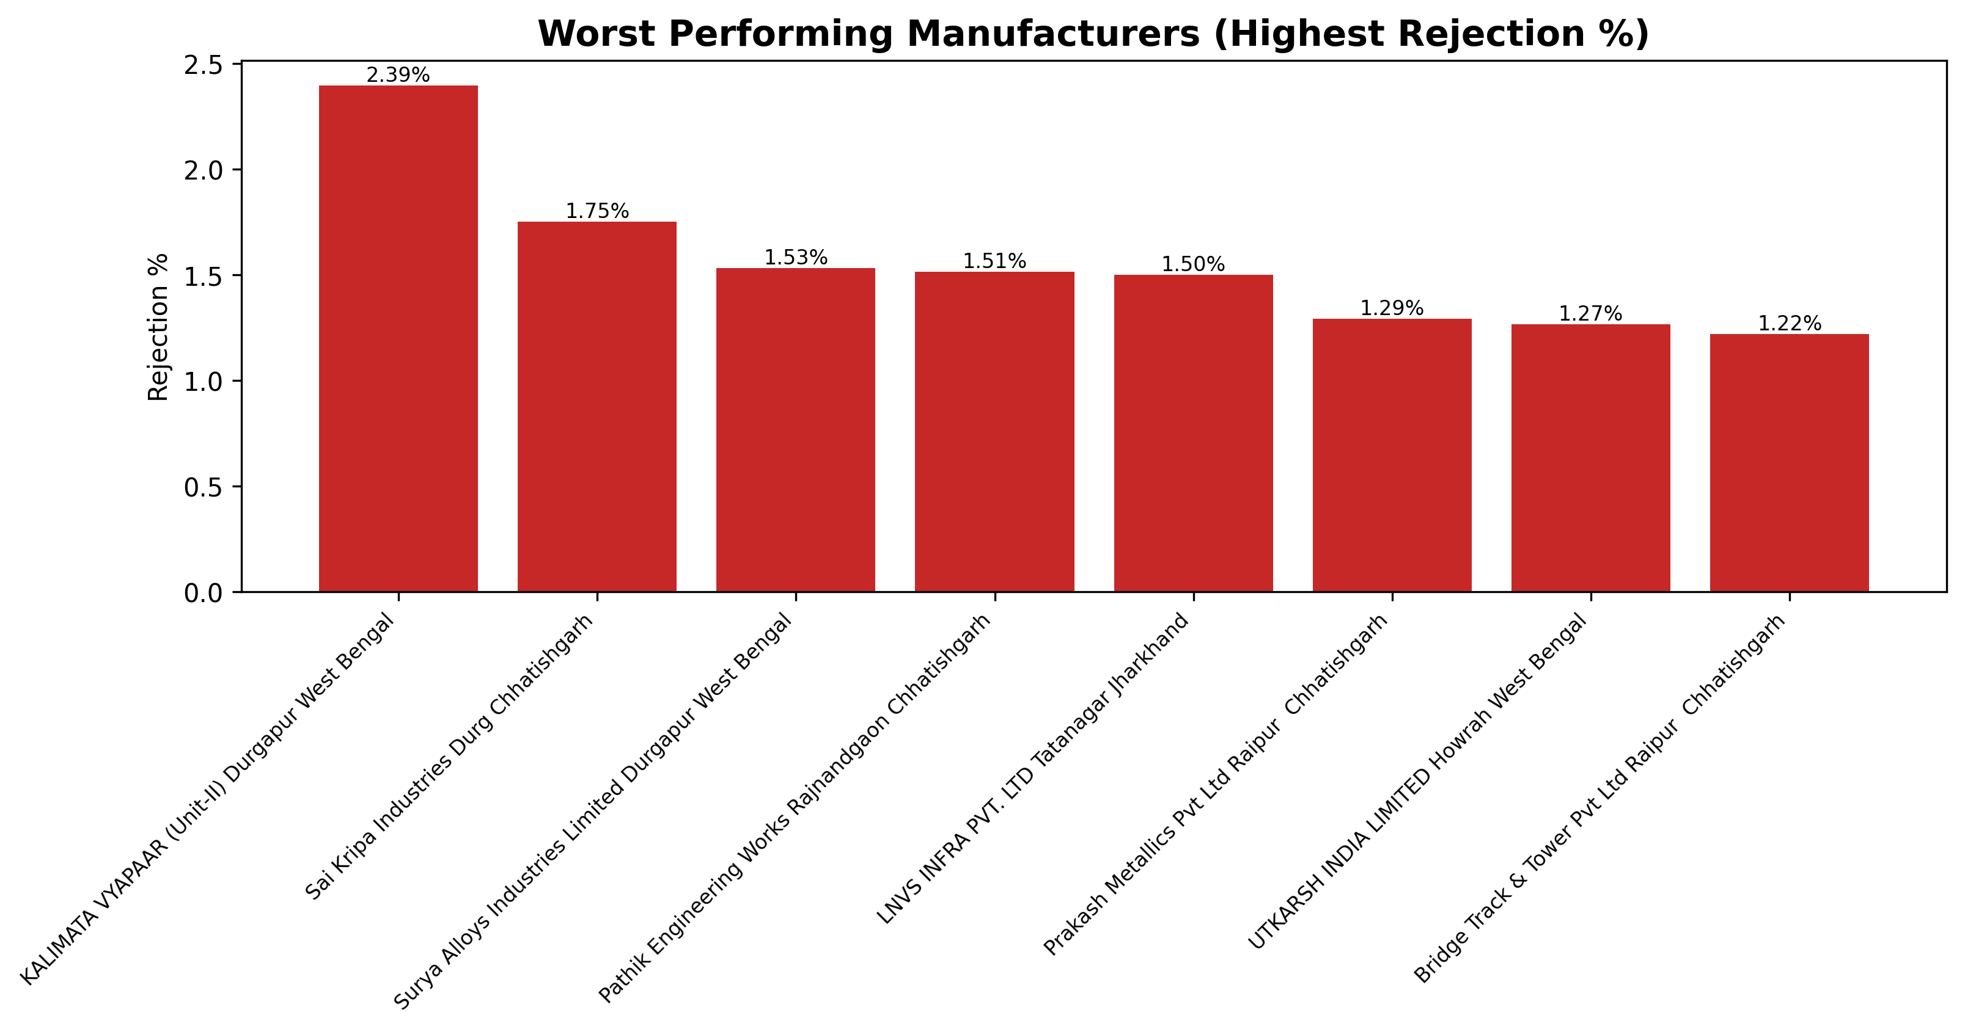
Worst Performing Manufacturers (Highest Rejection %)
Plant-wise Defect Analysis
1

Slide 25
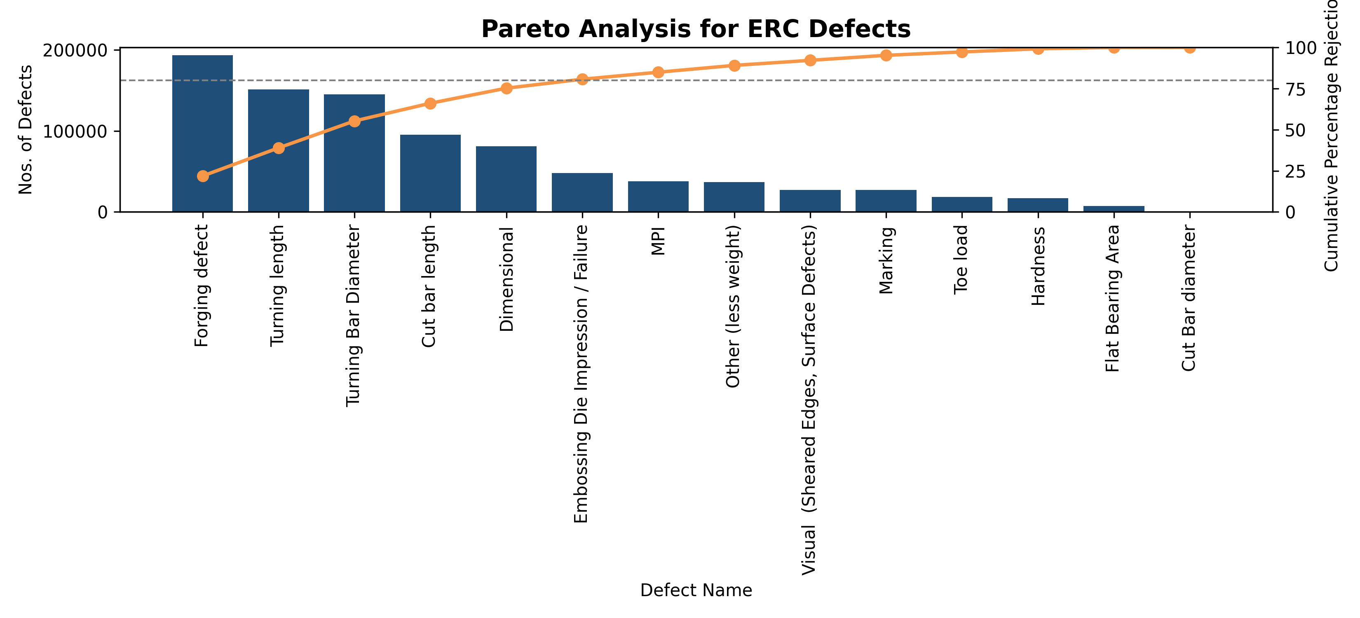
Pareto Analysis for ERC Defects
Plant-wise Defect Analysis
Highlights: Top defects contribute to ~80% of total rejections, enabling focused process control.
1

Slide 26
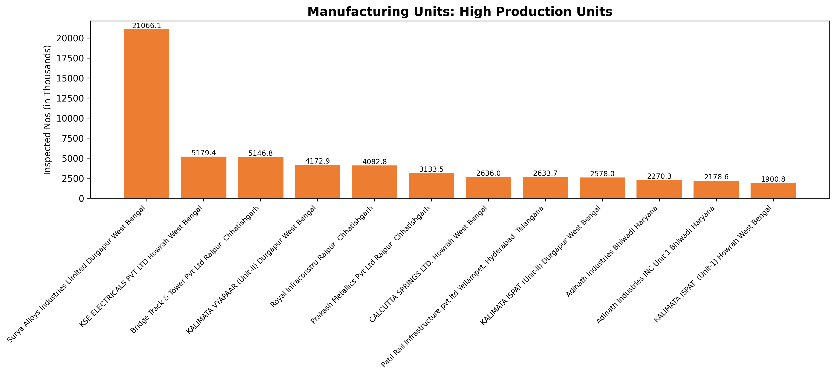
Manufacturing Units: High Production Units
Plant-wise Defect Analysis
1

