Slide 1
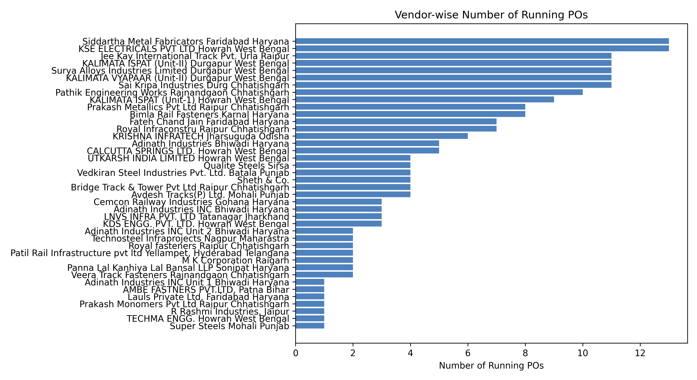
Vendor-wise Running Purchase Orders
Plant-wise Defect Analysis
1

Slide 2
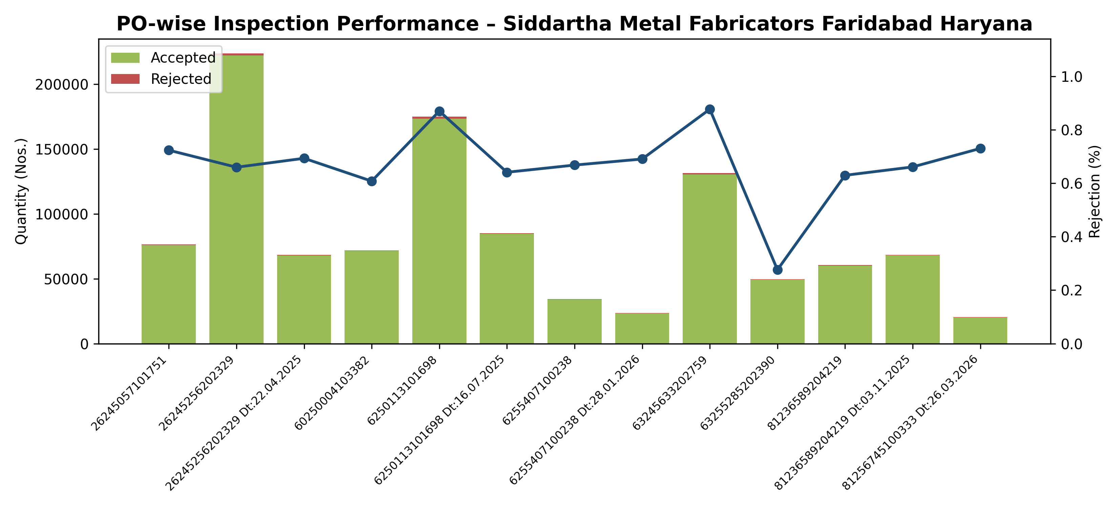
PO-wise Quality Performance – Siddartha Metal Fabricators Faridabad Haryana
Plant-wise Defect Analysis
1

Slide 3
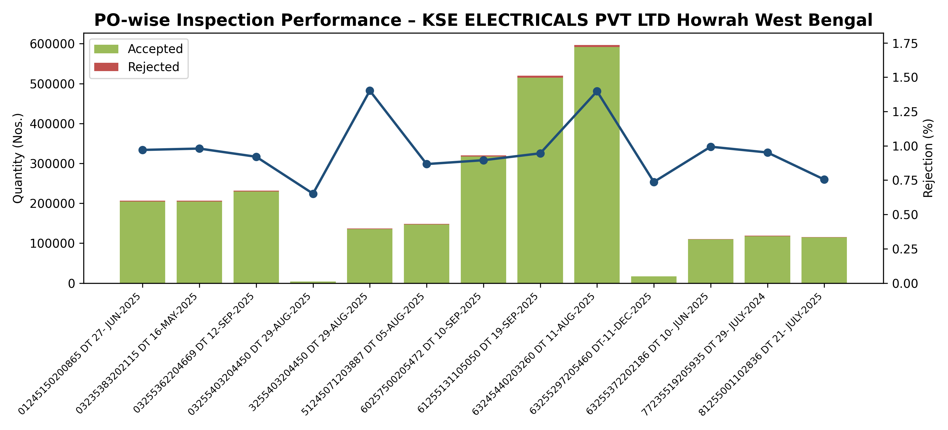
PO-wise Quality Performance – KSE ELECTRICALS PVT LTD Howrah West Bengal
Plant-wise Defect Analysis
1

Slide 4
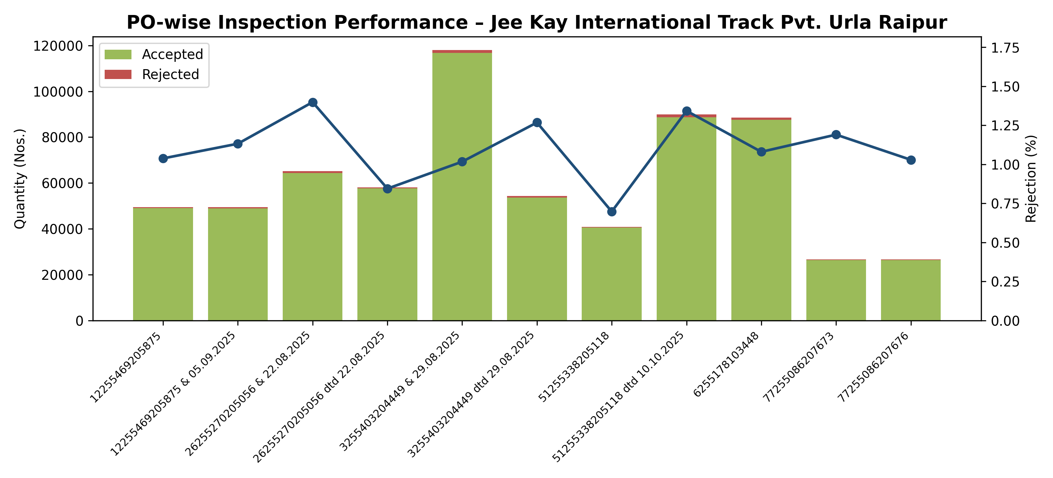
PO-wise Quality Performance – Jee Kay International Track Pvt. Urla Raipur
Plant-wise Defect Analysis
1

Slide 5
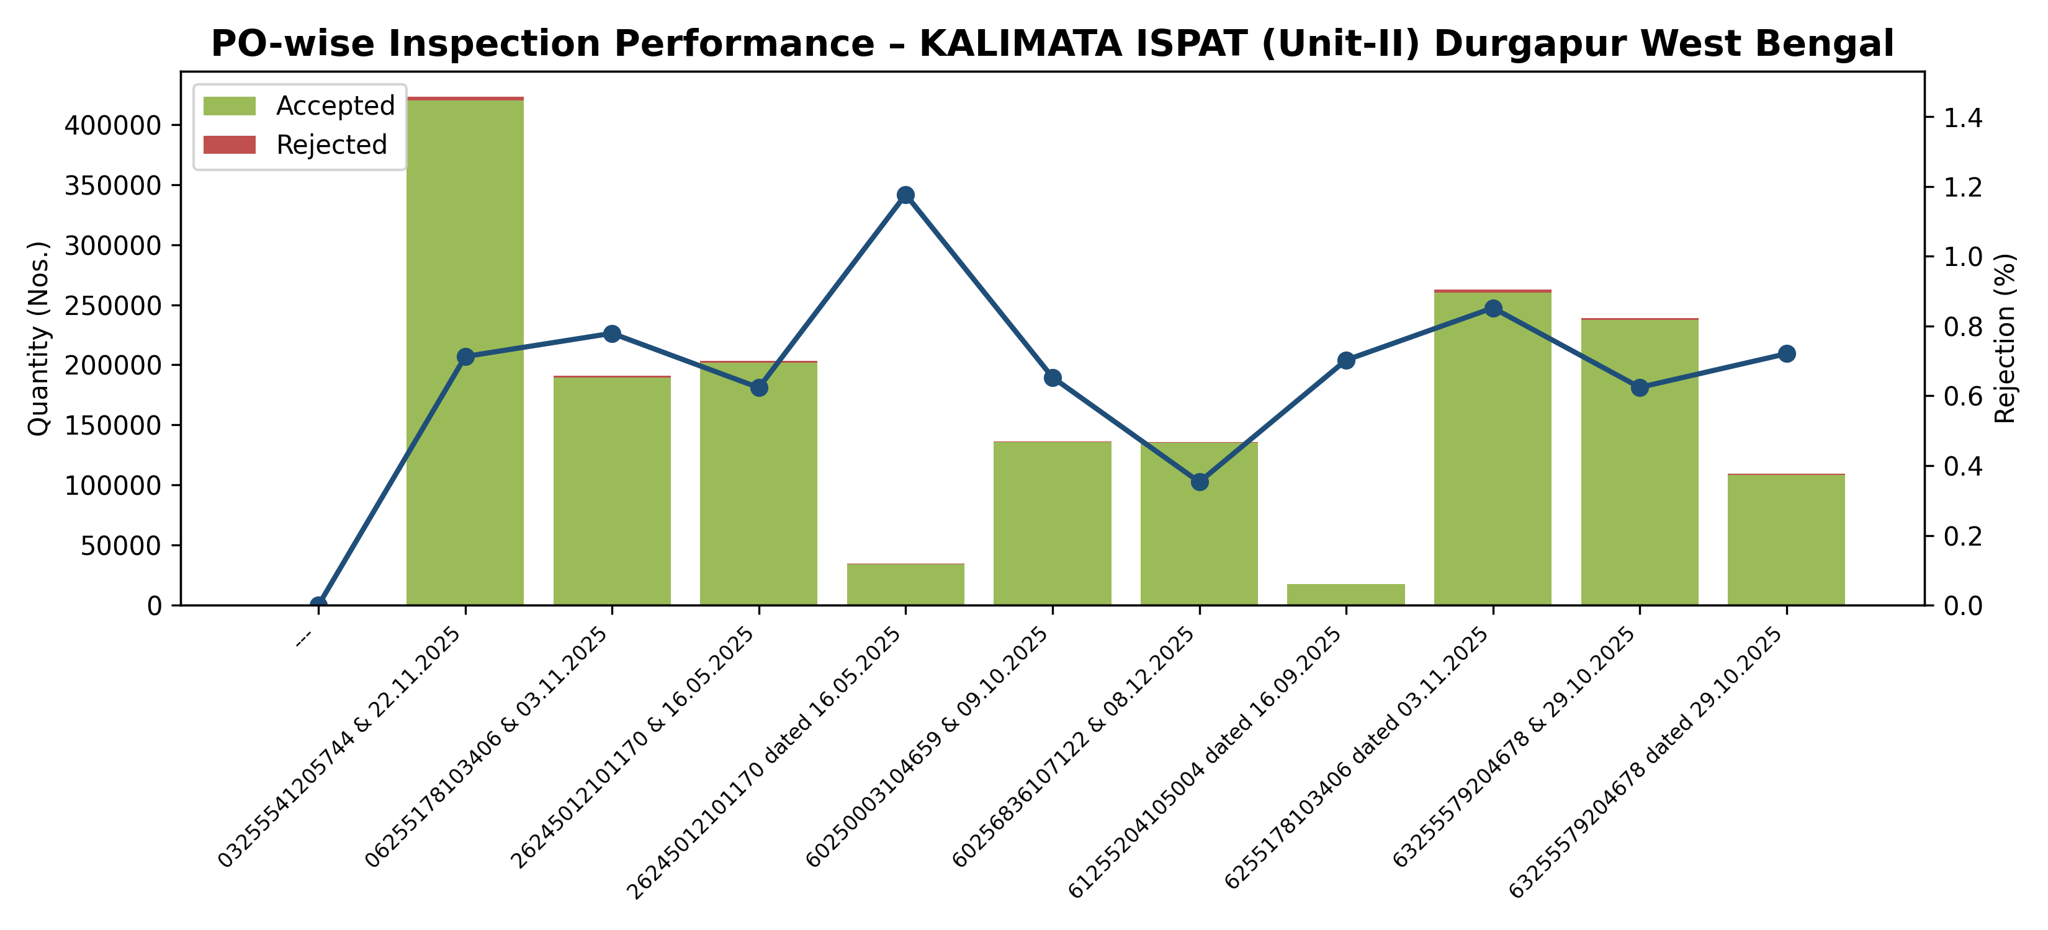
PO-wise Quality Performance – KALIMATA ISPAT (Unit-II) Durgapur West Bengal
Plant-wise Defect Analysis
1

Slide 6
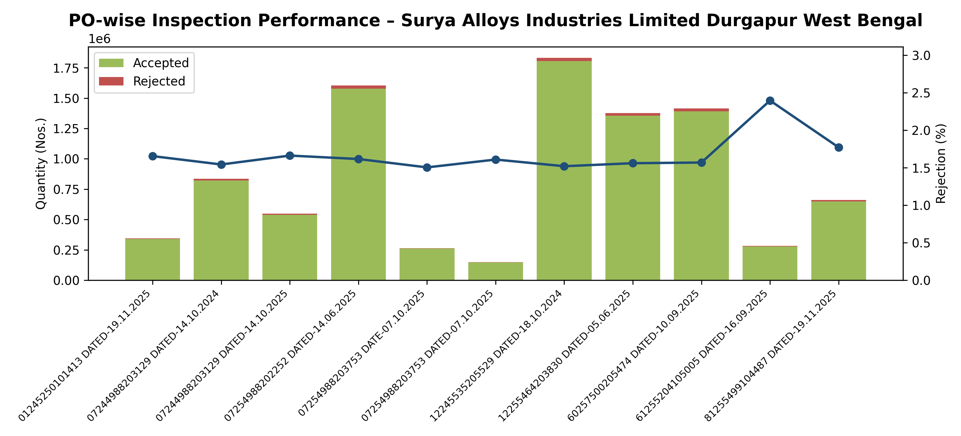
PO-wise Quality Performance – Surya Alloys Industries Limited Durgapur West Bengal
Plant-wise Defect Analysis
1

Slide 7
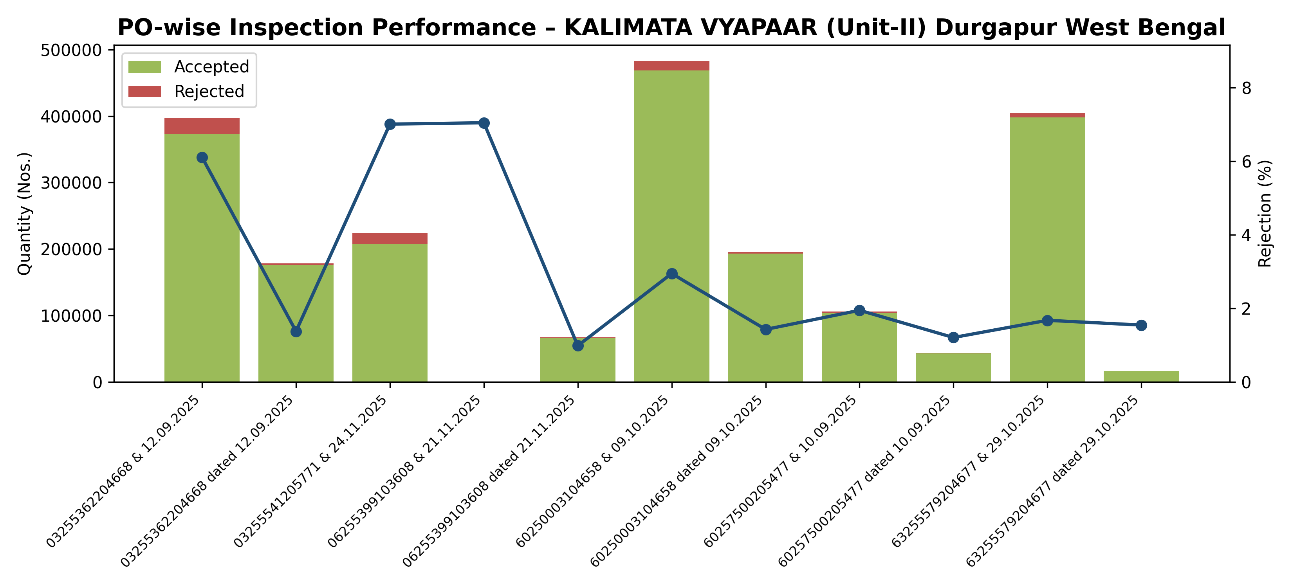
PO-wise Quality Performance – KALIMATA VYAPAAR (Unit-II) Durgapur West Bengal
Plant-wise Defect Analysis
1

Slide 8
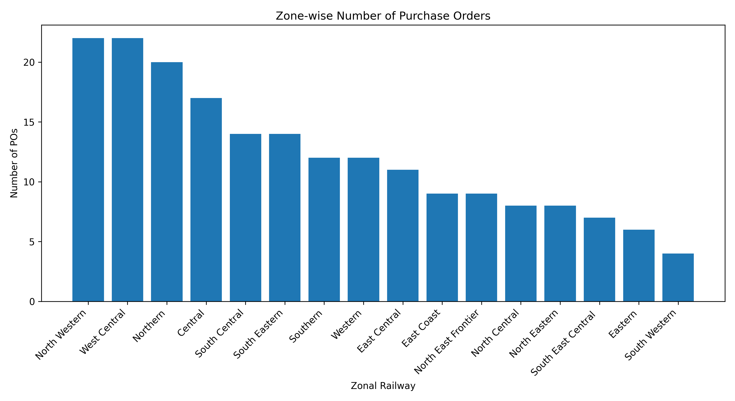
Zone-wise Number of Purchase Orders
Plant-wise Defect Analysis
1

