Slide 1
Transformation Process
1
<< Template>>
Standard Json
Standard Json
{ "patient": { "demographics": { "name": { "first": "<<first_name>>", "middle": "", "last": "<<last_name>>" }, "address": { "home": "<<address$home>>", "street": "<<address$street>>" }, "contact": { "phone": "<<phone>>" } } } }
{ "patient": { "demographics": { "name": {
"first": "amar”, "middle": "", "last": "jaiswal" }, "address": { "street": "ntnu", "home": "99B" }, "contact": { "phone": "+4712121212" } } } }
Client Json
{ "first_name": "amar", "last_name": "jaiswal", "address": { "home": "99B", "street": "ntnu" } }

Slide 2
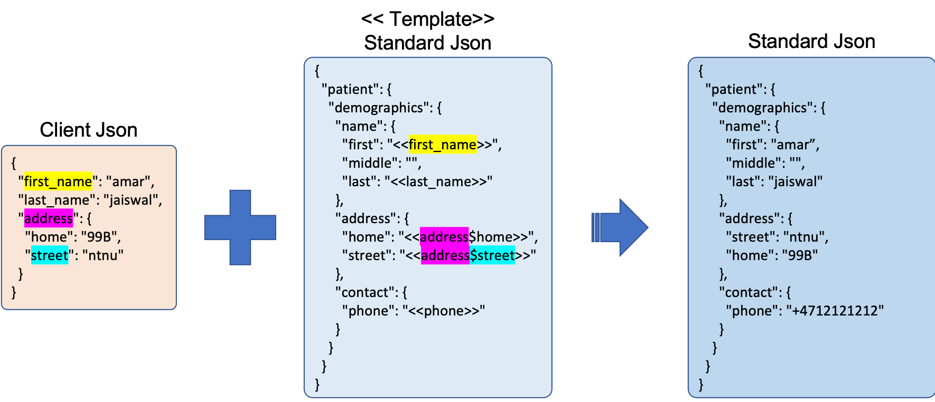
Transformation Process
2
<< Template>>
Standard Json
{ "patient": { "demographics": { "name": { "first": "<<first_name>>", "middle": "", "last": "<<last_name>>" }, "address": { "home": "<<address$home>>", "street": "<<address$street>>" }, "contact": { "phone": "<<phone>>" } } } }
<< Template>>
Child Json
{ "patient": { "name": { "firstName": "<<patient$demographics$name$first >>", "lastName": "<<patient$demographics$name$last>>" }, "address": { "home": "<< patient$demographics$address$home>>", "street": "<< patient$demographics$address$street>>" } } }

Slide 3
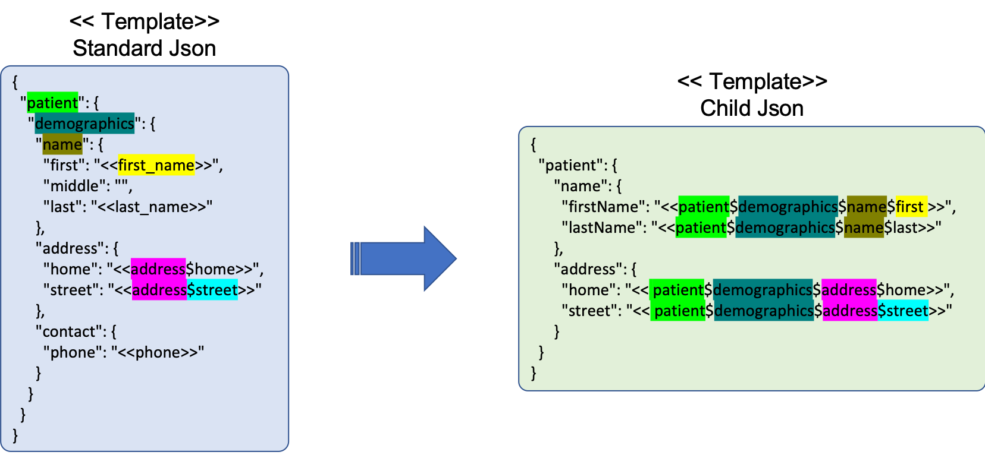
Transformation Process
3
1
2
Standard Json
{ "patient": { "demographics": { "name": {
"first": "amar”, "middle": "", "last": "jaiswal" }, "address": { "street": "ntnu", "home": "99B" }, "contact": { "phone": "+4712121212" } } } }
<< Template>>
Child Json
Child Json
{ "patient": { "name": { "firstName": "<<patient$demographics$name$first >>", "lastName": "<<patient$demographics$name$last>>" }, "address": { "home": "<< patient$demographics$address$home>>", "street": "<< patient$demographics$address$street>>" } } }
{ "patient": { "address": { "street": "ntnu", "home": "99B" }, "name": { "firstName": "amar", "lastName": "jaiswal" } } }

