Slide 1
2035 CASE STUDY · INVESTMENT-TO-OPERATION COUPLING
The Spanish Power System in 2035
From a European capacity-expansion plan to an operating grid
EMPIRE 2035 fleet · Hydro cost-to-go · Market chain
A 4-node European expansion plan (ES · PT · FR · EU) sets the 2035 system;
SDDP water values couple the hydro; the market chain clears it on the real grid.
Generated from results_plots_2035.ipynb · July 2026
Spanish Power System 2035 · EMPIRE + Market Chain
1

Slide 2
APPROACH
Three models, one chain — from plan to operation
To study 2035 we do not guess the future grid: we let a European planning model build it, value its hydro, then operate it hour-by-hour.
1
2
3
EMPIRE
SDDP
MARKET CHAIN
Capacity-expansion plan
Hydro cost-to-go
Operate the grid
4 nodes (ES·PT·FR·EU)
gives the 2035 fleet,
demand & interconnectors
Water values for the
reservoirs across a
full 77-week horizon
Day-ahead → intraday →
balancing → AC OPF
redispatch on the real grid
• The plan is not re-optimised for operation — the market chain tests whether the planned 2035 system can actually be dispatched on the existing transmission network.
• Scenario shown: NECPEssentials — a strongly renewable 2035 pathway with solar and wind dominating the added capacity.
Spanish Power System 2035 · EMPIRE + Market Chain
2

Slide 3
STEP 1 · EMPIRE
A European plan sets the 2035 system
• Four-node capacity-expansion model
– ES, PT, FR and an aggregate EU node, solved with OpenEMPIRE over the 2025→2040 horizon in five-year steps.
• Spain in nodal detail
– Spanish investments are resolved to the real grid; the rest of Europe stays zonal — enough to price the interconnectors.
• What the plan hands over for 2035
– Installed fleet by technology, demand, reservoir & pumped-storage sizes, and cross-border NTCs (ES–FR, ES–PT, FR–EU).
• A renewable-led picture
– Solar and wind dominate the added capacity through 2035; thermal is flat-to-declining across Spain.
2035 system at a glance
Nodes modelled
ES · PT · FR · EU
Scenario
NECPEssentials
Spain resolution
full nodal grid
Dominant new build
solar + wind
Peak demand (ES)
~55 GW
Midday solar (ES)
~59 GW
Interconnectors
ES–FR · ES–PT · FR–EU
Spanish Power System 2035 · EMPIRE + Market Chain
3

Slide 4
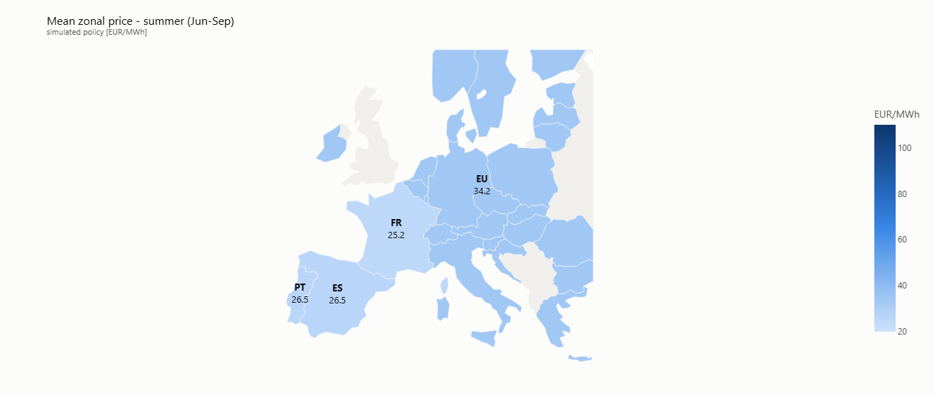
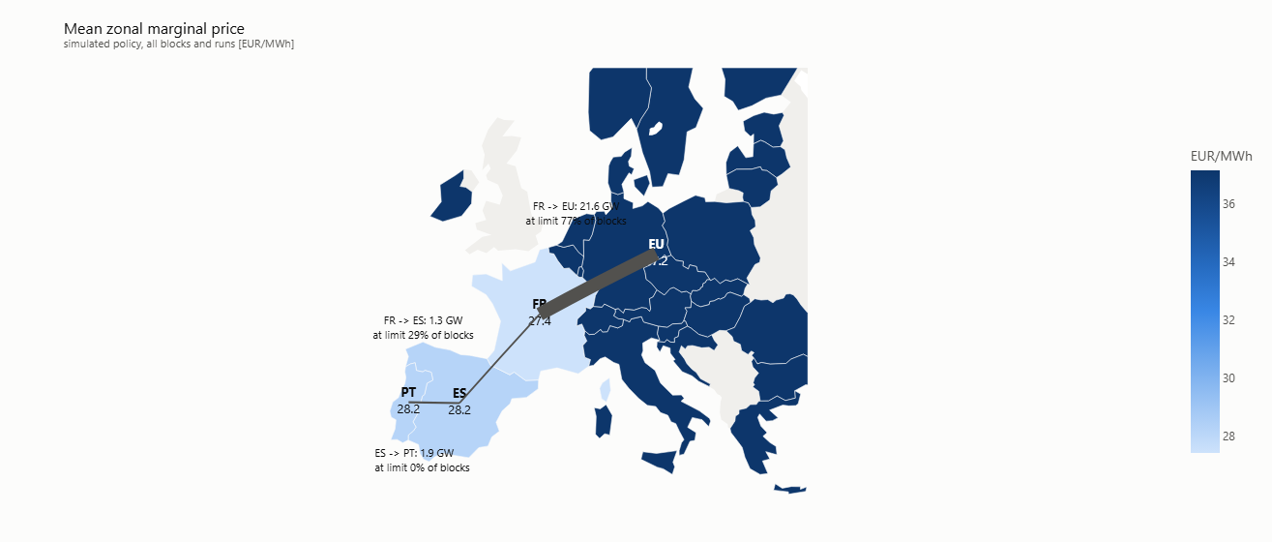
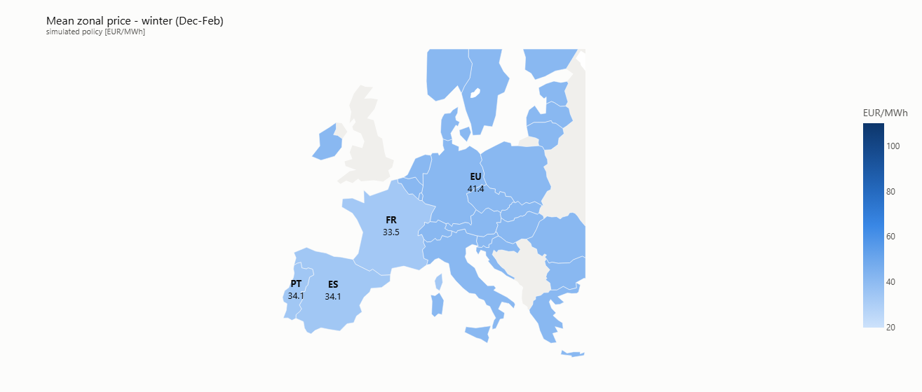
STEP 3 · MARKET CHAIN
Zonal prices and cross-border flows
Mean zonal marginal price and interconnector utilisation
Iberia sits below the EU node year-round; the gap widens in winter.
Spanish Power System 2035 · EMPIRE + Market Chain
6

Slide 5
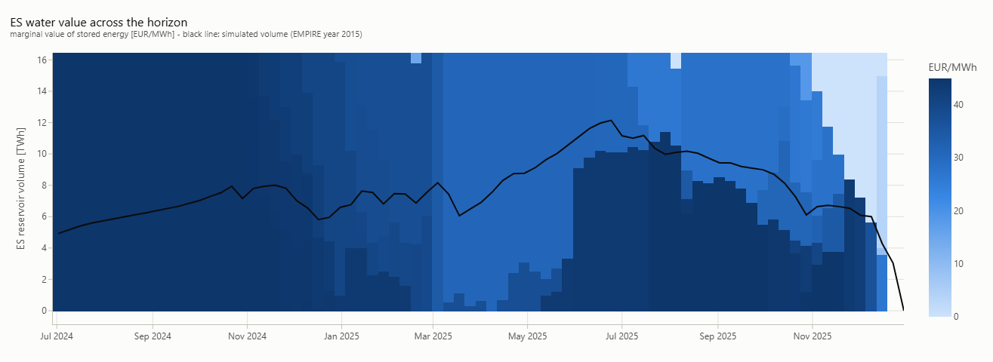
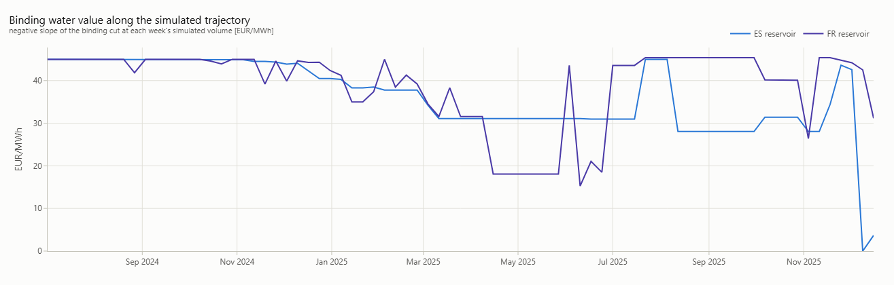
STEP 2 · HYDRO COST-TO-GO
Valuing the water before the market clears
A stochastic dual dynamic programming (SDDP) sweep over the year produces a cost-to-go for each reservoir — the marginal value of stored energy. The market chain then spends water only when it beats the thermal alternative.
ES water value across the horizon vs. simulated reservoir volume
Binding water value along the simulated trajectory (ES & FR)
Spanish Power System 2035 · EMPIRE + Market Chain
4

Slide 6
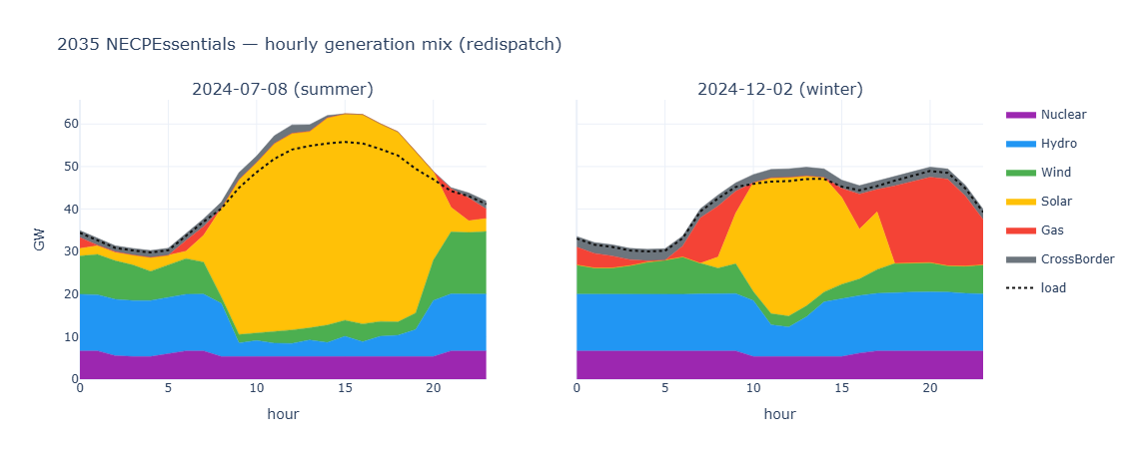
STEP 3 · MARKET CHAIN
How the 2035 system is dispatched
The full chain clears the planned 2035 fleet on two representative days. Solar carries the summer midday; gas and imports firm up the winter evening.
Hourly generation mix after redispatch — summer (left) and winter (right)
Spanish Power System 2035 · EMPIRE + Market Chain
5

Slide 7
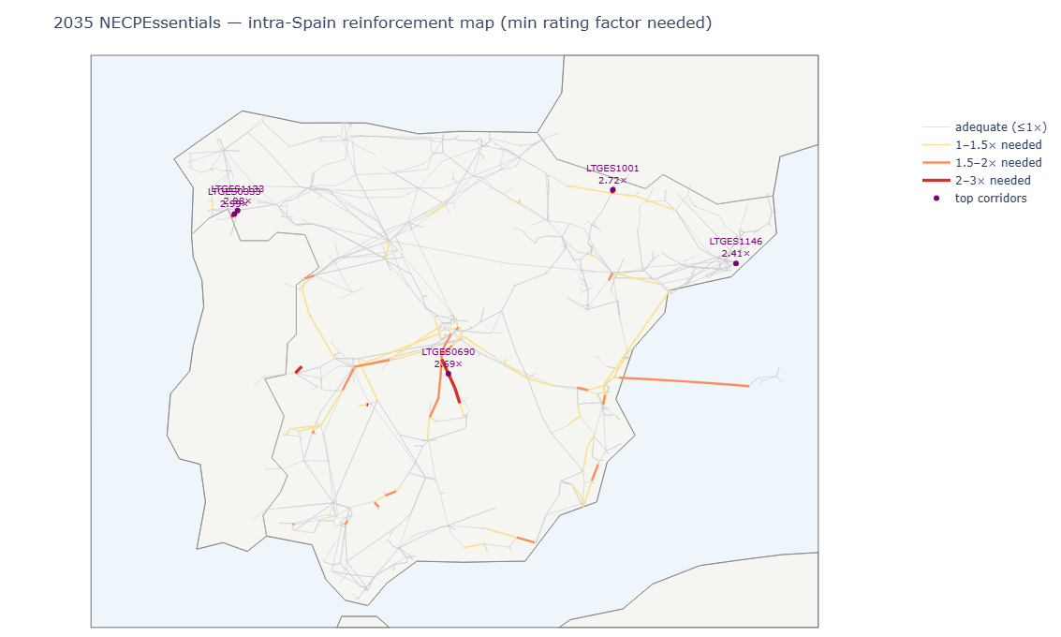
STEP 3 · GRID FEASIBILITY
The 2035 fleet needs a reinforced grid
• Markets clear — the grid does not
– Day-ahead, intraday and balancing all solve, but the AC OPF redispatch is infeasible on the un-reinforced 2024 network.
• A thermal bottleneck, not voltage
– A scaled-up renewable fleet on today's corridors overloads specific lines; relaxing thermal limits restores full feasibility.
• Targeted, not blanket
– System needs ≈ 3× headroom on the worst corridor; only ~7 lines exceed 2× and ~54 exceed 1.5×.
• The coupling insight
– EMPIRE reinforces interconnectors but not intra-Spain lines — the operational chain reveals where the internal grid must grow.
Intra-Spain reinforcement map — minimum line-rating factor needed
Spanish Power System 2035 · EMPIRE + Market Chain
7

Slide 8
TAKEAWAYS
What the 2035 case shows
1
Plan → operation, end to end
A European expansion plan can be handed to an operational market chain and run on the real grid.
2
Hydro is valued consistently
SDDP cost-to-go links the yearly water problem to the hourly market, so reservoirs are spent optimally.
3
Energy balances, the network binds
The 2035 renewable fleet clears in the market but overloads the existing internal transmission grid.
4
A targeted reinforcement signal
Only a handful of Spanish corridors need substantial upgrades — the chain pinpoints which.
Spanish Power System 2035 · EMPIRE + Market Chain

