Slide 1
SHORT-TERM ELECTRICITY MARKET SIMULATION
The Spanish Power System
A multi-stage market chain feeding an AC optimal power flow redispatch
Model · Case study · Results
Peninsular transmission grid — 1,236 buses · 2,345 branches · 2,035 generating units
Two representative days: 8 July 2024 (summer) and 2 December 2024 (winter)
Generated from results_plots.ipynb · June 2026

Slide 2
AGENDA
What this deck covers
1
The model — a multi-stage short-term market chain
Day-ahead → three intraday gates → balancing → AC OPF redispatch
2
The case — the Spanish peninsular grid
Full transmission network, two contrasting demand days, cross-border ties
3
Methodology
Copper-plate economic dispatch, Bellman-coupled hydro, AC redispatch with reactive realism
4
Dispatch results
Fuel mix, merit order, capacity utilisation, hourly profiles, system prices
5
Network & reactive results
Branch loading & congestion, voltage profile, reactive procurement, feasibility
Spanish Power System · Market-Chain + AC OPF
1

Slide 3
PART I
The Model
A multi-stage representation of the short-term electricity market
Spanish Power System · Market-Chain + AC OPF
2

Slide 4
MODEL · OVERVIEW
A market chain, not a single optimisation
Real electricity markets clear in sequential stages. The model reproduces that chain: a day-ahead schedule is progressively revised by intraday gates and a balancing market, then made physically feasible on the AC network by a redispatch step.
DAY-AHEAD
ID2
ID3
CID
BALANCING
REDISPATCH
Copper-plate economic dispatch
Intraday gate
Intraday gate (hours 12–23)
Continuous intraday
Copper-plate balancing (BE)
AC OPF on the real grid
Each stage hands its schedule to the next as a warm-start / anchor
• Stages 1–5 are copper-plate (system-wide power balance only, no network) and share one Bellman-coupled 24-hour formulation — they differ only in the input data and what is frozen.
• The intraday gates and the balancing market are adjustment markets: they re-clear cost first, then minimise total movement from the previous schedule (lexicographic tie-break) so units only move when there is a real reason.
• The final stage is a full AC optimal power flow that enforces the physical grid — line ratings, voltages and reactive power — by redispatching only the units that are allowed to move.
Spanish Power System · Market-Chain + AC OPF
3

Slide 5
MODEL · DAY-AHEAD
Stage 1 — Day-ahead economic dispatch
• Copper-plate dispatch over all 24 hours at once
– One system-wide balance per hour: Σ generation = Σ load
– No network, voltage or reactive constraints at this stage
• Reservoir hydro coupled across the day
– Full Bellman cost-to-go (water value) links the 24 hours so stored water is allocated to the most valuable hours
– Cost of reservoir output comes entirely from the future-value term
• Merit-order clearing
– Zero-cost renewables (wind, solar, run-of-river) dispatched first, then nuclear, hydro, gas …
– Cross-border imports enter as fixed injections; slack & load-shed units stand by
• Solves as a linear program in ~1–5 s per day
Objective (per day)
min Σₕ Σ_g c_g · p_{g,h}
+ θ_future(water)
subject to
Σ_g p_{g,h} = load_h ∀h
p_g^min ≤ p_{g,h} ≤ p_g^max
reservoir storage balance
+ Bellman value cuts
Output → day-ahead schedule,
the anchor for the intraday gates
Spanish Power System · Market-Chain + AC OPF
4

Slide 6
MODEL · INTRADAY & BALANCING
Stages 2–5 — Intraday gates & balancing market
The intraday gates (ID2 → ID3 → CID) and the balancing market refine the day-ahead schedule as forecasts are updated. Each is an adjustment market solved lexicographically, not a fresh clearing.
Step 1 — minimise dispatch cost
Step 2 — minimise movement
Re-clear the merit order for the updated demand — cheapest feasible units, as in any market.
Among all cost-optimal solutions, pick the one closest to the previous gate: min Σ (Δ↑ + Δ↓). Removes cost-degenerate reshuffles that move units for no net reason.
• Anchoring chain: ID2 anchors to day-ahead; ID3 retrades only hours 12–23 (0–11 carry over); CID rolls gate-by-gate, anchoring each hour to the latest market view.
• Stage 5 — Balancing: a copper-plate balancing market on balancing-energy (BE) data, anchored to the CID schedule with the same minimum-movement clearing — the final market schedule before the network step.
• Nuclear is frozen at its day-ahead value from ID2 onward, including balancing (baseload does not chase short-term signals).
• Every gate reuses the same Bellman-coupled 24-hour reservoir formulation as the day-ahead stage.
• The balancing schedule is the realised market dispatch that the AC redispatch must make grid-feasible.
Spanish Power System · Market-Chain + AC OPF
5

Slide 7
MODEL · REDISPATCH
Stage 6 — AC OPF redispatch
• Full non-linear AC optimal power flow
– Enforces the real grid: line thermal ratings, bus voltage band, and AC power-balance (active + reactive) at every bus.
– Warm-started from the balancing-stage schedule; the objective keeps the dispatch as close to it as possible while restoring feasibility.
• Who can move?
– Frozen at market value: Nuclear, run-of-river Hydro, Biomass (pmin = pmax).
– Free to redispatch: Gas, Coal, Oil, reservoir & pumped hydro, and curtailable Wind / Solar.
• Reactive & voltage realism
– Shunt reactors (REE fleet), full π-model line charging, per-fuel generator reactive capability, and an AVR voltage band.
• Solved with Ipopt + HSL/MA57 — every hour reaches a locally optimal AC solution.
Redispatch objective
min base cost
+ w · Σ (P_g − P_g^BAL)²
subject to
AC power balance (P & Q)
|S_line| ≤ rating
0.95 ≤ V ≤ 1.05 pu
gen P–Q capability limits
frozen units: P = P^BAL
P^BAL = balancing-stage schedule;
w = anchor weight to the market
Spanish Power System · Market-Chain + AC OPF
6

Slide 8
MODEL · AC REALISM
Methodology deep-dive — a physically realistic AC OPF
A pure loss-minimising AC OPF is physically naïve: it pushes reactive power onto generators and rails almost every bus up to the upper voltage limit. Four mechanisms — each calibrated to the real Spanish grid — restore realistic reactive flows and voltages.
1 · Line charging (π-model)
2 · Shunt reactors
Every AC line is a full π-model. ~48,000 km of EHV generate ≈21 GVAr of charging at 1.0 pu (≈17 GVAr from 400 kV alone) that must be absorbed.
REE's installed peninsular reactor fleet (15.5 GVAr) is placed on buses to soak up that charging — exactly what the real operator does.
3 · Generator reactive capability
4 · AVR voltage band
Technology-specific P–Q limits: a capability circle for synchronous machines, a grid-code cap for inverter-based wind & solar.
Synchronous machines hold their bus to an AVR setpoint near nominal, pulling the voltage profile off the upper rail.
Spanish Power System · Market-Chain + AC OPF
7

Slide 9
METHODOLOGY · REACTORS
Shunt reactors — compensating EHV line charging
• The problem
– Every line is a full π-model with charging susceptance. Across ~48,000 km of 400/220 kV this generates ≈21 GVAr at nominal voltage (≈17 GVAr from 400 kV alone).
– With nothing to absorb it, the OPF dumps that reactive onto generators and voltages ride the upper band — physically the job of shunt reactors.
– Modelled as proper shunt elements with negative susceptance (bs < 0, inductive). PowerModels ignores bus-level bs, so they must live in the shunt component.
• Disaggregation
– The aggregate fleet is spread to buses in proportion to the AC line charging connected at each bus, within each voltage group (400 kV vs ≤220 kV).
– Per-bus result cached in Data/reactors.csv — fixed and reproducible across runs.
– Config knob in_service_pct scales the energised fraction — emulating switched reactors without turning the AC OPF into a mixed-integer problem.
Installed peninsular fleet
REE Boletín Mensual, diciembre 2024
Voltage group
Installed
Units
400 kV
11,750 MVAr
80
≤ 220 kV
3,722 MVAr
55
Peninsular total
15,472 MVAr
135
≈ 80% of the EHV line charging is compensated — consistent with the standard EHV planning rule. Balearic & Canary systems excluded (non-synchronous).
config.toml
[reactors]
enabled = true
in_service_pct = 100.0
Spanish Power System · Market-Chain + AC OPF
8

Slide 10
METHODOLOGY · REACTIVE
Generator reactive capability — per technology
Reactive limits are technology-specific and enforced in every redispatch stage (hour-by-hour anchored solves and the Bellman-coupled multi-hour solve).
Synchronous machines
Inverter-based units
Nuclear · Gas · Coal · Oil · Biomass · Hydro
Wind · Solar
P² + Q² ≤ S_rated²
S_rated = installed MVA / 0.90
|Q| ≤ tan(acos(0.95)) · P
• An apparent-power capability circle, sized on installed nameplate MVA.
• A machine's MVA rating is fixed regardless of output, so it can supply reactive even at low MW.
• Convex (second-order cone) → Ipopt solves it as an NLP. Replaces the old ±Pmax box that allowed PF 0.707 at full output.
• A grid-code reactive cap tied to actual output, not nameplate.
• Sizing on actual P stops a heavily-derated farm (e.g. 38 of 100 MW) parking at a very low PF.
• An installed-MVA circle for renewables gave low-availability farms huge reactive headroom — the per-fuel split is what fixes it.
config.toml [generators]
apparent_power_limit = true rated_power_factor = 0.90 renewable_power_factor = 0.95
Spanish Power System · Market-Chain + AC OPF
9

Slide 11
METHODOLOGY · VOLTAGE
Voltage realism — load reactive & AVR regulation
Load reactive demand
AVR voltage band
qd = pd · tan(acos(power_factor))
• A loss-minimising OPF rails voltages to vmax (higher V ⇒ lower current ⇒ lower losses).
• Real synchronous machines are AVR-regulated to a setpoint: AVR buses (slack + synchronous-hosting) are held to a tight 0.98–1.03 band.
• Renewable-only & load buses keep the wider ±0.05 — a derated farm can't firmly hold a setpoint.
• power_factor is the net PF the transmission grid sees; distribution-level correction is assumed already applied below the model boundary.
• Default 1.0 ⇒ active-only load, leaving all the line charging for the reactors to absorb; a lower PF lets the load soak up much of it (~11.5 GVAr at 0.95). Tune with reactors together.
Effect on the profile
full fleet, 48 h
Mean bus voltage
1.037 → 1.023 pu
Buses sitting at vmax
7.8% → 0.9%
config.toml [network]
voltage_band = 0.05 gen_bus_voltage_control = true
gen_bus_vmin = 0.98 gen_bus_vmax = 1.03
Spanish Power System · Market-Chain + AC OPF
10

Slide 12
PART II
The Case
The Spanish peninsular transmission system on two contrasting days
Spanish Power System · Market-Chain + AC OPF
11

Slide 13
CASE · NETWORK
The Spanish peninsular grid
1,236
2,345
2,035
48
buses
AC branches
generating units
hourly snapshots
• Geographic transmission model of peninsular Spain at 400 / 220 / 132 kV and below, built from REE network data — every line is a full π-model with charging susceptance.
• EHV scale: ~48,000 km of lines carry roughly 21 GVAr of line charging at 1.0 pu (≈17 GVAr from the 400 kV layer alone) — reactive management is a first-order concern.
• Shunt reactors from the REE December-2024 fleet (≈11.75 GVAr at 400 kV, ≈3.72 GVAr at ≤220 kV) are placed on buses in proportion to connected line charging.
• Cross-border AC ties to France and Portugal (13 lines, no HVDC) inject the market-cleared exchange as fixed boundary injections — ~1.9 GW of net imports on average.
Spanish Power System · Market-Chain + AC OPF
12

Slide 14
CASE · DEMAND
Two representative days
Attribute
8 July 2024 · summer
2 December 2024 · winter
Season
Summer
Winter
Peak demand
39.4 GW
33.9 GW
Minimum demand
21.3 GW
21.4 GW
Avg. system cost
≈ 147 k€/h
≈ 464 k€/h
Dominant flexibility
Solar midday peak
Gas-heavy evenings
Hours solved (AC)
24 / 24
24 / 24
Two days chosen to bracket the system: a high-renewable summer day with a pronounced solar peak, and a tighter winter day where thermal generation carries the evening — driving the ≈3× higher system cost.
Spanish Power System · Market-Chain + AC OPF
13

Slide 15
PART III
The Results
Dispatch, prices, network loading, voltages and reactive power
Note: the operational results that follow reflect the chain through CID → redispatch. The balancing stage was added subsequently and its results are pending — they will refresh these figures once it is run.
Spanish Power System · Market-Chain + AC OPF
14

Slide 16
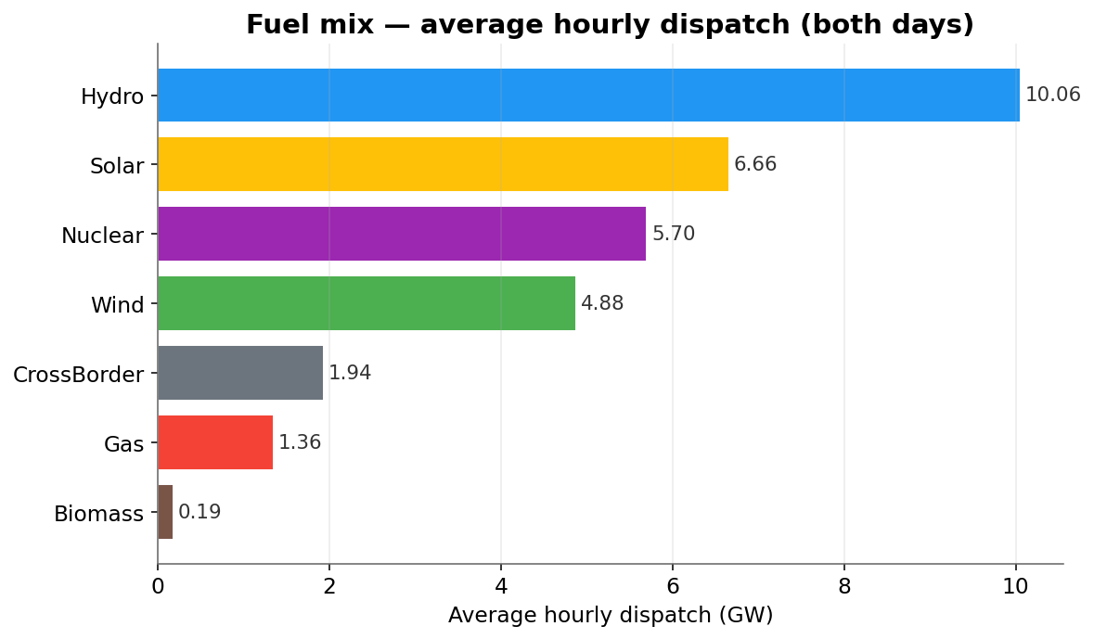
RESULTS · DISPATCH
Generation mix & average dispatch
Key takeaways
• Hydro is the workhorse of both days (≈10 GW average), followed by solar (≈6.7 GW) and nuclear baseload (≈5.7 GW).
• Wind contributes ≈4.9 GW on average; gas (≈1.4 GW) fills the residual and sets the price at the margin.
• Coal and oil sit essentially idle — pushed out of the merit order by cheap renewables and hydro.
Spanish Power System · Market-Chain + AC OPF
15

Slide 17
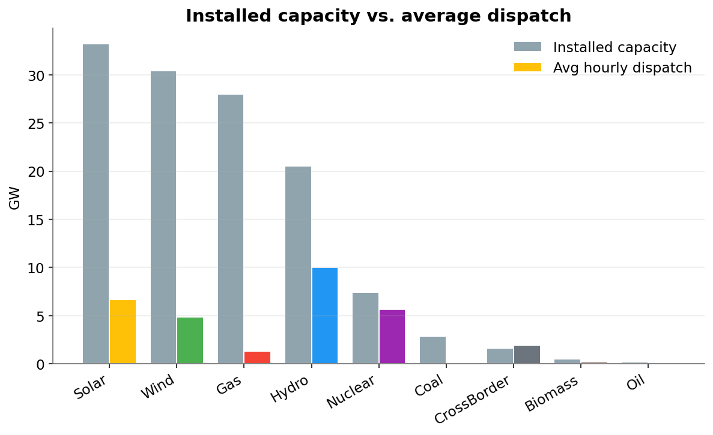
RESULTS · DISPATCH
Installed capacity vs. utilisation
Key takeaways
• Gas has the largest installed fleet (≈28 GW) but runs at low utilisation — a peaking / balancing role.
• Solar (33 GW) and wind (30 GW) dominate capacity; their average output reflects availability, not scarcity.
• Nuclear runs close to its ≈7.4 GW nameplate — the firm baseload of the system.
Spanish Power System · Market-Chain + AC OPF
16

Slide 18
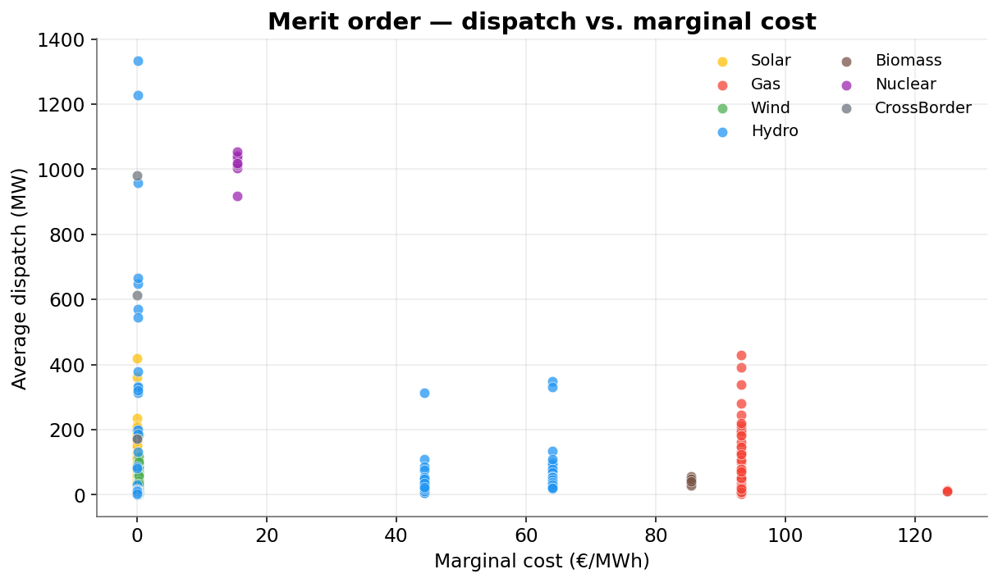
RESULTS · ECONOMICS
Merit order — dispatch vs. marginal cost
Key takeaways
• Zero-marginal-cost renewables and hydro are dispatched first and carry the bulk of the energy.
• Dispatch falls away as marginal cost rises — the classic merit-order staircase.
• Gas units cluster at the expensive, lightly-loaded end: on only when the grid needs them.
Spanish Power System · Market-Chain + AC OPF
17

Slide 19
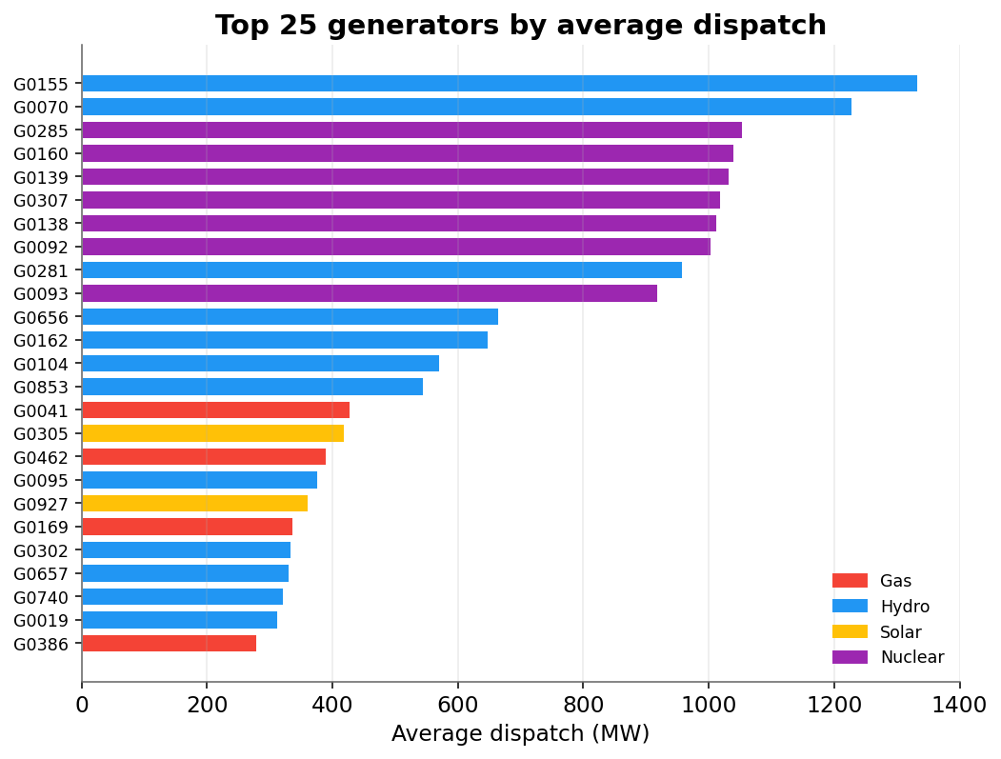
RESULTS · DISPATCH
Top dispatched generators
Key takeaways
• The most-dispatched units are large hydro and nuclear stations running near capacity.
• High average utilisation among the top units confirms a stable, baseload-anchored dispatch.
• No single thermal unit dominates — flexibility is spread across the gas fleet.
Spanish Power System · Market-Chain + AC OPF
18

Slide 20
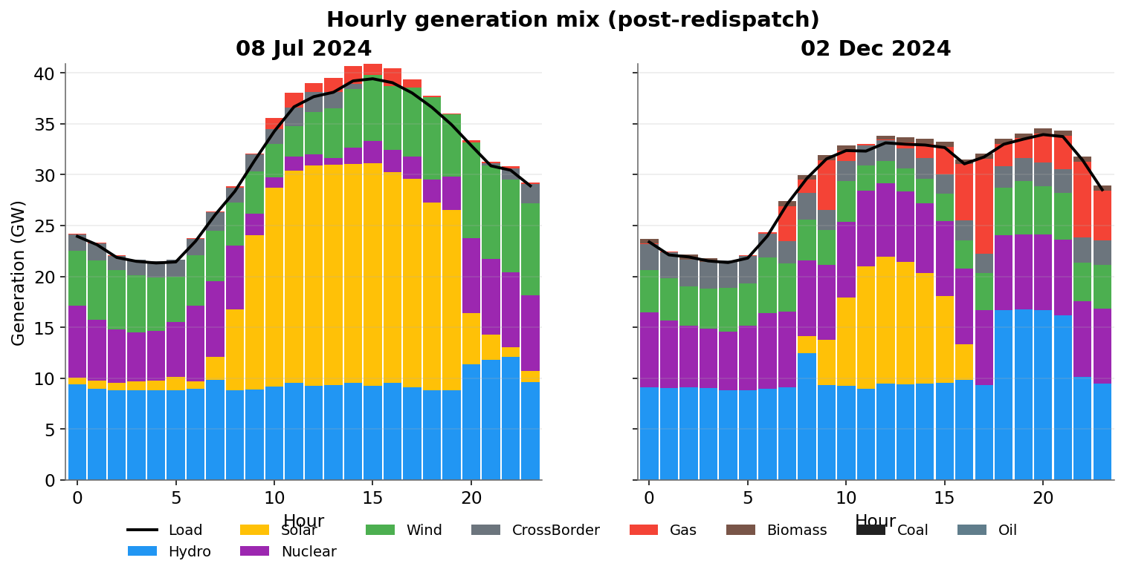
RESULTS · PROFILES
Hourly generation mix — both days
Key takeaways
• Summer (left): a strong midday solar bulge displaces gas and even backs nuclear down at the peak.
• Winter (right): no solar shoulder — hydro and gas shape the evening ramp, lifting system cost.
• Demand is met in every hour of both days with the real fleet (post-redispatch).
Spanish Power System · Market-Chain + AC OPF
19

Slide 21
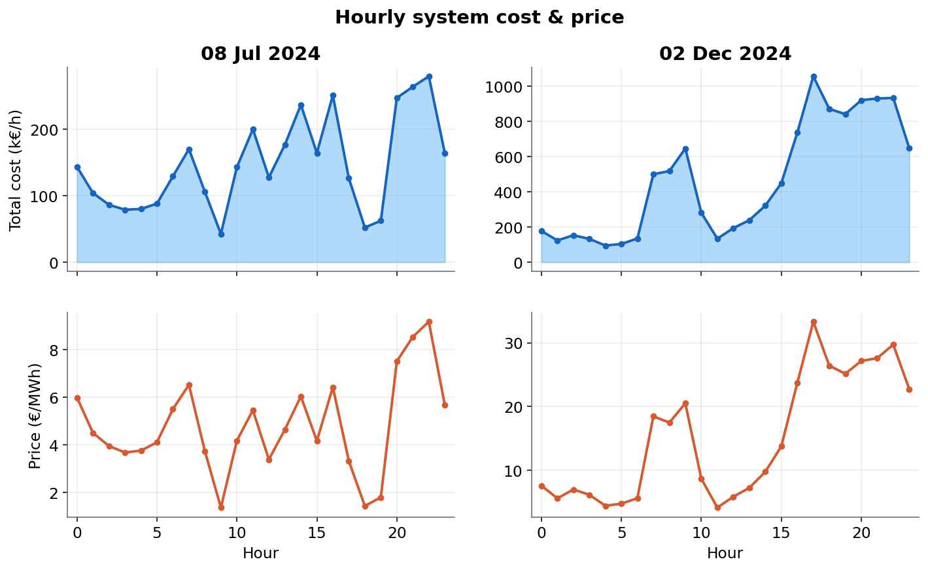
RESULTS · ECONOMICS
Hourly system cost & price
Key takeaways
• System price tracks the marginal technology: low when solar/hydro clear, high in thermal-heavy hours.
• The winter day is markedly more expensive (≈464 k€/h vs ≈147 k€/h average) — more gas at the margin.
• Price peaks align with the morning and evening demand ramps.
Spanish Power System · Market-Chain + AC OPF
20

Slide 22
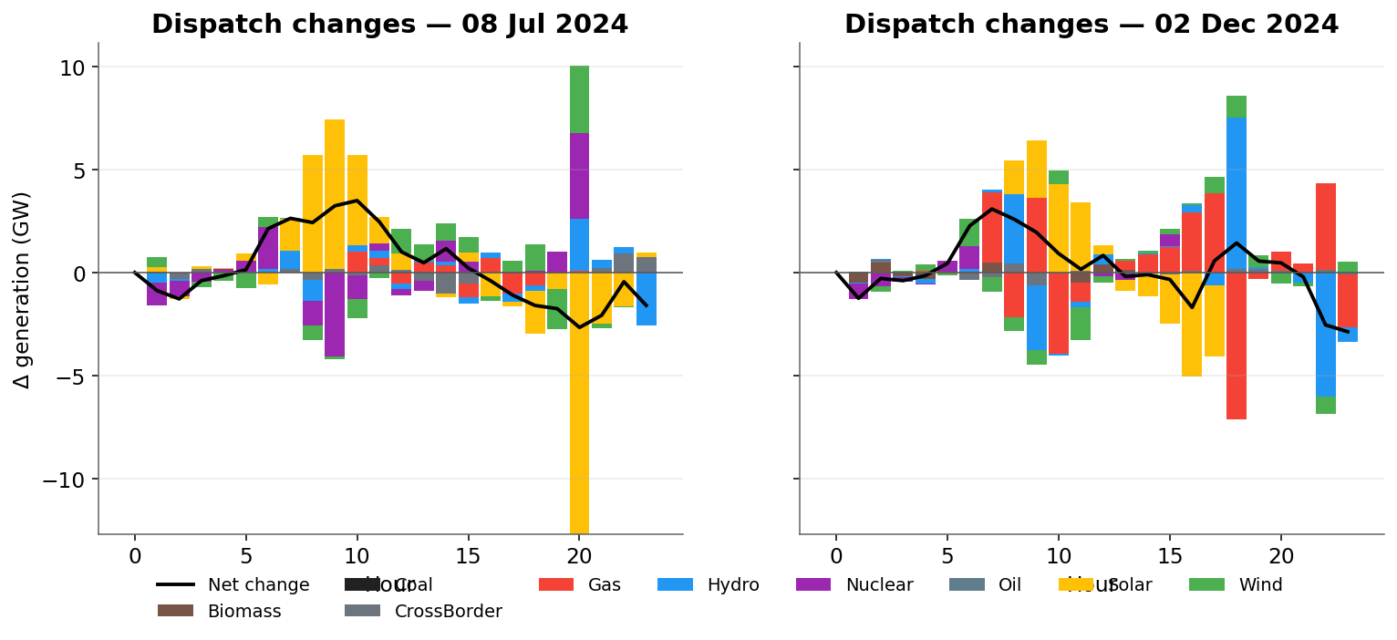
RESULTS · FLEXIBILITY
Hour-to-hour dispatch changes
Key takeaways
• Bars show each technology's hour-on-hour change; the line is the net load change.
• Hydro and gas provide the bulk of the ramping flexibility, mirroring the demand curve.
• Solar swings drive the largest mid-day movements on the summer day.
Spanish Power System · Market-Chain + AC OPF
21

Slide 23
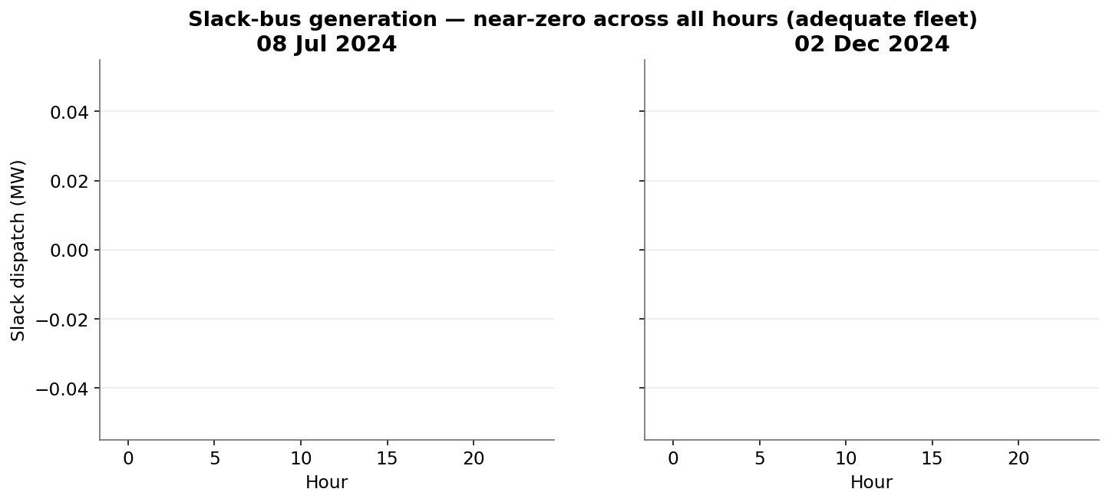
RESULTS · ADEQUACY
Slack-bus generation — capacity adequacy
Key takeaways
• The slack unit (priced at 1,000× base) only runs if the real fleet cannot meet demand.
• Dispatch stays negligible across all 48 hours — no genuine capacity shortfall.
• Confirms the modelled fleet plus imports is adequate for both days.
Spanish Power System · Market-Chain + AC OPF
22

Slide 24
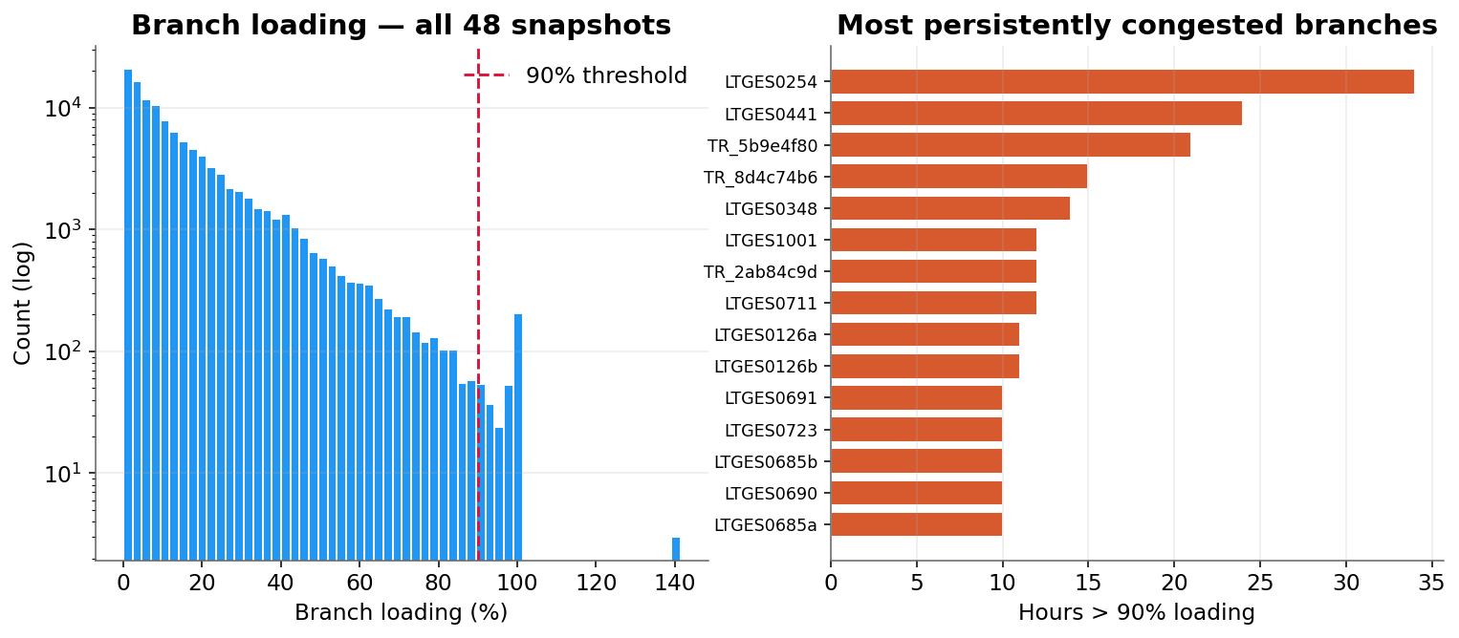
RESULTS · NETWORK
Branch loading & congestion
Key takeaways
• Across 48 hours and 2,345 branches, mean loading is only ≈14% — the grid is lightly loaded on average.
• Just ≈0.3% of branch-hours exceed 90% loading; congestion is rare and localised.
• A handful of branches are persistently the binding constraints that the redispatch works around.
Spanish Power System · Market-Chain + AC OPF
23

Slide 25
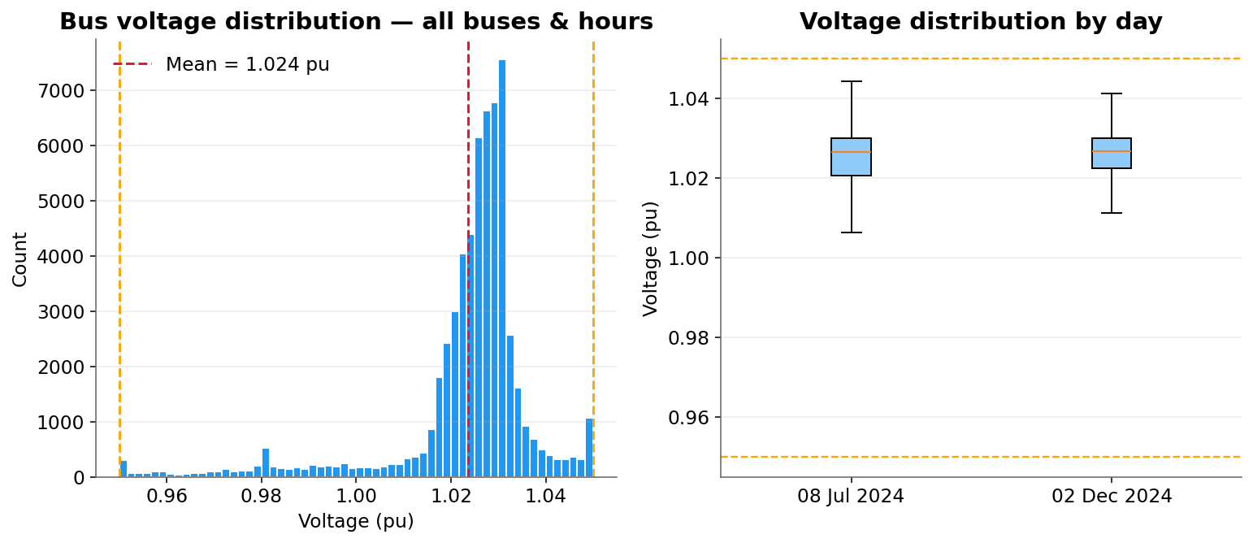
RESULTS · NETWORK
Bus voltage profile
Key takeaways
• Every bus in every hour stays inside the 0.95–1.05 pu band — no violations.
• Mean voltage ≈1.024 pu: the AC OPF holds a healthy, slightly-high profile.
• Reactor switching and reactive procurement keep EHV charging in check.
Spanish Power System · Market-Chain + AC OPF
24

Slide 26
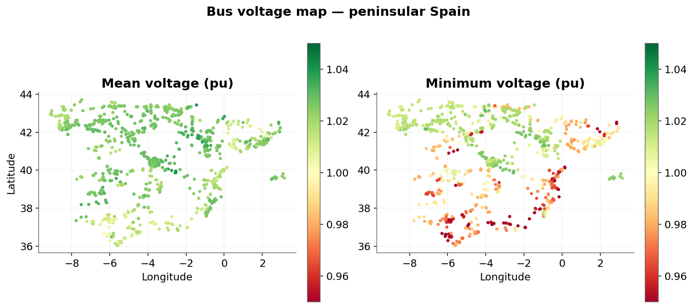
RESULTS · NETWORK
Voltage map — mean & worst-case
Key takeaways
• Left: mean voltage per bus; right: worst-case minimum across all solved hours.
• Voltages stay comfortably within limits across the whole peninsula.
• No regional pocket drops below 0.95 pu even in the worst hour.
Spanish Power System · Market-Chain + AC OPF
25

Slide 27
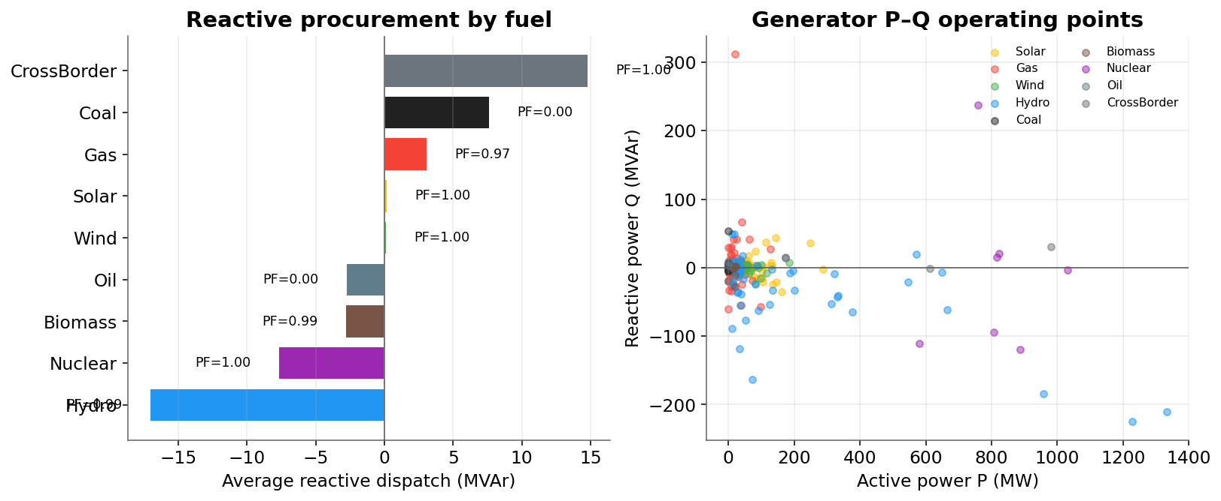
RESULTS · REACTIVE
Reactive power procurement
Key takeaways
• Synchronous hydro and gas units supply most of the reactive support, within their P–Q capability circles.
• Inverter-based wind and solar contribute bounded reactive tied to their actual output.
• Per-fuel power factors stay realistic — no unit is pushed to an implausible operating point.
Spanish Power System · Market-Chain + AC OPF
26

Slide 28
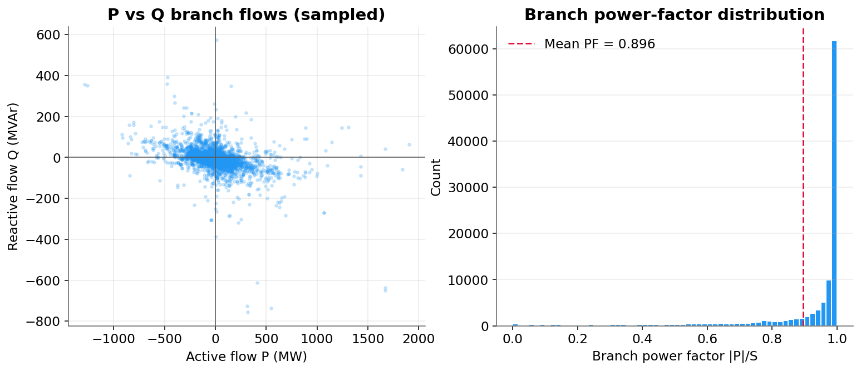
RESULTS · REACTIVE
Reactive branch flows
Key takeaways
• Most branches carry predominantly active power (high power factor) — the intended design point.
• Reactive flows concentrate where line charging and reactor compensation interact.
• The π-model line charging and shunt reactors net out to a stable reactive balance.
Spanish Power System · Market-Chain + AC OPF
27

Slide 29
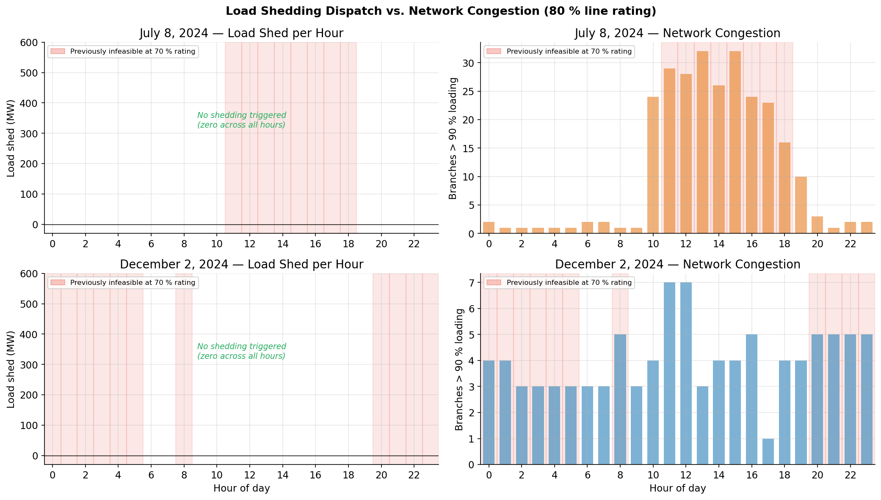
RESULTS · ADEQUACY
Feasibility & load shedding
Key takeaways
• A load-shedding unit (Value of Lost Load = 10,000 €/MWh) sits at every load bus as a safety valve.
• Zero load shedding was dispatched across all 48 hours.
• Raising the line-rating factor from 70% to 80% was enough to make every hour AC-feasible.
Spanish Power System · Market-Chain + AC OPF
28

Slide 30
SUMMARY
Results at a glance
48 / 48
0 MW
100%
hours solved to AC optimality
load shed — fully adequate
bus-hours within 0.95–1.05 pu
~14%
~0.3%
~1.9 GW
mean branch loading
branch-hours congested (>90%)
average net cross-border imports
• The market chain produces a realistic merit-order dispatch; the AC redispatch makes it physically feasible with minimal intervention.
• Summer is renewable-rich and cheap; winter leans on gas and costs roughly three times as much per hour.
• Network mismatch in the summary equals AC losses (≈0.2–1.4 GW, ≤4% of load) — not an imbalance.
Spanish Power System · Market-Chain + AC OPF
29

Slide 31
SUMMARY
A market-faithful, network-feasible simulation
• Day-ahead → intraday gates → balancing → AC OPF redispatch reproduces the Spanish short-term market chain end-to-end.
• Two contrasting days on the full peninsular grid solve to AC optimality with no load shedding and no voltage violations.
• All figures reproducible from results_plots.ipynb over the results/ CSVs.

Slide 32
PART IV · NEXT STEP
Investment pathways to 2035 & 2040
Capacity-expansion results from OpenEMPIRE — GoRES scenario (1 of 4) — that the operational market-chain analysis will be run on as the next phase
Spanish Power System · Market-Chain + AC OPF
30

Slide 33
NEXT STEP · CONTEXT
From operating today's grid to planning tomorrow's
• What this is
– A capacity-expansion (investment) optimisation of the European system in OpenEMPIRE, with Spain spatially disaggregated to the same nodal detail used in the operational model.
– It schedules generation and transmission build-out across three investment periods: 2025–2030, 2030–2035 and 2035–2040.
• The GoRES scenario
– These figures are one scenario — GoRES — of four that will be studied; each encodes a different trajectory for demand, technology cost and policy.
• Why it matters here
– The investment model decides what fleet exists in 2035 and 2040; the operational AC OPF market-chain then tests whether that future fleet can actually be dispatched on the network.
– Next phase: feed each scenario's 2035 & 2040 portfolio into the day-ahead → intraday → redispatch chain shown earlier.
The two-model workflow
OpenEMPIRE
Investment / capacity expansion (2030 · 2035 · 2040)
Future fleet
Per-node generation & transmission portfolio
Market chain
DA → ID2 → ID3 → CID → BAL
AC OPF redispatch
Network-feasible operation of the future grid
Spanish Power System · Market-Chain + AC OPF
31

Slide 34
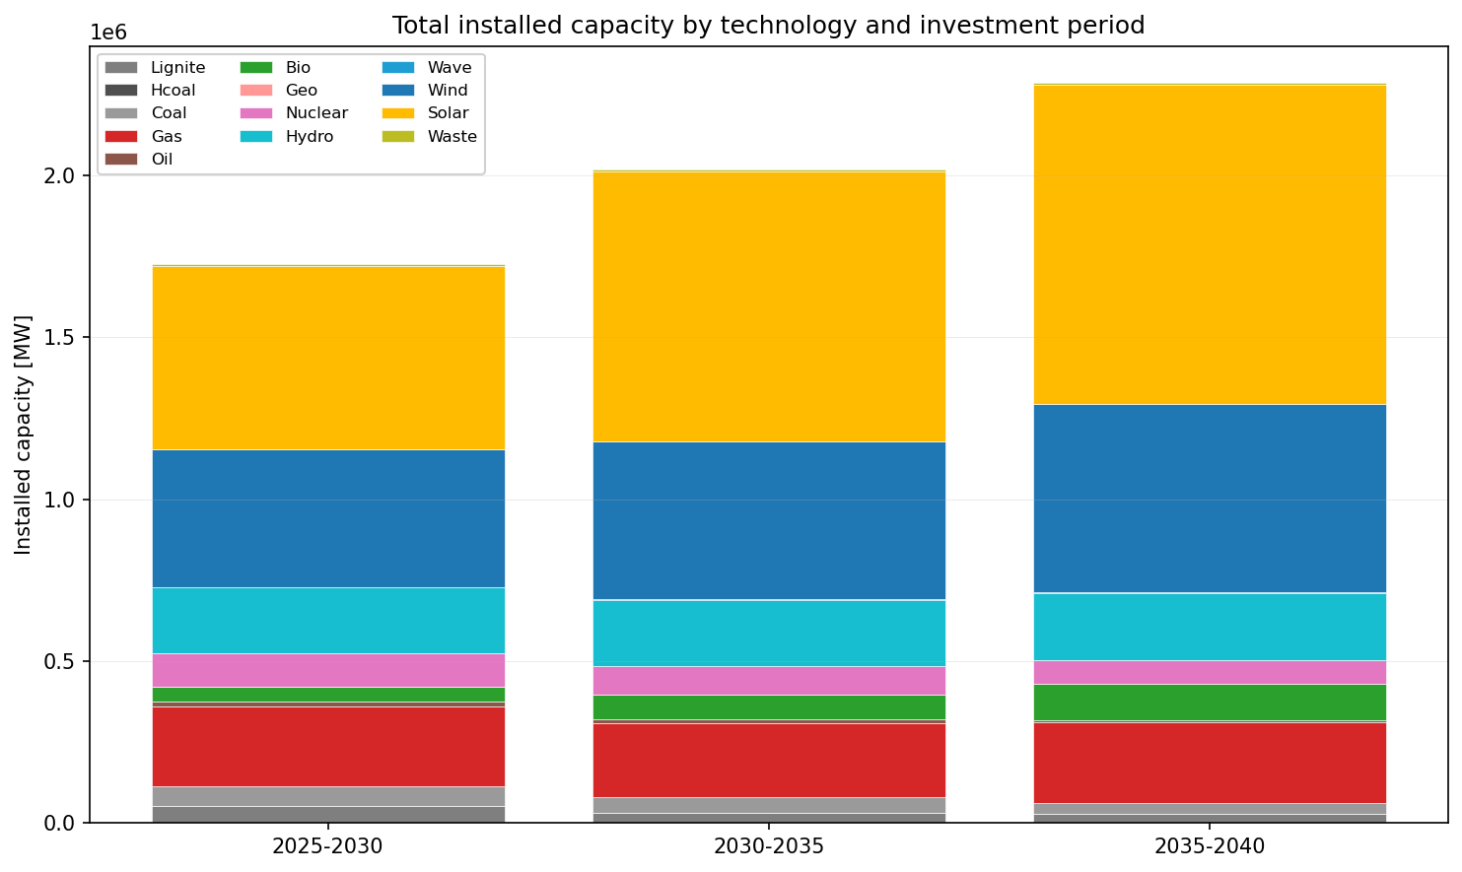
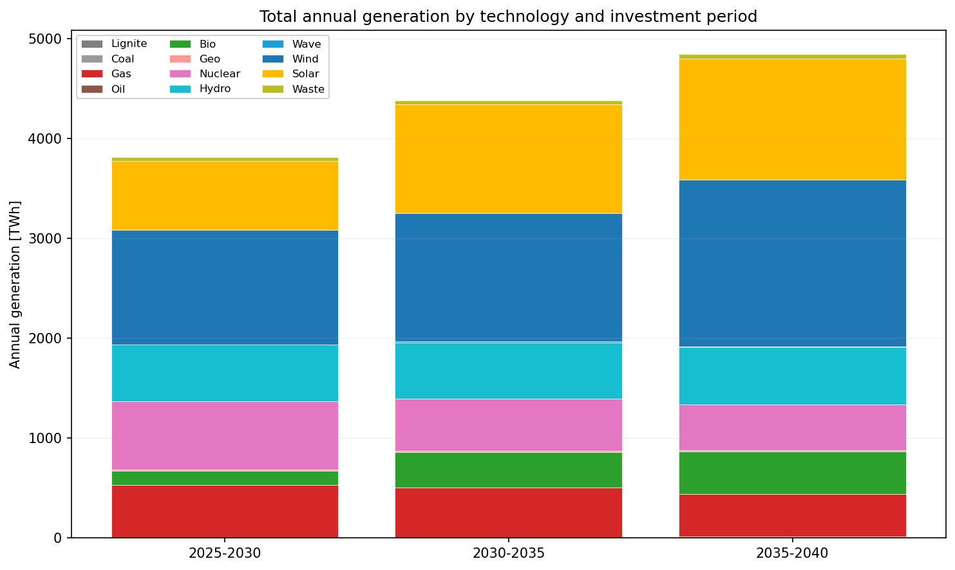
INVESTMENT · GORES
System pathway — capacity & generation to 2040
Installed capacity by technology & period [MW]
Annual generation by technology & period [TWh]
GoRES builds out a strongly renewable system: solar and wind dominate added capacity and energy through 2040, while thermal capacity stays flat-to-declining.
Spanish Power System · Market-Chain + AC OPF
32

Slide 35
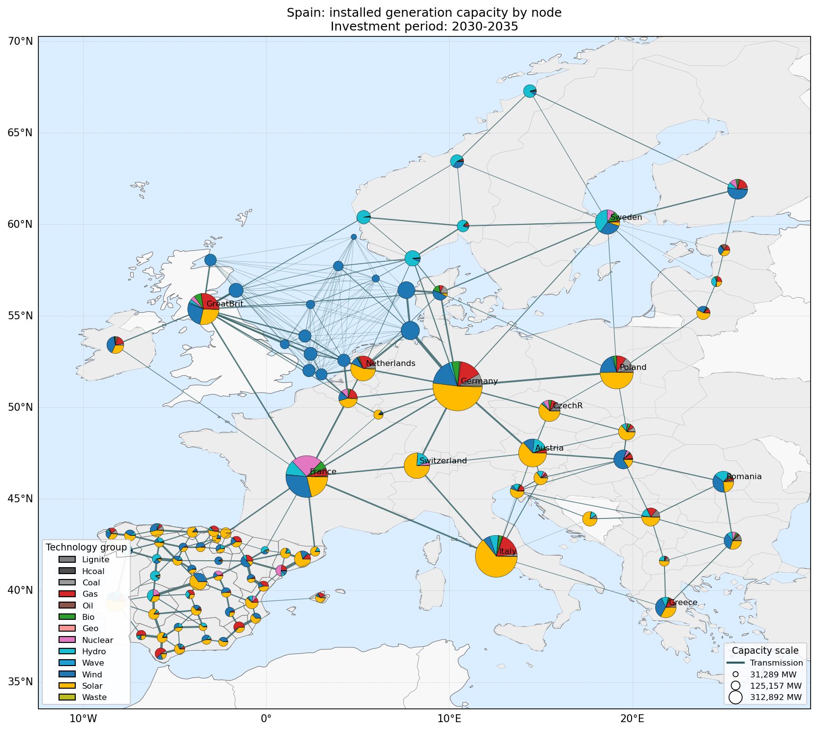
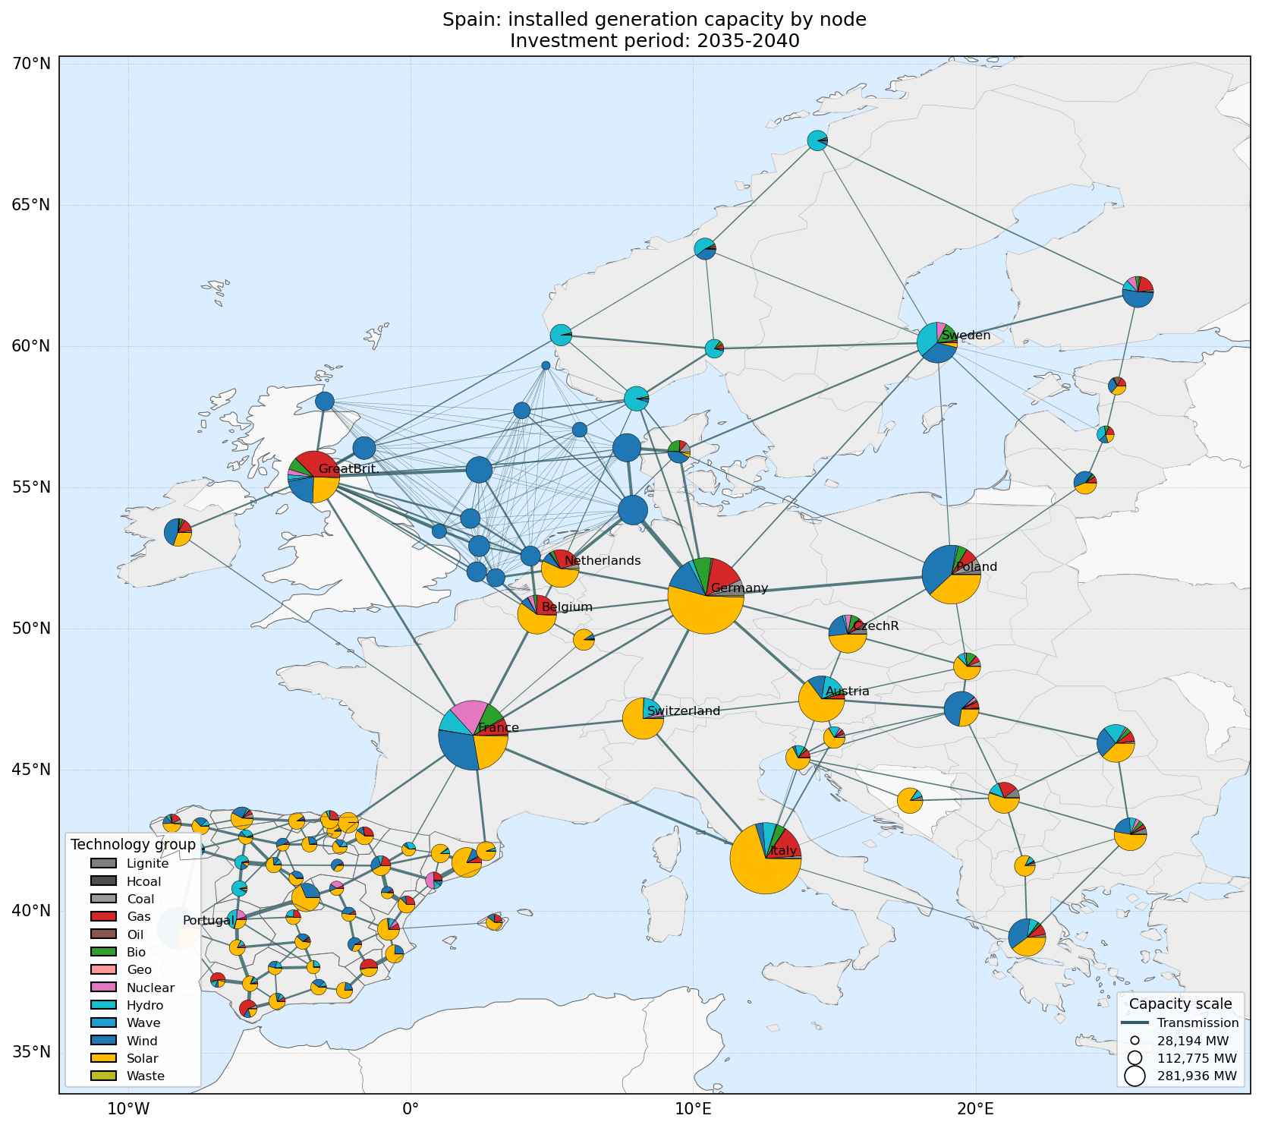
INVESTMENT · SPATIAL
Where capacity is built — nodal portfolios
Installed capacity by node — 2030–2035
Installed capacity by node — 2035–2040
Spain is resolved to full nodal detail (rest of Europe aggregated). Pie size = installed MW, colour = technology; lines are transmission capacity between nodes.
Spanish Power System · Market-Chain + AC OPF
33

Slide 36
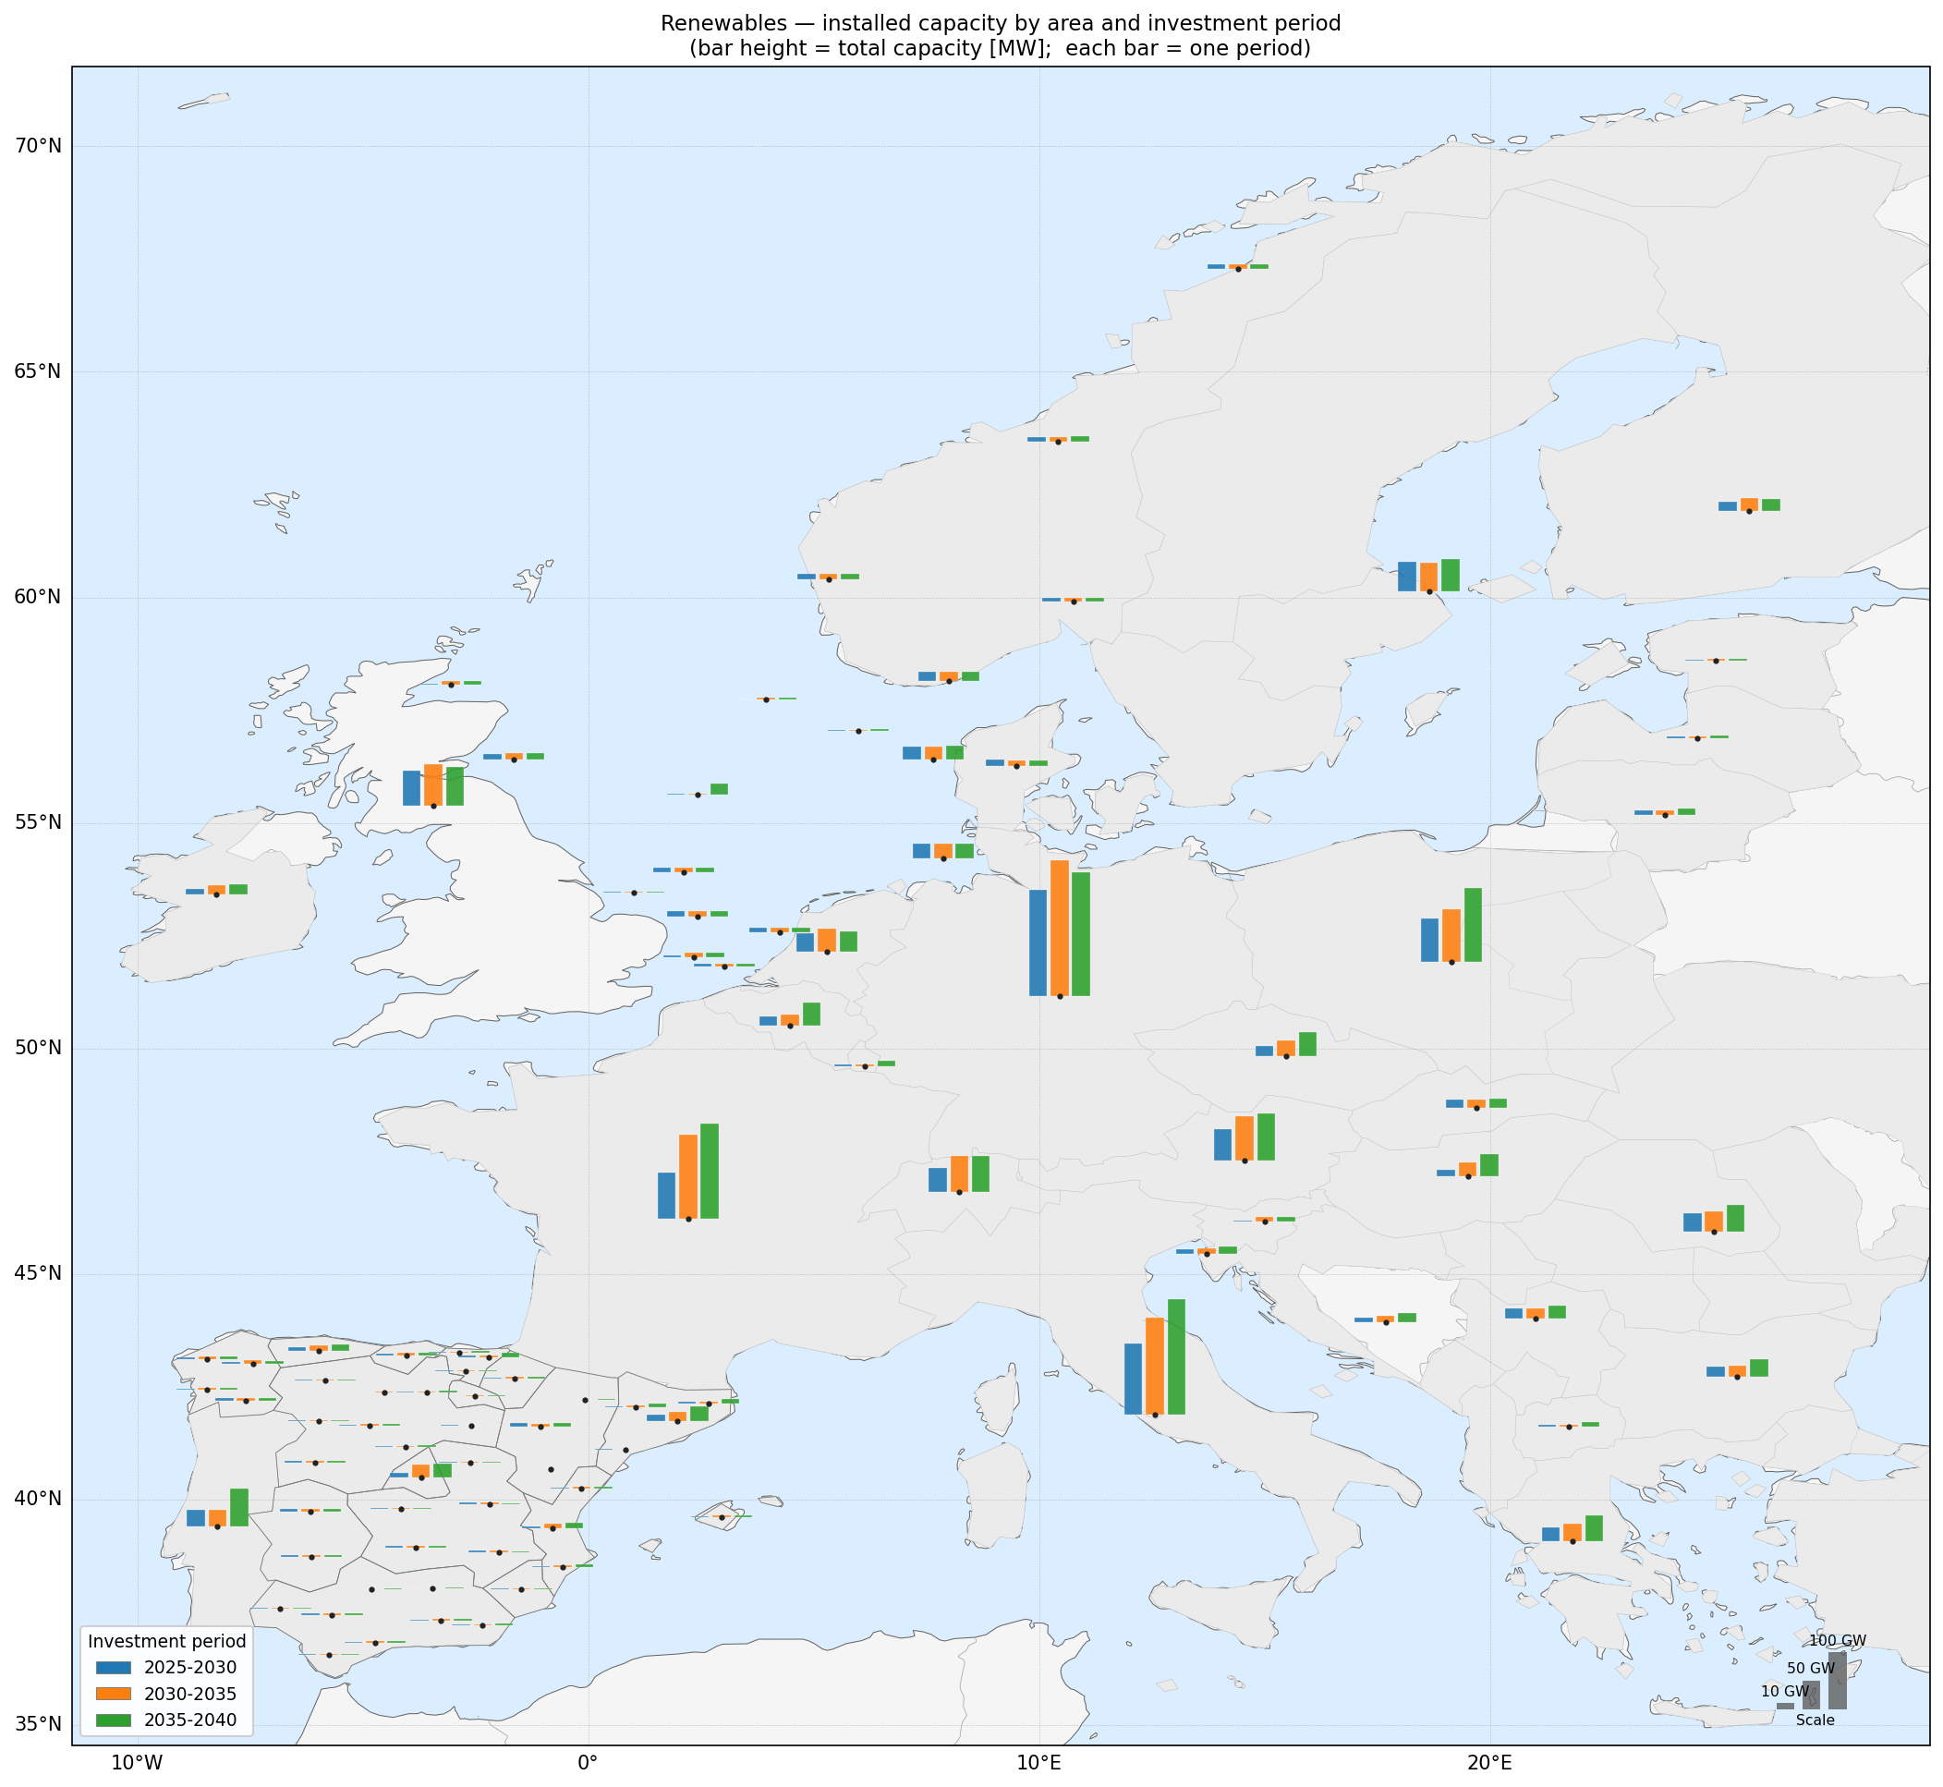
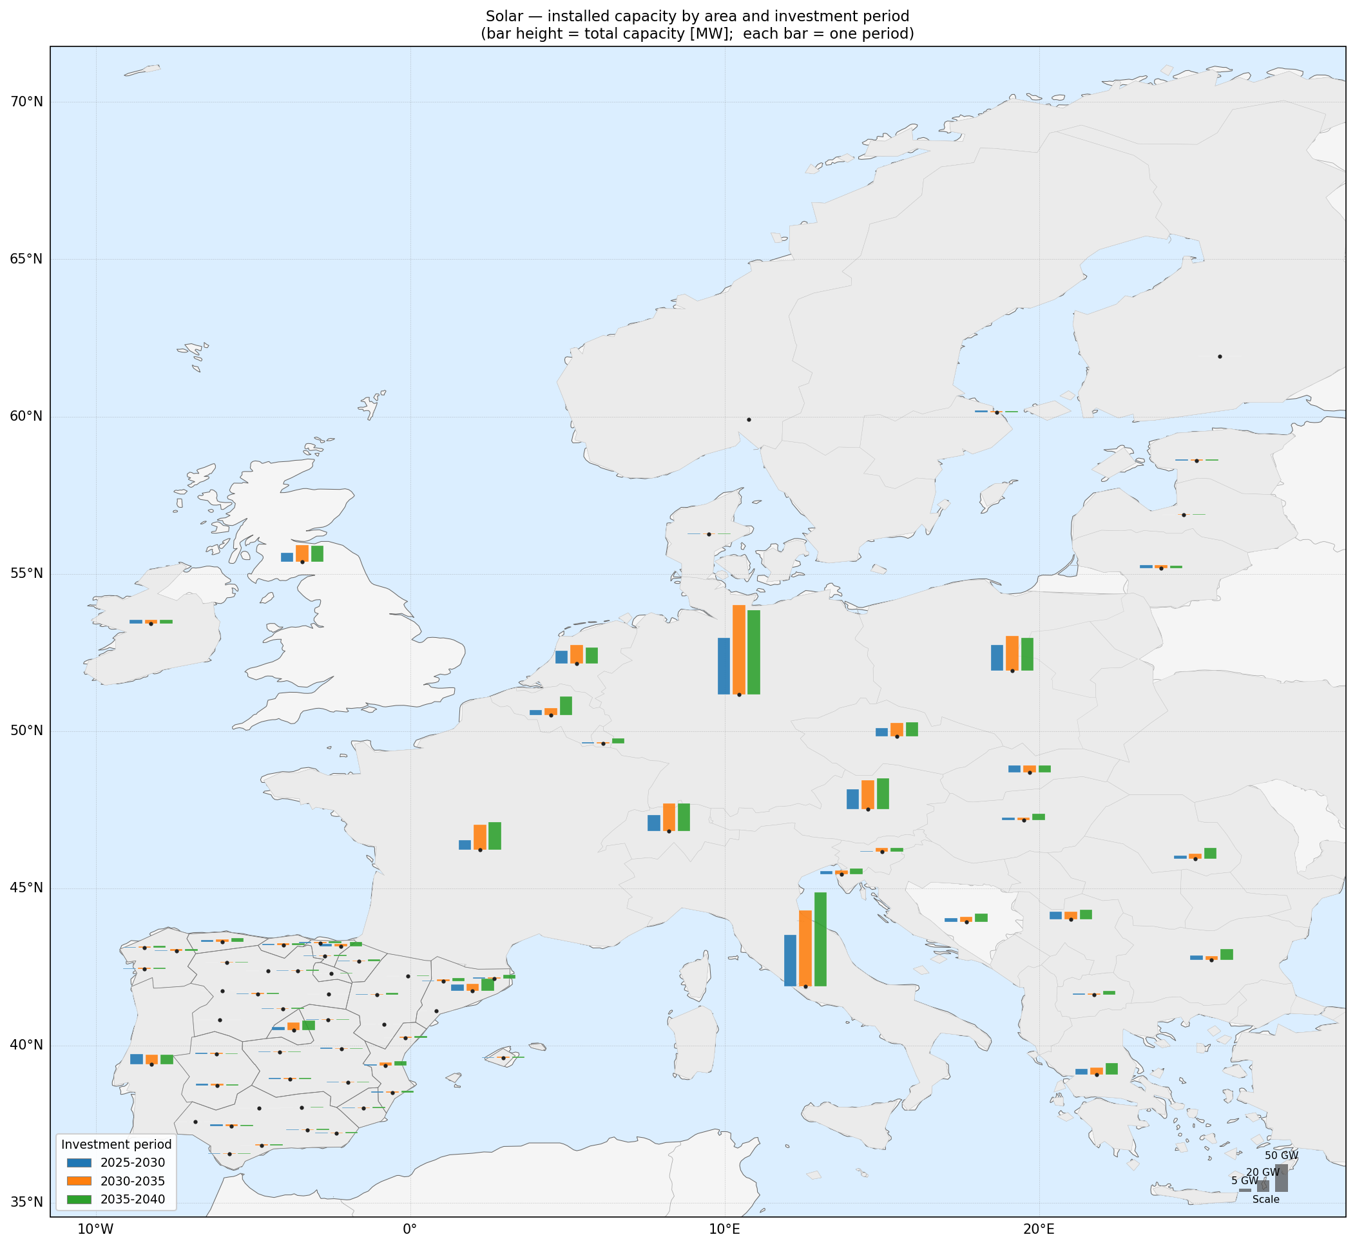
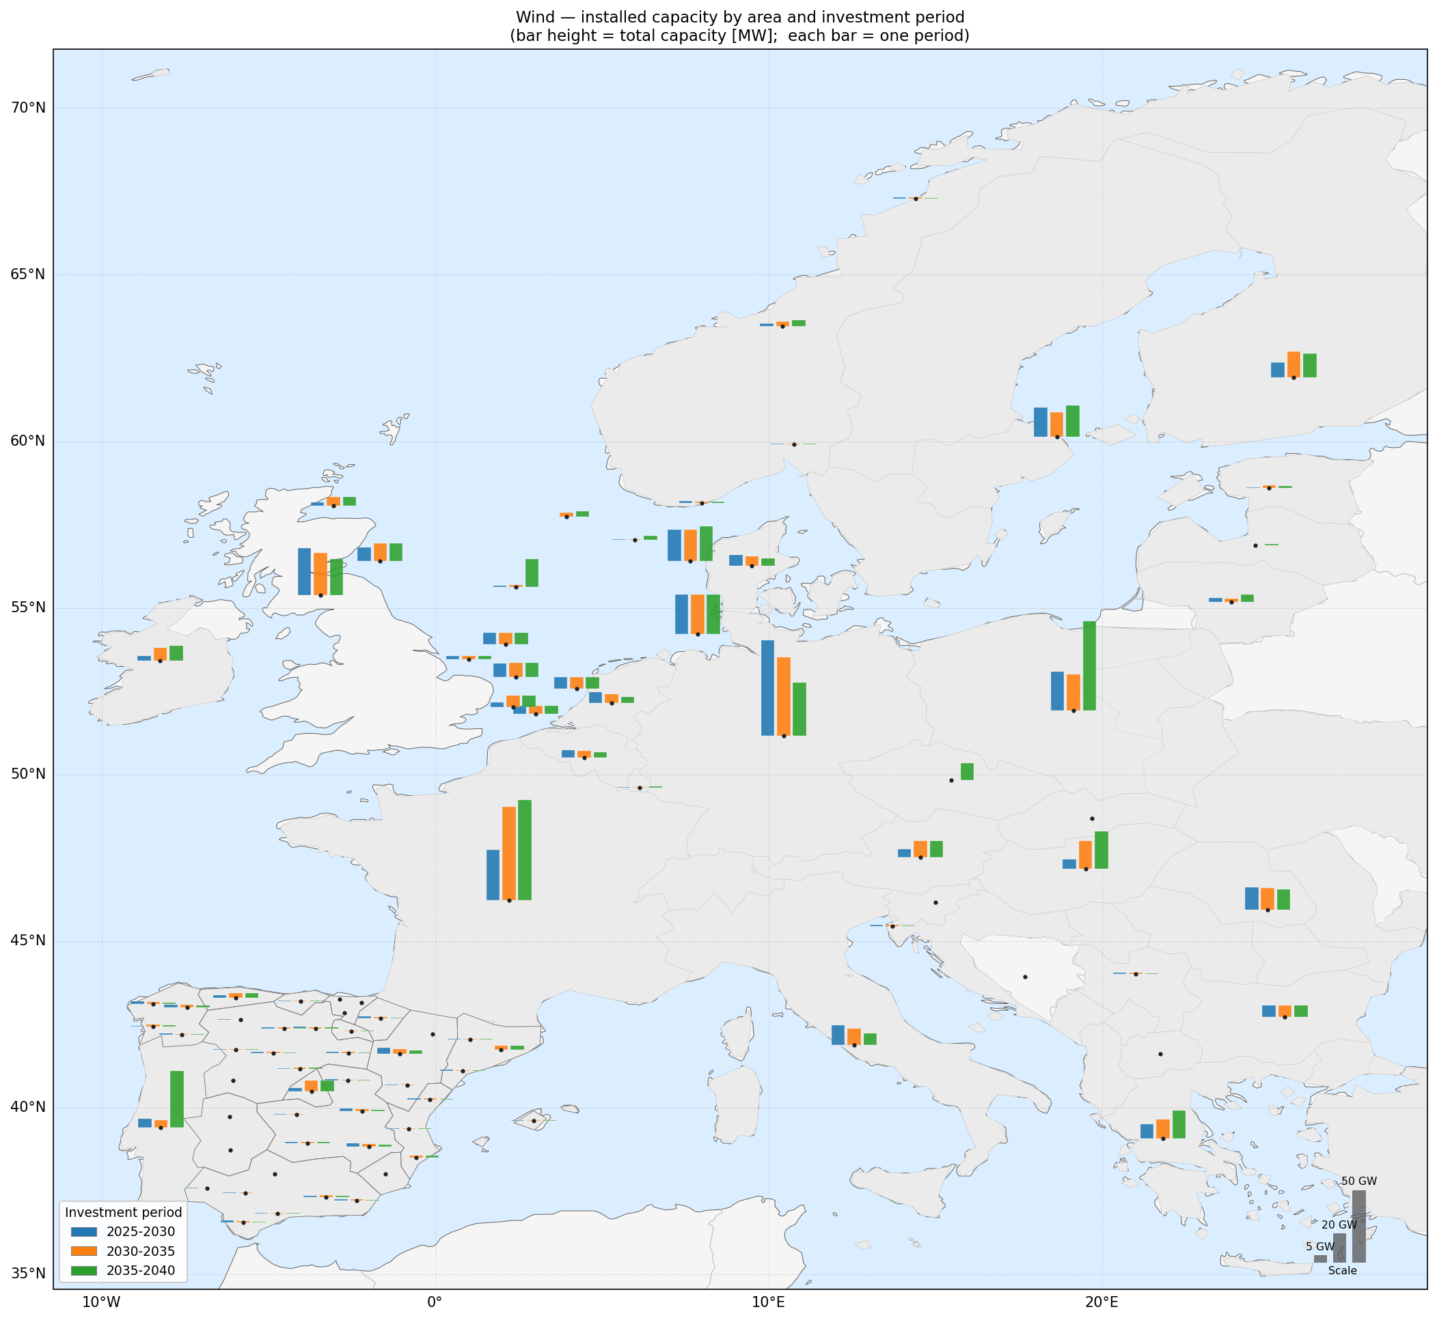
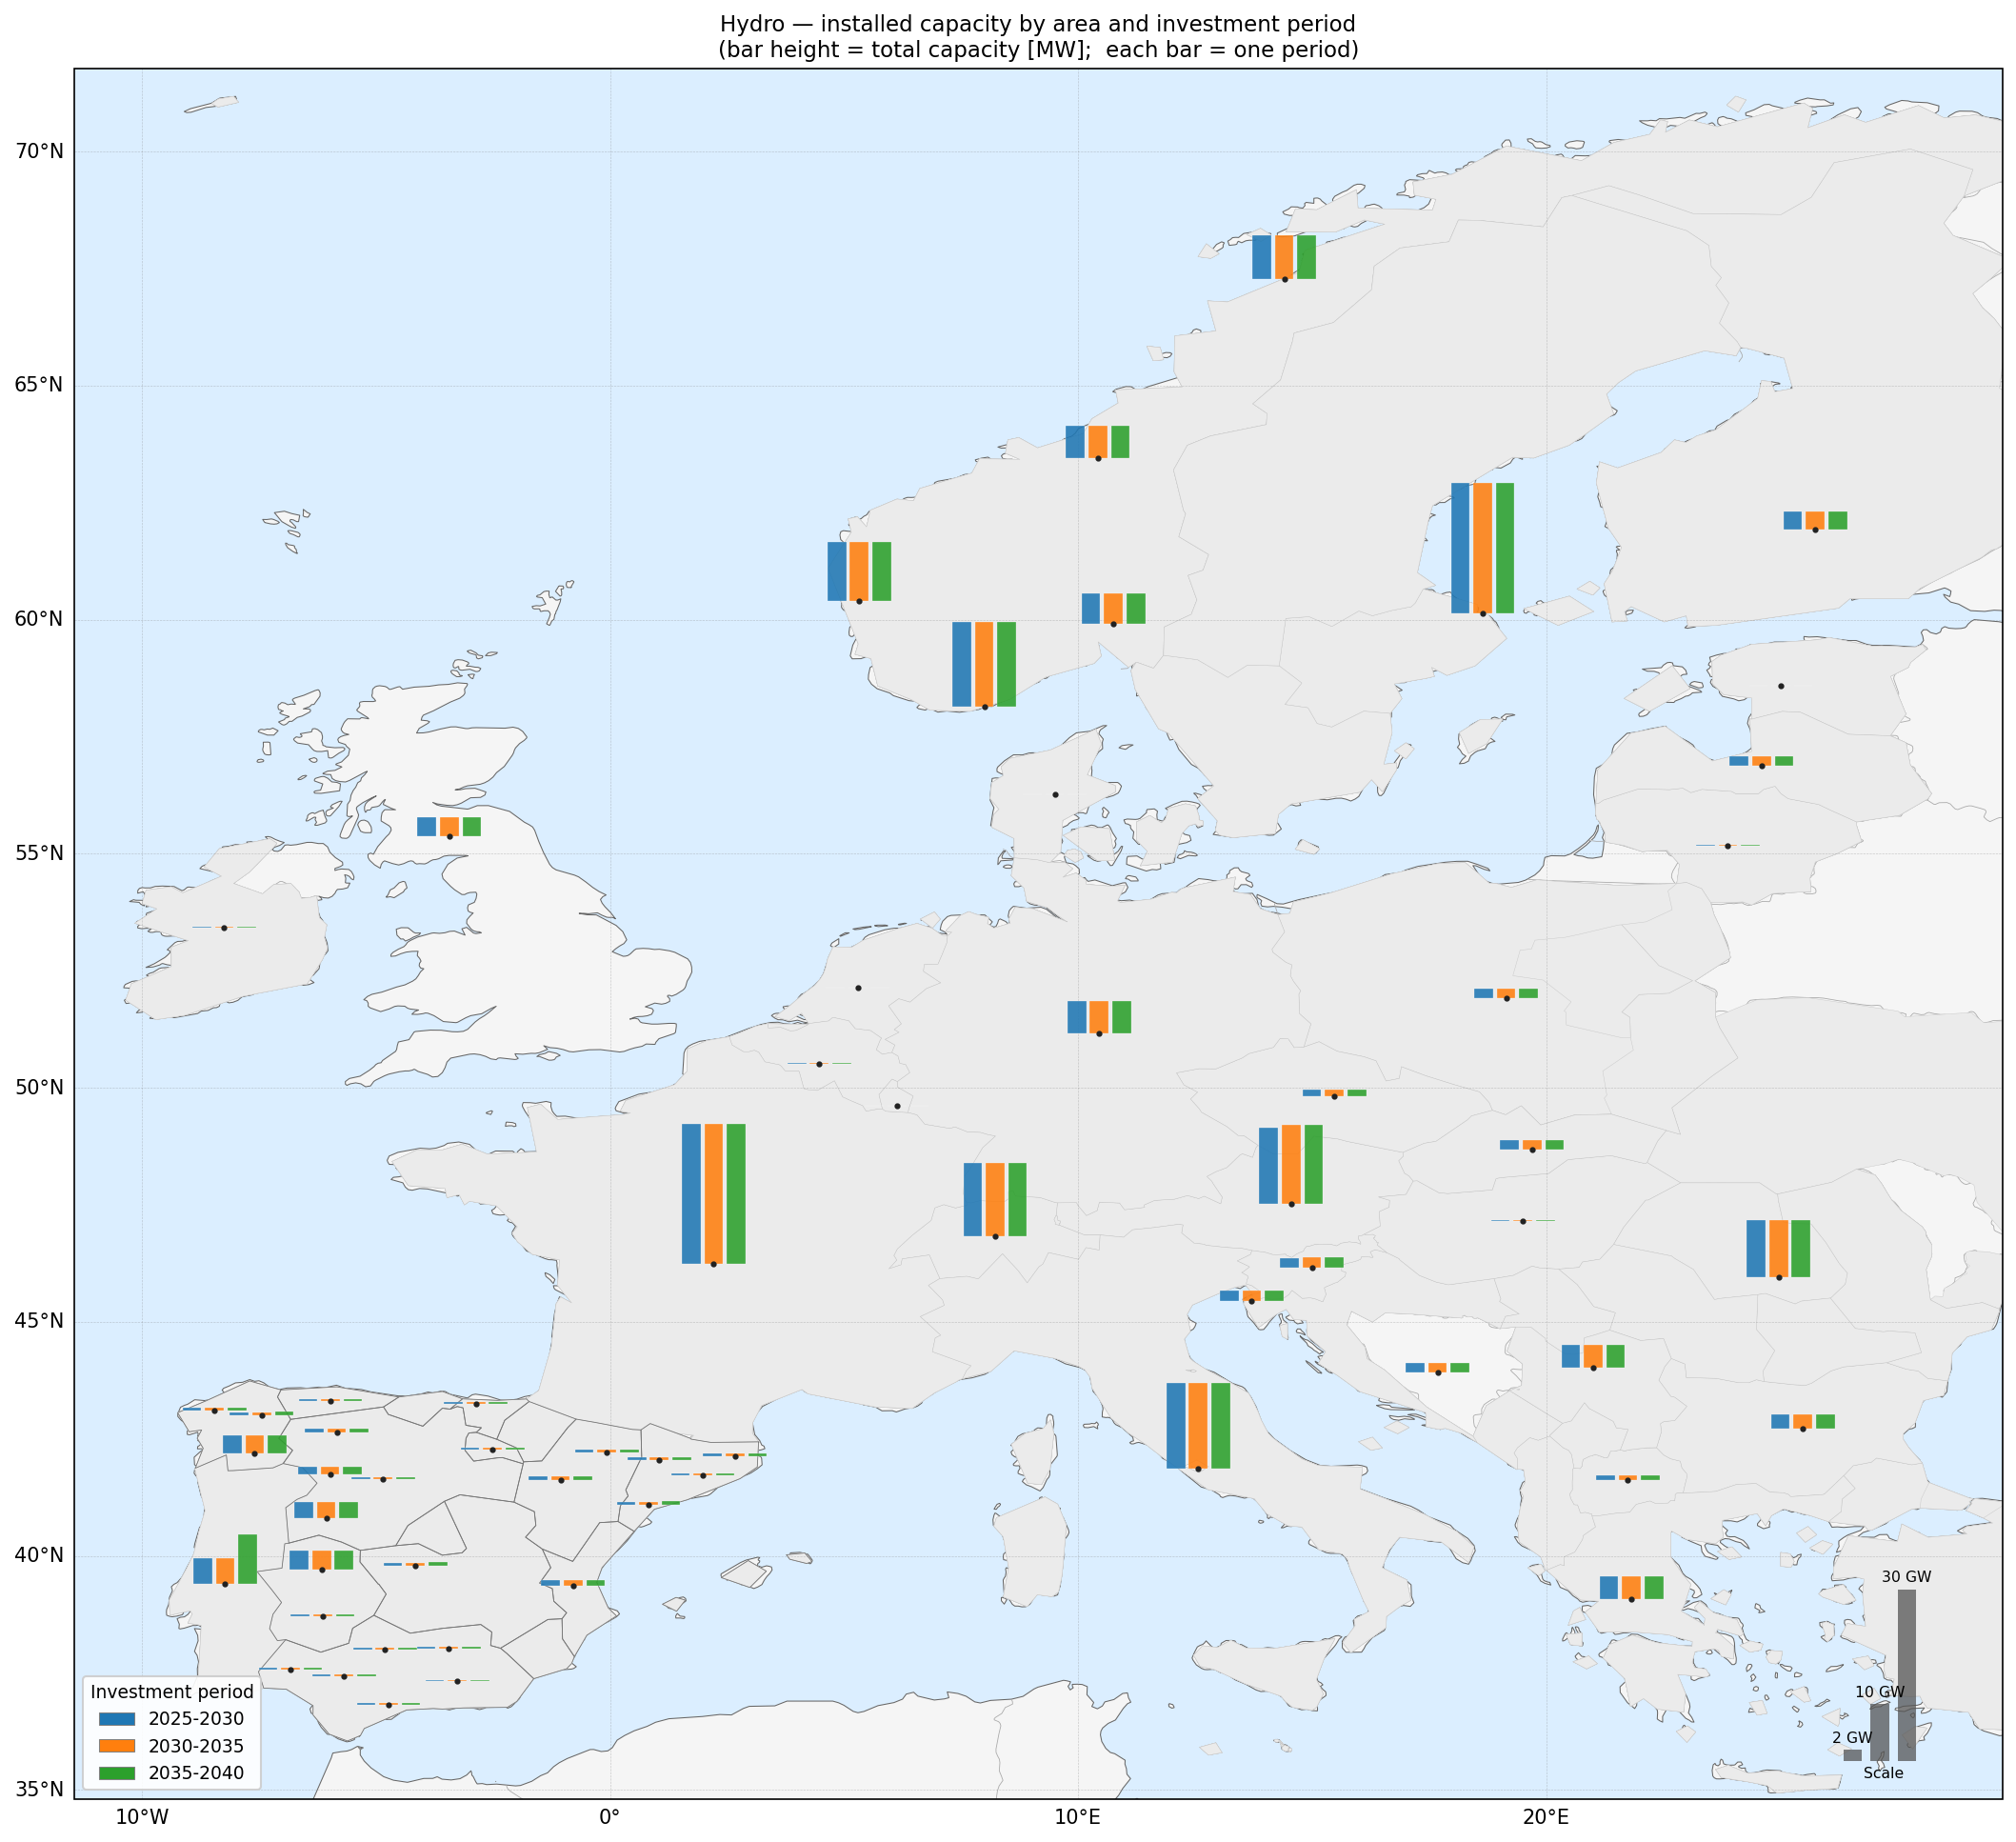
INVESTMENT · CAPACITY
Renewable build-out by node and period
All renewables
Solar
Wind
Hydro
Per-node installed capacity; the three bars per node are the 2025–30, 2030–35 and 2035–40 periods.
Spanish Power System · Market-Chain + AC OPF
34

Slide 37
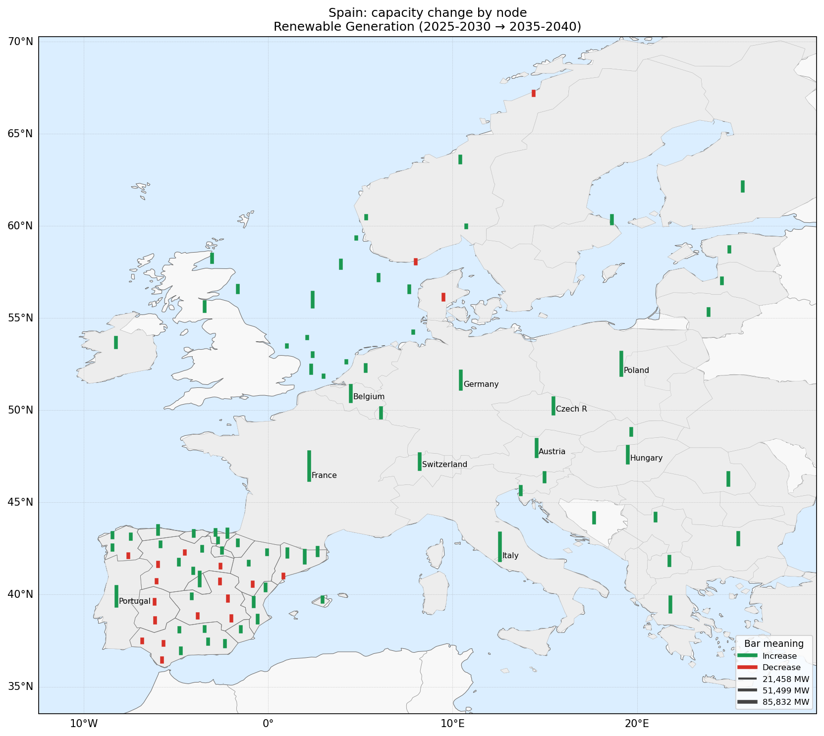
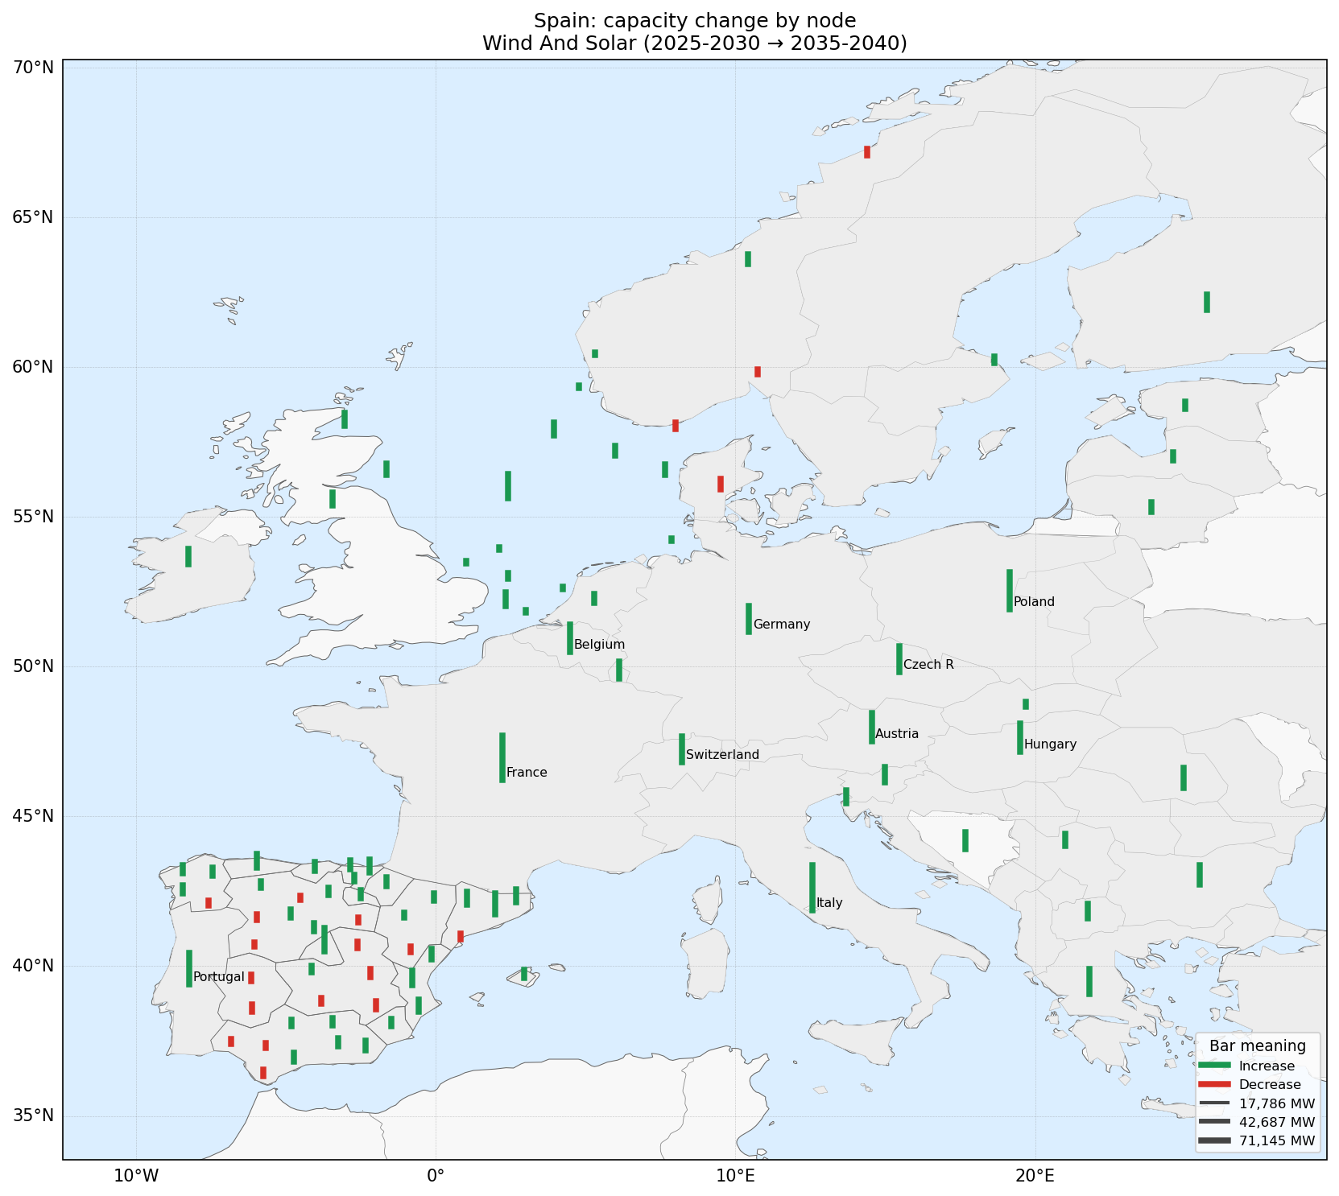
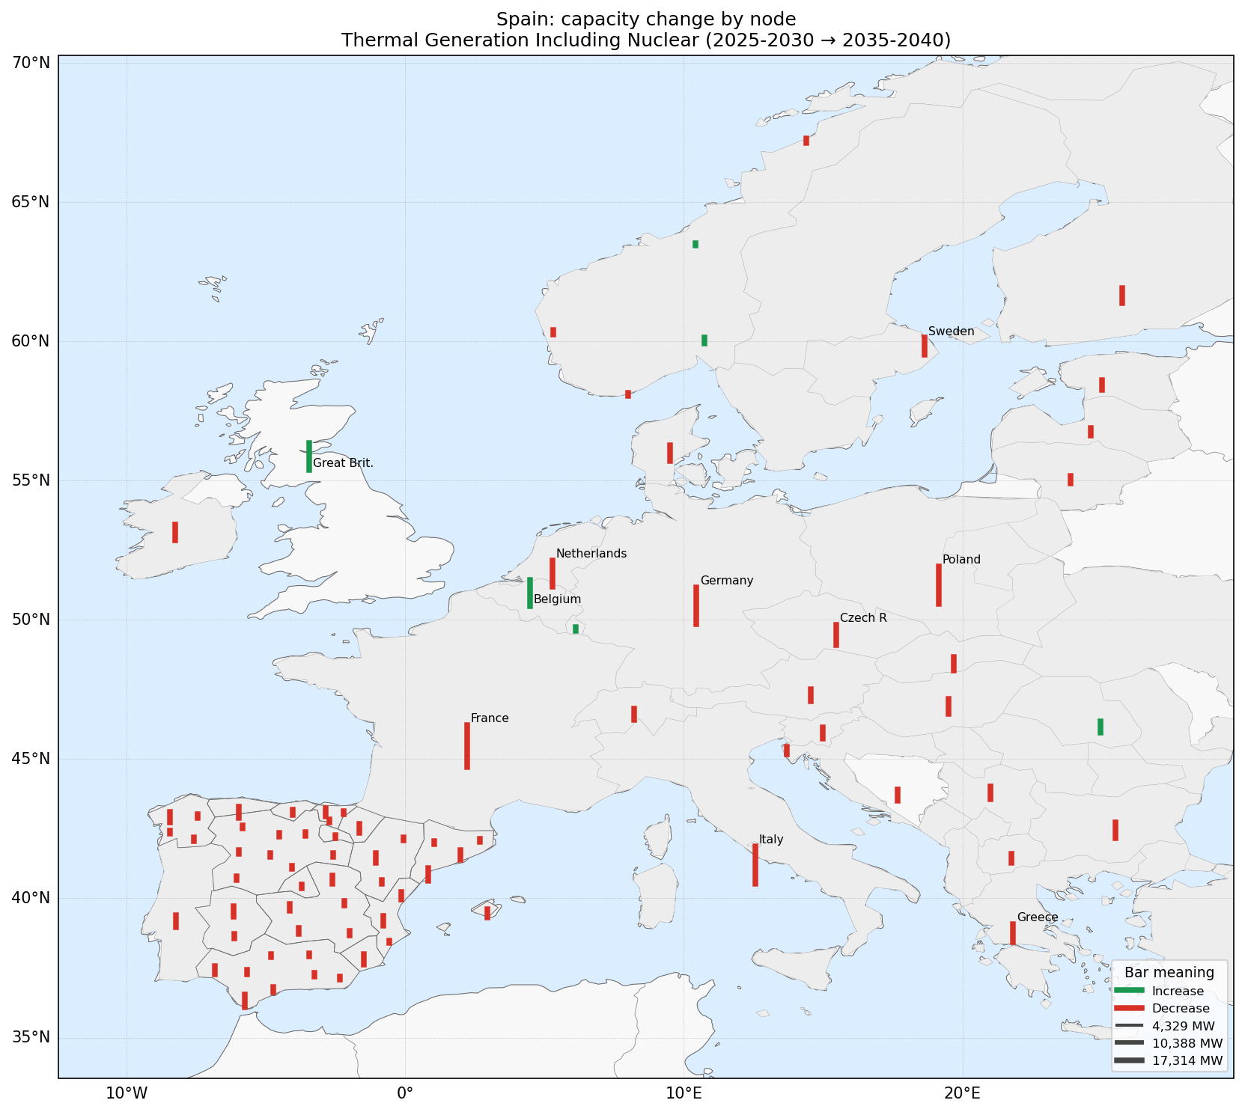
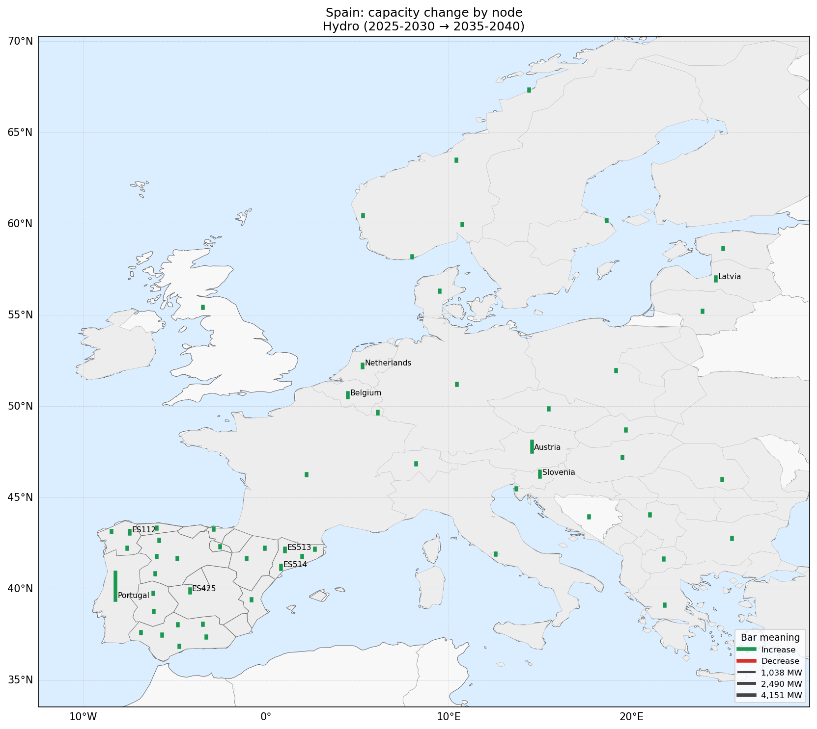
INVESTMENT · CHANGE
Net capacity change by node, 2025–30 → 2035–40
Renewable generation
Wind & solar
Thermal (incl. nuclear)
Hydro
Green = capacity increase, red = decrease per node. Renewables grow across Spain while thermal is retired.
Spanish Power System · Market-Chain + AC OPF
35

Slide 38
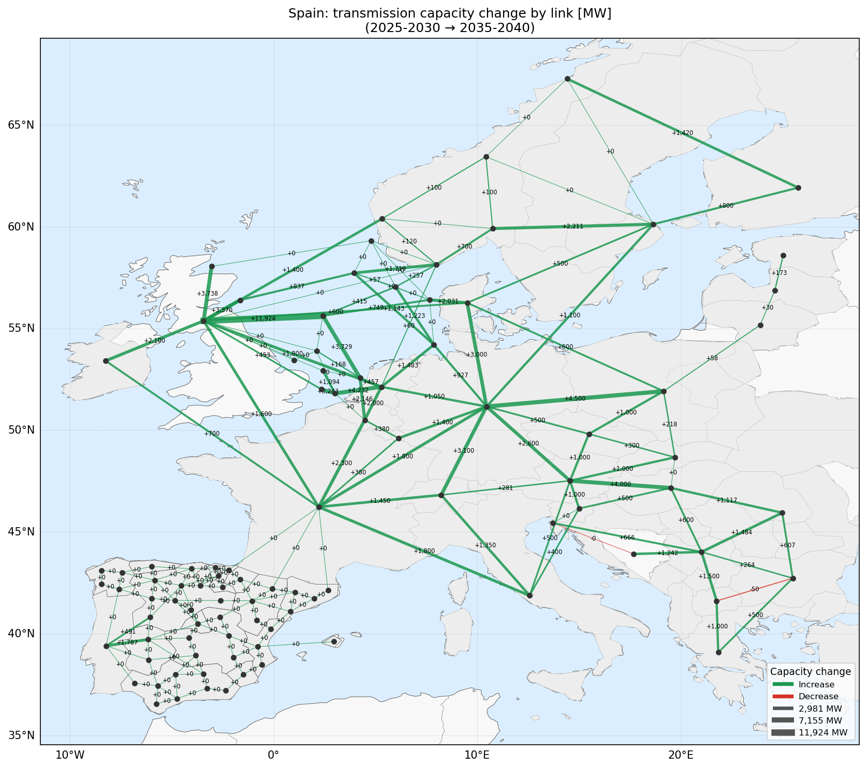
INVESTMENT · NETWORK
Transmission reinforcement
Key takeaways
• Capacity change per transmission link between 2025–30 and 2035–40.
• Green = reinforcement (increase); link thickness scales with the added MW.
• Strong cross-border and internal-Spain reinforcement underpins the renewable build-out.
• These line ratings become the network limits the operational AC OPF must respect.
Spanish Power System · Market-Chain + AC OPF
36

Slide 39
OUTLOOK
Coupling investment and operation
• OpenEMPIRE sets the 2035 & 2040 generation and transmission portfolios for the GoRES scenario.
• Next: run the day-ahead → intraday → AC OPF redispatch chain on those future fleets to test network feasibility, congestion, reactive adequacy and prices.
• Repeat across all four scenarios to compare how robustly each investment pathway can actually be operated on the Spanish grid.
Investment figures: OpenEMPIRE — dataset_ES_GoRES
Spanish Power System · Market-Chain + AC OPF
37

