Slide 1

FluidDB
Terry Jones
terry@jon.es
@terrycojones

Slide 2

Fluidinfo
Founded in the UK in March 2006
Two full-time employees
Development in Barcelona
Friends, family, & Esther Dyson funded

Slide 3
Proposal
FluidDB is a hosted database we (Fluidinfo) will launch - by hook or by crook - into Alpha shortly before EuroPython 2009

Slide 4
Agenda
51% me: Motivations, high-level view of FluidDB
49% you: Questions, details, API, architecture, etc.

Slide 5
Motivations
Contrasts in how we work with information
User interface and API difficulties / restrictions
Personalization
The computational world is not very writable!

Slide 6
Concepts
Are not owned.
No formal structure.
No permission is needed.
Partial or full disorganization.
No predefined set of qualities.
No special central piece of content.
Easy to reorganize or multiply organize.
To engineer this kind of flexibility,
we must rethink control

Slide 7

UIs and APIs
Where did my information go?Can I extract, re-use, add, delete?Is there an API?
What am I allowed to do?Can I search? On what?Special pleadingWouldn't it be cool if...

Slide 8
Personalization
In our hands, not just on our behalf
Add anything to anything, and search on it
Protect, share, combine, delete as you wish
Organize things as you please

Slide 9
Read ⊳ Search ⊳ Write ?
The web is readable (c. 1990)
And searchable (c. 1995)
But not generally writable
Plus, search is not very interactive:
Dull: refine query or ask for more results
Can’t change results
Can’t organize

Slide 10
Why don’t our architectures
let us work with information
more flexibly?

Slide 11
What would it take
to build something that did?

Slide 12
How can we address
all these problems at once ?

Slide 13
But...
Keep it simple
Make it realizable

Slide 14
Alan Kay
At PARC we had a slogan: “Point of view is worth 80 IQ points.” It was based on a few things from the past like how smart you had to be in Roman times to multiply two numbers together; only geniuses did it.We haven’t gotten any smarter, we’ve just changed our representation system. We think better generally by inventing better representations; that’s something that we as computer scientists recognize as one of the main things that we try to do.

Slide 15
1
2
4
8
16
32
64
128
256
512
1024
1
10
100
1000
10000
100000
1000000
10000000
100000000
1000000000
10000000000
+
+
??????
11111111111

Slide 16
VIII XVII XLIVLXXX XCVICCLV
+
D

Slide 17
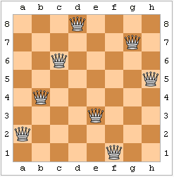
8 queens problem
Use a poor representation with 2⁶⁴ (281,474,976,710,656) states:Look for a smart algorithm!
Or...
Use a good representation with 8! (40,320) states
and exhaustive search as an algorithm!

Slide 18

A humble FluidDB object
digg.com/date
May 21, 2009
meg/web/rating
6
tim/seen
True
about
http://digg.com/news.html
mike/opinion
“half-baked nonsense”

Slide 19
A humble FluidDB object
digg.com/date
May 21, 2009
NO
meg/web/rating
6
tim/seen
true
OWNER!
about
http://digg.com/news.html
mike/opinion
“half-baked nonsense”

Slide 20
Consequences
Where to put related information / metadata?
How to get permission?
No need to anticipate
How to organize?
How to personalize?
Continue to own your data
Level playing field: no rules, & it’s OK to be late
Makes the world writable by default

Slide 21
What else?
Architecturally, no metadata/data duality
No a priori organization
Search, search, search!
Metadata engine for everyone / everything

Slide 22
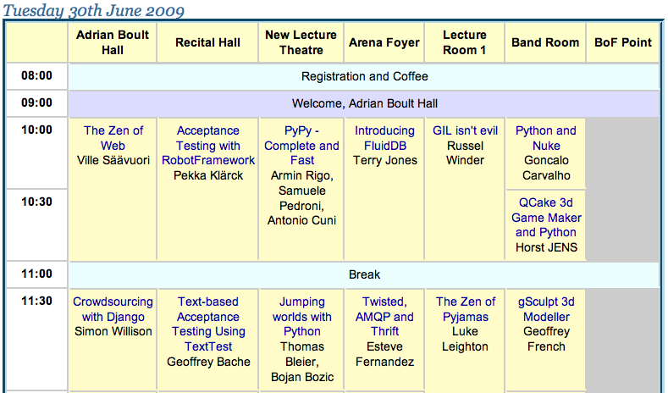
A handy object

Slide 23
In FluidDB
terry/rating
8
terry/will-attend
europython.eu/2009/time
11:30am
europython.eu/2009/date
June 29, 2009
europython.eu/2009/duration
30
europython.eu/2009/speaker
Esteve Fernández
europython.eu/2009/title
Twisted, AMQP and Thrift
europython.eu/2009/room
Arena Foyer
russell/will-attend

Slide 24
Double-click to edit
Can you add to this?
Why not?
Are you blogging/tweeting about it?

Slide 25
A folder
folder-manager/name-624CA19
chapter 1
jack/interesting
digg.com/date
russell/seen
amazon.com/price
meg/web/rating
james/stars
sam/wishlist
tim/seen
tim/own
folder-manager/tag-F5283AC21
about
about
mike/opinion
sally/read-it
folder-manager/tag-F5283AC21
folder-manager/tag-F5283AC21
folder-manager/name-624CA19
chapter 2
folder-manager/tag
folder-manager/tag-F5283AC21
folder-manager/name
folder-manager/name-624CA19

Slide 26
What’s FluidDB about?
Whatever you like

Slide 27
A voting box
russell/vote
pat/vote
tim/vote
james/vote
sally/vote
sofia/vote

Slide 28
Inter-process comms
producer/data/01
consumer1/seq
02
producer/data/02
producer/data/03
consumer2/seq
03

Slide 29
Social data
Data that increases in value when it’s co-located
All data is social, once we begin to interact with it

Slide 30
Info in context
Information is more useful in context:
  Google
  Wikipedia
FluidDB can do a similiar thing, but for DBs & apps
  Data is held in silos by apps
  Behind restrictive APIs

Slide 31
Web architecture

Slide 32
html
html
html
browser
html
html
w
e
b
html
browser
A
P
I
browser
browser
web
server
web
server
web
server
browser
browser
browser
g
o
o
g
l
e
html index
browser
A
P
I
browser
web
server
web
server
web
server
browser

Slide 33
FluidDB
Database of these simple objects
Enables sharing between applications, people
Single-instance, hosted (like SimpleDB)
Distributed storage and query processing

Slide 34
Sack the golden towns of Montezuma!
“My dear fellow,” Burlingame said caustically, “we sit on a blind rock careening through space; we are all of us rushing headlong to the grave. Think you the worms will care, when anon they make a meal of you, whether you spent your moment sighing wigless in your chamber, or sacked the golden towns of Montezuma? Lookee, the day’s nigh spent; ‘tis gone careening into time forever. Not a tale’s length since we lined our bowels with dinner, and already they growl for more. We are dying men Ebenezer: i’faith, there’s time for nought but bold resolves!”
John Barth The Sotweed Factor

Slide 35
Challenge
Engineer a system that can efficiently hold an effectively unlimited number of these objects
Let each object have an effectively unlimited number of tags
Design a query language, permissions, and API
Make simple and common things fast
Make it realizable

Slide 36
OK, your 49%
Questions
HTTP API
Query language
Python
Permissions
Access
AppsStorageArchitecture
DataDemo
Release!?

Slide 37
FluidDB design
Objects composed of tags with values
Tags in namespaces: joe/rating, amazon.com/price
Simple query language
Simple API: HTTP, JSON, REST etc.
Users, tags, namespaces each have an object
Applications are users too

Slide 38
Design goals
Simple data model
Simple permissions model
Simple, easily parallelizable, query language
Horizontally scalable
Fast for common tasks
Implementable!

Slide 39
Permissions
For each action on a namespace or tag:
  There’s a policy: ‘open’ or ‘closed’
  And a (possibly empty) list of exceptions

Slide 40
Permissions
tag or namespace | action | policy | exceptions
tim/seen | read | closed | tim, meg
mike/opinion | update | open
mike/ | create | closed | mike
meg/rating | see | open
meg/rating | read | closed | meg

Slide 41
Query language
Numeric: tag value (=, <, etc.)Textual: tag text matchPresence: has attribute
Grouping/logic: (...), and, or, not
Designed to bring back object ids

Slide 42
Demo

Slide 43
Data buffet
username seen, lastvisited, rating, goingtoread, comment
username me, FBfriend, linkedInContact, met, family
username/myusername name, password
flickr.com longitude, latitude, owner, date, camera/make
username/flickr title, description
VCspotter fredwilson, bradburnham
nasdaq.com name, symbol, type, outstanding, value, price
username/stocks shares, date
google.com pagerank
tracks album, artist, name, year
username/music count, favorite, lastPlay, stars, bestOf2007

Slide 44
Data buffet 2
email messageId, fromId, toId
username/email from, to, subject, date
        alexa.com rank
        digg.com title, description, date, diggs
        mahalo.com appeared, category
        readwriteweb.com appeared
        reddit.com date, score
        techcrunch.com appeared, URI
        attribute description, name, path
        namespace description, name, path

Slide 45
Example queries
terry/rating > 5 and has reddit.com/score
has goingtoread and seen > "January 1, 2008"
has FBfriend and has linkedInContact
has james/FBfriend and not has anne/FBfriend
alexa.com/rank < 50 and fred/comment ~ cool
has reddit.com/score and not has digg.com/diggs
has readwriteweb.com/appeared and not has techcrunch.com/appeared

Slide 46
More queries
terry/seen > "July 1, 2007"
has russell/myusername/name and not has terry/myusername/name
flickr.com/latitude > 52.15 and flickr.com/latitude < 52.35 and flickr.com/camera/make ~ Sony and has sally/seen
amazon.com/stars > 3 and amazon.com/price < 20 and amazon.com/title ~ chess and peter/bookrating > 3 sort by amazon.com/publication-date

Slide 47
Architecture
Software
Communications
Functional
Storage
Query processing
Per box

Slide 48
Software
Python
Twisted
PostgreSQL
Thrift
AMQP (RabbitMQ)
Lucene

Slide 49
AMQP
Standardized, high perfomance messaging
Backed by JP Morgan, Novell, MS, Redhat
Fully asynchronous, up to 600K messages/sec
Exchanges, queues, bindings
We released txAMQP

Slide 50
Thrift
Released by Facebook
Serialization of structures
Definition of services
RPC
We released txThrift

Slide 51

Communications
AMQP

Slide 52

coord
coord
Functional
objects
http
facade
sets
apps
objects
http
facade
sets
namespace
coord
namespace
coord
tag
tag
text
control
text

Slide 53
coord
coord
Functional
objects
db
kv
load
http
facade
sets
objects
db
load
http
facade
sets
db
namespace
load
xmpp
coord
amqp
namespace
db
load
xmpp
tag
db
coord
amqp
other
tag
db
memcache
other
text
db
memcache
text
db

Slide 54
Tag Storage
meg/rating
tim/books/opinion
object id | user id | value
1234567 | 667 | 26
6527527 | 667 | 188
2876281 | 17 | 207
7628876 | 667 | 1225
object id | user id | value
526141 | 362 | nice
726483 | 362 | fun
635378 | 362 | boring
477582 | 362 | sexy
362782 | 362 | long
PostgreSQL
Tall tables
Independent (column store)
Backed by key/value store (Amazon S3, for now)

Slide 55
Query processing
and
digg/date > “Monday”
or
meg/rating > 5
has tim/seen

Slide 56
Query processing
tag
set ops
digg/date > “Monday”
meg/rating > 5
has tim/seen

Slide 57
Tag affinity
attr
set ops
digg/date > “Monday”
meg/rating > 5
has tim/seen

Slide 58
Per box
A controller service, launched on boot
The controller launches new services (processes)
All services talk AMQP as well as pure Thrift
A coordinator brings up new boxes & services
We use Amazon EC2, for now

