Slide 1

Modeling and controlling the Mars Helicopter Ingenuity
Course of Control problems in robotics
Master's Degree in Control Engineering
Davide De Santis Simone Orelli Antonio Rapuano Mert Tekyurt
Academic Year 2023/2024

Slide 2

Table of Contents 1 Introduction
Introduction
Mathematical model
Control via I/O feedback linearization
Control via backstepping
Conclusions

Slide 3

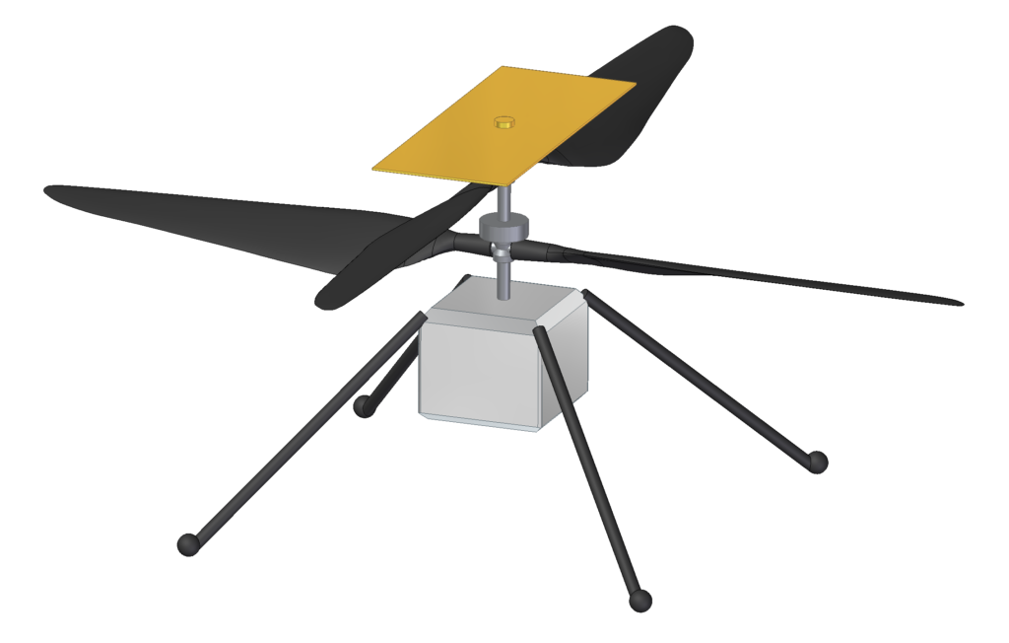
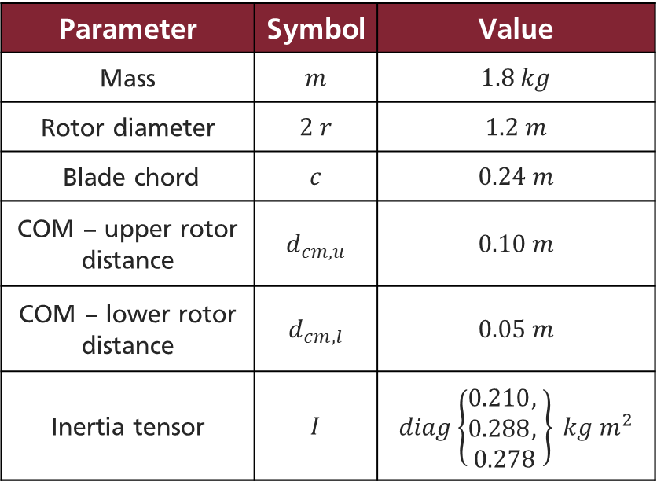
Ingenuity 1 Introduction
Ingenuity flies with a coaxial rotor system, comprising two horizontally-overlapping counter-rotating blades to mitigate reaction torque effects.
Parameter | Symbol | Value
Mass | $$m$$ | $$1.8 kg$$
Rotor diameter | $$2 r$$ | $$1.2 m$$
Blade chord | $$c$$ | $$0.24 m$$
COM – upper rotor distance | $$d_{cm,u}$$ | $$0.10 m$$
COM – lower rotor distance | $$d_{cm,l}$$ | $$0.05 m$$
Inertia tensor | $$I$$ | $$diag\left\{\begin{aligned}0.210, \\ 0.288, \\ 0.278\end{aligned}\right\} kg m^{2}$$
B

Slide 4
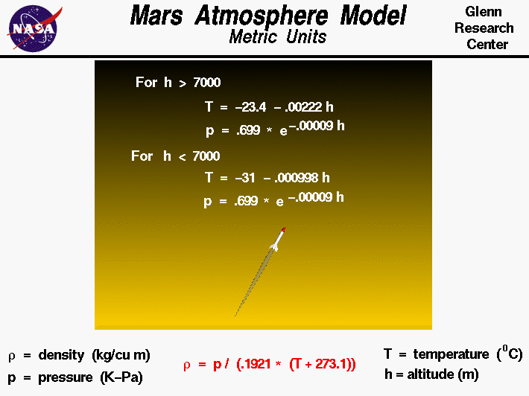
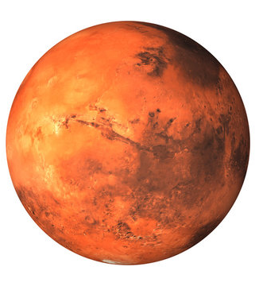

Martian environment 1 Introduction
Even though the Martian gravity is only about $38\%$ of the Earth's, its thin atmosphere makes it difficult for aerial vehicles to fly.
s

Slide 5
Table of Contents 2 Mathematical model
Introduction
Mathematical model
Control via I/O feedback linearization
Control via backstepping
Conclusions

Slide 6
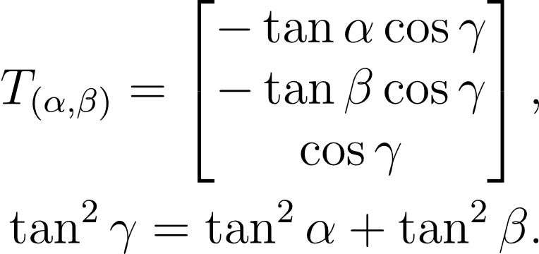
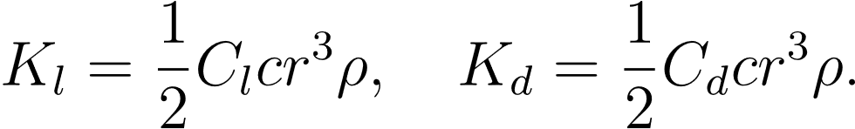
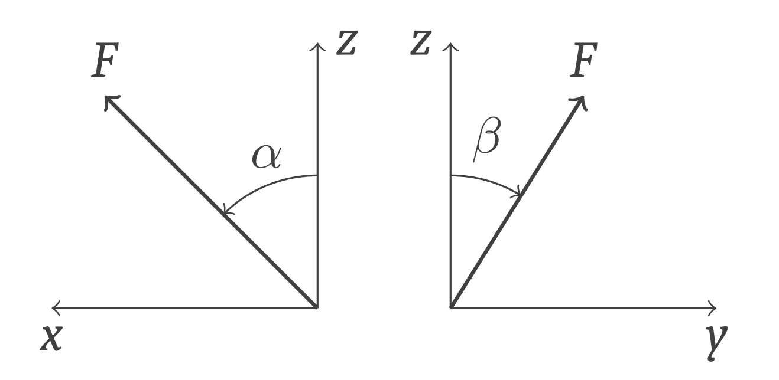

Forces 2 Mathematical model
Lift and drag coefficients:
Norm of the thrust generated by each rotor:
Thrust vector generated by each rotor:

Slide 7
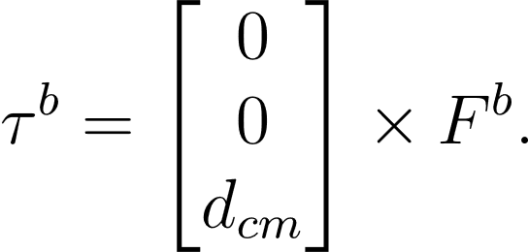
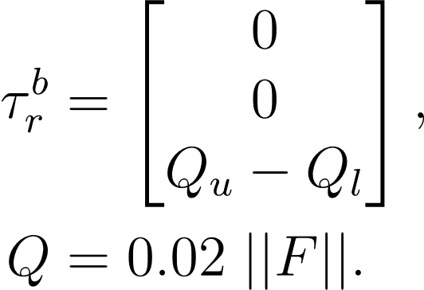
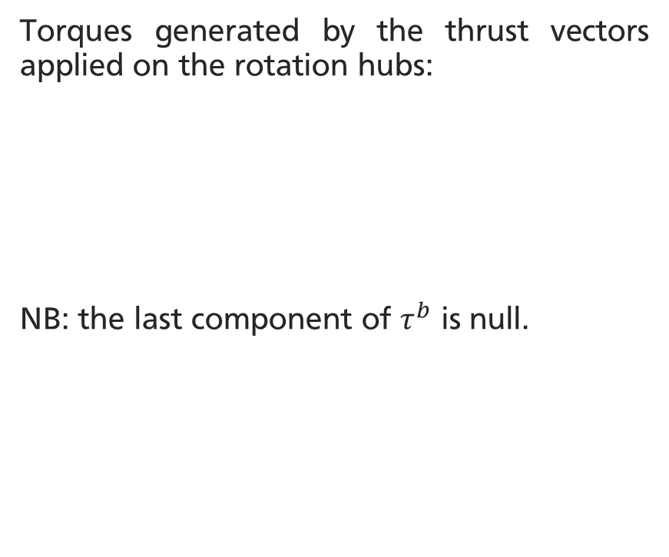
Torques 2 Mathematical model
The third component of the rotation is caused by the difference of the reaction torques:
Torques generated by the thrust vectors applied on the rotation hubs:
NB: the last component of $τ^{b}$ is null.

Slide 8

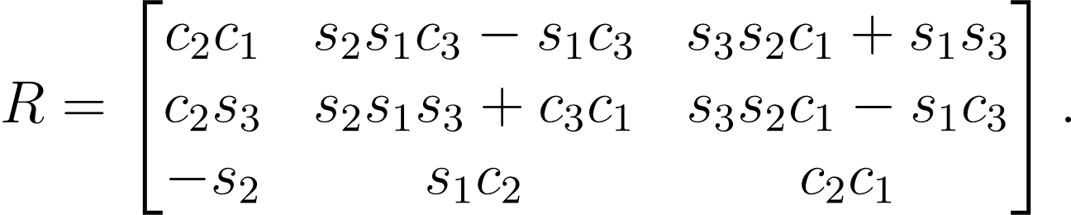
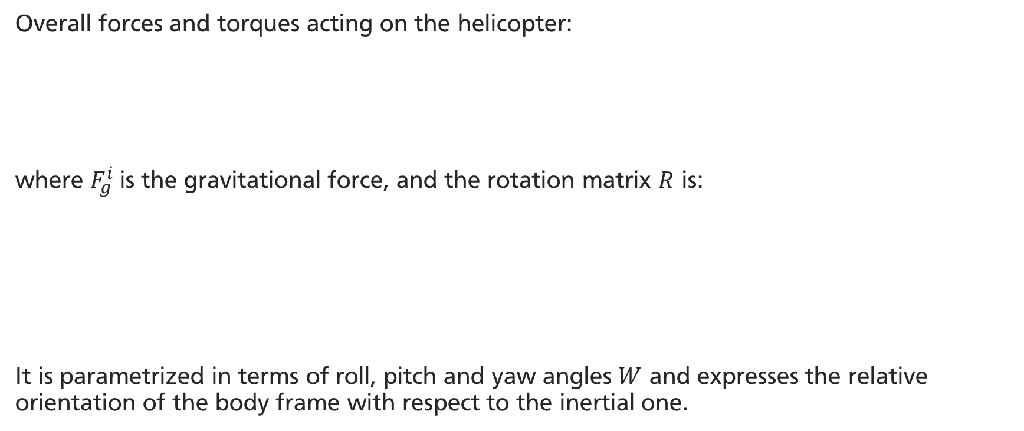
Overall forces and torques 2 Mathematical model
Overall forces and torques acting on the helicopter:
where $F_{g}^{i}$is the gravitational force, and the rotation matrix $R$ is:
It is parametrized in terms of roll, pitch and yaw angles $W$ and expresses the relative orientation of the body frame with respect to the inertial one.
Control inputs
Underactuated robot

Slide 9
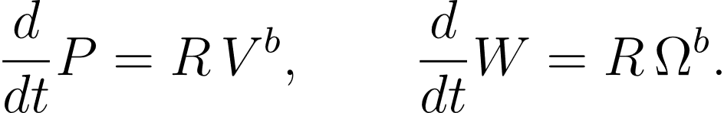

Dynamic equations 2 Mathematical model
Derivatives of the linear and angular velocity $V$ and $Ω$ in the body frame:
In the inertial frame, the position $P$ and the orientation $W$ of the robot are:
Coriolis effect
Gyroscopic effect

Slide 10
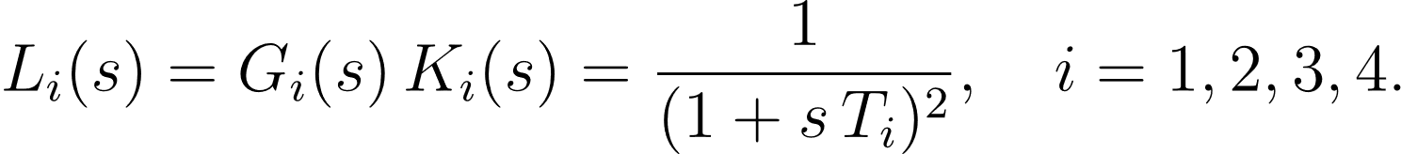
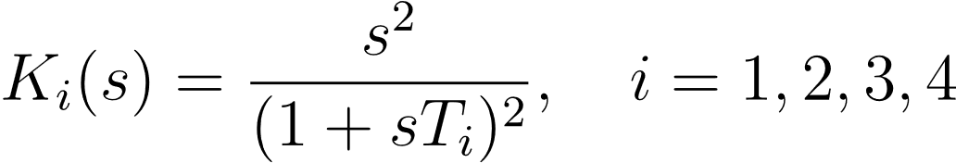
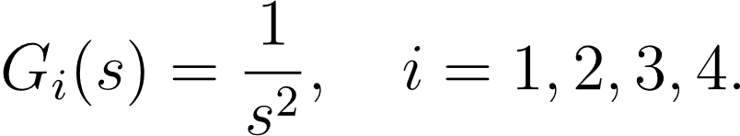
Actuator dynamics 2 Mathematical model
The input signals are not instantaneous, but they are influenced by the actuator dynamics:
Trivial physically realizable feedforward controller:
Resulting actuator open-loop transfer functions:

Slide 11
Table of Contents 3 Control via I/O feedback linearization
Introduction
Mathematical model
Control via I/O feedback linearization
Control via backstepping
Conclusions

Slide 12
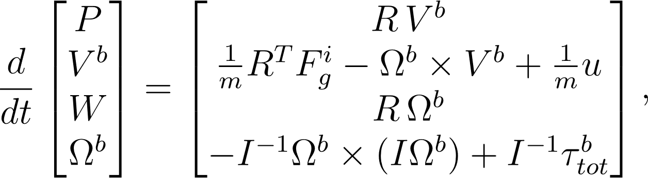

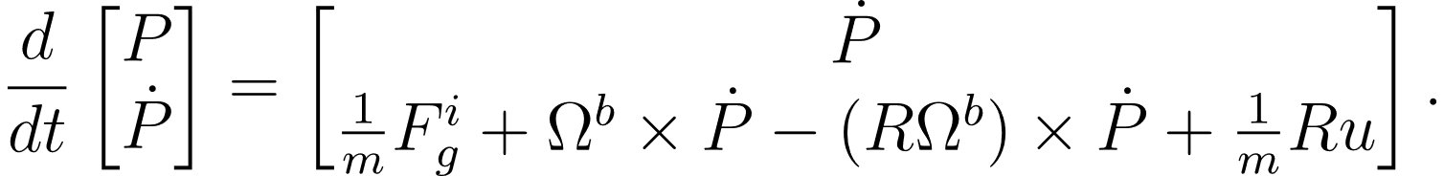
State space representation 3 Control via I/O feedback linearization
Nonlinear state-space representation of the helicopter dynamics:
where the total thrust generated by the rotors is:
Change of choordinates for the positional dynamics into the inertial frame:

Slide 13
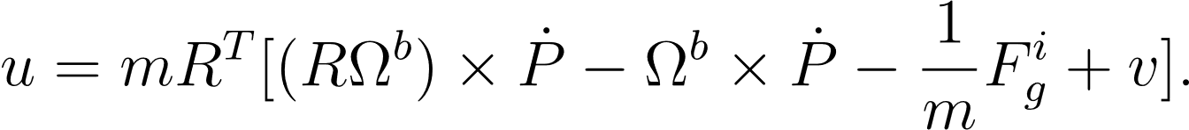
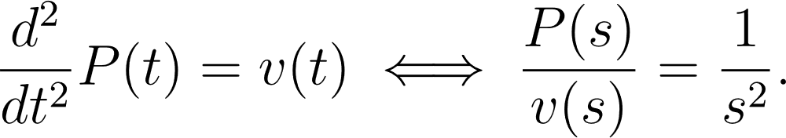
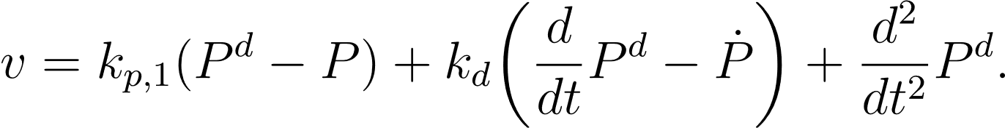

Position control law 3 Control via I/O feedback linearization
Choose $u$ to cancel the nonlinearities of the positional dynamics:
The new input-to-output transfer function is:
This can be controlled using a PD controller with a feedforward term:

Slide 14
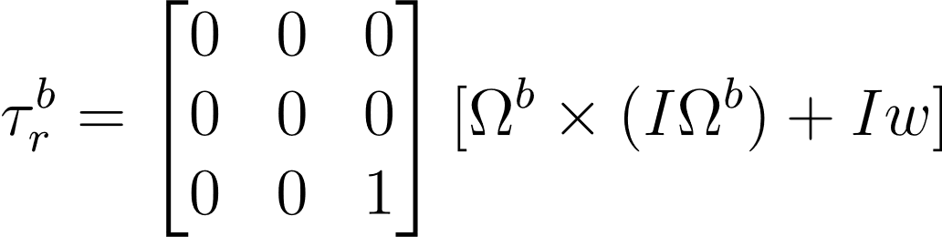
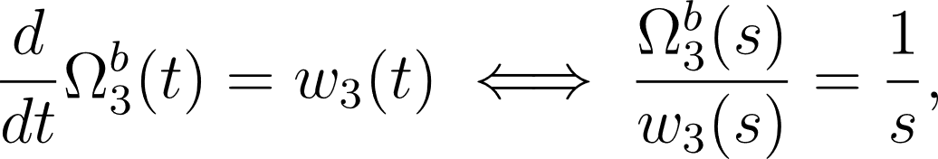
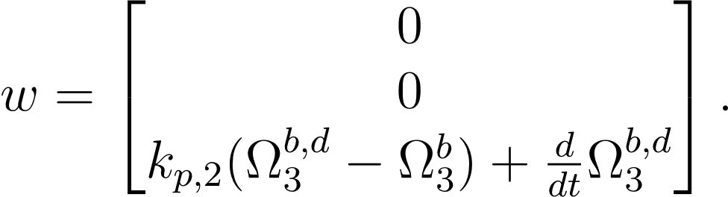
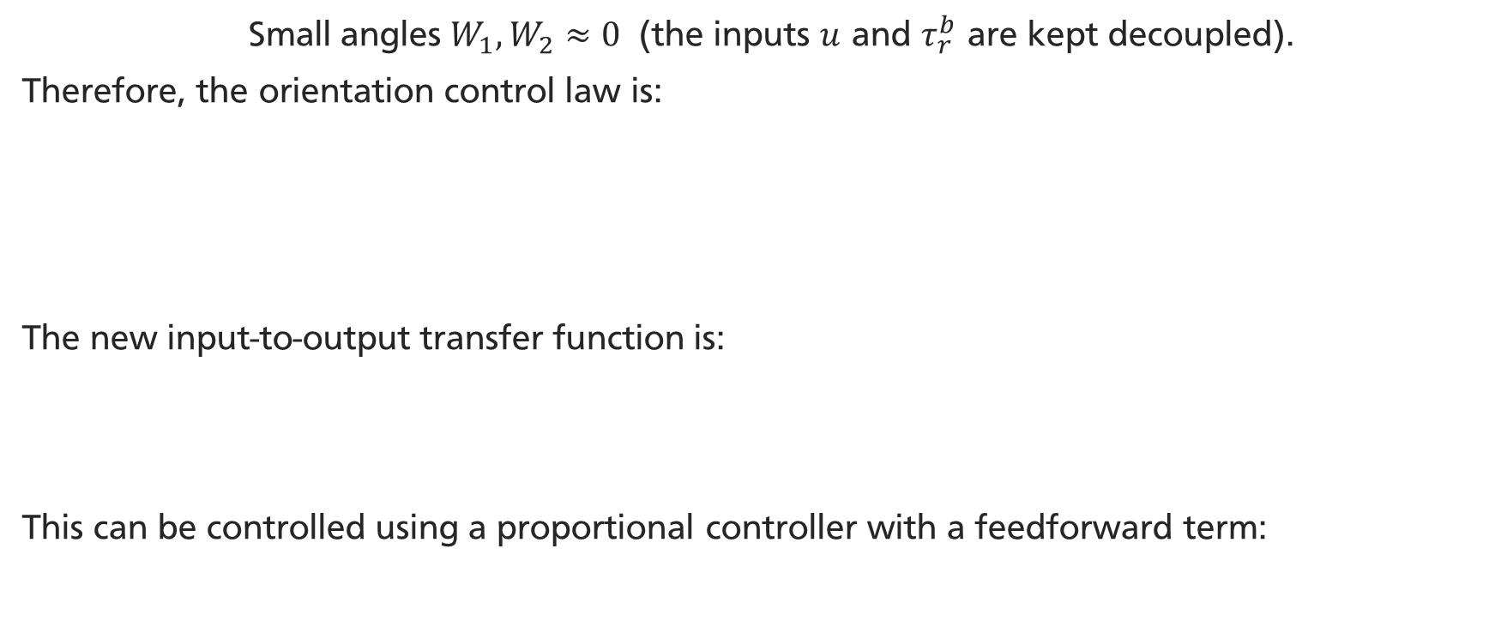
Orientation control law 3 Control via I/O feedback linearization
Small angles $W_{1}, W_{2}≈0$ (the inputs $u$ and $τ_{r}^{b}$ are kept decoupled).
Therefore, the orientation control law is:
The new input-to-output transfer function is:
This can be controlled using a proportional controller with a feedforward term:
ASSUMPTION
.

Slide 15
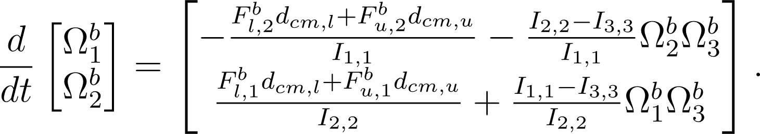
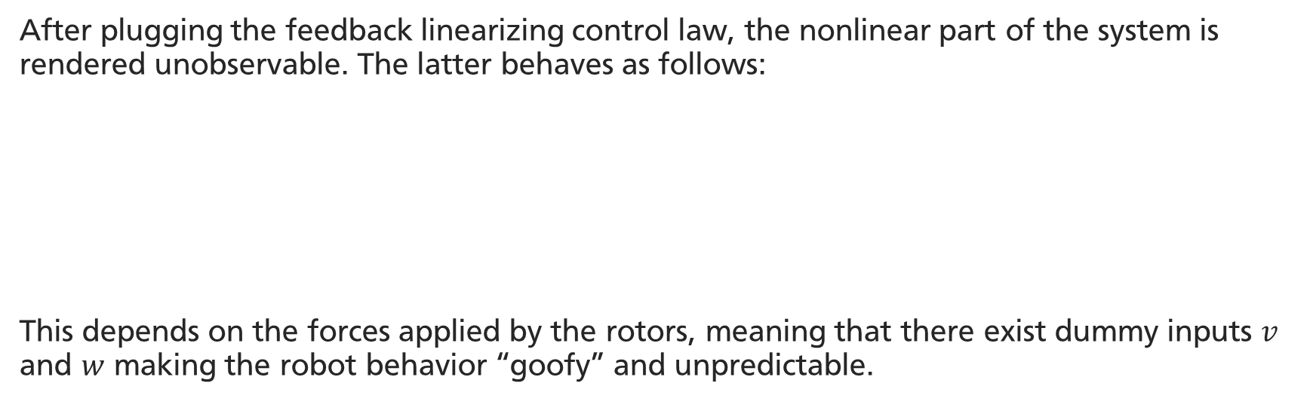
Forced zero dynamics 3 Control via I/O feedback linearization
After plugging the feedback linearizing control law, the nonlinear part of the system is rendered unobservable. The latter behaves as follows:
This depends on the forces applied by the rotors, meaning that there exist dummy inputs $v$ and $w$ making the robot behavior “goofy” and unpredictable.

Slide 16
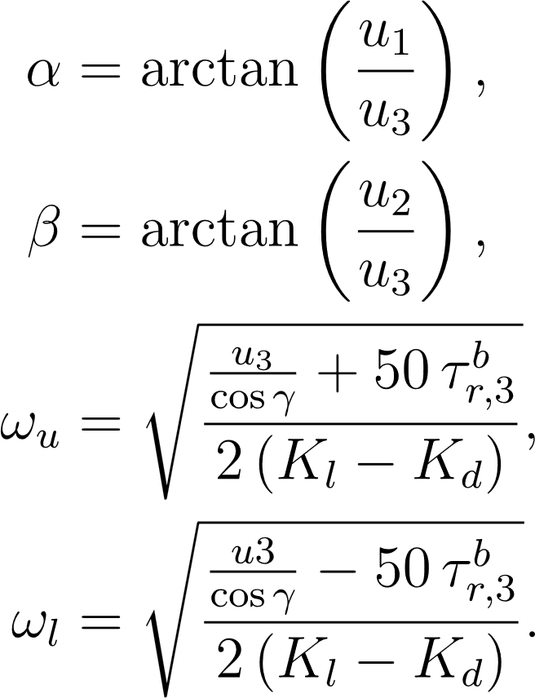
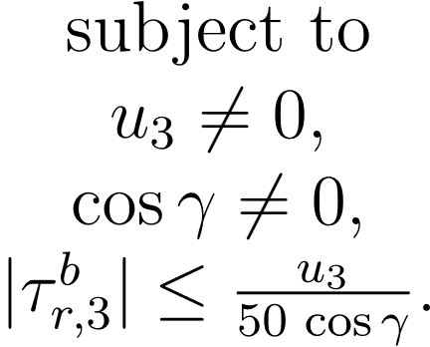
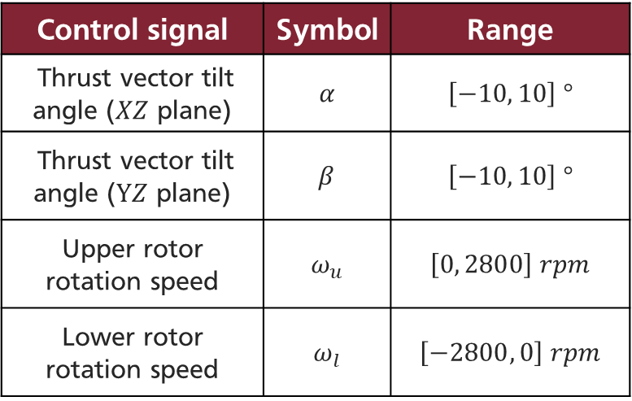

Actuation 3 Control via I/O feedback linearization
GOAL
Given $u, τ_{r}^{b}$ find the corresponding actuator inputs ${α, β, ω}_{u}, ω_{l}.$
Control signal | Symbol | Range
Thrust vector tilt angle ($XZ$ plane) | $$α$$ | $$\left[−10, 10\right] °$$
Thrust vector tilt angle ($YZ$ plane) | $$β$$ | $$\left[−10, 10\right] °$$
Upper rotor rotation speed | $$ω_{u}$$ | $$\left[0, 2800\right] rpm$$
Lower rotor rotation speed | $$ω_{l}$$ | $$\left[−2800, 0\right] rpm$$

Slide 17
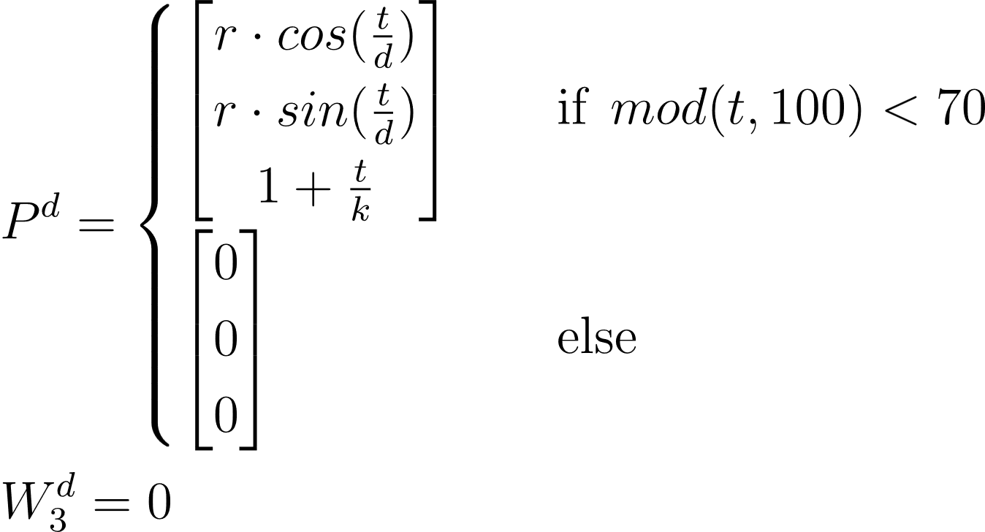
Desired trajectory 3 Control via I/O feedback linearization
Ingenuity is required to swap cyclically between an helical trajectory (70 seconds) and a static reference in the origin (30 seconds). The desired yaw is null.
METERE FOTO

Slide 18
Simulation results 1/3 3 Control via I/O feedback linearization

Slide 19
Simulation results 2/3 3 Control via I/O feedback linearization

Slide 20
Simulation results 3/3 3 Control via I/O feedback linearization

Slide 21
Table of Contents 4 Control via backstepping
Introduction
Mathematical model
Control via I/O feedback linearization
Control via backstepping
Conclusions

Slide 22

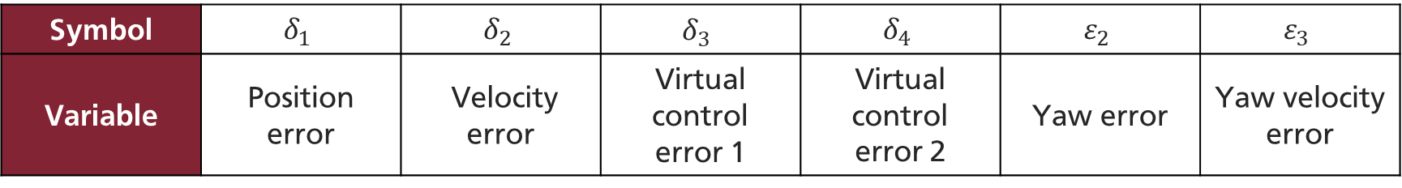
Control objective 4 Control via backstepping
No small body forces $u≈\left[\begin{aligned}0 \\ 0 \\ u_{3}\end{aligned}\right].$
Find $u_{3}, τ_{tot}^{b}$ making the following a valid Lyapunov function for the system:
ASSUMPTION
GOAL
Symbol | $$δ_{1}$$ | $$δ_{2}$$ | $$δ_{3}$$ | $$δ_{4}$$ | $$ε_{2}$$ | $$ε_{3}$$
Variable | Position error | Velocity error | Virtual control error 1 | Virtual control error 2 | Yaw error | Yaw velocity error

Slide 23
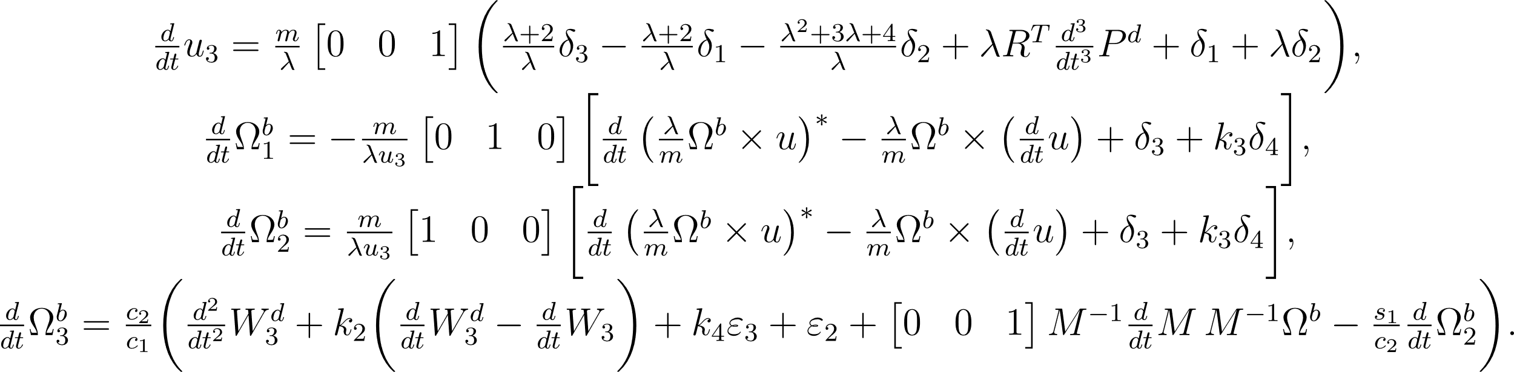
Control law 4 Control via backstepping
Monotonically decreasing

Slide 24
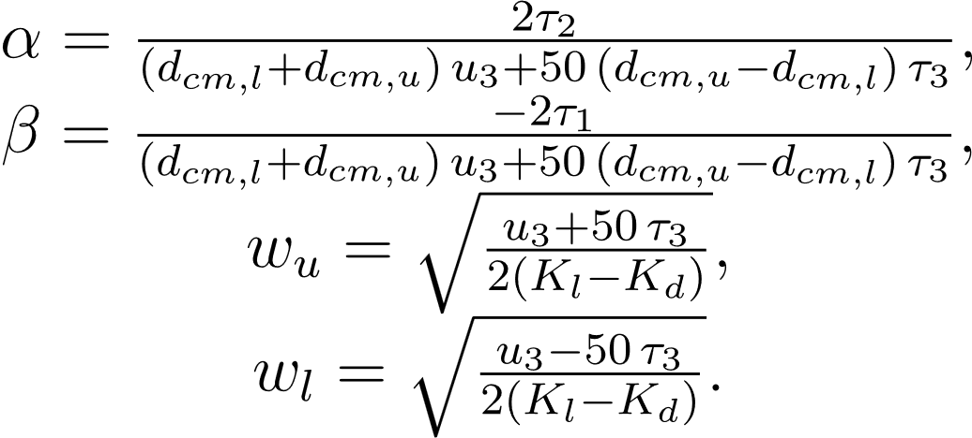
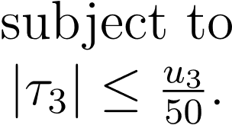
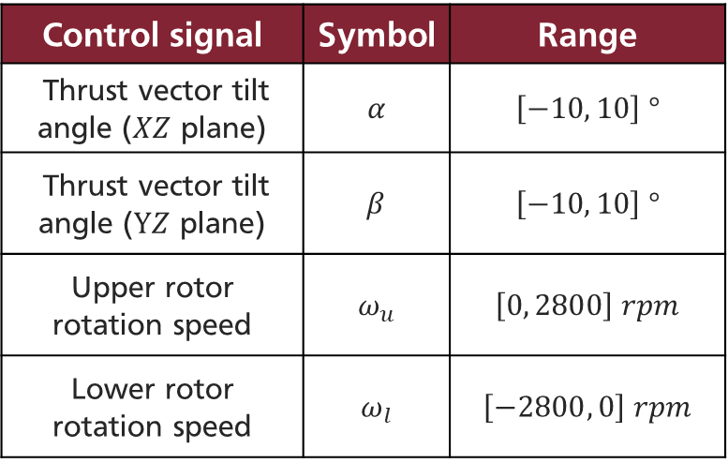

Actuation 4 Control via backstepping
Small angles $T_{(α,β)}≈\left[\begin{aligned}α \\ β \\ 1\end{aligned}\right].$
Given $u, {τ=τ}_{tot}^{b}$ find the corresponding actuator inputs ${α, β, ω}_{u}, ω_{l}.$
ASSUMPTION
GOAL
Control signal | Symbol | Range
Thrust vector tilt angle ($XZ$ plane) | $$α$$ | $$\left[−10, 10\right] °$$
Thrust vector tilt angle ($YZ$ plane) | $$β$$ | $$\left[−10, 10\right] °$$
Upper rotor rotation speed | $$ω_{u}$$ | $$\left[0, 2800\right] rpm$$
Lower rotor rotation speed | $$ω_{l}$$ | $$\left[−2800, 0\right] rpm$$

Slide 25
Desired trajectory 4 Control via backstepping
Ingenuity is required to swap cyclically between an helical trajectory (70 seconds) and a static reference in the origin (30 seconds). The desired yaw is null.
METERE FOTO

Slide 26
Simulation results 1/3 4 Control via backstepping

Slide 27
Simulation results 2/3 4 Control via backstepping

Slide 28
Simulation results 3/3 4 Control via backstepping

Slide 29
Table of Contents 5 Conclusions
Introduction
Mathematical model
Control via I/O feedback linearization
Control via backstepping
Conclusions

Slide 30
Conclusions 5 Conclusions
Ingenuity is an underactuated robot with 6 DOF and 4 actuators. The developed model is able to reproduce a good approximation of the behavior of the real system.
The feedback linearizing controller is able to stabilize the positional dynamics around a desired trajectory, but the hidden nonlinearities induce the robot to assume an undesirable behavior.
The backstepping controller is able to stabilize the full dynamics of Ingenuity because it exploits the cascade structure of the system and provides virtual control laws depending on the back-propagating error dynamics.

Slide 31
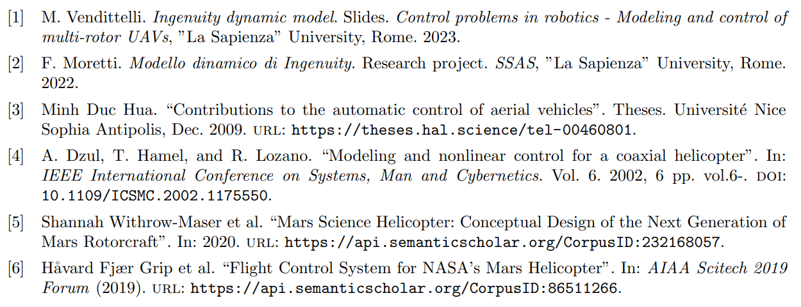
References

