Slide 1

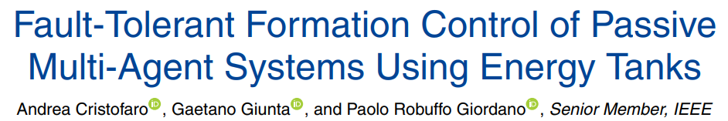
Fault-Tolerant Formation Control of Passive Multi-Agent Systems Using Energy Tanks
Course of Control of Autonomous Multi-agent Systems
Master's Degree in Control Engineering
Antonio Rapuano (mat. 2044902)
Academic Year 2023/2024
Based on
Notes:
My presentation is based on the paper *.

Slide 2

Table of Contents 1 Introduction
Introduction
Problem setup
Fault-tolerant formation control
Simulations
Conclusion

Slide 3


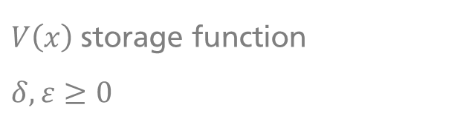
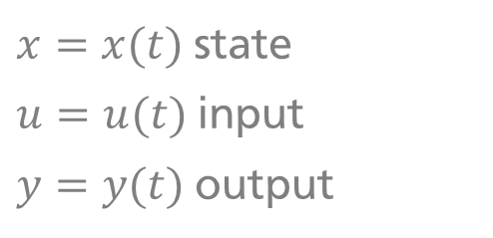
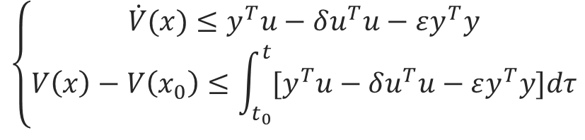
Objective 1 Introduction
GOAL
design a decentralized fault-tolerant formation control law for a multi-agent system
REQUIREMENT
inherently stable and MP easily controllable
the resulting system should be passive
$$\left\{\begin{aligned}\dot{V}(x)≤y^{T}u−δu^{T}u−εy^{T}y \\ V\left(x\right)−V\left(x_{0}\right)≤\int_{t_{0}}^{t}{{[y}^{T}u−δu^{T}u−εy^{T}y]dτ}\end{aligned}\right.$$
$x=x(t)$ state
$u=u(t)$ input
$y=y(t)$ output
$V\left(x\right)$ storage function
$δ, ε≥0$
Notes:
Consider a multi-robot system (like a group of UAVs): the aim of this work is to design a decentralized control law to keep the robots in formation, which means making them assume fixed relative generalized coordinates with respect to each other. Moreover, the formation should be able to respond to possible faults affecting one or more agents by reconfiguring itself. A fundamental requirement is that the final system should be passive with respect to an input/output pair and a storage function.
Advantages of passive systems include inherent stability and MP with respect to the chosen input/output pair, and easy controllability using simple feedback laws.

Slide 4
Table of Contents 2 Problem setup
Introduction
Problem setup
Fault-tolerant formation control
Simulations
Conclusion
Notes:
Let’s go ahead by describing the problem at hand.

Slide 5


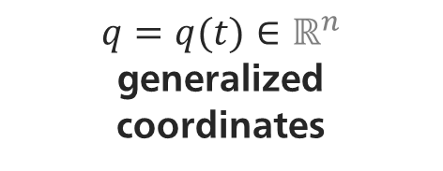
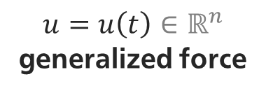

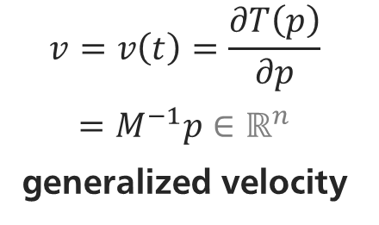
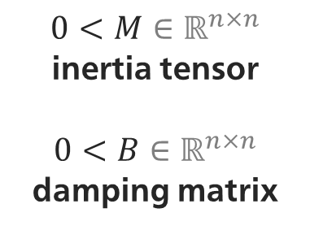
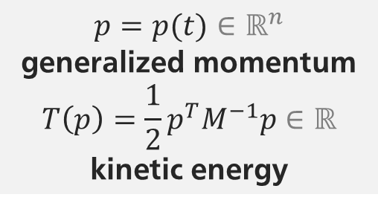
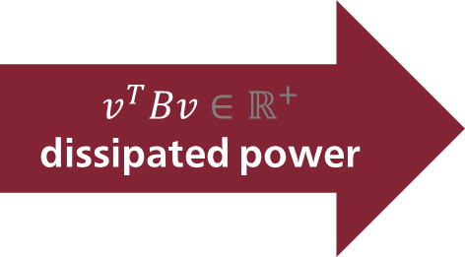
Robot dynamics 2 Problem setup
$0<M∈ℝ^{n×n}$
inertia tensor
$0<B∈ℝ^{n×n}$
damping matrix
$p=p(t)∈ℝ^{n}$
generalized momentum
$$T\left(p\right)=\frac{1}{2}p^{T}M^{−1}p∈ℝ$$
kinetic energy
$u=u\left(t\right)∈ℝ^{n}$ generalized force
$$u^{T}v∈ℝ$$
input power
$$v^{T}Bv∈ℝ^{+}$$
dissipated power
$$v=v\left(t\right)=\frac{∂T\left(p\right)}{∂p}$$
$=M^{−1}p∈ℝ^{n}$
generalized velocity
$\left\{\begin{aligned}\dot{p}=−B\frac{∂T(p)}{∂p}+u \\ v=\frac{∂T(p)}{∂p}\end{aligned}\right.$
$q=q(t)∈ℝ^{n}$
generalized coordinates
Notes:
Consider each robot as a simple point mass with gen. coordinates q in R^n. The best framework we can use to model this object and correctly take power flow (and therfore passivity) into account is the port-Hamiltonian: according to it, we can assign to each robot a state (its momentum p) and an energy function (its kinetic energy T). Naturally, the input should be a gen. force, and the output a gen. velocity. The dynamics also involves a dissipative term.
Computing the time derivative of T yields the power flowing through the robot: by the chain rule, there is a power quantity exchanged via the input port, and another positive quantity dissipated into heat.

Slide 6
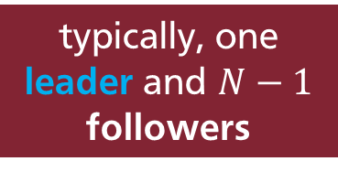
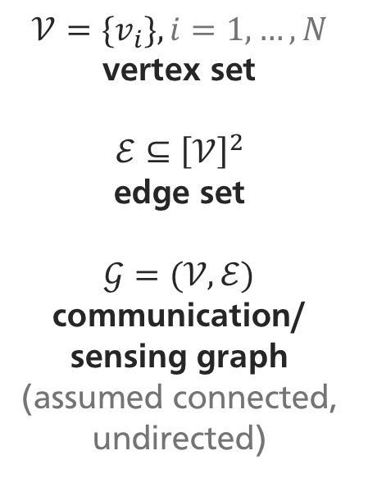
Formation control 2 Problem setup
GOAL
regulate the relative configuration (generalized coordinates) of $N$ agents
typically, one leader and $N−1$ followers
$$𝒱=\{v_{i}\}, i=1,…,N$$
vertex set
$$ℰ⊆{\left[𝒱\right]}^{2}$$
edge set
$𝒢=(𝒱, ℰ)$
communication/
sensing graph
(assumed connected, undirected)
Notes:
Once again, the goal is to regulate the relative configuration of a group of N robots, and this is only possible if the agents are able to communicate and sense each other. This capability is usually encoded for all the agents using a graph.
Typically, for formation control problem it is useful to set one agent as leader and the others as followers.

Slide 7
Table of Contents 3 Fault-tolerant formation control
Introduction
Problem setup
Fault-tolerant formation control
Simulations
Conclusion

Slide 8
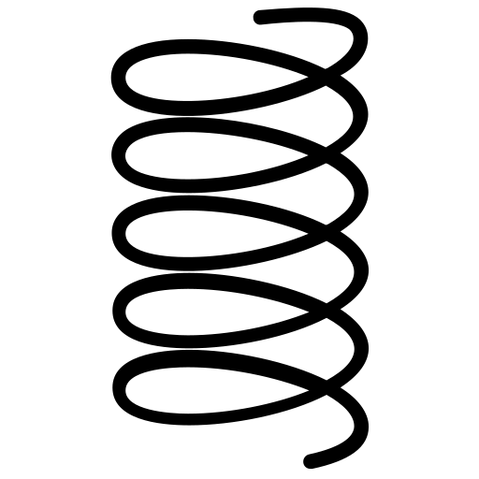

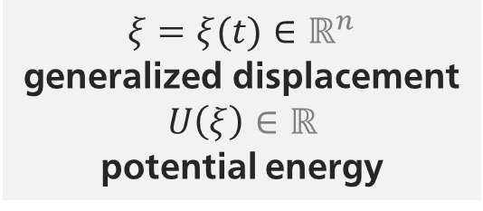

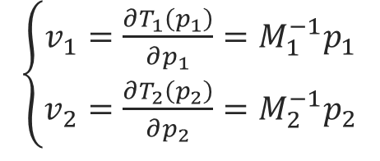
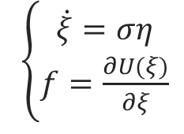
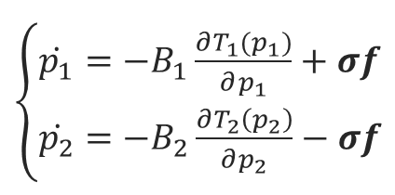
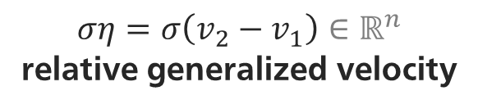
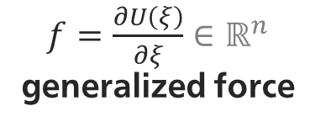

Virtual springs (1) 3 Fault-tolerant formation control
$ξ=ξ(t)∈ℝ^{n}$
generalized displacement
$$U\left(ξ\right)∈ℝ$$
potential energy
$ση=σ\left(v_{2}−v_{1}\right)∈ℝ^{n}$
relative generalized velocity
$\left\{\begin{aligned}v_{1}=\frac{∂T_{1}\left(p_{1}\right)}{∂p_{1}}=M_{1}^{−1}p_{1} \\ v_{2}=\frac{∂T_{2}\left(p_{2}\right)}{∂p_{2}}=M_{2}^{−1}p_{2}\end{aligned}\right.$
$$σf^{T}η∈ℝ$$
power exchanged w/ robots
2
$$σ∈\{0, 1\}$$
$f=\frac{∂U\left(ξ\right)}{∂ξ}∈ℝ^{n}$ generalized force
$\left\{\begin{aligned}\dot{p_{1}}=−B_{1}\frac{∂T_{1}(p_{1})}{∂p_{1}}+σf \\ \dot{p_{2}}=−B_{2}\frac{∂T_{2}\left(p_{2}\right)}{∂p_{2}}−σf\end{aligned}\right.$
1
$\left\{\begin{aligned}\dot{ξ}=ση \\ f=\frac{∂U(ξ)}{∂ξ}\end{aligned}\right.$
globally, interconnections between agents and springs are encoded in the graph incidence matrix $E$
Notes:
The idea to enforce the relative configuration between the agents (and thus formation keeping) is to use as control inputs n-dimensional virtual springs elements connecting pairs of agents according to the edges of the graph. In the pH framework, if connected (sigma) a spring integrates the relative gen. velocity of the two agents involved (here, 1 and 2) into a generalized displacement, the state xi, which corresponds to a value of a potential energy function U. The spring returns a virtual elastic force, input of the robot dynamics through sigma.
Once again, we can compute the derivative of U to highlight the power flow, corresponding to the inner product of elastic force and agent relative velocity.

Slide 9
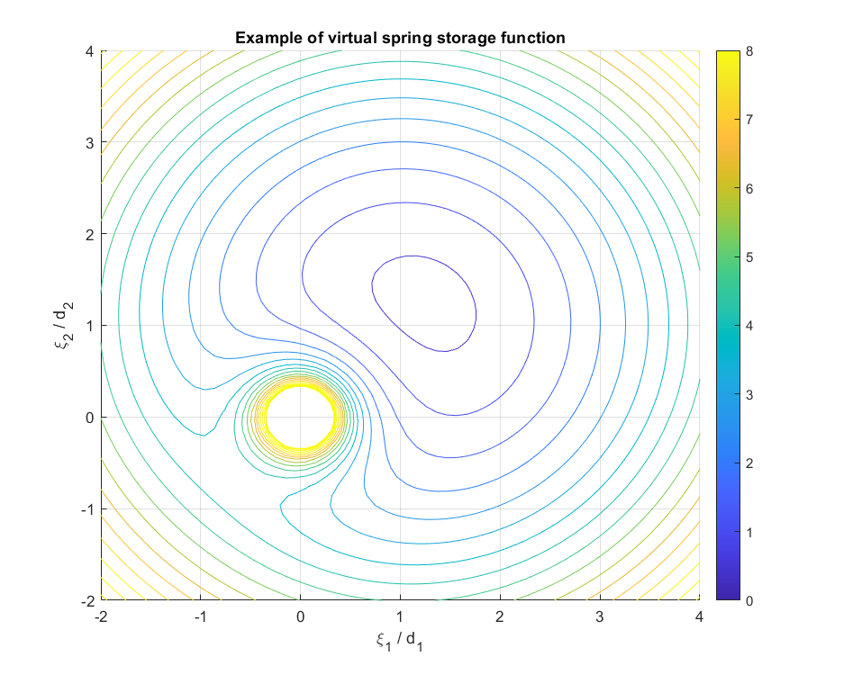
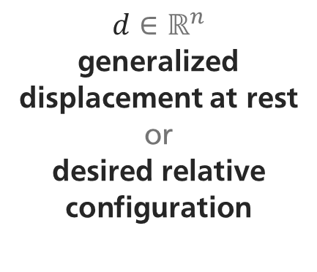
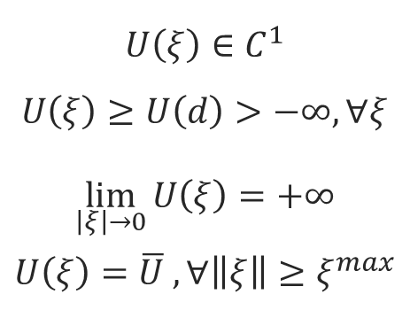
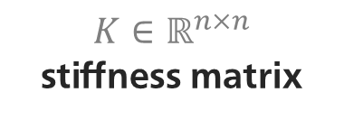
Virtual springs (2) 3 Fault-tolerant formation control
$$d∈ℝ^{n}$$
generalized
displacement at rest
or
desired relative configuration
$$U\left(ξ\right)∈C^{1}$$
$U\left(ξ\right)≥U\left(d\right)>−∞, ∀ξ$
$$\lim_{\left|ξ\right|→0}{U\left(ξ\right)=+∞}$$
$$U\left(ξ\right)=\overline{U} , ∀\left\|ξ\right\|≥ξ^{max}$$
$K∈ℝ^{n×n}$
stiffness matrix
$U\left(ξ\right)=\frac{1}{2}{\left(ξ−d\right)}^{T}K\left(ξ−d\right)$ satisfies the requirements locally around $d$
Notes:
But how should the potential energy function be made? For our purpose:
We should be able to compute derivatives continuously
It should be lower bounded and have a minimum in d, the desired configuration
It should hit a peak in 0, to avoid robot collisions
the last condition imposes a maximum connection range
the classical elastic energy expression, with stiffness matrix K, only satisfies these requirements in a neighborhood of d.

Slide 10


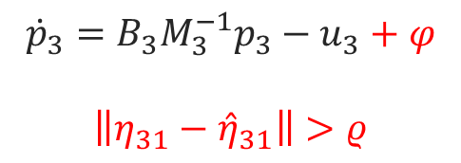
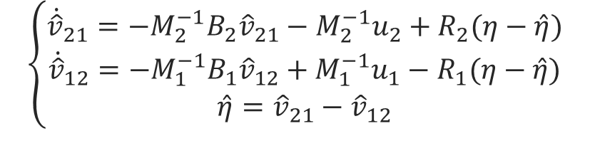
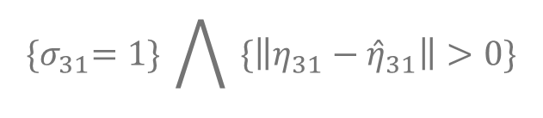







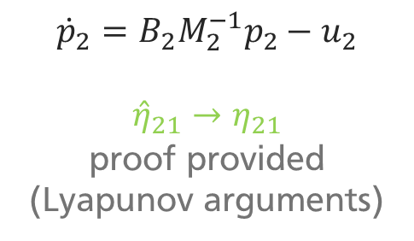
Fault detection (1) 3 Fault-tolerant formation control
$ρ>0$ threshold
$${\hat{v}}_{21}$$
$${\hat{v}}_{21}$$
$${\dot{p}}_{2}=B_{2}M_{2}^{−1}p_{2}−u_{2}$$
$${\hat{η}}_{21}→η_{21}$$
proof provided (Lyapunov arguments)
$$η$$
2
2
$$η_{21}$$
1
0 | 0 | 1
$$ζ∈{\left\{0, 1\right\}}^{N}$$
relative velocity measurements (relative position can be used too)
$${\{σ}_{31}=1\} \bigwedge{ \{\left\|η_{31}−{\hat{η}}_{31}\right\|>0\}}$$
1
$$η_{31}$$
$${\hat{v}}_{31}$$
$$\left\{\begin{aligned}{\dot{\hat{v}}}_{21}=−M_{2}^{−1}B_{2}{\hat{v}}_{21}−M_{2}^{−1}u_{2}+R_{2}(η−\hat{η}) \\ {\dot{\hat{v}}}_{12}=−M_{1}^{−1}B_{1}{\hat{v}}_{12}+M_{1}^{−1}u_{1}−R_{1}(η−\hat{η}) \\ \hat{η}={\hat{v}}_{21}−{\hat{v}}_{12}\end{aligned}\right.$$
$${\dot{p}}_{3}=B_{3}M_{3}^{−1}p_{3}−u_{3}+φ$$
$$\left\|η_{31}−{\hat{η}}_{31}\right\|>ρ$$
3
Notes:
The question is how can we detect a fault affecting one or more agents in a decentralized fashion? Let us suppose that relative velocity (or similarly, position) measurements are available to each agent with respect to its neighbors. The idea is that, since I know your dynamics and you know my dynamics NOMINALLY, each of us already expects the other to behave in some way (to assume a predicted velocity). Of course, small errors can be recovered through a correcting term relying on the actual measurements. If the estimated velocity are subtracted, under normal operating conditions the result should be pretty close to the relative velocity measurements (this is proven in the paper). But if this is not the case, the logical implication is that either my dynamics or yours is different from the nominal – meaning that there is a fault. Each agent can carry out this same reasoning for all the neighbors and build an array of N booleans, containing the «opinion» of the agent at hand on whether the other N-1 are faulty. (No connection or itself ->0)

Slide 11
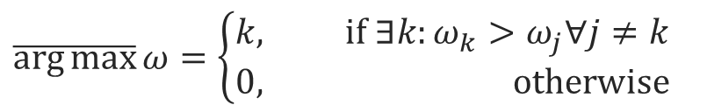
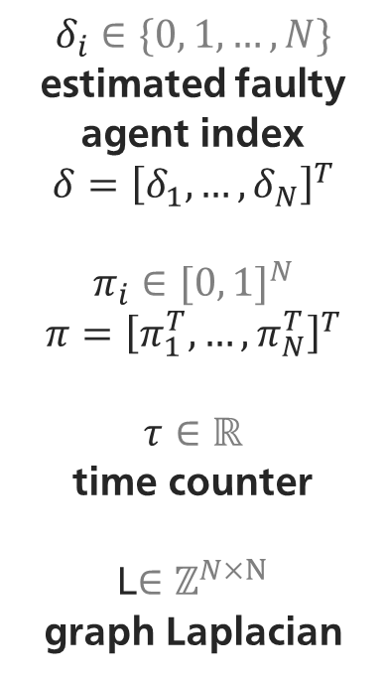


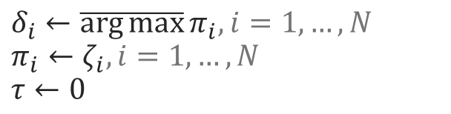
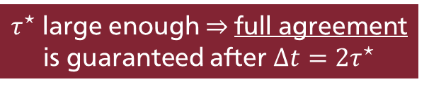
Fault detection (2) 3 Fault-tolerant formation control
$$δ_{i}∈\{0, 1, …,N\}$$
estimated faulty agent index
$$δ={\left[δ_{1},…,δ_{N}\right]}^{T}$$
$$π_{i}∈{[0, 1]}^{N}$$
$$π={\left[π_{1}^{T},…,π_{N}^{T}\right]}^{T}$$
$$τ∈ℝ$$
time counter
L$∈ℤ^{N×N}$
graph Laplacian
GOAL
agree on the index of the faulty agent
IDEA
run consensus periodically with a hybrid system
$$\dot{δ}=0$$
$$\dot{π}=−\left(L⊗I_{N}\right)π$$
$$\dot{τ}=1$$
$τ^{⋆}$ large enough $⇒$full agreement is guaranteed after $Δt=2τ^{⋆}$
$$τ=τ^{⋆}$$
$δ_{i}←\overline{\arg{max}}π_{i},$ $i=1, …,N$
$$π_{i}←ζ_{i},i=1,…,N$$
$$τ←0$$
$$\overline{\arg{max}}ω=\left\{\begin{aligned}k, if ∃k:ω_{k}>ω_{j}∀j≠k \\ 0, otherwise\end{aligned}\right.$$
Notes:
Of course, these «opinions» can be different from agent to agent. For instance, a faulty agent will say that all of its neighbors are faulty. To find an agreement on the possibly faulty agent in a decentralized way, the idea is to run consensus periodically (every tau_star seconds) on a FSM. While pi is the consensus variable, Delta, a scalar for each robot, encodes the index of the estimated faulty agent.
It can be proven that by choosing tau_star large enough each delta will converge to a unique value j0 after at most two cycles of the FSM.

Slide 12









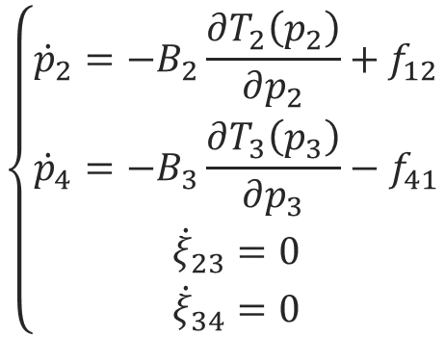




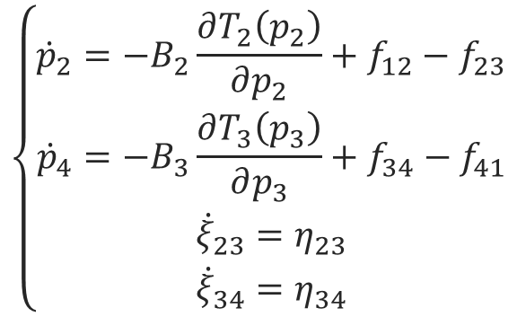



Reconfiguration (1) 3 Fault-tolerant formation control
graph is updated accordingly
$$p_{3}$$
$$p_{3}$$
$$ξ_{34}$$
$$ξ_{23}$$
$$σ_{23}, σ_{34}←0$$
$$p_{4}$$
3
$$p_{2}$$
$$p_{4}$$
3
$$p_{2}$$
$$ΔU≤0$$
splitting is passive
$$ξ_{41}$$
$$ξ_{12}$$
$$ξ_{41}$$
$$ξ_{12}$$
$$p_{1}$$
$$p_{1}$$
$$\left\{\begin{aligned}{\dot{p}}_{2}=−B_{2}\frac{∂T_{2}\left(p_{2}\right)}{∂p_{2}}+f_{12}−f_{23} \\ {\dot{p}}_{4}=−B_{3}\frac{∂T_{3}\left(p_{3}\right)}{∂p_{3}}+f_{34}−f_{41} \\ {\dot{ξ}}_{23}=η_{23} \\ {\dot{ξ}}_{34}=η_{34}\end{aligned}\right.$$
$$\left\{\begin{aligned}{\dot{p}}_{2}=−B_{2}\frac{∂T_{2}\left(p_{2}\right)}{∂p_{2}}+f_{12} \\ {\dot{p}}_{4}=−B_{3}\frac{∂T_{3}\left(p_{3}\right)}{∂p_{3}}−f_{41} \\ {\dot{ξ}}_{23}=0 \\ {\dot{ξ}}_{34}=0\end{aligned}\right.$$
Notes:
Once we have an agreement on the faulty agent index, the next step is to expel it from the formation to avoid disrupting the behavior of the rest of the system.
We first identify the springs involved with the faulty agent, and set to zero the relative coupling booleans sigma. As a consequence, the spring states xi are no longer updated: their energy can remain constant or be recovered, or it can be dumped by resetting xi to the rest value, meaning that the operation does not require additional energy and is passive. At the same time, the graph is updated deleting the corresponding edges.

Slide 13









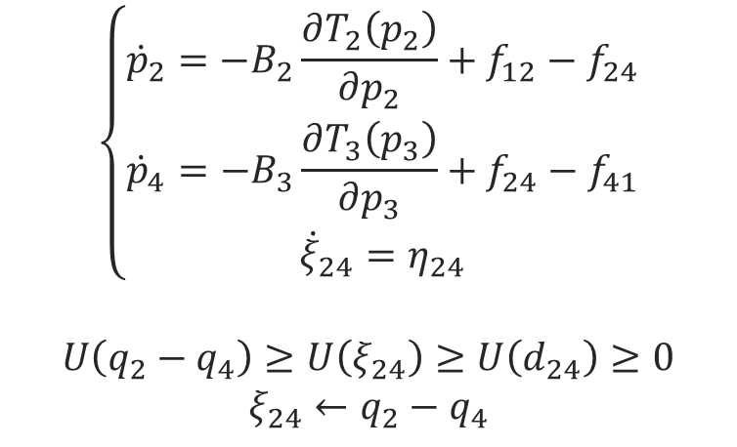


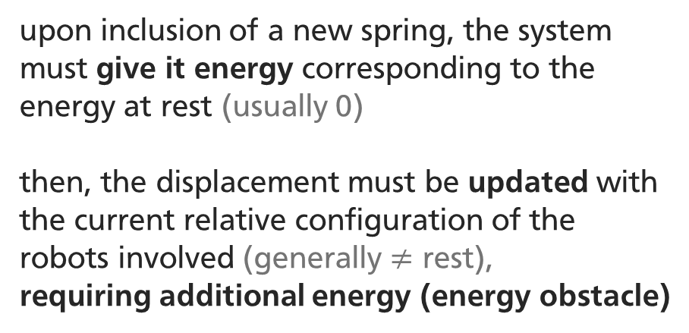


Reconfiguration (2) 3 Fault-tolerant formation control
graph is updated accordingly
$$σ_{24}←1$$
$$ξ_{24}$$
$$p_{4}$$
3
$$p_{2}$$
$$p_{4}$$
3
$$p_{2}$$
$$ΔU≥0$$
joining is not passive
$$ξ_{41}$$
$$ξ_{12}$$
$$ξ_{41}$$
$$ξ_{12}$$
$$p_{1}$$
$$p_{1}$$
SOLUTION
use energy tanks
upon inclusion of a new spring, the system must give it energy corresponding to the energy at rest (usually 0)
then, the displacement must be updated with the current relative configuration of the robots involved (generally $≠$ rest),
requiring additional energy (energy obstacle)
$$\left\{\begin{aligned}{\dot{p}}_{2}=−B_{2}\frac{∂T_{2}\left(p_{2}\right)}{∂p_{2}}+f_{12}−f_{24} \\ {\dot{p}}_{4}=−B_{3}\frac{∂T_{3}\left(p_{3}\right)}{∂p_{3}}+f_{24}−f_{41} \\ {\dot{ξ}}_{24}=η_{24}\end{aligned}\right.$$
$$U\left(q_{2}−q_{4}\right)≥U\left(ξ_{24}\right)≥U\left(d_{24}\right)≥0$$
$$ξ_{24}←q_{2}−q_{4}$$
Notes:
In order to keep a good level of graph connectivity, it may be necessary to enstablish new links between the neighbors of the agents that has just been removed. Updating the corresponding sigma coupling variable and the graph is not enough: upon creation of a new virtual spring (or recycling of a disabled one), its state must be updated with the current relative configuration of the agents involved in the link, corresponding, in general, to a different energy level: the difference between the potential energy of the spring before and after the join is called energy obstacle. Intuitively, you can think about the fact that to attach the spring between two fixed objects it must first be stretched enough, using adequate effort. And to ensure passivity of the system, this amount of energy must come from within the system.
Where can we get the required energy? The answer is that we must store it beforehand through energy tanks.

Slide 14

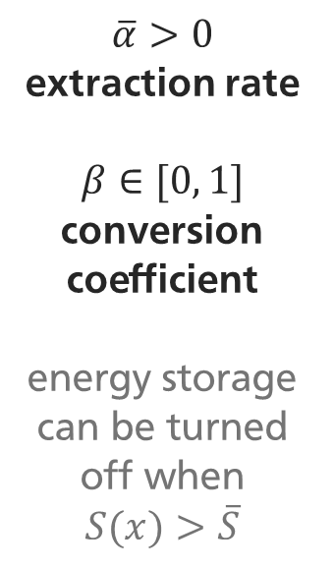

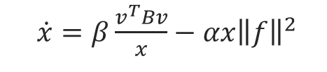
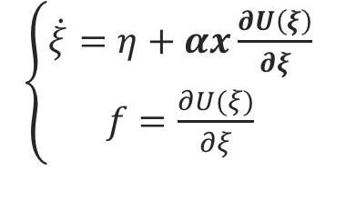

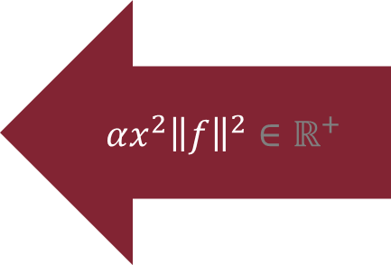
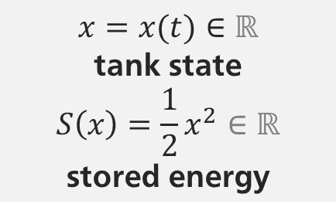
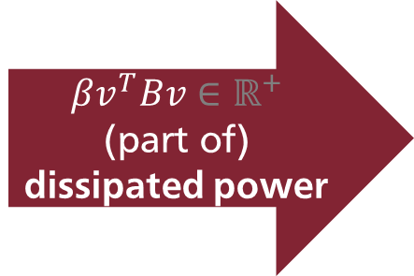

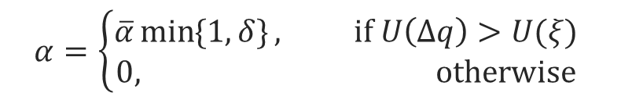


Energy tanks 3 Fault-tolerant formation control
$$β\frac{v^{T}Bv}{x}$$
$x=x(t)∈ℝ$
tank state
$$S\left(x\right)=\frac{1}{2}x^{2}∈ℝ$$
stored energy
$$βv^{T}Bv∈ℝ^{+}$$
(part of) dissipated power
$$\overline{α}>0$$
extraction rate
$$β∈[0, 1]$$
conversion coefficient
energy storage can be turned off when $S(x)>\overline{S}$
$\left\{\begin{aligned}\dot{p}=−B\frac{∂T(p)}{∂p}+u \\ v=\frac{∂T(p)}{∂p}\end{aligned}\right.$
$$x$$
$$αx^{2}{\left\|f\right\|}^{2}∈ℝ^{+}$$
$\left\{\begin{aligned}\dot{ξ}=η+αx\frac{∂U\left(ξ\right)}{∂ξ} \\ f=\frac{∂U(ξ)}{∂ξ}\end{aligned}\right.$
$$−αx{\left\|f\right\|}^{2}$$
$\dot{x}=β\frac{v^{T}Bv}{x}−αx{\left\|f\right\|}^{2}$
$$α=\left\{\begin{aligned}\overline{α}\min{\{1, δ\}}, if U\left(Δq\right)>U(ξ) \\ 0, otherwise\end{aligned}\right.$$
singularity in $x=0$
Notes:
the energy tank concept is intuitive: since, in the robot dynamics, there is some energy that is dissipated, then recovering some of this and storing it with the objective of subsequently performing actions that cost energy does not break the passivity of the system. Formally, the state of the energy tank is a scalar x, and its energy T is ... With the dynamics that can be read in the slide, the tank collects a fraction beta of the dissipated energy until a possible cap is reached (when beta can be set to 0). When a fault occurs and there is a need to overcome an energy obstacle for a spring state update, the coefficient alpha is set to a value higher than 0 and energy transfer takes place.
note that the particular expressions used for tank inputs are such that:
1) energy continuity is preserved in interconnections with robots and virtual springs
2) the power flow always goes from robot to tank to spring.
unfortunately, they also cause the presence of a singularity at x = 0: one has to make sure that the tanks never discharge completely

Slide 15

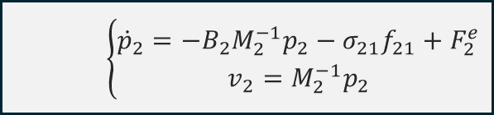
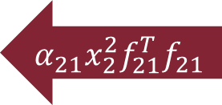

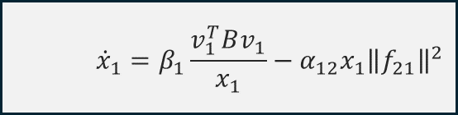
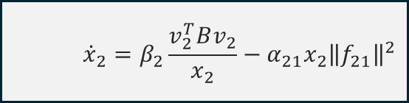
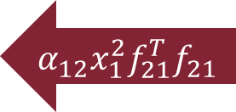
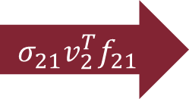








Passive interconnection 3 Fault-tolerant formation control
$$H\left(p1, p2, x1, x2, ξ_{21}\right)=T_{1}+T_{2}+S_{1}+S_{2}+U_{21}=H∈ℝ$$
total energy
$$\dot{H}=v_{1}^{T}F_{1}^{e}+v_{2}^{T}F_{2}^{e}−\left(1−β_{1}\right)v_{1}^{T}B_{1}v_{1}−\left(1−β_{2}\right)v_{2}^{T}B_{2}v_{2}$$
$≤v_{1}^{T}F_{1}^{e}+v_{2}^{T}F_{2}^{e}⇒$ the system is passive
$$v_{1}^{T}F_{1}^{e}$$
$$\left\{\begin{aligned}{\dot{p}}_{1}=−B_{1}M_{1}^{−1}p_{1}+σ_{21}f_{21}+F_{1}^{e} \\ v_{1}=M_{1}^{−1}p_{1}\end{aligned}\right.$$
$v_{1}^{T}B_{1}v_{1}$ $β_{1}v_{1}^{T}B_{1}v_{1}$
$${\dot{x}}_{1}=β_{1}\frac{v_{1}^{T}Bv_{1}}{x_{1}}−α_{12}x_{1}{\left\|f_{21}\right\|}^{2}$$
$$\left\{\begin{aligned}{\dot{ξ}}_{21}=σ_{21}\left(v_{2}−v_{1}\right)+\left(γ_{12}x_{1}^{2}+γ_{21}x_{2}^{2}\right)\frac{∂U_{21}}{∂ξ_{21}} \\ f_{21}=\frac{∂U_{21}}{∂ξ_{21}}\end{aligned}\right.$$
$$α_{12}x_{1}^{2}f_{21}^{T}f_{21}$$
$$σ_{21}v_{1}^{T}f_{21}$$
$$σ_{21}v_{2}^{T}f_{21}$$
$$α_{21}x_{2}^{2}f_{21}^{T}f_{21}$$
$$v_{2}^{T}F_{2}^{e}$$
$$\left\{\begin{aligned}{\dot{p}}_{2}=−B_{2}M_{2}^{−1}p_{2}−σ_{21}f_{21}+F_{2}^{e} \\ v_{2}=M_{2}^{−1}p_{2}\end{aligned}\right.$$
$v_{2}^{T}B_{2}v_{2}$ $β_{2}v_{2}^{T}B_{2}v_{2}$
$${\dot{x}}_{2}=β_{2}\frac{v_{2}^{T}Bv_{2}}{x_{2}}−α_{21}x_{2}{\left\|f_{21}\right\|}^{2}$$
Notes:
This is how a complete passive interconnection between two of the robots can take place. Notice:
External forces acting on the dynamics
Flow of power through the various subsystems
Part of the dissipated energy is not collected by the tanks
If we call V the total energy of the system (the sum of the storage functions of all the components), computing its derivative shows us that, of the energy that is introduced through the two input channels, a part (which may be even zero) is dissipated, and the rest ends up in V, so it is distributed within the system. There is no other way for V to vary, and this testifies that the resulting system satisfies the passivity requirement.

Slide 16










Overall port-Hamiltonian formulation 3 Fault-tolerant formation control
$$\left[\begin{aligned}\dot{p} \\ \dot{ξ} \\ \dot{x}\end{aligned}\right]=\left(\left[\begin{matrix}0 & E⊗I_{n} & 0 \\ \begin{aligned}−{\left(E⊗I_{n}\right)}^{T} \\ 0\end{aligned} & \begin{aligned}0 \\ −Γ\end{aligned} & \begin{aligned}Γ^{T} \\ 0\end{aligned}\end{matrix}\right]−\left[\begin{matrix}B & 0 & 0 \\ \begin{aligned}0 \\ −PB\end{aligned} & \begin{aligned}0 \\ 0\end{aligned} & \begin{aligned}0 \\ 0\end{aligned}\end{matrix}\right]\right)\left[\begin{aligned}\frac{∂H}{∂p} \\ \frac{∂H}{∂ξ} \\ \frac{∂H}{∂x}\end{aligned}\right]+GF^{e}$$
$$v=G^{T}\left[\begin{matrix}{\frac{∂H}{∂p}}^{T} & {\frac{∂H}{∂ξ}}^{T} & {\frac{∂H}{∂x}}^{T}\end{matrix}\right]$$
$ξ=$ $\left[\begin{aligned}\begin{aligned}ξ_{21} \\ ⋮ \\ ξ_{N,N−1}\end{aligned} \\ ξ_{1N}\end{aligned}\right]$
$$p=\left[\begin{aligned}p_{1} \\ ⋮ \\ p_{N}\end{aligned}\right]$$
$$x=\left[\begin{aligned}x_{1} \\ ⋮ \\ x_{N}\end{aligned}\right]$$
$$F^{e}=\left[\begin{aligned}F_{1}^{e} \\ ⋮ \\ F_{N}^{e}\end{aligned}\right]$$
$$B=\left[\begin{matrix}B_{1} & 0 & 0 \\ 0 & ⋱ & 0 \\ 0 & 0 & B_{N}\end{matrix}\right]$$
$$H\left(p, ξ, x\right)=H=\sum_{i=1}^{N}{\left[T_{i}\left(p_{i}\right)+S_{i}\left(x_{i}\right)\right]}+\sum_{i=1}^{N−1}{\sum_{j=i+1}^{N}{U(ξ_{ij})}}$$
$$Γ=\left[\begin{matrix}α_{21}x_{1}{\frac{∂H}{∂ξ_{21}}}^{T} & 0 & … & 0 & α_{1N}x_{1}{\frac{∂H}{∂ξ_{1N}}}^{T} \\ ⋮ & & ⋱ & & ⋮ \\ 0 & 0 & … & α_{N,N−1}x_{N}{\frac{∂H}{∂ξ_{N,N−1}}}^{T} & α_{1N}x_{N}{\frac{∂H}{∂ξ_{1N}}}^{T}\end{matrix}\right]$$
$$P=\left[\begin{matrix}β_{1}\frac{p_{1}^{T}M_{1}^{−T}}{x_{1}} & 0 & 0 \\ 0 & ⋱ & 0 \\ 0 & 0 & β_{N}\frac{p_{N}^{T}M_{N}^{−T}}{x_{N}}\end{matrix}\right]$$
$$G=\left[\begin{aligned}\left(I_{N}⊗I_{n}\right) \\ 0 \\ 0\end{aligned}\right]$$

Slide 17
Table of Contents 4 Simulations
Introduction
Problem setup
Fault-tolerant formation control
Simulations
Conclusion

Slide 18




Parameters & settings 4 Simulations
4 agents moving in a plane
square formation (equilateral triangle if $N=3$)
undirected cyclic graph
leader tracks a circular trajectory (PI control)
spring potential energy: $U_{i}\left(ξ_{i}\right)=\frac{1}{2}{\left(ξ_{i}−d_{i}\right)}^{T}K_{i}\left(ξ_{i}−d_{i}\right), i=1, …,N$
4
3
Parameter | Symbol | Value
Mass matrix | $$M_{i}$$ | $$1.6 I_{2} kg$$
Damping matrix | $$B_{i}$$ | $$1.5 I_{2}\frac{N⋅s}{m}$$
Stiffness matrix | $$K_{i}$$ | $$50 I_{2}\frac{N}{m}$$
Fault det. period | $$τ^{⋆}$$ | $$2 s$$
$$5 m$$
1
2
$$5 m$$
Notes:
I performed some simulations on the aforementioned machinery using MATLAB and Simulink. I considered a starting square formation with sides of 5 meters following a circular trajectory on a plane with a PI high-level control law, and a cyclic underlying communication and sensing graph. I used the classical elastic energy expression for the virtual spring potential functions, with rest positions in the vertices of the square. Finally, you can see the parameters that I chose. Of course, this setting is pretty similar to the one of the simulations whose results are in the reference paper.

Slide 19




Run #1 4 Simulations
agent $2$ loses $95\%$of the control action at $t=4s$
after disconnection, it is shut down
Notes:
For the first run, agent 2 is affected by a fault that reduces the control action by 95% after 4 seconds from the start (you can see it when the agents starts blinking). Once the fault has been detected (the detection takes slightly more than 2 seconds, and to flag it the agent color becomes red) the robot is detached from the formation and the others reconfigure into an equilateral triangle shape, continuing the task without lasting repercussions.
This plot shows the energy curve of the system vs. the one supplied through the input ports. Notice that
their difference is constant until the fault: this is because the conversion rate beta is set to 1, meaning that the constant value corresponds to the sum of the initial energy in the tanks. Some power is lost due to the fault, but the leak is fixed when the riconfiguration is carried out.

Slide 20



Run #2 4 Simulations
agent $4$ is affected by input disturbance at $t=4s$
after disconnection, it is shut down
Notes:
For the second run, agent 4 is affected instead by a random additive input disturbance that makes it behave unpredictably starting from t = 4 seconds. Also here, the faulty robot is identified and detached from the formation and the others reconfigure into an equilateral triangle shape, continuing the task without lasting repercussions.

Slide 21
Table of Contents 5 Conclusion
Introduction
Problem setup
Fault-tolerant formation control
Simulations
Conclusion

Slide 22


Observations 4 Conclusion
complete graphs do not require the agents to join after a fault; for other topologies, deciding what edges to create can be tricky;
if the energy stored in the tanks is not enough for the join action, it can be re-distributed among agents via consensus or replenished by resorting to a high damping regime;
easy extension to rigid bodies in $SE(3)$: need to consider coordinate transformations and apparent forces/torques; more complex dynamics are allowed;

Slide 23
Bibliography
A. Cristofaro. ”Control of Autonomous Multi-agent Systems”. Slides. ”La Sapienza” University, Rome. 2024.
A. Cristofaro, G. Giunta, P. R. Giordano. “Fault-Tolerant Formation Control of Passive Multi-Agent Systems Using Energy Tanks”. 2022. DOI: 10.1109/LCSYS.2022.3169308
A. Giuseppi, L. Benvenuti. ”Intelligent and Hybrid Control”. Slides. “La Sapienza” University, Rome. 2024.
F. Califano, R. Rashad, C. Secchi, S. Stramigioli. ”On the use of energy tanks for robotic systems”. 2022. DOI: 10.48550/arXiv.2211.17033L.
C. Visser, R. Carloni, R. Ünal, S. Stramigioli. ”Modeling and Design of Energy Efficient Variable Stiffness Actuators”. 2010. DOI: 10.1109/ROBOT.2010.5509349
V. Duindam, S. Stramigioli. ”Port-Based Asymptotic Curve Tracking for Mechanical Systems”. 2004. DOI: 10.3166/ejc.10.411-420

