Slide 1

Project: Crowd Simulation for Mobile VR
ΗΥ-553 Διαδραστικά Γραφικά Υπολογιστών CS-553Interactive Computer Graphics
Marios Ntoulas

Slide 2
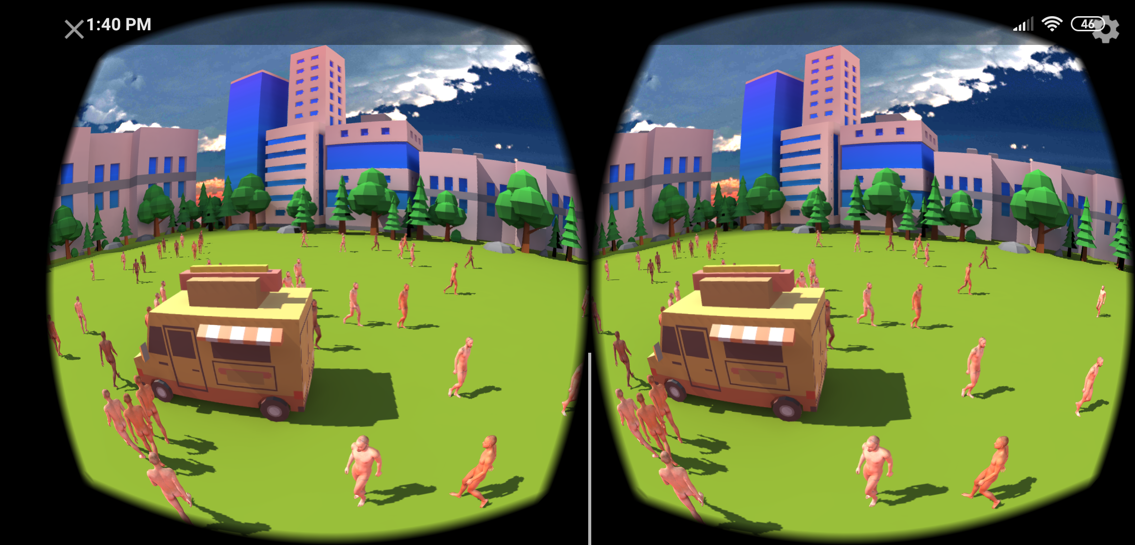
Overview
Introduction
What is Crowd Simulation?
Background
Social Force Model
Magnetic Force Model
Implementation
Velocity
Forces
References
Helpful papers, sites and resources

Slide 3
Introduction to Crowd Simulation
Simulating the movement of virtual characters
Entertainment industry (animation production, computer games)
Training of police & military (demonstrations, riots handling)
Architecture (planning of buildings, towns, visualization)
Safety science (evacuation of buildings, ships, airplanes)
Sociology (crowd behavior)
Physics (crowd dynamics)
Human behavior seems chaotic

Slide 4
Social Force Model
Microscopic Approach (Crowds formed of interacting agents)
Agent velocity
Sum of multiple forces
Desired Force
Social Force
Look ahead Force
Obstacle Force
Measure for the internal motivations of the individuals to perform certain actions

Slide 5
Magnetic Force Model
Microscopic approach
Inspired by Magnetism
Agent
Positively charged particle
Destination
Negative magnetic pole
Obstacle
Positive magnetic pole

Slide 6
Magnetic Force Model
Agent velocity
Sum of multiple forces
Destination Attraction Force
Agent Repulsive Force
Obstacle Repulsive Force
Attraction and Repulsive Forces
Coulomb’s law
F = k * q1 * q2 * r / sqr(r)

Slide 7
Implementation
Inspired by
Social Force Model
Magnetic Force Model
Agent
Positively charged particle
Moves to his destination by the desired force of SFM
Obstacle
Positively charged particles around its bounding box

Slide 8
Velocity
Agent velocity
Sum of multiple forces
Desired Force
Agent Repulsive Force
Obstacle Repulsive Force
Desired Force
Intention of agents to move at their destinations at full speed
Agent Repulsive Force
Coulomb’s law

Slide 9
Obstacle Repulsive Force
Obstacle Repulsive Force
Coulomb’s law
F = k * qa * qo * direction / sqr(d)
k is constant
qa is the charge of the agent
qo is the charge of the obstacle
d is the distance between them
direction is the direction of the force

Slide 10
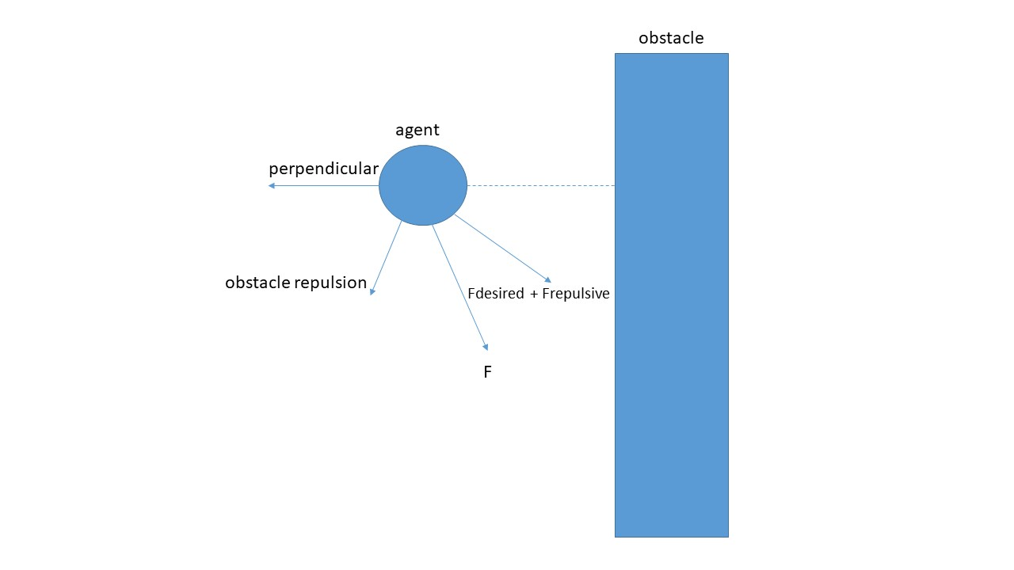
Obstacle’s Repulsive Force direction
Direction of the Obstacle Repulsive Force
Halfway vector of
Perpendicular vector from obstacle to agent and
Sum of desired and agent repulsive forces

Slide 11
References
Dirk Helbing and Peter Molnar 1998. Social Force Model for Pedestrian Dynamics
Shigeyuki Okazaki and Satoshi Matsushita 1997. A study of simulation model for pedestrian movement with evacuation and queuing
Nurulaqilla Khamis, Hazlina Selamat, Rubiyah Yusof, Fatimah Sham Ismail 2017. Magnetic Force Model Approach with Path Finding Feature for an Improved Crowd Movement Simulation
Microscopic Pedestrian Simulation: http://pedsim.silmaril.org/

Slide 12
Thank you!

