Slide 1

DECEMBER 10, 2025
REINFORCEMENT LEARNING
FOR FRAUD DETECTION
SANKOFA BENZO, MS CYBERSECURITY & NETWORKS ‘25

Slide 2

02
LIT REVIEW
01
. Ali et al [[1] presents a systematic literature review of financial fraud detection using machine learning
02
Pervin et al. [2] presented a hybrid CNN-LSTM approach for detecting anomalous credit card transactions.
03
Ubale et al. [3] presents a hybrid quantum LSTM for fraud detection to enhance the representational powers of classical models through quantum encoding.
[1] https://doi.org/10.3390/app12199637
[2] https://doi.org/10.37547/tajmei/Volume07Issue04-15
[3]https://doi.org/10.48550/arXiv.2505.00137

Slide 3


01
STATEMENT AND APPROACH
I hypothesize that a Q-deep learning algorithm coupled with LSTM will result in a model that can maximize detection of fraudulent banking activities.
EVAL METRIC # 1
EVAL METRIC # 2
EVAL METRIC # 3
Detection Improvement
Measure the agent’s ability to correctly detect fraud
Precision/Recall
Analyze the model's performance in predicting specific conditions
Confusion Matrix
Visualize false positives/negatives to understand where the model struggles

Slide 4
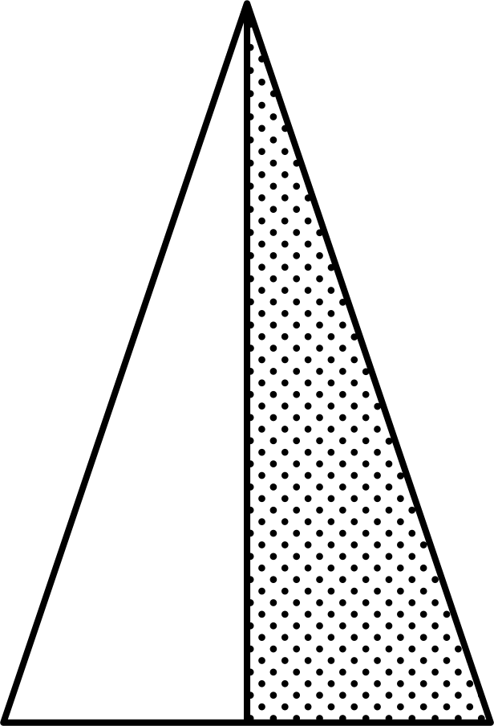

03
METHODOLOGY
Preprocess
Classic Algorithms
Transfer Weights
Q-LSTM
RFE+LSTM
LR, RF, XGBoost, LSTM
LSTM weights to Q
Build with Q-Deep Learning

Slide 5
MODEL METRICS
04
Classifier | Precision (%) | Recall | F1 (%) | ROC (%) | PRC (%) | Training Time(s)
XGBoost | 100 | 99.96 | 99.98 | 99.9 | 99.9 | 6.55
Logistic Regression | 99.9 | 99.72 | 99.8 | 99.98 | 99.99 | 0.95
Random Forest | 99.99 | 99.96 | 99.98 | 99.99 | 99.99 | 197.64
LSTM | 99.95 | 99.95 | 99.95 | 100 | - | 110.72
Q-LSTM | 99.53 | 99.97 | 99.75 | 99.99 | - | 999.67
Table 1: Model Metrics of Classic Algorithms and Q-LSTM
56863 | 0
472 | 56391
56805 | 58
159 | 56704
56859 | 4
20 | 56843
56835 | 28
27 | 56836
56593 | 270
15 | 56848
Table 2: Confusion Matrix: XGBoost - LR - RF - LSTM - Q-LSTM

Slide 6
CONCLUSION
05
Q-LSTM resulted in an overall higher recall rate and ROC-AUC compared to the other classifiers.
XGBoost outperformed all the classifiers in majority of the metrics, including Q-LSTM
LSTM marginally outperformed Q-LSTM in majority of the metrics.
However, in the long-term, Q-deep learning will be able to adapt to changes and trends in behavior.

Slide 7
THANK YOU
Sankofa Benzo
sbenz1@unh.newhaven.edu

