Slide 1
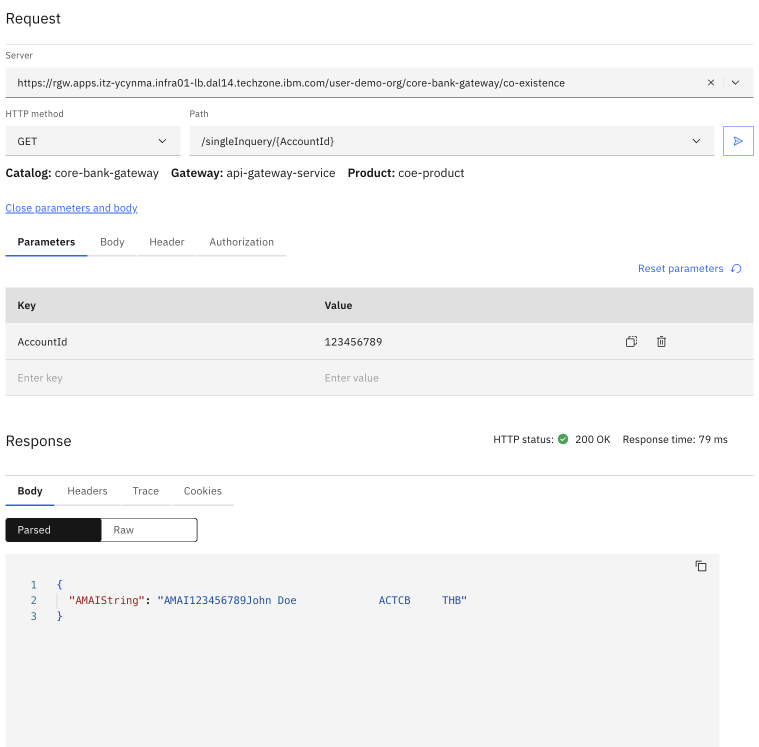

Old Core
1.1 : 1 API to 1 API Old Core – Success (Inquiry)
1.2 : 1 API to 5 APIs Old Core – Success (Inquiry)
1.3 : 1 API to 5 APIs Old Core – 3 of 5 API error (Inquiry)
1.4 : 1 API to 5 APIs Old Core - Timeout (Inquiry)
1.5 : 1 API to 3 API Old Core – Success (Update)
1.6 : 1 API to 3 API Old Core – 2 of 3 API error (Update)
New Core
1.7 : 1 API to 1 API New Core – Success (Inquiry)
1.8 : 1 API to 2 APIs New Core – Success (Inquiry)
1.9 : 1 API to 2 APIs New Core – 1/2 API error(Inquiry)
1.10 : 1 API to 1 API New Core – Success (Update)

Slide 2
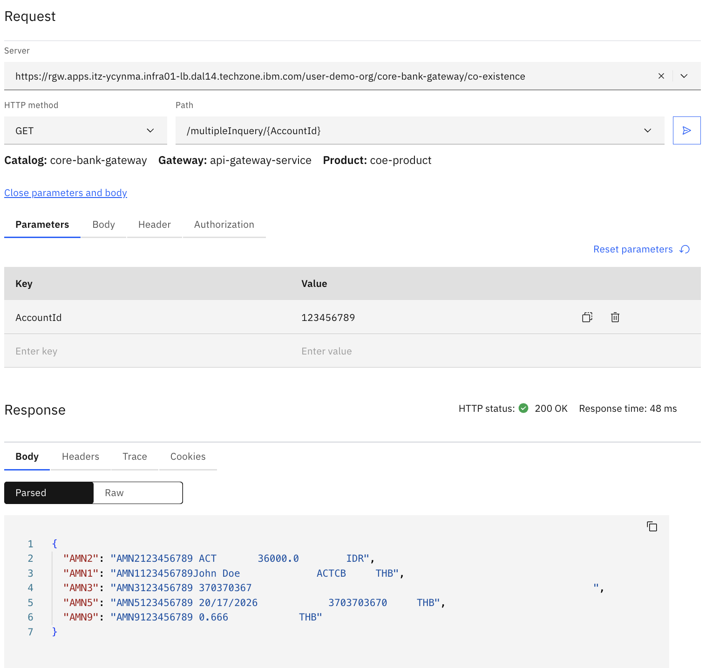
Old Core
1.1 : 1 API to 1 API Old Core – Success (Inquiry)
1.2 : 1 API to 5 APIs Old Core – Success (Inquiry)
1.3 : 1 API to 5 APIs Old Core – 3 of 5 API error (Inquiry)
1.4 : 1 API to 5 APIs Old Core - Timeout (Inquiry)
1.5 : 1 API to 3 API Old Core – Success (Update)
1.6 : 1 API to 3 API Old Core – 2 of 3 API error (Update)
New Core
1.7 : 1 API to 1 API New Core – Success (Inquiry)
1.8 : 1 API to 2 APIs New Core – Success (Inquiry)
1.9 : 1 API to 2 APIs New Core – 1/2 API error(Inquiry)
1.10 : 1 API to 1 API New Core – Success (Update)

Slide 3
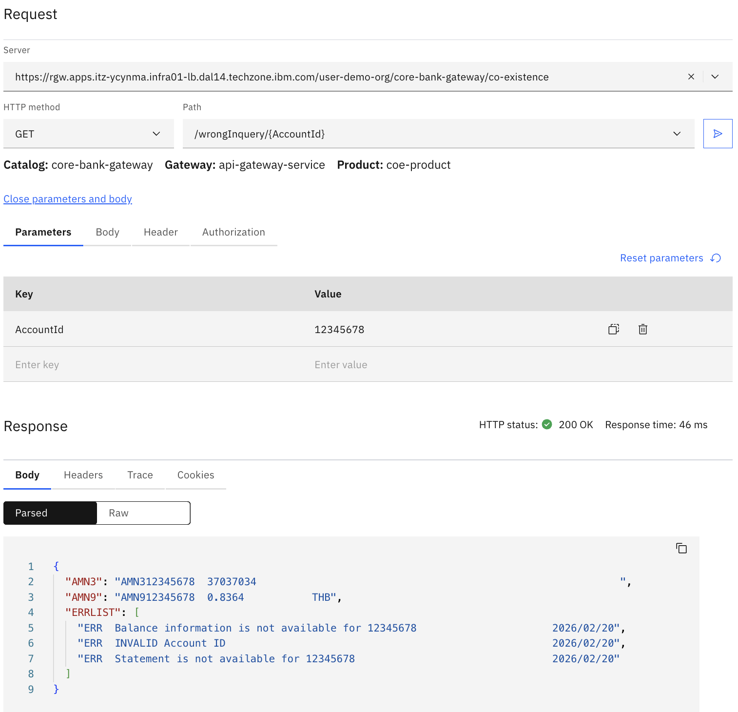
Old Core
1.1 : 1 API to 1 API Old Core – Success (Inquiry)
1.2 : 1 API to 5 APIs Old Core – Success (Inquiry)
1.3 : 1 API to 5 APIs Old Core – 3 of 5 API error (Inquiry)
1.4 : 1 API to 5 APIs Old Core - Timeout (Inquiry)
1.5 : 1 API to 3 API Old Core – Success (Update)
1.6 : 1 API to 3 API Old Core – 2 of 3 API error (Update)
New Core
1.7 : 1 API to 1 API New Core – Success (Inquiry)
1.8 : 1 API to 2 APIs New Core – Success (Inquiry)
1.9 : 1 API to 2 APIs New Core – 1/2 API error(Inquiry)
1.10 : 1 API to 1 API New Core – Success (Update)

Slide 4
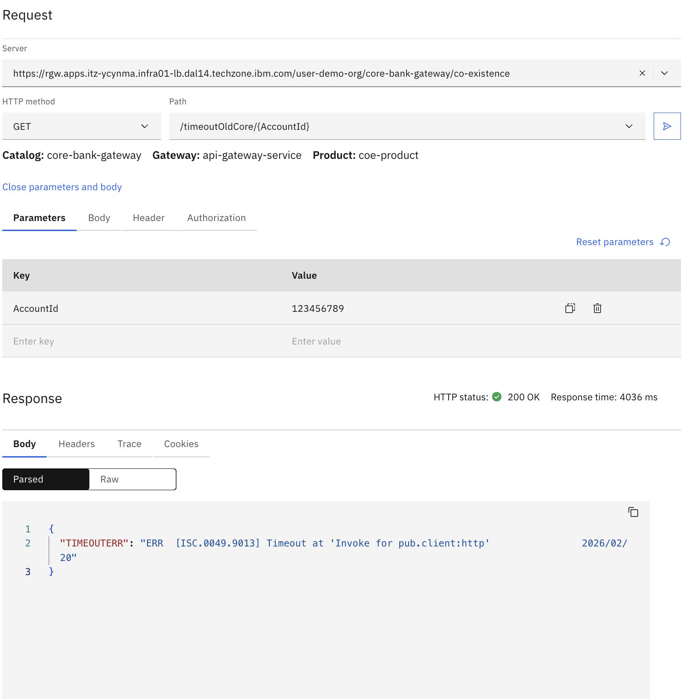
Old Core
1.1 : 1 API to 1 API Old Core – Success (Inquiry)
1.2 : 1 API to 5 APIs Old Core – Success (Inquiry)
1.3 : 1 API to 5 APIs Old Core – 3 of 5 API error (Inquiry)
1.4 : 1 API to 5 APIs Old Core - Timeout (Inquiry)
1.5 : 1 API to 3 API Old Core – Success (Update)
1.6 : 1 API to 3 API Old Core – 2 of 3 API error (Update)
New Core
1.7 : 1 API to 1 API New Core – Success (Inquiry)
1.8 : 1 API to 2 APIs New Core – Success (Inquiry)
1.9 : 1 API to 2 APIs New Core – 1/2 API error(Inquiry)
1.10 : 1 API to 1 API New Core – Success (Update)

Slide 5
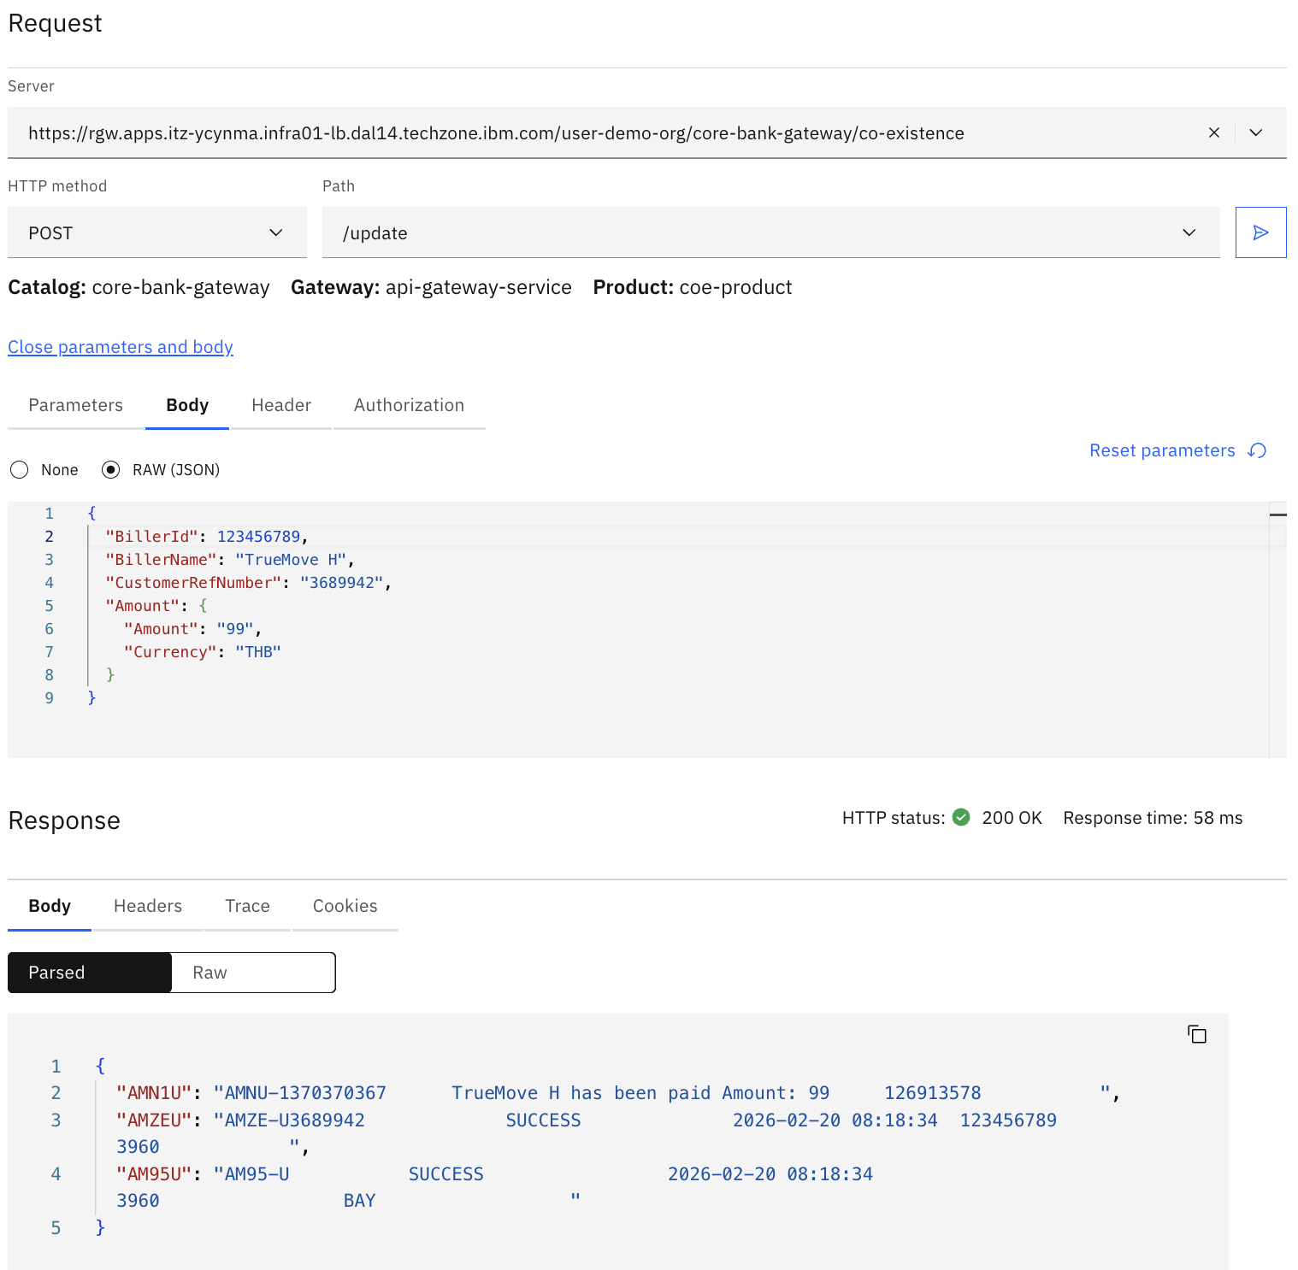
Old Core
1.1 : 1 API to 1 API Old Core – Success (Inquiry)
1.2 : 1 API to 5 APIs Old Core – Success (Inquiry)
1.3 : 1 API to 5 APIs Old Core – 3 of 5 API error (Inquiry)
1.4 : 1 API to 5 APIs Old Core - Timeout (Inquiry)
1.5 : 1 API to 3 API Old Core – Success (Update)
1.6 : 1 API to 3 API Old Core – 2 of 3 API error (Update)
New Core
1.7 : 1 API to 1 API New Core – Success (Inquiry)
1.8 : 1 API to 2 APIs New Core – Success (Inquiry)
1.9 : 1 API to 2 APIs New Core – 1/2 API error(Inquiry)
1.10 : 1 API to 1 API New Core – Success (Update)

Slide 6
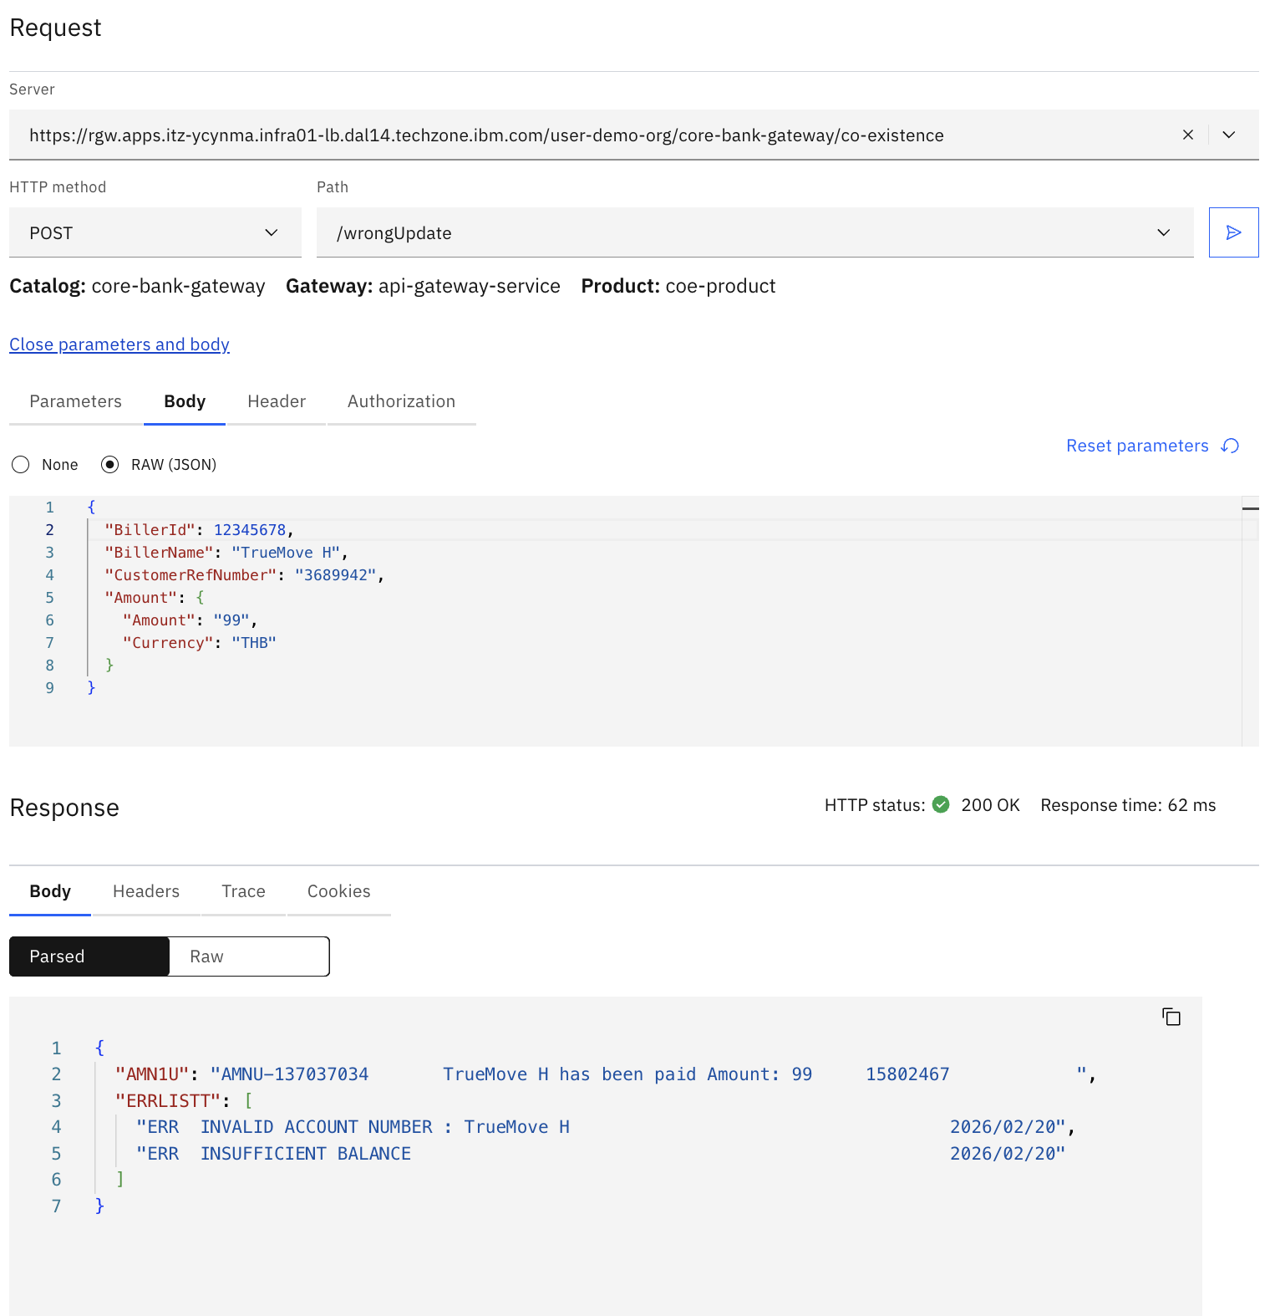
Old Core
1.1 : 1 API to 1 API Old Core – Success (Inquiry)
1.2 : 1 API to 5 APIs Old Core – Success (Inquiry)
1.3 : 1 API to 5 APIs Old Core – 3 of 5 API error (Inquiry)
1.4 : 1 API to 5 APIs Old Core - Timeout (Inquiry)
1.5 : 1 API to 3 API Old Core – Success (Update)
1.6 : 1 API to 3 API Old Core – 2 of 3 API error (Update)
New Core
1.7 : 1 API to 1 API New Core – Success (Inquiry)
1.8 : 1 API to 2 APIs New Core – Success (Inquiry)
1.9 : 1 API to 2 APIs New Core – 1/2 API error(Inquiry)
1.10 : 1 API to 1 API New Core – Success (Update)

Slide 7
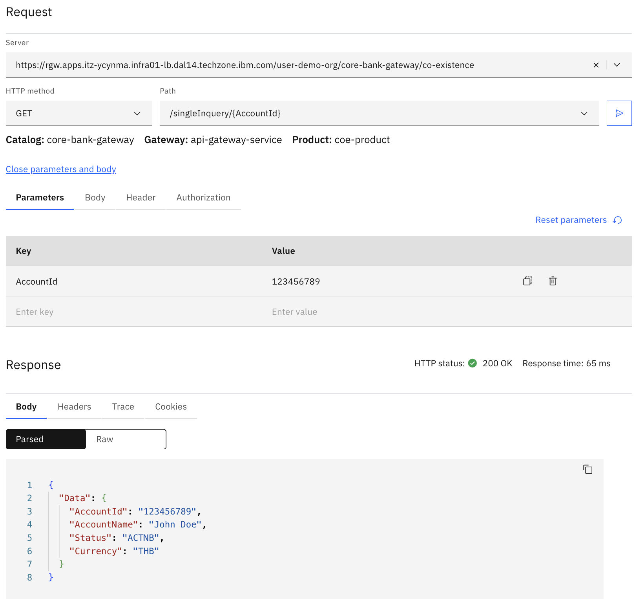
Old Core
1.1 : 1 API to 1 API Old Core – Success (Inquiry)
1.2 : 1 API to 5 APIs Old Core – Success (Inquiry)
1.3 : 1 API to 5 APIs Old Core – 3 of 5 API error (Inquiry)
1.4 : 1 API to 5 APIs Old Core - Timeout (Inquiry)
1.5 : 1 API to 3 API Old Core – Success (Update)
1.6 : 1 API to 3 API Old Core – 2 of 3 API error (Update)
New Core
1.7 : 1 API to 1 API New Core – Success (Inquiry)
1.8 : 1 API to 2 APIs New Core – Success (Inquiry)
1.9 : 1 API to 2 APIs New Core – 1/2 API error(Inquiry)
1.10 : 1 API to 1 API New Core – Success (Update)

Slide 8
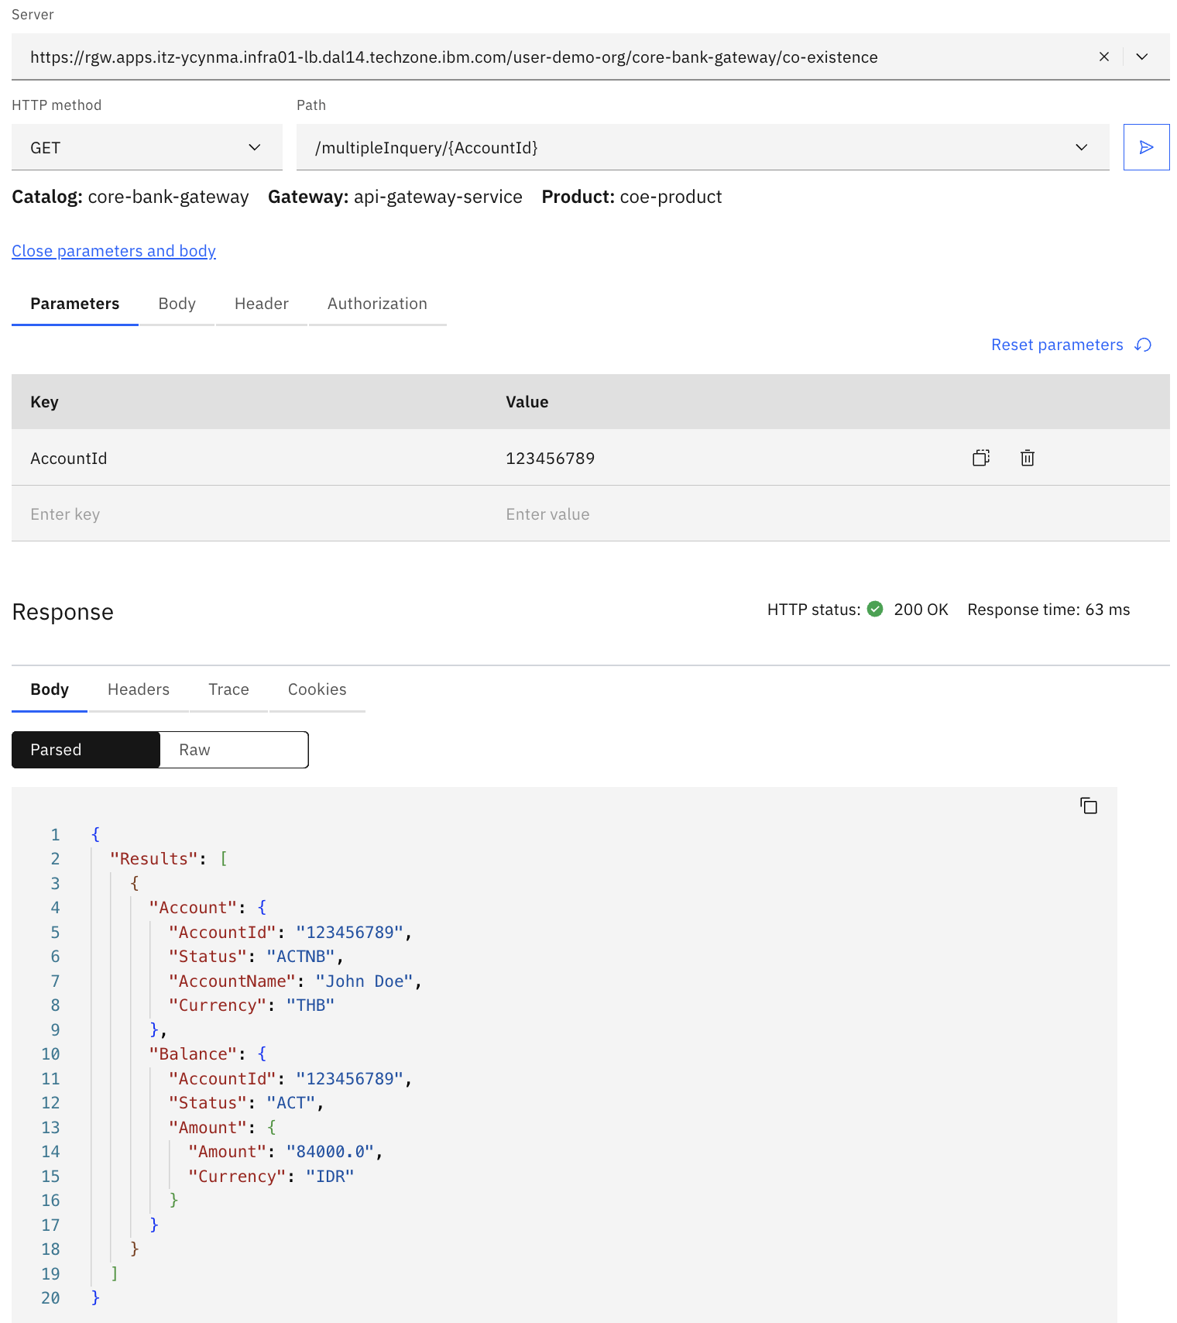
Old Core
1.1 : 1 API to 1 API Old Core – Success (Inquiry)
1.2 : 1 API to 5 APIs Old Core – Success (Inquiry)
1.3 : 1 API to 5 APIs Old Core – 3 of 5 API error (Inquiry)
1.4 : 1 API to 5 APIs Old Core - Timeout (Inquiry)
1.5 : 1 API to 3 API Old Core – Success (Update)
1.6 : 1 API to 3 API Old Core – 2 of 3 API error (Update)
New Core
1.7 : 1 API to 1 API New Core – Success (Inquiry)
1.8 : 1 API to 2 APIs New Core – Success (Inquiry)
1.9 : 1 API to 2 APIs New Core – 1/2 API error(Inquiry)
1.10 : 1 API to 1 API New Core – Success (Update)

Slide 9
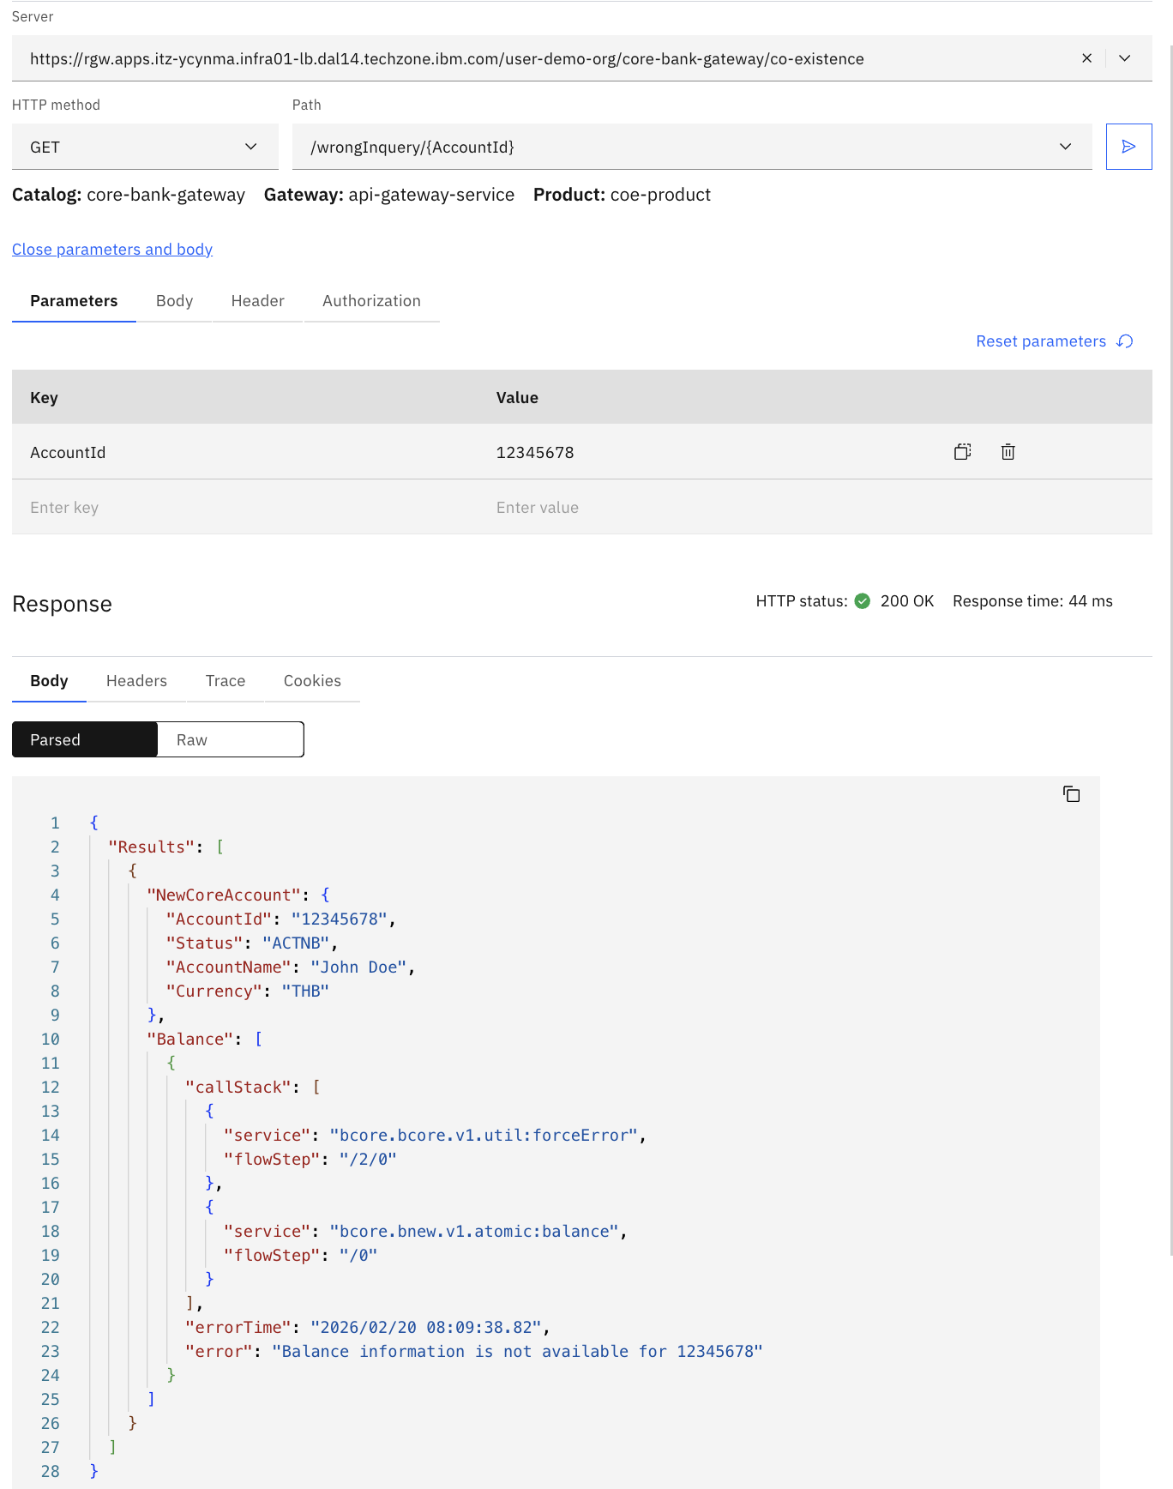
Old Core
1.1 : 1 API to 1 API Old Core – Success (Inquiry)
1.2 : 1 API to 5 APIs Old Core – Success (Inquiry)
1.3 : 1 API to 5 APIs Old Core – 3 of 5 API error (Inquiry)
1.4 : 1 API to 5 APIs Old Core - Timeout (Inquiry)
1.5 : 1 API to 3 API Old Core – Success (Update)
1.6 : 1 API to 3 API Old Core – 2 of 3 API error (Update)
New Core
1.7 : 1 API to 1 API New Core – Success (Inquiry)
1.8 : 1 API to 2 APIs New Core – Success (Inquiry)
1.9 : 1 API to 2 APIs New Core – 1/2 API error(Inquiry)
1.10 : 1 API to 1 API New Core – Success (Update)

Slide 10
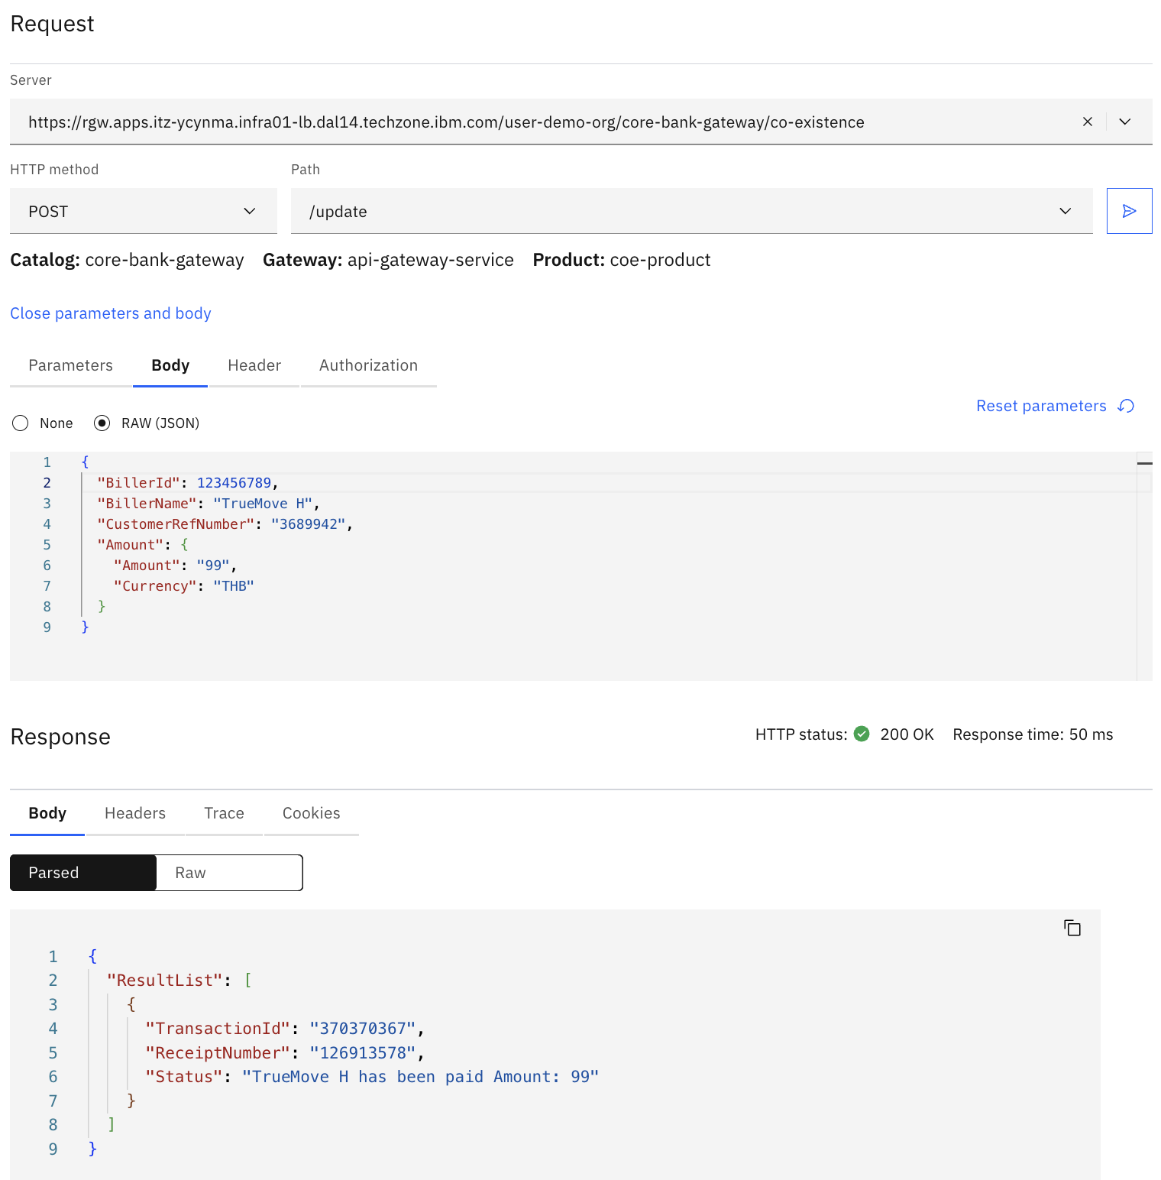
Old Core
1.1 : 1 API to 1 API Old Core – Success (Inquiry)
1.2 : 1 API to 5 APIs Old Core – Success (Inquiry)
1.3 : 1 API to 5 APIs Old Core – 3 of 5 API error (Inquiry)
1.4 : 1 API to 5 APIs Old Core - Timeout (Inquiry)
1.5 : 1 API to 3 API Old Core – Success (Update)
1.6 : 1 API to 3 API Old Core – 2 of 3 API error (Update)
New Core
1.7 : 1 API to 1 API New Core – Success (Inquiry)
1.8 : 1 API to 2 APIs New Core – Success (Inquiry)
1.9 : 1 API to 2 APIs New Core – 1/2 API error(Inquiry)
1.10 : 1 API to 1 API New Core – Success (Update)

